Slide 1

Automation
With
by
Shankar Dhandapani
Intern @ Ugam Solutions

Slide 2
THE FIRST ERA OF AUTOMATION

Slide 3
ROBOTIC PROCESS AUTOMATION
(RPA)

Slide 4



TOOLS FOR RPA

Slide 5
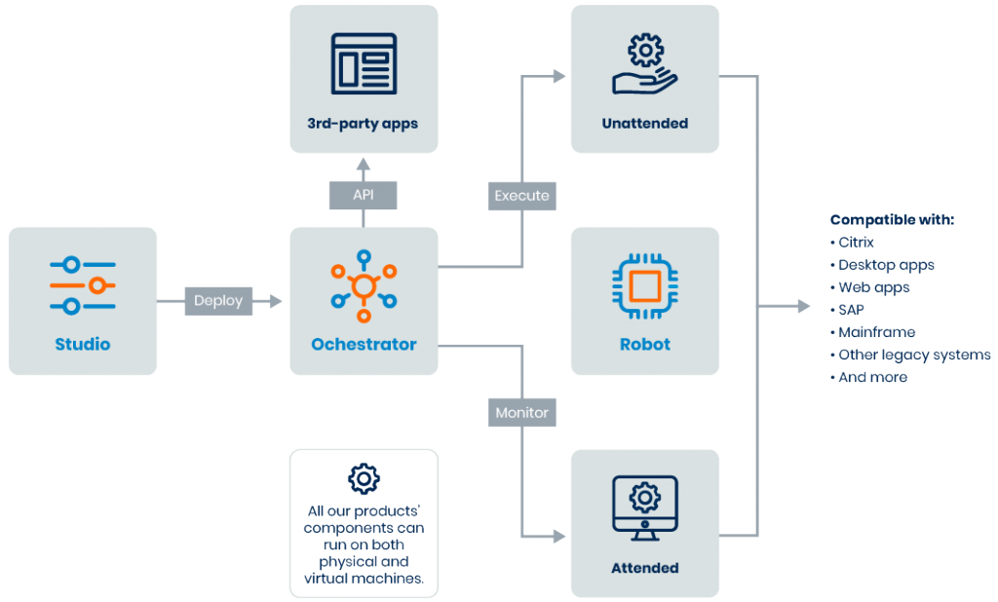
COMPONENTS OF UiPath

Slide 6

WORKFLOW
Different
Applications

Slide 7

User Interface
Automation

Slide 8

PDF
Automation

Slide 9

Excel
Automation

Slide 10


Email
Automation

Slide 11
CONTACT
Shankar Dhandapani
+91 9600311828
shankardhandapani1@gmail.com

