Slide 1

Ecommerce Application Software & hardware Requirement
Software requirement.
Development Tools
1.VS Code 2.Eclipse
Front End Tool :HTML, CSS, Bootstrap, JavaScript, Ajax, React Js.
Back End Tool :Core Java, Spring Boot
Database Tool : MySQL
Hardware requirement
Hard Disk – 1 TB HDD/ 125 GB SSD (minimum).
RAM – 4 GB (minimum).
Processor – Intel i3 or above.

Slide 2
Project Features
Outline the main features of the ecommerce platform:
User Authentication and Authorization.
Product Management .
Shopping Cart.
Checkout Process.
Order Processing.
Search Navigation.
User Reviews and Ratings
User Account Management
User Authentication and Authorization
JWT Implementation: Role-based access control with two roles: USER and ADMIN. USER can view
products and place orders, while ADMIN can manage products, view orders, and handle
administrative tasks.
Session management:
Briefly describe how session management is implemented for user
tracking and authentication.
Sessions play a pivotal role in user authentication, ensuring that
authenticated users can access authorized resources.

Slide 3
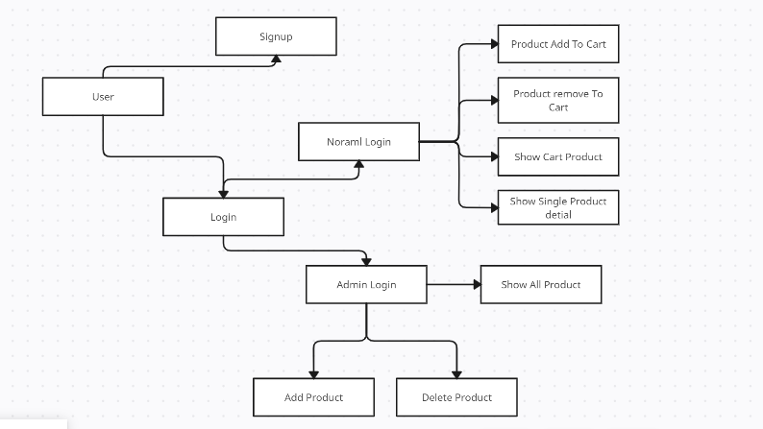
System design
2.Login
1.Registration

Slide 4
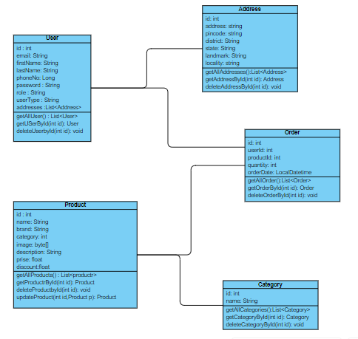
Class diagram

Slide 5
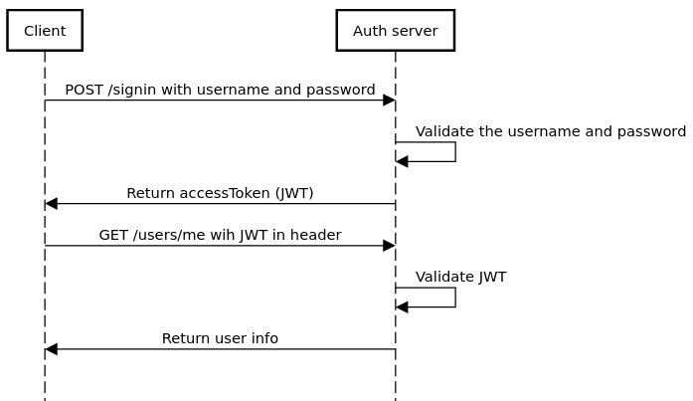
sequence diagram

Slide 6


