Slide 1
contents
Abstract
Introduction
Literature review
Problem Statement
Existing system
System Design
System Architecture
System Requirement
Software & Hardware requirement
Implementation
Result
Future Scope
Conclusion

Slide 2

Abstract
This Online Examination System is a software solution, which allows any industry or institute to arrange, conduct and manage examinations via an online environment. It can be done through the Internet/Intranet and Local Area Network environments. Some of the problems faced during manual examination systems are the delays occurred in result processing, filing poses a problem, filtering of records is difficult. The chance of loss of records is high also record searching is difficult. Maintenance of the system is also very difficult and takes lot of time and effort. Online examination is one of the crucial parts for online education system. It is efficient, fast enough and reduces the large amount of material resource. An examination system is developed based on the web. This paper describes the principle of the system, presents the main functions of the system, analyzes the auto-generating test

Slide 3
introduction
Online Exams is being launched because a need for a destination that is beneficial for both institutes and students.
With this site, institutes can register and host online exams. Students can give exams and view their results. This site is an attempt to remove the existing flaws in the manual system of conducting exams.
Online Exams System fulfills the requirements of the institutes to conduct the exams online.
They do not have to go to any software developer to make a separate site for being able to conduct exams online. They just have to register on the site and enter the exam details and the lists of the students which can appear in the exam.
Students can give exam without the need of going to any physical destination. They can view the result at the same time.
Thus the purpose of the site is to provide a system that saves the efforts and time of both the institutes and the students.

Slide 4
Literature review
Sr.No | Paper Name and Journal Name | Author Name | Description
01 | Online Examination Portal | Niraj Sunil Bharambe, Sanjana Ramesh Bhangale | The Online Examination Portal is a web application for to take online test in an efficient manner and no time wasting for checking the paper. The main objective of Online Examination Portal is to efficiently evaluate the candidate thoroughly through a fully automated system that not only saves lot of time but also gives fast results.
02 | ONLINE EXAMINATION SYSTEM | Deepankar Kotwal, Shubham Bhadke, Aishwarya Gunjal, Puspendu Biswas | Online examination is one of the crucial parts for online education system. It is efficient, fast enough and reduces the large amount of material resource. An examination system is developed based on the web.
03 | Online Examination Portal | Ashish srivastava, Niraj Tiwari, Shiv Ram Krishnan, Avinash Kumar | There are numerous benefits and disservices of an online test. It is very well directed for distant understudies that are primarily beneficial. The risks of this online exam are the incapacity of invigilating.

Slide 5

Problem Statement
We are going to make an attractive examination portal in which user can create an account after which user have to sign in to attempt the test.
Most of the currently existing portals we know have some problems like crashing or getting hanged.
We will try to overcome these problems.
We tried to make this site robust, reliable and it takes less bandwidth to move from one page to next page.
We have also working on encryption decryption of the password using some technologies like JWT Authentication(JSON token).

Slide 6

Existing System
Now a days many exam portal available like Testbook, Google form, Module etc.
Although there are many portal, but the students/Teacher cant be use it for ourself.
In this exam portal a system which allows the faculty to create , modify and store questions which can be grouped to form sections and these sections can be grouped together to form/examinations.

Slide 7
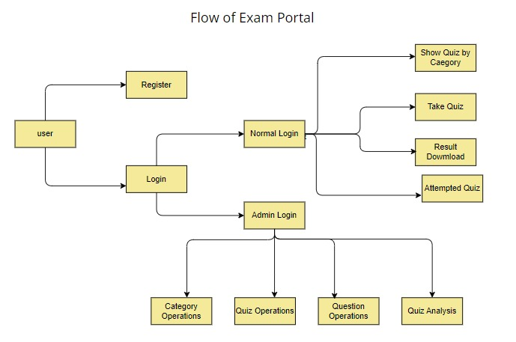
System design
2.Login
1.Registration
Normal user
1.Attempt quiz 2.Quiz category
Admin
1.Operation 2.Analysis
Manage normal user facility

Slide 8
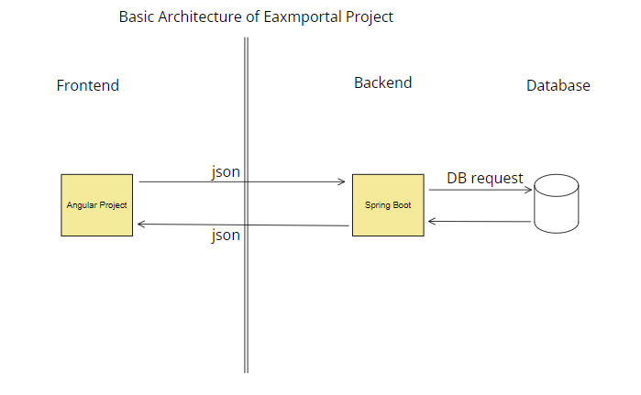

Slide 9
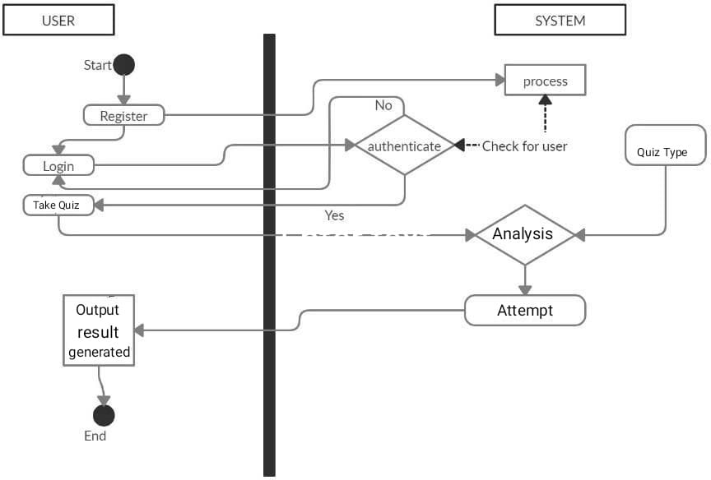
System flow
The online examination system uses client/ server architecture. At the client by using a web browser can connect via internet or local host with the server for the preparing exams processes and save and return data from database.

Slide 10
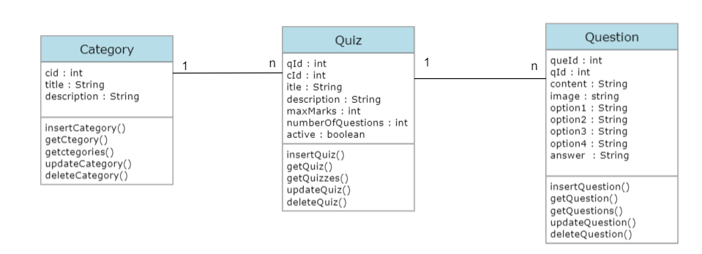
Class diagram

Slide 11
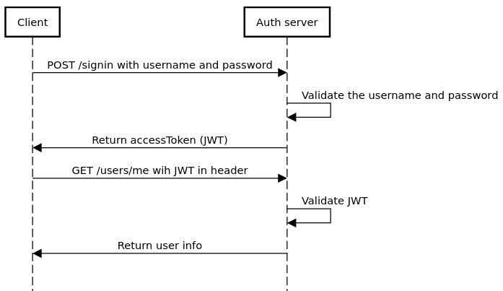
sequence diagram

Slide 12

Software & hardware Requirement
Software requirement.
Development Tools
1.VS Code 2.Eclipse
Front End Tool :HTML, CSS, Angular
Back End Tool :Java, Spring Boot
Database Tool :SQL Server
Documenting Tool: MS-Word, MS-Powerpoint
Hardware requirement
Hard Disk – 1 TB HDD/ 125 GB SSD (minimum).
RAM – 4 GB (minimum).
Processor – Intel i3 or above.

Slide 13
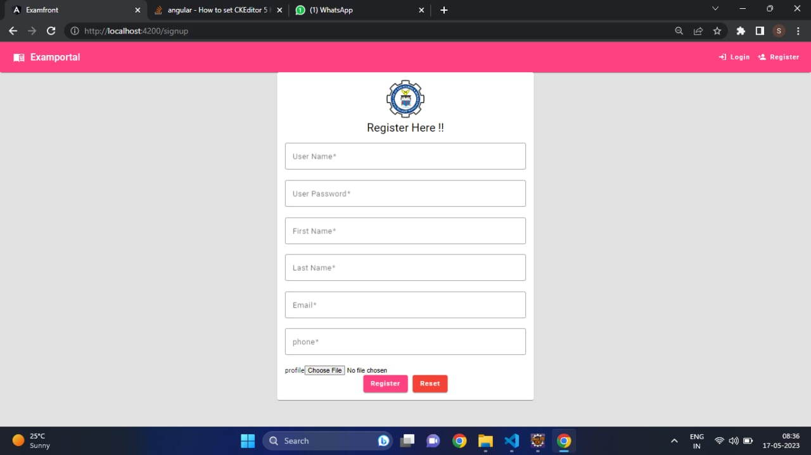
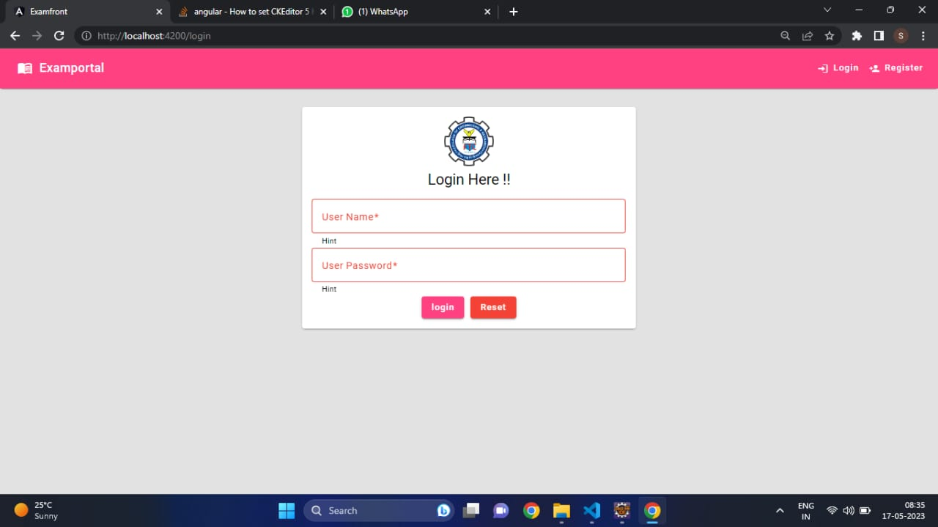
Implementation &Result

Slide 14
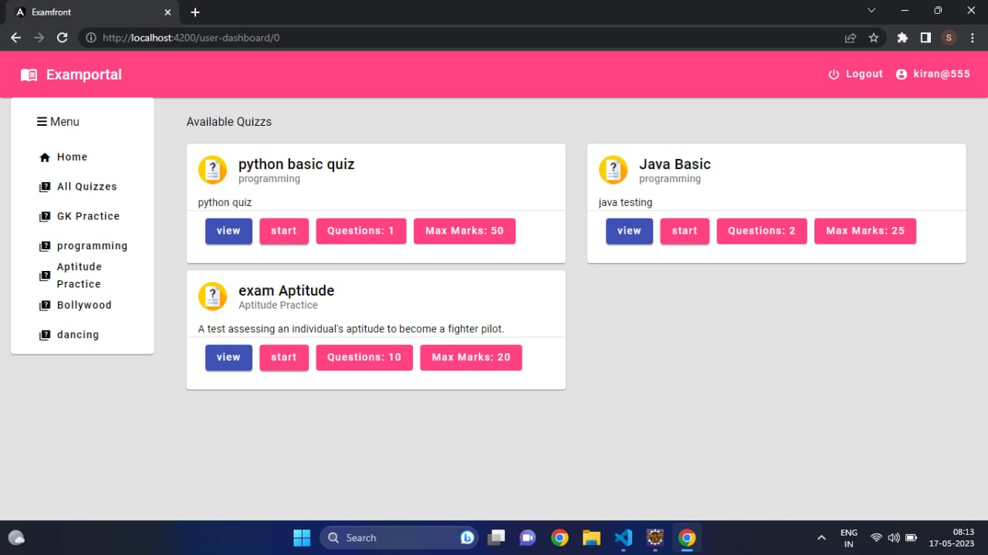
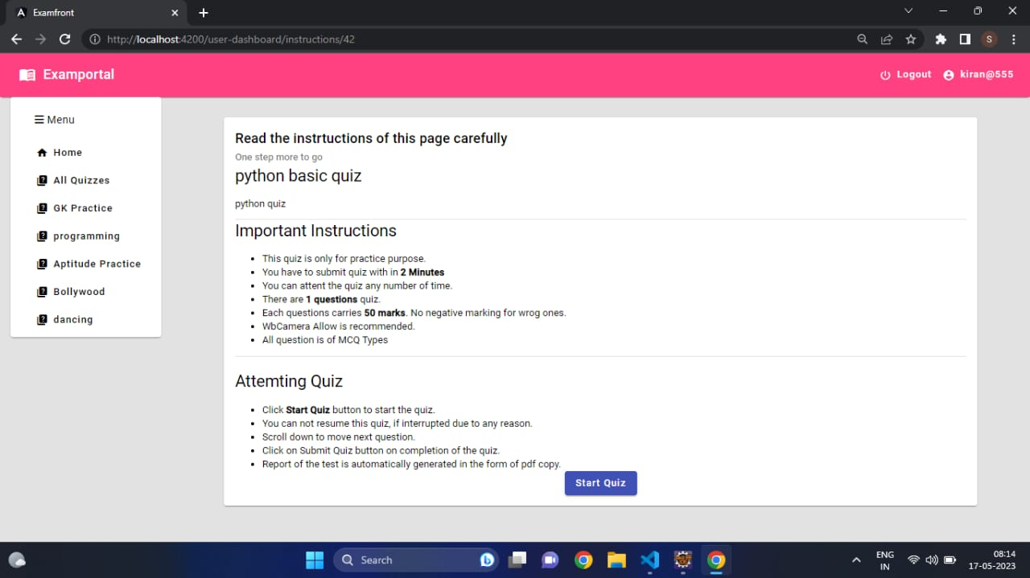

Slide 15
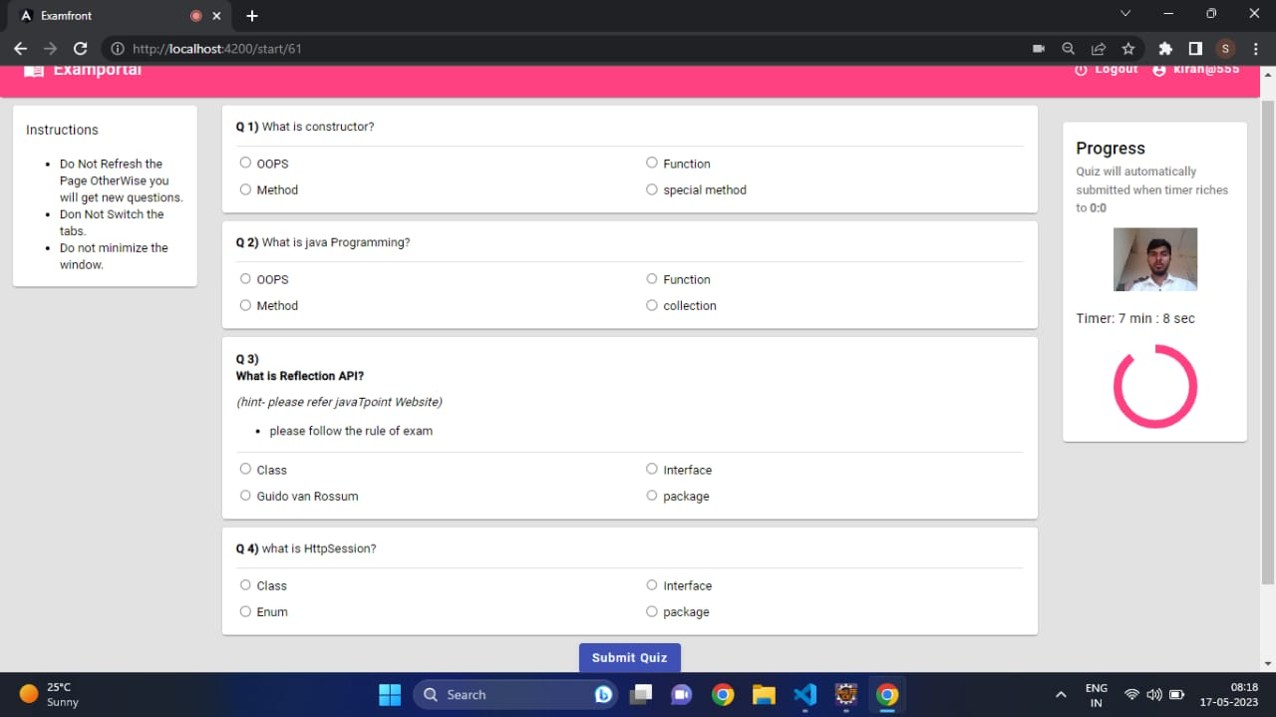
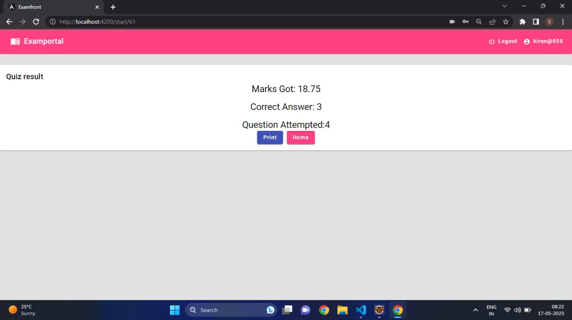

Slide 16
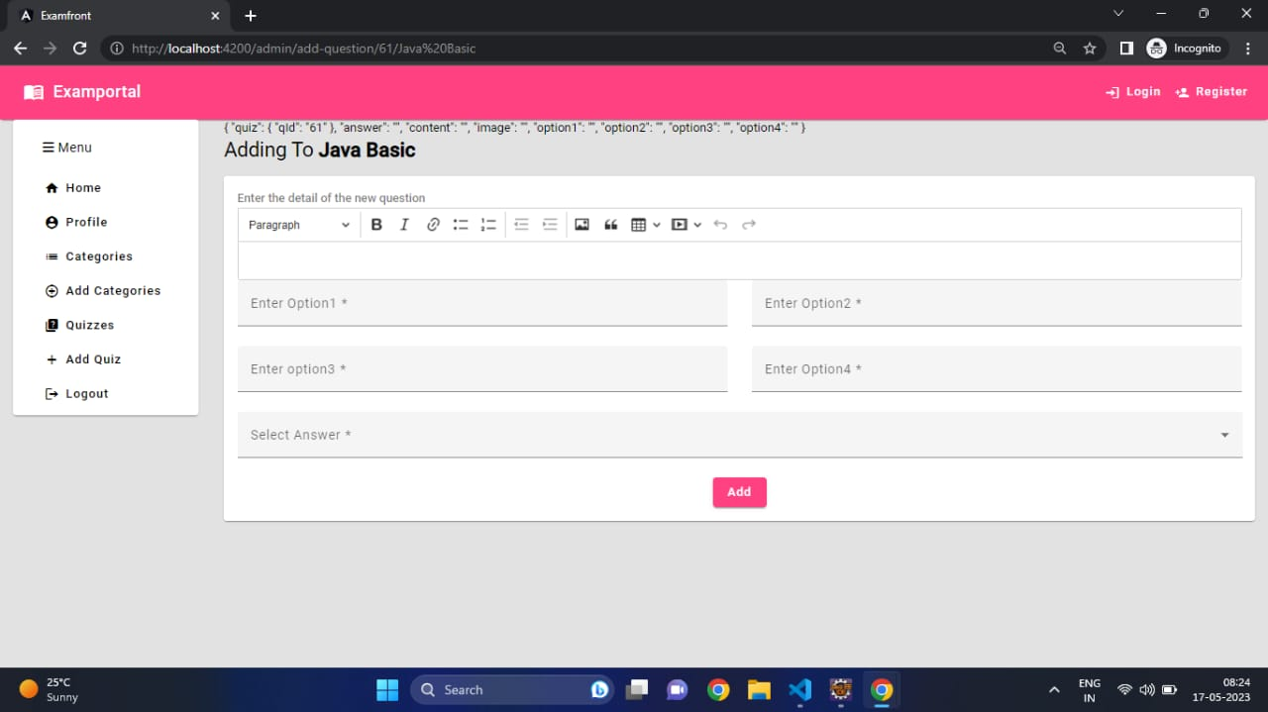
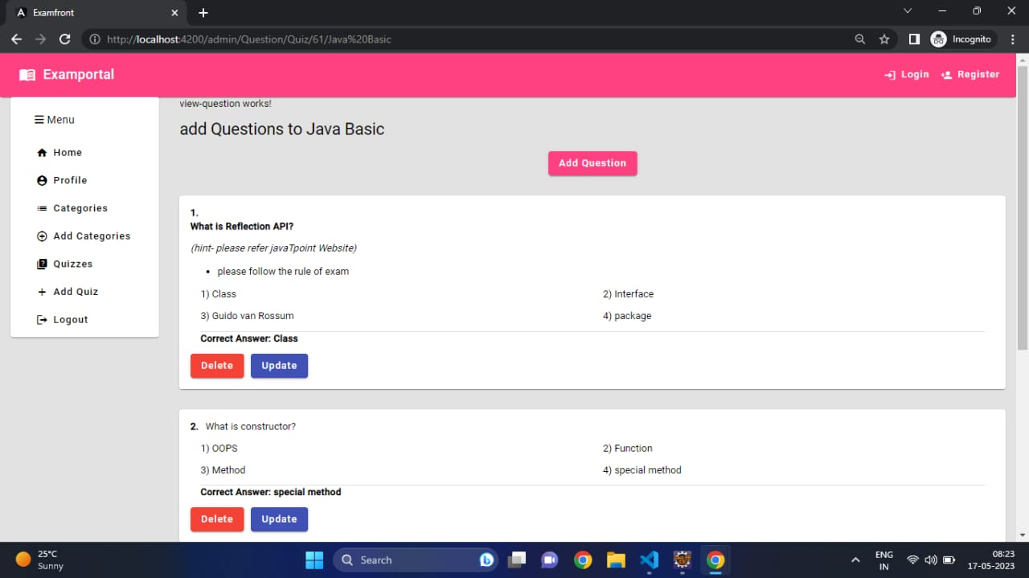

Slide 17
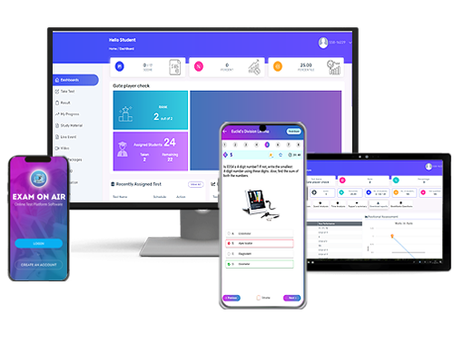
Future Scope
Automated
Modern Infrastructure
Reliable & Secure
Flexible & Accessible
Remote Proctoring
Quick result processing
India has 37.4 million students enrolled in the year 2019 for higher education. With this massive number of students, India is turning into one of the biggest organizers of online examinations globally. The online education market in India is estimated to grow by 14.33 billion dollars by 2024.

Slide 18

conclusion
We have tried to implement an examination portal for those who want to give the exam online or want to practice for the competitions.
When the user register on this portal the password is stored in the encrypted for using some algorithm.
User can take the test online of his/her choice regarding the field and see the progress according to the score card generated.

Slide 19


