Slide 1
Continuous Integration
Team 7:-

Slide 2
Agenda
Why Integration?
What is Continuous Integration?
Why Continuous Integration?
Five principles of Continuous Integration
Continuous Integration Process
Continuous Integration Infrastructure
Continuous Integration Tools
Continuous Integration benefits

Slide 3
Why integration?
Teams integrate their work multiple times per day.
Each integration is verified by an automated build
Significantly reduces integration problems
Develop cohesive software more rapidly

Slide 4
What’s Continuous Integration?
In software engineering, continuous integration (CI) implements continuous processes of applying quality control - small pieces of effort, applied frequently.
Continuous integration aims to improve the quality of software, and to reduce the time taken to deliver it, by replacing the traditional practice of applying quality control after completing all development.

Slide 5
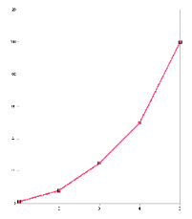
Why Continuous Integration?
Integration is hard, effort increase exponentially with
Number of components
Number of bugs
Time since last integration
Notes:
Regression

Slide 6
Five Principles of Continuous Integration
Environments based on stability
Maintain a code repository
Commit frequently and build every commit
Make the build self-testing
Store every build

Slide 7
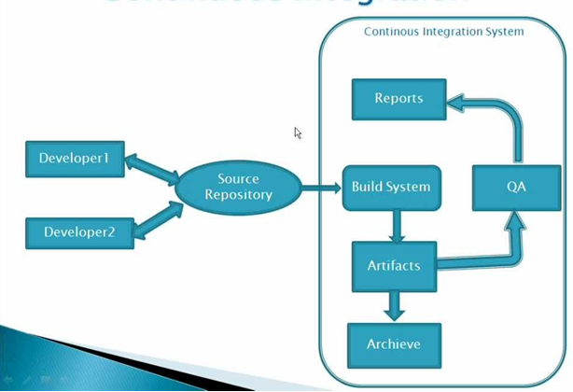
Continuous Integration Infrastructure

Slide 8
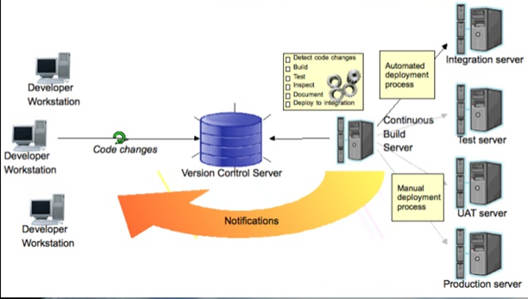
Continuous Integration Process

Slide 9
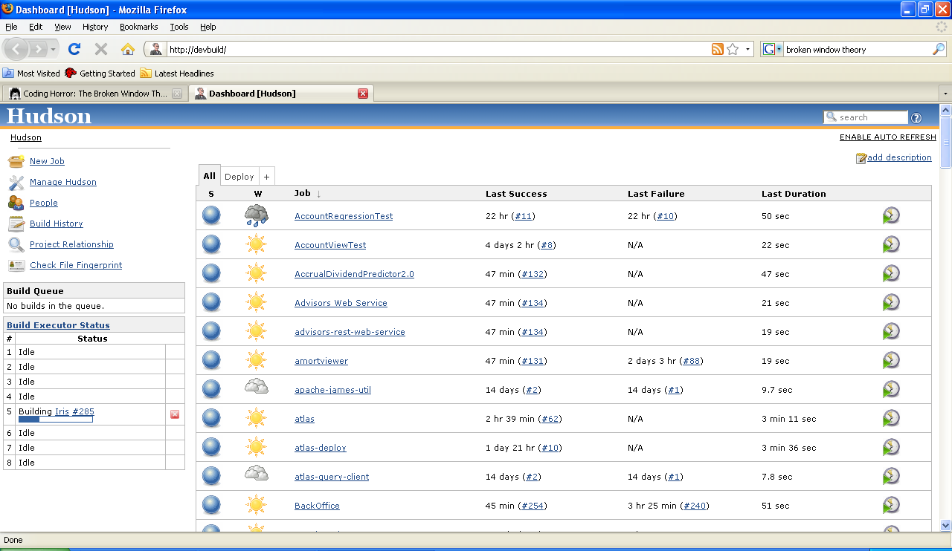

Slide 10
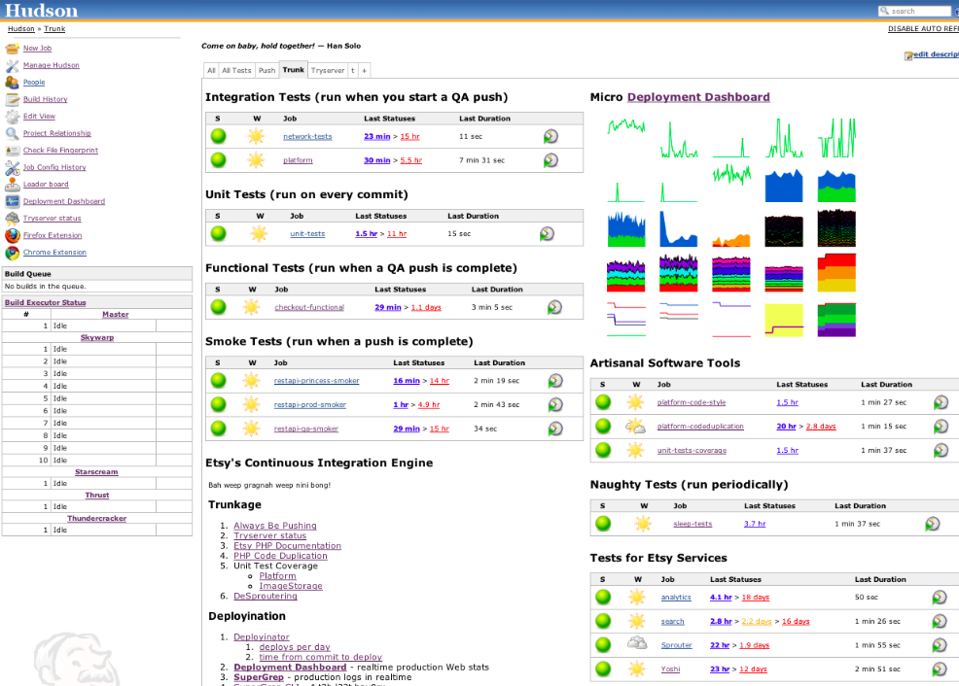

Slide 11
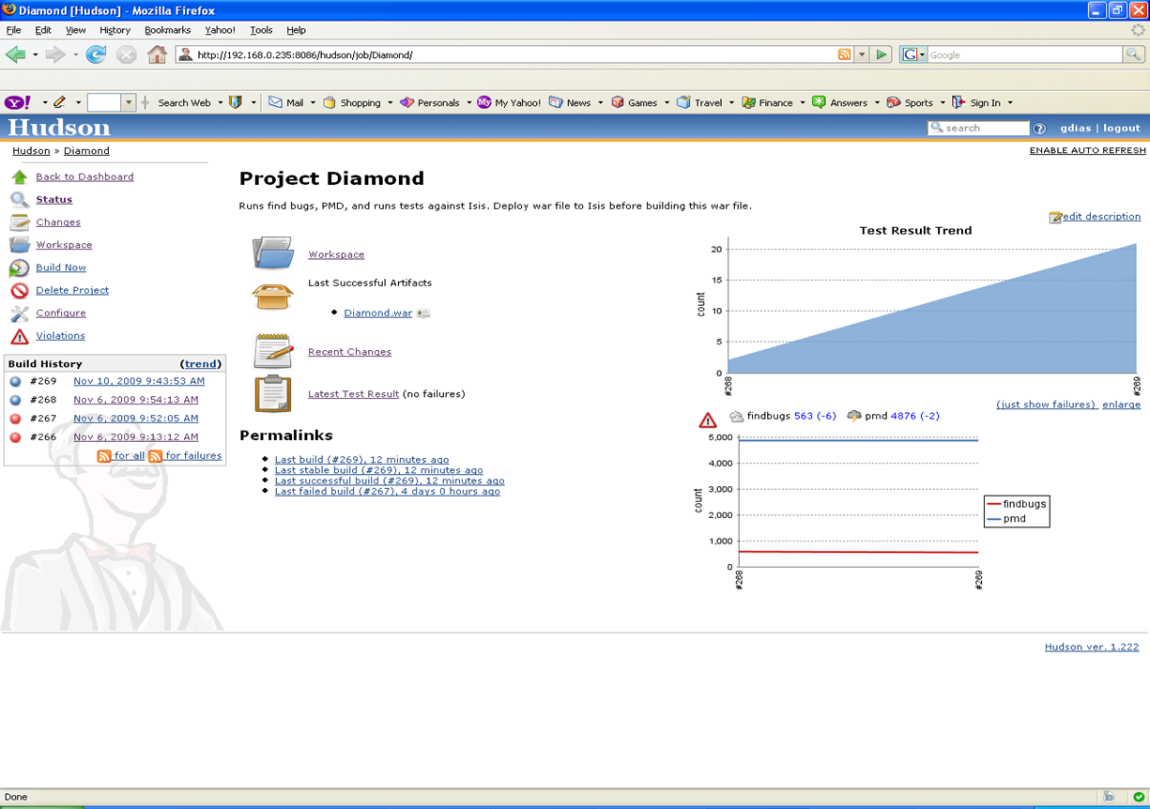

Slide 12
Continuous Integration benefits
Always aware of current status of the project
Less time spent investigating integration bugs
Integration testing performed early
Integration bugs caught early
Less time wasted because of broken code in version control system
Broken builds caught early
Prove your system can build!
Increase code quality with additional tasks
Discover potential deployment issue

Slide 13
Conclusion

Slide 14


Slide 15

Questions & Answers

