Slide 1
Headlines
People across India offended by Aamir Khan's statement: BJP.
‘Congress strongly believes in GST’, says Rahul.
Ukraine closes its airspace to Russia.
2015 set to be 'hottest year on record', says UN.
Apple Watch : Dial down the hype.
Google to answer complex questions soon.
ICC to pay seven full-member Boards USD 10 million each.
We deserve the semi-final spot: Materazzi.

Slide 2
National news

Slide 3
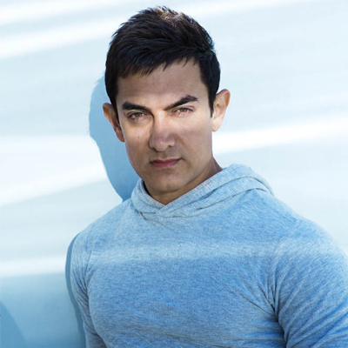
People across India offended by Aamir Khan's statement: BJP

Slide 4
BJP spokesman G V L Narsimha Rao said "people of the country cutting across the entire spectrum felt offended by what Aamir Khan said a couple of days ago and the actor's statement today "covers a wider issue where he talks about his love for the country.“
"Today, the youth of this country are in a positive frame of mind and they expect their national icons in any sphere of life to echo such positive sentiments...Presenting their own country in a negative light...certainly hurt the emotions of millions of people of this country," he added.

Slide 5

‘Congress strongly believes in GST’, says Rahul

Slide 6
Congress vice-president Rahul Gandhi on Wednesday said the party “strongly” believes in Goods and Service Tax (GST), but the government should reach out to the Opposition on certain issues.
Mr. Gandhi outlined the party’s stand on the contentious GST Bill even as he made an all-round attack on the Modi government calling it “much worse” than “suit-boot-ki-sarkar.”
The NDA government is keen to push key reforms legislations like the stalled GST Bill in the winter session.
When asked about the GST, which is hanging fire for the last several years, Mr. Gandhi said, “we strongly believe in GST.”

Slide 7
International News

Slide 8

Ukraine closes its airspace to Russia

Slide 9
Ukraine last month banned all Russian airlines from flying into Ukraine but Russian planes have been allowed to fly over its territory.
Ukraine’s Prime Minister said his government has decided to close the country’s airspace to all Russian planes.
The decision to shut the airspace was announced by Arseny Yatsenyuk at a televised government session on Wednesday. It comes as tensions simmer between Russia and Ukraine following Russia’s annexation of Crimea last year and a separatist war in eastern Ukraine which has killed more than 8,000 people and left parts of the industrial heartland in ruins.

Slide 10

2015 set to be 'hottest year on record', says UN

Slide 11
This year is set to be the hottest on record and 2016 could be even hotter due to the current El Niũo weather pattern, the U.N. weather agency said on Wednesday.
The World Meteorological Organization (WMO) said global average surface temperatures in 2015 were likely to reach what it called the "symbolic and significant milestone" of 1° Celsius above the pre-industrial era.
"This is due to a combination of a strong El Niũo and human-induced global warming," the WMO said in a statement.
Next week world leaders will gather in Paris to discuss plans to curb greenhouse gas emissions and prevent world temperatures rising beyond 2 degrees above pre-industrial levels.
The El Nino weather pattern, marked by warming sea-surface temperatures in the Pacific Ocean, causes extremes such as scorching weather and flooding. Meteorologists expect El Nino to peak between October and January and to be one of the strongest on record.

Slide 12
Tech News

Slide 13

Apple Watch : Dial down the hype

Slide 14
The powers that be in the tech industry want us to believe that there’s a wearable computing revolution underway. But so far, it feels like little more than a digital era re-enactment of The Emperor’s New Clothes. Even Apple, the almighty bellwether with a long and storied history of ignoring new technologies until they are ready for perfection, has thrown caution to the wind and jumped onto the bandwagon with the Apple Watch.
Despite Tim Cook’s plaintive protestations to the contrary, the Watch feels a bit prematurely born by Cupertino standards. Make no mistake, it is most likely the best smartwatch around at the moment. But whether a watch being smart adds much to your life at all is still highly debatable.

Slide 15

Google to answer complex questions soon

Slide 16
Google has updated its mobile app to better understand complex queries and decipher the meaning of questions.
Following the introduction of Knowledge Graph in 2012, which provided information on individual brands, countries and public figures, Google is now seeking to understand the meaning of questions, rather than simply understanding each component of a phrase individually.
“We can now break down a query to understand the semantics of each piece,” Google said in a blog post.
“So now we can get at the intent behind the entire question. That lets us traverse the Knowledge Graph much more reliably to find the right facts and compose a useful answer. And we can build on this base to answer harder questions,” it said.
In its blog post, Google put any initial failures down to the launch jitters and said it will improve over time.

Slide 17
Sports News

Slide 18

ICC to pay seven full-member Boards USD 10 million each

Slide 19
The International Cricket Council (ICC) has decided to pay seven full-member Boards USD 10 million over the next eight years as part of Test Cricket Fund announced last year, when Big Three (BCCI, ECB and CA) had gained control over revamped ICC.
According to reports, the remaining full-member boards will receive USD 1.25 million each annually, beginning January 2016.
The ICC plans to make its first Test Cricket Fund payment of USD 600,000 in early January, and then disburse another USD 650,000 to the ‘small seven’ member boards in July. Payments are expected to follow this biannual pattern until 2023.
The ICC had originally announced that the Test Cricket Fund was aimed to “encourage and support Test cricket” outside the Big Three nations, BCCI, ECB and CA.

Slide 20
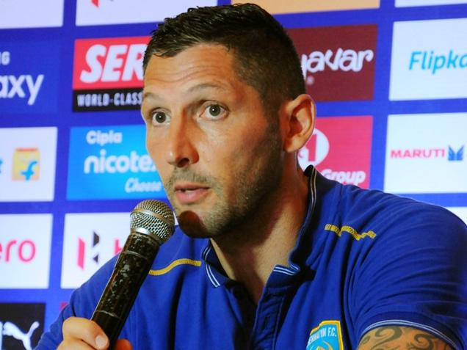
We deserve the semi-final spot: Materazzi

Slide 21
The 4-0 drubbing of Delhi Dynamos comes as a breath of fresh air for Chennaiyin FC’s World Cup winning coach Marco Materazzi, who says they deserve a semifinal spot in the second edition of Indian Super League.
The team was back in the reckoning when they beat Delhi Dynamos FC at the Jawaharlal Nehru Stadium on Tuesday evening.
This was their second successive win, having beaten Kerala Blasters FC 4-1 in their previous game.
Chennaiyin FC head coach Materazzi was happy with the turnaround.
“Nothing changed for us. Against Atlco de Kolkata also, we could have won. We deserve the semi-final spot,” the 42-year-old Italian said after the match.

