Slide 1
Nanorobotics & olap
By
M.v.s.s.Shankar
IH201585064

Slide 2
Contents
Introduction of nanorobotics
Working of nanorobots
Application
What is OLAP
OLAP structure
Why OLAP

Slide 3
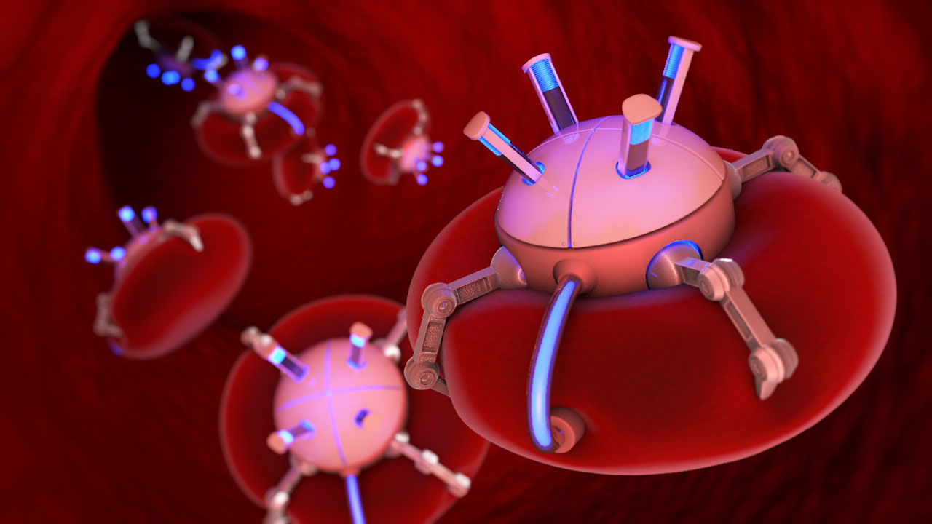
Nanorobotics

Slide 4
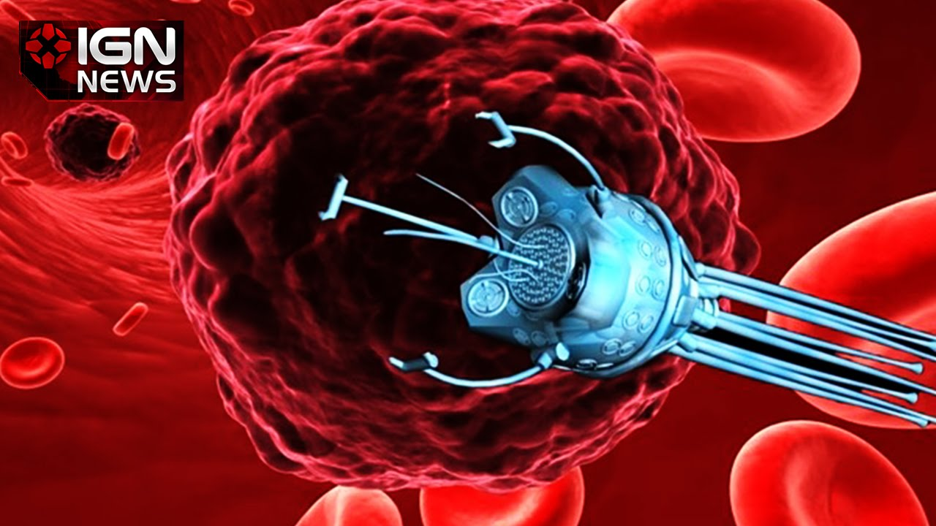
Introduction
Nanorobotics is the technology of creating machines or robots at or close to the scale of a nanometer .
Made of biological compounds.
Precision interactions with nanoscale objects.
They may be self replicated.
Notes:
Nanorobots (nanobots or nanoids) are typically devices ranging in size from 0.1-10 micrometres and constructed of nanoscale or molecular components.
Another definition sometimes used is a robot which allows precision interactions with nanoscale objects, or can manipulate with nanoscale resolution.
As no artificial non-biological nanorobots have so far been created, they remain a hypothetical concept at this time.

Slide 5
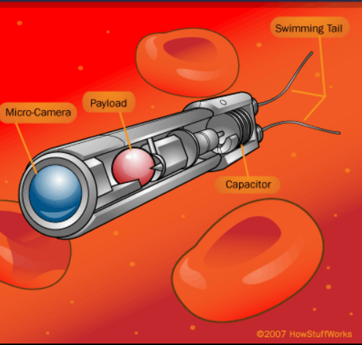
Working:
Find the target area.
Navigate nanobots.
Provide medication.
Undergo either replication
or self destruction
Notes:
Imagine that you go to a doctor for treatment of common cold. Instead of giving you a pill or an injection, your doctor sends you to a special medical team which implants a tiny robot into your bloodstream. The robot recognizes the cause of your illness, navigates through to appropriate system and provides a dose of medication directly to the infected area.
The nanobots a have propulsion system which allow them to navigate through blood stream.
They use ultrasonic waves to direct the bot to the target site and use MRI to track the position.
It has a drug reservoir which is released once it reaches the target location. It also has a camera which helps in studying about the tissue.
Finally it undergoes replication so that it can increase team size or self destruct according to the need.

Slide 6
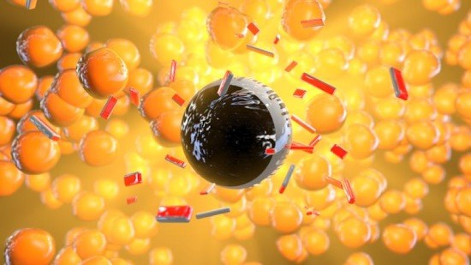
Applications:
Gout
Cleaning wound
Breaking of kidney stone
Fighting cancer
Treating arteriosclerosis
Breaking of clots
Parasite removal
Notes:
Gout: A condition in which the kidneys lose their ability to remove waste and breakdown of fats in the bloodstream. These wastes sometimes crystallize at points near the joints like knees and ankles. People suffering from gout experience intense pain in these joints. Nano robots can break down the crystals at the joints, providing relief from the symptoms, although not able to completely stop the process of their formation.
Cleaning wounds: Nanobots can help clean wounds from dirt, reducing the possibility of infection. They will be particularly useful in the case of stab wounds, which are difficult to treat using traditional methods.
Destruction of kidney stones: Kidney stones can be very painful – the larger the stone, the harder it is to get out. Doctors break large kidney stones using ultrasonic frequencies. But they are not always effective. Nanobots can break kidney stones using a small laser.
The fight against cancer: Doctors hope to use nanobots to treat cancer patients. Robots can either directly attack the tumor with lasers, microwaves or ultrasound, or become part of the chemotherapy, ensuring the delivery of drugs directly to the cancer cells. Doctors believe that the delivery of small but accurate doses of medication to the patient will minimize side effects and loss of drug efficacy.
Treatment of arteriosclerosis: Arteriosclerosis refers to a condition when the walls of the arteries are lined up by plaques or atheroma.Nanobots can help by cutting the plaques, which will then be carried away by the bloodstream.
Removing parasites: Nanobots can help remove bacteria and small parasitic organisms in the body. Nanobots need to work together to remove these micro organisms.

Slide 7
conclusion
The nanorobots are used in heart surgery, due to this number of risks and side effects are reduced.
The same techniques is used in various treatments like cancer, breaking kidney stones. breaking liver stones, parasite removal only with slight modification.
The microscopic size of robots require only a tiny amount of energg to operate.

Slide 8
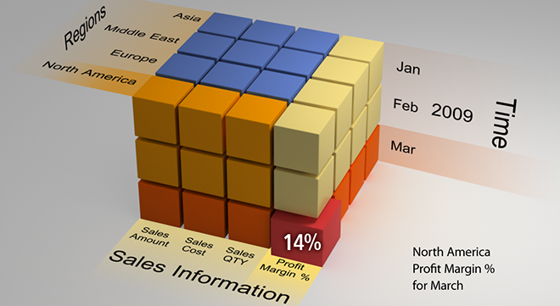
Online Analytical Processing

Slide 9
What is OLAP?
Olap is a technology that is used to organize large business databases and support the business intelligence.
It is used to create, update, delete and project data( view) that we fit into the database.
Notes:
When I say project the data, I mean view the data. It is a refined projection of our query in most user friendly environment. Just like applying filters. Like we say where roll num=10 and course1d=s002.

Slide 10
Olap structure
Olap is made up of cubes.(hyper cube)
Measures of cube are categorized by dimensions.
The usual interface to manipulate an olap cube is a matrix interface.
Notes:
Now you might get a doubt! When I say the data gets displayed as per filters you might say what more is this olap doing than a generic Oracle sql. Well actually this is the part where it gets more interesting…….

Slide 11
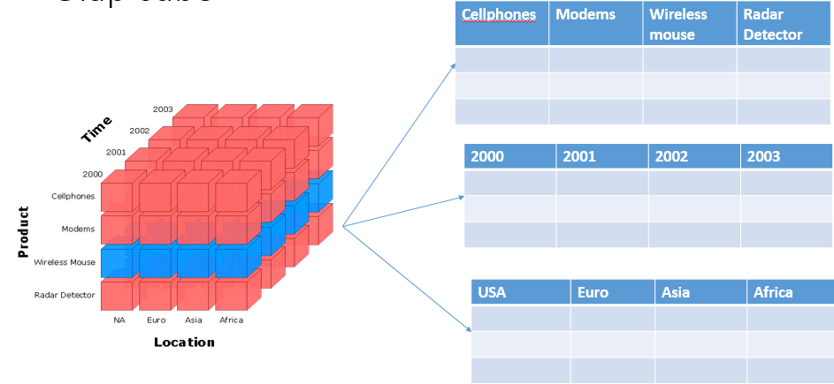
Olap cube
Notes:
This is how a cube gets constructed.

Slide 12
Why olap
Third party olap products compatibility. viz. microsoft sql with ole-db
Creating cube files for offline use.
Server actions
KPIs( key performance indicators)
Notes:
Well, these are the key features of OLAP, for which it is being popular.
Cross platform performance.
Offline!!!!!!!!!!!!!
Admin rights and DBA authority operational rights and grants.
Views
KPI’s are the intresting feature in the OLAP. They show you the uncommon and unique behaviour of the data when the trend line changes or according to the user specified querry

Slide 13
conclusion
Olap technology has been defined as the ability to achieve “fast access to shared multidimensional information.”

Slide 14
Thank you

