Slide 1

SHAREZONE
Sharing simplified!!!
Web Application Development
Course Instructor :
Dr. Balaji Raman
TEAM MEMBERS :
K. Balaram Singh ( S20180010089 )
O. Tarun Teja ( S20180010120 )
M. Mani Tej ( S20180010104 )
V. Shankar Sreenu ( S20180010186 )
P. Srujan Reddy ( S20180010123 )
T. Prem Ratan ( S20180010178 )

Slide 2
Project description:
Our app provides the medium between a borrower and lender by giving the option to a borrower to search from available things and request the lender to borrow a thing
The main essence of our app is to make the task of lending and borrowing things easier.

Slide 3
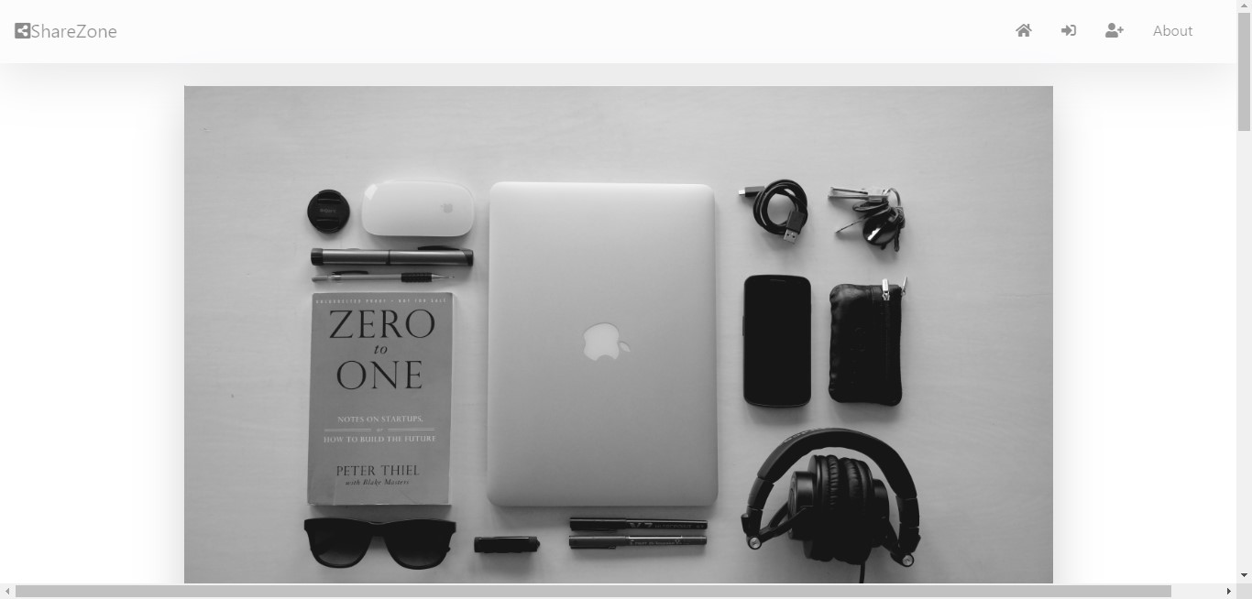
User interface of our app :
The landing/HOME page

Slide 4
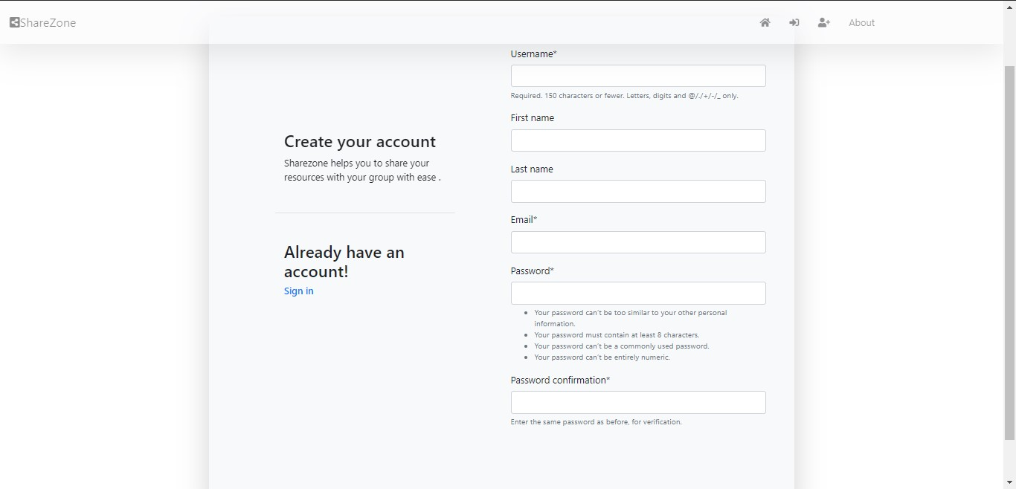
User Registration Page

Slide 5
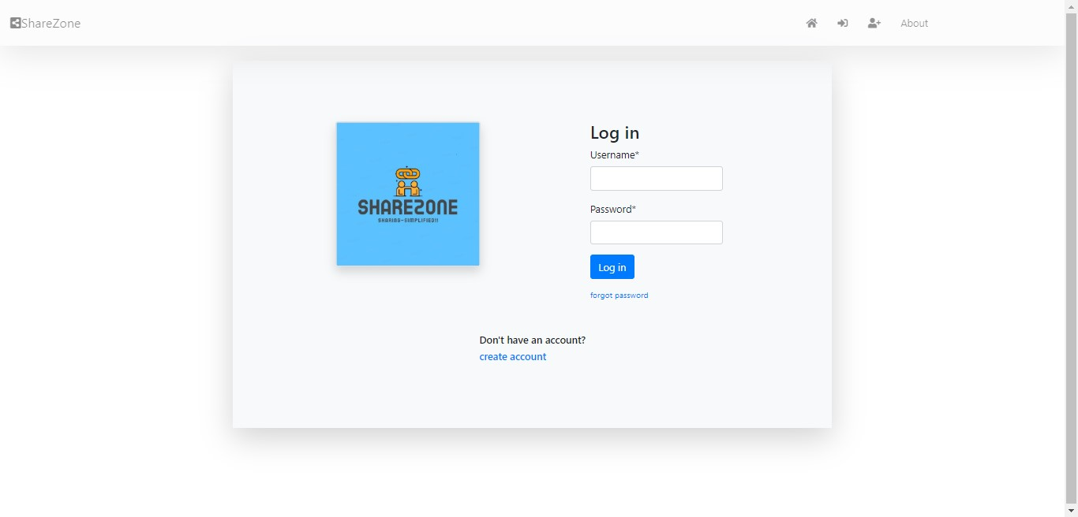
User Sign-in Page

Slide 6
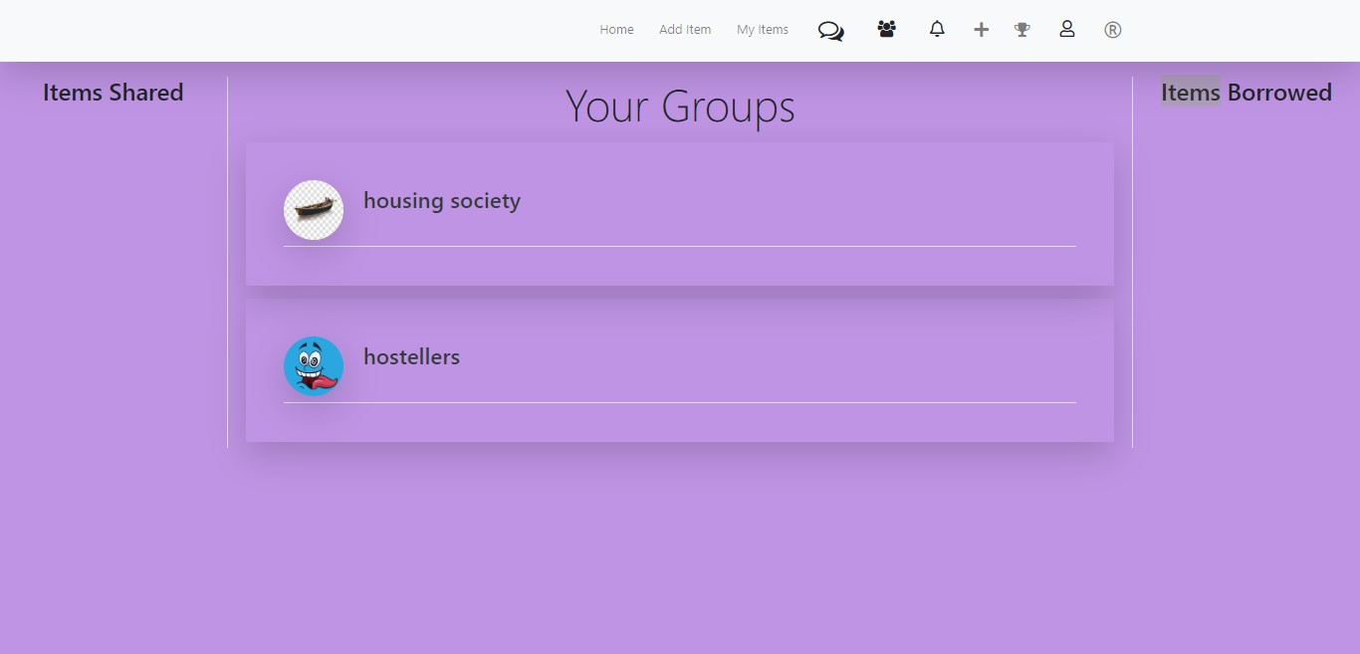
After Successful login , the home page renders where the user can see the items which he has borrowed , or the names of groups he has joined ( if any ) .
( the background can be changed )

Slide 7
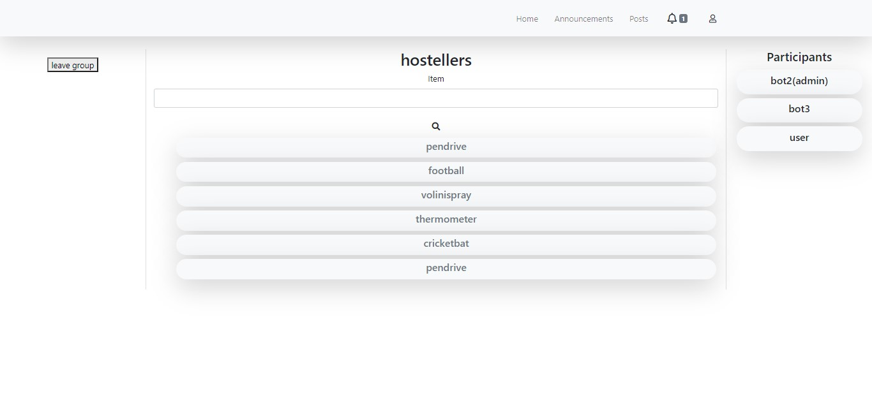
This is the home page of a specific group, here the group name is “Hostellers” . The user can find all the items available in middle portion of screen, we also have a search bar to find the required item .
The participants of group are displayed near right corner of screen . The user can leave the specific group by pressing leave group button on top left .

Slide 8
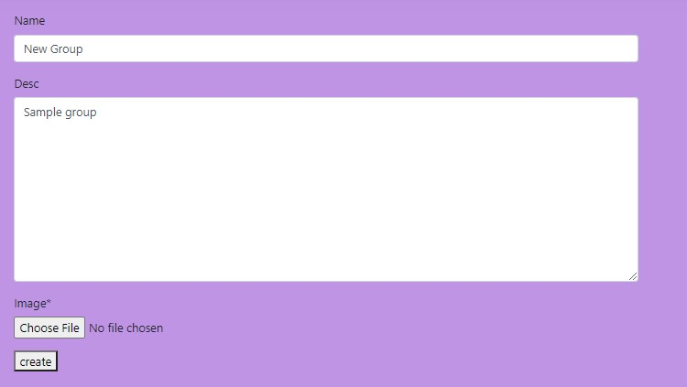
The user can also create a group by pressing the ‘+’ icon in the dashboard page . After giving suitable details , a new group is created .

Slide 9
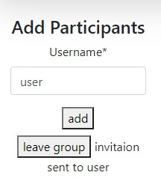
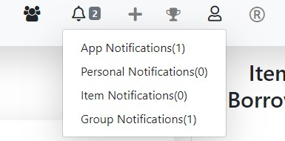
The group admin can send group invitation to a user by typing his username and pressing the ADD button .
After the admin sends an invite to a specific user ,
He/she receives a notification under
“Group Notifications”

Slide 10
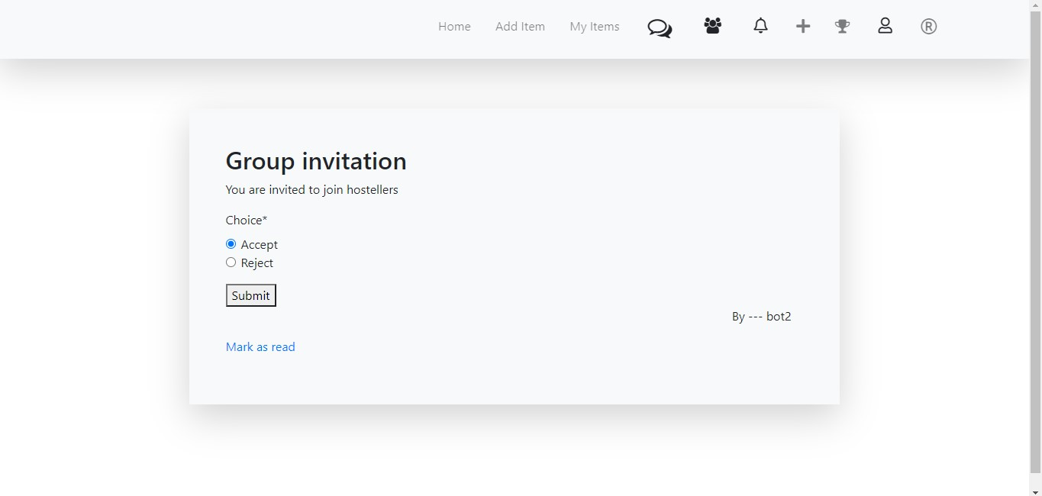
After clicking on group notifications , the user will be able to accept/reject the group invitation .
If the user wants to be added in the group , user can select accept and submit .
The user will be added to group

Slide 11
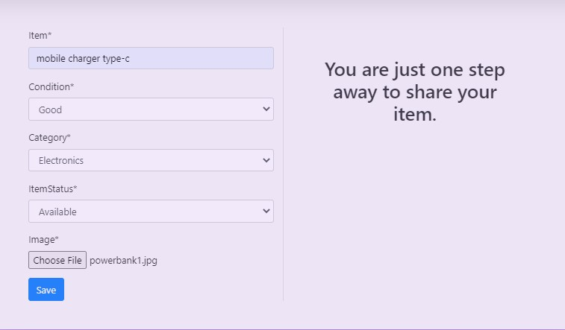
The most important part of our app : Items ( Things ) sharing
User can add an item , which he wants to share by filling the details of that item .
User has to select the condition of the item and category to share that item with other users .

Slide 12
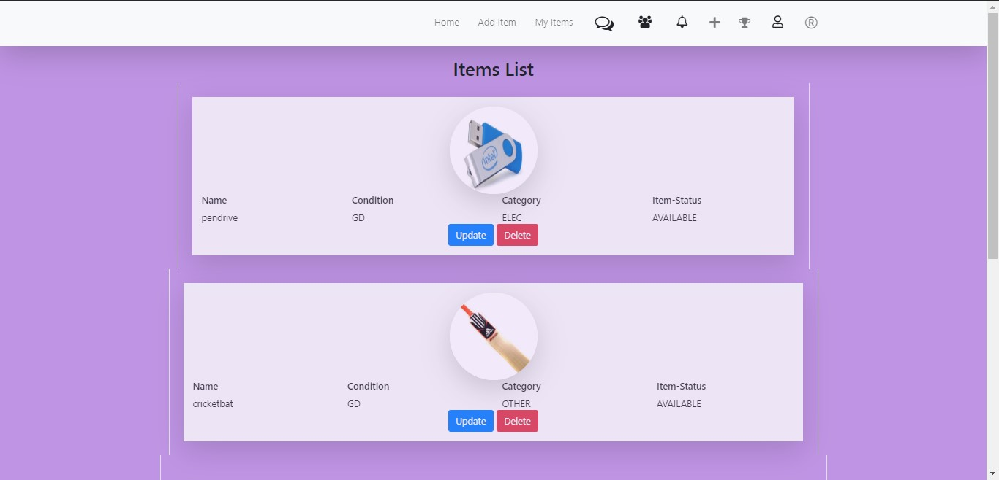
The user can view his items by clicking under myitems . All his items will be displayed including the condition , category and the availability status . The user can update the item or can delete the item by clicking UPDATE or DELETE

Slide 13
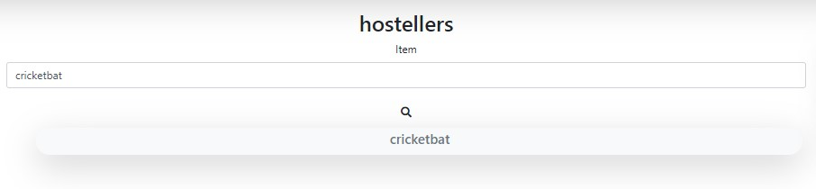
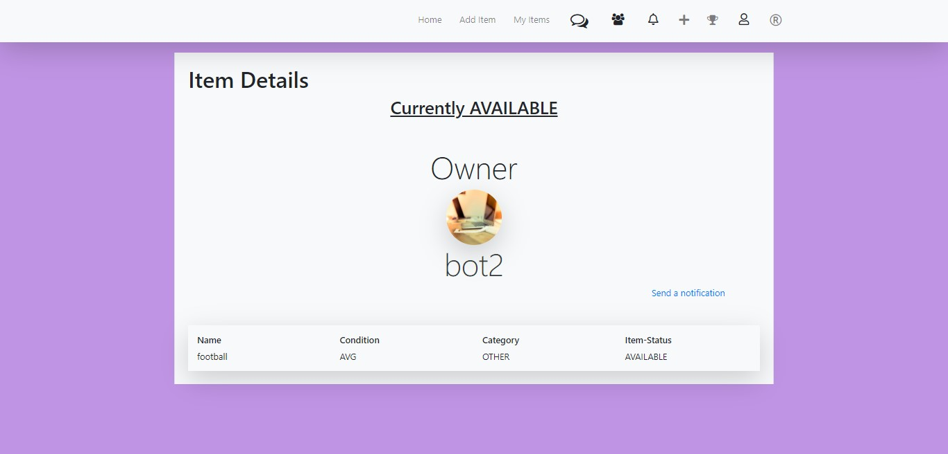
The user can search for an item by searching in search box
The user can view about the owner of item by clicking on the item names on above window

Slide 14
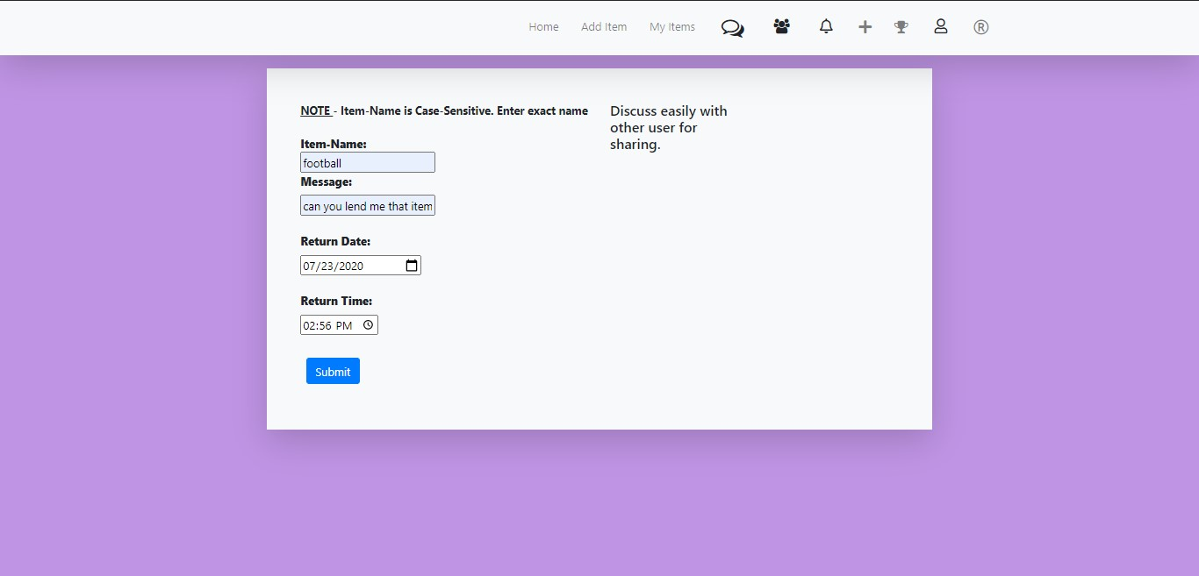
The user can send a notification to the owner , to request the particular item

Slide 15
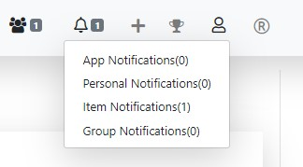
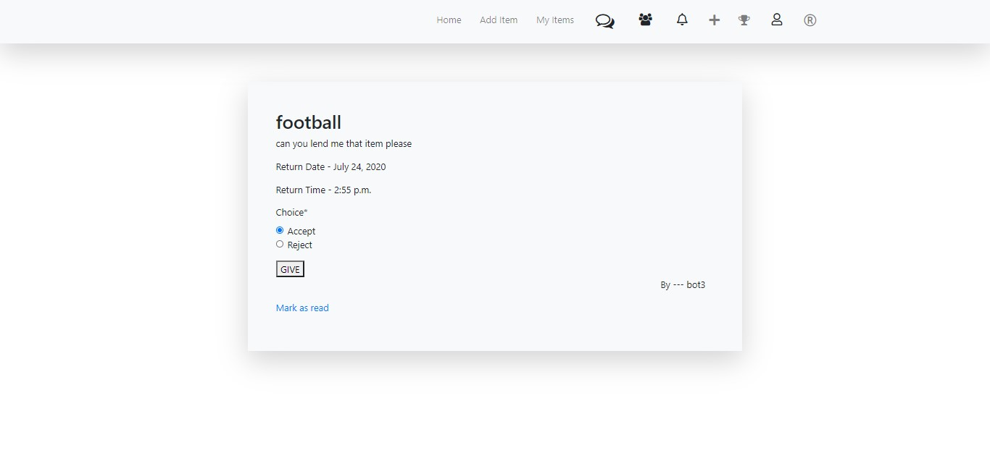
After a user sends a notification to owner , the owner receives a notification under Item notifications
The owner can view the request by clicking on the item notifications .
If the owner is willing to share the item , the borrower can meet the user to take the item . And the owner can accept the request here to keep track of items shared and borrowed .

Slide 16
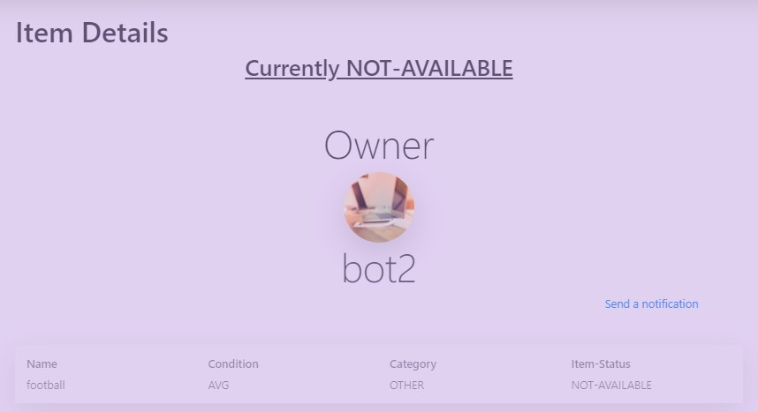
After the owner accepts the request , if any user views about the same item ; the above message is displayed.

Slide 17
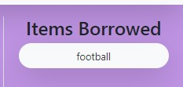
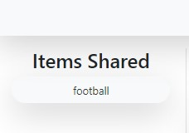
After the owner accepts the request , there will be an item under “ ITEMS BORROWED “ section in home page of user in the right edge of screen
After the owner accepts the request , there will be an item under “ ITEMS BORROWED “ section in home page of owner in the left edge of screen

Slide 18
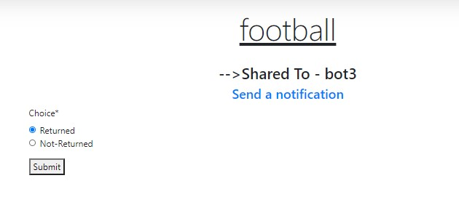
The user can return the item on or before the due date and the same can be updated in the website by user . He/she can click on the item in Items Borrowed and choose returned option and submit
After this submission , the item status is automatically updated from non-available to available

Slide 19
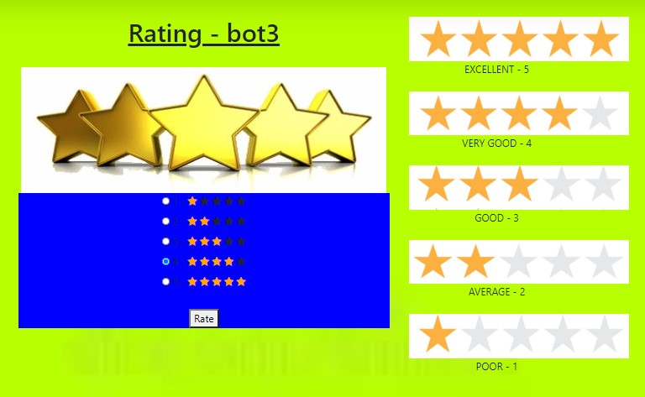
After updating in website , a rating dialog renders , the user can rate the other user , in terms of quality of response

Slide 20
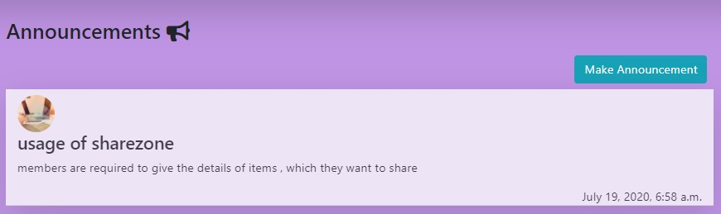
Other features in our app :
Users can announce the announcements they want to do .
The above displayed snippet is of home page of announcements , where all the announcements are displayed

Slide 21
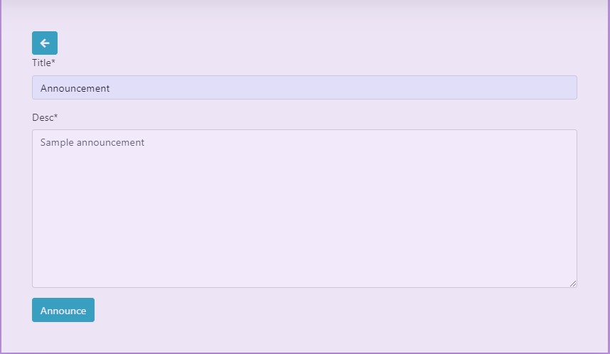
The user can make new announcements by clicking “MAKE ANNOUNCEMENT” in the previous screen .
The user has to fill the form which has title , description and click ANNOUNCE .

Slide 22
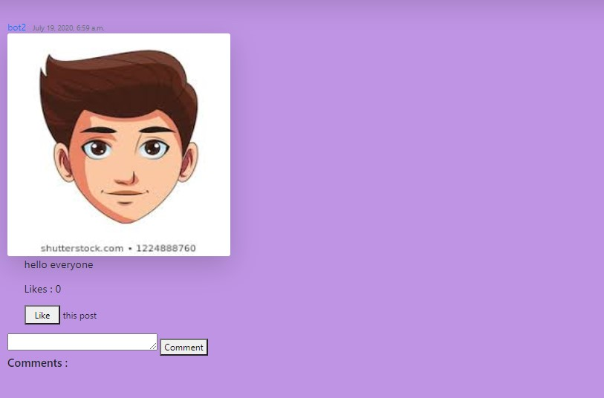
We also have developed a mini-social media in this app . Here the above snippet is of Posts . The user can upload posts , other users can interact by liking the post and commenting on post .

Slide 23
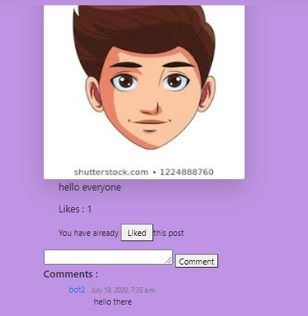
We can see the change in statement under the likes count .
This appears when the user has liked that particular post ,
User can also unlike the post by clicking on LIKED button

Slide 24
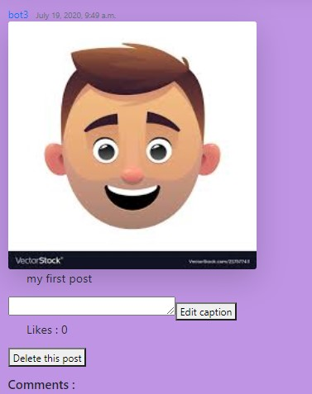
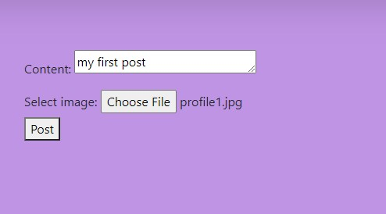
The user can view his posts by selecting My Posts button at top right of Home page of posts .
The user has the option to edit the caption and also has the option to delete his post
The user can create a new post by selecting new post after selecting my posts .
He has to fill a form which needs a caption and a image file

Slide 25
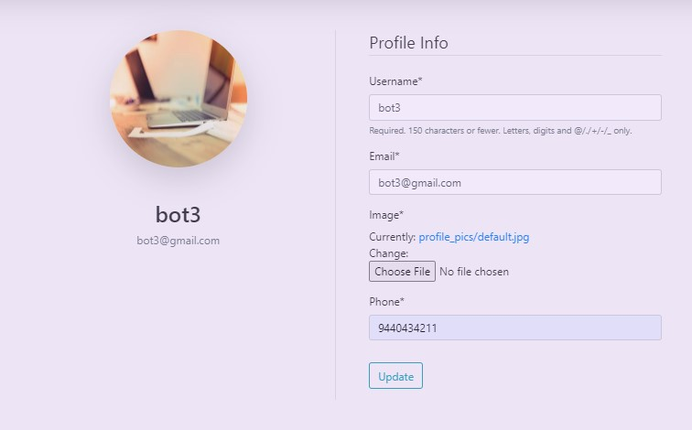
User can update his profile
Which involves profile picture , phone number ,
Email address and so on.
The option to update the profile can be found by clicking on user icon in home page

Slide 26
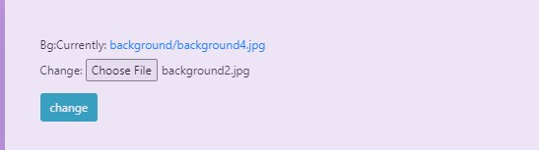
After we click on user icon in home page, we also find an option to change the background image of the whole app .

Slide 27
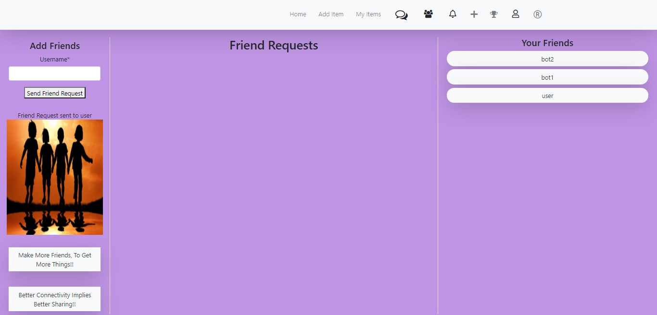
The above snippet is the home page of friends . User can send a friend request using the button in left of screen . Can view all his friends in right corner and the friend requests in center dialogue box .

Slide 28
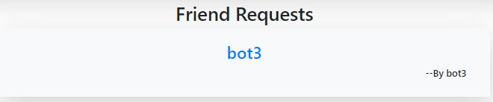
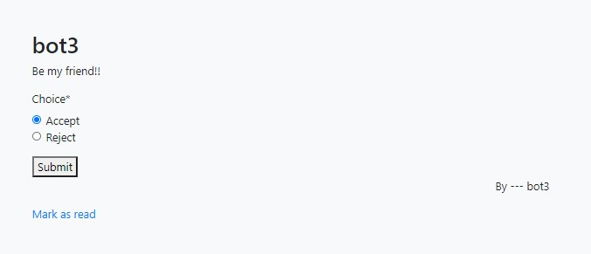
The Friend requests appear like the snippet above
The friend request is like the left snippet .
If user wants to accept the request , he/she can select ACCEPT and click SUBMIT

Slide 29
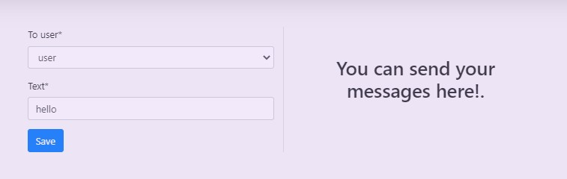

The user can send a message to any other user by selecting the receiver username from dropdown list , and also the user has to type the required text and click SAVE to send the message
The messages received can be viewed by selecting view messages .

Slide 30
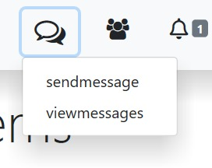
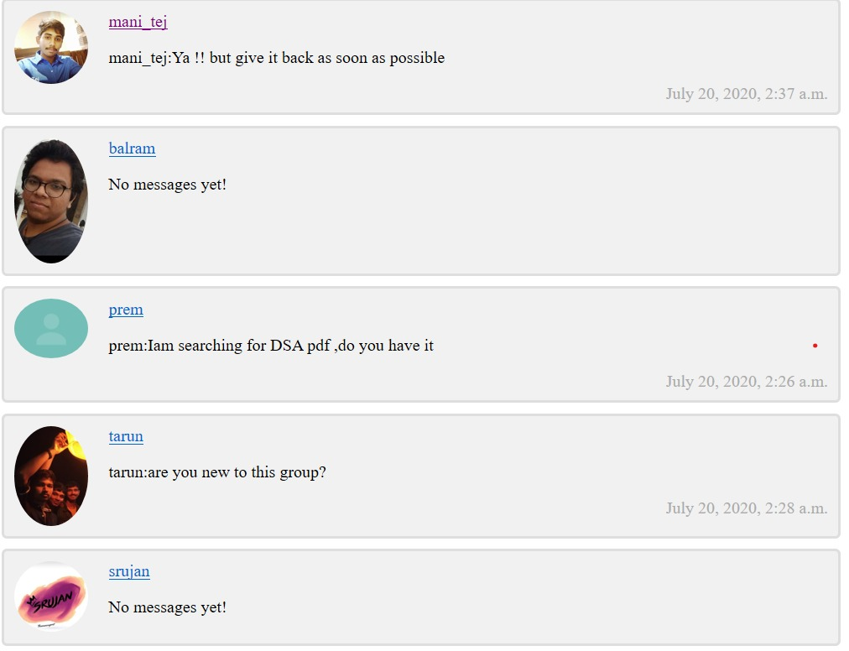
All the chats can be viewed by user by selecting view messages under chat icon

Slide 31
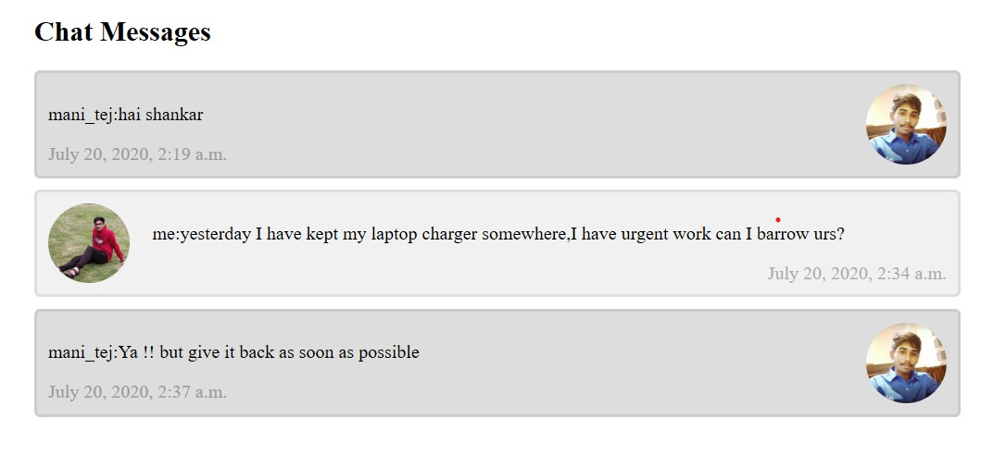
All the conversation to a particular user can be viewed by opening the profile in the last screen.

Slide 32
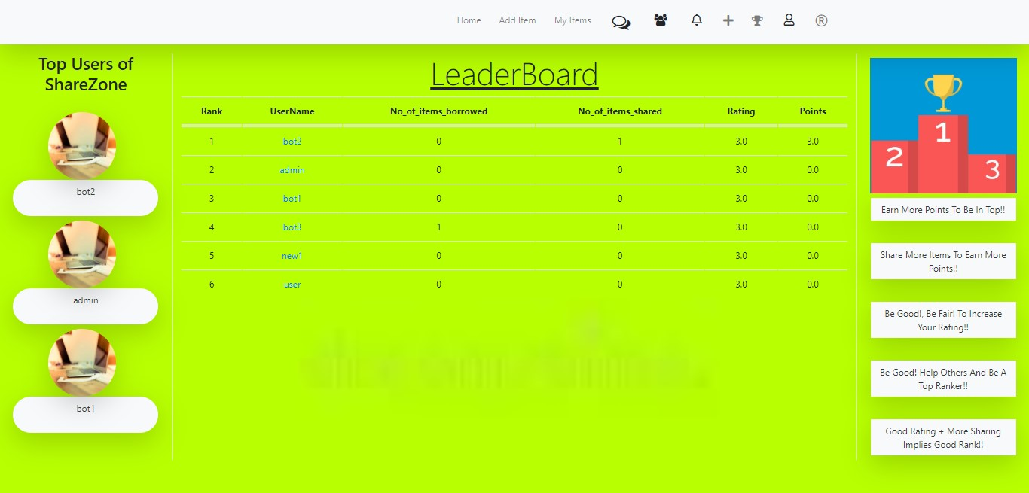
We also have the leaderboard which calculates the points based on no. of items shared successfully and the rating of that user .

Slide 33
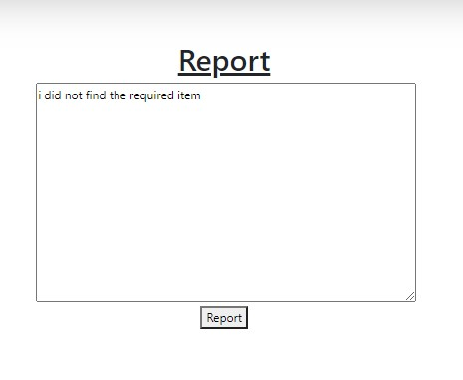
The user can report any problem by clicking the R button in dashboard page .
All the issues will be reviewed by Application Admin

Slide 34
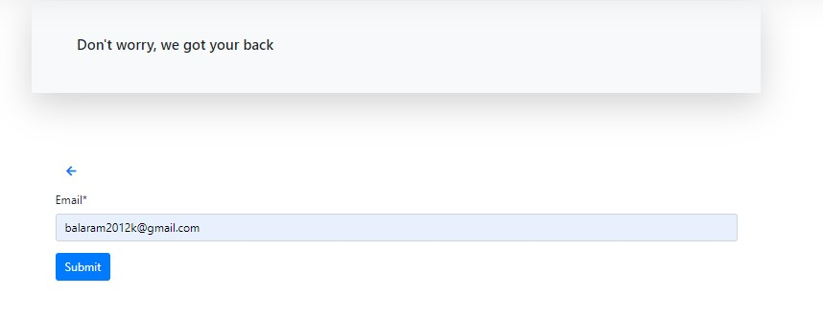
Forgot Password
There can be many users who could forget their password or would want to change the password .
This can be done in our website easily by clicking forgot password in the sign-in page .
The user has to enter the email-id associated with profile details .

Slide 35
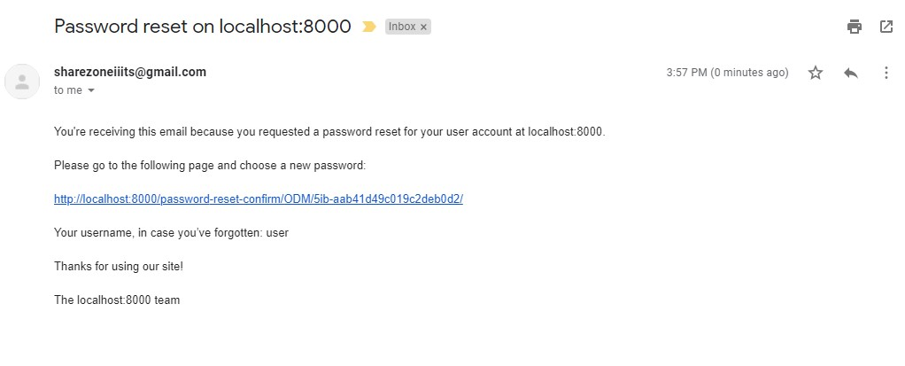
A mail similar to the above mail will be sent to the entered mail address .
Follow the link to change the password associated with user account

Slide 36
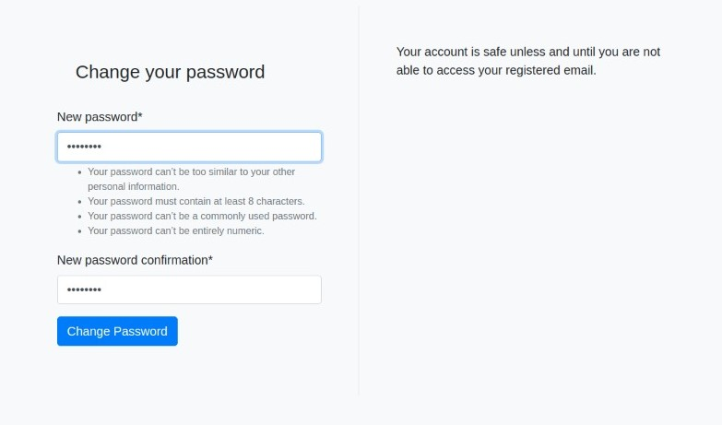
Enter the new password in both the fields to change the password successfully .

Slide 37
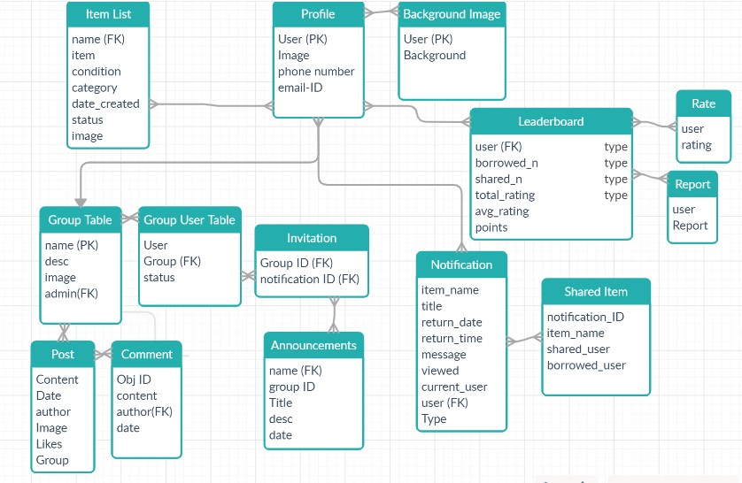
Connectivity of our Application Database

Slide 38
THANK YOU

