Slide 1

TEAM HOAX
GEETHANJALI COLLEGE OF ENGINEERING AND TECHNOLOGY
MEMBERS
A. SHANKAR SRIVATHSA CH. DIVYA K. SUHITHA
23R11A6602 23R11A6610 23R11A6620

Slide 2

PROBLEM
Delayed ambulance response time
Increases mortality and morbidity
The emergency system is not efficient
Hospital overcrowding can worsen the situation

Slide 3
PROBLEM STATEMENT
“Design and develop an emergency response app with an intuitive emergency button that alerts the nearest ambulance and hospital in real-time, providing accurate location tracking and pre-notification to ensure timely medical assistance while addressing challenges in location accuracy, real-time communication, integration, privacy, and scalability.”

Slide 4

SOLUTION
When an accident occurs at a location nearby individuals can open the app and press the Emergency Button.
App sends live location to the nearest hospital and alerts the ambulance crew.
Ambulance uses GPS to find the shortest path and reach the accident site quickly.
.
Nurse updates patient condition to the hospital in real time.
Hospital makes the arrangements for the patient’s arrival.

Slide 5
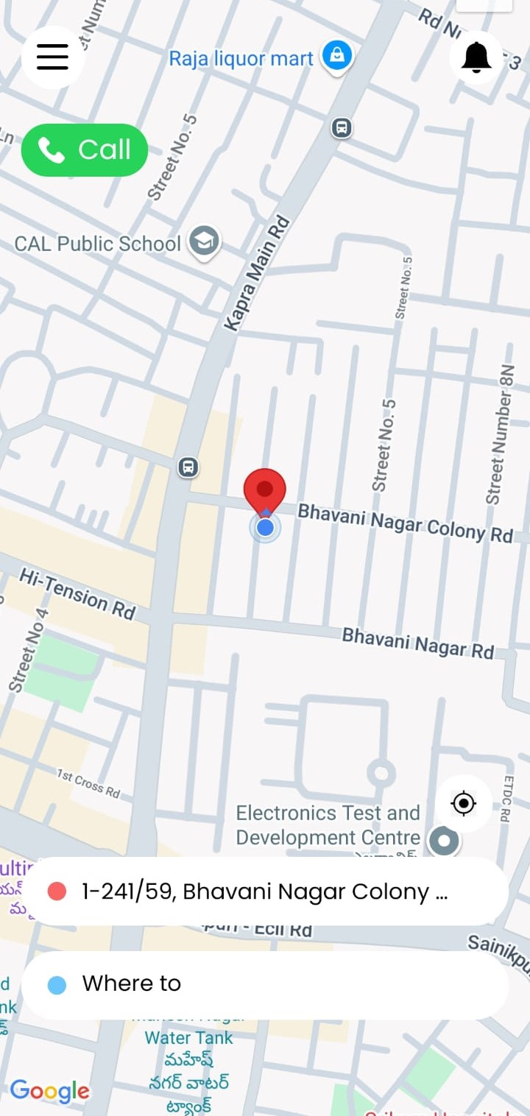
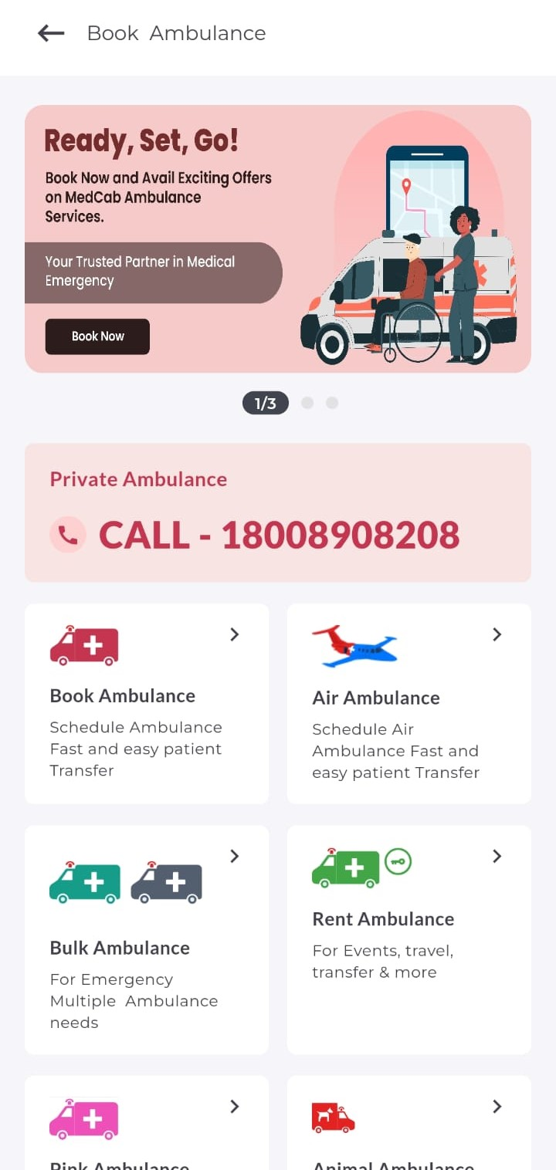
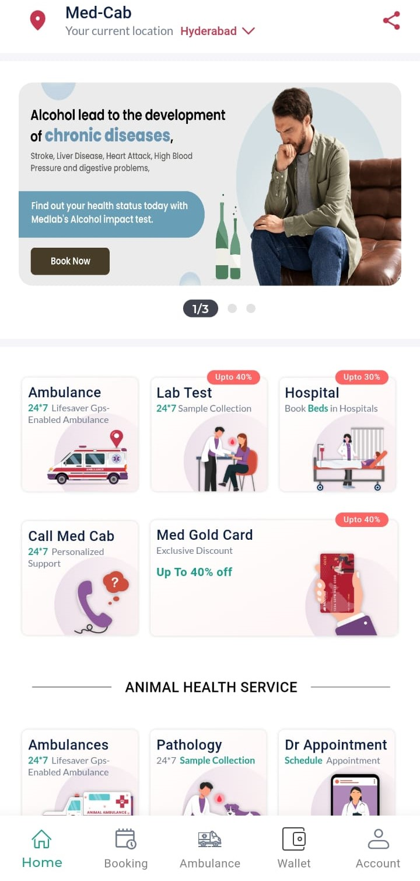
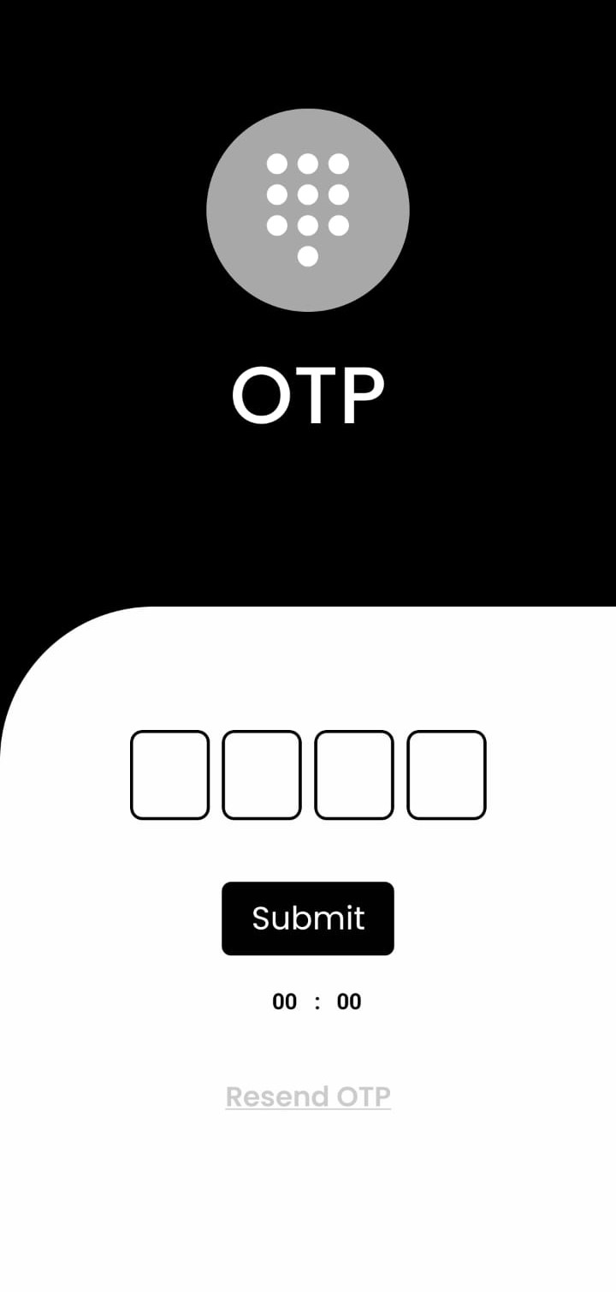
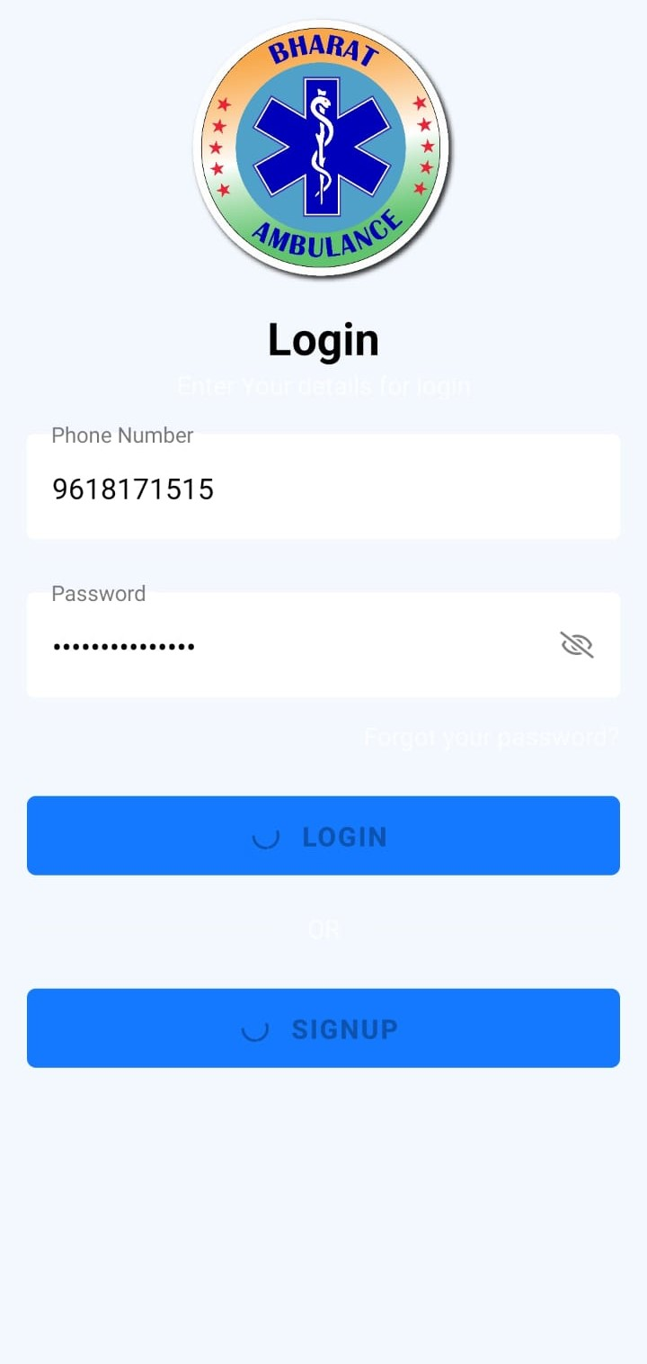
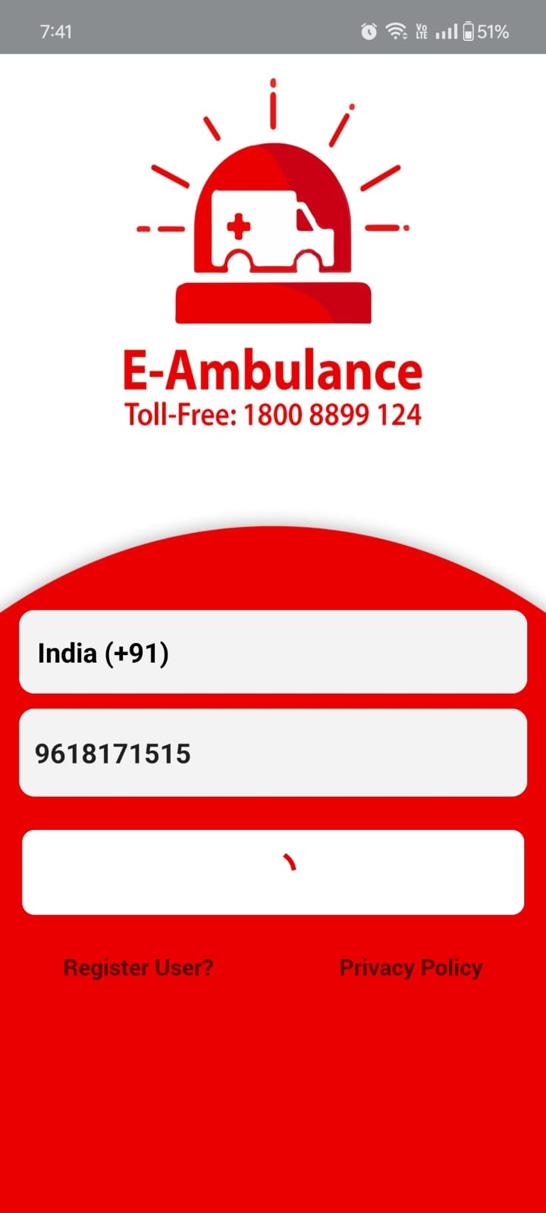


DEMERITS OF CURRENT APPS
POOR MAINTENENCE
7:51 pm
8:21 pm
7:41 pm

Slide 6
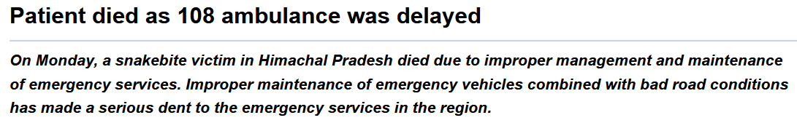

DELAYS

Slide 7
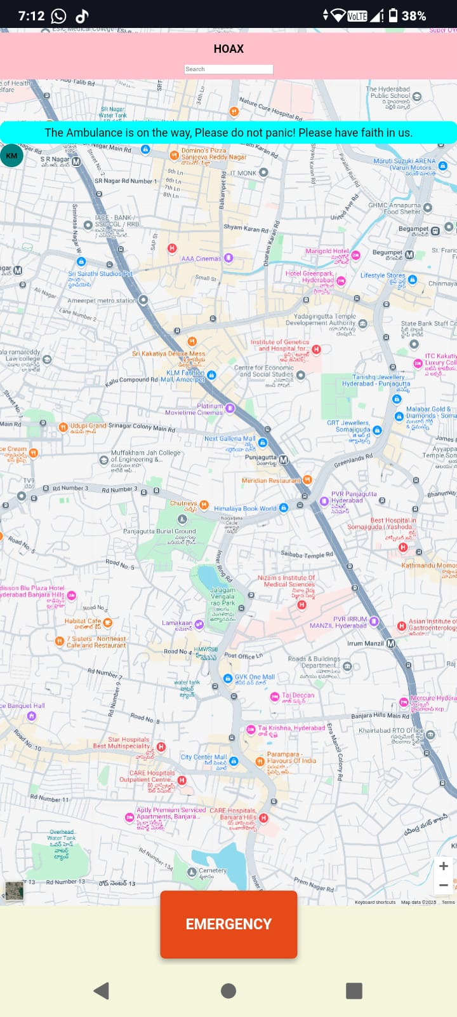
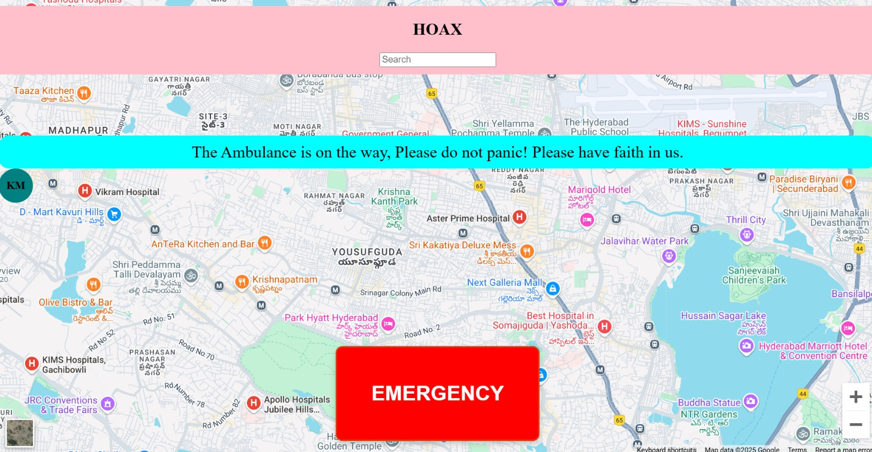

INTERFACE
Mobile view
DESKTOP VIEW

Slide 8
MERITS
Quick Emergency Response
Efficient Route Planning
Better Resource management
Real-Time Tracking
User Friendly and minimalist
Improved Patient Outcomes

Slide 9
AI TOOLS USED
ChatGPT – We used ChatGPT to answer our questions and provide us guidance.
Anomaly detection model - identifies suspicious activity which is out of your normal patterns or behavior (used it for speed meter).

