Slide 1



MARKETING AND RETAIL ANALYTICS PROJECT MILESTONE 1
SHANKAR S
PGP-DSBA
APRIL 2021
01/03/2022

Slide 2
AGENDA AND SUMMARY
AGENDA:
Agenda of this project is to find out the underlying patterns of the customers of an automobile part manufacturer based on the past 3 years of the company’s transaction data and recommend them customized marketing strategies for different segments of customers.
SUMMARY:
We have received the 3 years data of automobile part manufacture consisting of 2747 entries with 20 variable details regarding the demography and customer information.

Slide 3
CONTENTS
PROBLEM STATEMENT
DATA SUMMARY
EXPLORATORY DATA ANALYSIS
INFERENCE
CUSTOMER SEGMENTATION USING RFM ANALYSIS
KNIME WORKFLOW
INFERENCE FROM RFM ANALYSIS AND IDENTIFIED SEGMENTS
RECOMMENDATION

Slide 4
PROBLEM STATEMENT
An automobile parts manufacturing company has collected data of transactions for 3 years. They do not have any in-house data science team, thus they have hired you as their consultant. Your job is to use your magical data science skills to provide them with suitable insights about their data and their customers.
ORDER NUMBER: | Order Number | CUSTOMERNAME: | customer
QUANTITYORDERED : | Quantity ordered | PHONE : | Phone of the customer
PRICEEACH : | Price of Each item | ADDRESSLINE1 : | Address of customer
ORDERLINENUMBER : | order line | CITY : | City of customer
SALES : | Sales amount | POSTALCODE : | Postal Code of customer
ORDERDATE : | Order Date | COUNTRY : | Country customer
DAYS_SINCE_LASTORDER : | Days_ Since_Lastorder | CONTACTLASTNAME: | Contact person customer
STATUS : | Status of order like Shipped or not | CONTACTFIRSTNAME: | Contact person customer
PRODUCTLINE : | Product line – CATEGORY | DEALSIZE: | Size of the deal based on Quantity and Item Price
MSRP : | Manufacturer's Suggested Retail Price | PRODUCTCODE : | Code of Product

Slide 5
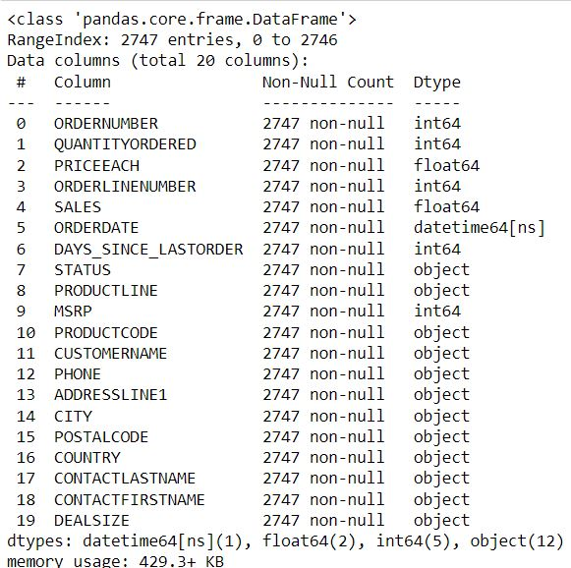
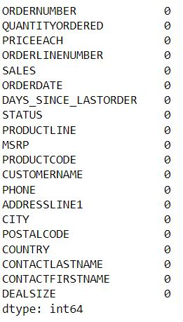
DATA SUMMARY
The Dataset is about an Automobile manufacturing Company. The Dataset consists of 2747 entries with 20 variables. Also we can see that there are no null values present in the dataset.

Slide 6
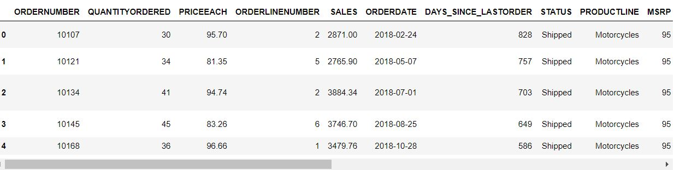
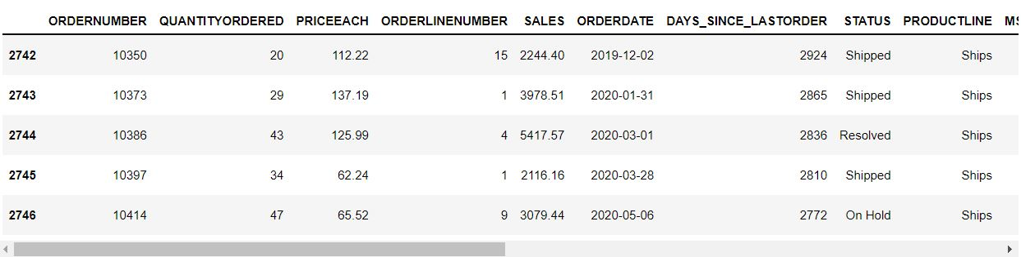
The head and tail of the dataset is shown below.

Slide 7
The data has no null values and the shape of the dataset is (2747,20).
This data reflects on the purchasing behaviour of customers in different categories. The company is in automobile part manufacture and the product line in which they are performing are Classic Car, Motorcycle, Plane, Train, Ship, Bus Truck, Vintage Cars etc.
The data is maintained at each transaction level along with order number and each order number will hold up all the information such as Customer Name, Phone, Country and the product details such as Product Code, Price, Quantity and Sales of each Customer.
We can notice that one order number has different entries with same or different product codes.
Manufacture suggested Retail Price for each product is decided but we can infer that this is not matching with Sales of each item to the customer.

Slide 8
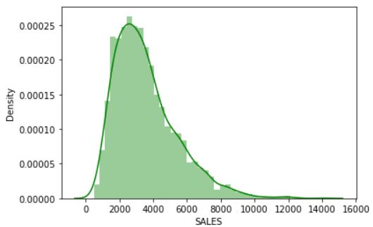
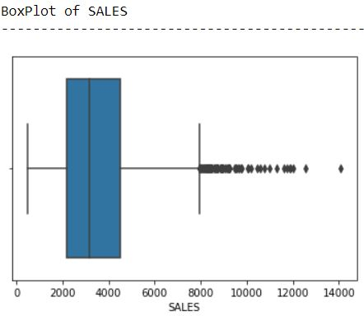
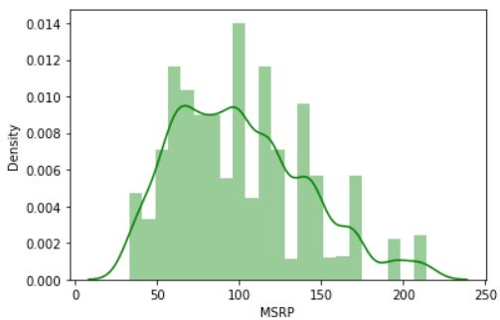
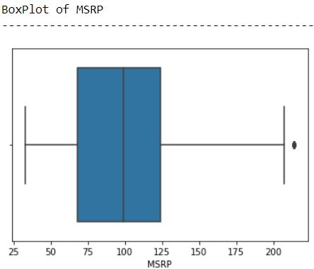
EXPLORATORY DATA ANALYSIS
SALES
MSRP

Slide 9
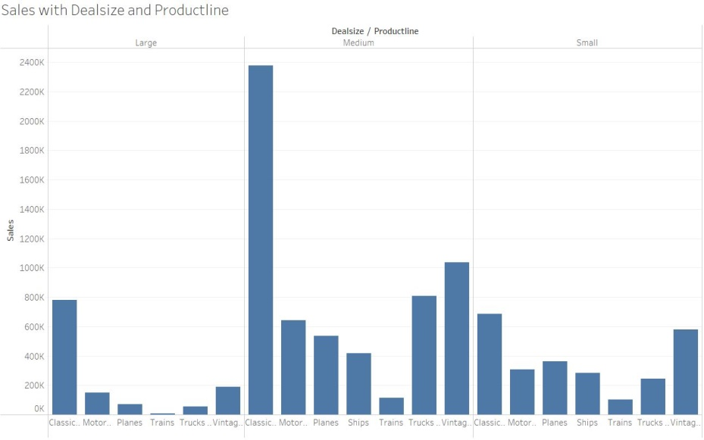
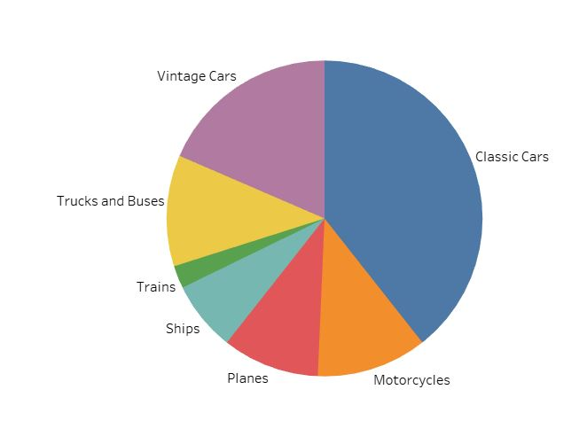
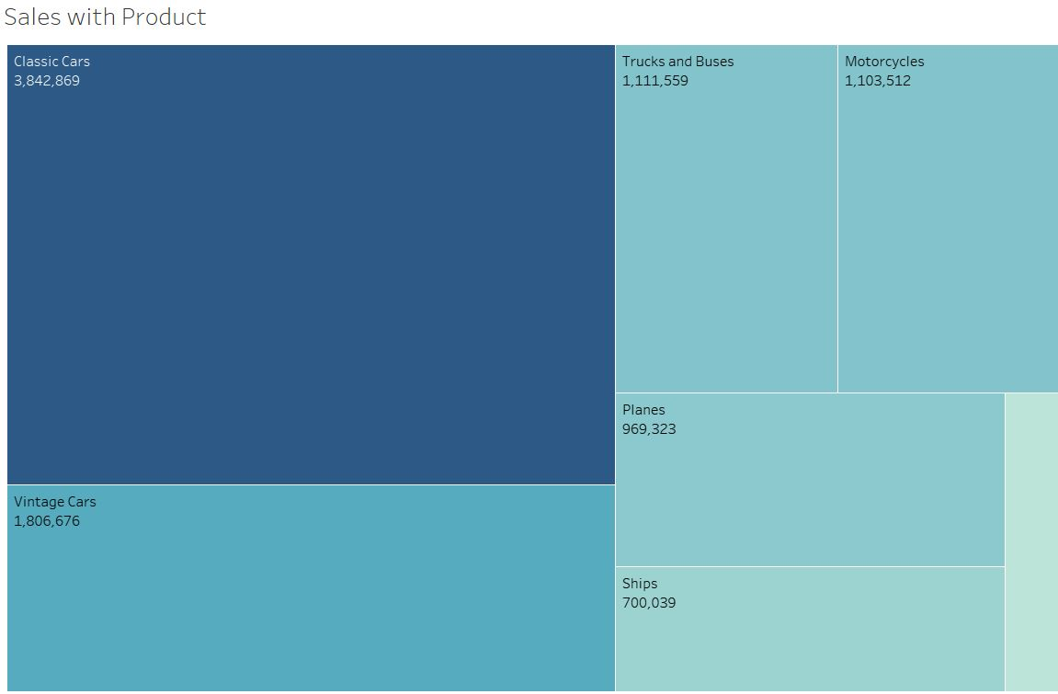
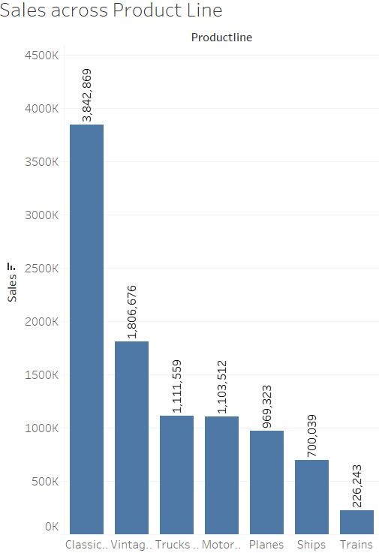

Slide 10
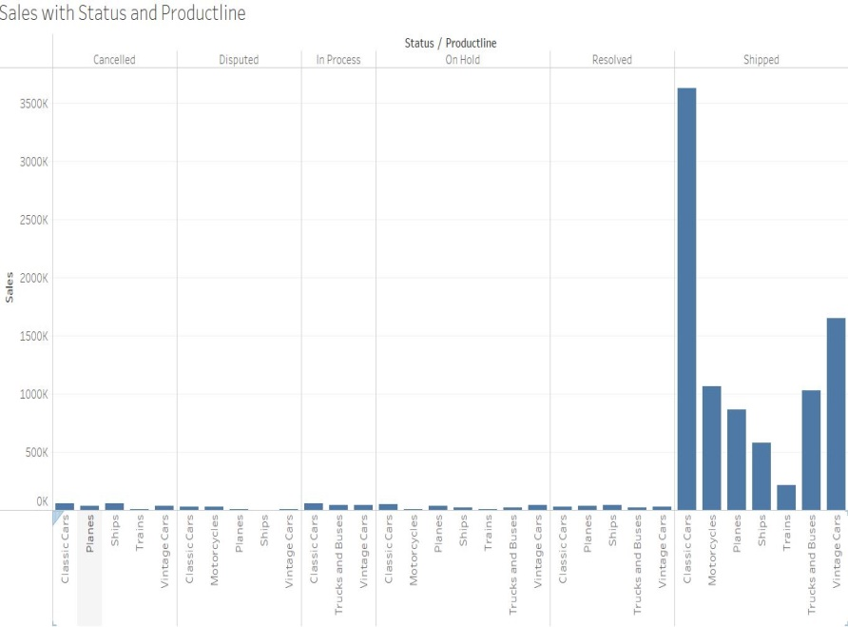
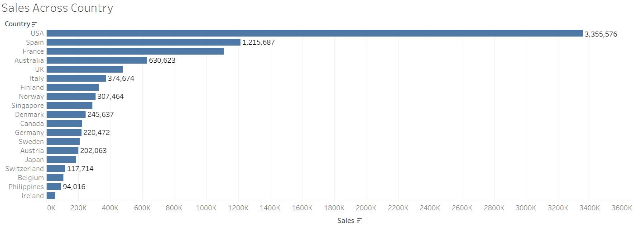
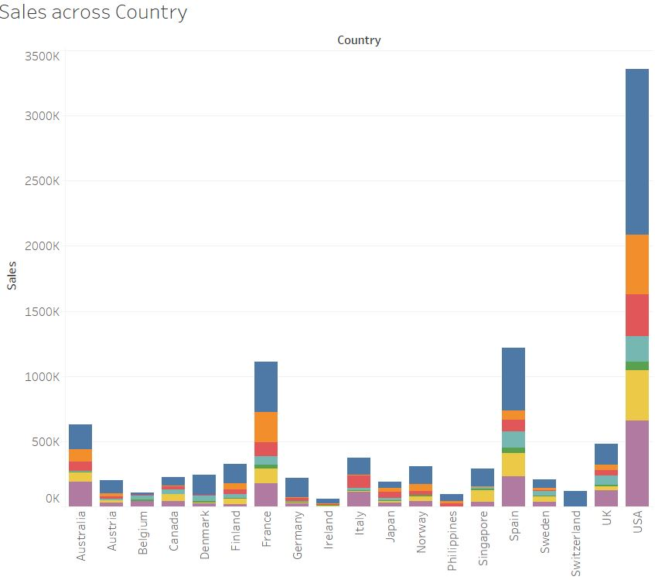
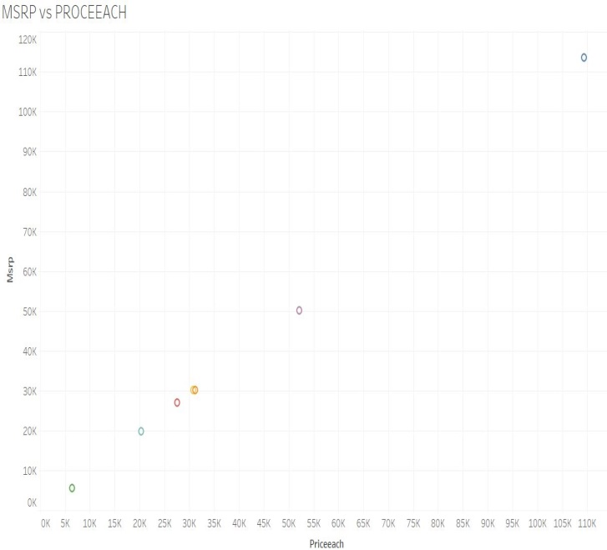
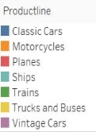

Slide 11
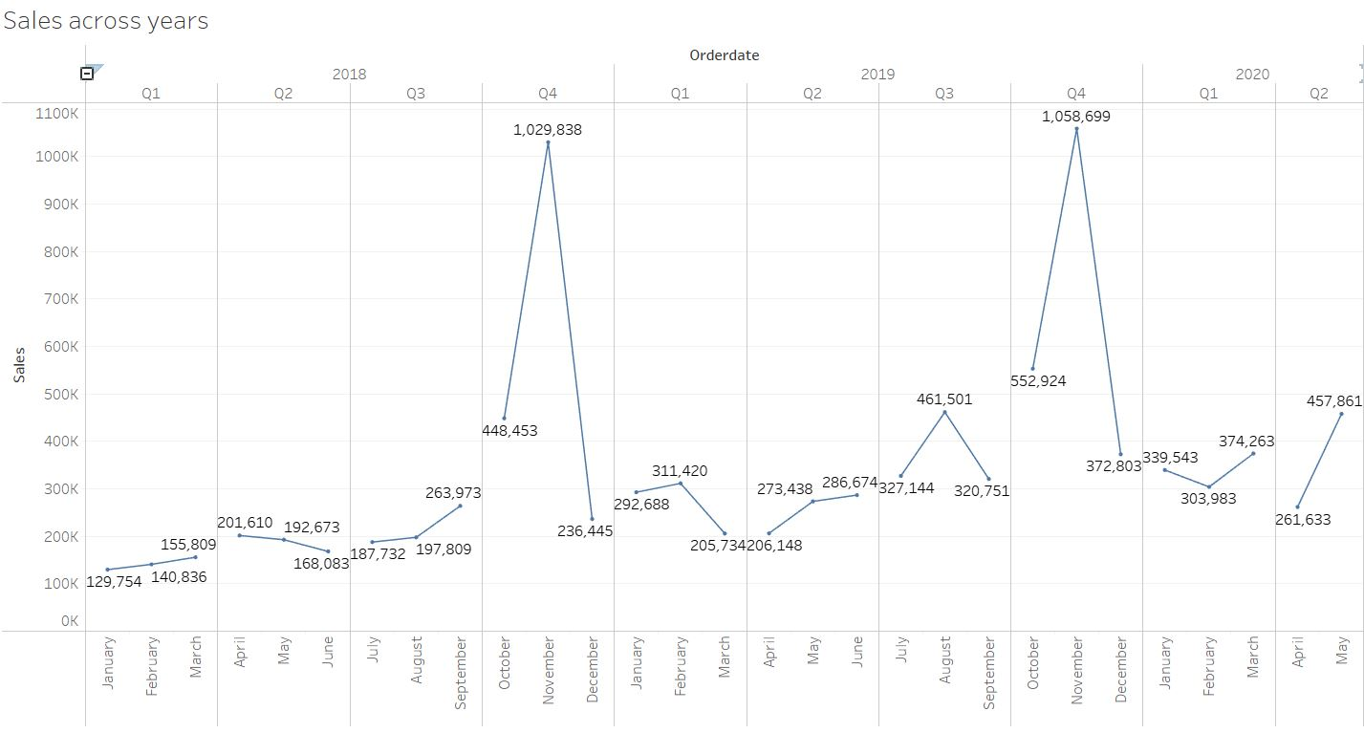

Slide 12
INFERENCE:
After performing EDA we can analyse that there are outliers present in all the variables.
After plotting histogram we can analyse that Sales of Classic Cars is the highest followed by Vintage Cars. Trains has the least sales among all the product line.
Classic Cars has the most sales with 39.37% of the total sales value.
USA has the highest sales compared to all other countries with 3,355,576.
After plotting trend lines across years we can able to analyse that November has the highest sales value both in 2018 and 2019. This leads us that there is seasonality present in the dataset.
We can see that the demand of Classic cars is high which leads the company to sell the product below the MSRP by giving some offers to the customers.
We can also see that the most preferred Deal Size by customers is Medium.
We can also see that most of the orders has been Shipped.

Slide 13
CUSTOMER SEGMENTATION USING RFM ANALYSIS
Which tool used?
The tool used here is KNIME.
What all parameters used and assumptions made
* Here we have excluded Days Since Last Order and created a new Column of Frequency with the current Date as reference.
* We can infer from the data there are some order number repeated for different product code. So we can assume that the count of each order number as Frequency of the order number.
* We have created a new Column ‘Monetary’ which is Quantity * Price Each which is further used for RFM Analysis.
* We have created four bins which are Churn, Low, Medium and High. Using this we can segregate the customers after performing RFM Analysis.
These are some of the assumptions and parameters which is used to create a KNIME workflow.

Slide 14
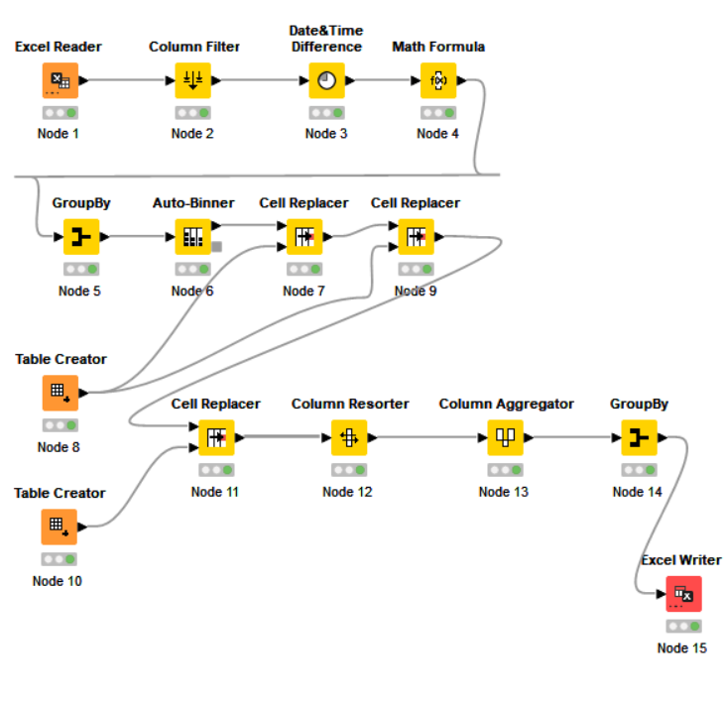
KNIME WORKFLOW
The KNIME workflow chart is displayed below.

Slide 15
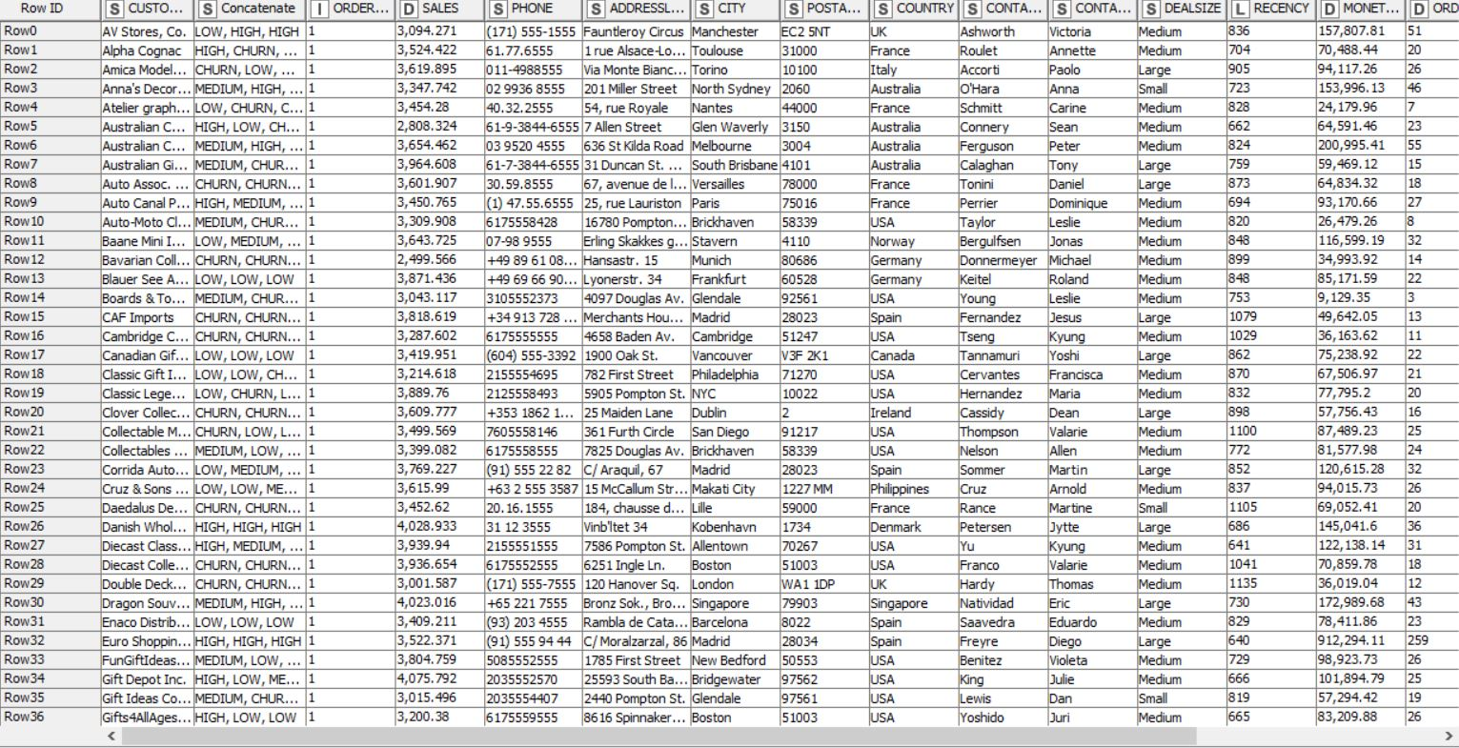
Output table head
The output table head is shown below after that RFM analysis is performed.

Slide 16
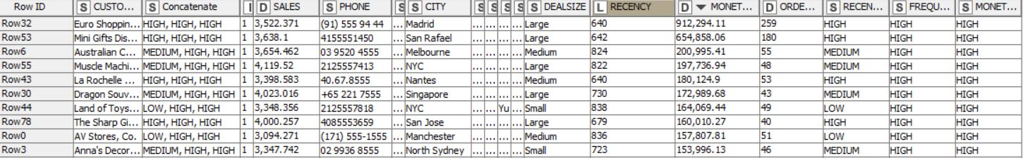
INFERENCES FROM RFM ANALYSIS AND IDENTIFIED SEGMENTS
Our Top Best Customer.
After performing RFM analysis these are the top customers for the company where Euro Shopping Channel is top customer where he recently visited and he his monetary value is high and he is frequently visiting the company. His RFM value is HHH.

Slide 17
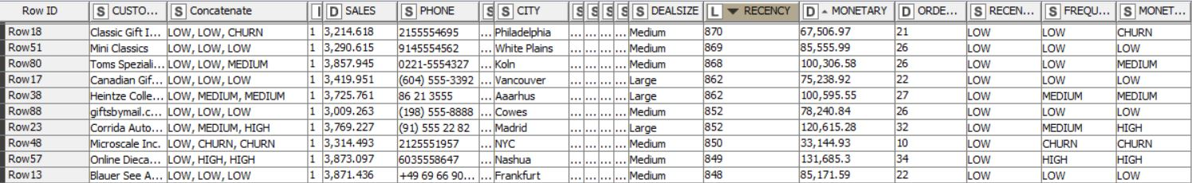
Which customers are on the verge of churning?
These are the customers who are on the verge of churning. Here if the company has some extra credit after the promotions to their top and medium customers they can focus over these customers so that they can turn into some potential customers.

Slide 18
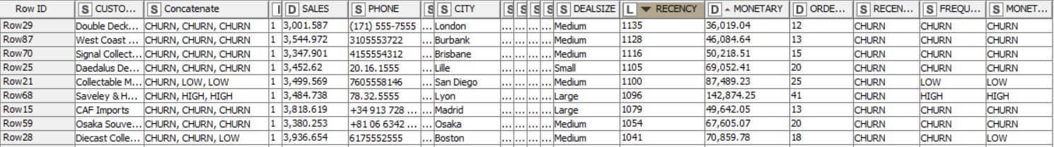
Who are your lost customers?
After performing RFM analysis we found out these are the customers that the company has lost over the years. These customers did not visit the company for more than 18 months and their monetary value is also not good. The company should let go of these customers instead of dwelling in this.

Slide 19
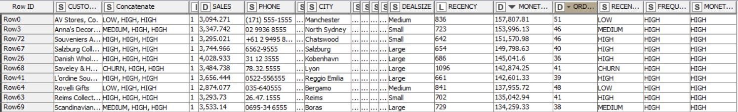
Who are your loyal customers?
After performing RFM analysis we found out that these are the company’s loyal customer. Here some customer won’t visit the company that much but they are making large orders with high monetary values. We can focus on these customers so that they can become top customers too.

Slide 20
RECOMMENDATIONS
Using RFM analysis we found out that the top, loyal customers and also the customers that are churned and on the verge of churning.
There are customers who are on the verge of churning. Here if the company has some extra credit after the promotions to their top and medium customers they can focus over these customers so that they can turn into some potential customers. This is vital for the company’s growth.
There are customers did not visit the company for more than 18 months and their monetary value is also not good. The company should let go of these customers instead of dwelling in this.
The Classis Cars has bought the most number of sales to the company. Also the company can stop manufacturing train since it has the least sales in the past two years and can use that manpower to manufacture their top products.

