Slide 1



MARKETING AND RETAIL ANALYTICS PROJECT MILESTONE 2
SHANKAR S
PGP-DSBA
APRIL 2021
06/03/2022

Slide 2
AGENDA AND SUMMARY
AGENDA:
The project involves conducting a thorough analysis of Point of Sale (POS) Data for providing recommendations through which a grocery store can increase its revenue by popular combo offers & discounts for customers.
SUMMARY:
The dataset contains transaction history of the grocery store of three years which contains multiple products with order number and the date of purchase and the shape of dataset is 20641, 3.

Slide 3
CONTENTS
PROBLEM STATEMENT
EXPLORATORY DATA ANALYSIS
INFERENCE
MARKET BASKET ANALYSIS
KNIME WORKFLOW
ASSOCIATIONS IDENTIFIED
RECOMMENDATION

Slide 4
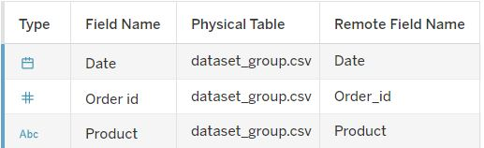
PROBLEM STATEMENT
A Grocery Store shared the transactional data with you. Your job is to identify the most popular combos that can be suggested to the Grocery Store chain after a thorough analysis of the most commonly occurring sets of items in the customer orders. The Store doesn’t have any combo offers. Can you suggest the best combos & offers?
The data dictionary is shown below.

Slide 5
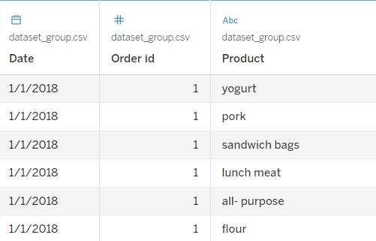
EXPLORATORY DATA ANALYSIS
The sample of the data is shown below.
There are no null values present in the dataset. There are multiple products in the same order ID.

Slide 6
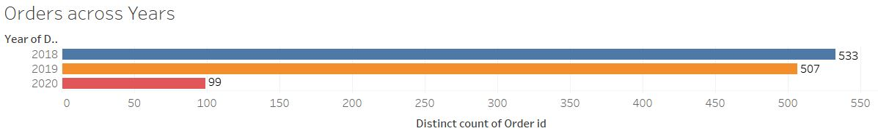
We can see that the year 2018 has the highest amount of orders with 533 and the number of orders in 2019 is less than compared to 2018 with 507 and the 2020 has only 99 orders. But the data we have contains only two months in 2020.

Slide 7
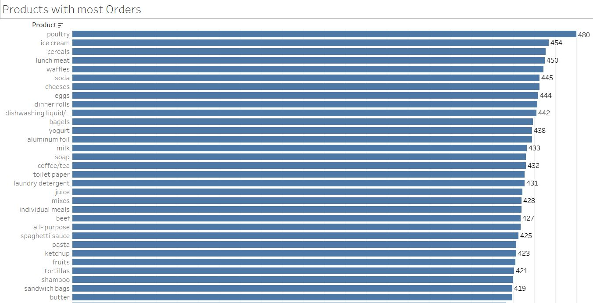
We can see that Poultry has the most number of orders compared to other products with 480 and following that we have ice cream and cereals and so on.

Slide 8
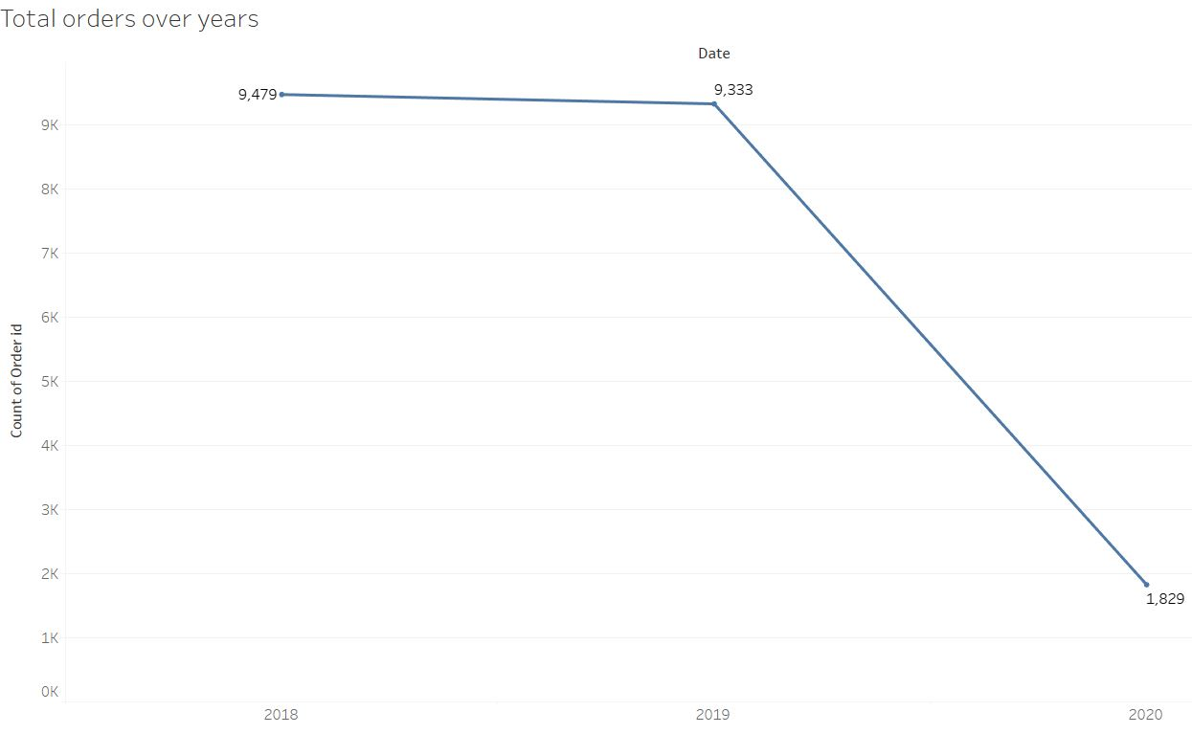
As we have seen the orders has been reduced from the year 2018 to 2019 to 2020. This shows that there is a downward trend across POS for the store over the years. Although we can skip the year 2020 since it has only two months.

Slide 9
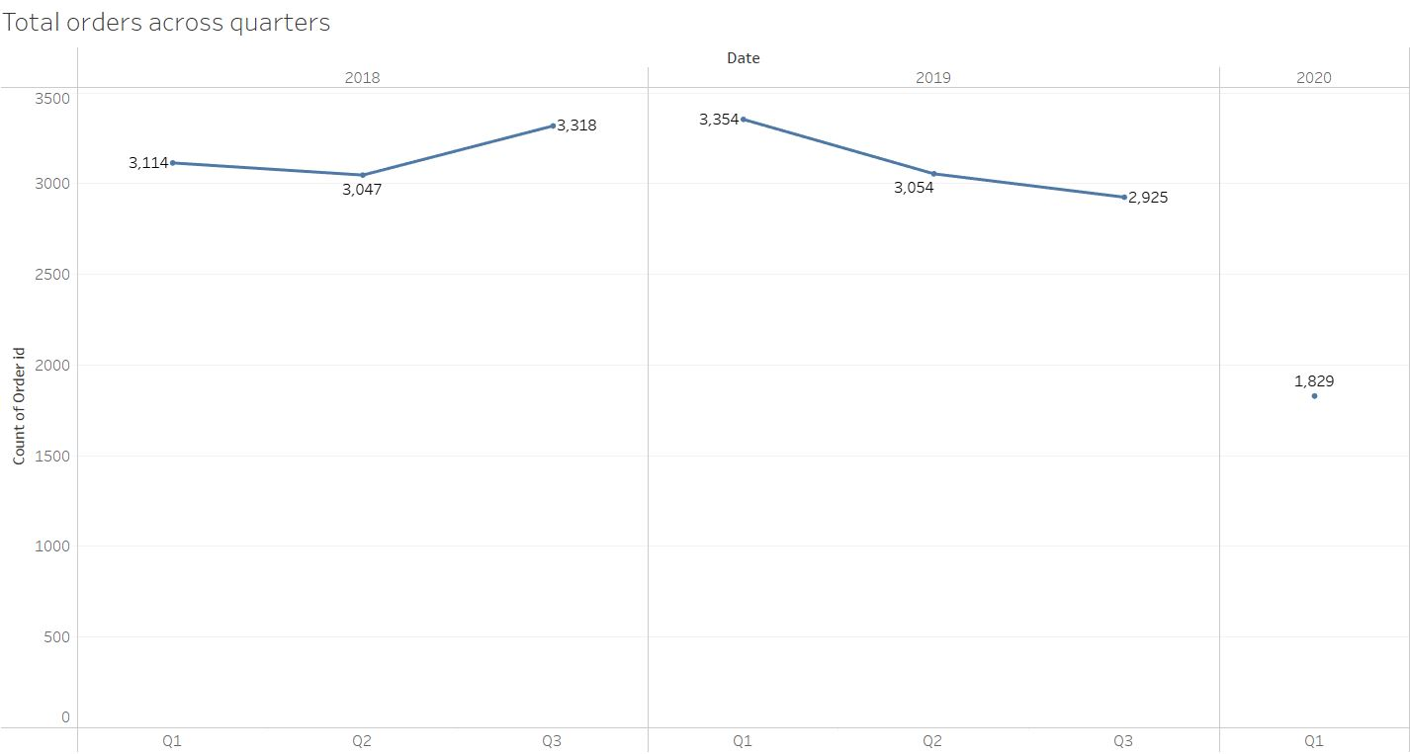
The following graph shows the orders in quarters over the years. As we can see that the order has been most less in Quarter 3 of the year 2019. The sales in Quarter 2 is almost the same for the year 2018 and 2019. Quarter 1 has the highest sales overall.

Slide 10
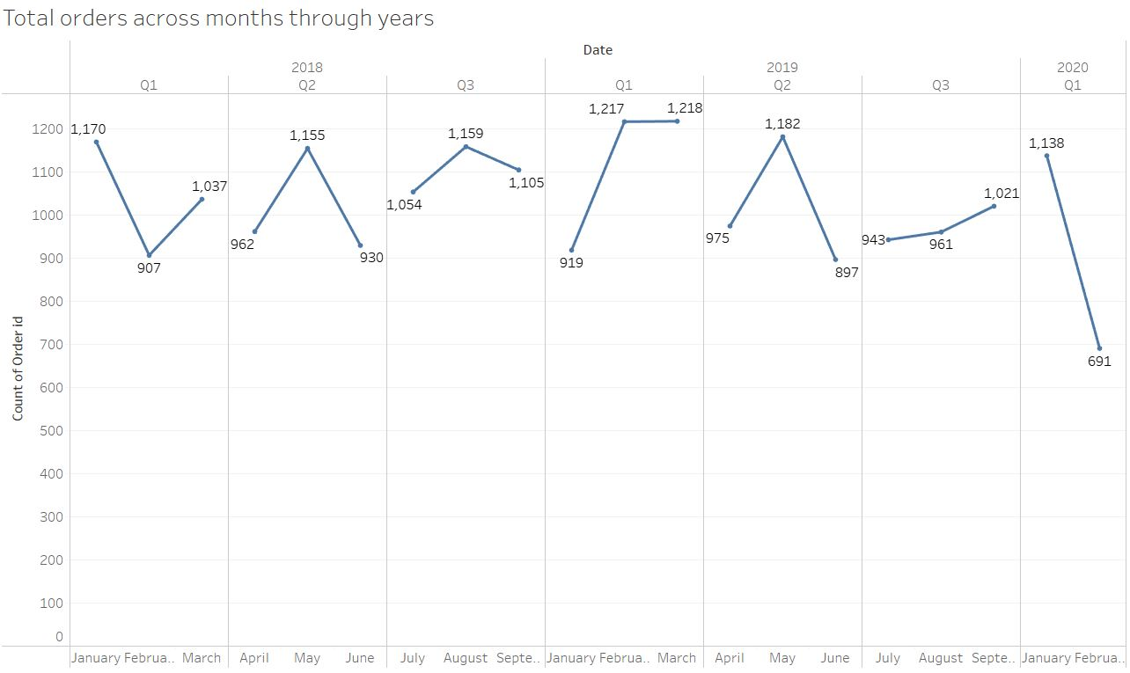
We can see the total orders of the products over months across years. As we can see the total order in February of 2020 in less compared to other years.

Slide 11
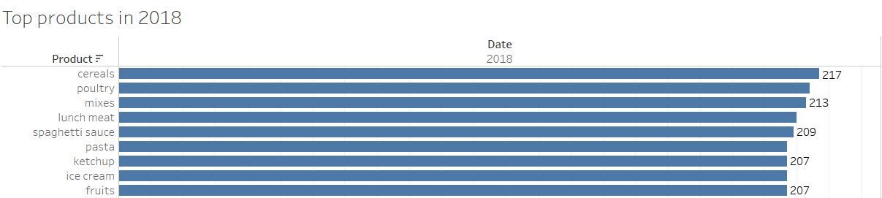
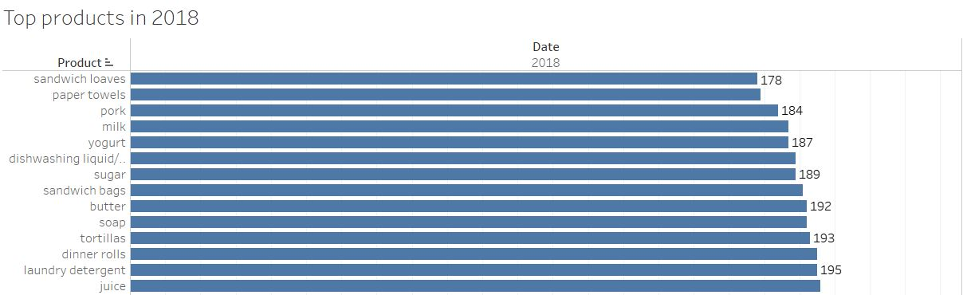
We can see that the most ordered product in 2018 is cereals followed by poultry and mixes and the lease ordered product is sandwich loaves followed by paper towels and pork.

Slide 12
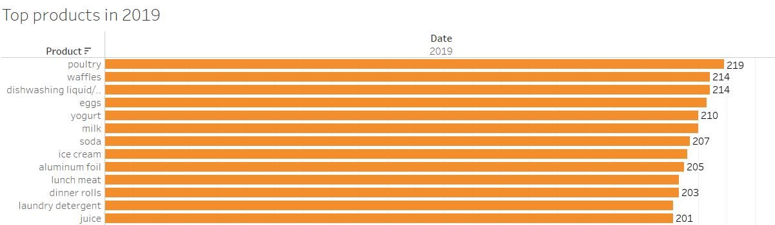
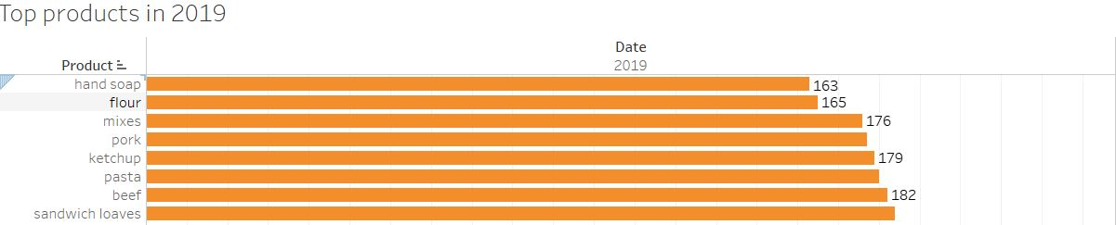
We can see that the most ordered product in 2019 is poultry followed by waffles and dishwashing liquid/detergent and the least ordered product is hand soap followed by flour and mixes.

Slide 13
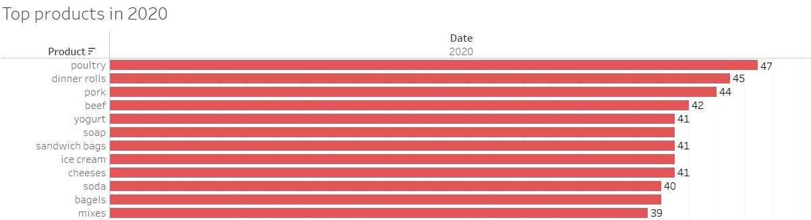
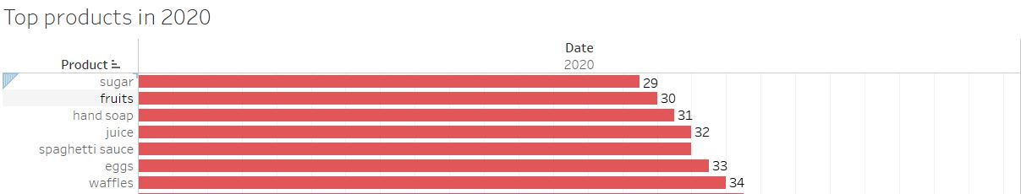
We can see that poultry is most ordered product in 2020 too followed by dinner rolls and pork whereas the least ordered product is sugar followed by fruits and hand soap.

Slide 14
INFERENCE
There are no null values present in the dataset. There are multiple products in the same order ID.
We can see that the year 2018 has the highest amount of orders with 533 and the number of orders in 2019 is less than compared to 2018 with 507 and the 2020 has only 99 orders. But the data we have contains only two months in 2020
We can see that Poultry has the most number of orders compared to other products with 480 and following that we have ice cream and cereals and so on.
As we have seen the orders has been reduced from the year 2018 to 2019 to 2020. This shows that there is a downward trend across POS for the store over the years.
We can see that the most ordered product in 2018 is cereals followed by poultry and mixes.
We can see that the most ordered product in 2019 is poultry followed by waffles and dishwashing liquid/detergent.
We can see that poultry is most ordered product in 2020 too followed by dinner rolls and pork.

Slide 15
MARKET BASKET ANALYSIS
ASSOCIATION RULES:
Association rules are widely used to analyse retail basket or transaction data and are intended to identify the strong rules discovered in transaction data using measures of support, confidence.
For example look at the output displayed below.
Here the customers who buys cheese, all-purpose, tortillas also tend to buy yogurt and the chances of buying this is high as the lift score is high.
This rule will help the sellers to identify the combination of items which can be bought together so that their POS can also increase. This is association rule which is applied in Market Basket Analysis.

Slide 16
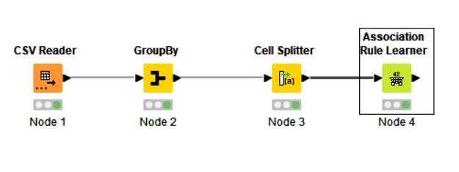
KNIME WORKFLOW
The KNIME workflow to get the association rule for the Market Basket Analysis is shown below.
Here we are grouping the products with the same order number and then performing association rules in order to get the maximum results.

Slide 17
THRESHOLD VALUES OF SUPPORT AND CONFIDENCE:
SUPPORT: The percentage of transactions that contain all of the items in an itemset.
CONFIDENCE: The probability that a transaction that contains the items on the lest side of the rule also contains the item on the right side of the rule.
Usually the threshold values of support and confidence would depend upon the dataset so that maximum the confidence the higher the lift we can get.
In this workflow we have applied the support of 0.02 and confidence of 0.08 as the threshold values so that we can high lift.

Slide 18
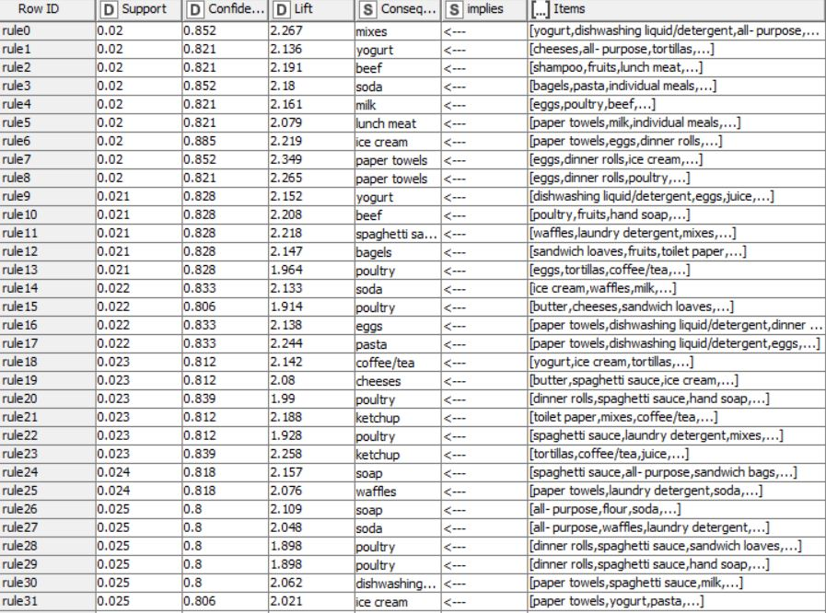
ASSOCIATIONS IDENTIFIED
After applying the association rules for the given dataset with the threshold values, we have got 39 association rules or combination.

Slide 19
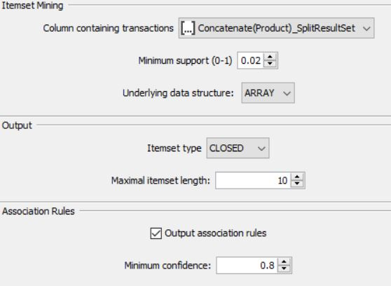
SUPPORT, CONFIDENCE AND LIFT VALUES:
The support values is the percentage of
transactions that contain all the items
in the dataset.
The confidence value is a probability that
a transaction that contains the items on the
left hand side of the rule also present in the
right hand side of the itemset.
Lift values are the probability of all the items in
a rule occurring together divided by the product
of probabilities of the items on the left and right
hand side occurring as if there was no association between them.

Slide 20
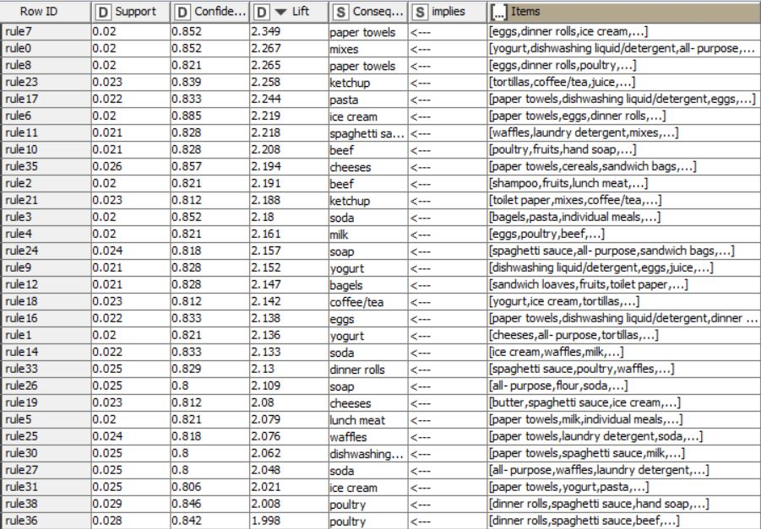
RECOMMENDATION
These are top combos with higher lift values.
As per rule 7 paper towels with eggs, dinner rolls and ice cream can be combined at Competitive Price.

Slide 21
We can suggest Poultry as a recommended combo with most of the products as it has a higher purchase rate.
Soda can also be given as a combo along with products like lunch meat, beef and pasta.
Hand soap and paper towels can be given as a combo since the order rate is less individually but as a combo people tend to buy it.
We can also come up with a Lunch Combo which is a Combo of Lunch meat and waffles with juice.
We can come up with a combo for Poultry which is Poultry with eggs(Buy Poultry get a carton of Egg Free).
We can have frequent sale offer on the lease sold products to increase its sales.
We can give away special discount coupon to customers who bought the lease sold products to increase the frequency of the customer and also to increase its sales.
We can give a discount of 5% on cheese with bagels.
We can give 5% off on Milk and Ice-Cream.

