Slide 1


OBJECT ORIENTED PROGRAMMING
(23EN1202)
UNIT- 4: Part 1
FILE HANDLING METHODS

Slide 2
Topics
File path
File types
File operations
File positions
Rename and delete files

Slide 3
What is file?
A file is a collection of data stored on a secondary storage device (like a hard disk).
Data on non-volatile storage media is stored in named locations, which are called files.
Example: Like a notebook → we can open, read, write, and close it.
Using the input() function for large amounts of data is tedious.
A better option is to use files for storing and processing data.

Slide 4
File-Contd.
S. No. | Volatile Memory | Non-Volatile Memory
1. | Volatile memory is the type of memory in which data is lost as it is powered-off. | Non-volatile memory is the type of memory in which data remains stored even if it is powered-off.
2. | Contents of Volatile memory are stored temporarily. | Contents of Non-volatile memory are stored permanently.
3. | It is faster than non-volatile memory. | It is slower than volatile memory.
4. | RAM(Random Access Memory) is an example of volatile memory. | ROM(Read Only Memory) is an example of non-volatile memory. Hard disk, USB drive, DVD etc

Slide 5
File-Contd.
Problems with console oriented I/O operations:
  Time consuming to handle huge amount of data.
  Using terminal, entire data is lost when the program is terminated or computer is turned off.

Slide 6
FILE PATH
Files are stored in a tree or hierarchical structure.
The top of the tree is one root nodes.
Under root node, there are other files and folders (directories).
Each folder contain other files and folders, It is a limitless path.
Type of the file is indicated by its extension.
Two types of paths: Absolute pathname, Relative pathname

Slide 7
Files and Folders
C:\
Teachers
Students
Staff
Undergraduate
Postgraduate
B.Tech_CS.docx

Slide 8
Absolute Pathname
Always contains the root and the complete directory list to specify the exact location of the file.
  Ex: C:\students\undergraduate\Btech_CS.docx

Slide 9
Relative Pathname
Starts with respect to the current working directory and therefore lacks the leading slashes.
  Ex: undergraduate\Btech_CS.docx

Slide 10
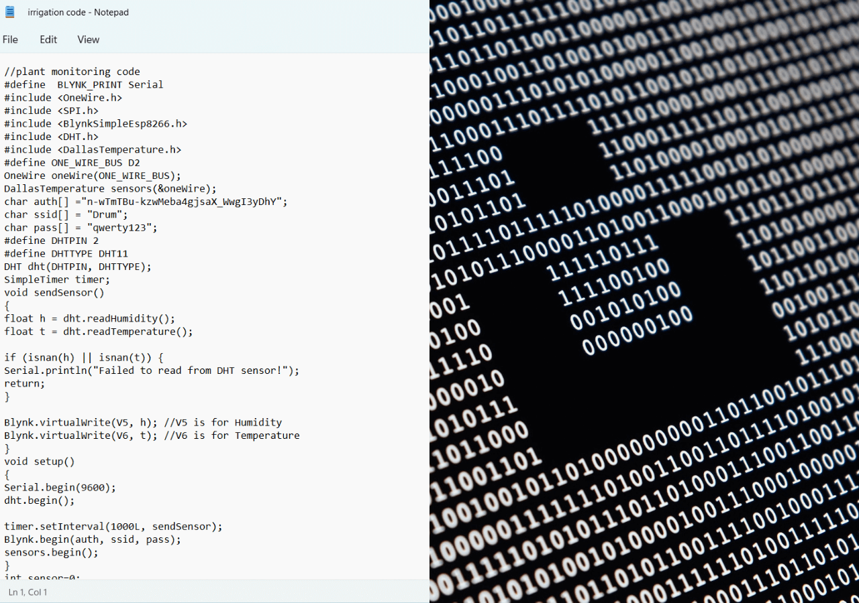
FILE TYPES
Text Files
Binary Files

Slide 11
Text Files
Text files are simple texts in human readable format.
It is stream of characters that are sequentially processed by a computer.
It can be opened for reading, writing or appending.
Each line contains zero or more characters and maximum of 255 characters.
In text file each line is terminated by special character called EOL.

Slide 12
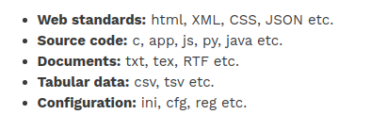
Text Files
Text files don’t have any specific encoding and it can be opened in normal text editor itself.

Slide 13
Binary Files
It stores the information in the same format as in the memory i.e. data is stored according to its data type so no translation occurs.
In binary file there is no delimiter for a new line.
Binary files are faster and easier for a program to read and write than text files.
Data in binary files cannot be directly read, it can be read only through python program for the same

Slide 14
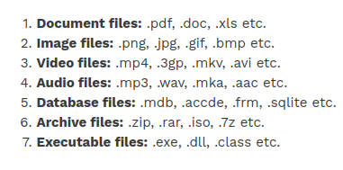
Binary Files
Most of the files that we see in our computer system are called binary files.

Slide 15
File
Operations
open()
read() & readlines()
close()
Built in Functions
append()
write()
writelines()

Slide 16
The Open() Function
Python has a built-in open() function to open files from the directory.
Two arguments that are mainly needed by the open() function are:
file name or file path and mode in which the file is opened.
The syntax for opening a file is
file_object = open(file_name , access_mode)

Slide 17
open()
file_name: File name contains a string type value containing the name of the file which we want to access.
access_mode: The value to access_mode specifies the mode in which we want to open the file, i.e., read, write, append, etc.

Slide 18
Example for open()
# Opening a file in current directory
*first create any file with “.txt” extension in same folder.
Example:
file=open("test.txt","rb")
print(file)
Output:
<_io.BufferedReader name='test.txt'>

Slide 19
Example for open()
# Opening a file in different directory
f=open("G:/DSU/CTPY/test.txt")
f
# Opens in w mode(writing only)
f=open("test.txt",'w')
f
output: <_io.TextIOWrapper name='test.txt' mode='w' encoding='cp1252'>
#read and write in binary mode
f=open("test.txt", 'rb+')
f
output: <_io.BufferedRandom name='test.txt'>

Slide 20
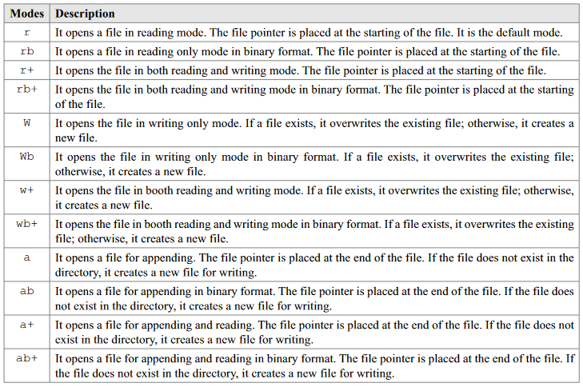

Slide 21
Closing a File
When the operations that are to be performed on an opened file are finished, we have to close the file in order to release the resources.
Although Python comes with a garbage collector responsible for cleaning up the unreferenced objects from the memory, we must not rely on it to close a file.

Slide 22
Closing a File
Proper closing of a file frees up the resources held with the file.
The closing of file is done with a built-in function close().
Syntax:
fileObject.close()

Slide 23
Closing a File
Example 1
# open a file
f = open("test.txt",'wb')
# perform file operations
# close the file
f.close()
f

Slide 24
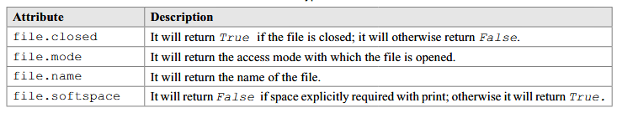
File Object Attributes
Once a file is opened and a file object created
Various pieces of information about that file can be gathered by using some predefined attributes.

Slide 25
Writing in a File
open it with ‘w’ mode, or ‘a’ mode, or any writing-enabling mode.
We should be careful when using the w mode because in this mode overwriting persists in case the file already exists.
Syntax
fileobject.write(string)

Slide 26
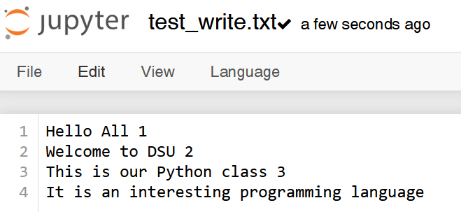
Example
# open the file with w mode
f = open("test_write.txt",'w’)
# perform write operation
f.write('Hello All 1\n')
f.write('Welcome to DSU 2\n')
f.write('This is our Python class 3\n')
f.write('It is an interesting programming language')
# close the file after writing
f.close()

Slide 27
Reading from File
Must open the file in the reading mode (r mode).
We can use read(size) method to read the data specified by size.
If no size is provided, it will end up reading to the end of the file.
Reading from any file is done with the method read().
The read() method enables us to read the strings from an opened file.

Slide 28
Example
#Reading from a file
f = open("test_write.txt",'r')
f.read(5)
f.read(7)
f.read()

Slide 29
readline()
readline() is a method of reading a file line by line. Whenever we write fileobject.readline().
it prints one line from that file and continues in this way until the end of the file.
f = open("test_write.txt",'r')
f.readline()

Slide 30
Opening Files using with Keyword
When the file is opened using with keyword, file will be automatically closed once the block of code finishes execution.
Ex:
with open("test.txt","r") as file:
for line in file:
print(line)
print("lets check if the file is closed:",file.closed)
Output:
hello
python
jupiter
dsu
programming
lets check if the file is closed: True

Slide 31
Using open()
When the file is opened using open() function, file will not be automatically closed.
Ex:
f11=open("test1.txt","r")
for lines in f11:
print(lines)
print("lets check if the file is closed:",f11.closed)
Output:
jupiter
moon
sun
lets check if the file is closed: False

Slide 32
File Position
When we read a line or some data from a file, the pointer points to the next line or data, and that when we end up reading whole file, it returns the empty string.
In Python, the tell() method tells us about the current position of the pointer.
The current position tells us where reading will start from at present.

Slide 33
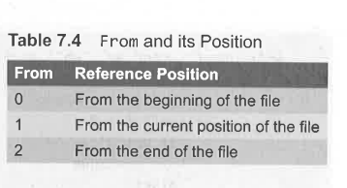
File Position
We can also change the position of the pointer with the help of seek() method.
Syntax: seek(offset[,from])
Offset-A number of bytes are passed to be moved by the pointer as arguments to the seek() method.
from-is given in table

Slide 34
Example of File position
# open the file
f = open("test_write.txt",'r')
# read 28 bytes of data
f.read(28)
# check the current position
f.tell()
# change the position to beginning
f.seek(0)
# again read 25 bytes
f.read(25)

Slide 35
Renaming a File
Renaming a file in Python is done with the help of the rename() method.
The rename() method is passed with two arguments, the current filename and the new filename.
Syntax
os.rename(current_filename, new_filename)

Slide 36
OS Module
The OS module in Python provides functions for interacting with the operating system.
OS comes under Python’s standard utility modules.
This module provides a portable way of using operating system-dependent functionality.
The *os* and *os.path* modules include many functions to interact with the file system.

Slide 37
Deleting File
Deleting a file in Python is done with the help of the remove() method.
It takes the filename as an argument to be deleted.
Syntax
os.remove(filename)

Slide 38
Example
  # import os
  >>>import os
  # deleting the file
  >>>os.remove(“test1.txt”)

Slide 39
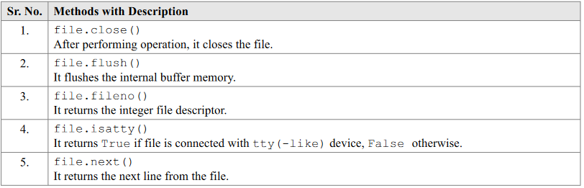
Methods to Manipulate Files

Slide 40
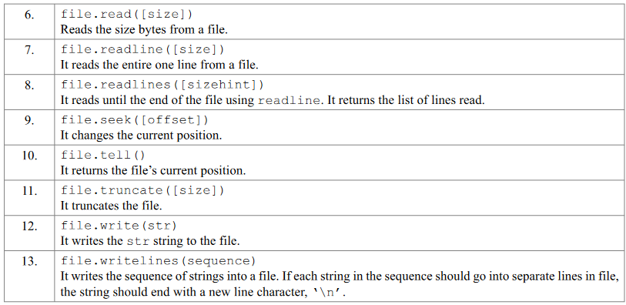
Methods to Manipulate Files

Slide 41
Activity
Write a function in python to read the content from a text file “introduction.txt" line by line and display the same on screen.
Create a text file and write some contents and few lines will start with letter ‘M’. Write a function in python to count the number of lines from a text file "introduction.txt" which is not starting with an alphabet “M".

Slide 42
Activity
Write a function in Python to read lines from a text file “introduction.txt". Your function should find and display the occurrence of the word “is".
Create a text file and store some contents in that file. Display the contents of the text which needs to be displayed such that every next character is separated by a symbol “*". Write a function definition for that it would display the entire content of the file in the desired format.

Slide 43
UNIT- 4: Part 2
USER DEFINED CLASSES AND OBJECTS

Slide 44
CLASSES AND OBJECTS
A class is a blueprint or template, using which objects are created.
Class defines the structure and behavior that objects of that type will possess. This includes data members also known as attributes and member functions also known as methods that operate on that data.
When a class is "instantiated," an object is created based on the specifications defined by the class. Each object has its own unique set of attribute values, but shares the same methods as other objects of the same class. Hence an object can be visualised as an instance of a class.

Slide 45
INTRODUCTION
Procedure-oriented programming
  Program is written using functions or blocks of statements to manipulate data.
Object oriented programming
  Object Oriented Programming is a programming paradigm based on the concept of objects.
  Objects contain data, in the form of attributes, and actions, in the form of functions known as methods.
  The aim of object oriented programming is to reuse the same code by providing the flexibility to create each object with their own features.

Slide 46
Example
If "Car" is a class, it might define attributes like "color," "make," and "model," and methods like "startEngine()" or "accelerate()."
An object, like "myCar," would be an instance of the "Car" class, with specific values for its attributes (e.g., "red," "Toyota," "Camry").
In Python, everything is an object or an instance of some class. For example, all integer variables are instances of class int and all string variables are instances of class str.

Slide 47
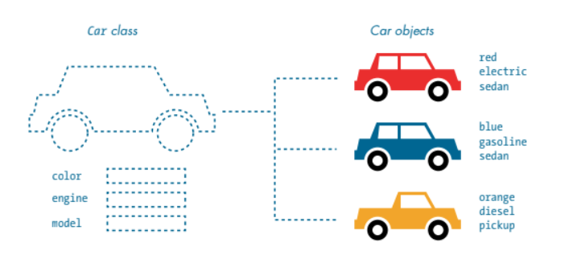
Example

Slide 48
DEFINING A CLASS
A class is created with the keyword class followed by the class name.
Within the indentation of the class block, write the class members i.e., attributes and actions.
The attributes are represented by variables and actions are performed by methods.
Class members are accessed through objects of that particular class.

Slide 49
DEFINING A CLASS
Naming Convention
  Each word of a class name should start with a capital letter.
  When a class represents exception, then its name should end with the word 'error'.
Note:
  Class definition can appear anywhere in the program.
  Usually class definition is written near the beginning of the program, after the import statement.

Slide 50
DEFINING A CLASS
  A class creates a new local namespace where all its members are defined. Namespace defines the scope of members specific to the class which means all attributes (variables) and methods (functions) defined within the class body belong to this class's local namespace. They are distinct from names in other namespaces (like the global module namespace or other class namespaces). This local namespace prevents name conflicts. For example, if you have a variable named name inside a class and another name variable in the global scope, they are treated as separate entities.
  A class that has no statements should have a pass statement at least.

Slide 51
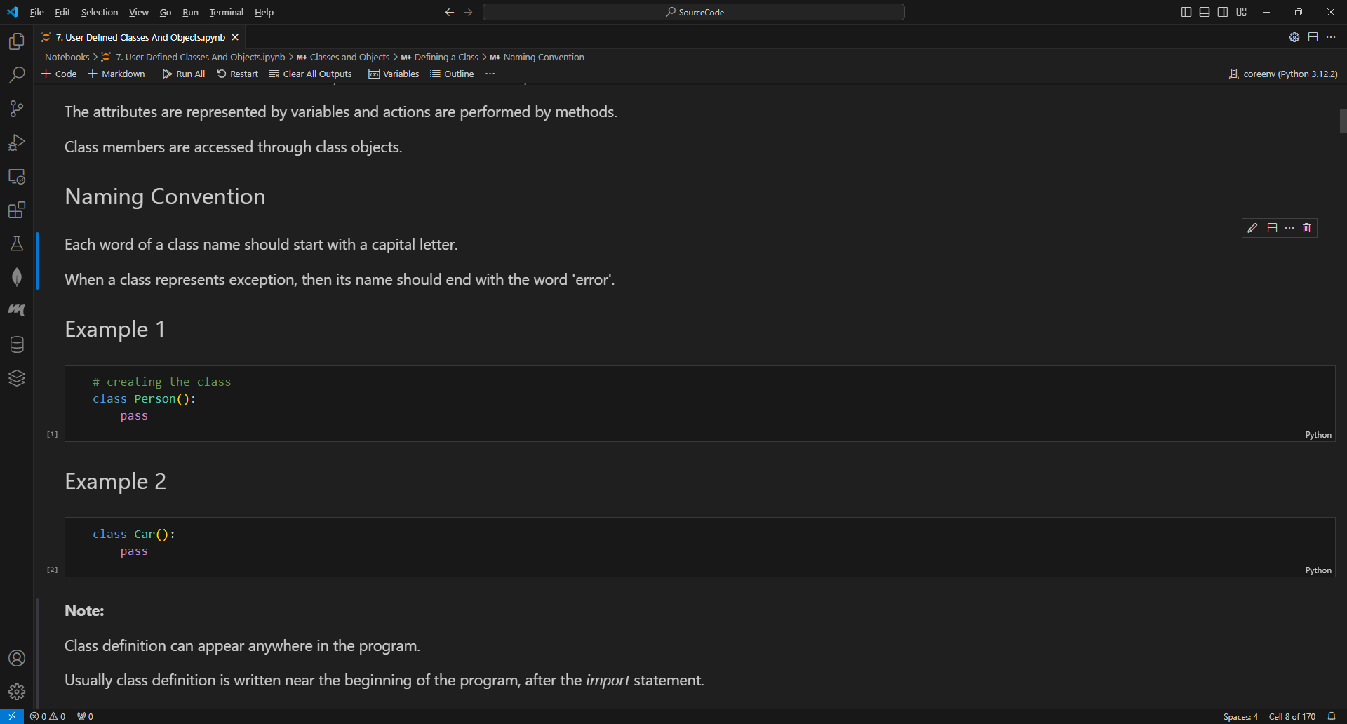
DEFINING A CLASS

Slide 52
CREATING OBJECTS
Once a class is created, the next job is to create an object or instance of that class.
The class members are accessed through the class object using the dot (.) operator.
Creating an object or instance of a class is known as class instantiation.
The code shown in the next slide creates an empty object of the class Person.
When an instance of the class (object) is created, the instance name holds the memory address of the instance.

Slide 53
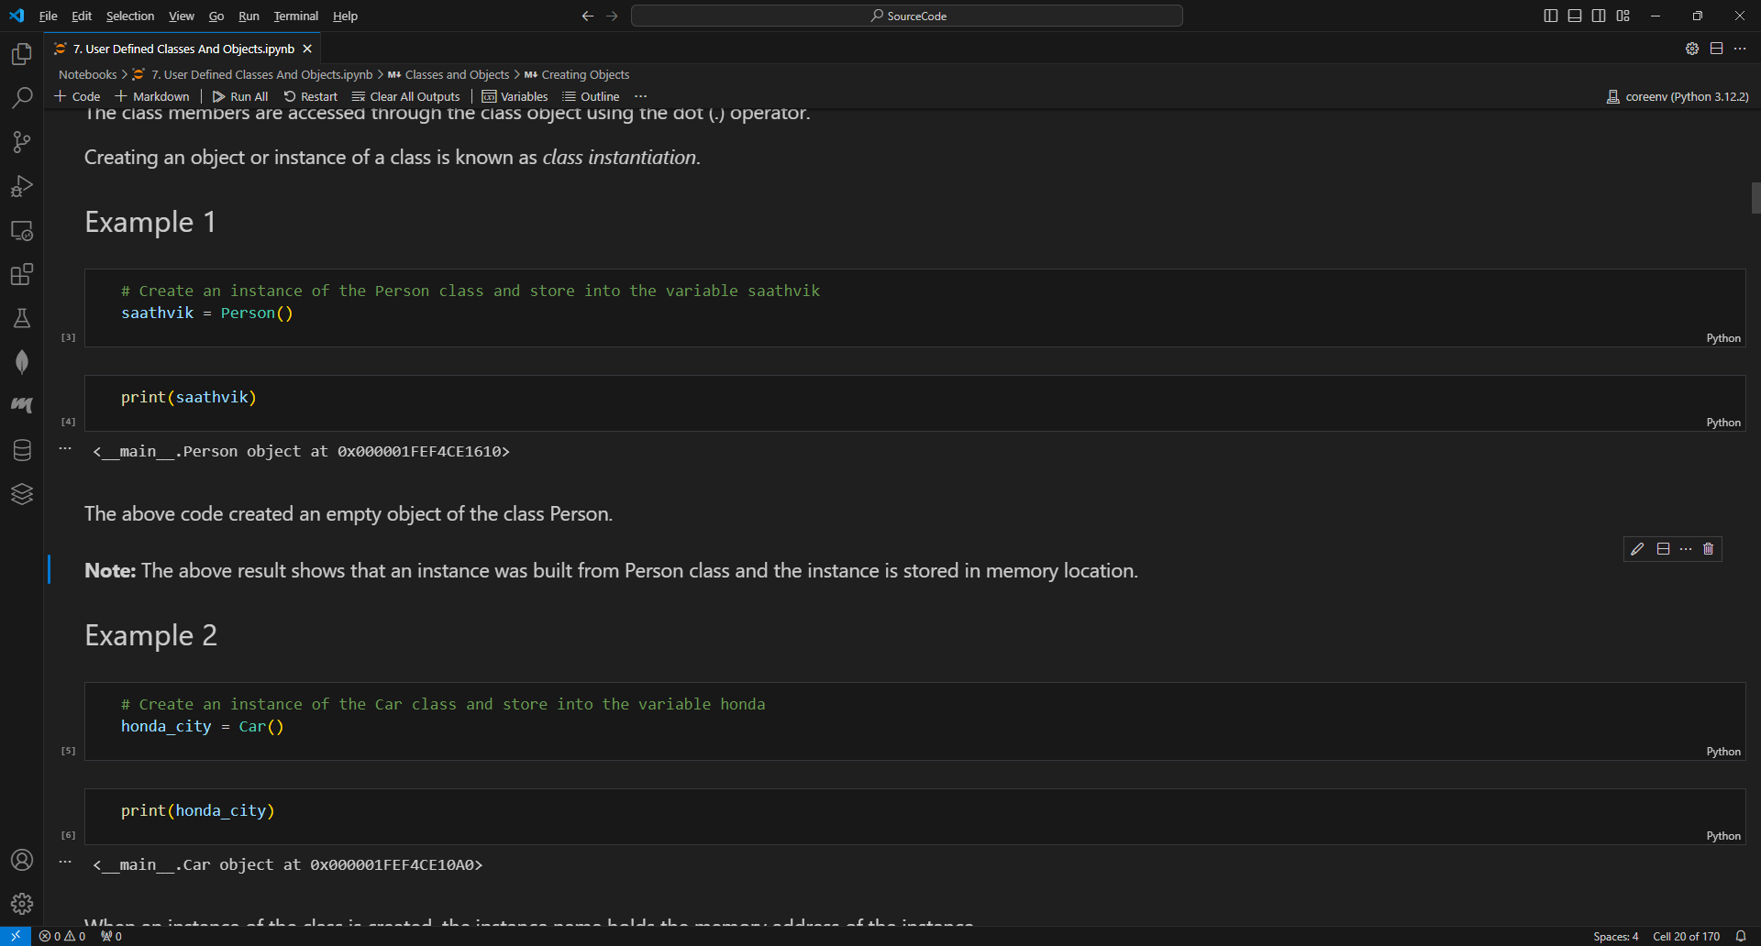
CREATING OBJECTS
Note: The above result shows that an instance was built from Person class and the instance is stored in memory location.

Slide 54
CREATING MULTIPLE INSTANCES
We can create as many instances as we want from each class.
Store each instance in a separate variable.
Note: Although the two instances are created from the same class, they are stored as separate entities within the program.

Slide 55
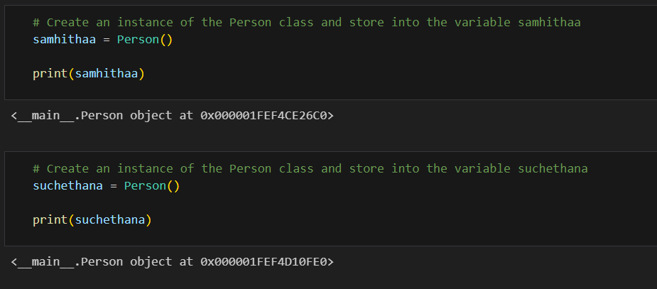
CREATING MULTIPLE INSTANCES

Slide 56
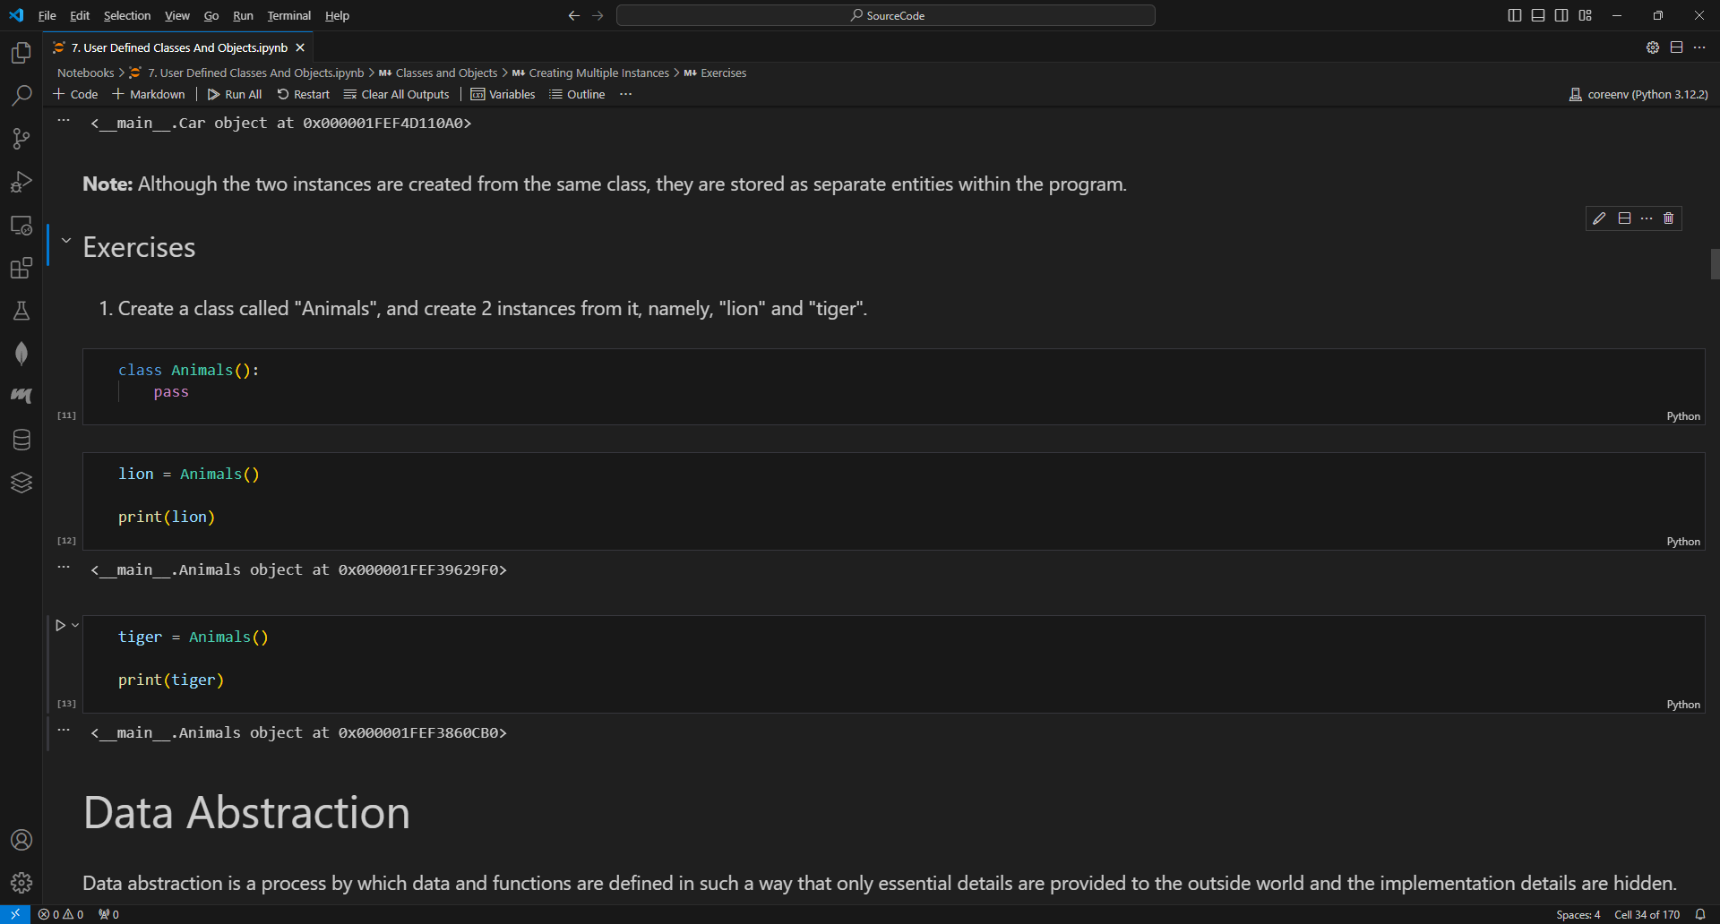
EXERCISE
Create a class called "Animals", and create 2 instances from it, namely, "lion" and "tiger".

Slide 57
DATA ABSTRACTION
Data abstraction is a process by which data and functions are defined in such a way that only essential details are provided to the outside world and the implementation details are hidden.
In Python, a class provides methods to the outside world to provide the functionality of the object or to manipulate the object's data.

Slide 58
DATA ENCAPSULATION
Encapsulation involves the bundling of data members and functions inside a single class.
Encapsulation defines different access levels for data variables and member functions of the class:
  public
    Any data or function with access level public can be accessed by any function belonging to any class.
  private
    Any data or function with access level private can be accessed only by the class members, in which it is declared.
    In Python, private variables are prefixed with a double underscore.
    Example: __date_of_birth = None

Slide 59
METHOD
Objects are associated with certain attributes and actions with them.
Example:
  Consider a car. It has attributes like make, model, variant, color, number of wheels, etc.
  It also perform actions like accelerate, stop, turn, etc.
In a class, actions are represented through methods.
Methods are essentially functions defined in the class.

Slide 60
DEFINING AND CALLING A METHOD
To define a method, define a function within the class indentation block.
To call the method use dot syntax and use parenthesis after the name.
Naming Convention
  Method name should be all lower case letters.
  When multiple words are used for a name, separate them using an underscore.

Slide 61
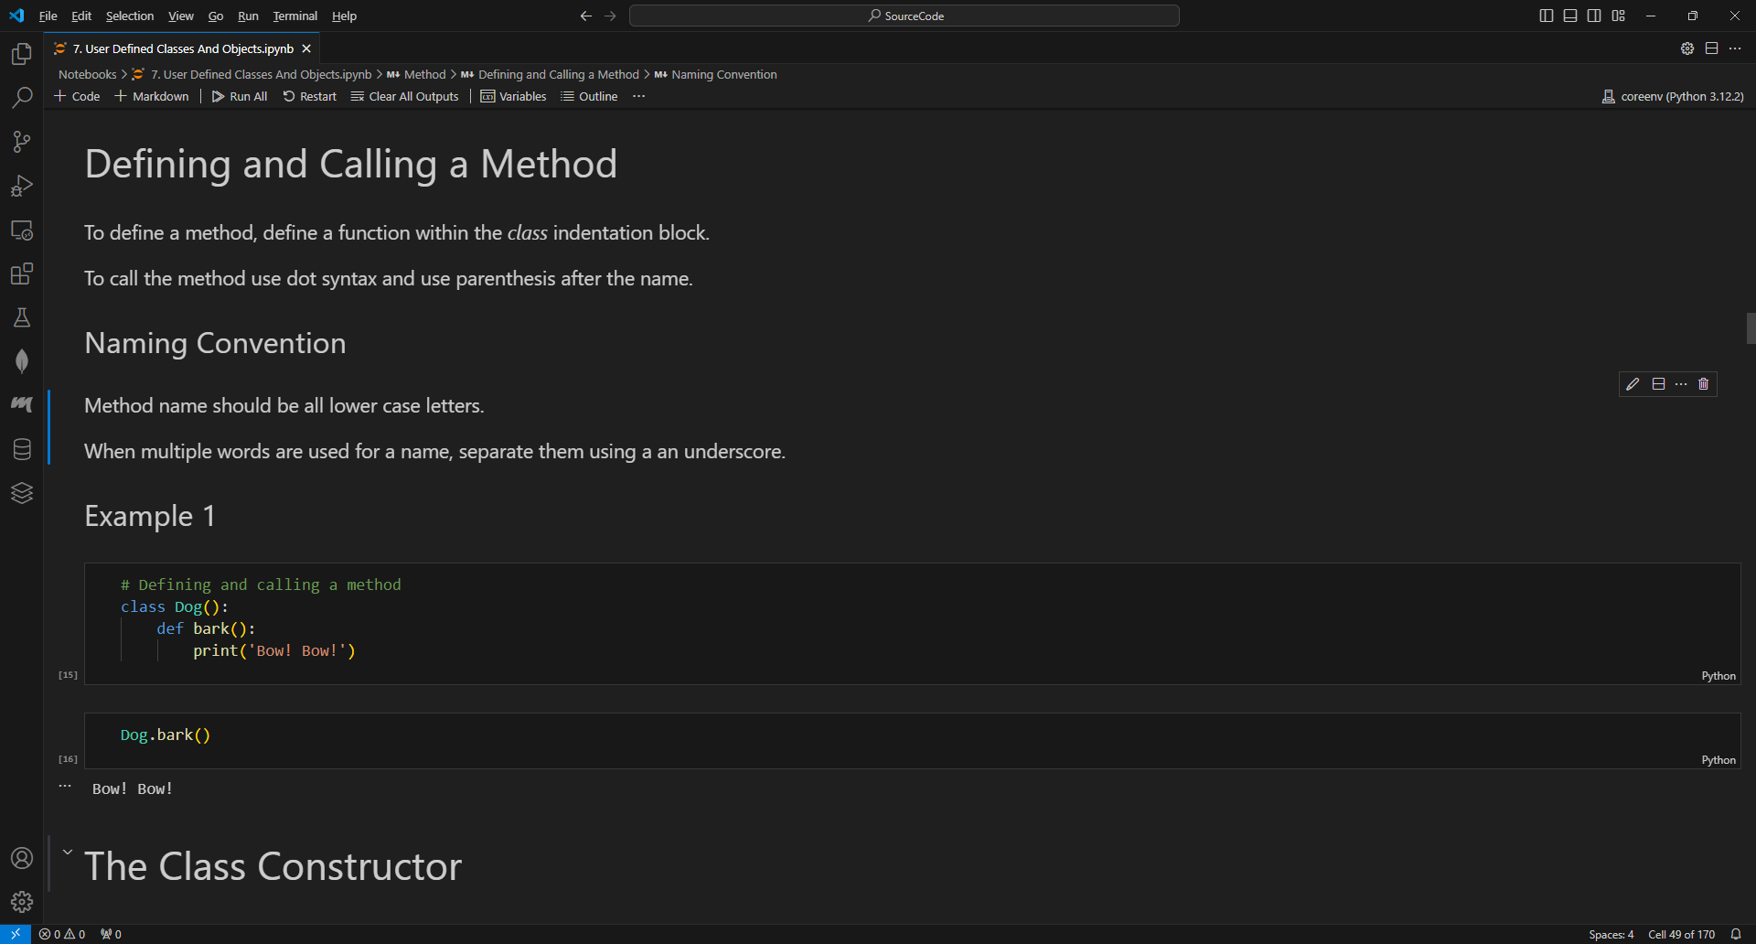
DEFINING AND CALLING A METHOD

Slide 62
THE CLASS CONSTRUCTOR
A constructor is a special method that is used to initialize the instance variables of a class.
A constructor is a method that has 2 underscores before and after the word init:
  __init__()
A constructor includes the “self” variable as a first mandatory parameter.
A constructor facilitates to instantiate objects with different attribute values upon creation.
The __init__() method is executed automatically when an object of a class is created.

Slide 63
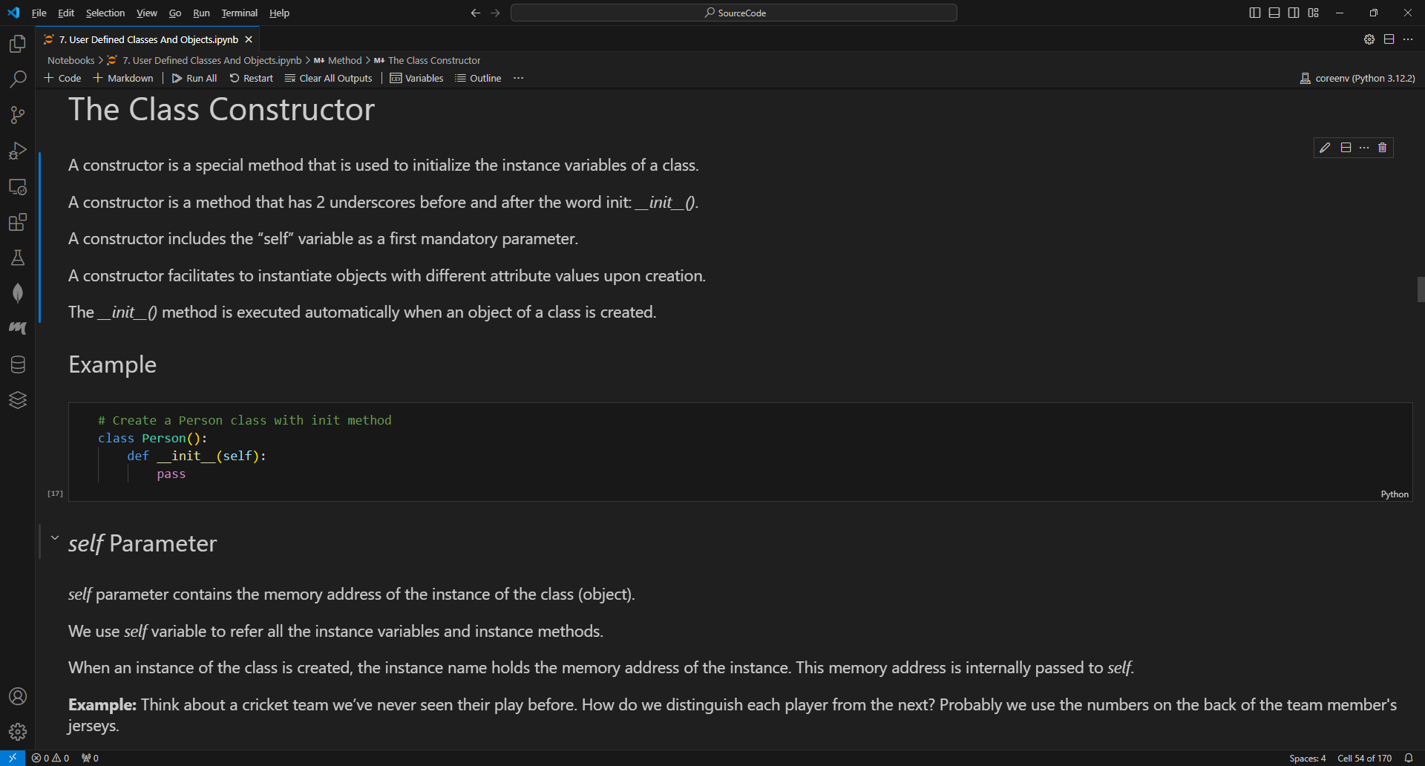
THE CLASS CONSTRUCTOR

Slide 64
SELF PARAMETER
Note:
  The self argument is ignored while the init method is called. The init method is called immediately when an object is created.
  It is recommended to initialize all the attributes of a class in the __init__() method.

Slide 65
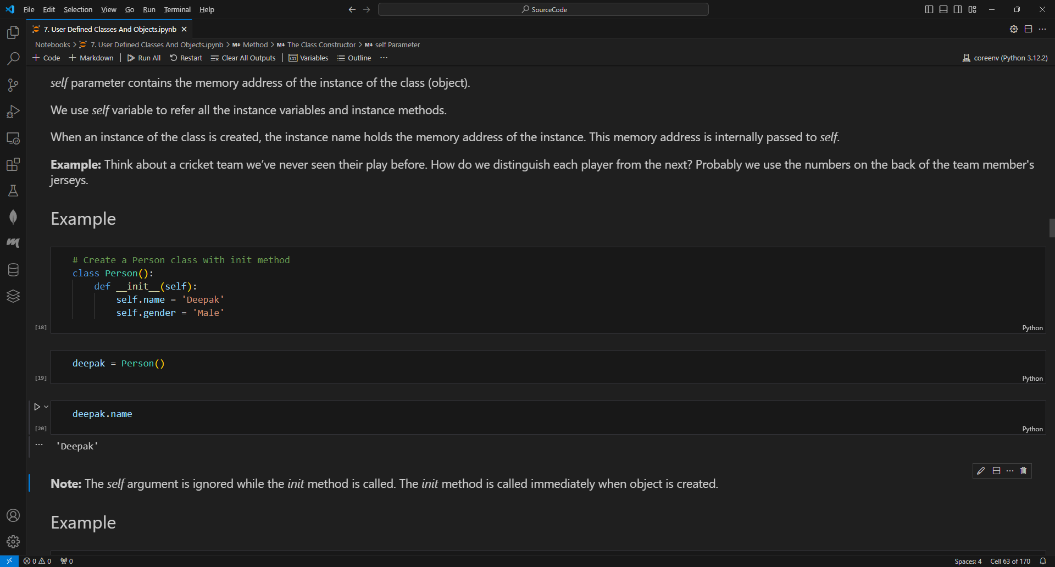
SELF PARAMETER

Slide 66
DESTRUCTOR
Destructor is automatically called when an object is going out of scope.
Destructor is used to return the resources occupied by the object, back to the system so that they can be reused.
In Python, __del__() method does the job of the destructor.
Note:
  If the method is intended to be accessed through instance, use self as the first parameter in the definition. Without the self parameter, the method can only be accessed by the class itself.
  A class can have as many methods as required.

Slide 67
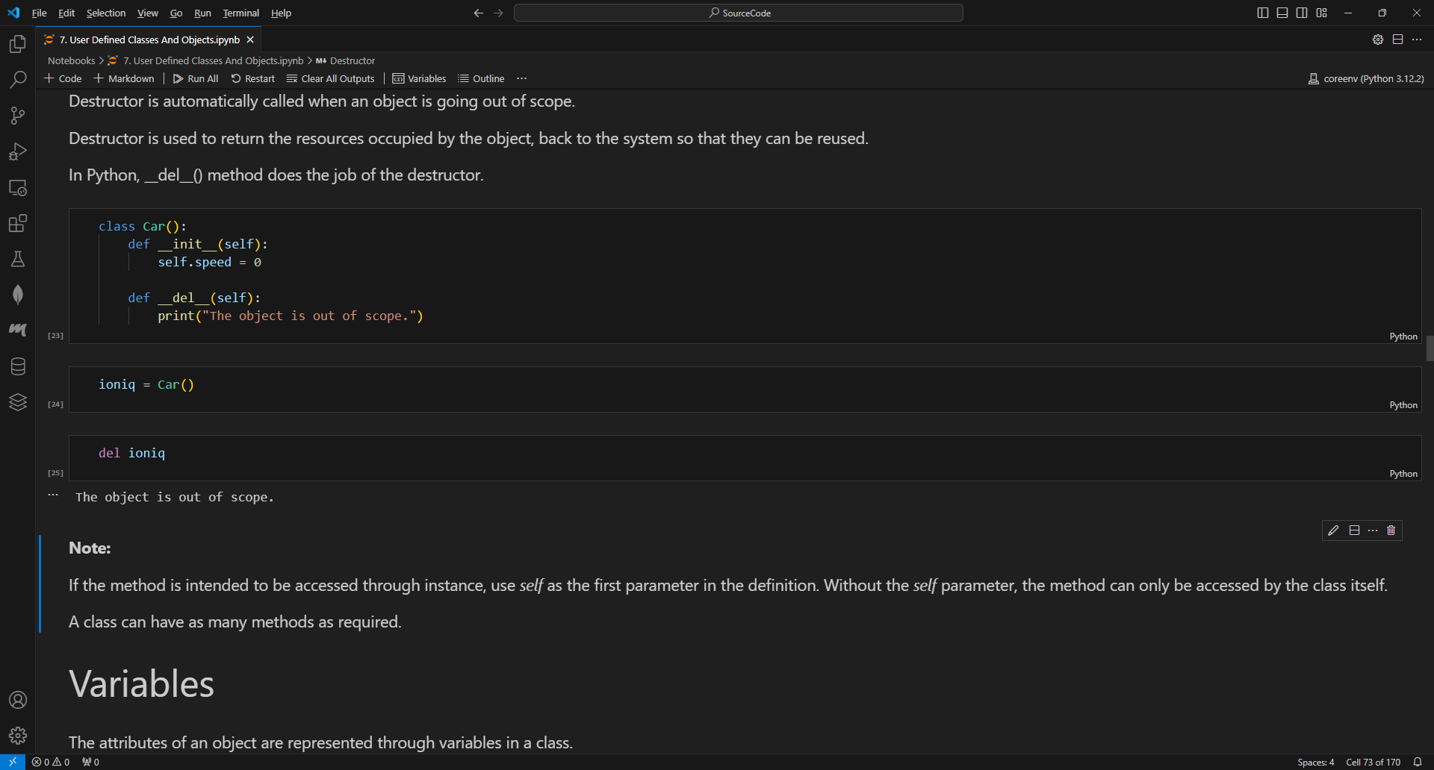
DESTRUCTOR

Slide 68
VARIABLES
The attributes of an object are represented through variables in a class.
The variables written inside a class are of 2 types:
  Class Variables or Static variables
  Instance Variables
Naming Convention:
  Variable names should be all lower case letters.
  When multiple words are used, separate them using an underscore.

Slide 69
CLASS OR STATIC VARIABLES
Class variables are the variables whose single copy is available to all the instances of the class.
Class variables are also called static variables.
Class variables are accessed outside the class using the class name followed by the dot operator.

Slide 70
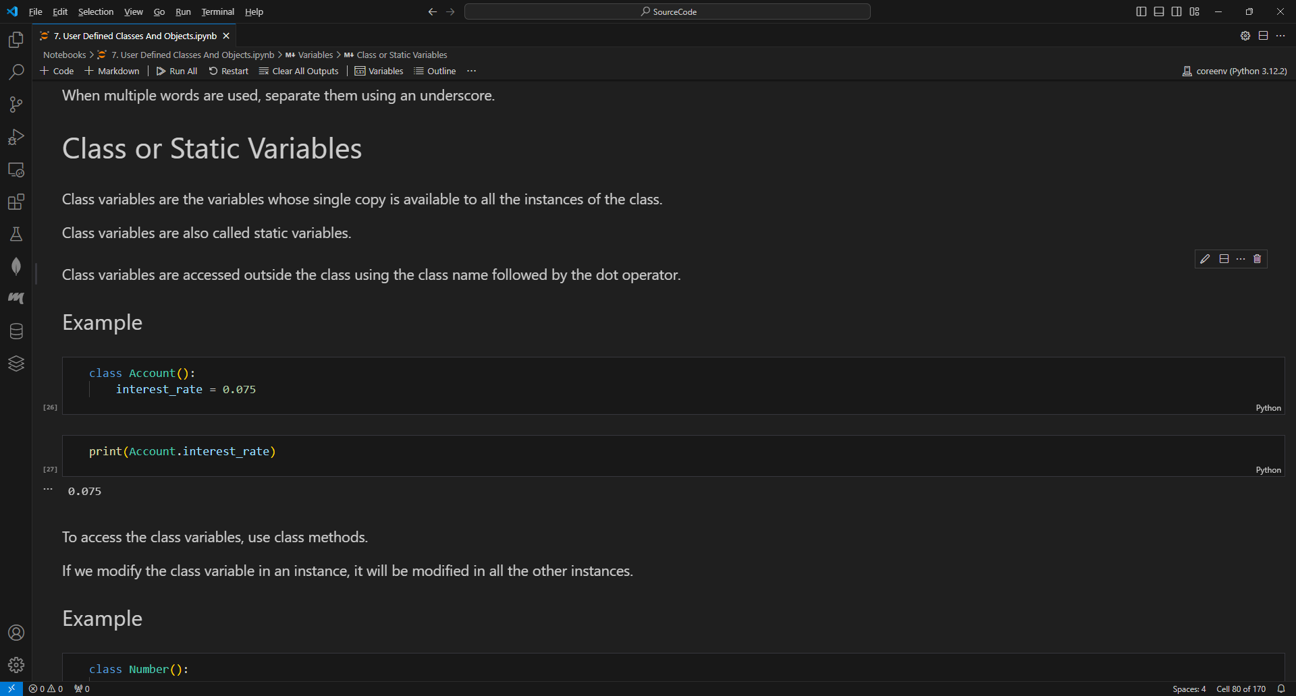
CLASS OR STATIC VARIABLES

Slide 71
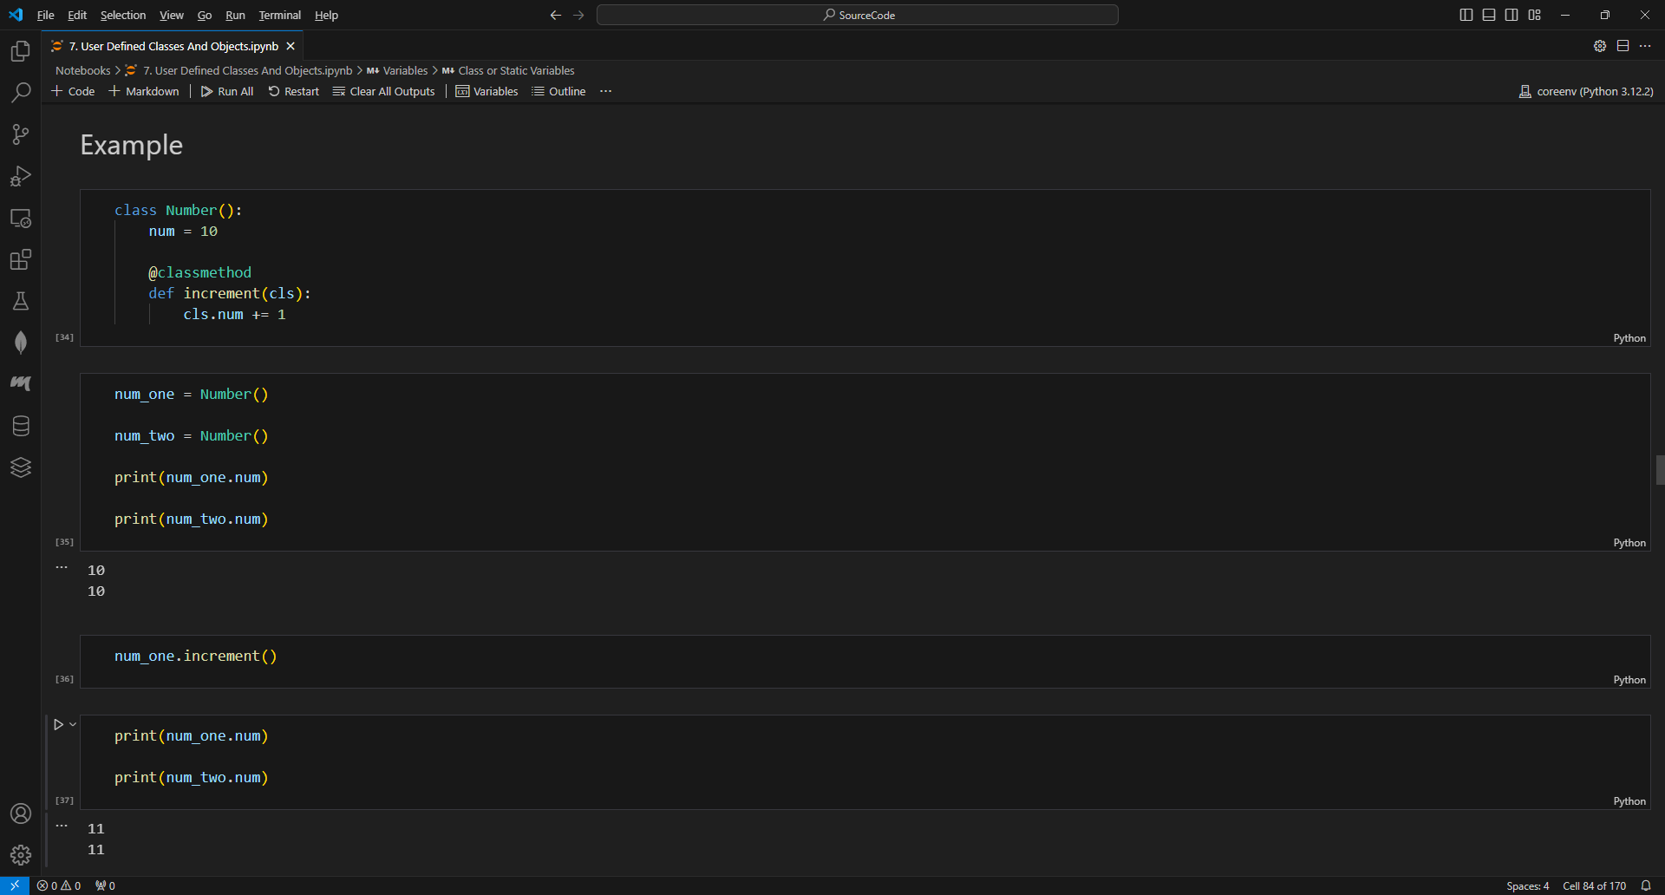
CLASS OR STATIC VARIABLES
To access the class variables, use class methods.
If we modify the class variable in an instance, it will be modified in all the other instances.

Slide 72
CLASS OR STATIC VARIABLES
Class variables are usually used to keep a count of number of objects created from a class.
Class variables are used to define constants associated with a particular class or provide default attribute values.

Slide 73
INSTANCE VARIABLES
Instance variables are the variables whose separate copy is created in every instance.
Instance variables are defined and initialized using the constructor.
Instance variables are accessed using instance methods.

Slide 74
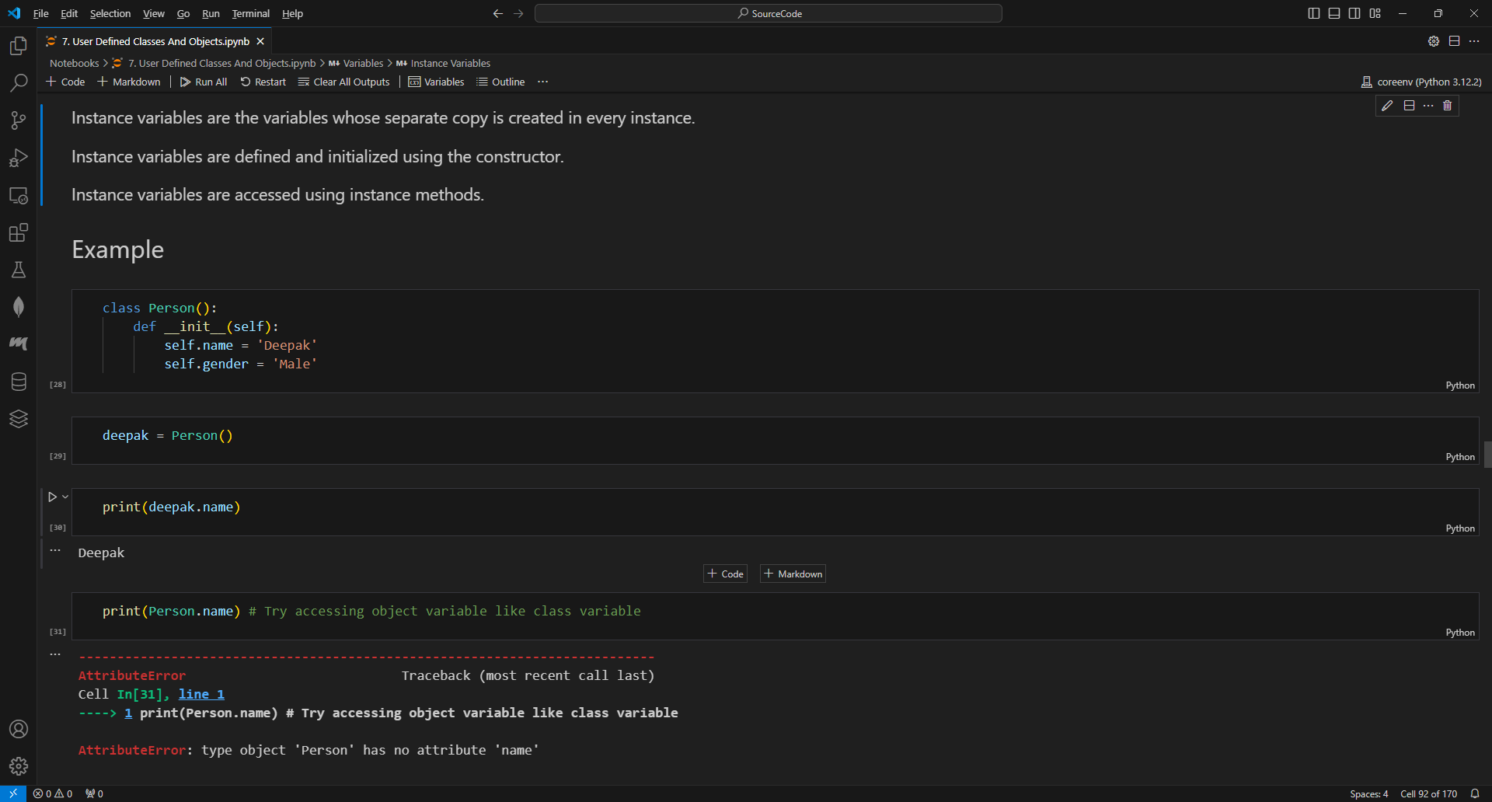
INSTANCE VARIABLES

Slide 75
INSTANCE VARIABLES

Slide 76
EXERCISES
1. Create a Dog class that has one class attribute and two instance level attributes. The class attribute should be “species” with a value of “Canine.” The two instance attributes should be “name” and “breed.” Then instantiate two dog objects, a Husky named Sammi and a Chocolate Lab named Casey.
2. Create a Person class that has a single instance level attribute of “name.” Ask the user to input their name, and create an instance of the Person class with the name they typed in. Then print out their name.

Slide 77
PUBLIC AND PRIVATE DATA MEMBERS
Public members can be accessed from anywhere in the program i.e., they can be accessed within the class as well as from outside the class in which they are defined.
Private members can only be accessed within the class.
Private members are defined in the class with a double underscore prefix.

Slide 78
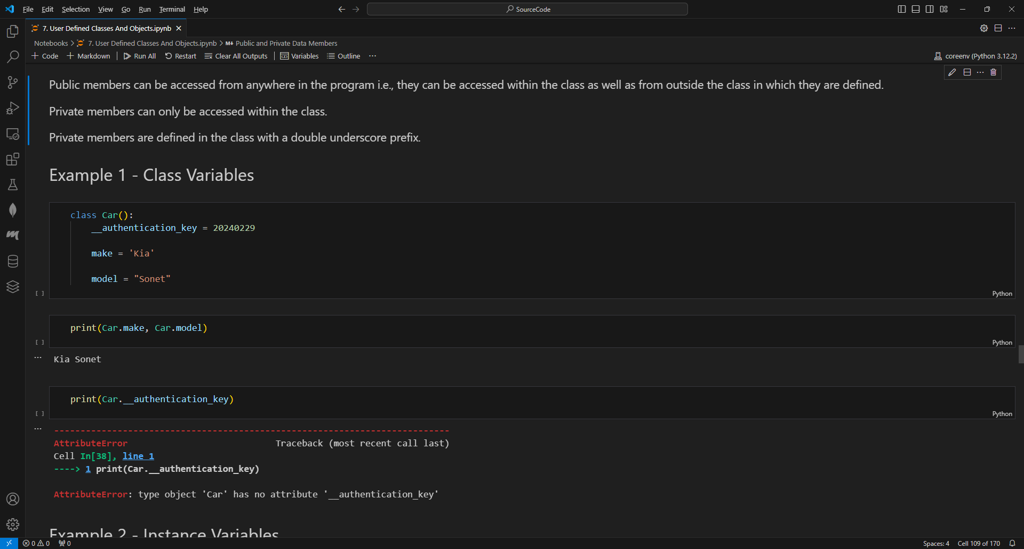
PUBLIC AND PRIVATE DATA MEMBERS

Slide 79
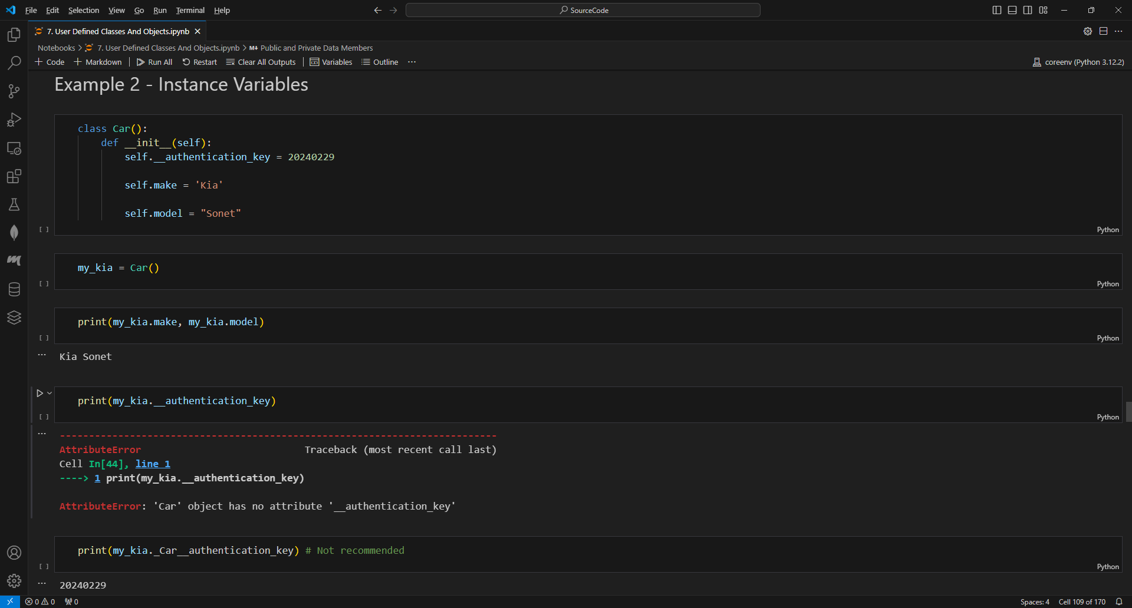
PUBLIC AND PRIVATE DATA MEMBERS

Slide 80
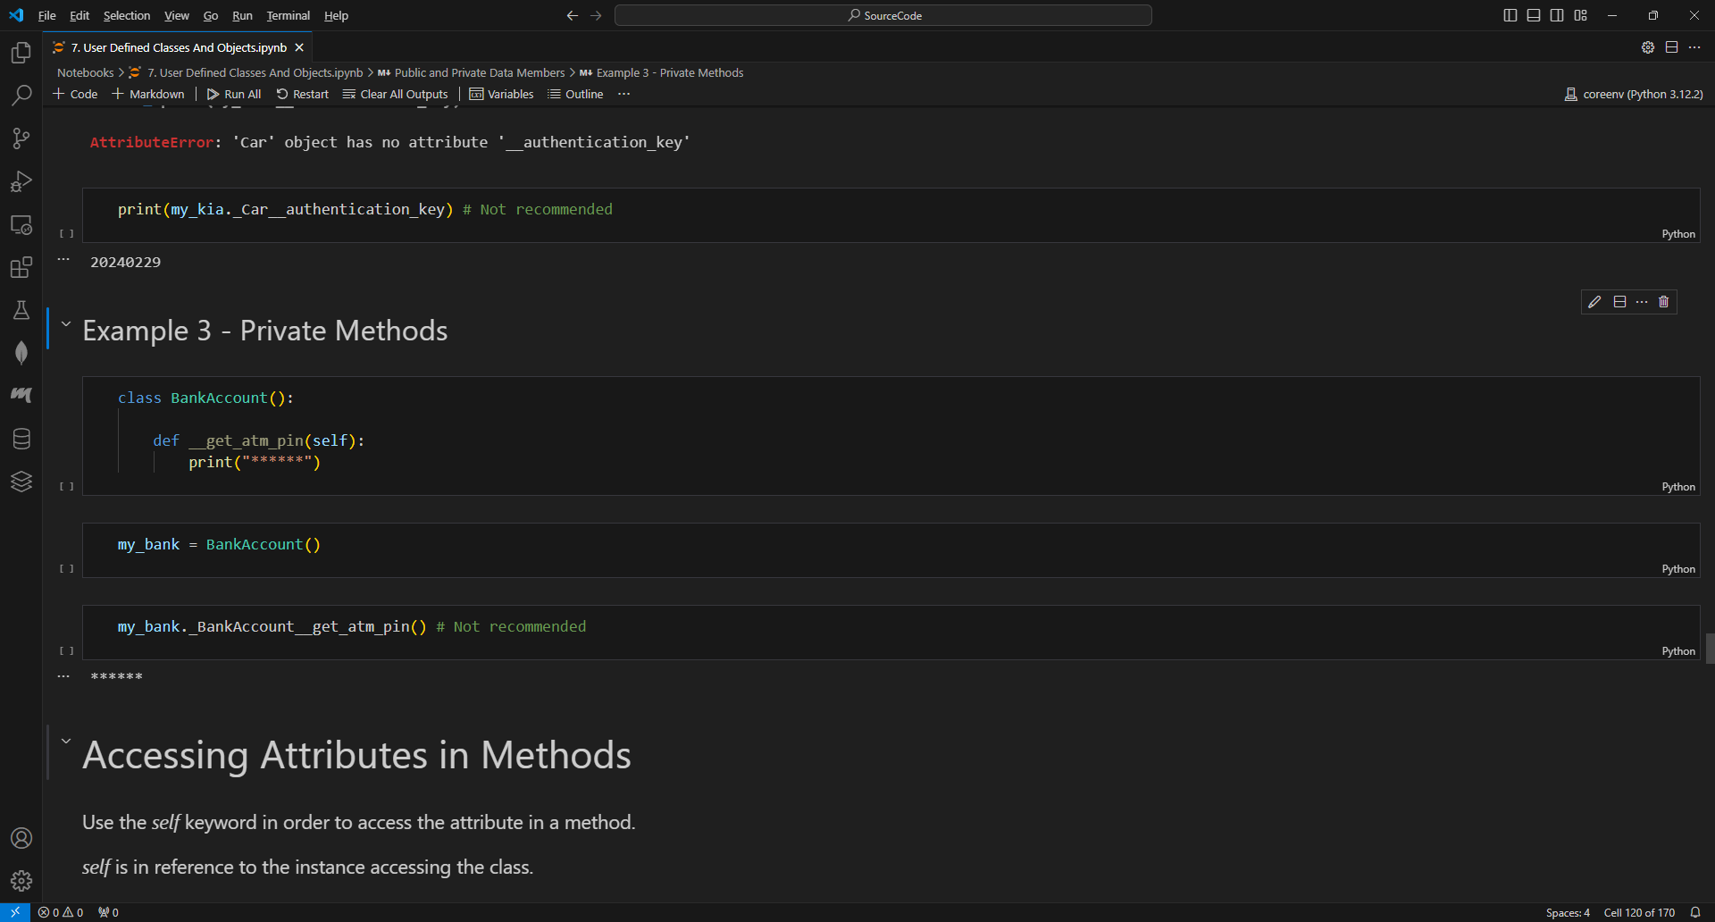
PRIVATE METHODS
Private methods can’t be accessed from anywhere outside the class.
Private methods are used to include implementation details of an object.

Slide 81
CLASS METHODS
Class methods are called by a class and not by instance of the class.
The first parameter of the class methods is cls and not self.

Slide 82
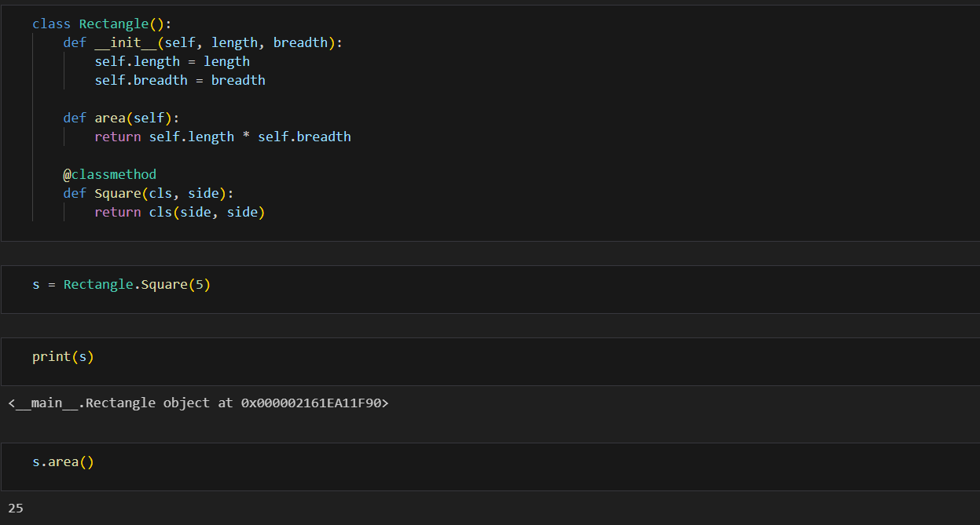
CLASS METHODS

Slide 83
STATIC METHODS
A functionality that belongs to a class, but does not require the object, is placed in the static method.
Static methods does not receive any additional arguments like self, cls.
A static method is defined using a built-in function staticmethod.
Static method knows nothing about the class and just deals with the parameters.
Static method cannot access the properties of the class itself.
When we need a utility function that doesn't access any properties of a class but makes sense that it belongs to the class, we use static methods.
A static method can be called either on the class or on an instance.

Slide 84
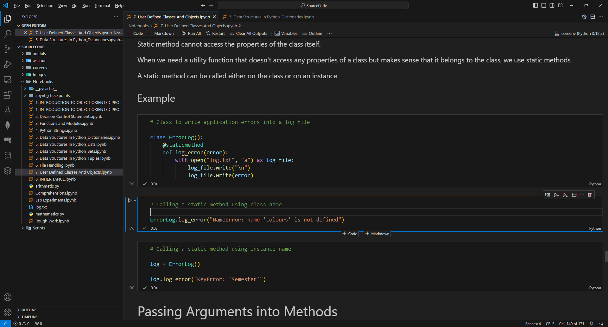
STATIC METHODS

Slide 85
EXERCISES
Python program to manage patient records effectively in Hospital Management System using Data Abstraction.
Python program to develop a University Management System to efficiently manage information related to students and faculty members while maintaining data security and proper encapsulation.
Python program to develop a program to manage employee information in an organization using a constructor for data initialization.
Design a Math Operations Utility class to perform basic arithmetic operations using static methods.

