Slide 1
TEAM 11
Building a Recommendation System for Cell Line Selection Using
Integration of Biological Datasets
ASTRAZENCA
Group members: 1) Thrijwal Krishnappa
2) Shankara Narayana NG
3) Chirag Aggarwal
4) Vian Dsouza
Supervisor: Daniel D’Andrea

Slide 2
Problem Statement
Build CellLineSelector, a tool that recommends and justifies the best cell lines for a given experiment using public multi-omics evidence in place of ad-hoc and manual selection.
What was asked
DepMAP
Human Protein Atlas
GEO
•Recommend the most suitable cell lines for a given experiment by integrating public transcriptomic and proteomic datasets.
•Identify lines expressing user-defined target genes while allowing exclusion of lines expressing undesirable or confounding genes.
•Justify every recommendation with transparent, auditable evidence, pathway activity, lineage, mutation/receptor status flagging data gaps rather than hiding them.
CellLineSelector
Classical Stats + Agentic AI
Two frameworks that were required
•Classical statistical model: data aggregation, missing-data handling, thresholding, quantitative confidence scoring → reproducible, evidence-based rankings
•Agentic AI model: retrieval-augmented reasoning → structured, interpretable, plain-language justification for each ranking
•Delivered as both an API and a user-facing interface, with exportable reports for audit trails
Ranked lines + confidence scores
Plain language rationale per line

Slide 3
Exploratory Data Analysis
14 raw files, three incompatible naming systems, and four omics layers are unified into one 1,479-line reference table before any scoring happens.
How the data comes together
Three ID Systems, One lookup table
Transcriptomics
Proteomics
Metabolomics
Genomic signatures
•DepMap ACH-/PR-IDs, HPA cell-line names, and Cellosaurus CVCL_ IDs don't share a key, so:
•1: sample-info name → 2: CCLE-name prefix → 3: Cellosaurus cross-reference → 4: stripped-name match → 5: fallback to the raw ACH-code
•80 lines were initially unmapped; the chain resolves all but 41 of them
3 ID systems(DepMap,HPA,Cellosaurus) reconciled
Disease-label coverage
•34 disease categories are captured across the 1,479 lines; spanning major lineages such as lung, breast and colorectal cancer
•67 lines carry no disease label at all: 41 are the anonymous ACH-fallback lines, 26 are named but unassigned
•Four omics layers, drawn from 14 raw files, sit behind every one of these 1,479 resolved, labelled lines
Master lookup-1,479 unified cell lines
14 raw files · 4 omics layers · 1,479 unified lines

Slide 4
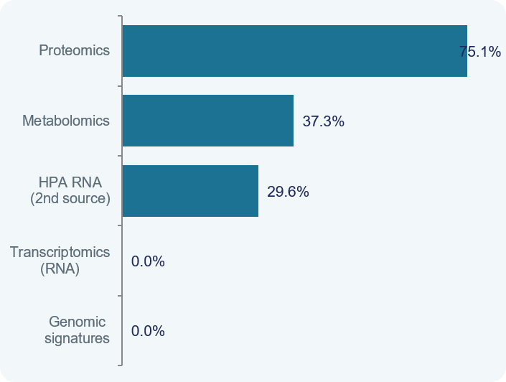
Data completeness varies sharply across the five profiled sources and that exact pattern, not a preference for one algorithm, is what drives the modelling choices downstream.
COMPLETENESS BY SOURCE
Missing data by source after merging with DepMap RNA
•Genomic signatures & DepMap RNA : 0% missing; these anchor all 1,479 lines
•HPA RNA (2nd source) : 29.6% missing, reflecting HPA's narrower profiling scope
•Metabolomics : 37.3% missing
•Proteomics : 75.1% missing; the sparsest layer, a structural gap from mass-spectrometry coverage, not a data-quality error
WHAT THIS MEANS FOR MODELLING
•No modality is imputed, every gap is carried through to the Confidence score rather than guessed
•This exact 0% → 75.1% missingness pattern is why MOFA was chosen over PCA/SVD, which both require a complete matrix
missing data % across the 1,479 anchor cell lines
Note:- The missing data is based on comparison to the anchor table. Individually the data is present.

Slide 5
Data Challenges & Solutions
Heterogeneous formats, duplicate IDs and missing identifiers — resolved before any modelling
Data Heterogeneity & Normalization
Gene Name & Ensembl ID Mapping
Source | Raw Format | For Preprocessing | For Scoring
RNA | log₂(TPM+1) values | z-score | MinMax [0,1]
Proteomics | MS-normalised | z-score | MinMax [0,1]
Metabolomics | Normalised values | z-score | MinMax [0,1]
Global Signatures | Various scales | z-score | MinMax [0,1]
Problem: several columns contained ENSG IDs only - no gene symbols
22 genes could not be resolved from the dataset alone
BioMart export resolved 12 of the 22 missing mappings
Gene-to-protein mapping table: links RNA ENSG IDs to proteomics UniProt IDs
Two-Phase Normalization - Why Kept Separate
Profile ID Deduplication (RNA base table)
Z-score (Preprocessing only)
Centers each feature around zero - required because MOFA assumes zero-centered input.
Applied to raw values before latent factor learning.
Zero-centering is a hard MOFA requirement; without it, the first latent factor simply captures the mean.
MinMax [0,1] (Scoring only)
Bounds every value to [0,1] so the multiplicative scoring formula is always valid.
Applied independently to each gene across all 1,479 cell lines.
Keeps each gene's relative variation intact while making scores directly comparable.
1,495 Profile IDs found in DepMap RNA base table
16 duplicate IDs identified and removed (first entry kept per cell line)
1,479 unique cell lines confirmed as the anchor set for all modalities
Why this matters: every downstream step — MOFA factor learning, cosine similarity, and the scoring formula — depends on a single consistent cell line namespace. These preprocessing steps establish that namespace before any data enters the model.

Slide 6
Identifier Harmonization
Resolving three independent naming systems into one master lookup table across 1,479 cell lines
Cell Line Name & Model ID Matching
Missing Data across Modalities after merging on the DepMap RNA table
3 naming systems: DepMap ACH-IDs/PR-IDs ; Cellosaurus CVCL IDs ; Cell Line Names
Cellosaurus cross-reference used as primary bridge between all three systems for unmapped cases
This missingness is not based on the individual datasets
0%
DepMap RNA
5-Step Priority Resolution Chain:
1. sample-info name → 2. CCLE-name prefix → 3. Cellosaurus cross-reference → 4. stripped-name → 5. ACH-code fallback
~97% resolved | 41 remain as ACH-codes | Master Lookup Table used for all merges
anchor - 0% missing
29.6%
HPA RNA
ACH ID | PR ID | CVCL ID | CCLE Name | Cell line name | Primary disease | Lineage | Unmapped
ACH-000520 | PR-09gmEI | CVCL_2291 | 59M_OVARY | 59M | Ovarian Cancer | ovary | FALSE
ACH-000575 | PR-0B6q0Z | CVCL_5134 | HCC364_LUNG | HCC364 | Lung Cancer | lung | FALSE
ACH-000856 | PR-0f2vAo | CVCL_1110 | CAL51_BREAST | CAL-51 | Breast Cancer | breast | FALSE
ACH-001335 | PR-0fum2y | CVCL_1095 | C4II_CERVIX | C-4 II | Cervical Cancer | cervix | FALSE
ACH-000411 | PR-0hvX2B | CVCL_1050 | 769P_KIDNEY | 769-P | Kidney Cancer | kidney | FALSE
ACH-000414 | PR-0jK5CP | CVCL_1508 | NCIH1944_LUNG | NCI-H1944 | Lung Cancer | lung | FALSE
secondary RNA source
37.3%
Metabolomics
partially sparse
75.1%
Proteomics
most sparse
Key outcome: all source files now reference the same 1,479 cell line IDs, enabling clean joins across every omics layer without information loss.
The 0% → 75.1% range drove MOFA over PCA/SVD ; PCA/SVD need complete matrices; MOFA handles missing modalities natively ; No imputation in the scoring pipeline
1,479 unified cell lines ; 3 naming systems resolved ; 1 Master Lookup Table

Slide 7
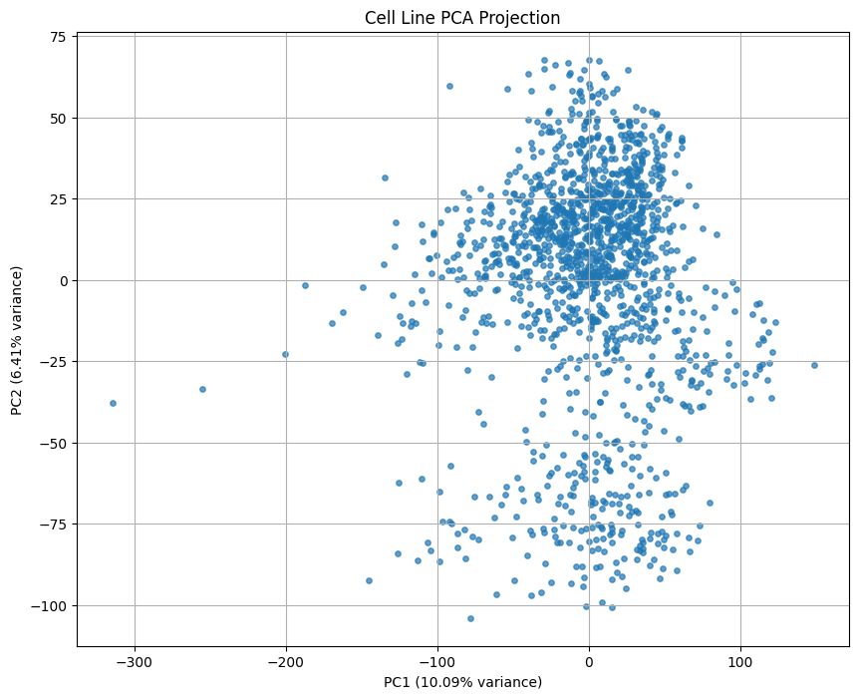
Integrating four omics layers with MOFA
Why the standard decompositions failed, and what MOFA+ does instead
Why not PCA / Truncated SVD
PCA needs a complete matrix, so missing entries were median-imputed per feature
That gave 1,110 cell lines the exact same fake protein profile. They all looked identical, so the protein data told us nothing about them
SVD gave the same result as PCA, so it wasn't a fix
MOFA+
Models missingness natively via variational Bayesian inference: a line's latent position is inferred only from the modalities observed for it, with no imputation
Treats each view separately, with its own noise model and scale, so narrow views are not drowned out under concatenation
Training setup and outputs
Four Z-scored views; NaN retained as structural missingness
20 latent factors, spike-and-slab weights, ARD priors on factors and weights to encourage sparsity
Produces Z ∈ ℝ^(1479×20) (cell-line factors) and W_RNA ∈ ℝ^(19900×20) (gene weights)

Slide 8
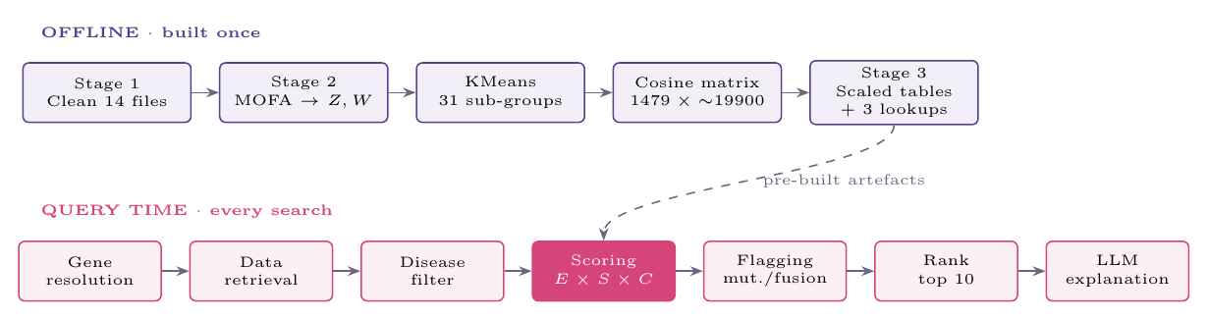
System architecture
The offline part
Files are processed one at a time and cleared from memory, so we never need to hold all 14 at once
It saves everything the app needs later, so the app never touches the raw data
The app
The researcher enters target genes, and optionally genes to avoid, a disease, and filters for mutations and fusions
Each recommended line is tagged with the group it belongs to
Returns six things: the top 10 celllines, alternative celllines, mutation and fusion detail tables, a map of the cell lines, and the explanation

Slide 9
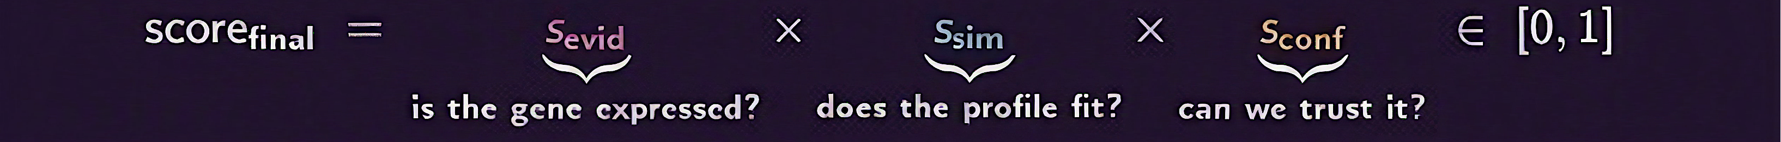
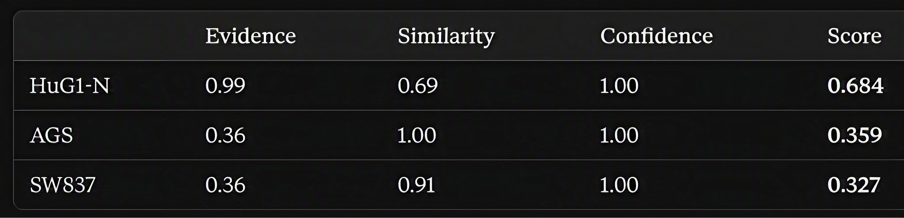
How a cell line gets its score
Score = Evidence × Similarity × Confidence
Evidence (three modalities)
ε_target = 1/3(ε_rna + ε_hpa + ε_prot)
Each term is the mean MinMax-scaled expression over the n target genes
A missing modality contributes 0 while the denominator stays at 3, so one modality caps a line at 1/3, two at 2/3
Averages the gene's expression across three sources
Similarity (MOFA factor space)
sim(c,g) = (z_c · w_g) / (||z_c|| ||w||)
Cosine, not Euclidean: what matters is which factors a line engages, not how strongly
Each gene column MinMax-scaled independently, as raw cosines are not comparable across genes
Evidence is about how much of the gene is there. Similarity is about whether the cell line looks like the kind of cell that uses it
Confidence (data quality)
s_conf = (m + a)/2, m = n_avail/3, a = 1/(1 + Var)
m rewards modality coverage, a rewards cross-modal agreement (variance over available values, zeros excluded)
One modality alone gives a = 1: nothing can contradict it
NaN is never imputed, so absence is scored rather than hidden

Slide 10
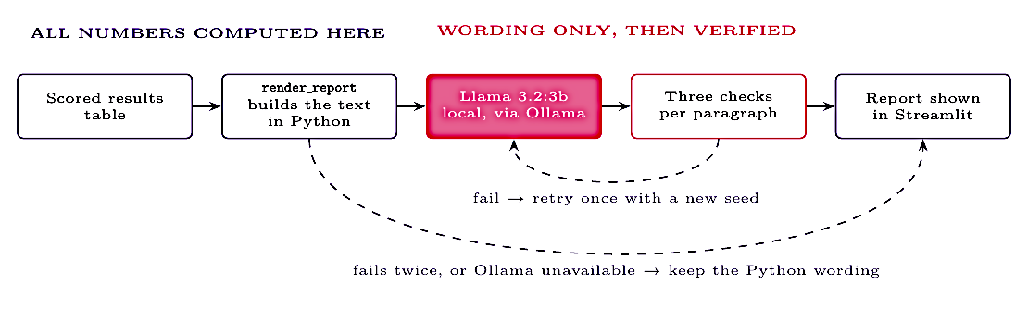
The written explanation
Two versions that didn't work
We gave the model the numbers and asked it to write the report. It put one cell line's score against another and compared things we never gave it
We gave it a finished report and asked it to rewrite it. It made up numbers and moved them between paragraphs
So Python writes it first
The whole report is assembled in code, straight from the results table. No AI involved at this stage
For each cell line it gives the three parts and the final score, how it compares to the others, which part is holding it back, which group it belongs to, and whether low confidence means missing data or disagreeing data
Then the AI just rewords it
Sent one paragraph at a time, so if something goes wrong it only affects that paragraph
Each paragraph is checked three ways: are all the numbers still there, in the same order, and still attached to the right label
That last check exists because one rewrite kept every number but called a final score a similarity score
If a paragraph fails twice, we keep the plain Python version. Worst case the writing is a bit stiff, never wrong

Slide 11
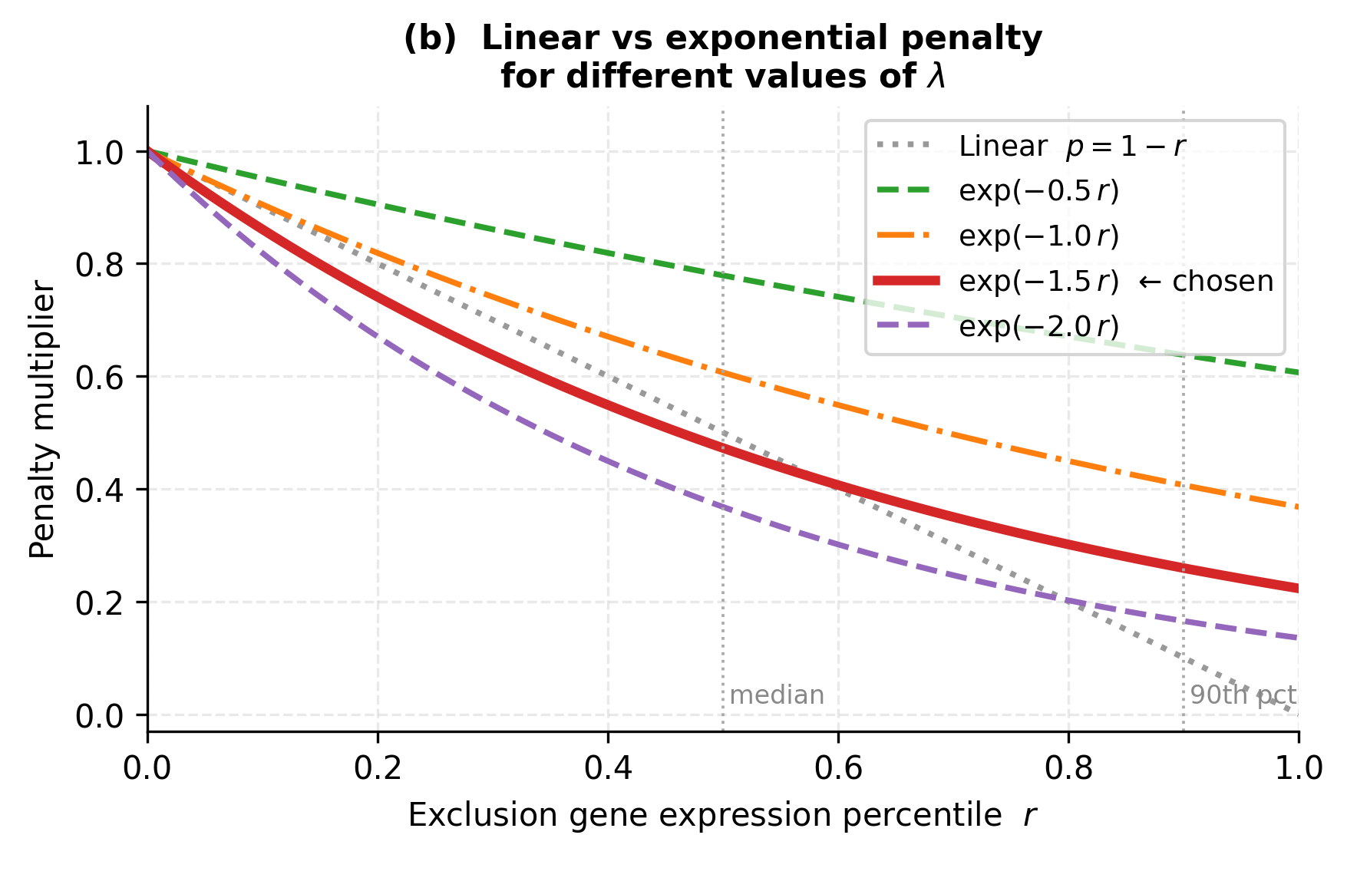
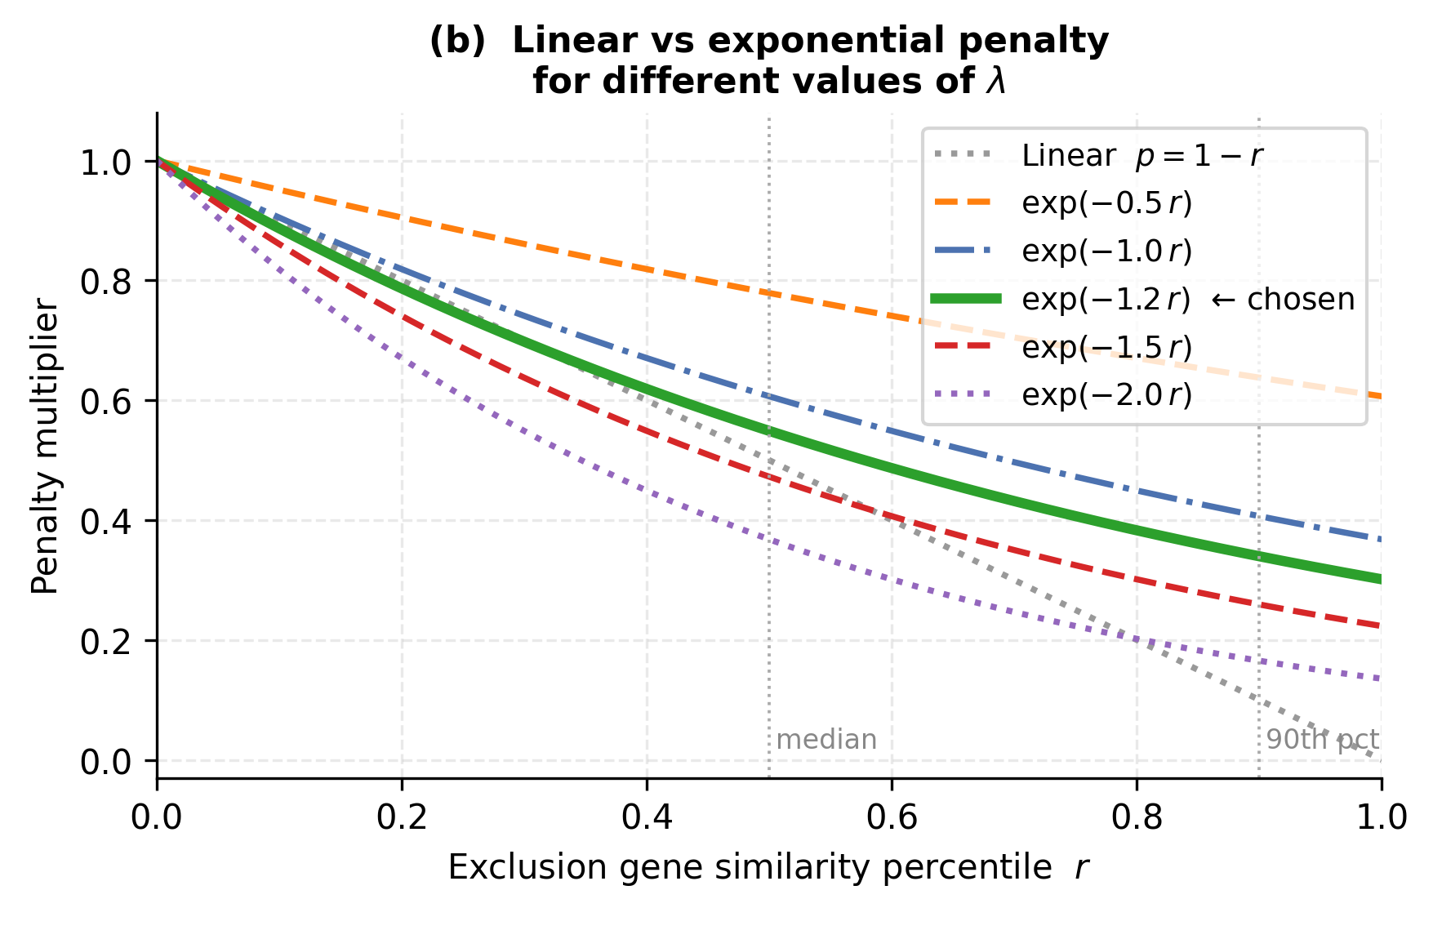
Exclusion Gene Penalties
Extending the base formula with exponential decay penalties on both evidence and similarity
When exclusion genes are specified, both scores are multiplied by an exponential decay term - penalising cell lines that express or resemble those genes
Evidence Penalty (λ = 1.5)
Similarity Penalty (λ = 1.2)
S*evid = Sevid × exp(−1.5 × re) where re = percentile rank of exclusion-gene expression
S*sim = Ssim × exp(−1.2 × rs) where rs = percentile rank of exclusion-gene similarity
Percentile rank re used instead of raw score - ensures fair comparison across genes with different expression distributions
At re=0 (no exclusion signal): multiplier = 1.0 (no penalty)
At re=0.5 (median): multiplier = exp(−0.75) ≈ 0.47
Cosine similarity to the exclusion profile used as input - directly measures how much the MOFA factor space resembles an excluded cell type
λ = 1.2 (softer than evidence) - similarity space is denser, so a gentler slope avoids over-penalising related-but-valid lines
If no exclusion gene is given: penalty term = 1.0 → score unchanged
Complete final score:
Scorefinal = [ Sevid × exp(−1.5 × re) ] × [ Ssim × exp(−1.2 × rs) ] × Sconf ∈ [0, 1]

Slide 12
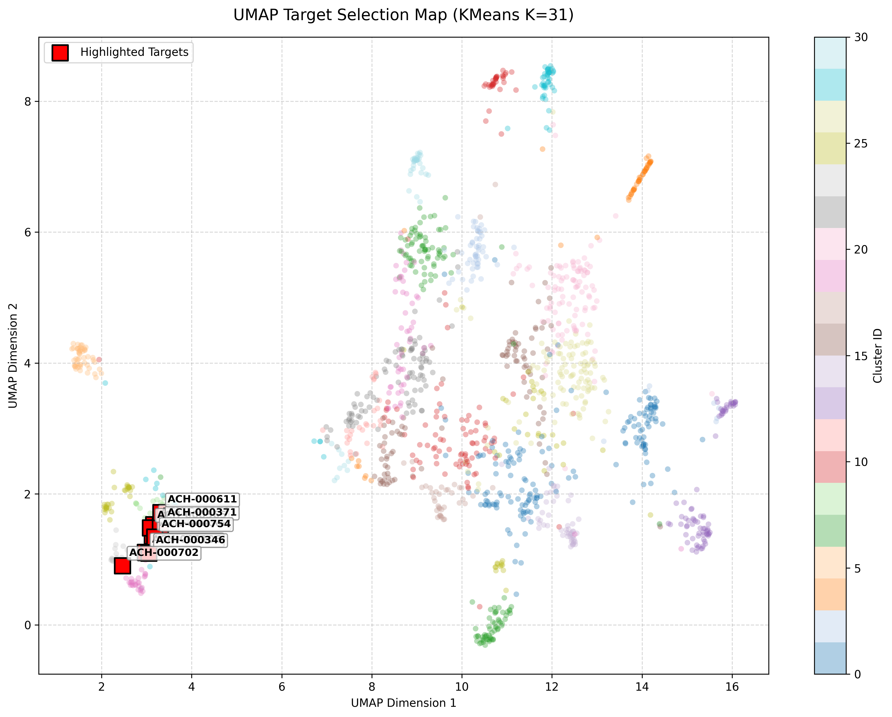
Clustering the Cell Lines
•KMeans (K = 31) partitions the 20-dimensional MOFA factor space into biological sub-groups and the cluster tab situates each recommendation within the wider population.
KMeans vs HDBSCAN
Choosing the clustering model
Method | Silhouette | Clusters
KMeans (K=31) | 0.165 | 31
HDBSCAN | ≤ 0.08 | 3–8
KMeans swept K = 2–49 had no elblow so silhouette score was used as the main metric
K = 31 sits on the silhouette plateau with silhouette 0.165 and inertia 66K
HDBSCAN scored ≤ 0.08 with only 3–8 clusters
KNN alternative-search did not add much meaning and was unstable
What the cluster tab shows
A 2-D UMAP view of Z for display only and the pipeline keeps all 20 dimensions
KMeans sub-groups shown as colours an axis independent of disease label
Top-10 in one sub-group = coherent
Top-10 spread across several = many contexts

Slide 13
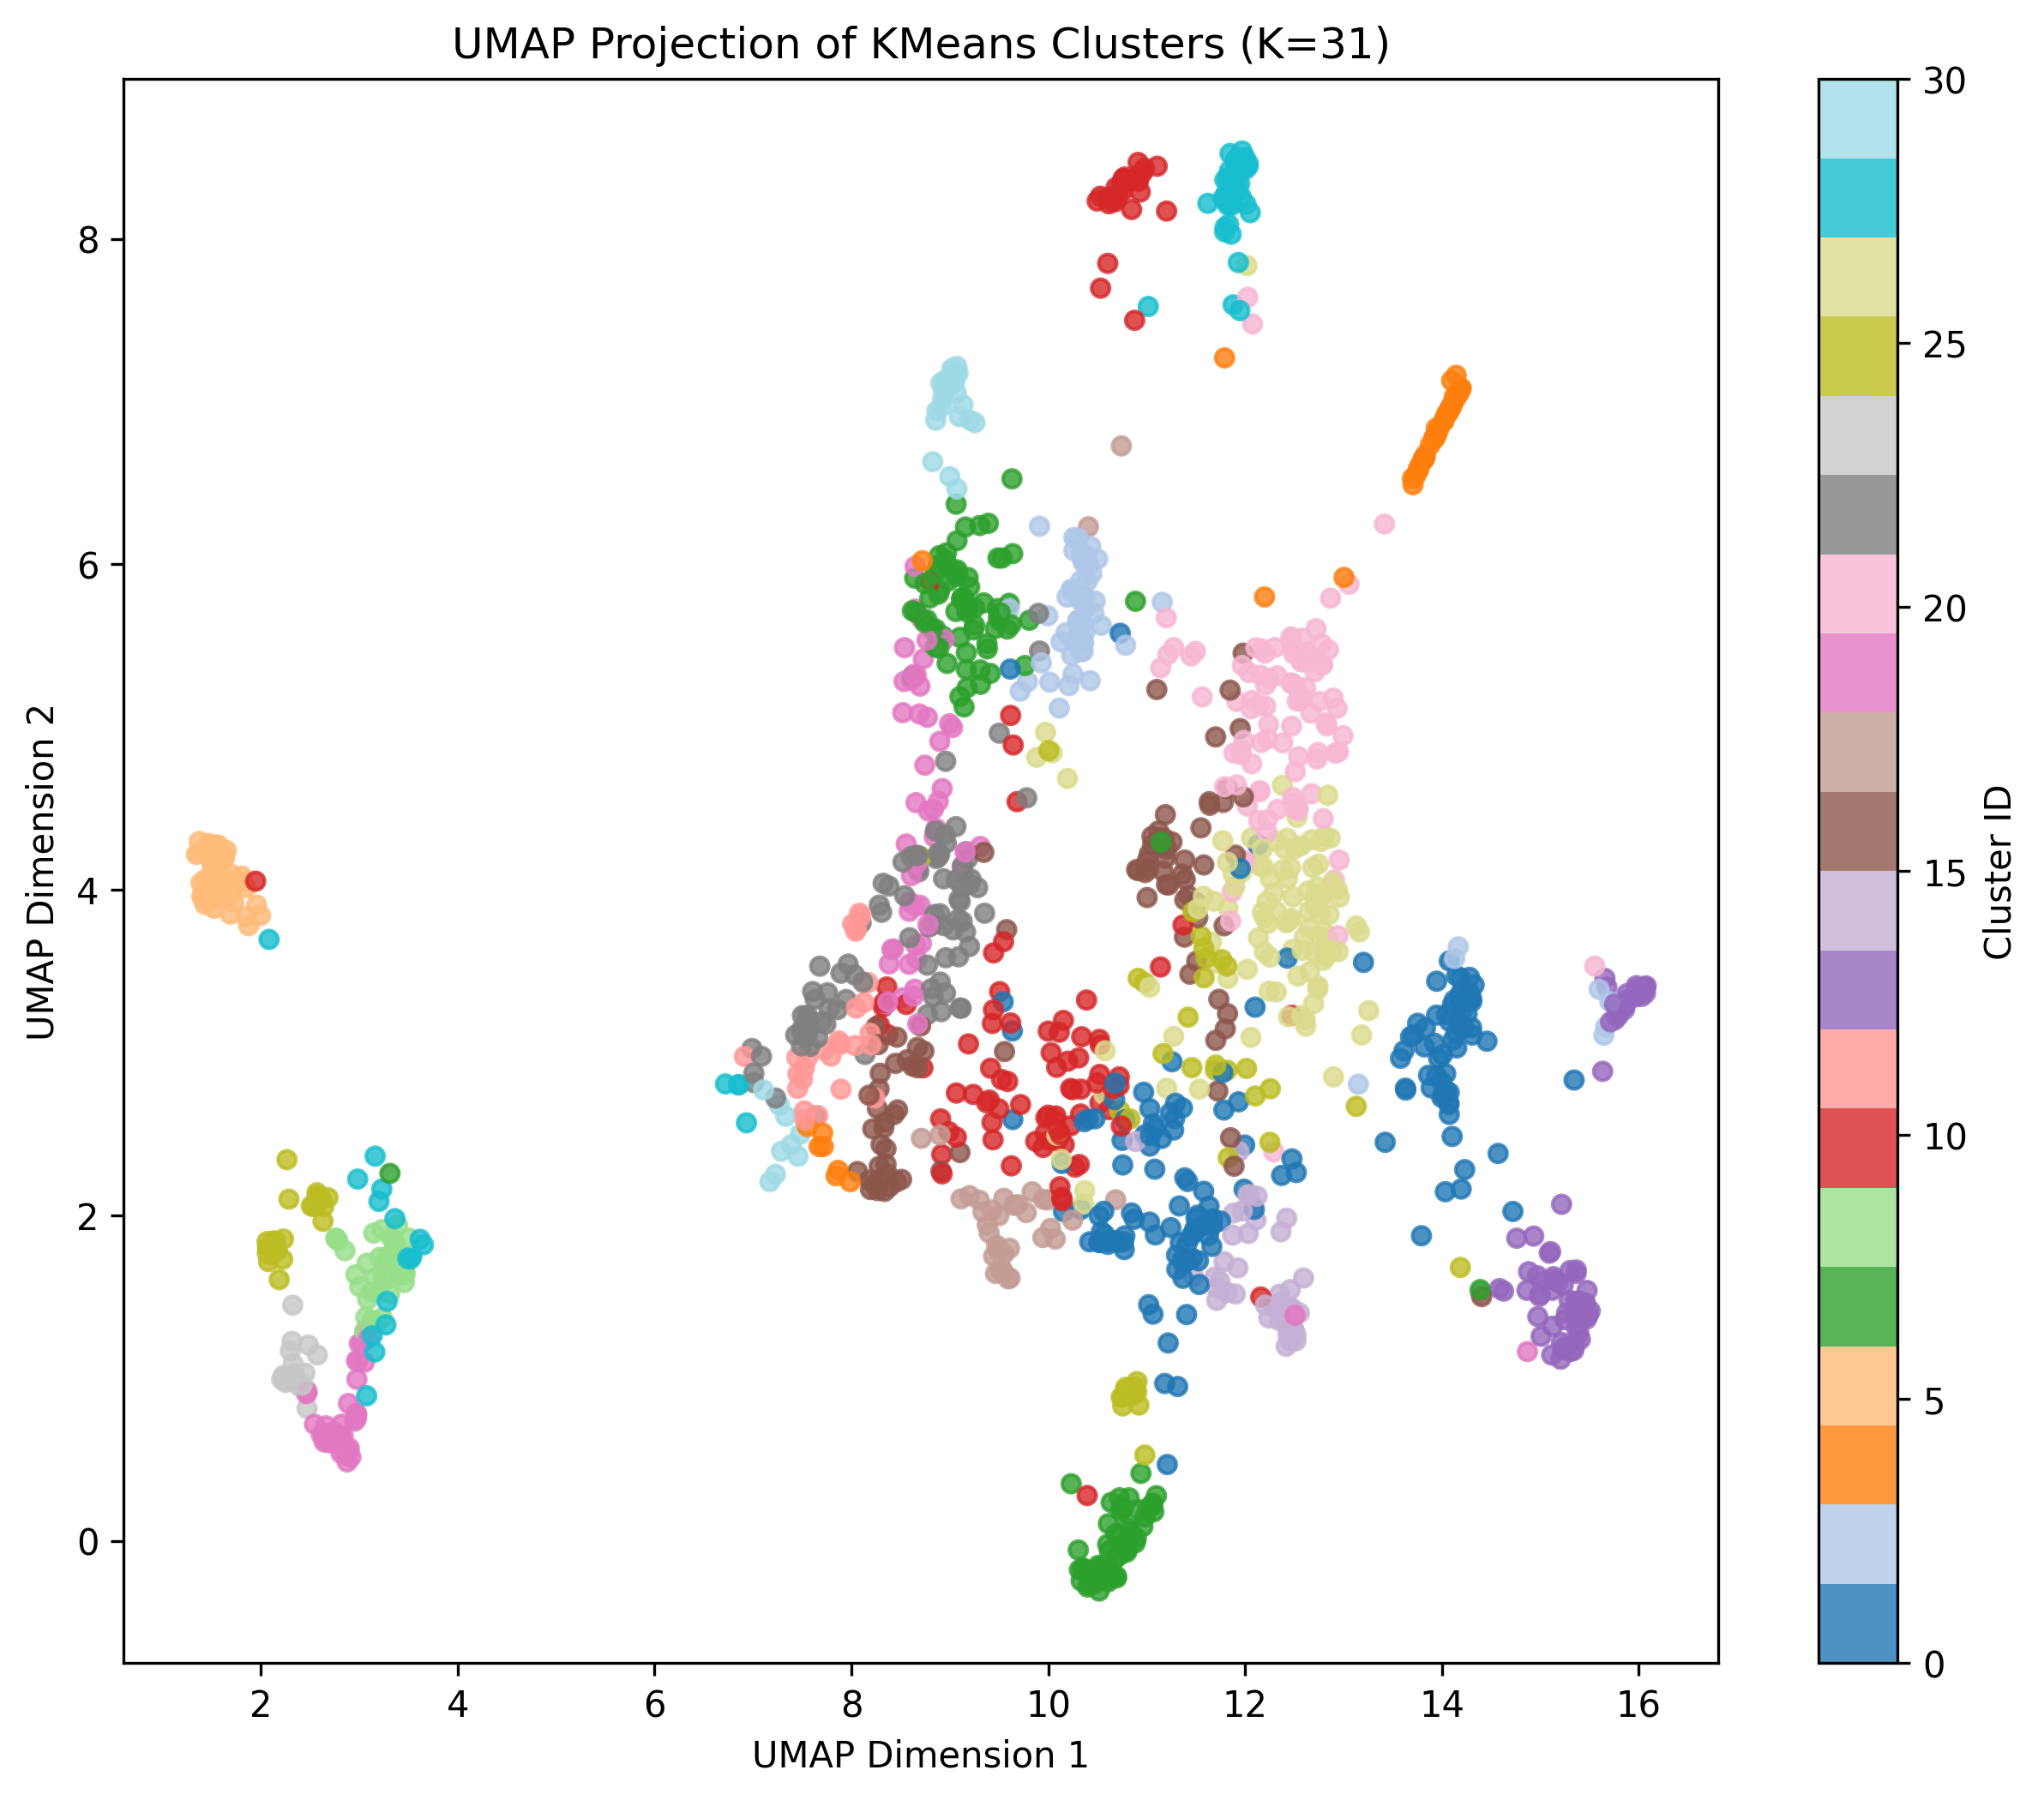
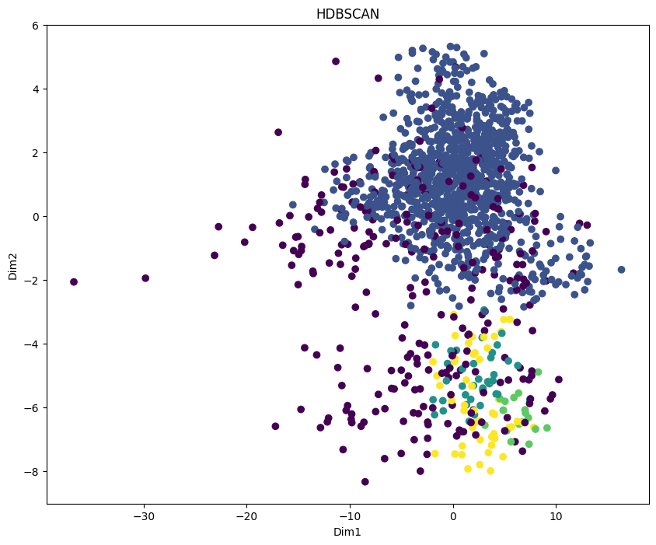
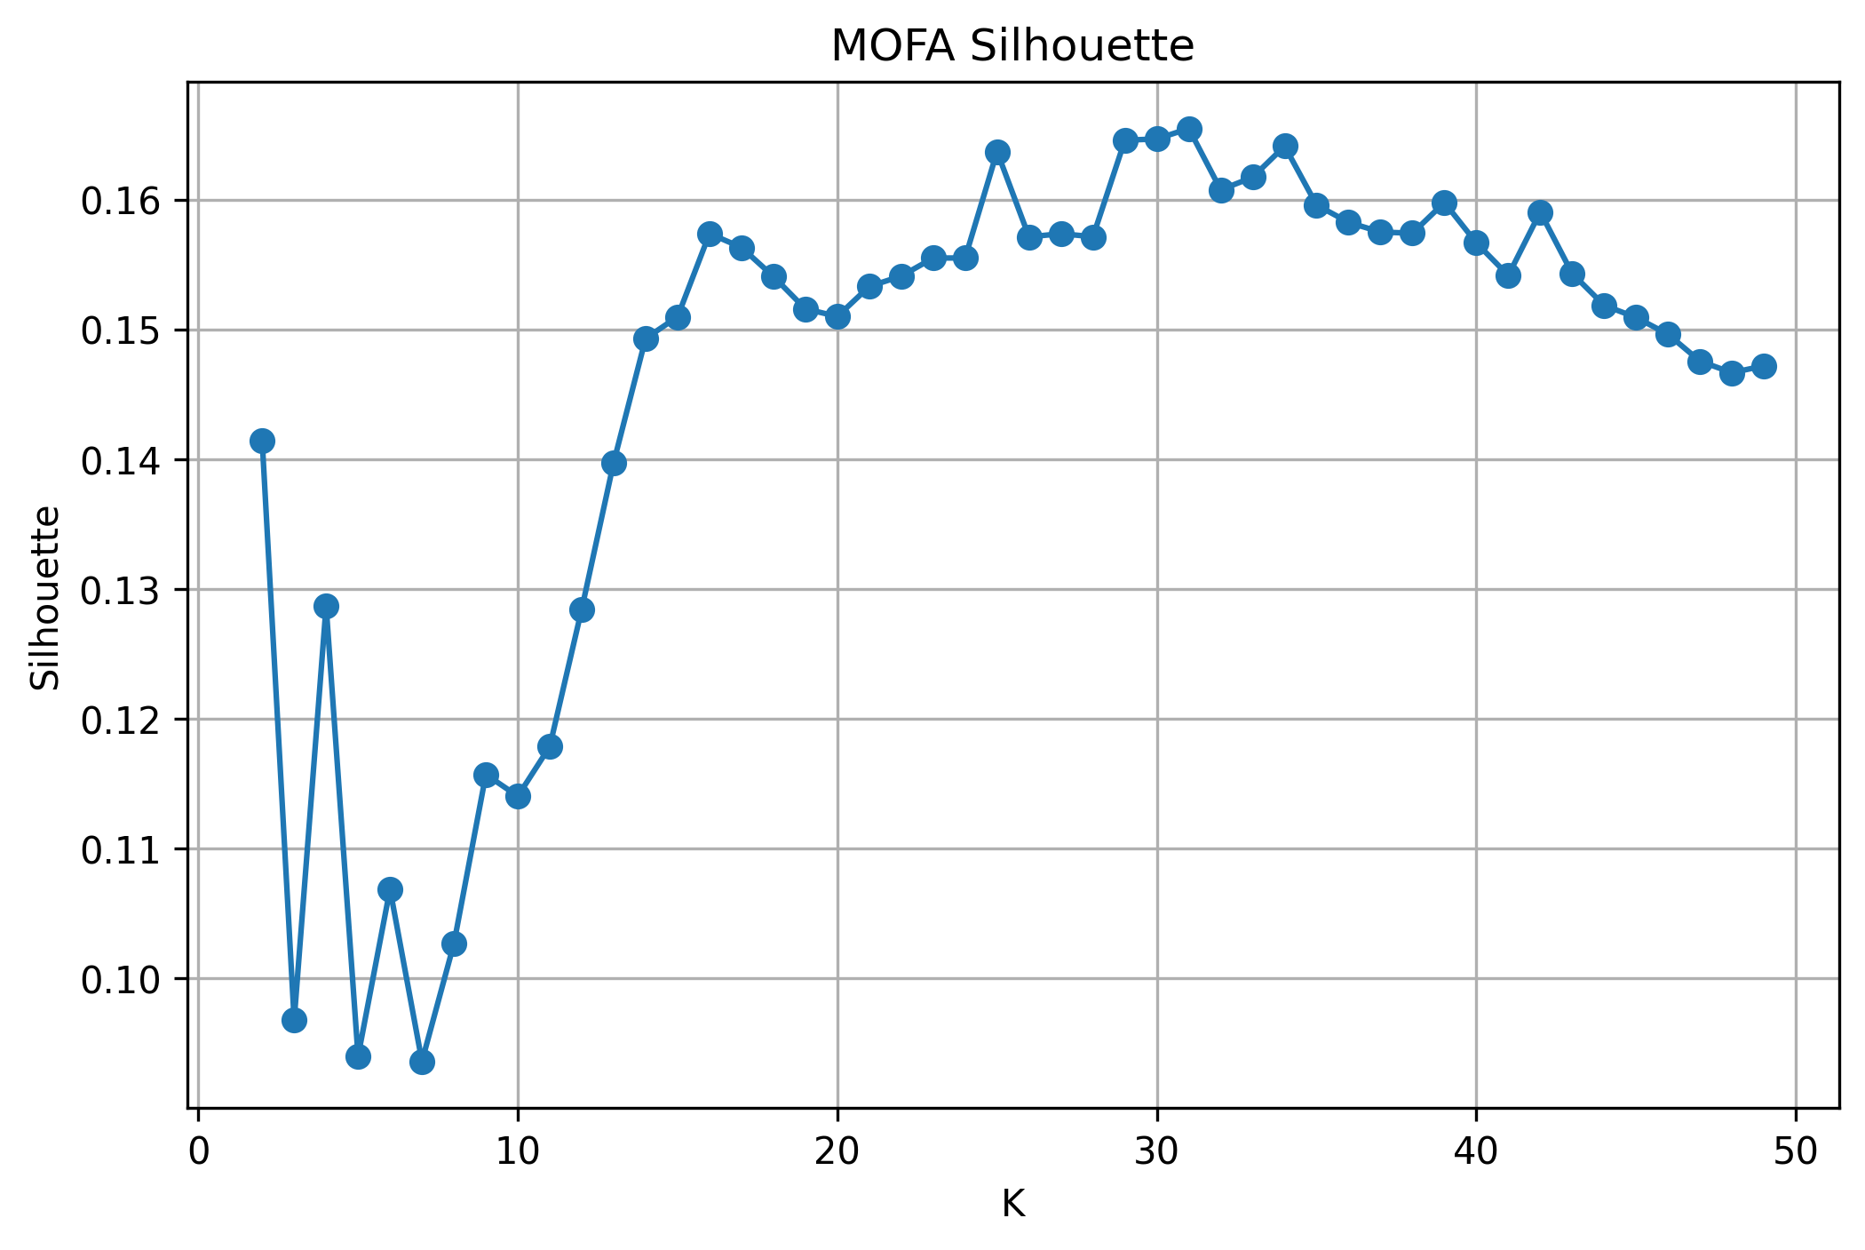
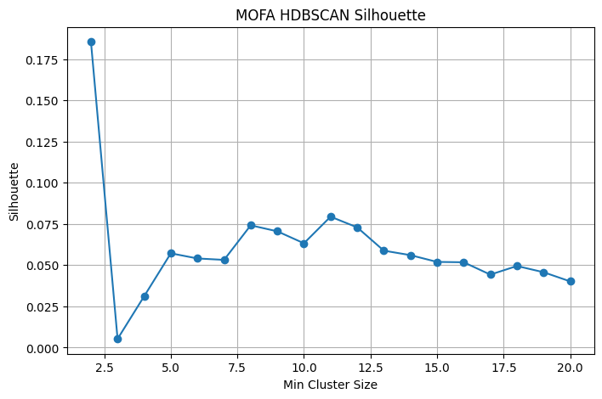
Clustering Images
Kmeans
Above image is the Kmeans projection of cell lines across all the 20 factors
Below is the Silhouette score from 2 to 49 for kmeans
HDBSCAN
Above image is the HDBSCAN projection of cell lines across all the 20 factors
Below is the Silhouette score from 2 to 20 for HDBSCAN

Slide 14
Query and Results
A query is one or more target genes with optional exclusions, disease and flag filters
we have performed three validation queries to confirm the ranking and verify if it tracks real target biology.
CONSTRUCTING A QUERY
EGFR Ranking
# | Cell line | Disease | Score
1 | HCC827 | Lung | 0.719
2 | U-BLC1 | Bladder | 0.664
3 | CAL 27 | Head & Neck | 0.646
4 | NCI-H292 | Lung | 0.622
5 | KYSE-150 | Esophageal | 0.605
Target & exclusion genes drawn from 19,900 protein-coding symbols
Optional disease filter and 3-state mutation / fusion filters
Empty targets, or a gene in both target and exclusion sets, are blocked
Filters change what is shown, never the scores (full-population scoring)
VALIDATION OF QUERY
EGFR :- lung & head-and-neck lines recovered with HCC827 taking the lead (0.719)
ERBB2:- HER2-amplified breast/oesophageal lines with EFM-192A taking the lead (0.871)
ERBB2 with CD86 exclusion:- scores fall due to exclusion, EFM-19 takes the lead (0.404)

Slide 15
Limitations And Future Work
Validation is qualitative on a couple well-understood genes
The priority next step is turning that concordance into a quantitative, benchmarked result.
LIMITATIONS
Qualitative validation on three genes with no labelled benchmark yet
Cluster silhouette 0.165 gives real structure but not sharply separated
Explanation fluency limited by the 3B model
FUTURE WORK
Labelled gene–line pairs that is NDCG@10 and tuning of λ, λ_sim on evidence
Parallelise the per-section LLM calls that dominate query time
Test a larger local model against the same verification checks

Slide 16
Thank you

Slide 17

The original discrepancy was caused by the mapping order, not by a fundamental difference between Model ID and CVCL ID.
After correcting the mapping pipeline, the missing count was 438 out of 1479 DepMap cell lines.
This primarily reflects the different baseline coverage of the datasets:
DepMap: 1479 cell lines
HPA RNA: 1206 cell lines
Therefore, the unmatched cell lines represent differences in dataset coverage, rather than data being lost because of the merge.
Once the mapping is performed correctly, using Model ID or CVCL ID as the link ultimately leads to the same mapped HPA RNA relationships.
Some valid DepMap models do not have a CVCL ID. Using CVCL ID as the primary base would unnecessarily exclude 80 valid cell lines.
When combined using hpa rna cell line description and then on the depmap sample info

Slide 18
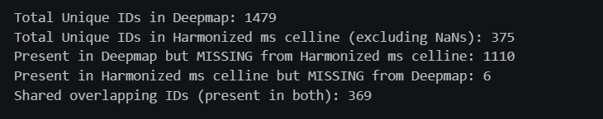
Protein Data missing
DepMap: 1479 cell lines
Harmonized Cellline: 375 cell lines
Missing percentage is equalent to 75.1% for proteomnics layer

Slide 19
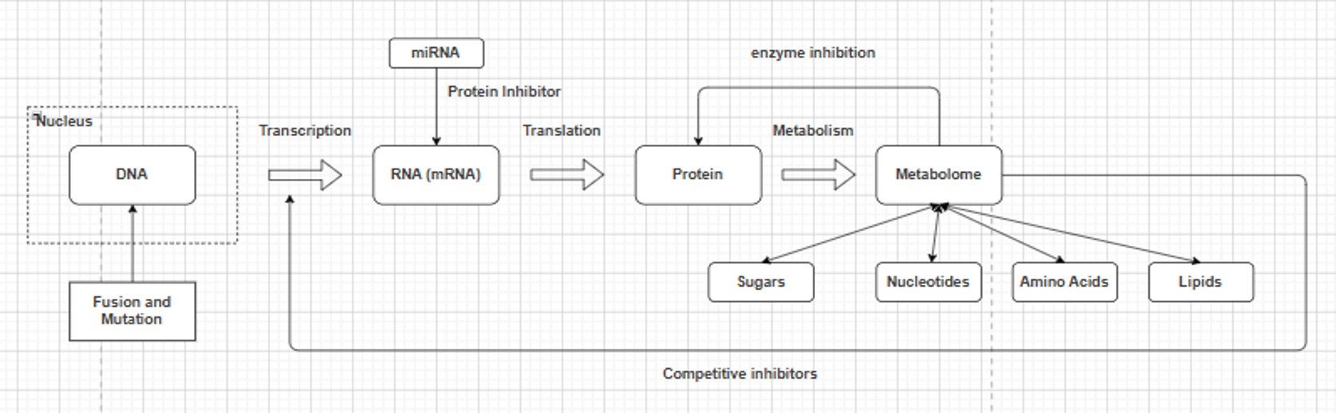
How is the cell line selected?
A gene originates in DNA and is transcribed into mRNA, then translated into protein a cell line is selected only if evidence of this active journey is confirmed at both the RNA and protein layer, since either step can be silenced before the gene becomes functional
The metabolome reflects the combined output of all active genes and pathways two cell lines expressing the same gene can behave very differently if their underlying metabolic states differ, making metabolic similarity a critical factor in identifying truly equivalent cell lines.
Expression at one biological layer does not guarantee function at the next which is why cell line selection requires evidence across multiple layers rather than relying on any single measurement alone

Slide 20
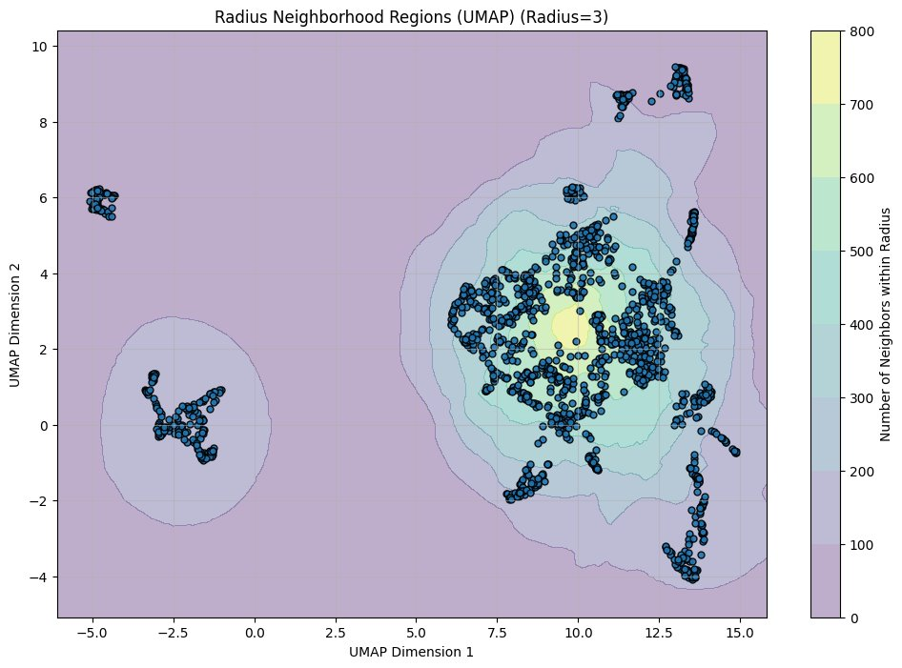
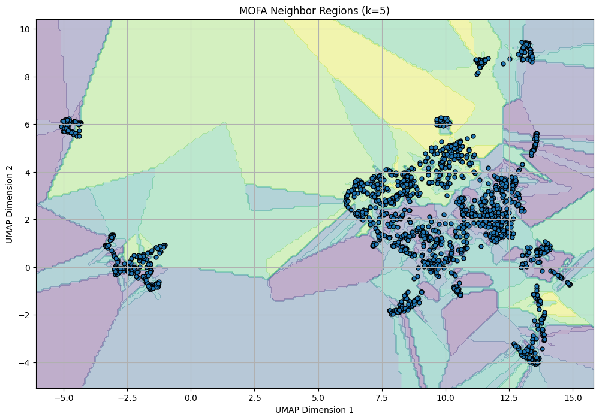
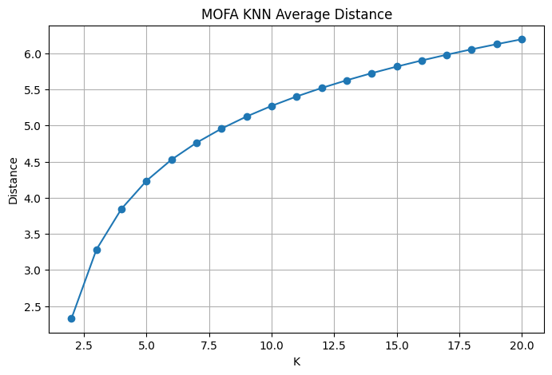
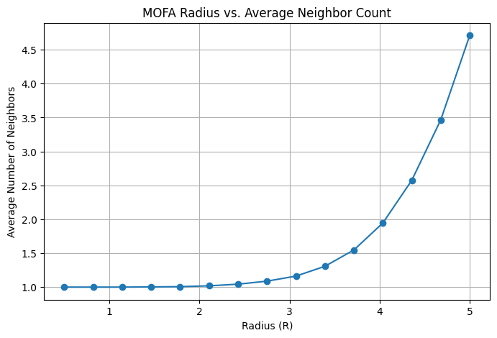
Clustering Images
KNN Linear
KNN Radial

Slide 21
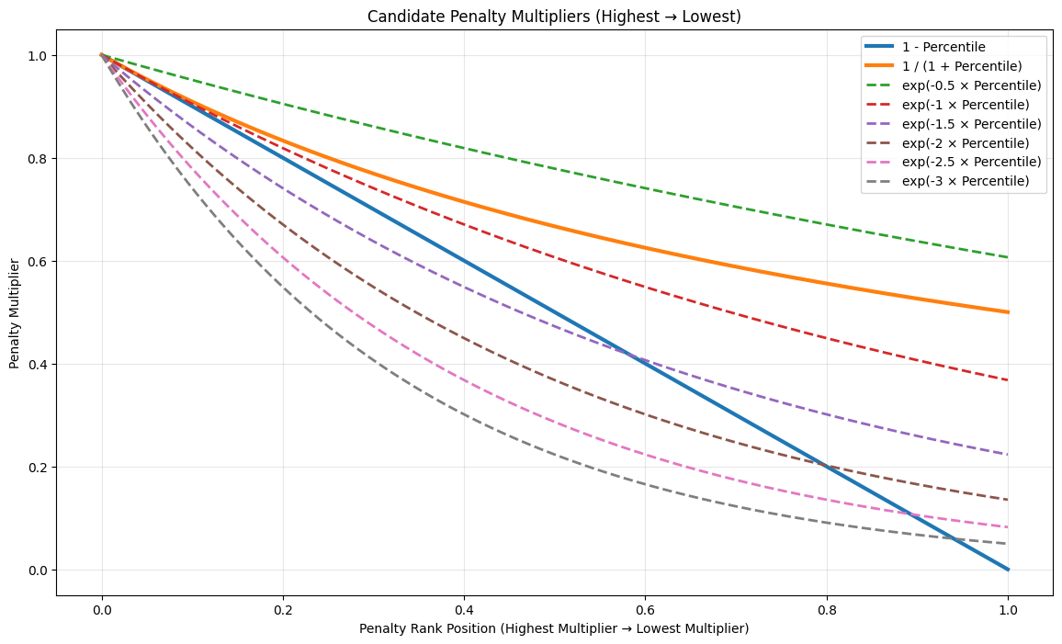
Selection of Lambda and equations for scoring

Slide 22
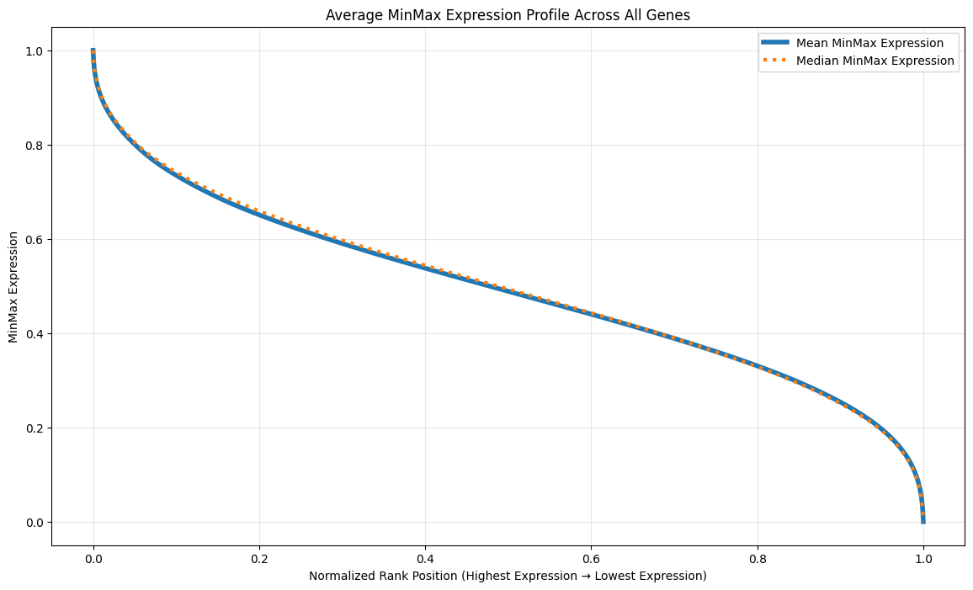
Selection of Lambda and equations for scoring

