Slide 1

f
Department of Information Technology
Healthguard : Evaluating Health Monitoring System
Under the guidance of
Mr. B SRINIVASULU
Associate Professor
Department of IT
By :Team Members
Bairedla Pavan Kumar [21911A1207]
Beldhare Shankar [21911A1210]
Samala Saiteja [21911A1250]

Slide 2
Abstract
The fitness training web application is an innovative platform designed to help users achieve their health and wellness goals through personalized and accessible solutions. Key features include an AI chatbot for real-time assistance, providing fitness tips, answering queries. The platform also offers a rich library of video training sessions led by professional trainers, catering to various skill levels and fitness goals. Users can engage in direct interactions with certified personal trainers for customized guidance, ensuring tailored advice and personalized plans. Additional features include nutrition tracking, progress monitoring, and integration for seamless activity tracking. By combining technology with expert human support, this application empowers users to adopt sustainable fitness habits and achieve long-term success.

Slide 3
Introduction
The Fitness App is an innovative solution designed to revolutionize the way individuals manage their fitness journeys. In a world where fitness management is often fragmented across multiple platforms, our app offers a unified ecosystem that integrates exercise routines, diet planning, and trainer interactions. With seamless user registration and login processes, users gain access to personalized exercise routines, comprehensive diet plans, and the ability to calculate BMI. Admins oversee the system, managing trainers and user data, while trainers create and manage tailored diet plans. Premium users enjoy enhanced features for a more enriching fitness experience. By simplifying fitness management and providing personalized support, our app empowers users to achieve their health and fitness goals effectively.

Slide 4
Existing Method
Traditional Fitness Programs:
Conventional fitness programs often rely on in-person gym sessions, group classes, or personal trainers. While effective, these methods lack the flexibility and accessibility that many users need, especially those with busy schedules or limited access to gyms.
Generic Fitness Apps:
Many fitness applications offer pre-recorded workout videos, generic fitness plans, and calorie trackers. However, these apps often lack personalization, real-time support, and seamless integration with wearable devices.
Manual Progress Tracking:
Users often rely on spreadsheets, paper logs, or standalone tracking apps to monitor their fitness progress and nutrition. This approach is time-consuming and may result in inconsistent tracking or a lack of motivation.

Slide 5
Proposed Method
The proposed methods for this fitness training web application focus on creating a user-centric platform that combines innovative technology with expert guidance. The development process begins with a thorough requirement analysis to identify user needs, followed by designing an intuitive interface and building a responsive frontend and robust backend. Key features include integrating an AI chatbot for real-time assistance, a video training library led by certified trainers, and a system for direct interaction with personal trainers. Tools for nutrition tracking, progress monitoring, and synchronization with fitness devices ensure a comprehensive experience, while data security and privacy measures protect user information.

Slide 6
Objective
Develop a comprehensive fitness training web application to help users achieve their health and wellness goals.
Provide real-time assistance through an AI chatbot, offering fitness tips and answering queries.
Offer a diverse library of video training sessions led by professional trainers, catering to various skill levels and fitness goals.
Facilitate personalized guidance through direct interactions with certified personal trainers.
Includes nutrition tracking and progress monitoring.
Promote sustainable fitness habits and long-term user success through a combination of technology and expert human support.
Ensure a user-friendly and accessible platform for a holistic fitness experience.

Slide 7
Requirements
Hardware Requirements:
System : Ryzen 55600H
RAM : 16 GB DDR4
Hard Disk : 512 GB SSD
Software Requirements:
Operating System : Windows 11
Framework : Express.js
Database : MongoDB
Backend : Node.js
Technologies : HTML,CSS,JavaScript,Node.js

Slide 8
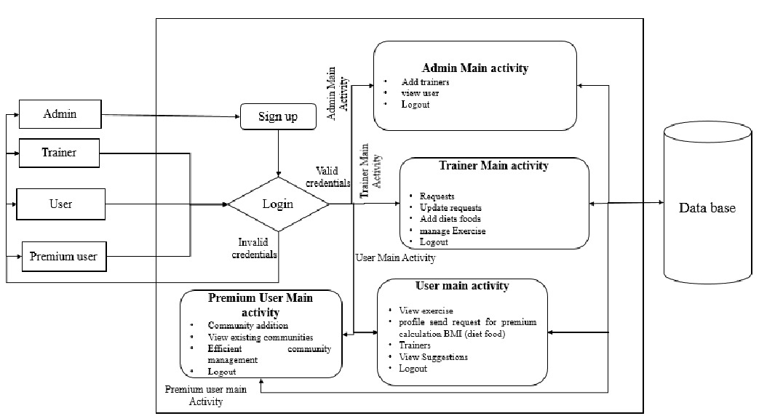
System Architecture

Slide 9
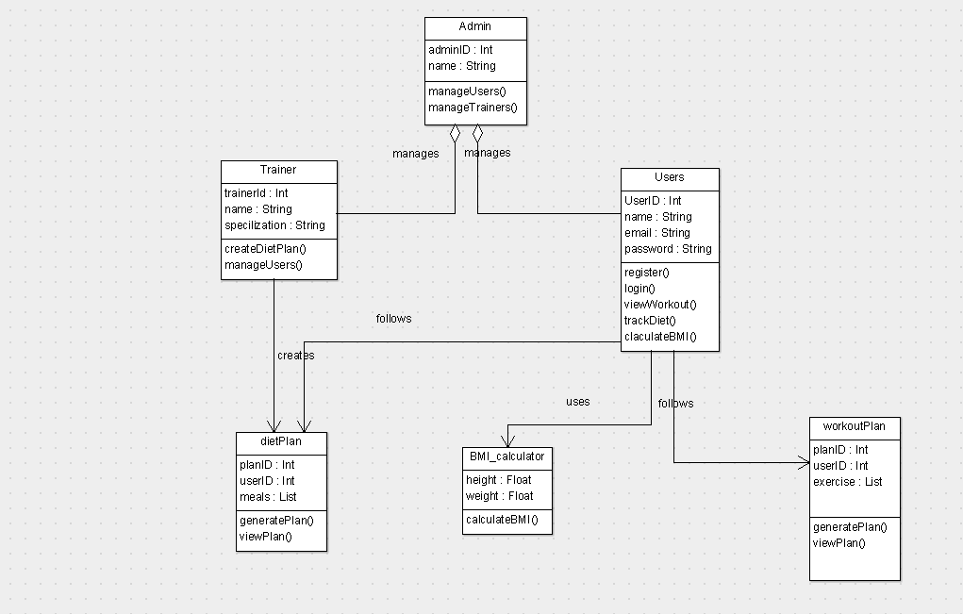
UML Diagrams
Class Diagram:

Slide 10
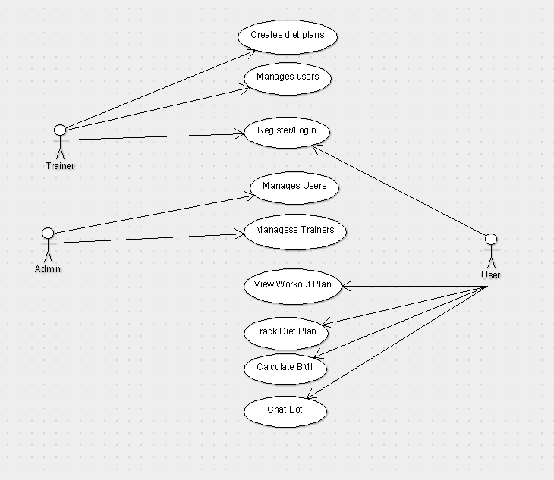
Use Case Diagram:

Slide 11
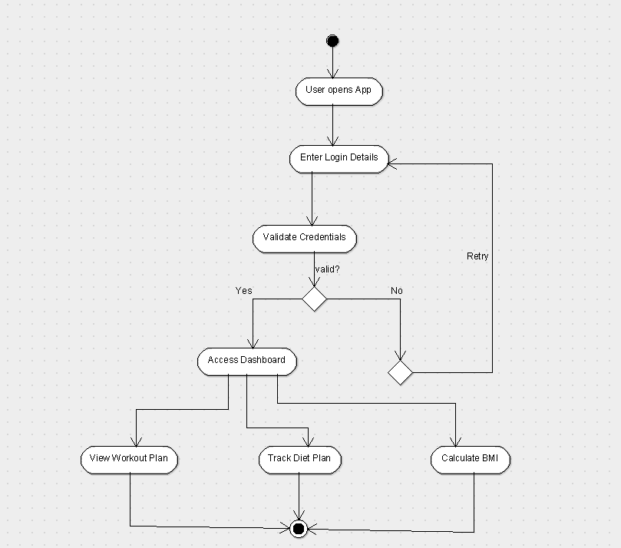
Activity Diagram:

Slide 12
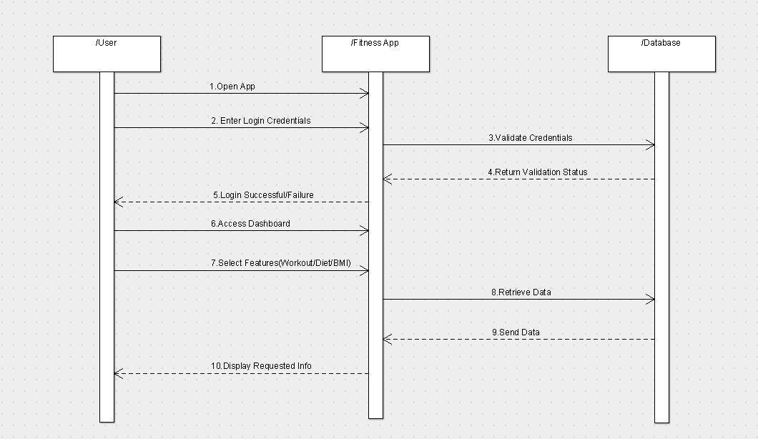
Sequence Diagram:

Slide 13
Work Flow Modules
1. User Registration & Authentication Module
User Workflow:
Users sign up with their details (name, email, password, fitness goals).
Existing users log in, and credentials are validated against the database.
Successful login redirects users to their personalized dashboard.
Trainer Workflow:
Trainers and admins log in with role-based access.

Slide 14
2. Dashboard & Profile Management Module
User Workflow:
Users access their dashboard to view fitness progress.
They can update personal details, set fitness goals, and manage subscriptions.
Trainer Workflow:
Trainer's view and update user fitness plans.

Slide 15
3. Workout Plan Module
User Workflow:
Users receive a personalized workout plan based on fitness goals.
The app displays exercises with sets, reps, and video demonstrations.
Users mark workouts as completed and track progress over time.
Trainer Workflow:
Trainers create, modify, and assign workout plans to users.
Trainers monitor user progress and suggest improvements.

Slide 16
4. AI Chatbot Module
User Workflow:
Users interact with an AI Chatbot for instant assistance.
The chatbot answers queries related to workouts, diet, BMI, progress tracking, and app navigation.
The chatbot offers AI-based recommendations on exercise routines and nutrition plans.
Users can ask real-time fitness-related questions and receive AI-driven responses.
Trainer Workflow:
Trainers receive chatbot-generated insights about user queries and progress.

Slide 17
5. Diet Plan & Nutrition Tracking Module
User Workflow:
Users get a customized diet plan tailored to their fitness goals.
The app allows users to log meals, track calories, and receive nutritional insights.
AI Chatbot provides dietary suggestions based on user preferences and fitness goals.
Trainer Workflow:
Trainers design diet plans for users based on fitness assessments.
They modify meal recommendations as per progress.

Slide 18
6. BMI & Health Metrics Calculation Module
User Workflow:
Users input their height and weight to calculate BMI.
The app categorizes BMI into Underweight, Normal, Overweight, or Obese.
AI Chatbot provides fitness tips based on BMI results.

Slide 19
7. Logout & Session Management Module
User Workflow:
Users can log out securely.
Sessions expire automatically for security.
Trainer Workflow:
Trainers follow the same session management process.

Slide 20
Future Plan
0-6 Months (Short-Term)
Complete development & testing.
Launch Beta version & gather feedback.
Deploy on Google Play & App Store.
6-12 Months (Mid-Term)
Enhance AI Chatbot with voice & personalization.
Add gamification (challenges, rewards, leaderboards).
Introduce trainer live sessions & premium features.

Slide 21
1-2 Years (Long-Term)
Integrate wearable devices (smartwatches, fitness trackers).
Expand to corporate wellness & B2B market.
Develop AI-powered virtual personal trainer.
Beyond 2 Years
Expand globally with multi-language support.
Partner with international trainers & gyms.
Goal: Build a smart, interactive, and global fitness solution with AI-driven insights & real-time coaching.

Slide 22
References
• R. Pevin Raj', S. Nirmala Sujithra Rajini; FIT Quest App Embark on Your Fitness Journey; March 2024.
• Ritik Gaur', Rohit Singh, Mrs. V. Vijayalakshmi; Human Fitness Application; December 2022.
• Karan Kumar Waghmare', Vinay Funde, Disha Dhawle, Asmita Jangle, Prof. Anuja Ghasad'; Survey on Unite
Gymnasium Web Application for Daily Routine; October 2023.
• Mr. Atharva S. Wankhade', Mr. Prathamesh M. Bambal, Mr. Sarthak S. Kharkar, Mr. Smit D. Solao,
Mr. Mandar V. Charthal, Prof. N.G. Rathi; Doctor Appointment Booking System; May 2023.

Slide 23
Thank You !

