Slide 1
Online Learning Management System (LMS)
JF/BSCSD/15/21

Slide 2
Introduction
The proposed Learning Management System (LMS) addresses challenges in existing LMS by introducing a user-friendly interface, machine learning-powered content delivery, performance tracking, and personalized learning. It integrates a robust MySQL database, improving accessibility and enhancing learning outcomes.

Slide 3
Background of the Study
Rising demand for distance education
Universal implementation of LMS worldwide
Need for centralized academic content management
Shift towards online and blended learning models
Growing importance of accessibility and scalability

Slide 4
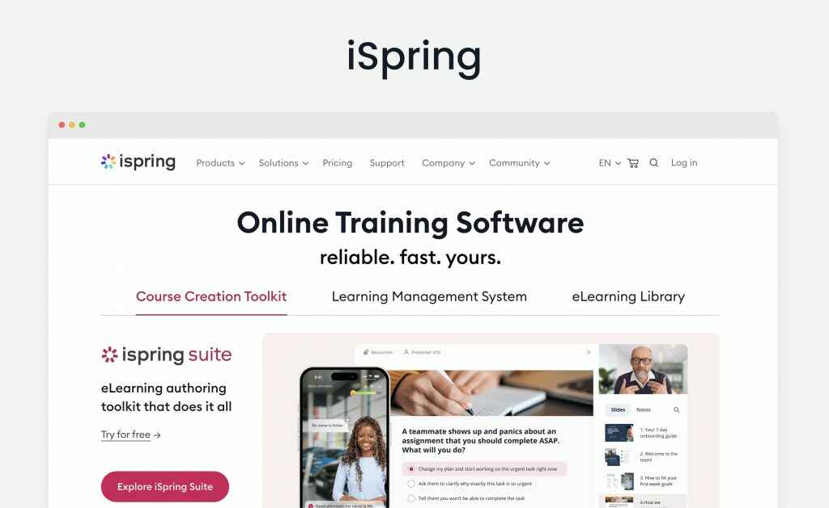
Sample design for LMS

Slide 5
Problem Statement
Challenges in current LMS platforms:
Limited usability
Scalability issues
Poor integration with educational tools
Fragmented user experience
Need for more intuitive interfaces
Lack of progress tracking features

Slide 6
Project Objectives
Develop user-friendly Online Learning Management System
Implement core LMS features
Enable efficient course material access and submission
Integrate database management
Ensure system security and scalability
Incorporate machine learning for performance prediction

Slide 7
System Features
For Students:
User registration and authentication
Personalized dashboard
Course enrollment
Assignment submission
Personalized recommendations
For Instructors:
Course creation and management
Assignment creation and grading
Student performance monitoring
Communication tools

Slide 8
Technical Architecture
Frontend: Angular
Backend: Node.js with Express
Database: MySQL
Machine Learning: Python
Version Control: Git
Testing: Postman

Slide 9
Database Structure
Student Data:
Personal information
Enrollment details
Academic performance
Instructor Data:
Course Information
Assignment Records
Performance Metrics

Slide 10
Machine Learning Integration
Predictive Analytics:
Student performance prediction
Early risk detection
Resource recommendations
Features Used:
Historical grades
Participation metrics
Time management data

Slide 11
Development Methodology
Agile Development Approach
Iterative Development Cycles
Continuous Testing and Feedback
Regular Stakeholder Communication
Quality Assurance at Each Stage

Slide 12
Project Timeline
Proposal Writing (Weeks 1-2)
Planning and Design (Weeks 3-4)
Implementation (Weeks 5-9)
Testing (Weeks 10-11)
Documentation (Weeks 12-13)
Final Submission (Week 14)

Slide 13
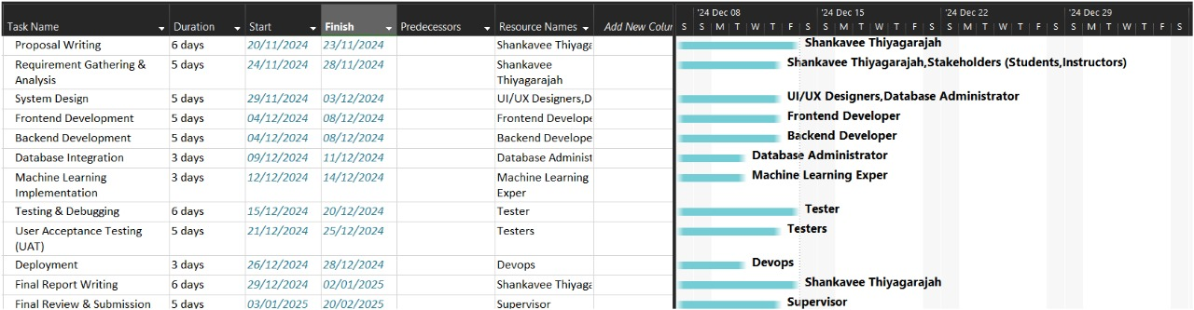

Slide 14
Thankyou

