Slide 1


Slide 2
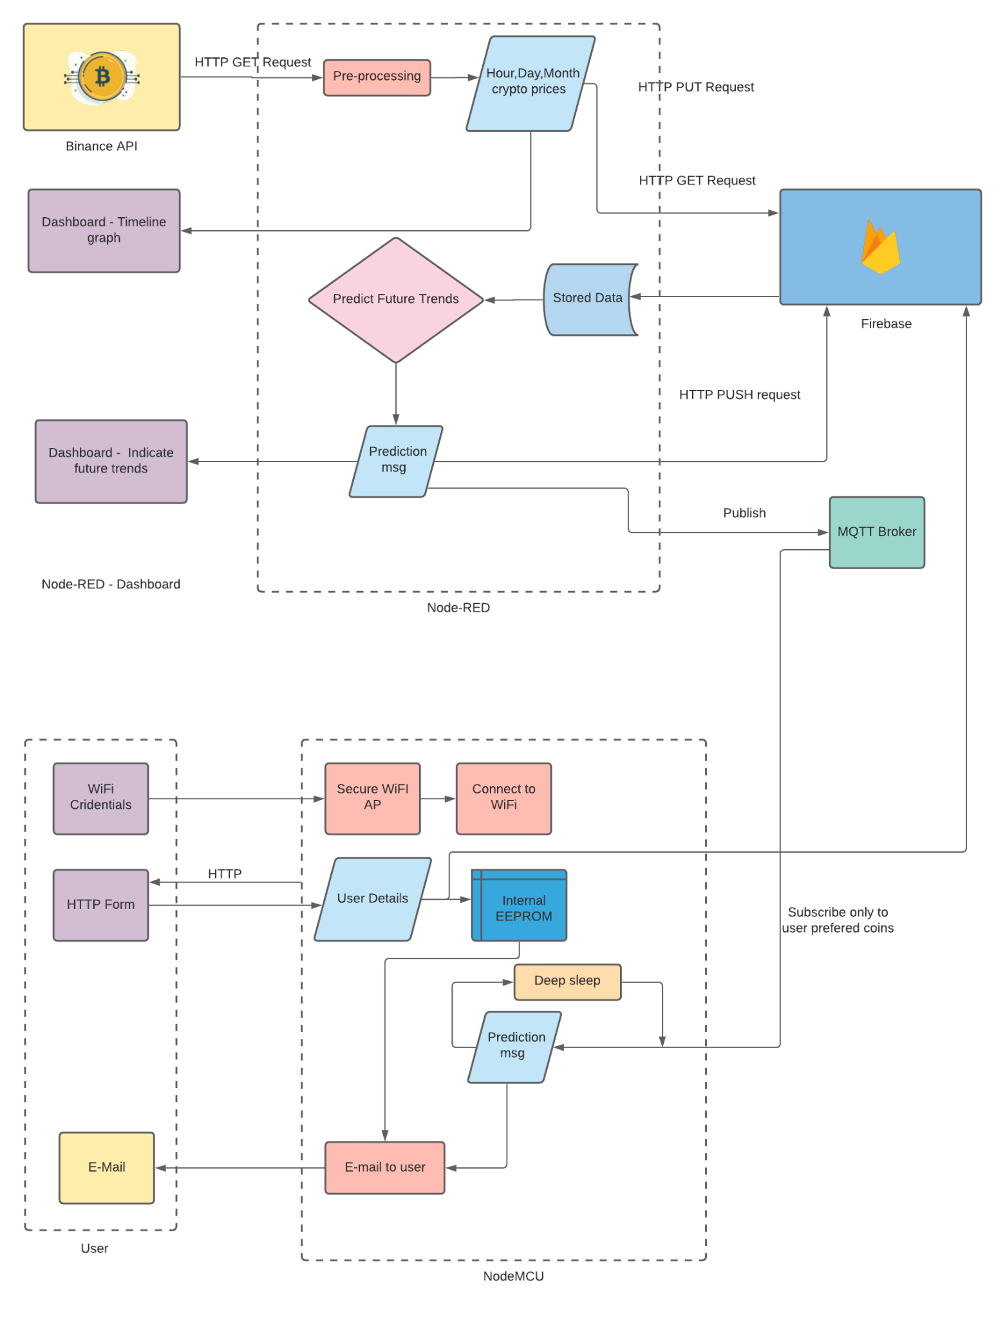
System Overview
IoT based cryptocurrency adviser system.
Notify user with their preferred crypto currency updates.
Dashboard for detailed view of the system users, Updates and Plots

Slide 3
Data Source
Inbuilt Node-Red Node for Binance REST API
Values of ten most prominent Cryptocurrencies right now
Bitcoin, Ethereum
Litecoin, Cardano
Polcadot, Bitcoin Cash
Steller, Dogecoin
Binance Coin, Monero

Slide 4
Data Input Processing
Node-Red Processing
Cryptocurrency value gathering - 5 minutes interval
Fixed Database
Last Hour data - 12 points
Last Day data - 24 points
Last Month data - 30 points
Update Database using REST API- 5 minutes interval

Slide 5
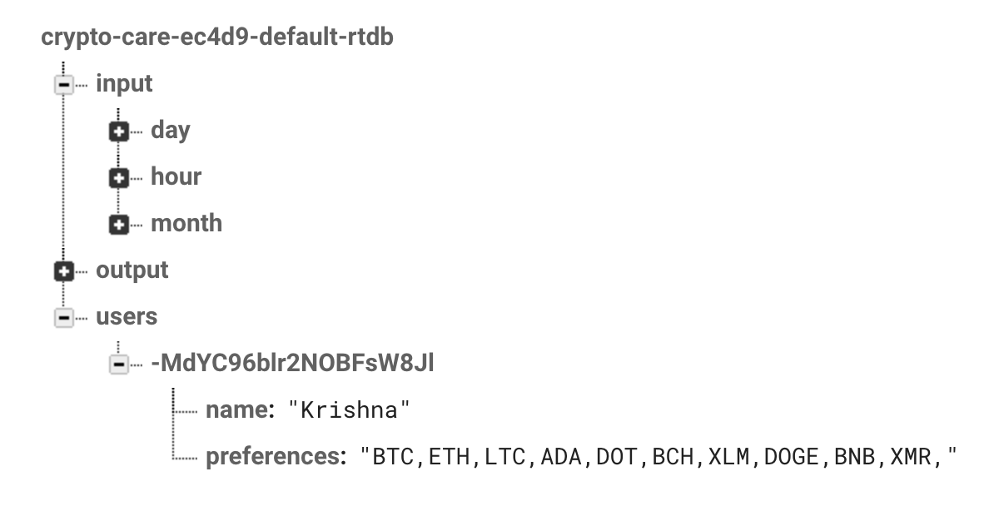
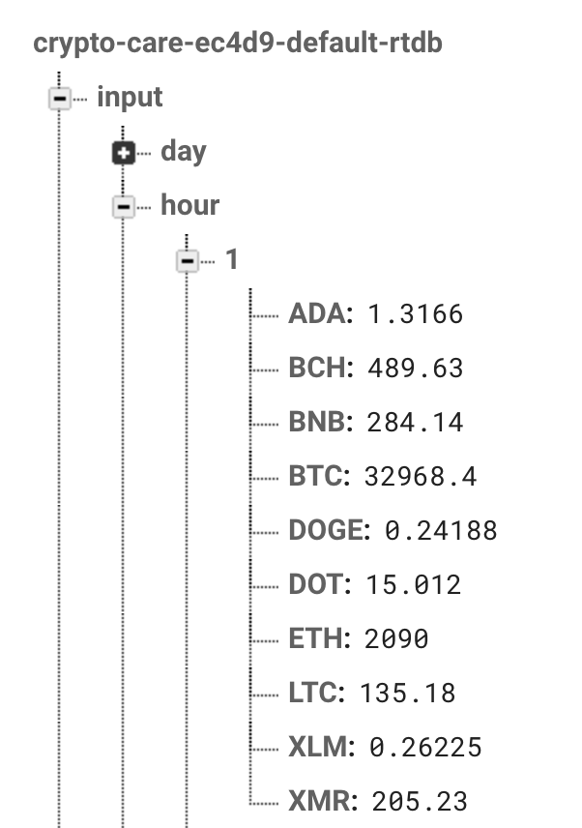
Database
Firebase RTDB is used
Collect current currency values in 5 min interval
Stored data
Last hour, Last Day and Month values calculated and stored.
Predicted Message
User preference data from ESP32.

Slide 6
Decision Making
Get Updated data from Firebase Realtime Database
Separate Linear Regression for Hour, Day and Month Data and currency
Predict Hike/ Fall of price in next 5 minutes, next hour and next day
MQTT based publishing for profitable currencies
Update last profitable predictions on Database using REST API

Slide 7
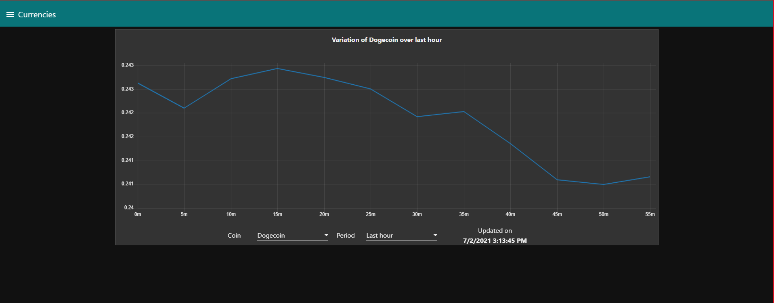
Node-red Dashboard
Crypto-Currency values with Time

Slide 8
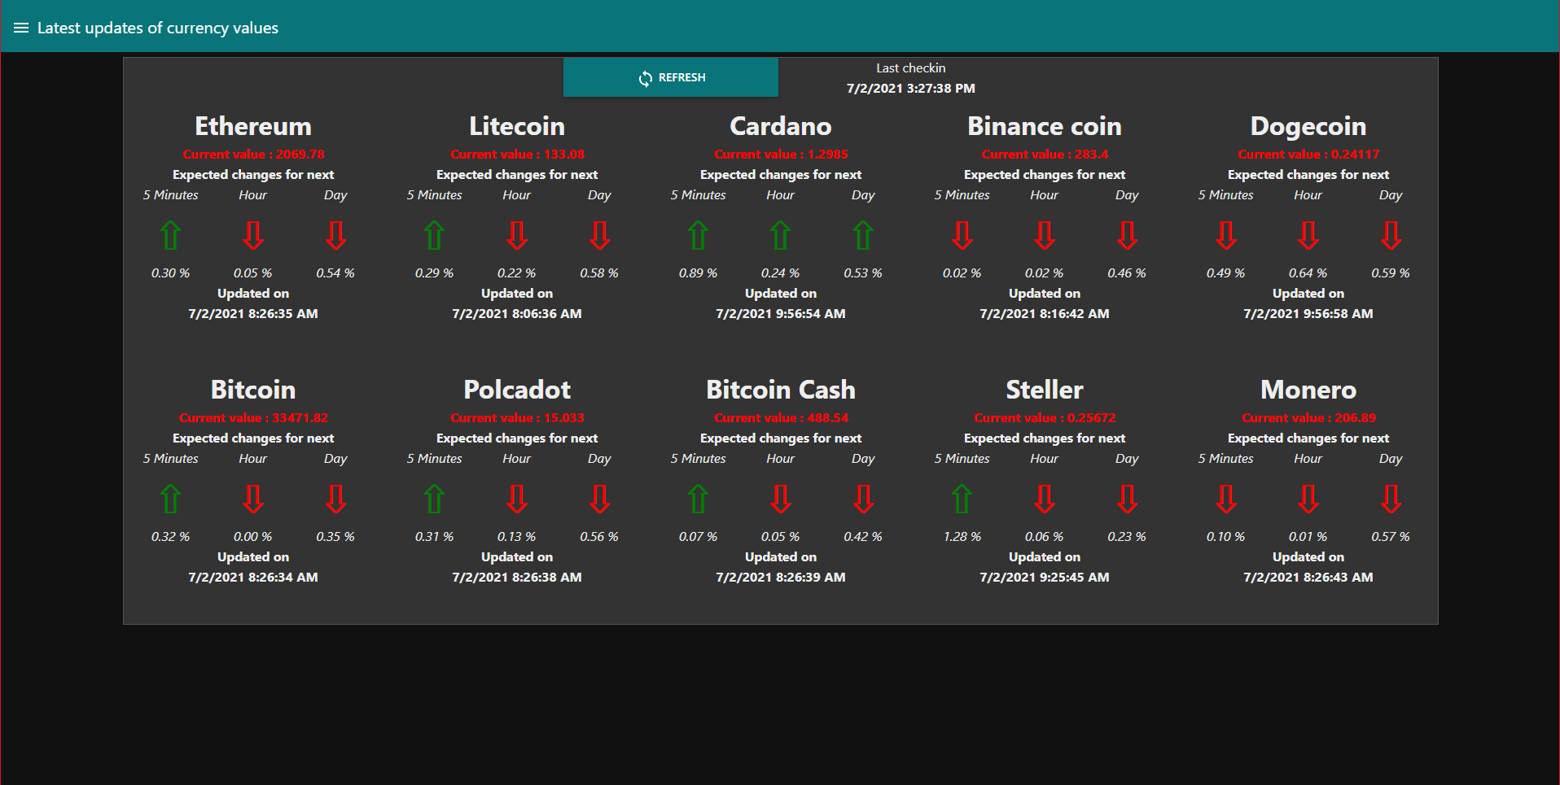
Latest Currency Updates

Slide 9
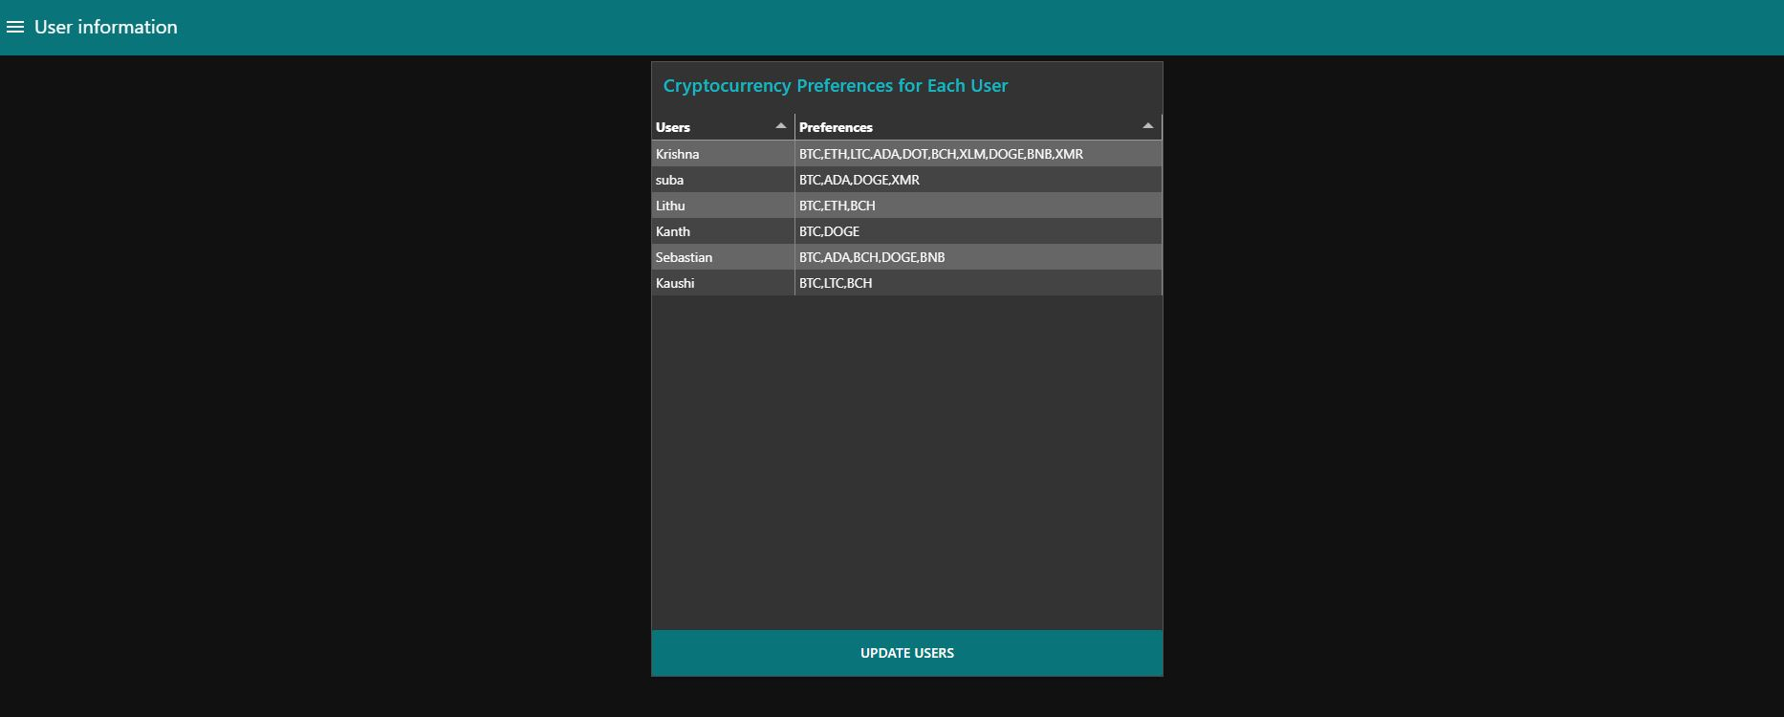
User Information

Slide 10
HTTP based Wifi Authentication and User Details gathering
Each user is provided with their own Node-MCU device
Used Wificlient library to avoid hardcoding the credentials
Async Web Server from ESP32 as AP to add credentials
Async Web Server to serve User Details form
Gathered details stored in EEPROM

Slide 11
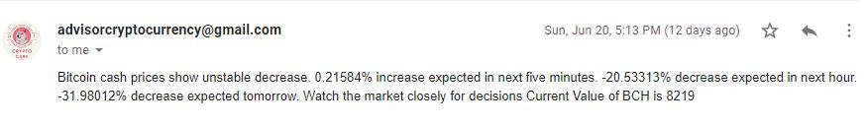
Email Notifications
Gets user details upon wakeup
MQTT Client Subscribes to topics
MQTT Client in ESP32 awaits updates on subscribed topics
Creates instant SMTP server and sends EMAIL to respective user

Slide 12
Power Saving Features
Used deep sleep mode of ESP32
Deep sleep time - 270 seconds
Automatically Synchronize after receiving first subscription topic value
Goes to sleep after sending Emails
Wakes up using internal clock for next publication

Slide 13
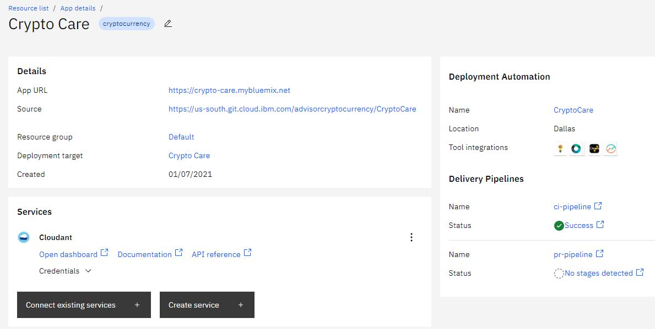
Hosting
A single Node-Red instance
Hosted in IBM Cloud
Uses Cloud Foundry for Application Delivery
Access URL - https://crypto-care.mybluemix.net/
App Details -

Slide 14
Demo Time

