Slide 1







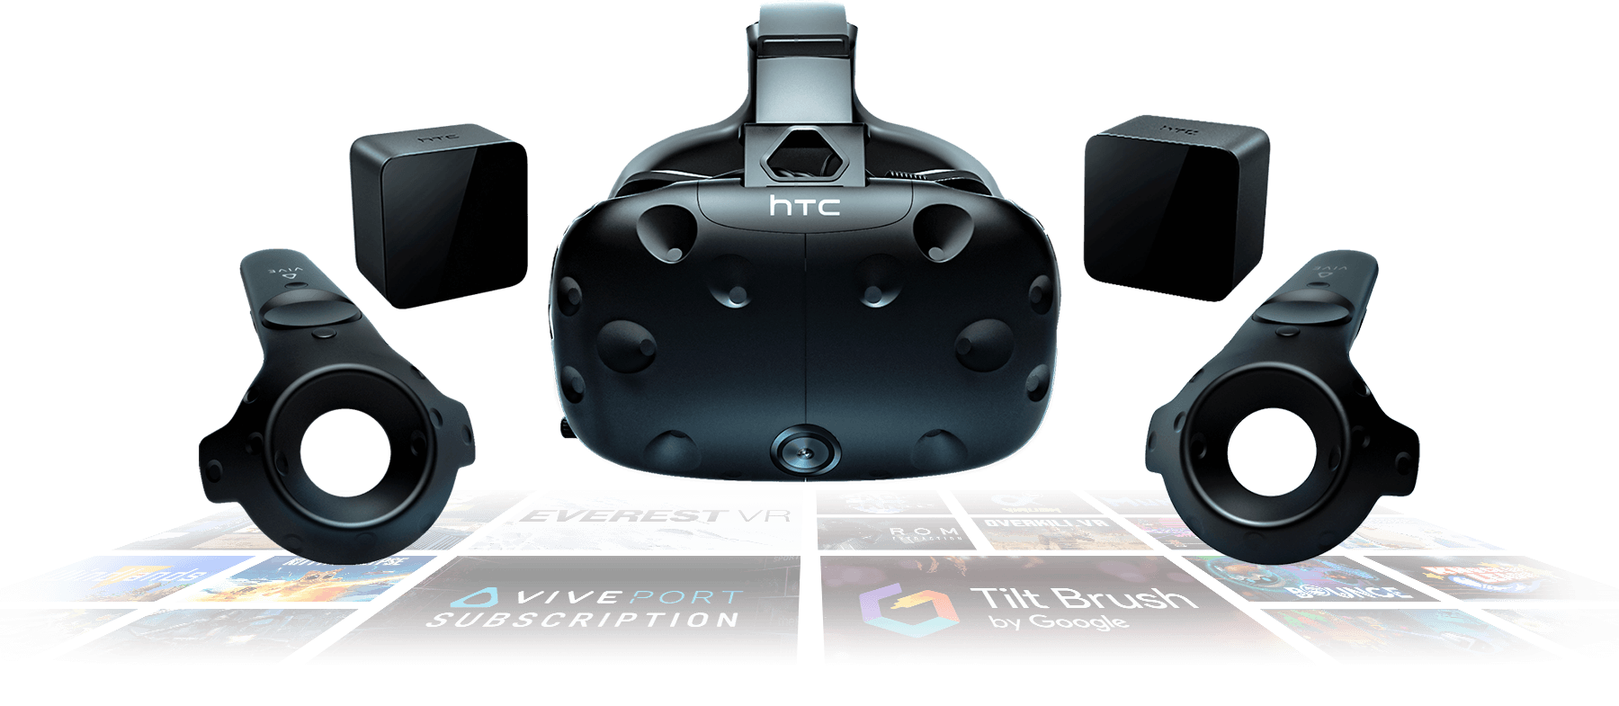
The Lab 2
An Educational Tool Within Virtual Reality
Shankly Richard Cragg (shc27)
Aim of the Project
Virtual Reality is an exciting, adventurous medium, with great potential in the educational landscape [1]. This project aims to make use of 3 key facets of the world of Virtual Reality; Dangerous or expensive settings, difficult or impossible to recreate in the real world, and use of gameplay elements to enhance feedback. With inspiration from existing titles including Valves “The Lab”, and “Job Simulator”, this project looks into giving the experience of a Steam Engine Fireman to the user.
Progress
Initial work was done into interaction methods, forms of feedback, and sense of scale, perspective and immersion within the virtual reality realm. Unlike normal video game experiences, Virtual Reality must contend with totally new form of interaction and feedback when compared to traditional means. The idea of a “User Interface” goes against the idea of really being transported to another place, and as such means of feedback must exist naturally in the world we are creating.
The Unity asset store features a plethora of free, high quality assets to give the scenes a look and feel fitting of the environment. However, the creation of my own objects using a tool such as Blender has shown to be necessary for simple features not found on either the Unity Game Engine itself or the asset store. A hollow cylinder, as a coal spawning shoot was created in Blender, and imported into Unity for use in my project currently.
After a lengthy and prosperous experimentation phase, work has begun on the complete idea of the Steam Engine Fireman. With 3 core gameplay elements working to create a gameplay loop:
Most classically, shovelling coal into the furnace, to provide fuel for the train.
Using water to maintain the engine at an appropriate temperature
Maintenance of mechanical/physical objects in the engine room.
Technical Information
The game is being developed in Unity3D. The hardware designed for is the HTC Vive. For creating custom assets, a tool called “Blender” is used.
Unity utilises C# as its programming language, and makes use of a design pattern called the “Object Component Design Pattern” [2].
An important consideration of virtual reality is keeping the FPS (Frames Per Second) above an acceptable level. This is an incredibly important consideration when it comes to the number of object within the scene. As such great care is taken to ensure only as many elements with rigidbodies and physics colliders exist as necessary.
Remaining Work
The remaining work is focussed on completing the rest of the interaction left, and adding textures and scenery to create a more immersive experience.
The spawning, and pouring of the cooling water into the system to reduce the engine temperature needs to be implemented.
It will have to be seen how “realistic” the water ends up being, as fluids are a notoriously difficult thing to simulate [3]. A more stylized, cartoony method that makes sense within the world built will probably be used.
Future Work
With respect to carrying on this product for a full-fledged release, the most important carry on would be to improve the quality and detail of the immersive, world building elements. With a focus on textures and scenery, work on the graphical side of the project, as opposed to the coding side of the project, would put the polish expected to meet the demands of an audience used to triple A products with professional artists working on items full time.
Expanding on the list of jobs you can complete related to the train would be a fun way to expand the product too, with possibilities of being the driver or the server. These would allow for similar experiences, with the gameplay focus maintaining the idea of balancing 2 or more ever changing variables.
Further Information
[1] N. E. Seymour, A. G. Gallagher, S. A. Roman, M. K. O'Brien, V. K. Bansal, D. K. Andersen and R. M. Satava, "Virtual reality training improves operating room performance: results of a randomized, double-blinded study.," Annals of surgery, vol. 236, no. 4, pp. 458-63; discussion 463-4, 10 2002. [2] Robert Nystrom, "Component · Decoupling Patterns · Game Programming Patterns," [Online]. Available: http://gameprogrammingpatterns.com/component.html. [3] R. Bridson, Fluid Simulation for Computer Graphics, Second Edition., CRC Press, 2015, p. 269.
Image Source: https://www.vive.com/us/product/vive-virtual-reality-system/

