Slide 1
SPAM
SPAM MAIL PREDICTION
using Machine Learning
Shashank Deshmukh
AI & ML Internship | Naviotech Solutions Pvt Ltd
Guide: Mr. Md. Ameen
Bharati Vidyapeeth (Deemed to be University)
Notes:
Introduce yourself, the company and the guide. This is my second internship project after Customer Churn Prediction. The goal: a model that decides whether an SMS is spam or ham.

Slide 2
Problem Statement
Given a text message, automatically decide whether it is SPAM or HAM (legitimate).
1
2
3
Wastes time
Costs money
Security risk
Users sort junk to find real messages
Premium-rate numbers and extra network load
Phishing links and fake prize scams
Binary text classification: input = free-form message, output = spam (1) or ham (0).
Notes:
Explain why spam is a problem: wastes time, costs money, and phishing is a security risk. Rules get outdated, so we let the machine learn the patterns from labelled examples.

Slide 3
Objectives
Understand the dataset and the spam / ham imbalance
Clean and pre-process the raw text
1
2
Convert text to numbers with TF-IDF
Train and compare 4 classifiers
3
4
Evaluate with accuracy, precision, recall, F1, ROC-AUC
Analyse errors; save the model and predict new messages
5
6
Notes:
Read each objective briefly. Mention that we compare 4 models and also analyse the errors.

Slide 4
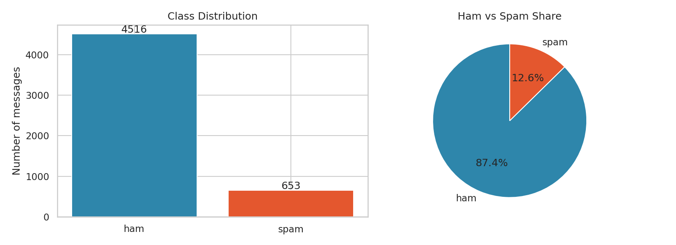
Dataset: SMS Spam Collection
5,169
4,516
unique messages
ham (87.4%)
653
71 vs 138
spam (12.6%)
avg characters: ham vs spam
Source: UCI ML Repository. Two columns: label (ham/spam) and message (text). No missing values; 403 duplicates removed.
Notes:
5,572 raw messages, 403 duplicates removed so the same message cannot appear in both train and test. Only about 13% are spam, so accuracy alone is misleading - that is why we use precision, recall and F1.

Slide 5
Methodology
1
2
3
4
5
6
Load data
Clean text
TF-IDF
Split
Train
Evaluate
pandas, remove duplicates
lowercase, tokens, stop-words
unigrams + bigrams
80% train / 20% test
4 classifiers
6 metrics + CV
Tools: Python, pandas, scikit-learn, matplotlib, seaborn, Google Colab
Notes:
Walk through the pipeline left to right. Stress that the same cleaning and TF-IDF steps are reused for new messages.

Slide 6
Text Pre-processing and TF-IDF
BEFORE
Free entry in 2 a wkly comp to win FA Cup final tkts 21st May 2005. Text FA to 87121 to receive entry question(std txt rate)T&C's apply 08452810075over18's
AFTER
free entry 2 wkly comp win fa cup final tkts 21st 2005 text fa longnumber receive entry questionstd txt ratetcs apply longnumber over18s
Cleaning: lowercase, URL and long-number tokens, remove punctuation and stop-words
TF-IDF: weight = term frequency x log(N / df); unigrams + bigrams, 5,476 features
No stemming: spam spellings like 'wkly' and 'txt' are useful signals
Notes:
Show the before/after example. Explain TF-IDF: a word gets a high weight if it is frequent in the message but rare across all messages, like 'prize'. Bigrams capture phrases like 'free entry'.

Slide 7
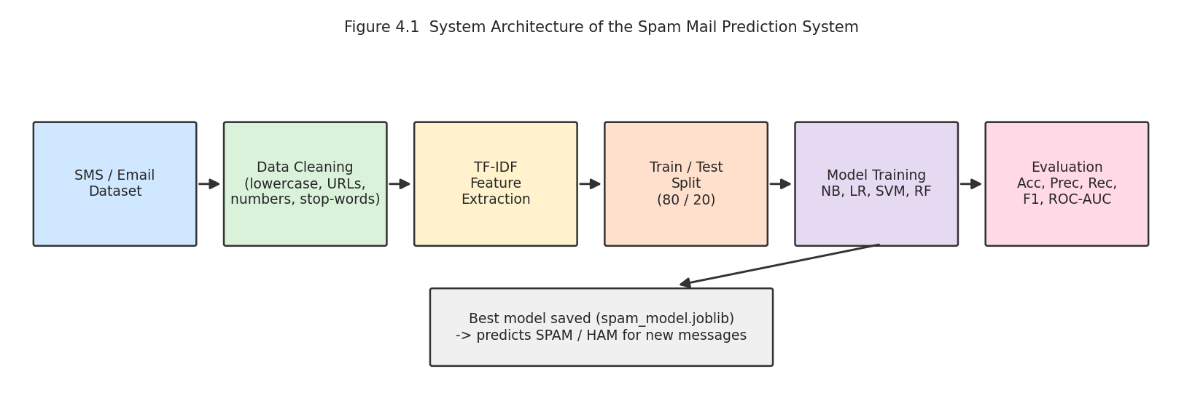
Model Architecture
Naive Bayes
Logistic Regression
Linear SVM
Random Forest
word probabilities, alpha = 0.1
linear + sigmoid, C = 10
max-margin boundary, C = 1
200 voting trees
Notes:
Each model is a scikit-learn Pipeline: TF-IDF then classifier. Using a pipeline prevents data leakage because TF-IDF is fitted only on training data.

Slide 8
Results: Model Comparison
BEST MODEL
Naive Bayes
Accuracy 98.74%
Precision 98.36%
Recall 91.60%
F1-score 94.86%
ROC-AUC 0.9905
Notes:
All models are close because TF-IDF separates the classes well. Random Forest has perfect precision but the lowest recall. Naive Bayes has the best F1 and accuracy, and is fastest, so it is selected.

Slide 9
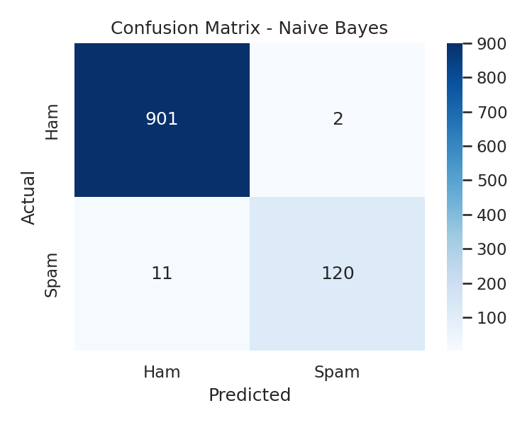
Results: Confusion Matrix
2 of 903
120 of 131
genuine messages wrongly blocked
spam messages caught
Ham recall 99.78%: genuine messages almost never blocked
Spam precision 98.36%: flagged spam is almost always real
Spam recall 91.60%: 11 missed, mostly spam written like friendly chat
Notes:
Only 2 genuine messages were blocked out of 903. 11 spam messages were missed out of 131. False positives matter most in a spam filter, because a genuine bank alert might be hidden.

Slide 10
Results: Stability and Key Words
Strongest SPAM words
claim, prize, won, guaranteed, awarded, ringtone, landline, longnumber, urltoken
Strongest HAM words
ill, lor, da, later, lol, thats, doing, really, sure
Spam is about twice as long as ham on average.
Notes:
Five-fold cross-validation shows the score does not depend on one lucky split. The top spam words match real scams: prizes, claims, guaranteed offers, premium numbers.

Slide 11
Final Prediction Output
Congratulations! You have won a free iPhone. Click http://win-prize.com now to claim
SPAM
Hey, are we still meeting for lunch at 1 pm tomorrow?
HAM
URGENT! Your account is suspended. Call 09061701461 to claim your 1000 pound cash prize
SPAM
Please send me the internship report draft by evening
HAM
Notes:
These messages are not in the dataset. The model labels the two scams as SPAM and the two normal messages as HAM.

Slide 12
Conclusion
Naive Bayes + TF-IDF reached 98.74% accuracy and 98.36% spam precision
Only 2 genuine messages blocked out of 903 in the test set
Cross-validation mean accuracy 98.59%: the result is stable
Data cleaning and good features mattered more than model complexity
Accuracy alone misleads on imbalanced data; precision, recall and F1 tell the full story
Notes:
Summarise: Naive Bayes + TF-IDF reached about 98.7% accuracy. Data preparation mattered more than the algorithm. Always look at precision and recall for imbalanced data.

Slide 13
Future Scope
Deep learning
Richer features
Multilingual data
LSTM / BERT for context
length, capitals, digits, symbols
Hindi and Hinglish spam
Web app / API
Continuous learning
Explainability
Streamlit or Flask demo
retrain on user-reported spam
LIME / SHAP word-level reasons
Notes:
Most errors are spam written like friendly chat. Context-aware models such as BERT, plus hand-made features, can help. Hindi/Hinglish spam is common in India, so multilingual data is a natural next step.

Slide 14
Thank You
Questions?
Shashank Deshmukh | Naviotech Solutions Pvt Ltd | Guide: Mr. Md. Ameen

