Slide 1
AI & ML INTERNSHIP PROJECT
Customer Churn Prediction
using Machine Learning
Presented by: Shashank Deshmukh
Guide: Mr. Md. Ameen
NAVIOTECH SOLUTIONS PVT LTD

Slide 2


01 — THE BUSINESS QUESTION
Customer churn is costly and predictable
Revenue at risk
Retention matters
Telecom customers can switch providers easily, putting recurring revenue at risk.
Retention is cheaper than acquiring a new customer.
26.54%
Predict early
Churn, creating an imbalanced classification problem.
Predict churn from account and service data.
Account and service data can reveal who is most likely to leave.
Customer Churn Prediction using Machine Learning
2

Slide 3
02 — PROJECT SCOPE
Objectives: build, compare, and explain
A complete workflow from dataset understanding to interpretable model results.
01
02
03
Explore
Prepare
Compare
Explore and understand the Telco Customer Churn dataset.
Clean, encode, scale, and split the data.
Compare Logistic Regression, Random Forest, and Gradient Boosting.
04
05
Evaluate
Explain
Evaluate accuracy, precision, recall, F1-score, and ROC-AUC.
Identify the factors most associated with churn.
Customer Churn Prediction using Machine Learning
3

Slide 4
03 — DATASET
The dataset captures customers, services, and contracts
Telco Customer Churn dataset from Kaggle / IBM · 18 object, 2 integer, 1 float columns · 0 reported missing values; 11 blank TotalCharges
7,043
21
1,869
5,174
customers
columns
churned · 26.54%
stayed · 73.46%
Group | Examples
Demographics | Gender, senior citizen, partner, dependents
Services | Phone, internet, security, support, streaming
Account | Tenure, contract, payment, monthly and total charges
Target | Churn: Yes / No
Customer Churn Prediction using Machine Learning
4

Slide 5
04 — FEATURE ENGINEERING
Preprocessing turns raw fields into model-ready features
The transformation preserves signal while making mixed fields usable for machine learning.
01
Convert TotalCharges to numbers; fill 11 blanks with the median.
02
Drop customerID and encode Yes = 1, No = 0.
03
One-hot encode 19 categorical attributes; the final feature count is 30 after preprocessing.
04
Use a stratified 80/20 split: 5,634 train, 1,409 test.
05
Standard-scale inputs for Logistic Regression.
Customer Churn Prediction using Machine Learning
5

Slide 6
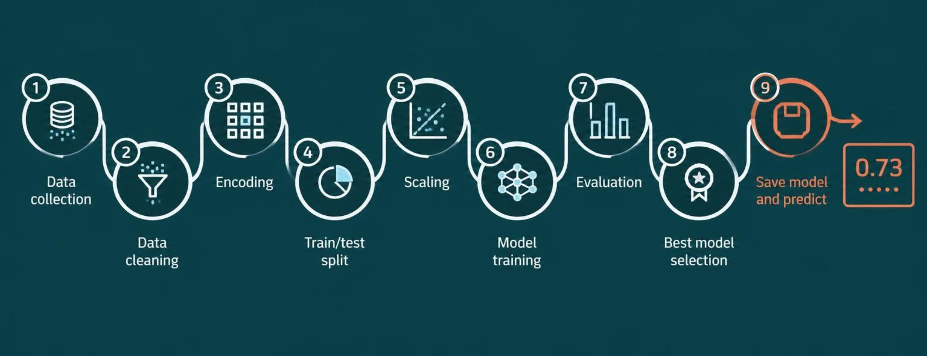
05 — END-TO-END PIPELINE
Methodology: from raw data to a saved predictor
Customer Churn Prediction using Machine Learning
6

Slide 7
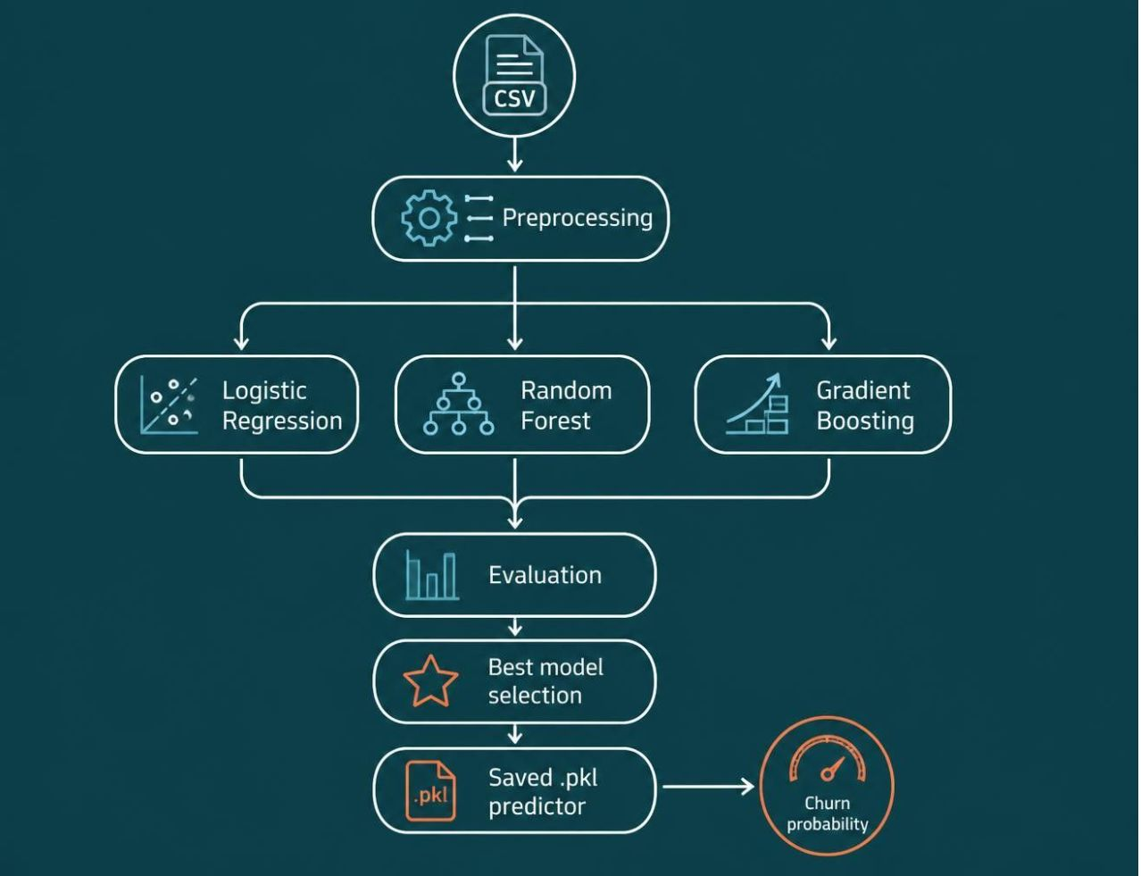
06 — MODEL DESIGN
Three models create a practical comparison
Logistic Regression
Linear baseline with balanced class weights.
Random Forest
300 trees with balanced class weights.
Gradient Boosting
Sequential trees correct earlier errors.
Implemented in Python on Google Colab using pandas, scikit-learn, Matplotlib, and Seaborn.
Customer Churn Prediction using Machine Learning
7

Slide 8
07 — EVALUATION FRAME
Accuracy alone misses the churn problem
Metric | Meaning
Accuracy | Overall correct predictions
Precision | Predicted churners who really churned
Recall | Real churners successfully caught
F1-score | Balance of precision and recall
ROC-AUC | Ranks churners above non-churners
Because 73% of customers stay, accuracy alone can be misleading.
Customer Churn Prediction using Machine Learning
8

Slide 9
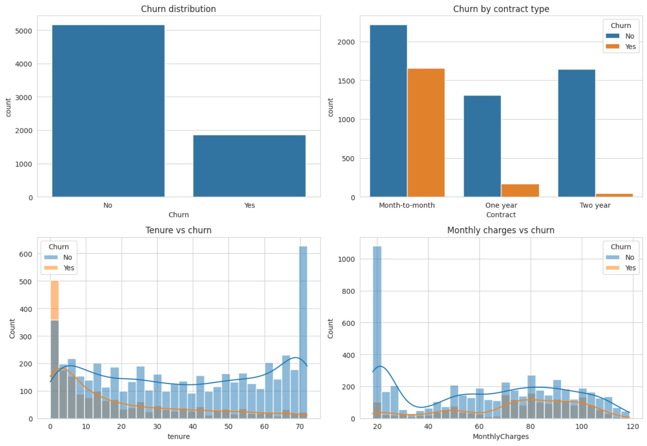
08 — FEATURE SIGNALS
Contract length is the clearest churn signal
42.7%
Month-to-month churn
18 months
Churners' average tenure: 74.44 monthly charges
37.6 months
Retained customers' average tenure: 61.27 monthly charges
Additional callouts: fibre-optic churn 41.9%; electronic-check churn 45.3%.
Customer Churn Prediction using Machine Learning
9

Slide 10
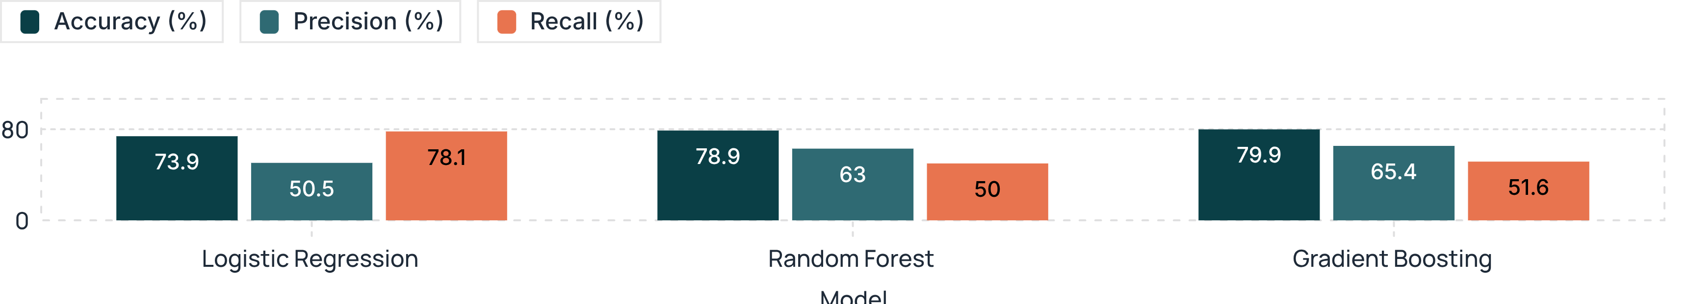
09 — MODEL RESULTS
Gradient Boosting leads overall performance
Gradient Boosting wins overall; Logistic Regression catches the most churners.
Model | Accuracy | Precision | Recall | F1 | ROC-AUC
Logistic Regression | 73.9% | 50.5% | 78.1% | 61.3% | 0.841
Random Forest | 78.9% | 63.0% | 50.0% | 55.7% | 0.825
Gradient Boosting | 79.9% | 65.4% | 51.6% | 57.7% | 0.843
Customer Churn Prediction using Machine Learning
10

Slide 11
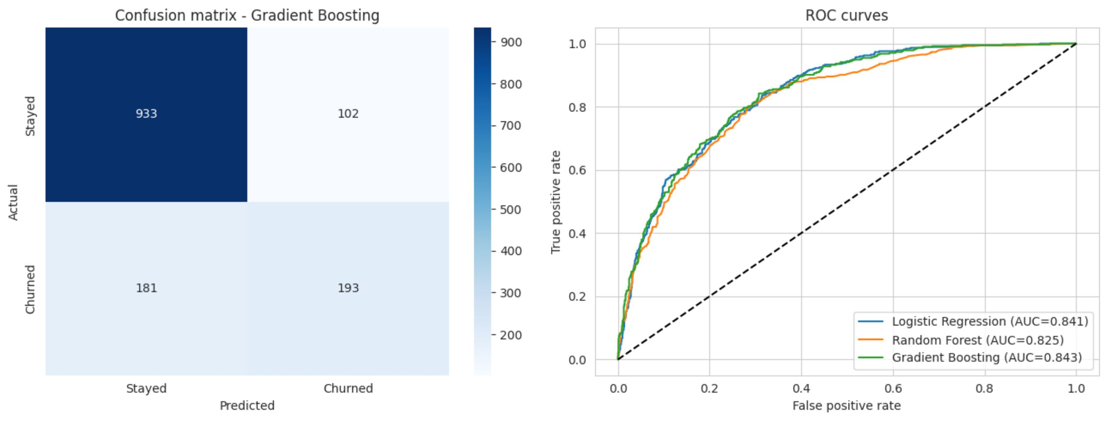
11 — RESULTS: BEST MODEL DETAILS
Gradient Boosting catches churners with fewer false alarms
Confusion matrix for Gradient Boosting on the test set, and ROC-AUC for the three main models.
When the model flags a customer as likely to churn, it is right about 2 out of 3 times.
Customer Churn Prediction using Machine Learning
11
Notes:
Explain the matrix: 193 churners caught, 181 missed, 102 false alarms.

Slide 12
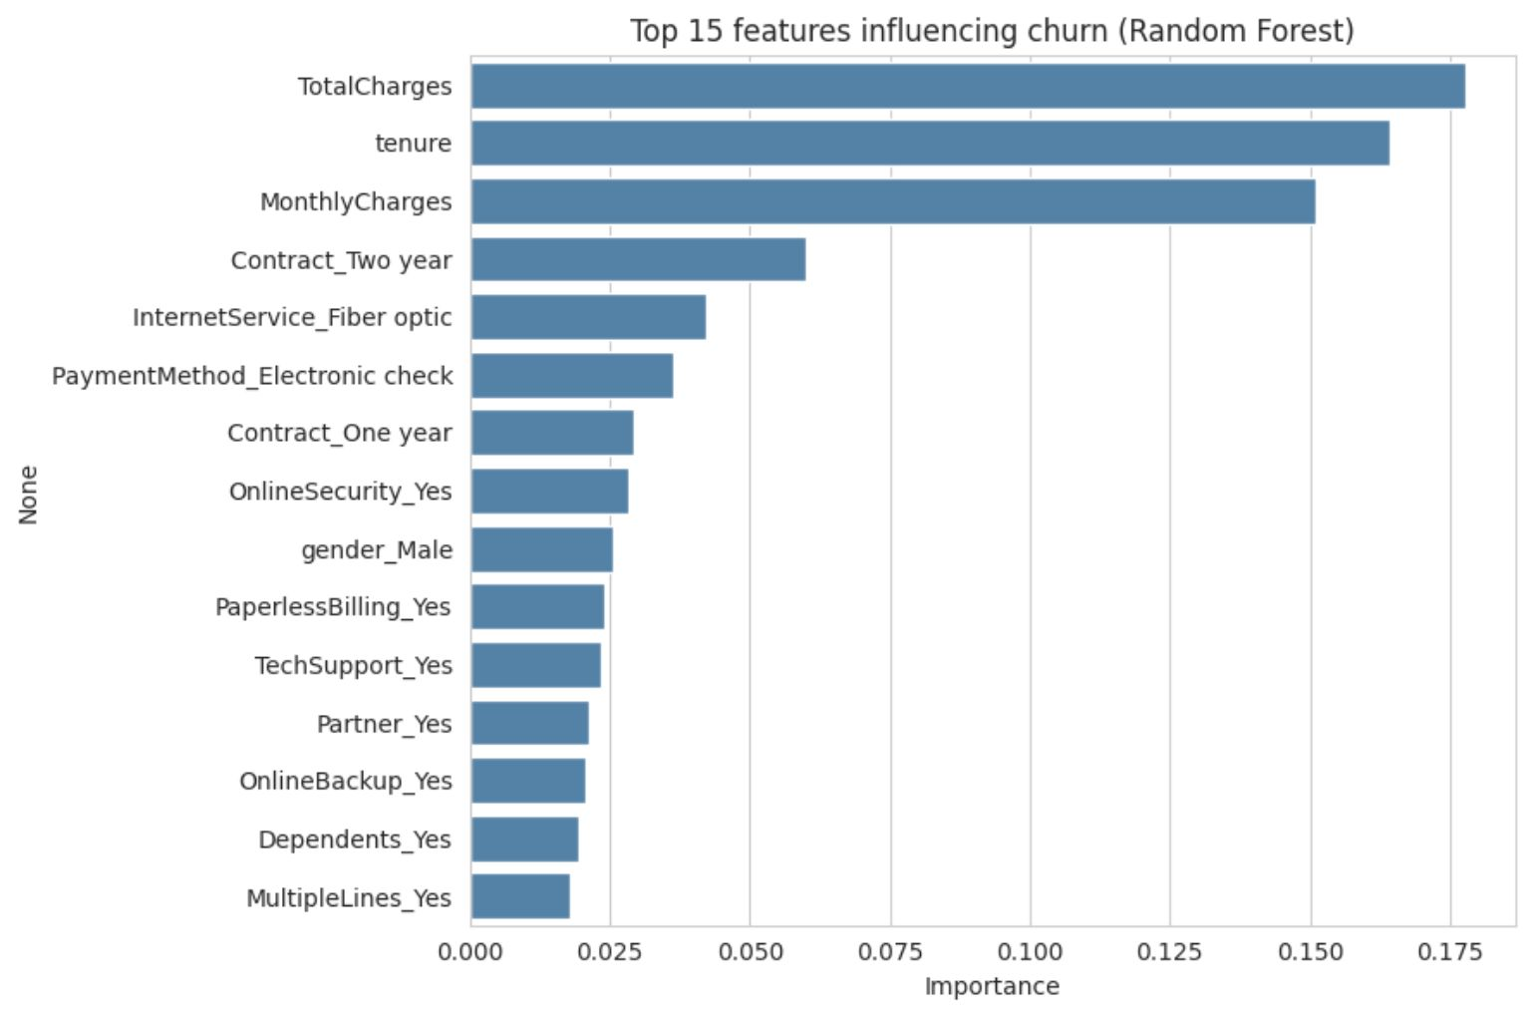
12 — WHAT DRIVES CHURN
Price, tenure and contract shape who leaves
Top features from the model, and the business actions they suggest.
Business actions
Offer incentives to move month-to-month customers to longer contracts
Focus on new customers in their first months
Encourage automatic payments
Bundle tech support and online security
Customer Churn Prediction using Machine Learning
12

Slide 13
13 — CONCLUSION
A complete churn pipeline with a clear winner
Built a complete ML pipeline for churn prediction on Google Colab
Gradient Boosting achieved 79.9% accuracy and 0.843 ROC-AUC
Logistic Regression had the highest recall at 78.1%, useful when missing a churner is costly
Model and scaler saved for new customers
Limitations: a small single dataset and no hyperparameter tuning
79.9%
Gradient Boosting accuracy
0.843
Gradient Boosting ROC-AUC
78.1%
Logistic Regression recall
Customer Churn Prediction using Machine Learning
13

Slide 14
14 — FUTURE SCOPE AND THANK YOU
Next steps for a stronger churn model
Hyperparameter tuning and cross-validation
XGBoost, SMOTE and threshold optimization
SHAP explainability
Streamlit web app or API for live predictions
Usage and complaint data
Thank you — Questions?
Shashank Deshmukh
Email: shashankdeshmukh202@gmail.com
Github Repo: https://github.com/Shanky2003/customer-churn-prediction?tab=MIT-1-ov-file
Customer Churn Prediction using Machine Learning
14

