Slide 1

Implementation and Performance Analysis of OpenCL Programming Model on GPU and FPGA
Md Maruf Hossain - 801036549
Sowmya Suresh Chander - 800963593
Shanmathi Rajasekar - 800966697

Slide 2

OUTLINE
Objective
Introduction
Resources
Applications used
Results:
-Run Time - CPU Vs GPU Vs FPGA
-Speedup - GPU Vs FPGA
-Resource Utilization of FPGA
-Power on FPGA
Conclusion

Slide 3
OBJECTIVE
The main aim of the project is to implement OpenMP codes on CPU and OpenCL codes on GPU ,FPGA and compare the performance on 6 benchmarks.
The performance analysis metrics:
Speedup
Power

Slide 4
INTRODUCTION
Graphic Processing Units(GPU):
Handles large amount of data
Suited for parallel applications
High Power Consumption
Field Programmable Gate Array (FPGA):
Low Power
Low Latency
Difficult to Program
OpenCL:
Standard framework for parallel programming across heterogenous processors- GPU & FPGA

Slide 5
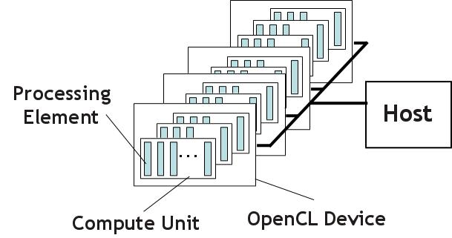
OPENCL PLATFORM MODEL
Platform model used for heterogeneous computing
Host -> CPU : controls , queries ,selects devices using OpenCL API
Device ->FPGA/GPU

Slide 6
HARDWARE PLATFORMS AND COMPILERS
Platform | Hardware | Software
GPU | NVIDIA TESLA K80 NVIDIA TESLA K20 | OpenCL Version 2
FPGA | Altera Arria 10 GX 1150 FPGA | OpenCL Version 2.0 Altera SDK Profiler Tool NSF Chameleon FPGA CLOUD
CPU | Intel 2.6GHz 16-core processor – E5-2697A V4 | GCC Compiler

Slide 7
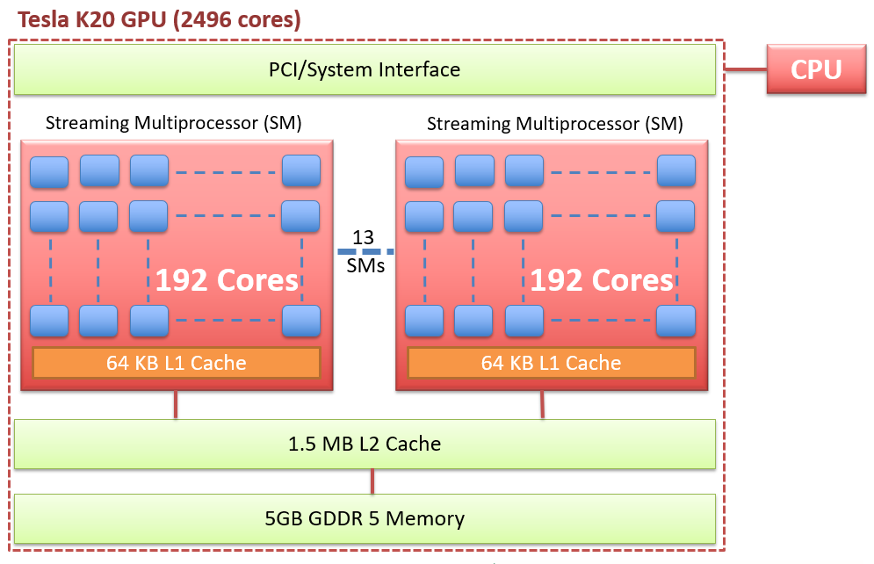
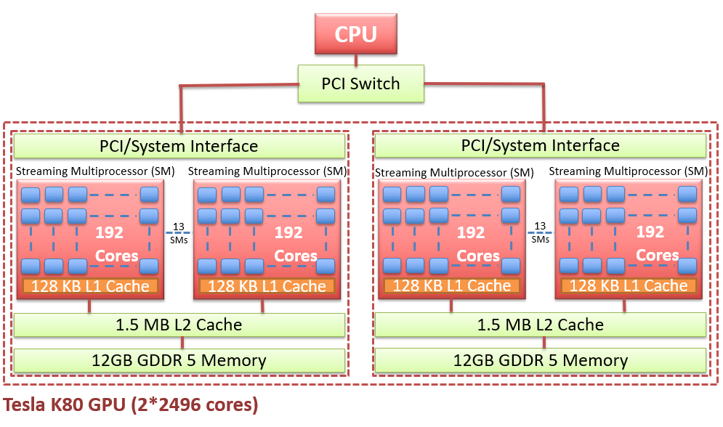
GPU K20 vs K80
Kepler architecture
Designed to provide double precision computing performance
PARAMETERS | K20 | K80
GPU chips | GK 110 | 2 GK 210
SM & cores | 13 2496 | 26 2*2496
Shared memory | 64 KB | 128 KB
Register file | 65536 | 2 *65536 /GPU

Slide 8
APPLICATIONS
KERNEL | DOMAIN | APPLICATIONS
Computational Fluid Dynamics(CFD) | Fluid Dynamics | A solver for the three-dimensional Euler equations
Pathfinder (PF) | Grid Traversal | Finds the shortest path of a 2D grid, row by row
Lower Upper Decomposition(LUD) | Linear Algebra | Parallel application for calculating a set of linear equations
K-means | Data Mining | clustering based dividing
Leukocyte | Medical Imaging | Detects and tracks rolling leukocytes in vivo video microscopy of blood vessels
Nearest Neighbor (K-nn) | Data Mining | find the k-nearest neighbours from an unstructured data set

Slide 9
LEUKOCYTE
Matrix Size | K_80(ms) | K_20 (ms) | FPGA (ms) | CPU (ms)
104448x36 | 371.83 | 2802.67 | 3845.92 | 3903.39
Time Complexity of Rodinia Leukocyte Benchmark

Slide 10
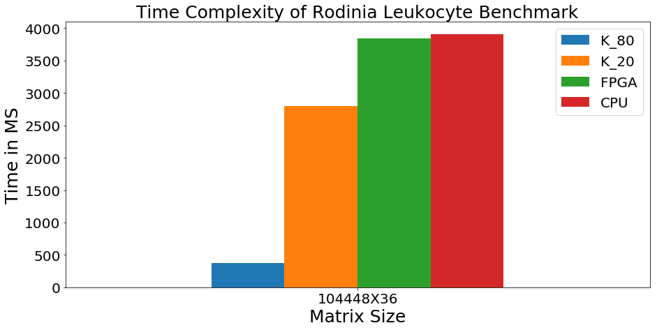
LEUKOCYTE
RUN TIME :CPU Vs GPU Vs FPGA

Slide 11
NEAREST NEIGHBOR
Matrix Size | K_80 (ms) | K_20 (ms) | FPGA (ms) | CPU (ms)
42764X10 | 270.96 | 1624.75 | 3724.9 | 270
Time Complexity of Rodinia nn Benchmark

Slide 12
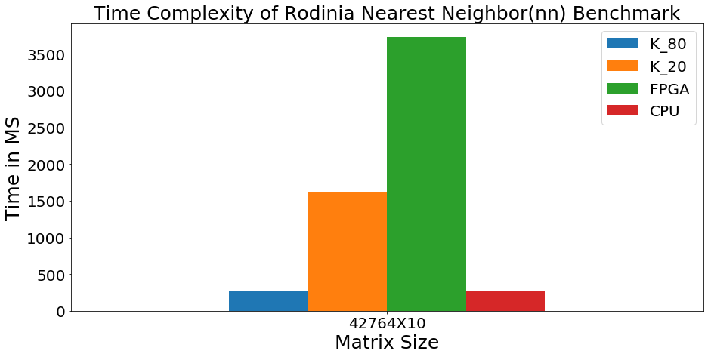
NEAREST NEIGHBOR
RUN TIME :CPU Vs GPU Vs FPGA

Slide 13
COMPUTATIONAL FLUID DYNAMICS(cfd)
Suitable for the heterogeneous system architecture.
GPU performance better than FPGA
Matrix Size | K-80(ms) | K-20(ms) | FPGA (ms) | CPU (ms)
9704X13 | 2938.75 | 5558.94 | 12523.36 | 27744.24
193474X13 | 5321.63 | 8376.63 | 22774.47 | 47518.6
232536X13 | 5931.81 | 9381.25 | 26256.49 | 81387.56
Time Complexity of Rodinia CFD Benchmark
Logic Utilization | ALUTs | Logic Register | Memory Blocks | DSP Blocks
54% | 20% | 34% | 52% | 20%
FPGA Resource Utilization cfd
Notes:
a solver for the three-dimensional Euler equations used in fluid dynamics.
We try implement cfd in three different architecture
Multicore
GPU
FPGA
And calculate their run time in these architecture that showing that CFD is more suitable in Heterogeneous system
It also reflect that the performance in GPU is better than FPGA.

Slide 14
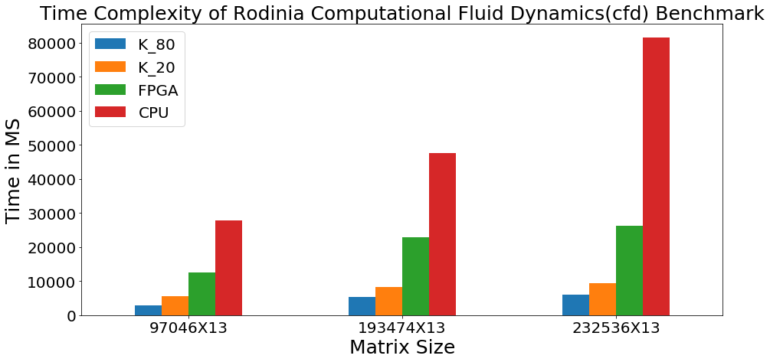
COMPUTATIONAL FLUID DYNAMICS RUN TIME: CPU Vs GPU Vs FPGA

Slide 15
PATHFINDER
Not suitable for FPGA.
CPU perform slightly better than GPU in small dataset.
GPU can do better performance in sufficiently large dataset.
Matrix Size | K-80 (ms) | K-20 (ms) | FPGA (ms) | CPU(ms)
1000X100 | 199.33 | 1931.31 | 437.18 | 43.85
1000X10000 | 554.38 | 2176.07 | 383.91 | 210.61
1000X1000 | 215.91 | 2051.25 | 4045.61 | 69.44
10000X100 | 437.4 | 2241.4 | 40646.52 | 532.95
Time Complexity of Rodinia Pathfinder Benchmark
Logic Utilization | ALUTs | Logic Register | Memory Blocks | DSP Blocks
35% | 13% | 22% | 15% | 5%
FPGA Resource Utilization for Pathfinder

Slide 16
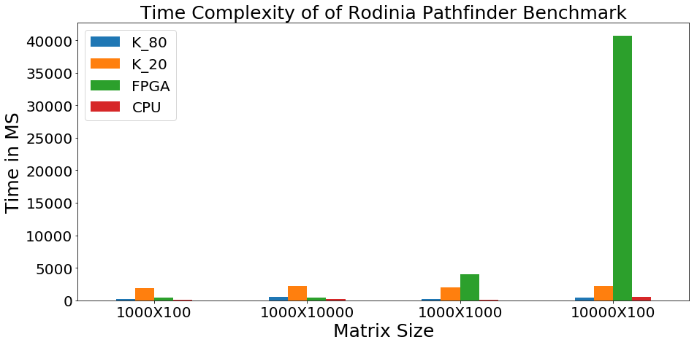
PATHFINDER
RUN TIME :CPU Vs GPU Vs FPGA

Slide 17
LOWER UPPER DECOMPOSITION
(LUD)
Size (ms) | K_80(ms) | K_20(ms) | FPGA(ms) | CPU(ms)
256X256 | 258.68 | 1927.93 | 87.17 | 4.23
512X512 | 254.52 | 1649.05 | 444.78 | 31.79
1024X1024 | 203.99 | 1660.92 | 2612.29 | 73.66
2048X2048 | 243.88 | 1731.51 | 17170.21 | 182.21
Time Complexity of Rodinia LUD Benchmark

Slide 18
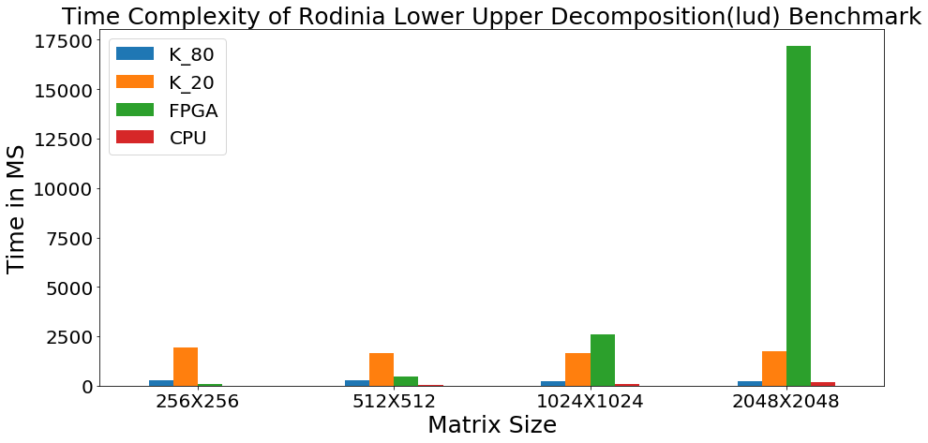
LOWER UPPER DECOMPOSITION
RUN TIME :CPU Vs GPU Vs FPGA

Slide 19
KMEANS
Size | K_80(ms) | K_20(ms) | FPGA(ms) | CPU(ms)
10000X34 | 347.54 | 2042.18 | 7019.15 | 306.81
30000X34 | 518.98 | 2394.08 | 8417.75 | 1436.91
100000X34 | 811.7 | 2722.55 | 22657.69 | 1090.38
300000X34 | 2061.03 | 4655.68 | 63302.75 | 4359.16
Time Complexity of Rodinia K-means Benchmark

Slide 20
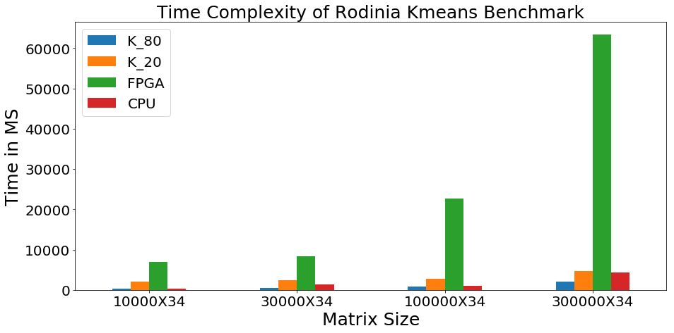
KMEANS
RUN TIME :CPU Vs GPU Vs FPGA

Slide 21
Speed Up
Speedup = Runtime GPU/Runtime FPGA
Benchmark | Program Size | GPU (ms) | FPGA (ms) | Speedup | GPU or FPGA
Leukocyte | 104448x36 | 371.83 | 3845.92 | 0.096 | GPU
K-nn | 42764x10 | 270.96 | 3724.9 | 0.072 | GPU
LUD | 256x256 | 258.68 | 87.17 | 2.96 | FPGA
K-means | 10000x34 | 347.54 | 7019.15 | 0.029 | GPU
Path Finder | 1000x100 | 199.33 | 437.18 | 0.455 | GPU
CFD | 97046x13 | 2938.75 | 12523.36 | 0.23 | GPU

Slide 22
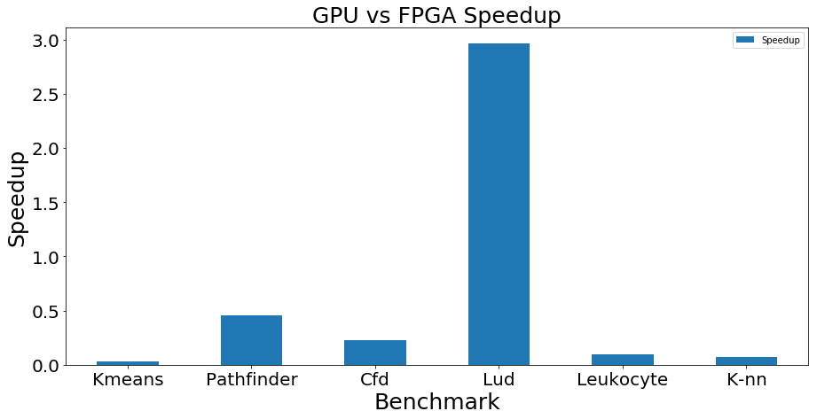
Speed Up
Speedup = Runtime GPU/Runtime FPGA
2.96
0.455
0.23
0.096
0.029
0.072

Slide 23
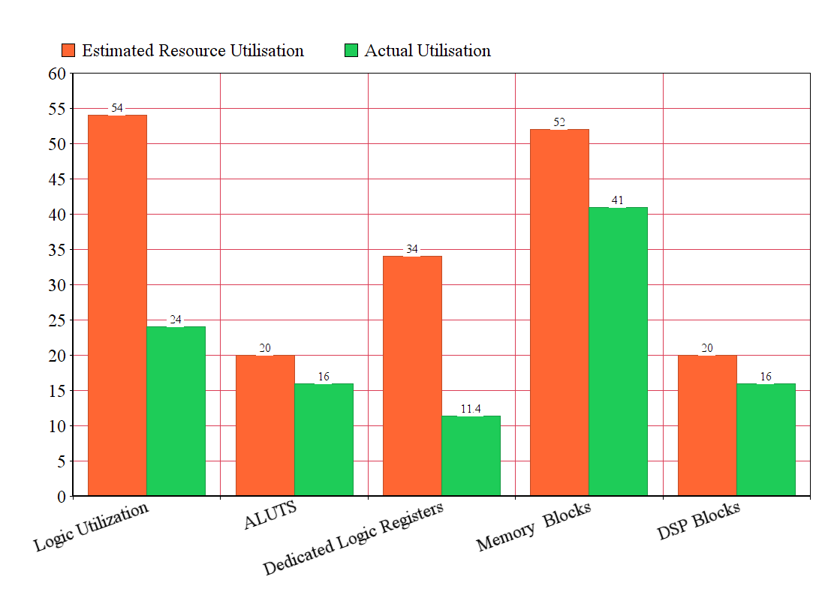
Resource Utilization
Estimated Resource Utilization
Actual Resource Utilization

Slide 24
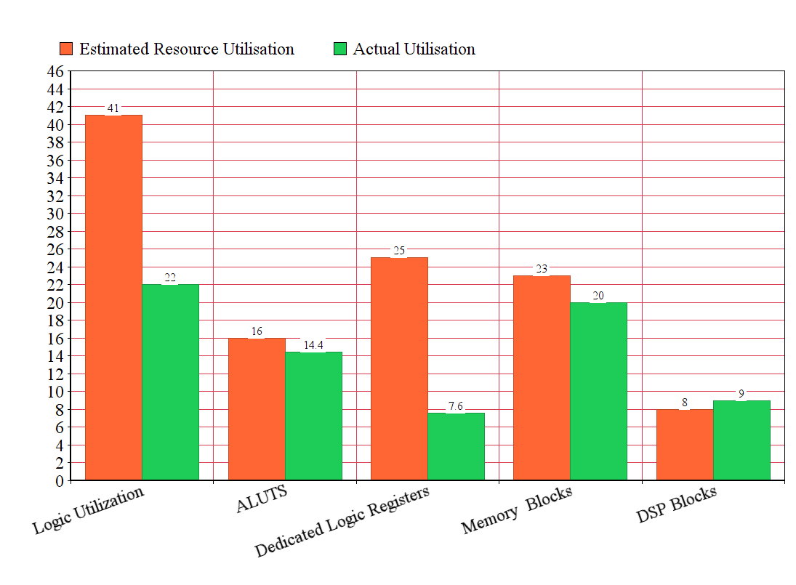
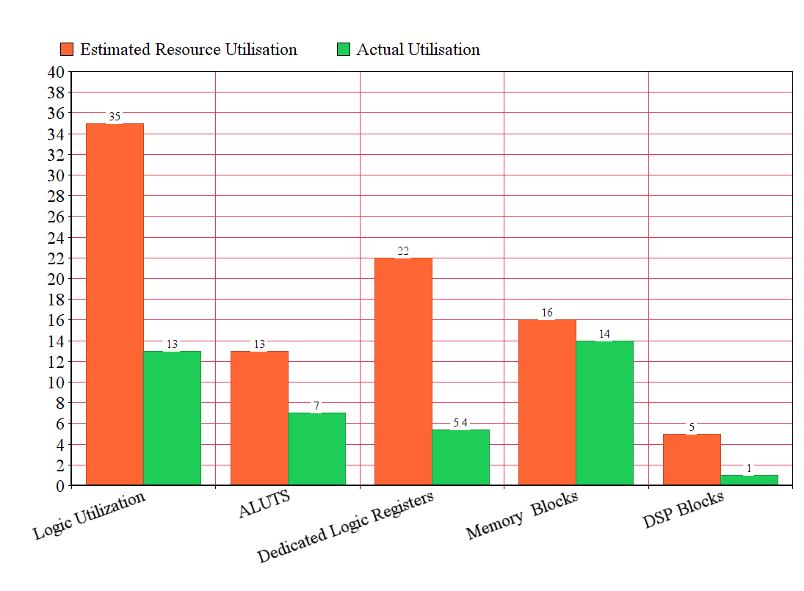
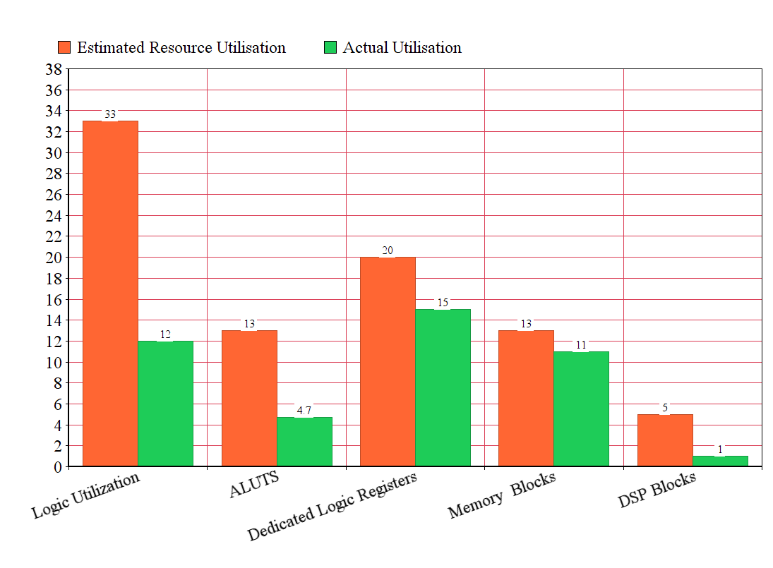
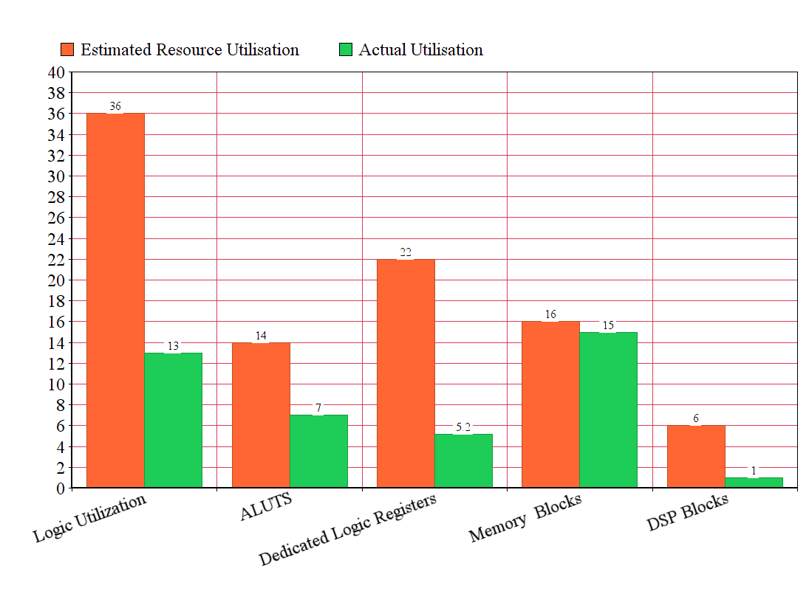
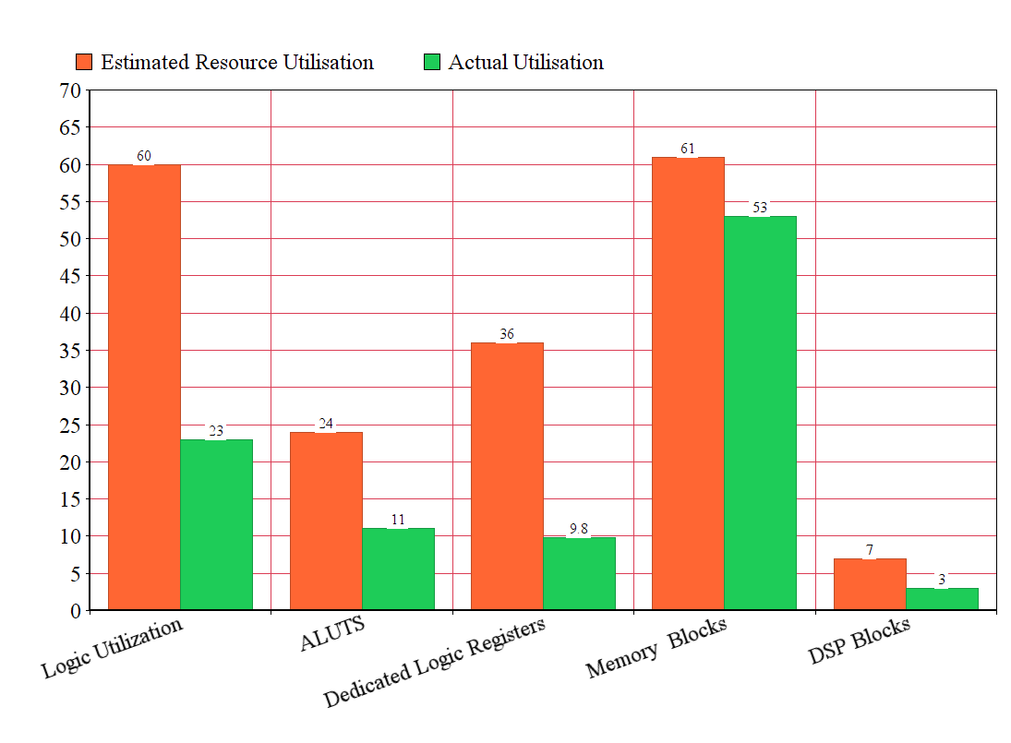
Resource Utilization
Leukocyte
K-nn
CFD
Path Finder
K-means
LUD
Estimated Resource Utilization
Actual Resource Utilization

Slide 25
Power Estimation
Using Arria 10 Early Power Estimator
Benchmark | FPGA (watts)
Leukocyte | 2.556
K-nn | 2.389
LUD | 2.701
K-means | 2.406
Path Finder | 2.409
CFD | 2.950

Slide 26
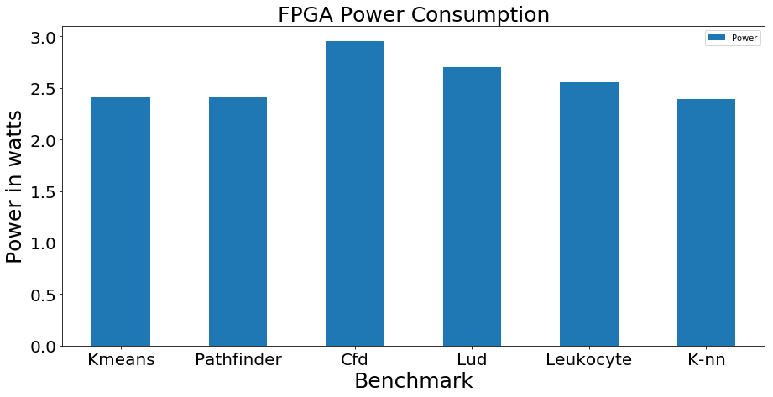
Power Estimation

Slide 27
CONCLUSION
Based on the Run time, we observed that 3 of 6 benchmarks seems to perform better in GPU
Depending on choices of parameters, best platform can be chosen
To decisively conclude whether GPU or FPGA as best platform, requires further research

Slide 28
THANK YOU

