Slide 1



JAVA-BASED ENTERPRISE INVENTORY
MANAGEMENT SYSTEM
Project Code: #z-13-18
Presented by:
Kathir& Team
Batch- 13

Slide 2
Table of Contents
Introduction
Problem Statement
Project Objectives
System Architecture
Technology Stack
System Modules
Database Design
Key Features
Conclusion
Future Scope
Team Details

Slide 3
INTRODUCTION
Inventory Management Overview
Ensures products are available in the right quantity at the right time
Helps reduce operational costs and avoid stock shortages
Improves overall customer satisfaction
Challenges in Manual Systems
High chances of human errors
Delayed stock updates
No real-time inventory tracking
Limited reporting capabilities
Need for Automation
Real-time inventory tracking
Automated stock updates
Data-driven reporting & analytics
Low-stock alerts

Slide 4
Project Objective
1.Automate Inventory Tracking
Develop a system to efficiently manage and update product stock
levels in real time.
2.Implement Secure User Access
Provide role-based authentication (Admin/User) to ensure secure
access and controlled inventory operations.
3.Generate Inventory Reports
Enable generation and export of inventory data such as stock details
and summaries for analysis.
4.Monitor Stock Levels and Alerts
Detect low-stock products and notify users to maintain optimal
inventory levels and prevent shortages.

Slide 5
SYSTEM ARCHITECTURE
The system follows a layered architecture to ensure scalability, maintainability, and smooth data flow.
Layers:
User Interface (Frontend)
Built with HTML, CSS, Bootstrap, Thymeleaf; handles user interaction
Controller Layer
Processes requests and connects frontend with backend
Service Layer
Contains business logic and manages inventory operations
Repository Layer
Handles database operations using Spring Data JPA
Database Layer
Stores users, products, and inventory data (MySQL)

Slide 6
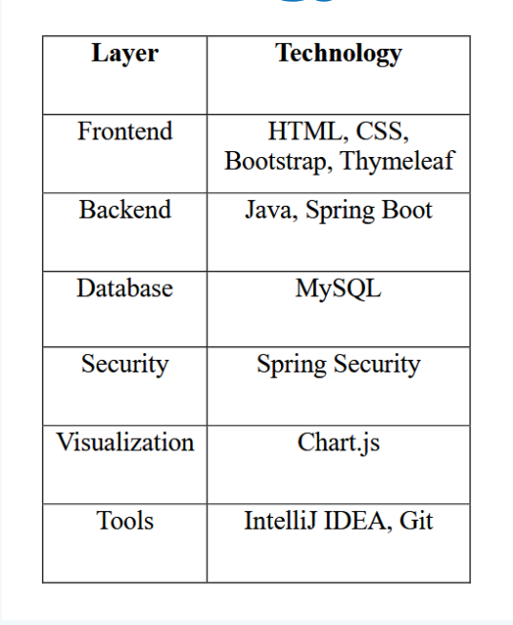
TECHNOLOGY STACK

Slide 7
SYSTEM MODULES
1. Inventory Tracking Engine
Manages core inventory operations such as adding products, updating stock
levels, and viewing product details. It ensures accurate tracking of inventory data.
2. User Authentication System
Provides secure login and role-based access control to ensure that only
authorized users can manage or modify inventory information.
3. Reporting and CSV Integration
Generates inventory reports and summaries and allows exporting data into CSV
files for analysis and record-keeping.
4. Stock Alert System
Monitors inventory levels and detects low-stock products, helping users reorder
items on time and avoid shortages.

Slide 8
DATABASE DESIGN
Uses MySQL to store and manage inventory data.
Tables:
Users → user_id, username, password, role
Products → product_id, name, category, price, quantity
Inventory → inventory_id, product_id, stock_level, last_updated
Relationship:
Each product is linked to its inventory details

Slide 9
KEY FEATURES
1.User Login & Signup
2.Role-based access
(Admin/User)
3.Add / Update products
4.Stock update system
5.Low stock alerts
6.Dashboard analytics
7.Graph visualization
8.CSV export reports
9.Search and filtering

Slide 10
CONCLUSION
1.Developed a Java-based inventory management system that
automates product tracking, secure authentication, and real-time
stock monitoring.
2.Replaces manual inventory methods, reducing errors and
improving operational efficiency through features like stock
alerts, reporting, and role-based access.
3.Built with a modular design, allowing future enhancements
such as email notifications, advanced analytics, and cloud
deployment.

Slide 11
THANK
YOU

