Slide 1
22CSP72 – PROJECT WORK II PHASE I
Deep Learning-Based River Pollution Forecasting and Early Warning System
Date : 25.06.2026
Team Number : D02
Team Guide : Dr. R. Thamilselvan
Team Members :
Shanmathi S (23CSR198)
Suhash V (23CSR220)
Varun Prasath M A (23CSR235)

Slide 2
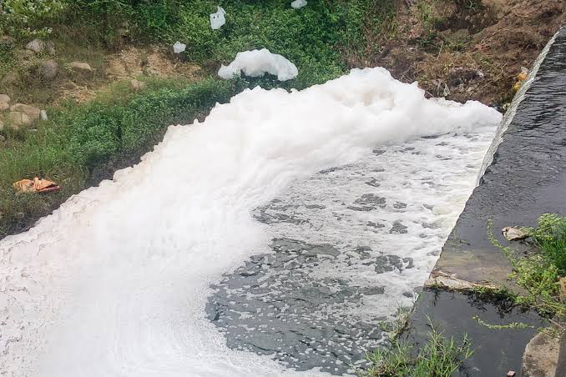
PROBLEM STATEMENT
The Ganga River, which flows for approximately 2,525 km across five Indian states, is continuously affected by pollution from untreated sewage, industrial effluents, agricultural runoff, and over 3,700 grossly polluting industries in the basin. Existing water quality monitoring systems only measure the current status of the river and cannot predict future water quality, making it difficult for authorities to take preventive actions.

Slide 3
Objectives
Aims of the Proposed Work
To develop an iTransformer-based deep learning framework for forecasting future river water quality using historical monitoring station data.
To identify future pollution hotspots and rank multiple monitoring stations based on predicted pollution levels.
To analyze pollution trends and classify pollution risk for proactive river water quality management.
To generate an intelligent early warning system that supports timely environmental monitoring and decision-making.

Slide 4
Literature Survey
FEATURE | PAPER 1 | PAPER 2 | PAPER 3
TITLE | Long-Term Water Quality Prediction With Transformer-Based Spatial-Temporal Graph Fusion | Transformer-Based Multi-Horizon Dissolved Oxygen Forecasting in River Systems | A Hybrid Approach of Deep Autoregression and Bidirectional LSTM Network
AUTHOR | Jing Bi, Ziqi Wang, Haitao Yuan, Xiangxi Wu, Renren Wu | A. J. Ali, A. A. Ahmed | D. Narmadha, Mythily M., G. Gifta Jerith, Sweety Julia,
DATASET USED | Historical River Water Quality Dataset | River Lee Water Quality Dataset | River Water Quality Time-Series Dataset
ALGORITHM | LSTM-based Deep Learning | Informer, TFT, LSTM,GRU | DAFA-BiLSTM
PREDICTION TARGET | Water Quality / DO Prediction | Dissolved Oxygen Forecasting | River Water Quality Forecasting

Slide 5
Research Gap
Existing studies primarily focus on forecasting water quality parameters or WQI but do not identify future pollution hotspots across multiple monitoring stations.
Current models provide prediction results but lack pollution trend analysis and multi-station priority ranking, which are important for efficient monitoring.
Most approaches do not include an early warning mechanism to alert authorities before pollution reaches critical levels.
Existing models provide limited decision-support, such as pollution risk assessment and early warning alerts.

Slide 6
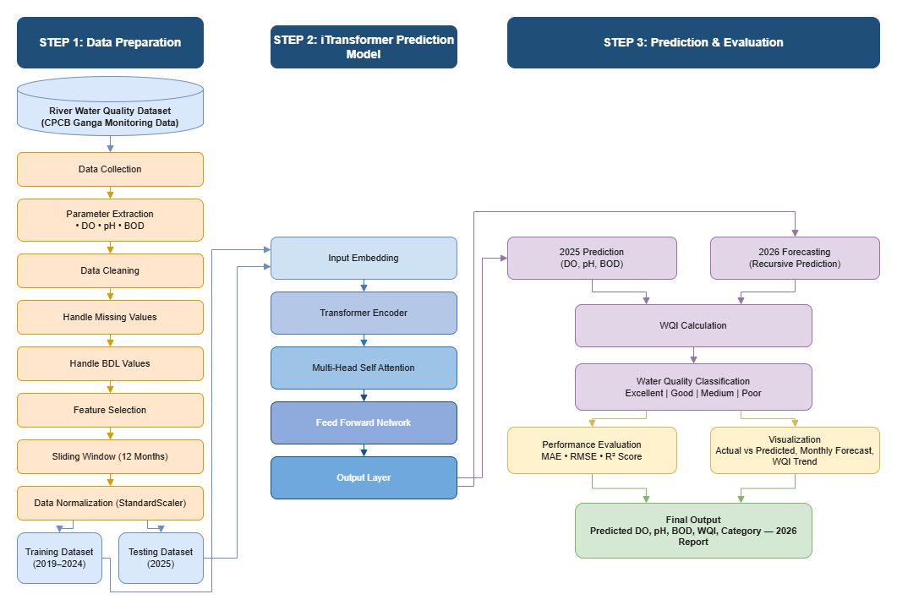
Architecture Design

Slide 7
Proposed Work
Collect historical Ganga River water quality data.
Preprocess and clean the dataset (missing values, BDL handling, scaling).
Generate 12-month time-series sequences for each monitoring station.
Train an iTransformer deep learning model to predict DO, pH, and BOD.
Calculate the Water Quality Index (WQI) from predicted parameters.
Planned Innovation
iTransformer-based multivariate time-series forecasting for river water quality.
Simultaneous prediction of DO, pH, and BOD instead of a single parameter.
Automatic WQI computation from predicted values.

Slide 8
Modules of the project
Data Collection
Ganga River Dataset (2014–2025)
│
▼
Data Preprocessing
(Data Cleaning, Missing Value Handling)
│
▼
Sequence Generation
Create 12-Month Time-Series Windows
│
▼
iTransformer Training
Embedding → Self-Attention → Prediction
│
▼
Model Evaluation
MAE • RMSE • R²
│
▼
WQI Calculation
│
▼
2026 Forecasting

Slide 9
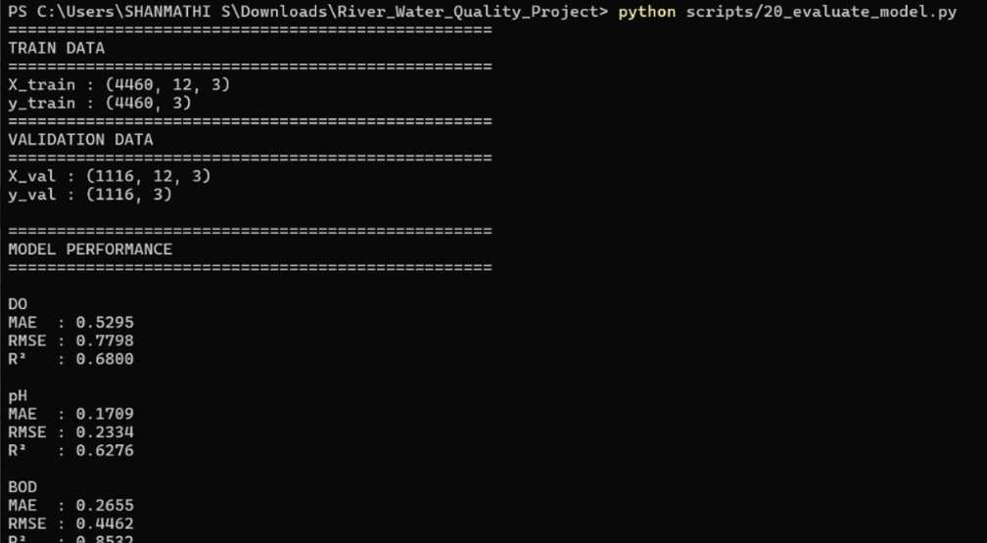
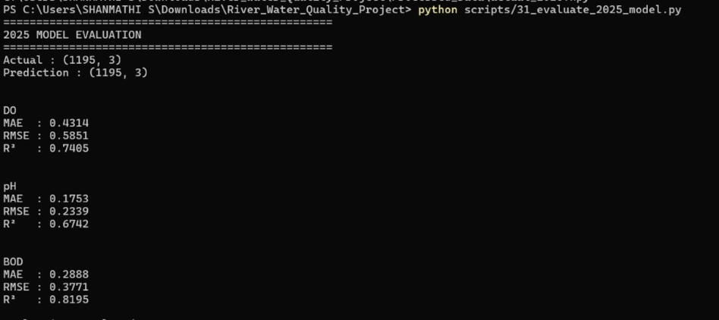
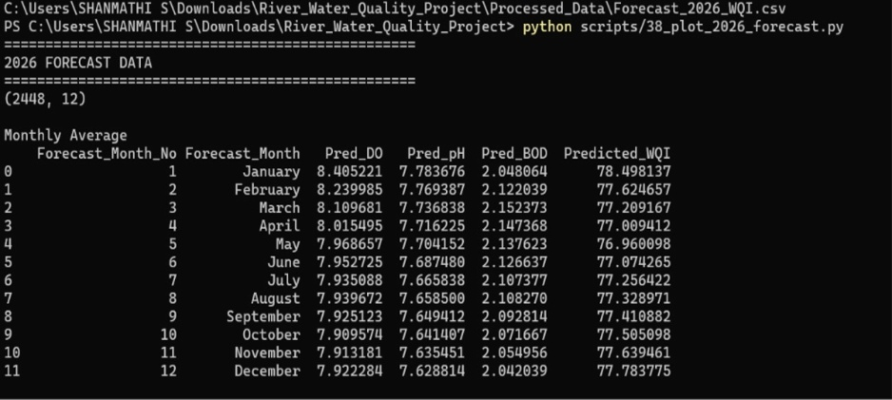
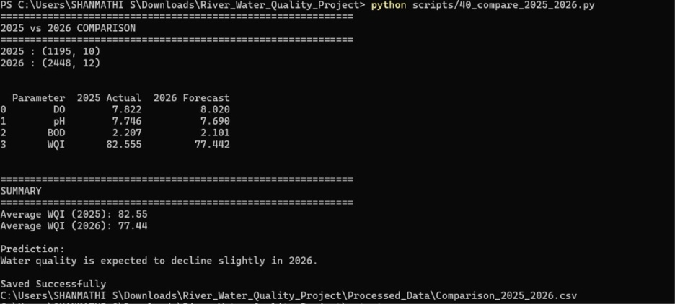
OUTCOMES

Slide 10
Reference
Base Paper 1
Title: Temporal Fusion Transformer: A Deep Learning Approach for Modeling and Forecasting River Water Quality Index
Journal: International Journal of Intelligent Systems and Applications in Engineering (IJISAE)
Year: 2023
Base Paper 2
Title: Advancing River Water Quality Prediction: A Comparative Assessment of Deep Learning Models for Dissolved Oxygen Forecasting
Journal: International Journal of River Basin Management
Year: 2026
Base Paper 3
Title: Enhancing River Water Quality Prediction: A Hybrid Approach of Deep Autoregression and Bidirectional LSTM Networks
Journal: Journal of Information Systems Engineering and Management (JISEM)
Year: 2025

Slide 11
Thank You

