Slide 1
22CSP72 – PROJECT WORK II PHASE I
Deep Learning-Based River Pollution Forecasting and Early Warning System
Date : 25.06.2026
Team Number : D02
Team Guide : Dr. R. Thamilselvan
Team Members :
Shanmathi S (23CSR198)
Suhash V (23CSR220)
Varun Prasath M A (23CSR235)

Slide 2
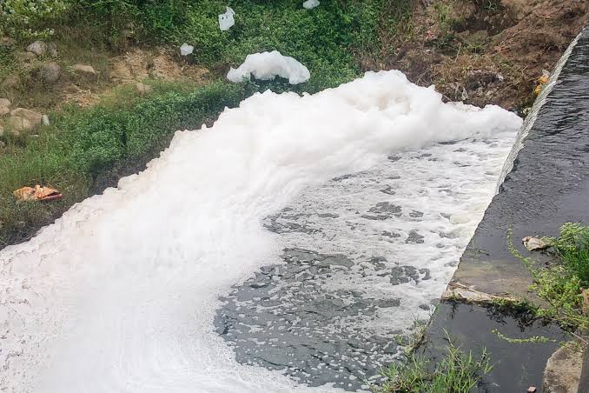
PROBLEM STATEMENT
Existing river water quality monitoring systems detect pollution only after laboratory testing, resulting in delayed action. This project proposes a Deep Learning-Based River Pollution Forecasting and Early Warning System that predicts future pollution levels from historical water quality data, enabling early intervention and effective river management.

Slide 3
Literature Survey
➤ Paper 1 (2022): ANN-WT-LSTM Model
Used ANN, Wavelet Transform, and LSTM for river water quality prediction, improving prediction accuracy but lacking early warning and pollution risk analysis.
➤ Paper 2 (2020): CNN-LSTM Model
Applied CNN-LSTM to predict water quality and water level from historical data, but did not provide explainable predictions or decision support.
➤ Paper 3 (2023): Temporal Fusion Transformer (TFT)
Used TFT for long-term water quality forecasting with improved accuracy, but lacked pollution risk prediction, early warning alerts, and Explainable AI.

Slide 4
Research Gap
Existing models focus mainly on water quality prediction and do not provide pollution risk classification.
Most studies lack an early warning system for proactive pollution management.
Current approaches do not use Explainable AI (XAI), making predictions difficult to interpret.
Most models rely on a single deep learning architecture, limiting their forecasting performance.

Slide 5
Objectives
Aims of the Proposed Work
Develop a deep learning model using ANN and Temporal Fusion Transformer (TFT) for river pollution forecasting.
Predict future Water Quality Index (WQI) and pollution risk levels from historical water quality data.
Generate early warning alerts to enable timely preventive actions. Integrate Explainable AI (SHAP) to provide transparent and interpretable predictions.
Improve river pollution management by supporting data-driven environmental decision-making.

Slide 6
Novelty
ANN-assisted Temporal Fusion Transformer (TFT) for improved pollution forecasting.
Multi-task prediction of Water Quality Index (WQI), pollution risk, and future pollution levels.
Explainable AI (XAI) with an Early Warning System for transparent predictions and proactive river pollution management.

Slide 7
Proposed Methodology
Historical Water Quality Dataset
↓
Data Preprocessing
(Cleaning, Missing Value Handling using ANN, Normalization)
↓
Feature Selection
(pH, DO, BOD, COD, NH₃-N, Temperature, Turbidity)
↓
Temporal Fusion Transformer (TFT)
(Time-Series River Pollution Forecasting)
↓
Explainable AI (SHAP)
(Identify Important Factors)
↓
Output
• Water Quality Index (WQI)
• Pollution Risk (Low/Medium/High)
• Early Warning Alerts

Slide 8
Base Papers
Base Paper 1
A Hybrid Model for Water Quality Prediction Based on an Artificial Neural Network, Wavelet Transform, and Long Short-Term Memory – Junhao Wu, Zhaocai Wang, 2022
Base Paper 2
Prediction of Water Level and Water Quality Using a CNN-LSTM Combined Deep Learning Approach – 2020
Base Paper 3
Temporal Fusion Transformer: A Deep Learning Approach for Modeling and Forecasting River Water Quality Index – 2023

Slide 9
Thank You

