Slide 1
Digital Portfolio
STUDENT NAME: M.SHANMUGA PRIYA
REGISTER NO :astvu36336324u18060
NMID: 6B73664AE95C803BE3345633252E439A
DEPARTMENT: COMPUTER SCIENCE
COLLEGE: COLLEGE/ UNIVERSITY SREE ABIRAAMI ARTS AND SCIENCE COLLEGE FOR WOMEN, GUDIYATHAM
FROMTHIRUVALLUR UNIVERSITY.

Slide 2
MY DIGITAL PORTFOLIO RESUME

Slide 3

AGENDA
Problem Statement
Project Overview
End Users
Tools and Technologies
Portfolio design and Layout
Features and Functionality
Results and Screenshots
Conclusion
Github Link

Slide 4
PROBLEM STATEMENT “Traditional resumes are limited in showcasing skills and achievements. A digital portfolio resume is needed to present personal,academic,and professional details in engaging and accessible way.”

Slide 5
PROJECT OVERVIEW The Portfolio Resume project is a digital platform that showcases an individual’s personal,academic,and professional details.Built using HTML,CSS and Javascript, it provides a responsive and user-friendly way to present skills, achievements,and contact information in a modern and appealing format

Slide 6

WHO ARE THE END USERS? The end users of the portfolio resume are mainly students and job seekers who develop it to showcase their skills, achievements and personal detailson the other side,employers, recruiters,academicians,and clients use it to evaluate the candidate’s qualification in a morden and accessible way.

Slide 7
TOOLS AND TECHNIQUES HTML5 - for structuring the content of portfolio. CSS- for styling,layout,and responsive designs. javascript- for interactivity and dynamic elements code editor- visual studio Browser- for testing and running the project Responsive Design Techniques- media queries and flexible layouts for mobile compatibility.

Slide 8
POTFOLIO DESIGN AND LAYOUT:
The portfolio resume is a single-page responsive website with sections like Home,About me,skills, certificates,Hobbies,and Contact.It uses a clean layout with consistent colors,simple navigation,and
Responsive design to showcase details in a modern
And user-friendly way.
8

Slide 9
FEATURES AND FUNCTIONALITY Responsive Design-works on desktop,tablet,and mobile. Navigation Menu - smooth scrolling between section About Me Section - personal details and introduction. Skills & Certificates - showcasing strengths and achievements. Hobbies section - Highlights personal interests. Contact Form/Info - Easy way to connect. Interactive Elements - javascript for dynamic effects.

Slide 10
RESULTS AND SCREENSHOTS The portfolio resume is responsive and user-friendly showcasing personal details,skils,certificates, hobbies,and contact information.Screenshorts displaythe layout and functionalities across devices.
3/21/2024 Annual Review
10

Slide 11
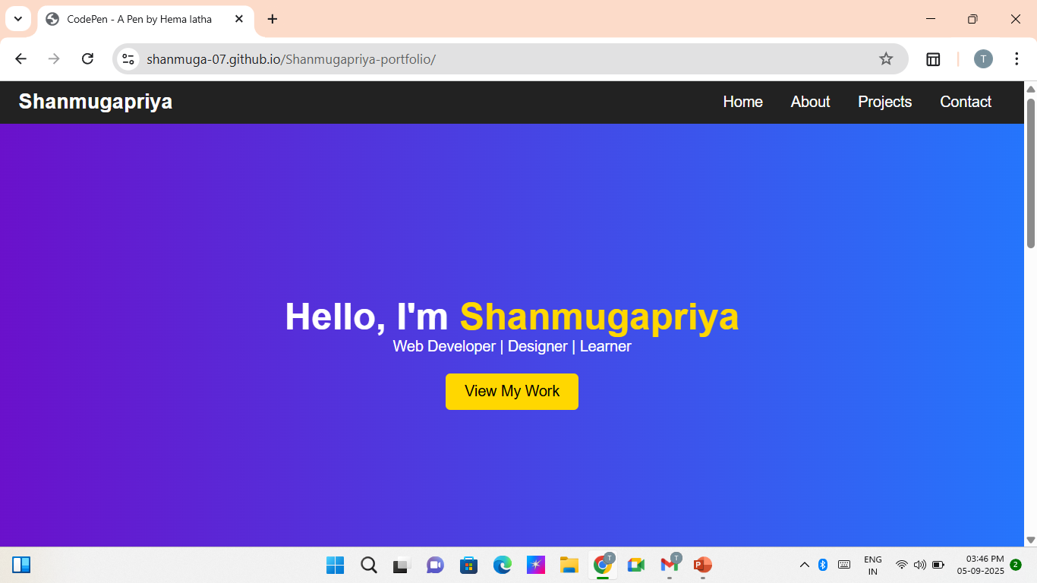
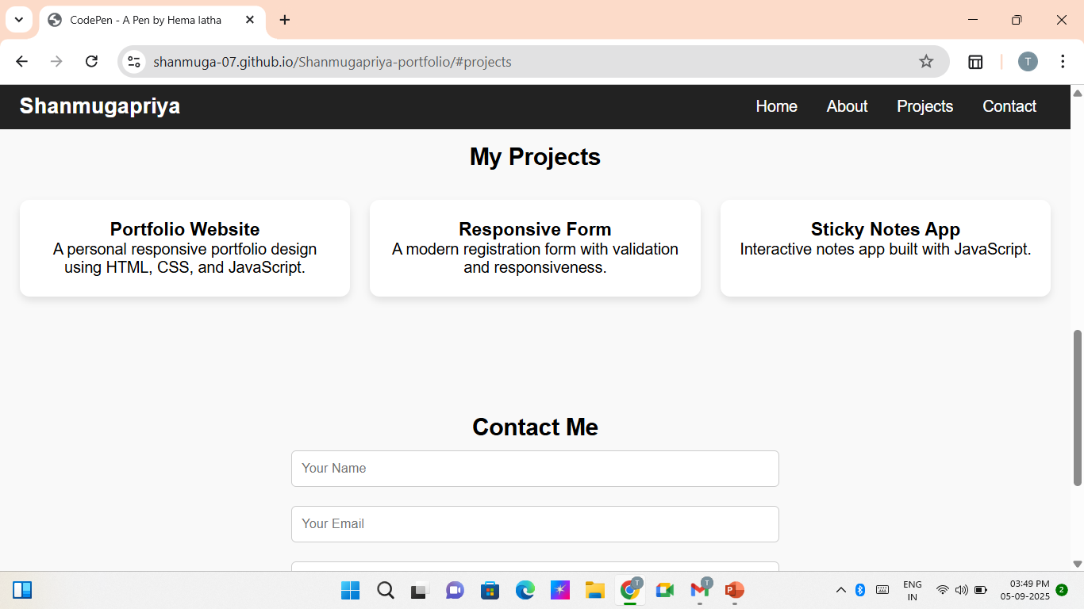
ScreenShot

Slide 12
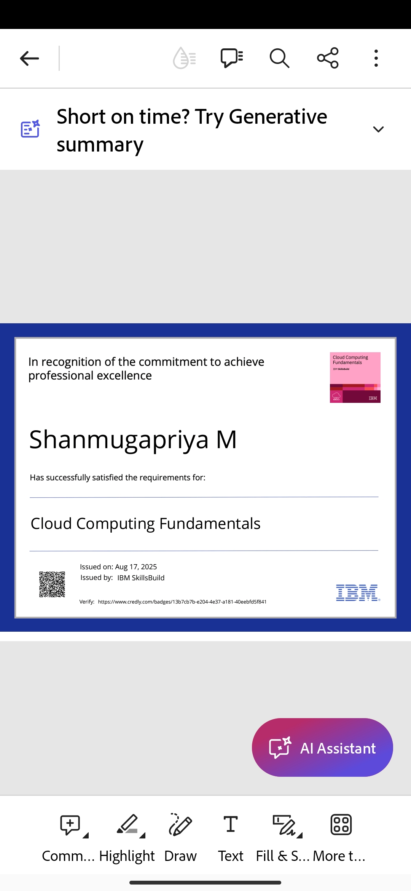
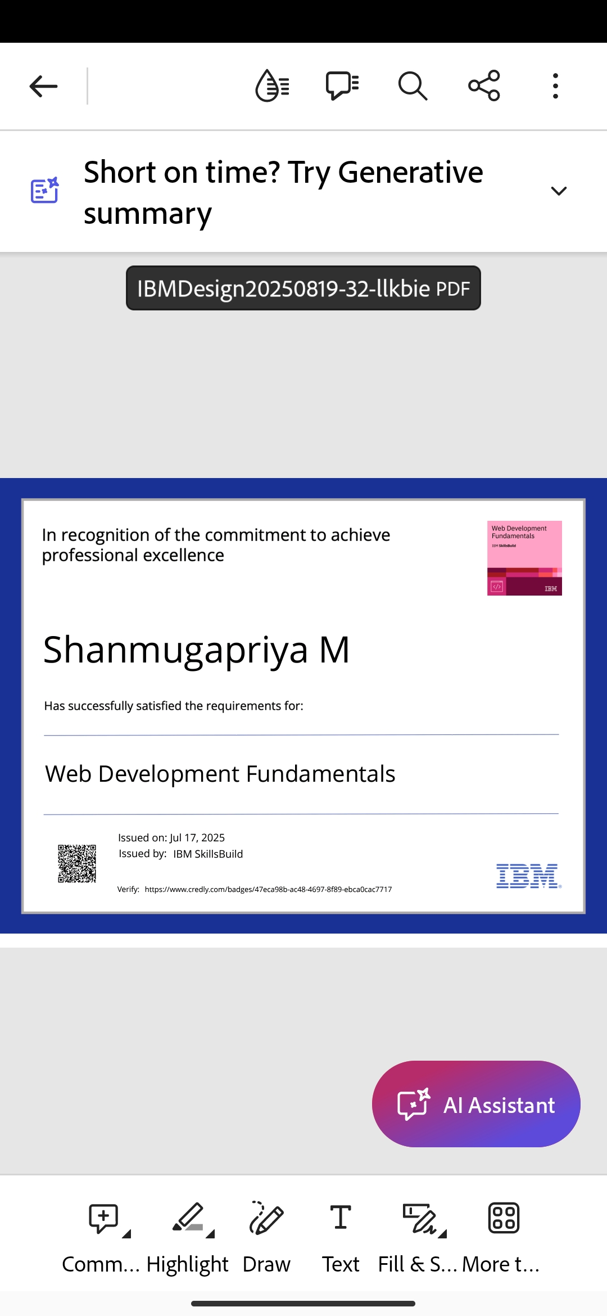

Slide 13
GITHUB LINK: https://shanmuga-07.github.io/ shanmugapriya-portfolio/

Slide 14
CONCLUSION The portfolio resume project successfully creats a modern digital resume.it allows users to showcase personal,academic,and professional details.The design is responsive,user-friendly,and visual appealing across devices.Overall,it serves as an effective alternative to traditional resume.
14

