Slide 1
Image Steganography
Shanmuga Ganesh

Slide 2
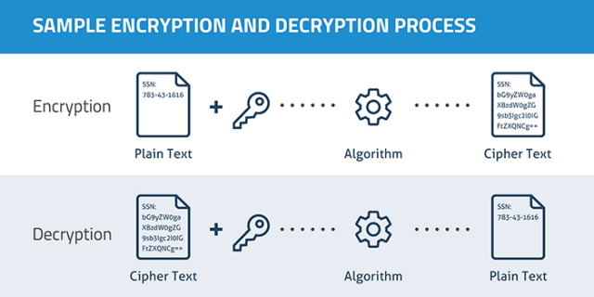
Encryption
Changes done to the information.
Therefore making it unreadable.
Can be transformed back , by the one who possess the key.

Slide 3
why Encryption?
To securely protect the data.
Deny access from everyone except the one having the key.
Businesses to protect their corporate secrets.
Government institutions to secure classified informations.
Individuals to protect personal details.

Slide 4
Issues
Computer is being updated faster than we expected.
Powerful computers decrypt the code within days or weeks.
Simply done through brute force method.
Example- DES cracker breaks in 56 hours.
DES in association with distributed.net breaks key in 22 hours and 15 mins.

Slide 5
Steganography
Steganography is the practice of concealing a file, message, image, or video within another file, message, image, or video.
The word steganography comes from New Latin steganographia, which combines the Greek words steganós, meaning "covered or concealed", and -graphia meaning "writing".

Slide 6
Why steganography?
Steganography messages do not attract attention to themselves.
Plainly visible encrypted messages—no matter how unbreakable—will arouse suspicion.
Incriminating in countries where encryption is illegal.
Cryptography protects the contents of a message.
Steganography protect both messages and communicating parties.

Slide 7
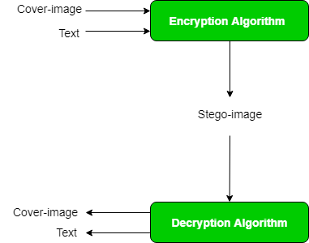
CONCEPT
An image is represented as N*M*3 (in case of color images) matrix in memory, with each entry representing the intensity value of a pixel. In image steganography, a message is embedded into an image by altering the values of some pixels, which are chosen by an encryption algorithm. The recipient of the image must be aware of the same algorithm in order to known which pixels he or she must select to extract the message.

Slide 8
Encode Algorithm
def encode_enc(newimg, data):
w = newimg.size[0]
(x, y) = (0, 0)
for pixel in modPix(newimg.getdata(), data):
# Putting modified pixels in the new image
newimg.putpixel((x, y), pixel)
if (x == w - 1):
x = 0
y += 1
else:
x += 1

Slide 9
# Encode data into image
def encode():
img = input("Enter image name(with extension): ")
image = Image.open(img, 'r')
data = input("Enter data to be encoded : ")
if (len(data) == 0):
raise ValueError('Data is empty')
newimg = image.copy()
encode_enc(newimg, data)
new_img_name = input("Enter the name of new image(with extension): ")
newimg.save(new_img_name, str(new_img_name.split(".")[1].upper()))

Slide 10
Decode Algorithm
# Decode the data in the image
def decode():
img = input("Enter image name(with extension) :")
image = Image.open(img, 'r')
data = ''
imgdata = iter(image.getdata())
while (True):
pixels = [value for value in imgdata.__next__()[:3] +
imgdata.__next__()[:3] +
imgdata.__next__()[:3]]
# string of binary data
binstr = ''

Slide 11
for i in pixels[:8]:
if (i % 2 == 0):
binstr += '0'
else:
binstr += '1'
data += chr(int(binstr, 2))
if (pixels[-1] % 2 != 0):
return data

Slide 12


Steganography In Use
Before
After(text hidden:sample_test)

Slide 13
MERITS
Easy process to encrypt text on image.
Fast and easy way of to send secure stuff.
This system can be used by everyone who wants send some confidential text to someone
Image can be shared by any easy mean like email, whatsapp, etc.

Slide 14
References
https://www.geeksforgeeks.org/program-decimal-binary-conversion/
https://www.geeksforgeeks.org/working-images-python/
https://dev.to/erikwhiting88/let-s-hide-a-secret-message-in-an-image-with-python-and-opencv-1jf5

Slide 15
THANK YOU

