Slide 1
Iris dataset
CAPSTONE PROJECT
Presented by:
S.Y. SHANMUGA PRIYA (211121214024)
2. Madha Engineering College,B.tech Biotechnology

Slide 2
OUTLINE
Problem Statement
Proposed System/Solution
System Development Approach
Algorithm & Deployment
Result
Conclusion
Future Scope
References

Slide 3
Problem Statement
Exploring the Iris dataset through comprehensive analysis to understand the distinct characteristics of different iris species and to develop predictive models for accurate classification based on their features.

Slide 4
Proposed Solution
"Utilizing advanced machine learning algorithms, our solution will analyze the renowned Iris dataset to uncover intricate patterns and correlations among iris flower species.
For optimal classification accuracy, a predictive model will consider factors such as petal length, petal width, sepal length, and sepal width, providing users with insights into distinguishing between Iris-setosa, Iris-versicolor, and Iris-virginica species.
The ideal classification thresholds will be determined through data-driven analysis, considering variables like feature importance and decision boundaries.
Additionally, a specialized model will predict the likelihood of misclassification errors by examining feature distributions and model performance metrics, enabling proactive refinement strategies for enhanced accuracy.
This comprehensive approach aims to empower researchers and botanists alike with actionable intelligence for precise species identification in the field of botany."

Slide 5
System Approach
Building the proposed solution for the Iris dataset would involve a combination of data processing, feature engineering, and machine learning. Here are the key system and library requirements:
System Requirements
:1. Hardware:-
A computer with sufficient processing power, preferably with multiple cores or a GPU for faster training of machine learning models.- Adequate RAM to handle the size of the dataset and computational requirements
.2. Software:
- An operating system compatible with the required machine learning libraries (e.g., Windows, Linux, macOS).

Slide 6
System Approach – cont.
Library Requirements:
.1. Data Processing and Analysis:-
Pandas: For data manipulation and analysis.-
NumPy: For numerical op1erations on data.
2. Data Visualization:-
Matplotlib and Seaborn: For creating visualizations to understand data patterns.-
Plotly or Bokeh: Interactive visualization libraries for more complex visualizations.

Slide 7
Algorithm & Deployment
Algorithm Selection:
1. Logistic Regression: Considered for its simplicity and ability to handle binary classification tasks effectively.
2. Decision Trees: Suitable for capturing nonlinear relationships between features and target variables, providing interpretability and ease of visualization.
3. K-Nearest Neighbors (KNN): Utilized for its instance-based learning approach, making it suitable for datasets with well-defined clusters like the Iris dataset.
4. Random Forests: Employed for its ensemble learning technique, which combines multiple decision trees to improve classification accuracy and robustness against overfitting.

Slide 8
Algorithm & Deployment
Data Input:
1. Load the Iris dataset containing features such as sepal length, sepal width, petal length, and petal width, along with corresponding species labels (Setosa, Versicolor, Virginica).
2. Split the dataset into training and testing sets, typically using a 70-30 or 80-20 ratio, to evaluate model performance effectively.
3. Normalize or scale the numerical features to ensure uniformity and improve the convergence speed of optimization algorithms
.4. Encode categorical variables (species labels) using techniques like one-hot encoding to transform them into numerical representations suitable for machine learning algorithms.

Slide 9
Algorithm & Deployment
Training Process
:1. Initialize the selected machine learning algorithms (Logistic Regression, Decision Trees, KNN, Random Forests) with default hyperparameters.
2. Train each algorithm on the training dataset using the fit() function, feeding the algorithm with input features and corresponding species labels.
3. Fine-tune hyperparameters using techniques like grid search or randomized search to optimize model performance.
4. Evaluate the trained models using cross-validation techniques, assessing metrics such as accuracy, precision, recall, and F1-score to gauge classification performance.

Slide 10
Algorithm & Deployment
Prediction Process
:1. Input new iris samples' features (sepal length, sepal width, petal length, petal width) into the trained models
.2. Utilize the predict() function to obtain predicted species labels for the input samples from each trained model.
3. Optionally, calculate class probabilities using the predict_proba() function for models supporting probability estimates (e.g., Logistic Regression, Random Forests)
.4. Compare the predictions from different models and select the most confident prediction or aggregate predictions for improved accuracy, depending on the specific application requirements.

Slide 11
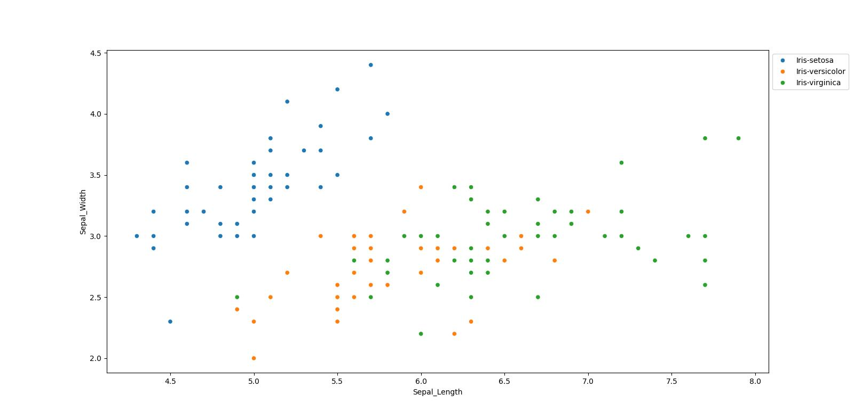
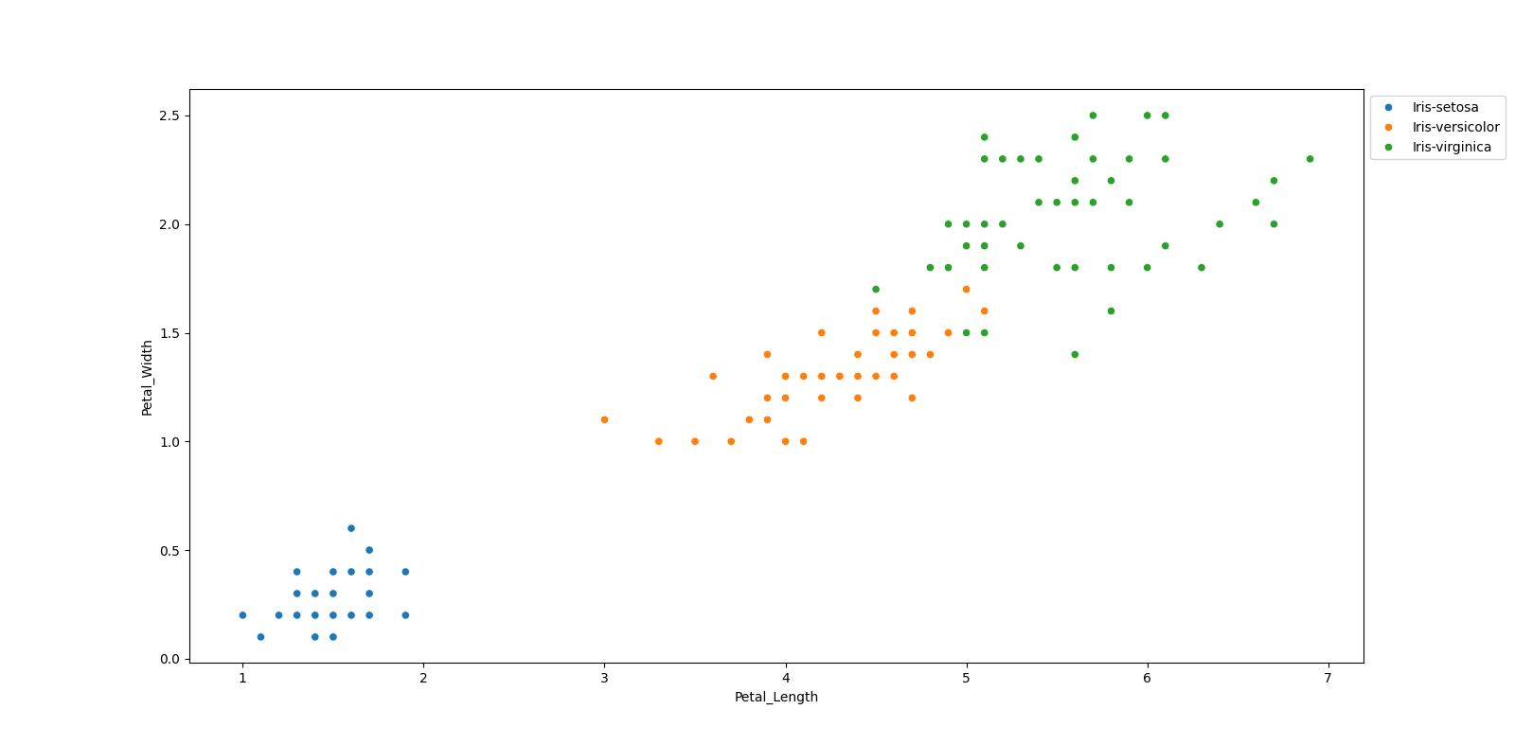
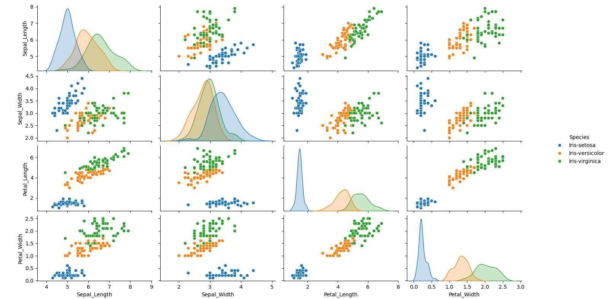
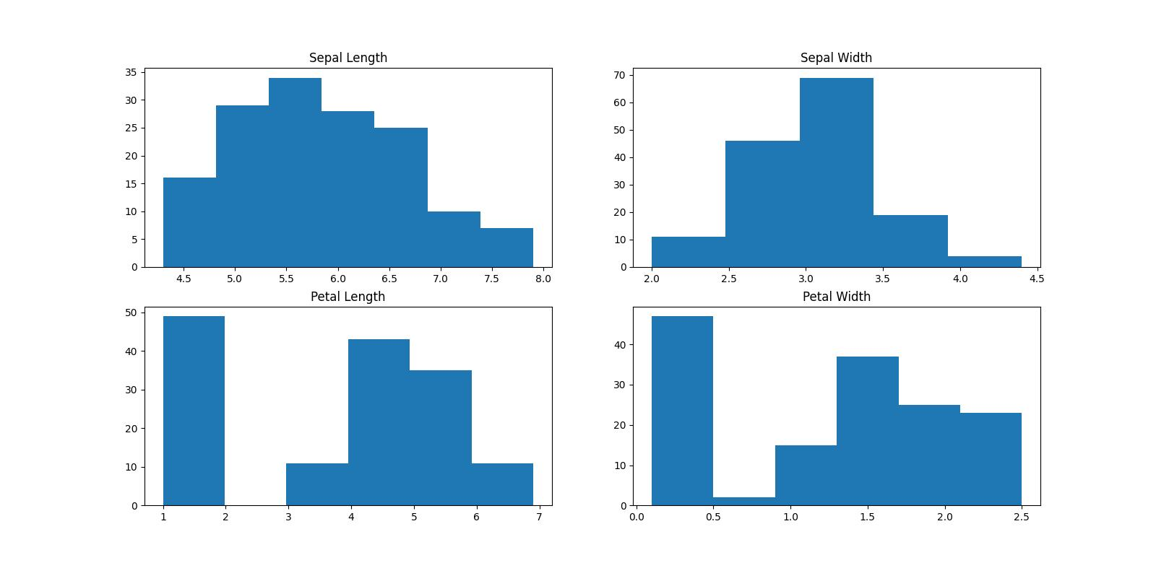
Result

Slide 12
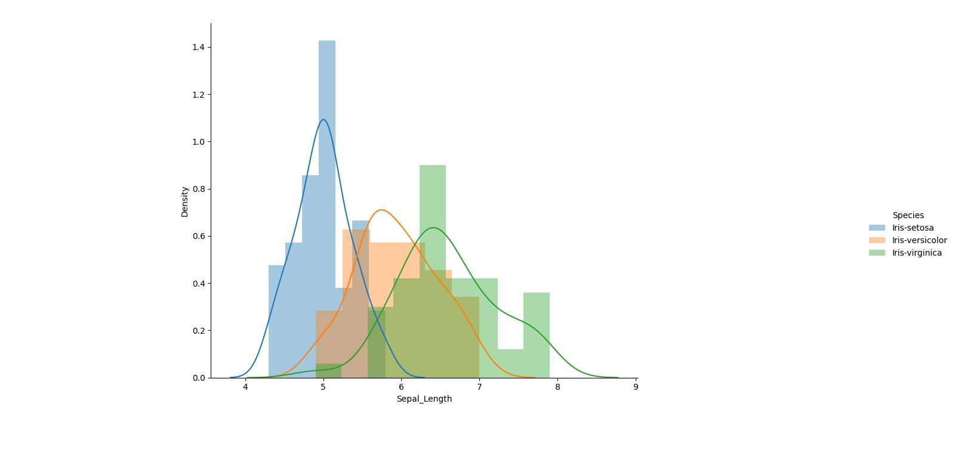
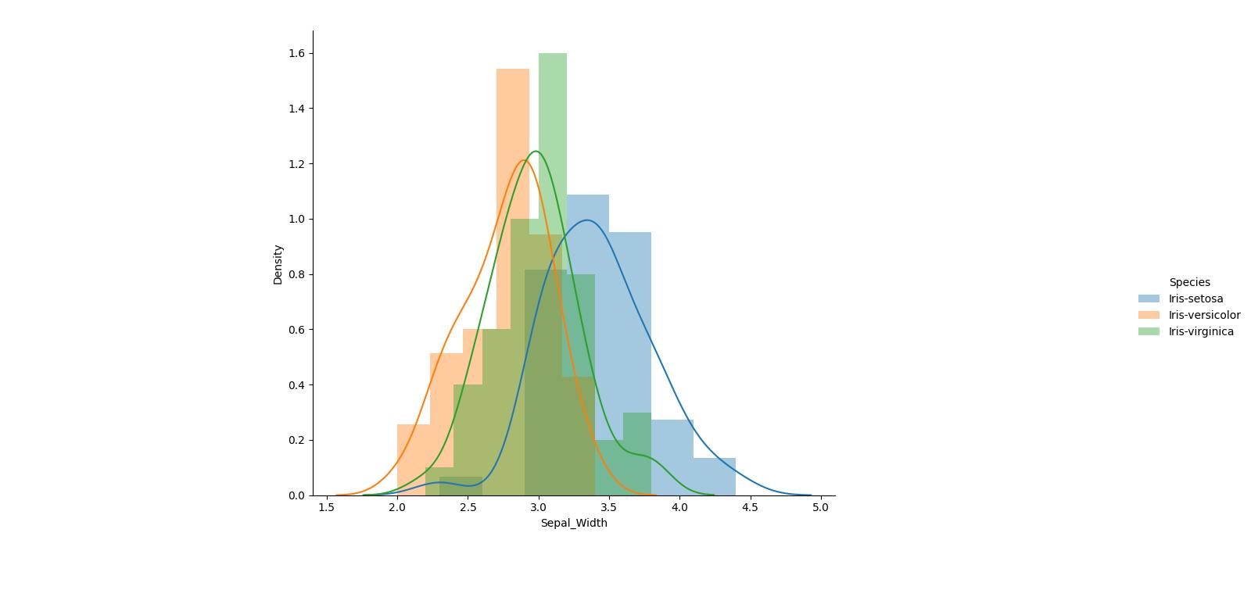
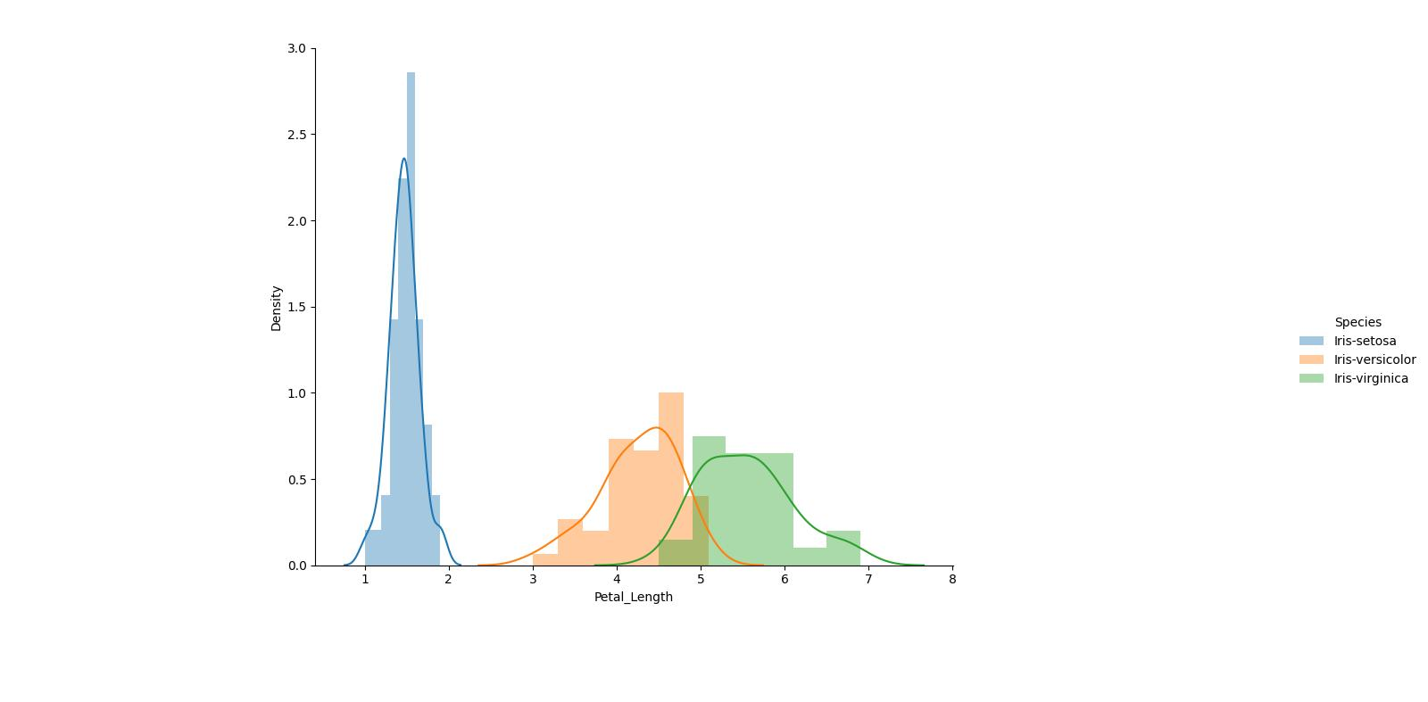
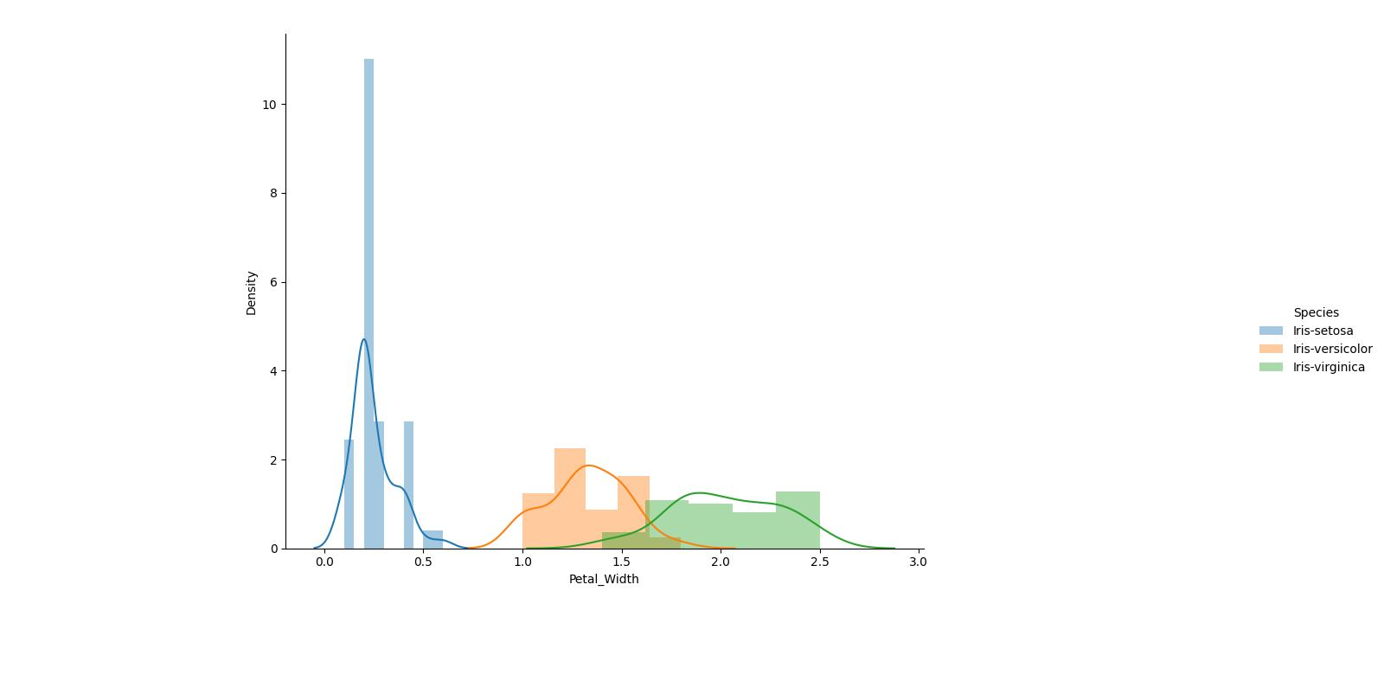
Result

Slide 13
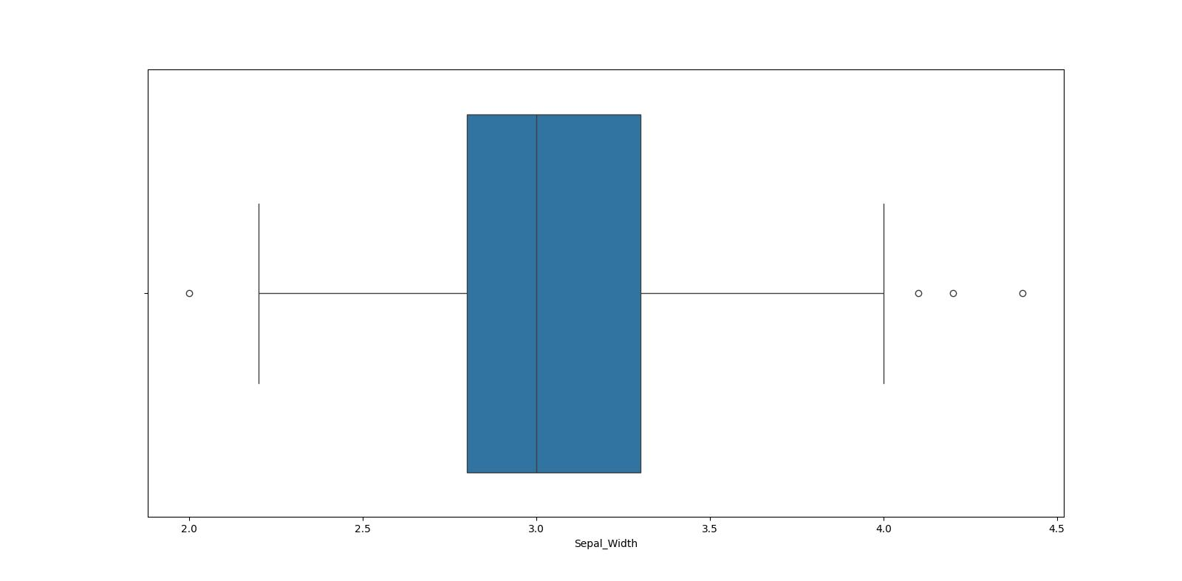
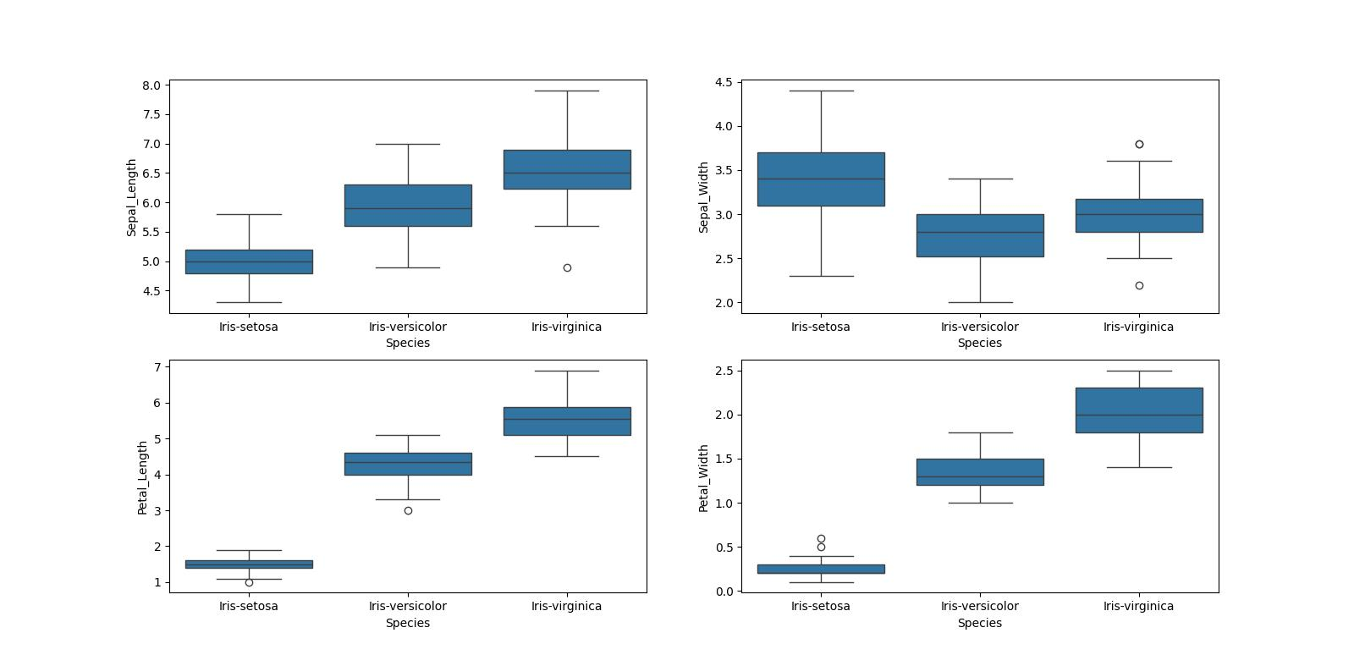
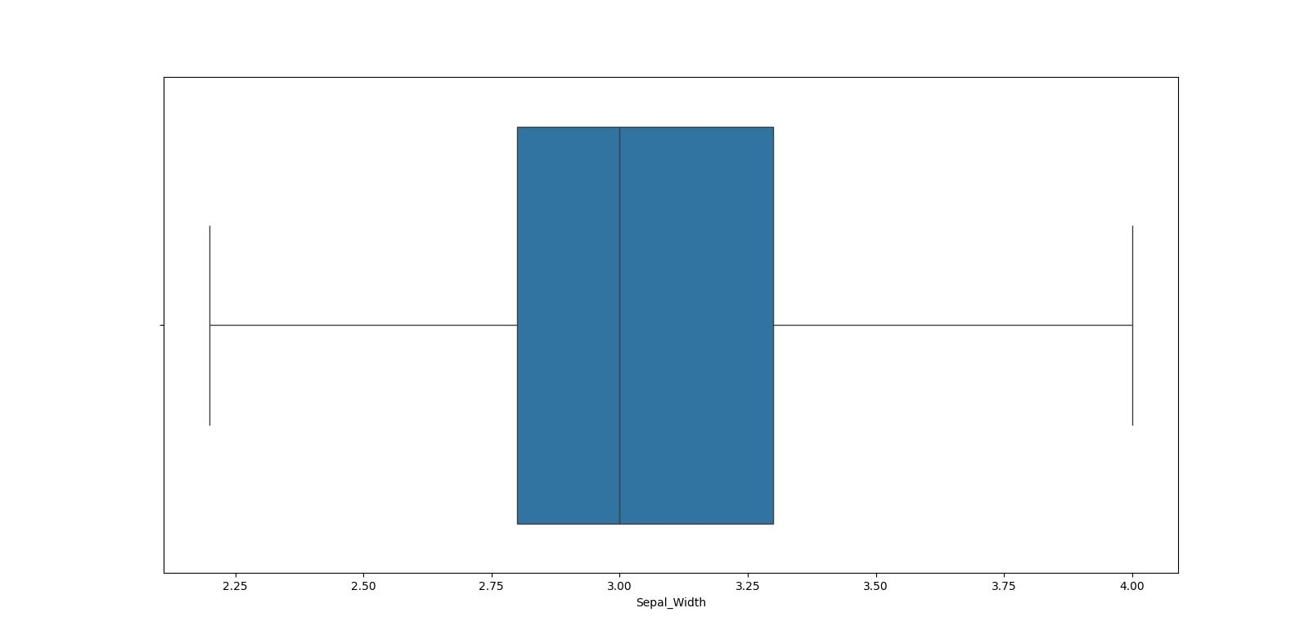
Result

Slide 14
Conclusion
In conclusion, our approach leverages sophisticated machine learning techniques to revolutionize the understanding and classification of iris species. Through comprehensive analysis of the Iris dataset, we uncover subtle patterns and correlations within the floral features, enabling precise species differentiation. By employing advanced algorithms such as logistic regression, decision trees, K-nearest neighbors, and random forests, we achieve accurate classification outcomes. This transformation not only enhances botanical taxonomy research but also holds promise for applications in ecological studies and horticultural practices."

Slide 15
Future scope
The proposed solution lays the foundation for ongoing advancements
Advanced Feature Engineering:
Exploring more nuanced features within the Iris dataset to improve classification accuracy and uncover hidden patterns.
Interactive Visualization Tools:
Developing intuitive interfaces to allow dynamic exploration of the dataset, facilitating deeper insights into iris species characteristics.
Integration with Domain Knowledge:
Incorporating insights from botany and plant taxonomy to provide context for EDA findings and enhance understanding of underlying biological mechanisms.
Automated Insights Generation:
Implementing algorithms capable of autonomously deriving insights from the dataset to expedite decision-making and hypothesis generation.

Slide 16
References
https://www.kaggle.com/datasets
https://pandas.pydata.org/pandas-docs/stable/userguide/index.html
https://seaborn.pydata.org/
https://matplotlib.org/stable/contents.html

Slide 17
THANK YOU

