Slide 1
Assignment
By Shanmuga

Slide 2
CONTENTS
Frameworks used
Algorithm
High Level Block diagrams
Applied Design patterns
Class diagrams
Architecture decisions
Application snap shots

Slide 3
Frameworks used
Jquery – 3.2.1 / Javascript/ HTML/CSS
Bootstrap – 3.3.7 - used for Responsive web pages
Angular JS – 1.6.4 - used for MVC at the Front End level
Swagger - Swashbuckle – 5.4.0 – used for Web API documentation
Microsoft OWIN – 2.0.2 – used for self hosting web server
.NET Web API 2.0 – used for RESTful Web service implementation
NuGet – used as Package Manager
.NET framework – 4.5.2

Slide 4
Number to Text Algorithm
Receive Input number as string data type. Example Input: 6790.426
Parse Input NUMBER into Integer & decimal part. Integer part = 6790; Decimal Part =43
Integer part is divided into units from right to left based on Number system. Unit1= 790; unit2=6;
For each unit, corresponding Text is built. All are concatenated together to form Integer part of Text. Unit1= 790 = SEVEN NINENTY; unit2=6 = SIX; SIX THOUSAND + SEVEN NINENTY HUNDRED = SIX THOUSAND SEVEN NINENTY HUNDRED
Decimal part is always rounded to 2 decimal places, which is then built into corresponding text. 43= FORTY THREE
Finally Integer part Text + DOLLARS + Decimal Part + CENTS Text gives final result. SIX THOUSAND SEVEN NINENTY HUNDRED + DOLLARS + FORTY THREE + CENTS

Slide 5
Design patterns applied
Template method. Complete process of converting Number to Text follows template method pattern.
Strategy pattern . Number system dynamically decided western Number system or Indian Number system.
Builder Pattern. Number system object is built in multiple stages.

Slide 6
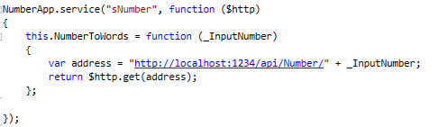

HIGH LEVEL Block diagram
SELF HOSTED USING OWIN
NumberService.js
Front End
GET
Web API

Slide 7
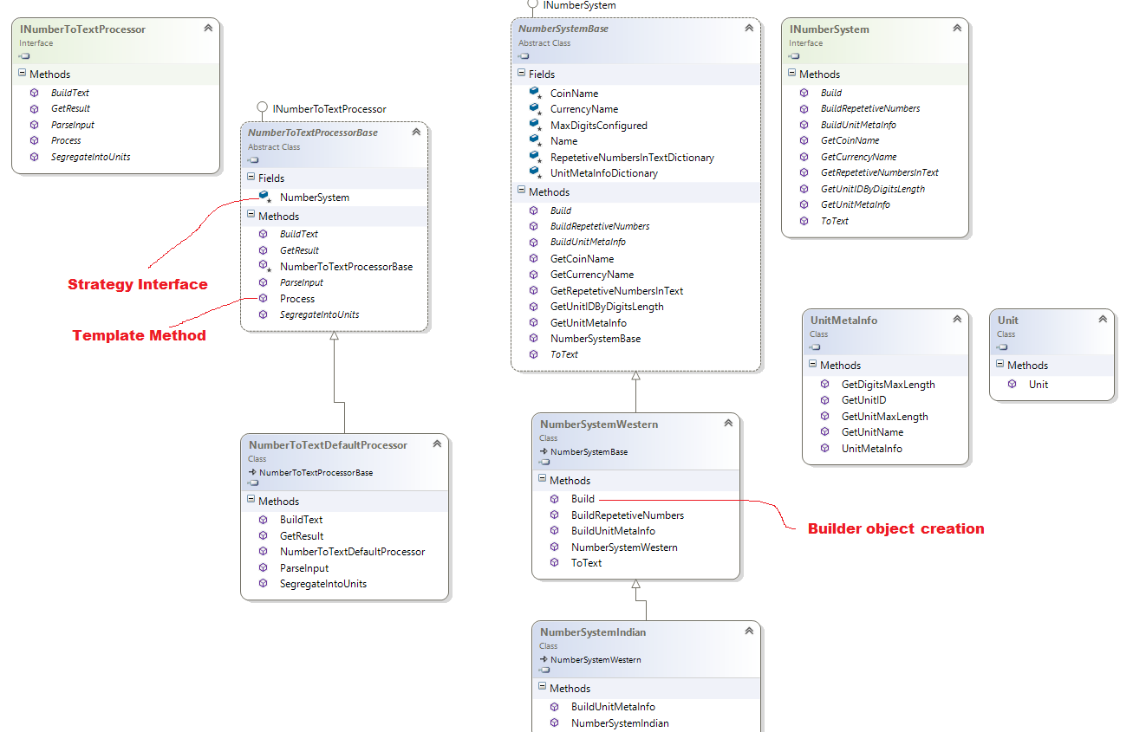
CLASS DIAGRAM

Slide 8
Few Architecture decisions
Input Number is read as String data type to support infinitely long number.
Content Delivery Network (CDN) is used instead of local copy.
Self hosted using OWIN is selected over IIS in order to provide seamless server access where there is no configurations required for CORS since all configurations are already configured through programmatically.
Swagger – swash buckle is used to provide documentation, Integration Tester for Web API Number service. It is customized to provide custom look & feel.
Responsive design used to support multiple devices like Pc, Mobile, Tablets, etc.,

Slide 9
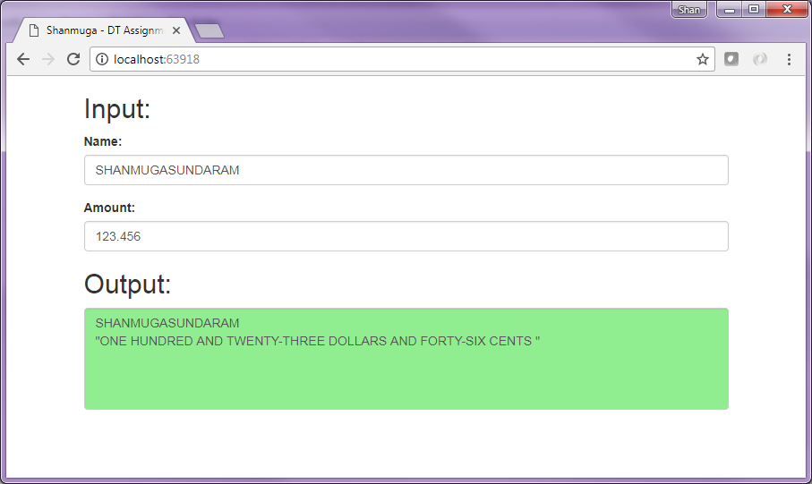
Snap shot – Front End
Small number – Output in Google Chrome

Slide 10
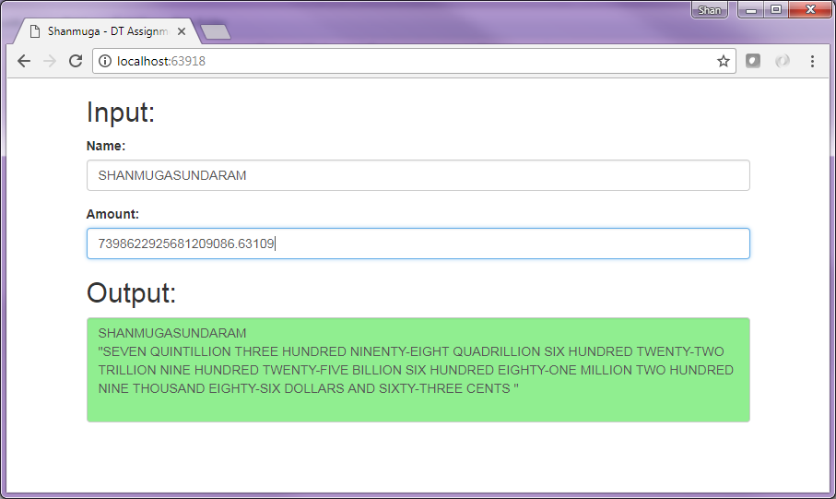
Snap shot – Front End
Large number – Output in Google Chrome

Slide 11
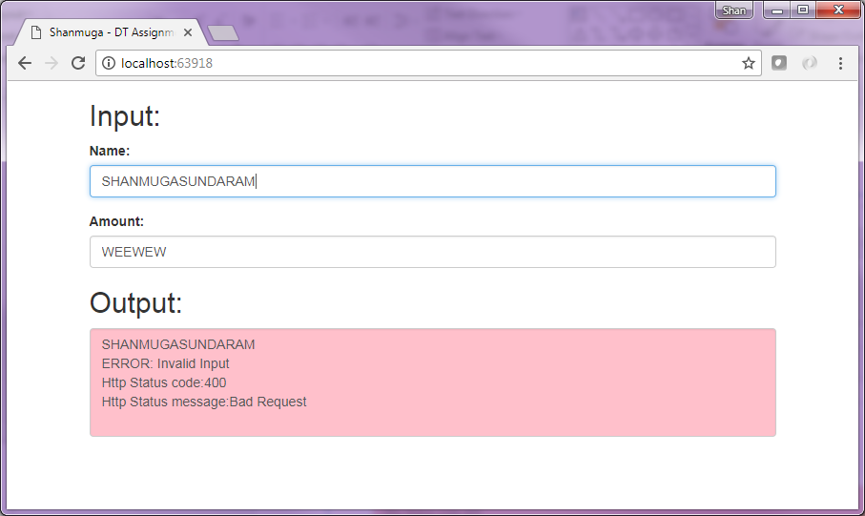
Snap shot – Front End
Output in case of Invalid Input - – Output in Google Chrome

Slide 12
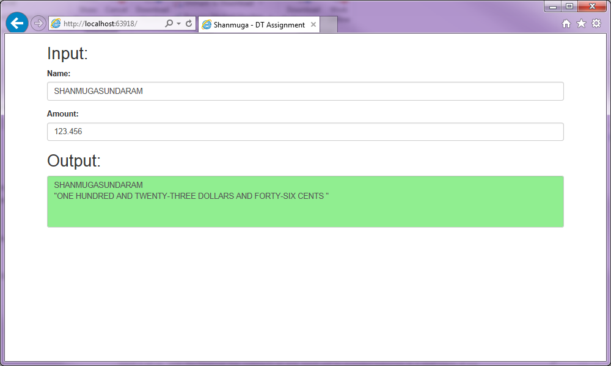
Snap shot – Front End
Output in Internet Explorer

Slide 13
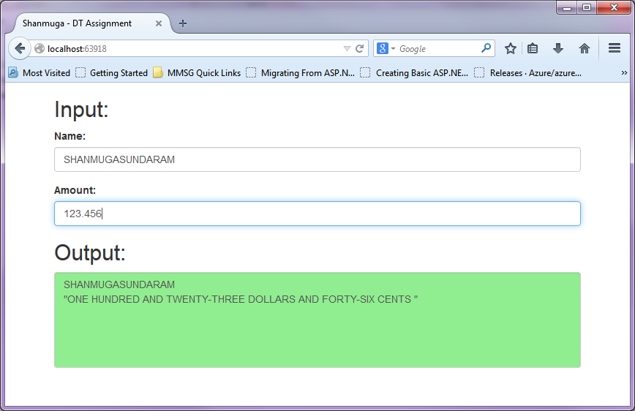
Snap shot – Front End
Output in Mozilla Firefox

Slide 14
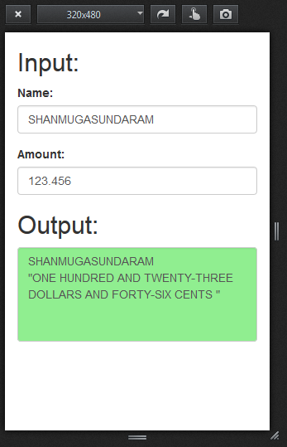
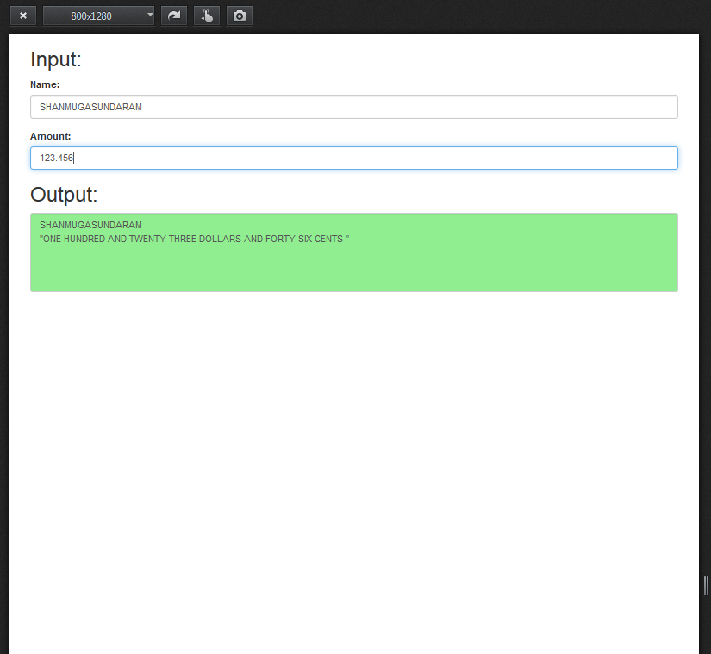
Snap shot – Front End
Output of Responsive design

Slide 15
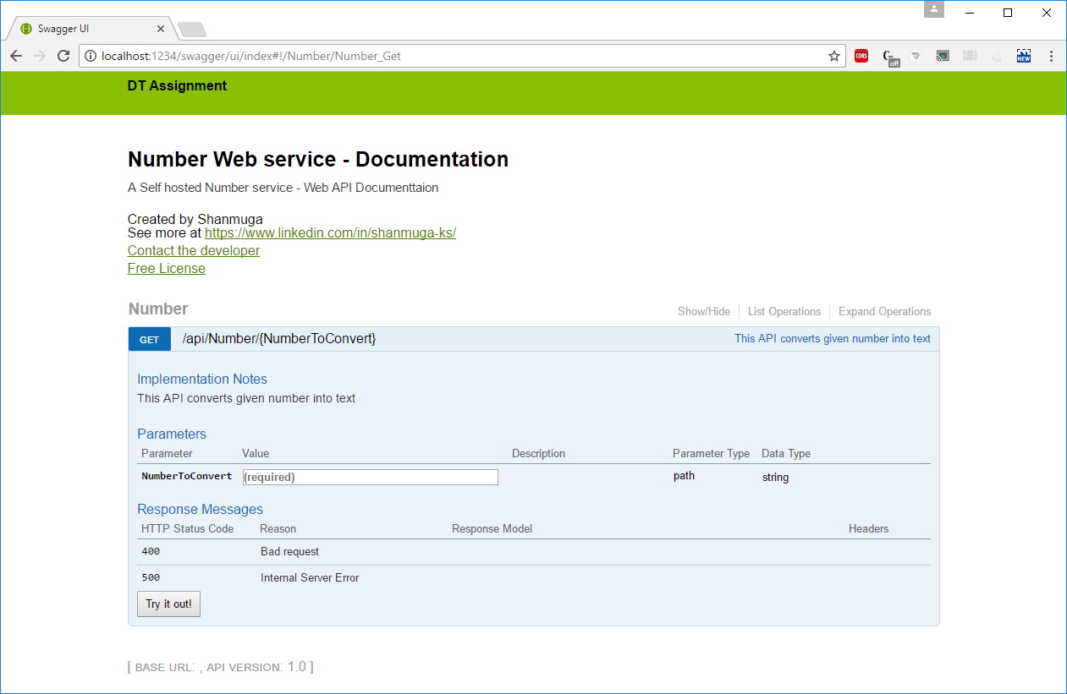
Snap shot – Swagger
Used for Documentation

Slide 16
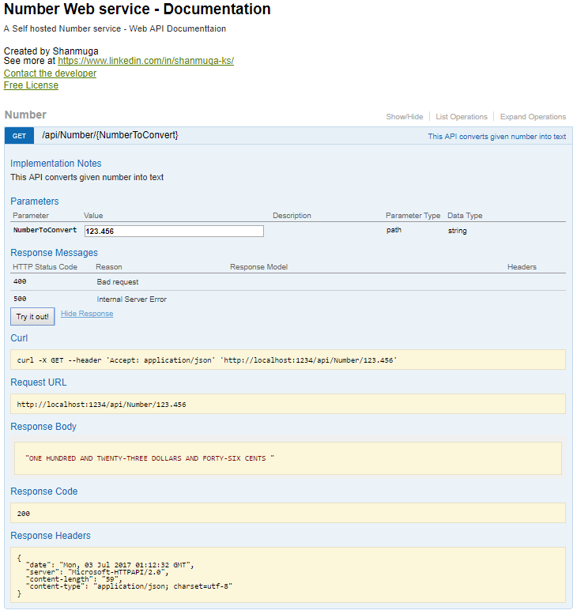
Snap shot – Swagger
Used for Integration Test

Slide 17
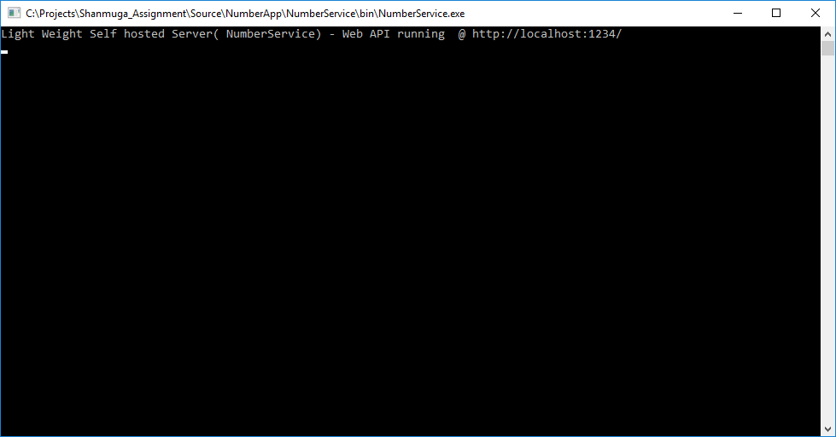
Snap shot – Self hosted server

