Slide 1
Unsupervised Learning in Sensor data
Shanmuga Lakshmi Devaraj

Slide 2
K-Means Clustering
There are too many outliers.
On removing the outliers, the important column Anomaly gets affected.
Oversampling using SMOTE is done.
The important data Anomaly with value 1 is found above temperature 40 degrees which is found in the outlier.
The number of values above 40 degrees is limited which makes it an outlier.

Slide 3
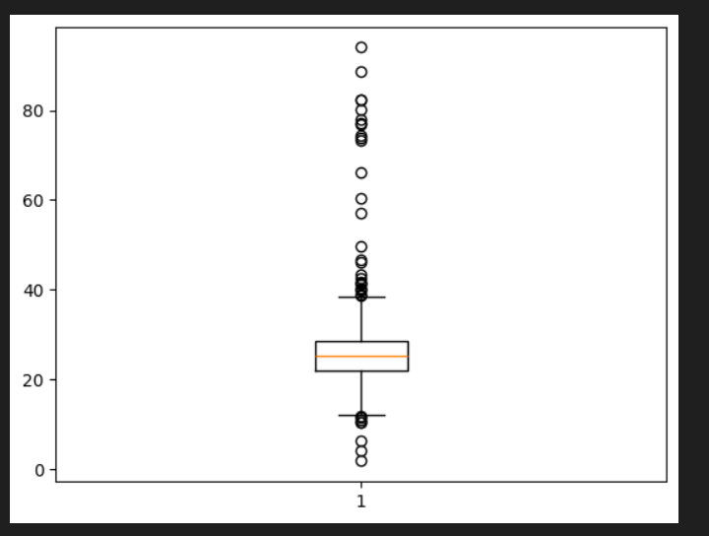
Outliers in Temperature

Slide 4
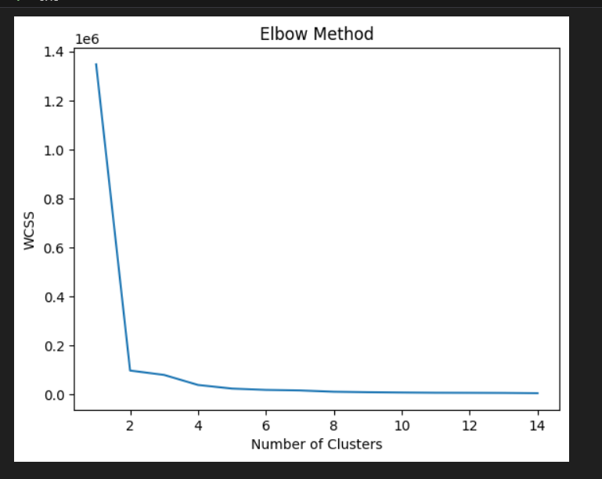
Elbow curve(n_clusters=4)

Slide 5
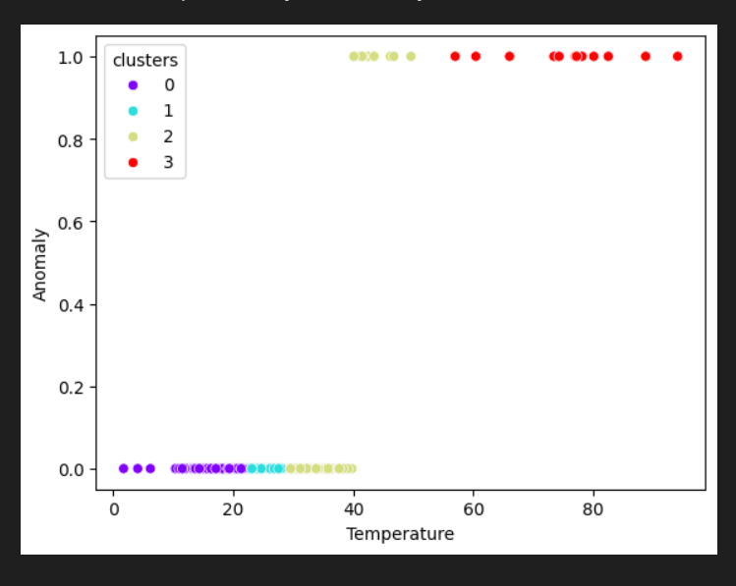
Anamoly is above 40 degrees

Slide 6
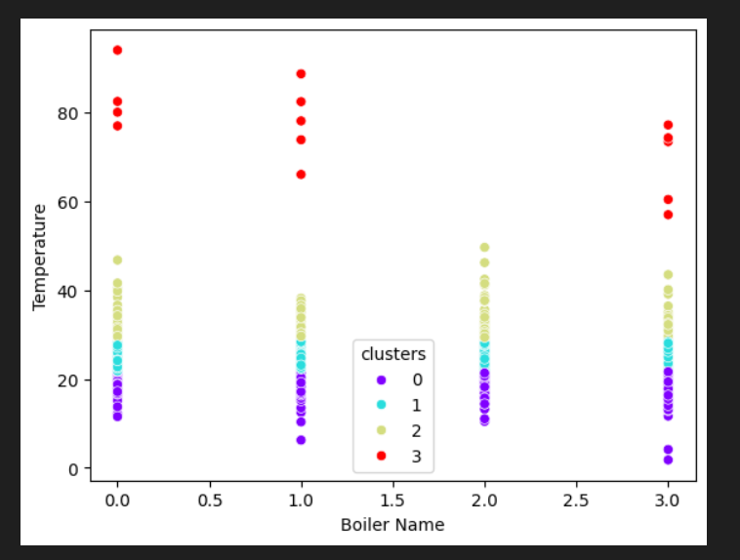
From the temperature data, data in each boiler above 40 degrees

Slide 7
Conclusion
Boiler C and D arent much prone to anomaly
All the other three namely A and B are prone to anomaly above 40 degrees
Silheoutte score: 0.682 for 4 clusters
Silheoutte score: 0.83 for 2 clusters

