Slide 1



DEPARTMENT OF ELECTRICAL AND ELECTRONICS ENGINEERING
BATTERY VOLTAGE MONITOR

Slide 2
ABSTRACT
The Battery Voltage Monitor is a simple and effective project designed to monitor the voltage levels of a battery using an LM339 comparator IC. The system visually indicates different voltage levels using LEDs, providing an easy way to check the battery's status. This project is crucial for applications where maintaining the battery within a specific voltage range is critical, such as in automotive or renewable energy systems. The project employs four LEDs, each corresponding to a different voltage level, to indicate whether the battery is fully charged, undercharged, or in a critical state. The design is compact, cost-effective, and easy to implement on a breadboard.

Slide 3



IDENTIFICATION & DEFINITION OF PROBLEM
Monitoring battery voltage levels is essential to prevent damage due to overcharging or deep discharging.
Many battery systems lack a simple visual indication of voltage status, which canlead to inefficiency and potential failure in various applications.
There is a need for a cost-effective and straightforward solution to monitor batteryvoltage levels in real-time.

Slide 4
IDENTIFICATION OF ALTERNATE SOLUTIONS
Using a digital voltage meter to continuously measure the battery voltage.
Implementing a microcontroller-based solution with an LCD display to show precise voltage levels.
Developing a wireless voltage monitoring system that sends alerts when voltage levels fall outside safe limits.

Slide 5


PROJECT OBJECTIVES
To design a simple battery voltage monitoring system that indicates different voltage levels using LEDs.
To ensure that the system provides real-time feedback on the battery's condition (charged, undercharged, critical).
To build a low-cost, reliable, and easy-to-use device using an LM339 comparator and other basic electronic components.

Slide 6




CIRCUIT DIAGRAM

Slide 7
COMPONENTS USED
LM339 IC
100k-ohm variable
Ik resistor-8
LED-4
12 watts bablery-1
Connector-1
Bread Board -1
wire - few

Slide 8
COMPONENTS DESCRIPTION
LM339 (Quad Comparator IC): The LM339 is a low-power, quad comparator IC that features four independent voltage comparators designed to operate from a single power supply over a wide range of voltages.
100kΩ Variable Resistor: This variable resistor (potentiometer) is used to adjust the reference voltage levels that the LM339 compares the battery voltage against.
1kΩ Resistors (x8): Each resistor is connected in series with an LED to limit the current flowing through it.

Slide 9
COMPONENTS DESCRIPTION
LEDs : The Light Emitting Diodes (LEDs) serve as visual indicators for the battery voltage levels. Each LED corresponds to a different voltage threshold, illuminating when the battery voltage meets or exceeds the preset levels.
12V Battery: The 12V battery powers the entire circuit and is also the subject of voltage monitoring. The project is designed to work with this common battery voltage, making it suitable for various applications.
Breadboard: A breadboard is used to build the circuit without the need for soldering, allowing for quick assembly and testing.

Slide 10
PROGRESS OF WORK
The progress of the Battery Voltage Monitor project began with researching different voltage monitoring methods and selecting suitable components like the LM339 comparator, resistors, and LEDs. The circuit was then designed on paper, focusing on detecting key voltage levels. After that, the components were assembled on a breadboard, and the connections were made according to the circuit design. The system was tested using a 12V battery, and the voltage thresholds were calibrated using a variable resistor to ensure the LEDs displayed the correct voltage levels. Finally, adjustments were made to improve accuracy, and the results were documented for the project report.

Slide 11
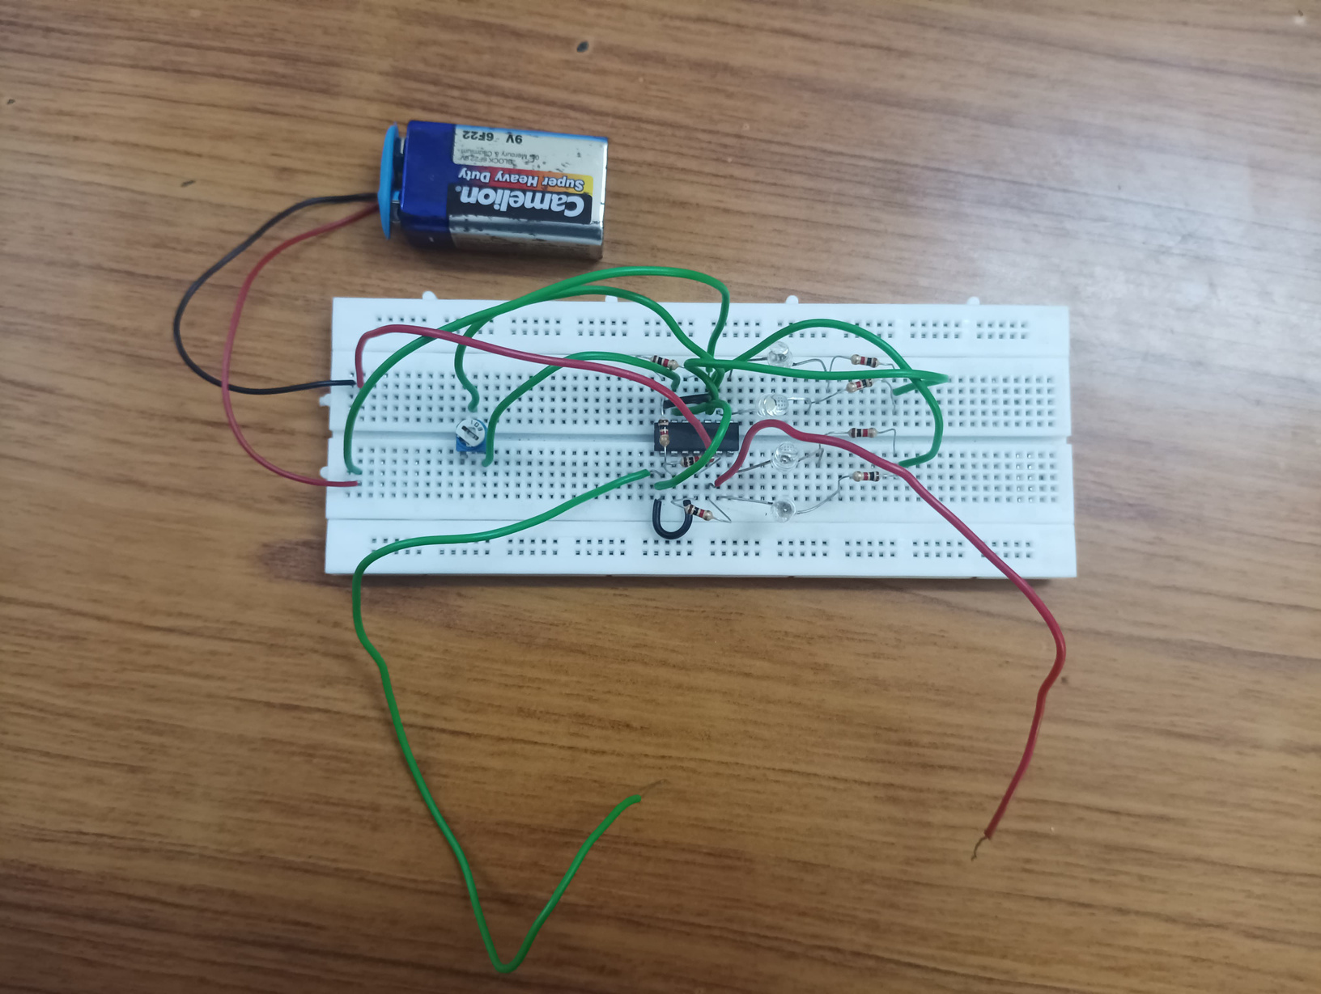
HARDWARE PHOTO
Voltage level-0% :

Slide 12
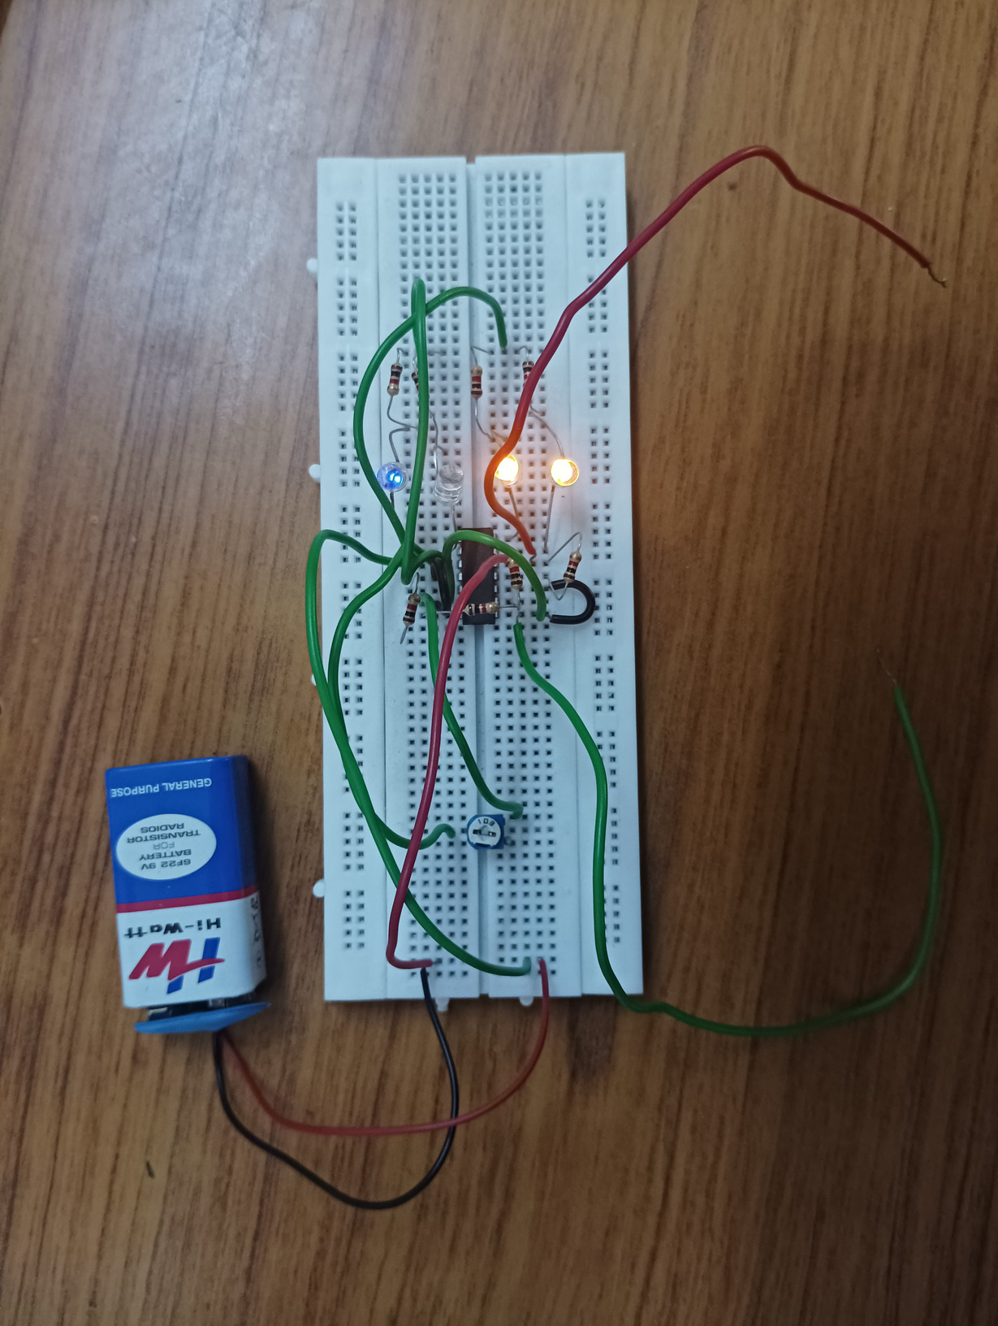
HARDWARE PHOTO
Voltage level - 50% :

Slide 13
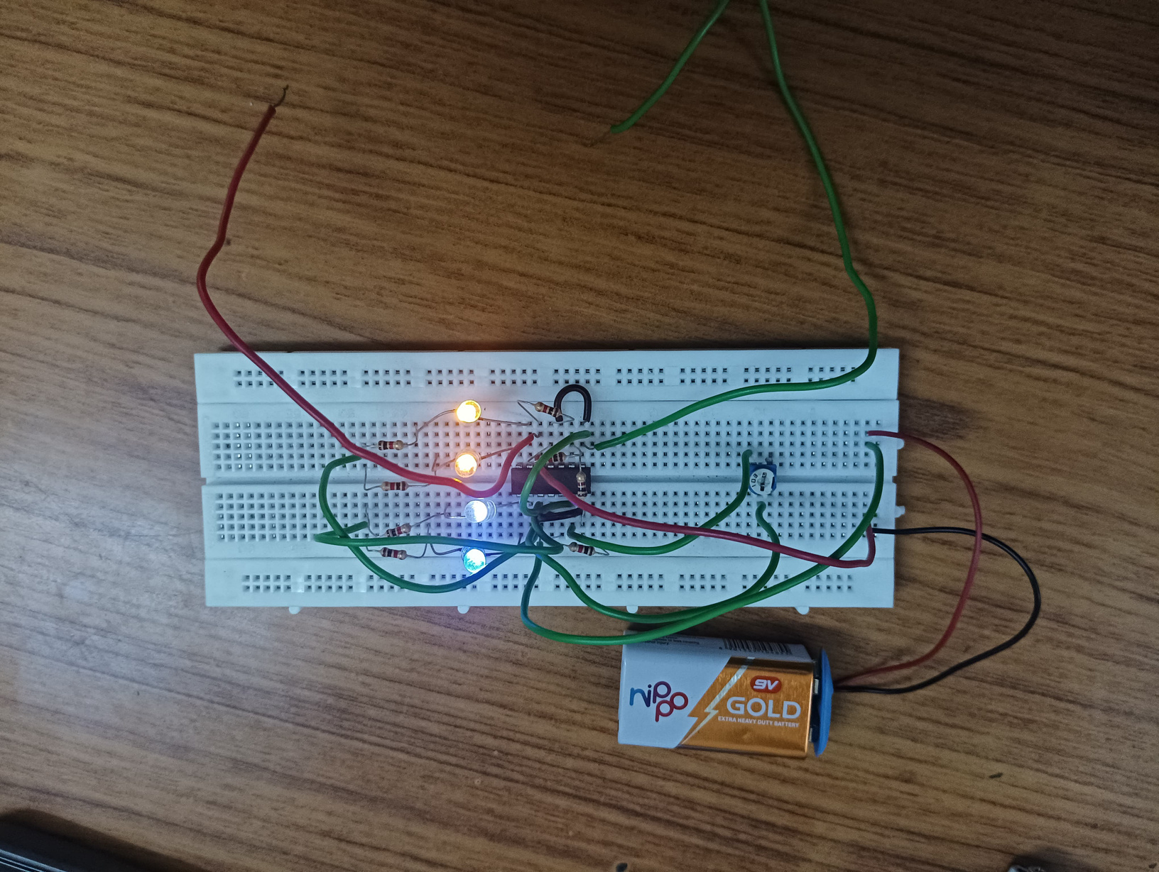
HARDWARE PHOTO
Voltage level 100% :

Slide 14
WORKING
The Battery Voltage Monitor operates using an LM339 comparator IC to compare the battery voltage with preset reference voltages. The circuit consists of four comparators within the LM339, each configured to detect a specific voltage level. A variable resistor is used to set the reference voltage for comparison.
When the battery voltage reaches or exceeds a particular threshold, the corresponding comparator output goes low, activating the connected LED. Each LED represents a specific voltage range, providing a clear visual indication of the battery's status.

Slide 15
WORKING
For example, one LED might indicate a critical low voltage, while others show undercharged, normal, or fully charged conditions.
This simple setup ensures real-time monitoring, making it easy to assess the battery's condition and prevent overcharging or deep discharge. The circuit is powered by the battery itself, making it self-sustained and compact.

Slide 16
FUTURE ENHANCEMENT
Monitoring battery voltage is crucial for ensuring the longevity and proper functioning of batteries in various applications. Numerous studies have highlighted the importance of keeping batteries within their optimal voltage range to prevent overcharging and deep discharge, which can significantly reduce their lifespan.
Previous designs for battery voltage monitoring systems have typically relied on complex and expensive equipment, such as digital voltmeters or microcontroller-based systems, to provide accurate readings. These methods, while effective, can be impractical for small-scale or cost-sensitive applications due to their complexity and high cost.

Slide 17
REFERENCE
1. LM339 Comparator Datasheet, Texas Instruments, available at: https://www.ti.com
2. Boylestad, R. L., & Nashelsky, L. (2006). Electronic Devices and Circuit Theory. Pearson Education.
3. LED Basics and Applications, Electronics Tutorials, available at: https://www.electronics-tutorials.ws
4. Resistor and LED Applications, Circuit Basics, available at: https://www.circuitbasics.com

Slide 18
CONCLUSION
In conclusion, the Battery Voltage Monitor project successfully provides a low-cost and efficient solution for monitoring battery voltage levels. By using the LM339 comparator and LEDs, the system gives a clear visual indication of different voltage ranges, helping to prevent battery damage due to overcharging or deep discharge. The project was designed, assembled, and tested on a breadboard, and it demonstrated accurate performance in monitoring voltage. Overall, this project proves to be a reliable and straightforward method for real-time battery voltage monitoring in various applications.

