Slide 1
SHANMUGAPRIYA T
NM Project
College name: Anna University, MIT
Email id:shanmugapriyathirumalaiselvan@gmail.com
NM id:6DBFE81D44AB1C6BF9D476F96360D9FA

Slide 2
PROJECT TITLE
Fashion MNIST Autoencoder: Image Reconstruction and Visualization
2

Slide 3


AGENDA
PROBLEM STATEMENT
PROJECT OVERVIEW
END USERS
SOLUTION AND VALUE PROPOSITION
NOVELTY
MODELLING
RESULTS
3/21/2024 Annual Review

Slide 4

PROBLEM STATEMENT
The project seeks to enhance image reconstruction using autoencoder models applied to the Fashion MNIST dataset.
It aims to evaluate the models' accuracy in maintaining image fidelity and essential visual features, investigate their capability in handling the dataset's diversity of textures and patterns, and explore practical applications such as image compression and denoising.
The project aims to contribute insights into deep learning techniques for image processing tasks, with a focus on real-world applicability and performance assessment.
Challenges:
Image Fidelity
Dataset Complexity
Latent Space Optimization
Practical Applicability

Slide 5

PROJECT OVERVIEW
Developing a Deep Learning-based Autoencoder Model for Image Reconstruction.
Implementing advanced optimization algorithms to enhance model accuracy and efficiency.
Evaluating model performance using the Fashion MNIST dataset and exploring practical applications such as image compression and denoising.
Employing visualization techniques to compare original and reconstructed images, providing insights into model effectiveness.
Contributing to advancements in image processing and deep learning techniques for practical use cases.

Slide 6

WHO ARE THE END USERS?
Potential users of the image reconstruction system: Image processing professionals, software developers, researchers in computer vision, manufacturing and quality control industries, and general users interested in deep learning applications.
Applications: Image compression, denoising, anomaly detection, quality control in manufacturing, image editing software, and advancements in deep learning techniques for image processing.

Slide 7

YOUR SOLUTION AND ITS VALUE PROPOSITION
Solution: Creating an autoencoder model that excels in reconstructing images with high fidelity and preserving essential visual features.
Value Proposition:
Enhanced image quality for image processing professionals.
Improved user experience in applications relying on image data.
Practical tools for researchers studying deep learning and image reconstruction.
Contributions to advancements in image processing and deep learning techniques.

Slide 8

THE WOW IN YOUR SOLUTION
Integration of OpenCV with the autoencoder model for real-time image reconstruction.
Implementation of sophisticated optimization algorithms to improve model accuracy and efficiency.
Creation of a comprehensive pipeline for image reconstruction, encompassing data preprocessing, model training, and real-time inference.
3/21/2024 Annual Review
8

Slide 9
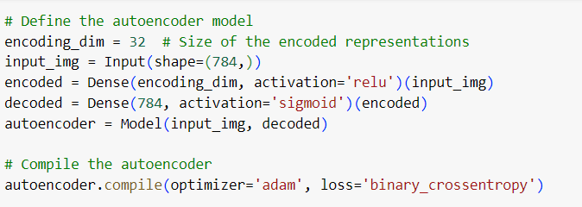
MODELLING
AUTOENCODER MODEL:
9

Slide 10
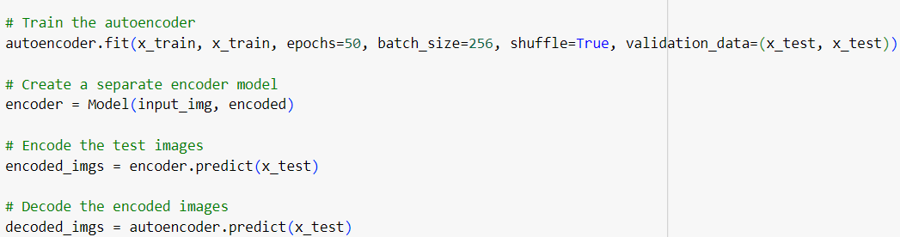
RESULTS
10

Slide 11
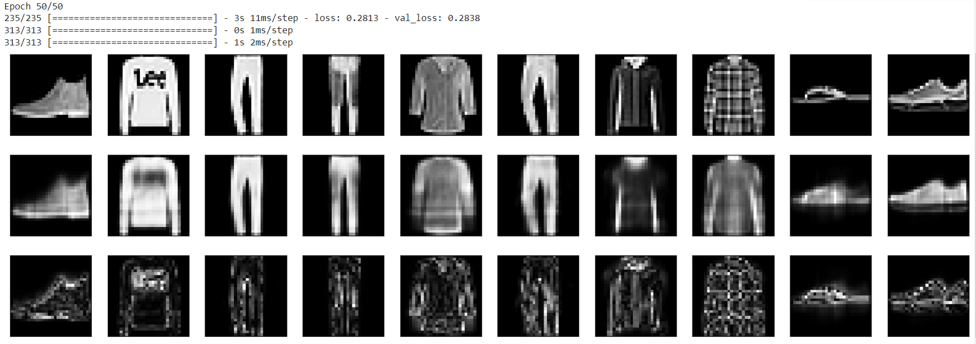
RESULTS
Demo link
11

