Slide 1
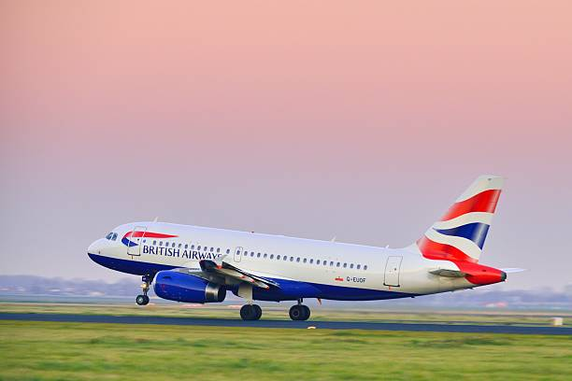
SENTIMAL ANALYSIS OF BRITISH AIRWAYS CUSTOMER REVIEWS
BY WEB SCRAPING
SHANKUGAPRIYA KUMAR / 16-12-2024

Slide 2
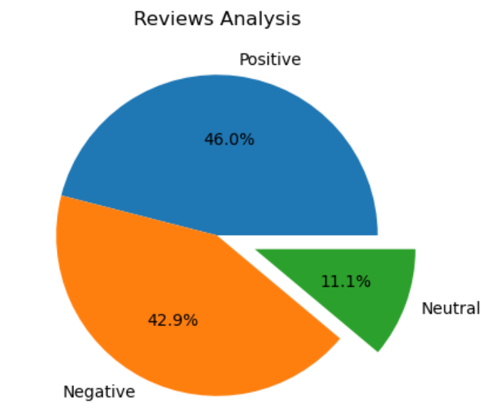
REVIEW ANALYSIS
Positive – 46%
Negative – 42.9 %
Neutral – 11.1%
RECOMMENDATIONS
Be transparent- Communicate changes made based on feedback and show customers that their concerns addressed.
Prioritize the most frequent complaints and fix them.
Reward loyal customers to build trust.
To convert neutral to satisfied customers, understand their concern and encourage them to share more feedback.

Slide 3
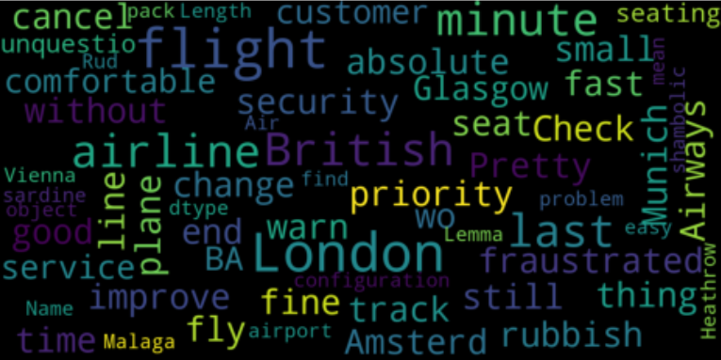
WORD CLOUD OF CUSTOMER REVIEWS

