Slide 1
EXTENSIVE SENTIMENT ANALYSIS USING INFORMATION GAIN
PROJECT GUIDE
Dr. A. Meenakowshalya, M.E.,Ph.D., (Assistant Professor)
PROJECT TEAM
Reshma Begam S 1517140
Shanmugapriya L 1517145
Sridevi K 1517149
Swathi M S 1517152
Swetha K A 1517306

Slide 2
INTRODUCTION
Sentiment Analysis is the text classification mechanism that analyses the context and tells whether the underlying sentiment is positive or negative.
Enormous features make the sentiment analysis slow and less sensitive.
Finding the optimum feature selection and classification is still a challenge.
In order to provide better feature selection effectively, an information-based feature selection and classification are introduced.

Slide 3
PROBLEM STATEMENT
This project implements extensive Sentiment analysis using information gain based feature selection and classification on
Document level
Sentence level
Feature level

Slide 4
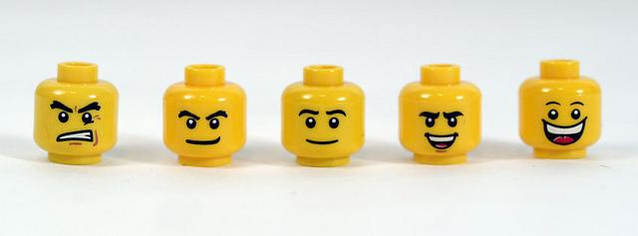
MOTIVATION
In recent years, people share their experiences online, through Social Channels, Blogs, Review Sites etc., using emojis, emoticons.
In order to understand the emotions, opinions and attitudes of people for business needs, Sentimental analysis is needed.
This motivated to determine the most appropriate classifier on various levels.

Slide 5
LITERATURE SURVEY
DOCUMENT-LEVEL SENTIMENT ANALYSIS
“Feature Selection and Weighting Methods in Sentiment Analysis” by Tim O’Keefe and Irena Koprinska
 | TECHNOLOGY USED | RESULT
[1] | A range of feature selectors and feature weights are systematically evaluated with both Naive Bayes and Support Vector Machine classifiers. | The best accuracy result was 87.15%, which was achieved using PD feature selection with a threshold of 0.125 and FP as a feature weighting method. SVM classifiers are significantly more accurate than NB classifiers.

Slide 6
LITERATURE SURVEY
SENTENCE-LEVEL SENTIMENT ANALYSIS
“Sentence Level Sentiment Analysis in the Presence of Conjuncts Using Linguistic Analysis” by Arun Meena and T.V. Prabhakar
 | TECHNOLOGY USED | RESULT
[2] | For the sentiment classification we perform steps such as POS-tagging,conjunctions analysis,polarities of individual words using Wordnet,polarity calculation using DPC and then apply the conjunction rules. | We used word dependencies and dependency trees to analyze the sentence constructs and were able to get results close to 80% Conjunction analysis improves the sentiment classification by more than 25% and thus results in a better accuracy

Slide 7
LITERATURE SURVEY
FEATURE-LEVEL SENTIMENT ANALYSIS
“Recognizing Contextual Polarity in Phrase-Level Sentiment Analysis” by Theresa Wilson, Janyce Wiebe and Paul Hoffmann.
 | TECHNOLOGY USED | RESULT
[3] | This paper presents new experiments in automatically distinguishing prior and contextual polarity. We use a two-step process that employs machine learning and a variety of features. The first step classifies each phrase containing a clue as neutral or polar. The second step takes all phrases marked in step one as polar and disambiguates their contextual polarity. | Neutral-Polar Classification with all 28 features will give the good precision with the highest recall. Polarity Classification with all the 10 polarity features will achieve both higher precisions and higher recalls.

Slide 8
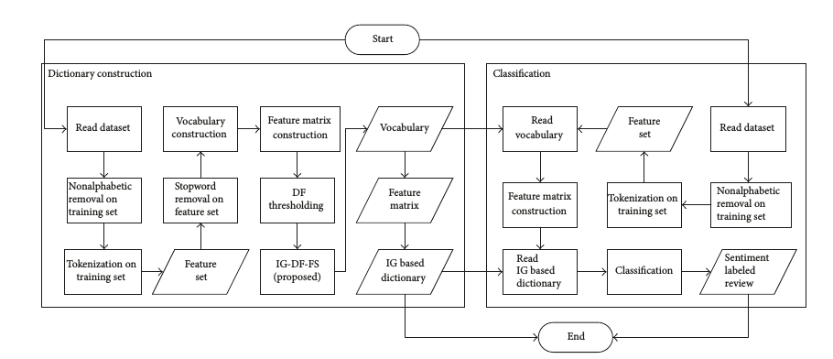
FLOW CHART

Slide 9
PHASES
Phase 1 - Feature selection in
Document level Sentiment Analysis
This project combines the Information gain and DF thresholding, named IGDFFS.
IGDFFS selects a feature that has IG score equal to 0.5.
It means those features highly related to one class only.
This phase succeed in reducing about 90% of unnecessary features.

Slide 10
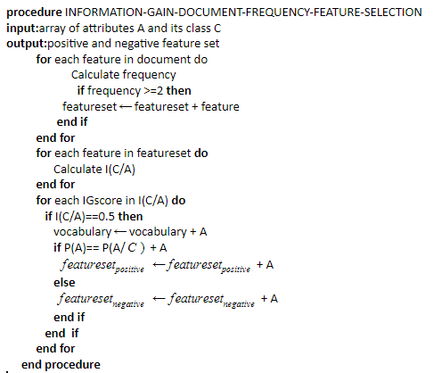
ALGORITHM
IG-DF FEATURE SELECTION

Slide 11
Phase 1 - Feature selection in
Sentence and feature level Sentiment analysis
This project combines the Information gain and TF-IDF feature selection.
It selects a feature that has IG score equal to 0.5.
It means those features highly related to one class only.
These schemes succeed in reducing about 90% of unnecessary features.

Slide 12
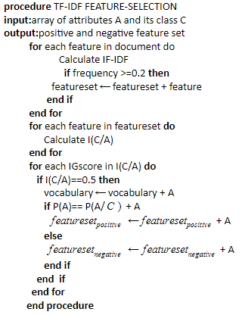
IG-TF-IDF FEATURE SELECTION

Slide 13
PHASE 2 - CLASSIFICATION
Entropy and information gain are commonly used in decision tree.
The selected feature with the highest information gain determines the class of the review.
Based on this intuition, we categorize our vocabulary into the positive feature and negative feature.
A review will be classified into positive review if most of the features are positive and vice versa.

Slide 14
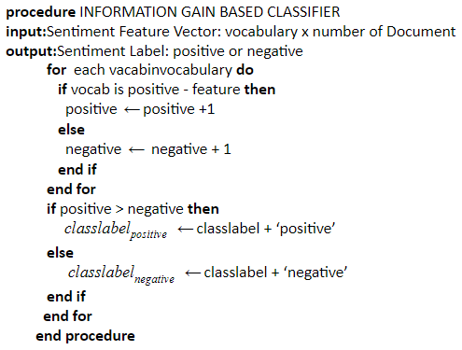
INFORMATION GAIN CLASSIFIER

Slide 15
DATASETS
Document level sentiment analysis
Dataset - URL | http://www.cs.cornell.edu/people/pabo/movie-review-data/
Review - URL | https://www.imdb.com/
Documents | 2000
Movies | Hitcher(1986),Beyond Therapy(1987),Angel Heart(1987),Radio Days(1987),Lethal Weapon(1987),etc.,

Slide 16
DATASETS
Sentence level sentiment analysis
Dataset - URL | http://www.cs.cornell.edu/people/pabo/movie-review-data/
Review - URL | https://www.rottentomatoes.com/
Sentences | 10662
Movies | Aankhen(2002),Abandon(2002),Mr.Cinderella(2002), Men in Black II(2002),Down the Road(2002)etc.,

Slide 17
DATASETS
Feature level sentiment analysis
Dataset - URL | https://www.kaggle.com/c/sentiment-analysis-on-movie-reviews/data
Review - URL | https://www.rottentomatoes.com/
Features | 76479
Movies | 2010-2014 movies

Slide 18

PYTHON PACKAGES
Scikit-learn
Scikit-learn provides a range of supervised and unsupervised learning algorithms via a consistent interface in Python. It features various classification, regression and clustering algorithms including SVM,Random forest etc.,
Pandas
Pandas is used for data manipulation and analysis. It offers data structures and operations for manipulating numerical tables and time series.
NumPy
NumPy is the fundamental package for scientific computing in Python. NumPy can be used as an efficient multi-dimensional container of generic data.

Slide 19
PYTHON PACKAGES
nltk
The Natural Language Toolkit(NLTK) is a leading platform for building Python programs to work with human language data. It contains text processing libraries for tokenization, parsing, classification, stemming, tagging and semantic reasoning.
matplotlib
Matplotlib is a plotting library in Python, which produces 2D graphics in different interactive environments.Matplotlib can be used to draw different types of graphs, like line, scattered, bar, etc.

Slide 20
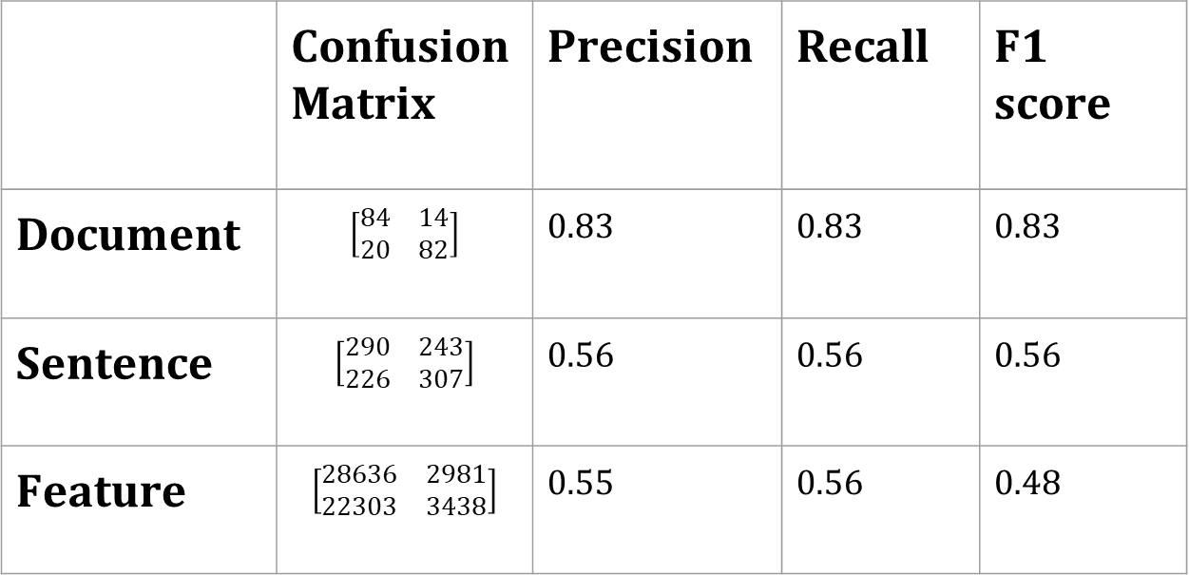
MODULES
SUPPORT VECTOR MACHINE
 | Confusion Matrix | Precision | Recall | F1 score
Document | $$\left[\begin{matrix}84 & 14 \\ 20 & 82\end{matrix}\right]$$ | 0.83 | 0.83 | 0.83
Sentence | $$\left[\begin{matrix}290 & 243 \\ 226 & 307\end{matrix}\right]$$ | 0.56 | 0.56 | 0.56
Feature | $$\left[\begin{matrix}28636 & 2981 \\ 22303 & 3438\end{matrix}\right]$$ | 0.55 | 0.56 | 0.48

Slide 21
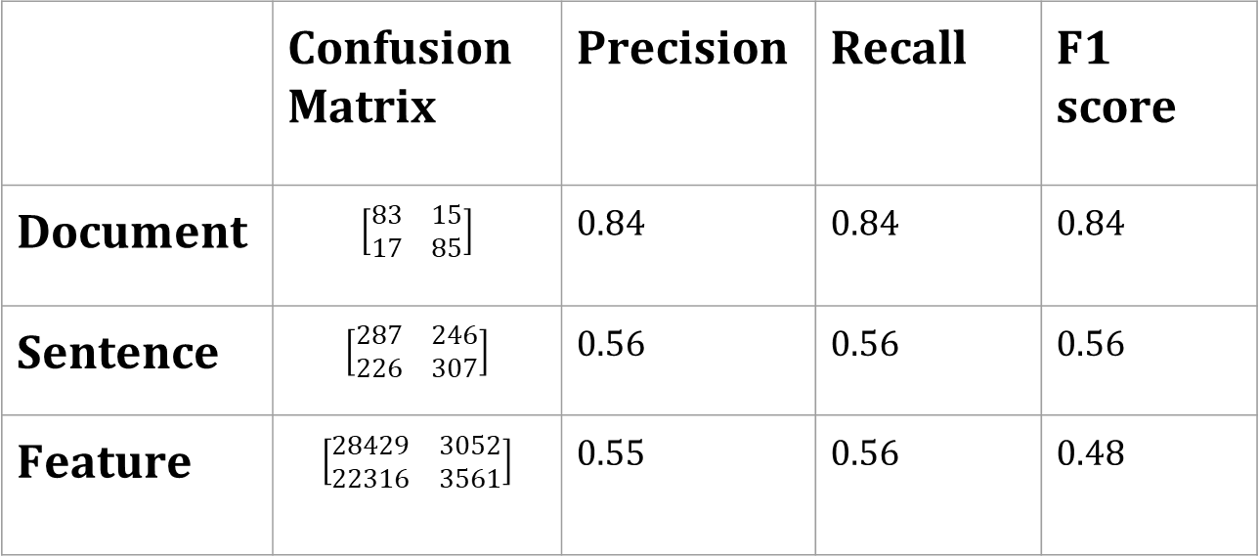
MODULES
LOGISTIC REGRESSION
 | Confusion Matrix | Precision | Recall | F1 score
Document | $$\left[\begin{matrix}83 & 15 \\ 17 & 85\end{matrix}\right]$$ | 0.84 | 0.84 | 0.84
Sentence | $$\left[\begin{matrix}287 & 246 \\ 226 & 307\end{matrix}\right]$$ | 0.56 | 0.56 | 0.56
Feature | $$\left[\begin{matrix}28429 & 3052 \\ 22316 & 3561\end{matrix}\right]$$ | 0.55 | 0.56 | 0.48

Slide 22
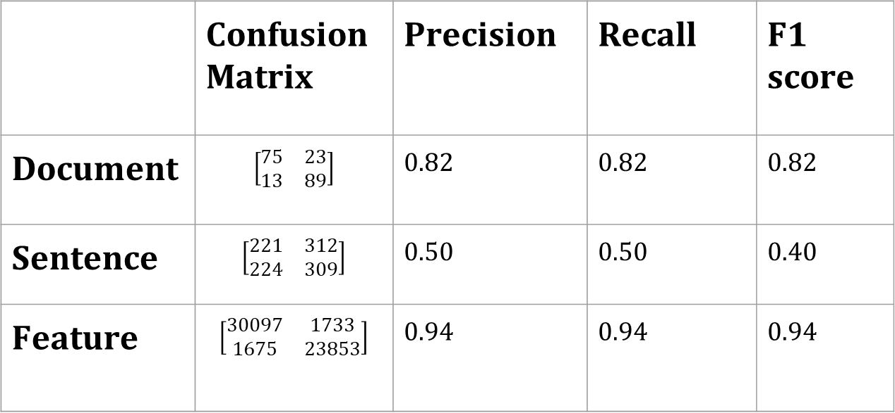
MODULES
RANDOM FOREST
 | Confusion Matrix | Precision | Recall | F1 score
Document | $$\left[\begin{matrix}75 & 23 \\ 13 & 89\end{matrix}\right]$$ | 0.82 | 0.82 | 0.82
Sentence | $$\left[\begin{matrix}221 & 312 \\ 224 & 309\end{matrix}\right]$$ | 0.50 | 0.50 | 0.40
Feature | $$\left[\begin{matrix}30097 & 1733 \\ 1675 & 23853\end{matrix}\right]$$ | 0.94 | 0.94 | 0.94

Slide 23
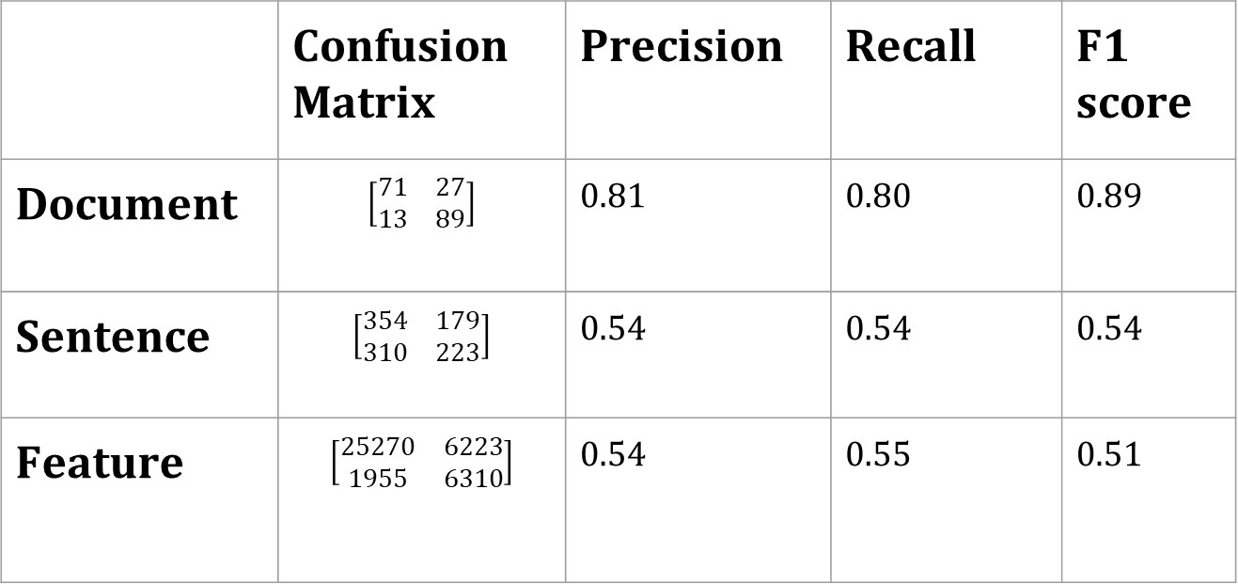
MODULES
NAIVE BAYES
 | Confusion Matrix | Precision | Recall | F1 score
Document | $$\left[\begin{matrix}71 & 27 \\ 13 & 89\end{matrix}\right]$$ | 0.81 | 0.80 | 0.89
Sentence | $$\left[\begin{matrix}354 & 179 \\ 310 & 223\end{matrix}\right]$$ | 0.54 | 0.54 | 0.54
Feature | $$\left[\begin{matrix}25270 & 6223 \\ 1955 & 6310\end{matrix}\right]$$ | 0.54 | 0.55 | 0.51

Slide 24
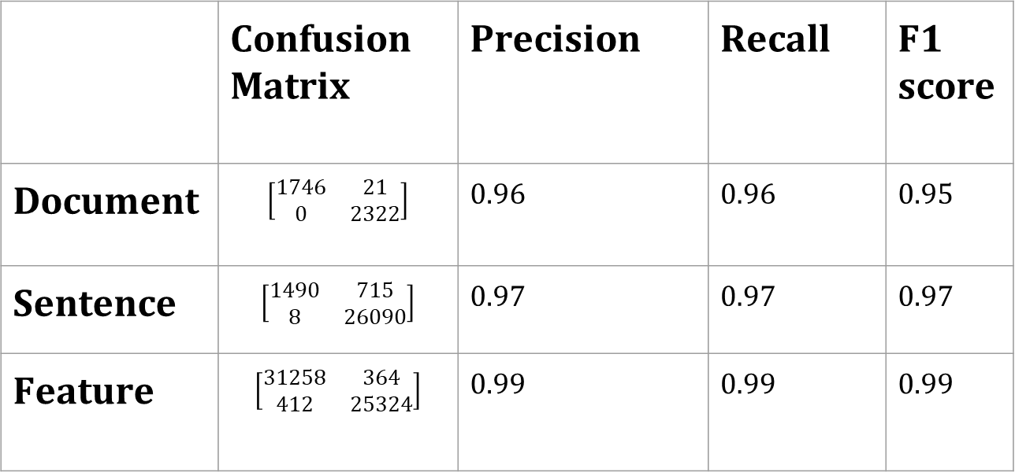
MODULES
INFORMATION GAIN
 | Confusion Matrix | Precision | Recall | F1 score
Document | $$\left[\begin{matrix}1746 & 21 \\ 0 & 2322\end{matrix}\right]$$ | 0.96 | 0.96 | 0.95
Sentence | $$\left[\begin{matrix}1490 & 715 \\ 8 & 26090\end{matrix}\right]$$ | 0.97 | 0.97 | 0.97
Feature | $$\left[\begin{matrix}31258 & 364 \\ 412 & 25324\end{matrix}\right]$$ | 0.99 | 0.99 | 0.99

Slide 25
MODULES
ACCURACY
ALGORITHM/LEVEL | DOCUMENT | SENTENCE | FEATURE
INFORMATION-GAIN | 96 | 97.4 | 98.6
RANDOM FOREST | 82 | 52 | 93
LOGISTIC REGRESSION | 84 | 55 | 55
SUPPORT VECTOR MACHINE | 83 | 56 | 56
NAIVE BAYES | 80 | 54 | 55

Slide 26
CONCLUSION
The proposed information gain feature selection method selects the feature that has high information gain and occurrence. The proposed Information gain model is efficient in terms of classification accuracy compared to the existing Support Vector Machines, Logistic Regression, Random Forest, and Naive Bayes models. The proposed Information gain model shows the highest accuracy of 96%, 97.4% and 98.6% for document, sentence and feature level sentiment analysis respectively.

Slide 27
The next challenging task is to enhance the feature selection process by the provision of larger set of data, with respect to various contexts. The accuracy and real-time usage of the proposed application depend on the size of the dataset and the effective selection of the features, at the document, sentence and phrase level.

Slide 28
REFERENCES
[1]T. OKeefe and I. Koprinska, “Feature selection and weighting methods in sentiment analysis,” in Proceedings of the 14th Australasian document computing symposium, pp. 67–74, Citeseer, Sydney, Australia, 2009.
[2] Meena, Arun and T. V. Prabhakar. 2007. Sentence Level Sentiment Analysis in the Presence of Conjuncts Using Linguistic Analysis.Lecture Notes in Computer Science, 573-580.
[3] Wilson, Theresa, Janyce Wiebe, and Paul Hoffmann. 2005. Recognizing contextual polarity in phrase-level sentiment analysis. In Proceedings of the Human Language Technologies Conference/ Conference on Empirical Methods in Natural Language Processing (HLT/EMNLP-2005),pages 347–354, Vancouver.

Slide 29
THANK YOU

