Slide 1
G.SHANMUGASUNDARAM
Final Project

Slide 2
PROJECT TITLE
Gender and Age Prediction from Images

Slide 3


AGENDA
Introduction
Problem Statement
Project Overview
End Users
Solution Highlights
Modeling Approach
Results
Conclusion
3/21/2024 Annual Review

Slide 4

PROBLEM STATEMENT
Age and gender recognition from images finds wide-ranging applications, including targeted advertising and security systems.
Nevertheless, achieving precise and swift detection of age and gender in real-time images poses a persistent challenge.

Slide 5

PROJECT OVERVIEW
Goal: Develop a system with the ability to precisely identify age and gender from images or video feeds in real-time.
Tools Employed:
OpenCV: Applied for image manipulation and computer vision functions.
Deep Learning Models: Leveraging pre-trained architectures for tasks like face detection, age estimation, and gender classification.
Python: Utilized as the programming language for system implementation.

Slide 6

WHO ARE THE END USERS?
Marketing Agencies: Utilizing demographic data for targeted advertising campaigns.
Security Systems: Employing age and gender analytics for surveillance and access management.
Entertainment Industry: Conducting audience profiling to tailor content experiences.
Healthcare: Utilizing demographic analysis for patient monitoring and management.

Slide 7

YOUR SOLUTION AND ITS VALUE PROPOSITION
Solution: Our approach involves the utilization of deep learning models for precise face detection, age estimation, and gender classification.
Value Proposition:
Precision: Harnessing cutting-edge deep learning architectures guarantees accurate identification of age and gender. Real-Time Capability: Capable of analyzing images or video feeds instantly, facilitating swift decision-making.
Versatility: Applicable across diverse industries, delivering valuable insights tailored to specific needs. Efficiency: Optimized implementation ensures resource efficiency and optimal performance. Scalability: Seamlessly integrates into existing systems or functions as a standalone solution.
Customization: Offers flexibility for parameter adjustments and integration with complementary modules for specialized requirements.

Slide 8

THE WOW IN YOUR SOLUTION
High Precision: Attaining accurate age and gender identification even under demanding circumstances.
User-Friendly Interface: Intuitive design for straightforward deployment and user interaction.
Adaptability: Ability to adjust to various environments and situations seamlessly.
Ethical Considerations: Guaranteeing privacy and ethical handling of demographic data.
3/21/2024 Annual Review
8

Slide 9
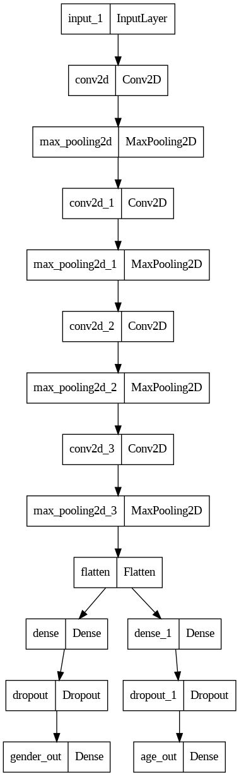
MODELLING
9

Slide 10
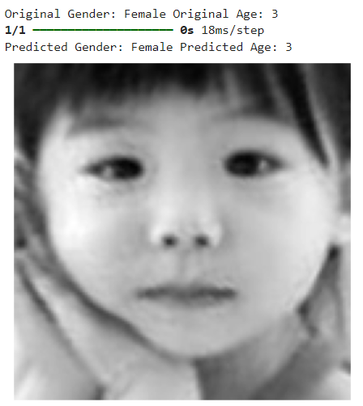
RESULS
Original Gender: Female Original Age: 3
Predicted Gender: Female Predicted Age: 3
Accuracy above 80% for all test cases(Images)
DRIVE LINK:
https://colab.research.google.com/drive/1TKCDEmVr0dYCncUzIKCa_U3o3pD-wYnE?usp=drive_link
10

