Slide 1


SALES DATASET ANALYSIS
-Advanced excel project
SHANMUGASUNDARI B
09-09-2025
DADS [July]

Slide 2
OBJECTIVE AND OVERVIEW
To analyse sales data to identify trends,understand sales performance,and provide actionable business
insights.
Goals:
• Perform comprehensive sales data analysis
• Extract meaningful insights
• Create interactive visualizations and dashboards
• Leverage advanced Excel features
• Provide actionable recommendations

Slide 3
Data description:
9900+ rows,columns such as Order ID,Sales ID,
Product Type,etc..
Data Cleaning Process:
  Date formatting
  Discount as percentage(%)
  Profit as currency($)
  Removed duplicate records
  Numerical as correction of two decimal values
  Remove blanks

Slide 4
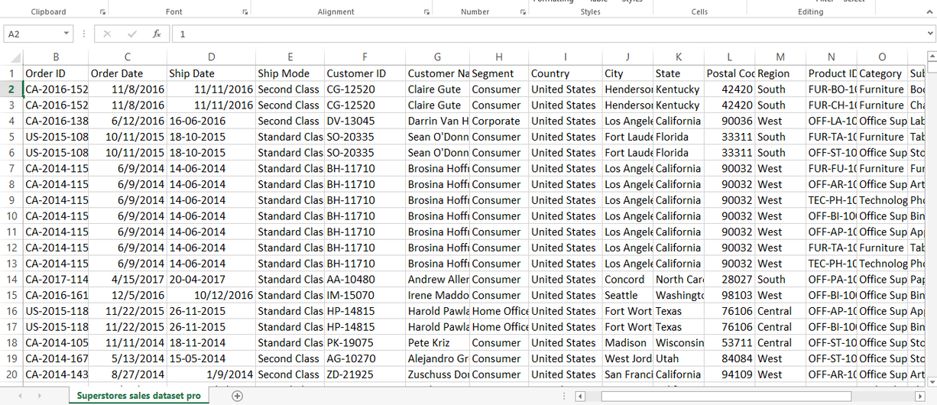
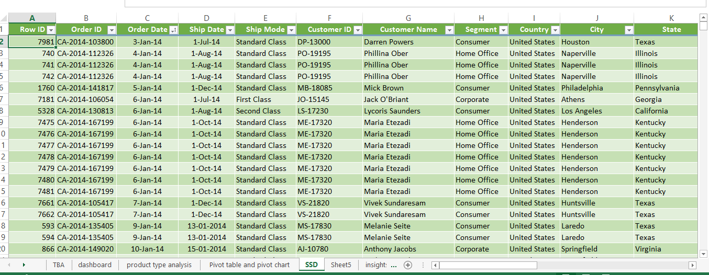
DATASET BEFORE AND AFTER
Before
After

Slide 5
KEY METRICS CALCULATION AND DATA ANALYSIS
  Adjusted Sales = Sales*(1-Discount)
  Total Revenue = Sum of Adjusted sales
  Average Order Value=Total Adjusted sales / Total Revenue
  Discount Amount= Sales*Discount
  Total Discounts= Sum of all Discounts

Slide 6
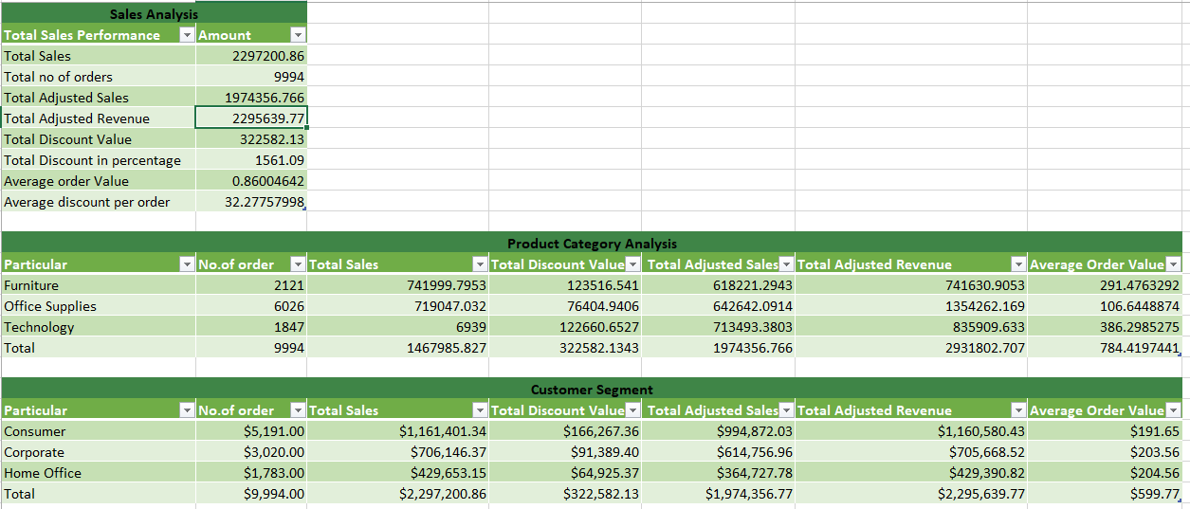
KEY METRICS AND INSIGHTS CALCULATION AND DATA ANALYSIS

Slide 7
PIVOT TABLE AND PIVOT CHARTS
Fields Used: Segment & Category
Purpose: Analyze sales and profit performance by product type.
Pivot Setup:
Rows: Segment
Category
Values:
Adjusted Sales (Sum) & (avg)
discount(Sum)

Slide 8
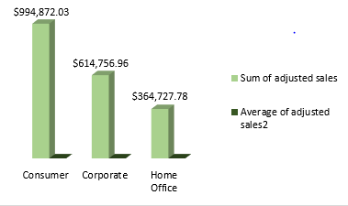
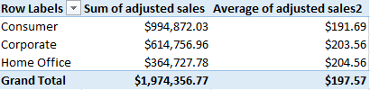
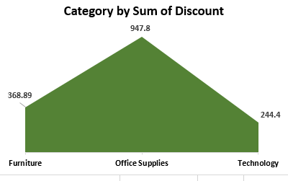

Table:
chart:

Slide 9
DASHBOARD OVERVIEW
This dashboard provides a comprehensive analysis of sales performance, discounts, and profitability across different dimensions such as time, product sub-categories, ship modes, and customer segments.
Key Metrics
  Total Sales: 2,297,200.86
  Average Sales: 0.86
  Total Discount: 1,561.09
  Top Product Sales: 741,999.80

Slide 10
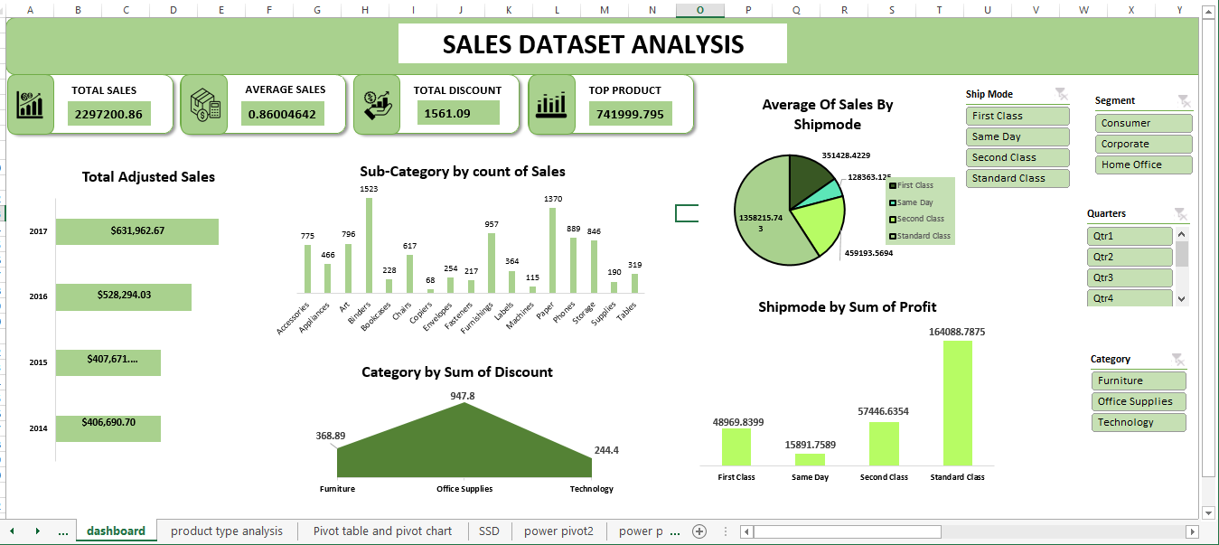

Slide 11
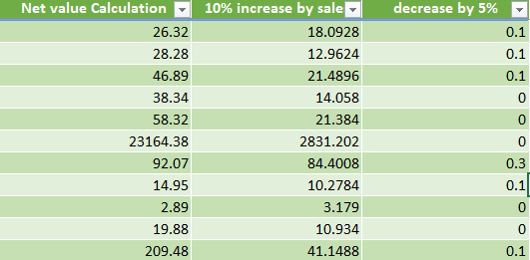
WHAT IF ANALYSIS
The process of changing the values in cells to see how those changes will affect the outcome of formulas on your worksheet. It is a powerful forecasting and planning tool that allows you to explore multiple scenarios and make data-driven decisions without changing your original data.
  Net Value Calculation:
=Sales*(1-Discount)*Quantity
  5% Decreased Discount:
=Netvalue*((1-Discount)-0.05)

Slide 12
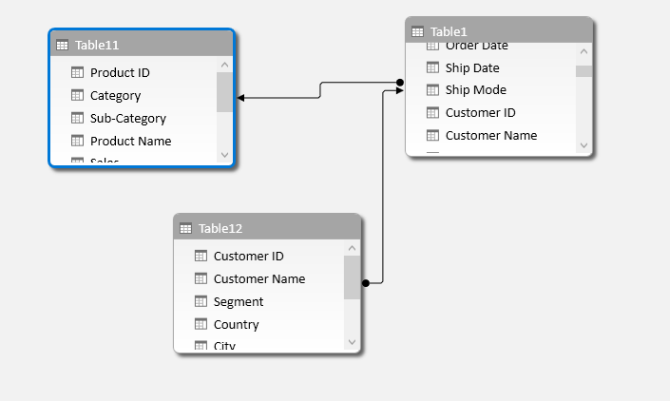
POWER PIVOT

Slide 13
INSIGHTS
  Technology products bring the highest sales and profit.
  Office Supplies also do well, with good profit.
  Furniture sells a lot but makes very little profit → discounts and delivery costs are
eating margins.
  Standard Class shipping gives the most sales and profit.
  First Class and Same Day shipping cost more and bring less profit.
  Discounts are high (13–16%), and they hurt profits, especially for Furniture.

Slide 14
RECOMMENDATIONS
  Fix Furniture → Reduce big discounts and control shipping costs.
  Control Discounts → Offer discounts only on selected products, not everywhere.
  Focus on Tech & Office Supplies → Promote more, as they give good profit.
  Push Standard Shipping → Encourage customers to use it (like free shipping offers).
  Use Premium Shipping wisely → Keep Same Day and First Class for urgent or VIP orders only.

Slide 15
THANK
YOU

