Slide 1
BUSINESS ANALYST ASSIGNMENT
DATA ANALYSIS AND INSIGHTS FOR DIFFERENT PAGE OPTIMIZATION
How to get more user install and Engagement from the App and Website;
Shanmugavel S

Slide 2
CONTENTS
01
08
INTRODUCTION & OBJECTIVE
GENDER REPORT
02
09
USER ACQUISITION
USER BY INTEREST
03
TRAFFIC ACQUISITION
10
USER BY LANGUAGE
04
EVENT REPORT
11
USER BY AGE
05
CONVERSION REPORT
12
RECOMMENDATIONS
06
PAGES AND SCREEN REPORT
07
CITIWISE REPORT

Slide 3
INTRODUCTION AND OBJECTIVE

Slide 4
INTRODUCTION AND OBJECTIVE
ASSIGNMENT DESCRIPTION
As an intern in the Business Analytics team, the task of a Business Analyst is to analyze the dataset and generate actionable insights to optimize page performance for a fictional company called “XYZ”.
The dataset contains user data from various regions, customer demographics, product information, and marketing campaign details
ASSIGNMENT OBJECTIVE
The objective of the assignment is to identify critical factors influencing Data Analysis and Insights for different Page Optimization and how to get more user installation and engagement from the App and Website User and propose recommendations for improving performance.

Slide 5
USER ACQUISITION

Slide 6
USER ACQUISITION
User acquisition is a fundamental aspect of business growth, emphasizing the strategic methods employed to increase the user base.
Successful user acquisition involves understanding the target audience, creating compelling value propositions, and utilizing various marketing channels such as content marketing, social media, paid advertising, and email campaigns.
The goal is not only to acquire users but also to convert them into active and engaged customers. Analytics and tracking play a crucial role in measuring the effectiveness of different acquisition channels, enabling businesses to make data-driven decisions over time.

Slide 7
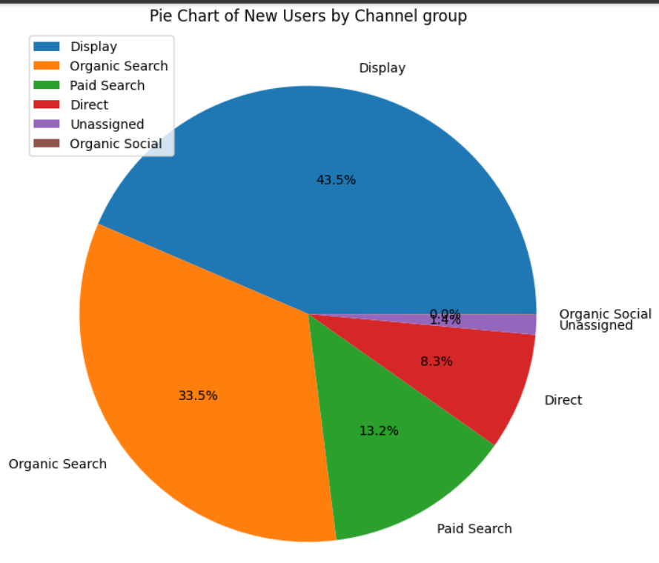
NEW USER BY CHANNEL GROUP
Channels are predefined categories that help you track and analyze where your website's traffic comes from. -
They provide a clear way to monitor the performance of different sources sending visitors to your site, such as search engines, social media, or referral links.
THE FINDINGS:
Most amount of Users reached our website by the Display Channel Mode.
Organic Search Mode generated 33.5% of User Acquisition.
Paid Search stood third in terms of most contributions towards user acquistion with 13.2% of Acquisition.
Only 8.3% of the Users reached our website in the Direct Channel Mode.
The Unassigned channel mode contributed the second least with just 1.4% of Users.
Organic Social contributed the least amount of Users to the website.

Slide 8
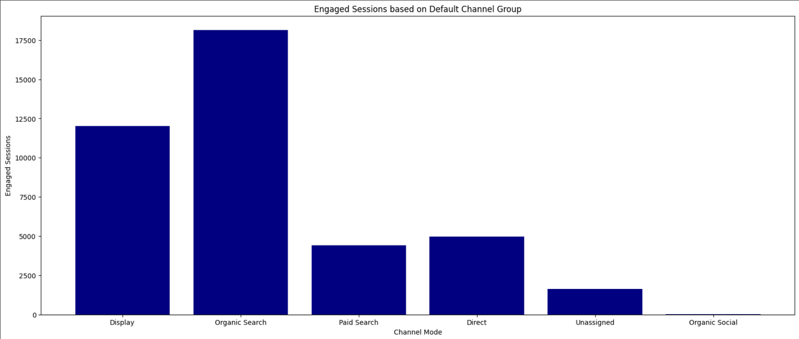
ENGAGED SESSIONS BASED ON CHANNEL GROUP
Engagement session is a metrics that enables you to measure and analyze user engagement with your website or app.
THE FINDINGS:
The users that found us using Organic Search had the most amount of Engaged Session.
The Display Channel generated the second most Engaged Session for the User.
The users who Directly searched for our website stood third in terms of Engaged Session.
The Paid Search mode accounted to be the fourth most Session Engagement to the Users.
The Unassigned and Organic Social generated the least amount of User Engagement

Slide 9
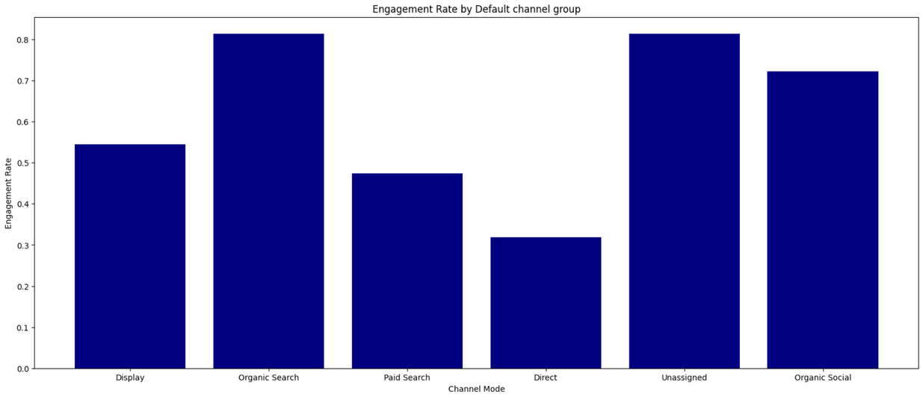
ENGAGEMENT RATE BASED ON CHANNEL GROUP
The engagement rate is the percentage of engaged sessions on your website or mobile app
THE FINDINGS:
The Organic Search Users accounted the most amount of Engagement Rate.
The Unassigned Channel stood second.
Users with Organic Social accounted to be the third most Engagement rate for the Users.
The Display mode generated the fourth most amount of Engagement Rate.
The Paid Search and Direct channel mode generated the least engagement rate compared to the other channels

Slide 10
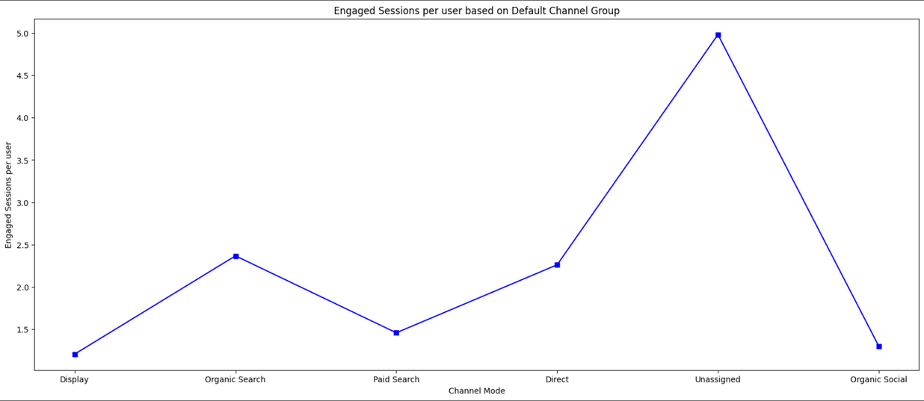
ENGAGED SESSIONS PER USER BASED ON CHANNEL GROUP
An engaged session is a period during which a user is engaged with your website or app.
An engaged session is a session that lasts longer than 10 seconds, has a conversion event, or has at least 2 pageviews
THE FINDINGS:
The Unassigned Search mode accounted the most amount of Engagement per User amount.
Users finding us through Organic Search stood second.
The Direct Search mode generated the third most amount of engagement per user.
Paid Search and Display channel mode generated the least amount of Engagement per user.

Slide 11
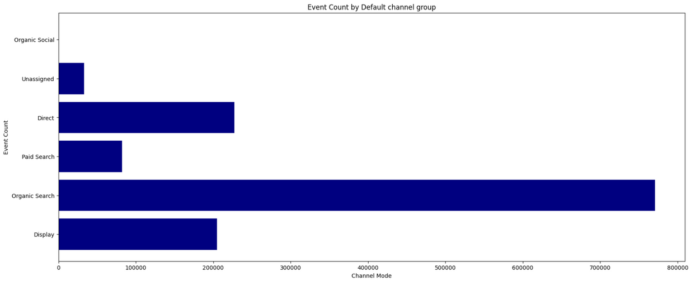
EVENT COUNT BY CHANNEL MODE
Event count measures how often users interact with specific elements on a website within a given time span. The higher the number, the more likely users are to find something worth clicking, watching, or purchasing on the site.
THE FINDINGS:
Users that found the website using Organic Search accounted to generate the most Event Counts.
The Display mode generated the second most Event Counts.
The Direct mode generated the third most Event Counts.
Users that found using the Paid Search mode generated the fourth most Event Counts.
Unassigned and Organic Social generated the least amount of Event Counts

Slide 12
CONVERSION BASED ON BY CHANNEL GROUP
A conversion is any user action that's valuable to your business; for example, a user purchasing from your store or subscribing to your newsletter are examples of common conversions.
THE FINDINGS:
The Organic search mode generated the most amount of Conversions.
The Display search mode generated the second most amount of Conversions.
Users with Direct Channel mode generated the third most Conversions.
Paid Search accounted to generate the Fourth most amount of conversions.
Unassigned and Organic Social generated the least amount of conversions

Slide 13
TRAFFIC ACQUISITION

Slide 14
TRAFFIC ACQUISITION
Traffic acquisition is the strategic process of attracting and directing visitors to a website or online platform.
The ultimate goal of traffic acquisition is not just to bring in any visitors but to target and engage the right audience—those who are likely to convert into customers, subscribers, or active users.
Analyzing the effectiveness of different acquisition channels, optimizing strategies, and adapting to changing trends are essential aspects of a successful traffic acquisition strategy, contributing significantly to the overall growth and success of an online presence

Slide 15
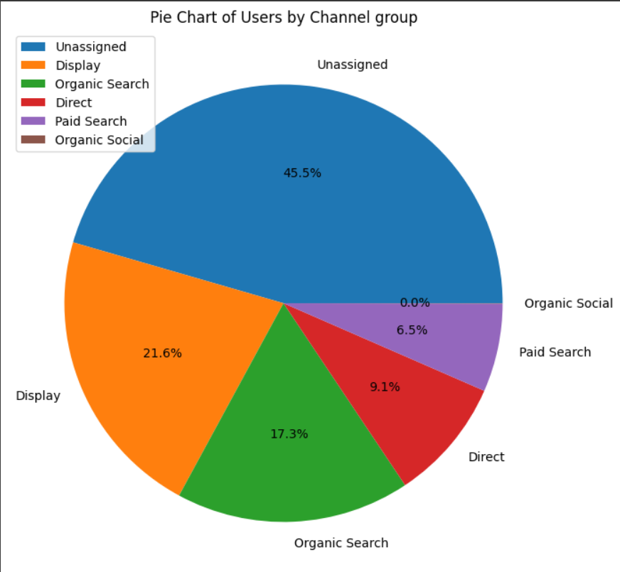
USER BY CHANNEL GROUP
Users by Channel Group refers to a metric that provides insights into the number of users visiting a website based on different predefined channel groupings. Channels represent the various sources through which users find and access a website.
THE FINDINGS:
The Unassigned Channel Group attracted the most amount of Users.
The Display Channel group stood second in terms of Traffic Acquisition.
The Organic Search Channel generated the third most amount of Users.
Users through Direct Search generated the fourth most amount of Users.
The least amount of Traffic was generated by the Paid Search and Organic Social Channel mode.

Slide 16
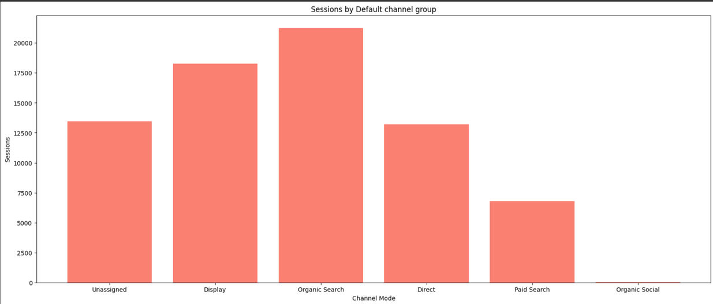
SESSION BY CHANNEL MODE
Engagement session is a metrics that enables you to measure and analyze user engagement with your website or app.
THE FINDINGS:
The Organic Search Channel Group generated the most amount of Sessions.
The Display Channel group stood second in terms of Sessions.
The Unassigned Channel generated the third most amount of Sessions.
Users through Direct Search generated the fourth most amount of Users.
The least amount of Session was generated by the Paid Search and Organic Social Channel mode.

Slide 17
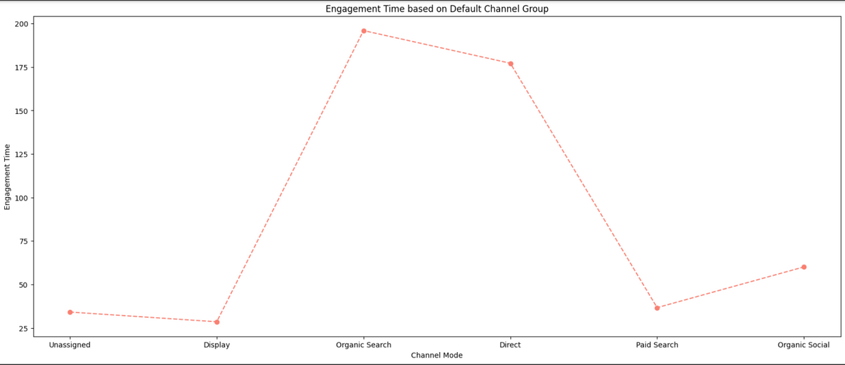
ENGAGEMENT TIME BASED ON GROUP CHANNEL
Engagement time refers to the amount of time users spend actively interacting with or consuming content on a website, application, or digital platform.
It is a metric used to gauge the level of user involvement and interest in the provided content.
THE FINDINGS:
The Organic Search Channel observed the most amount of Time Engagement.
The Direct Search Channel observed the second most amount of Time Engagement.
The Organic Social stood third.
Users through Paid Search Channel observed the fourth most amount of Time Engagement.
The Display and Unassigned Channel observed the least amount of Time Engagement

Slide 18
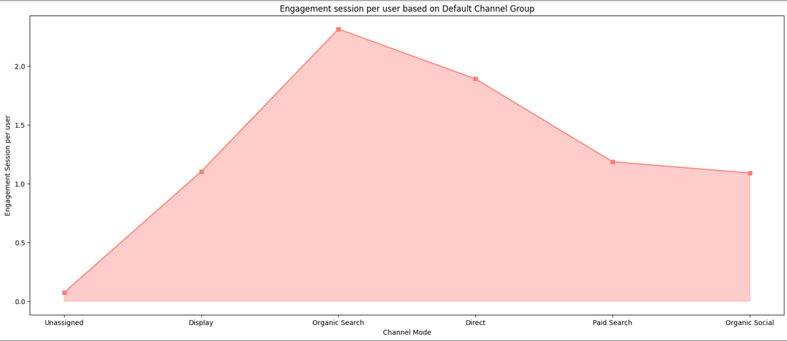
ENGAGEMENT SESSION PER USER
Engagement session per user is a crucial metric that provides insights into the level of interaction and interest a user has with a website or application during a single visit.
This metric measures the average time a user spends actively engaging with content or features, indicating the depth of their involvement
THE FINDINGS:
The Organic Search Channel observed the most amount of Engagement Session per user.
The Direct Search Channel observed the second most amount of Engagement session per user.
Users through Paid Search Channel observed the third most amount of Engagement Session per user.
The Organic Social stood fourth in terms of most amount of Engagement session per user.
The Display and Unassigned Channel observed the least amount of Engagement

Slide 19
CONVERSION REPORT

Slide 20
CONVERSION REPORT
A conversion report is a comprehensive analysis that provides valuable insights into the success of a website, campaign, or marketing strategy in terms of achieving predefined goals.
The conversion report typically outlines the number of conversions, conversion rates, and the effectiveness of different channels in driving successful outcomes.
This report is a critical tool for businesses to evaluate the performance of their digital initiatives, helping them identify high-performing channels and areas that may require improvement.
A well-analyzed conversion report not only provides a snapshot of past performance but also serves as a valuable guide for making data-driven decisions to improve future campaigns and achieve business objectives.

Slide 21
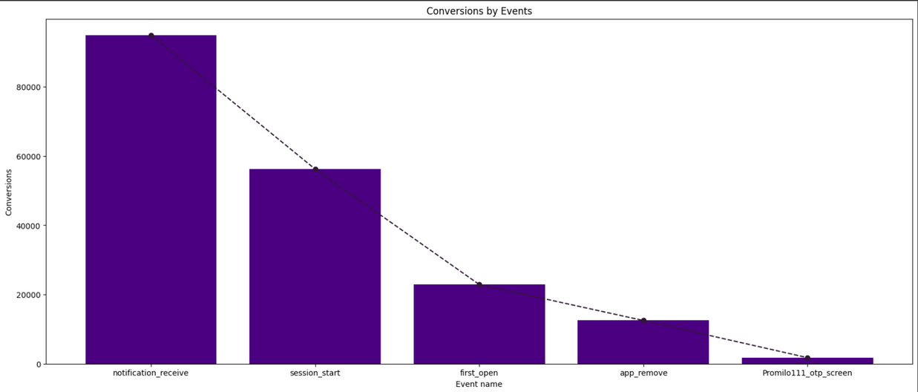
CONVERSION BASED ON TOP 5 EVENTS
Conversions, or successful outcomes on a website, become clearer when we focus on the top five events that matter most, shedding light on the key actions users take to achieve specific goals.
THE FINDINGS:
The top-most Event was named notification_receive, which gives us an insight that the specific event generated the most amount of Conversions.
session_start event generated the second-most amount of Conversions.
The third most Conversion was generated by first_open event.
app_remove event Converted to be the fourth-most Event.
Promilo_111_otp_screen stood fifth in terms of most Conversions

Slide 22
TOTAL USERS BY EVENT NAME
The total number of users categorized by event name gives a detailed breakdown of user interactions, providing a comprehensive view of specific actions and their respective impacts on a website or application
THE FINDINGS:
first_open events generated the most amount of Users.
session_start event generated the second most amount of Users in terms of Conversions.
app_remove event generated the third most amount of Users.
notification_receive generated the fourth most amount of Users.
Promilo11_Event_Enter_Feed_Page generated the fifth mostamount of Users based on Conversion.

Slide 23
EVENT REPORT

Slide 24
EVENT REPORT
An event report is a detailed analysis that offers insights into the occurrences and impact of specific events tracked on a website or digital platform.
Events can range from user interactions, such as clicks, downloads, or form submissions, to more complex activities like product views or purchases.
The event report typically provides a comprehensive overview of the frequency and distribution of these events, allowing businesses to gauge user engagement, identify patterns, and assess the effectiveness of various features or campaigns.
By delving into the event report, organizations can make informed decisions, optimize their strategies, and enhance the overall user experience based on a thorough understanding of user behavior and interaction with key events.

Slide 25
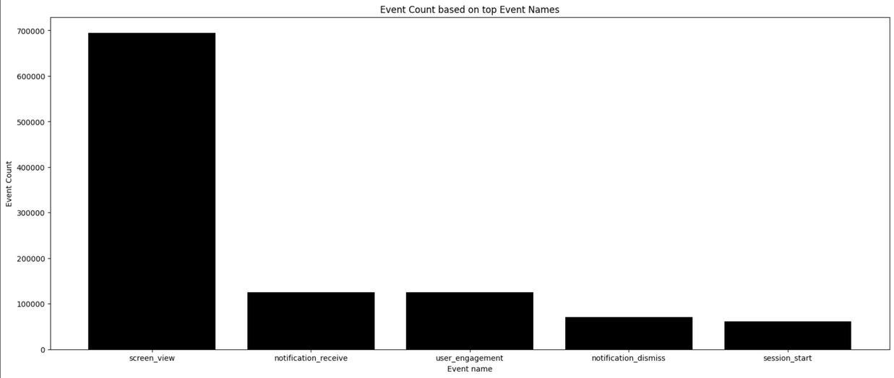
EVENT COUNT BASED ON EVENT NAME
Event counts based on specific event names provide a numerical breakdown, offering a precise overview of user interactions and engagement with distinct activities on a website or digital platform.
THE FINDINGS:
The most amount of Event Count was observed by the screen_view event.
notification_receive and user_engagement event shared the second spot in terms of Event Counts.
notification_dismiss event stood third in terms of most event counts.
session_start stood fourth in terms of most event counts.

Slide 26
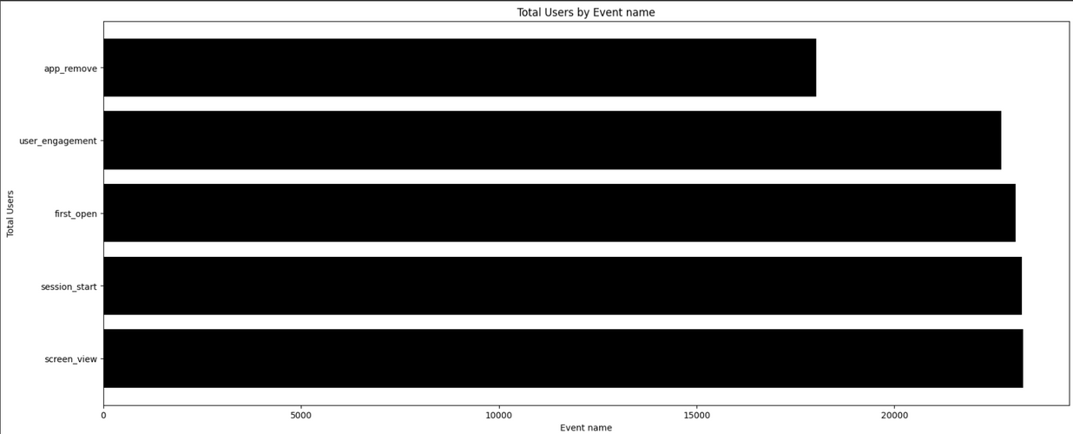
TOTAL USERS BY EVENT COUNT
The total user count by event provides a consolidated measure of user engagement, offering a clear snapshot of how many individuals have participated in specific activities or interactions on our website.
THE FINDINGS:
The screen_view event generated the most amount of Users.
The session_start event generated the second most amount of Users.
Third most Users were generated by the first_open event.
user_engagement generated the fourth most amount of Users.
The fifth-most amount of Users were generated by the app_remove event.

Slide 27
PAGES AND SCREEN REPORT

Slide 28
PAGES AND SCREEN REPORT
A pages and screen report is a valuable analytical tool that provides insights into user navigation and content consumption on a website or digital application.
This report typically outlines the number of pages viewed or screens accessed by users during their sessions. By examining this data, businesses can identify popular content, track user journeys.
Understanding the pages and screen report helps organizations optimize user experiences, enhance site navigation, and tailor content to better meet user expectations.
Additionally, this report can uncover potential areas for improvement, guiding strategic decisions to boost engagement and overall user satisfaction.
In essence, the pages and screen report serves as a key resource for businesses aiming to refine their online presence and deliver a more seamless and engaging digital experience.

Slide 29
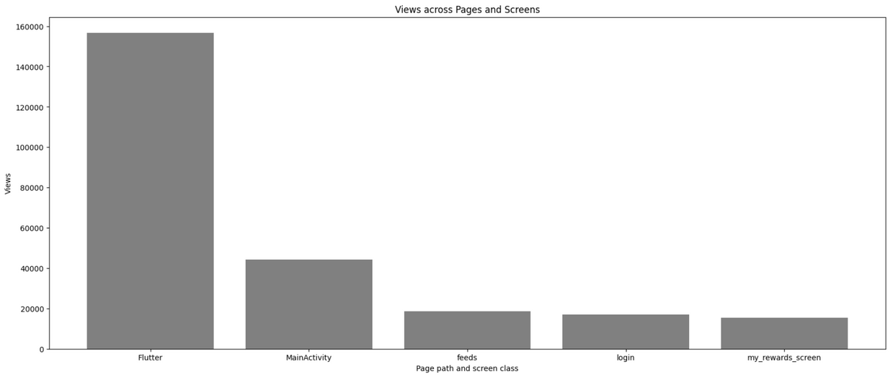
VIEWS ACROSS PAGES AND SCREENS
Views across pages provide a measure of how users engage with different sections of a website or digital platform.
THE FINDINGS:
The Flutter Page and Screen accounted with the most amount of views.
The Main Activity Page and Screen accounted with the second-most amount of views.
The third most amount of page views was observed by the feeds Page.
The login page stood fourth in terms of views.
The my_rewards_screen stood fifth in terms of most viewed page.

Slide 30
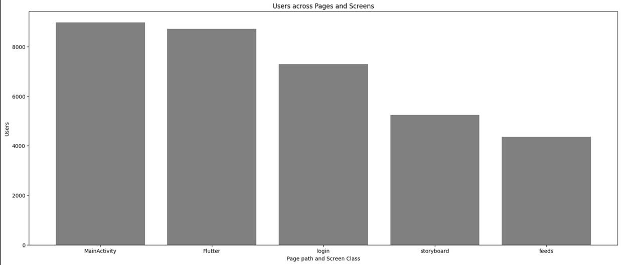
USERS ACROSS PAGES AND SCREENS
Users across pages indicate the breadth of engagement, revealing how individuals navigate and interact with diverse sections on a website.
THE FINDINGS:
The Main Activity page accounted to be gather more users.
The Flutter page gather the second-most amount of users.
The third most Users were generated by the login page.
The storyboard generated the fourth-most amount of Users.
The feeds page generated the fifth-most amount of Users.

Slide 31
CITIWISE REPORT

Slide 32
CITIWISE REPORT
Citywise reports is an essential component of analysis that focuses on dissecting user data and performance metrics based on geographic locations.
This detailed breakdown allows businesses to understand how users from different cities interact with their online platforms.
By examining factors such as user engagement, traffic sources, and conversion rates on a city-by-city basis, organizations gain valuable insights into regional preferences and behaviors.
This information is invaluable for tailoring marketing strategies, optimizing content, and enhancing the overall user experience to better resonate with diverse audiences across various geographical locations.

Slide 33
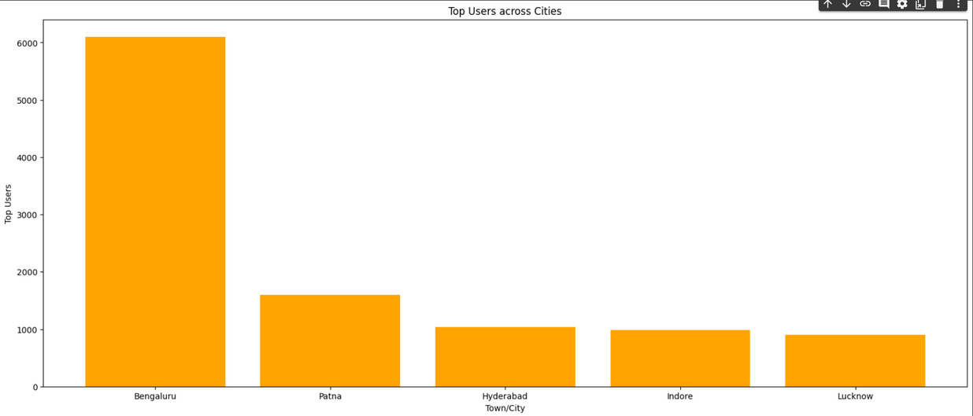
TOP USERS ACROSS CITIES
Top users across cities represent the most actively engaged individuals in different geographic locations, providing insights into the regions where user interactions and online activities are most pronounced on our website.
THE FINDINGS:
The most amount of Users were found in the city of Bengaluru.
The second most amount of Users were found in the city of Patna.
The third-most profitable city in terms of Users was Hyderabad.
Indore generated the fourth-most amount of users.
Lucknow generated the fifth-most amount of users

Slide 34
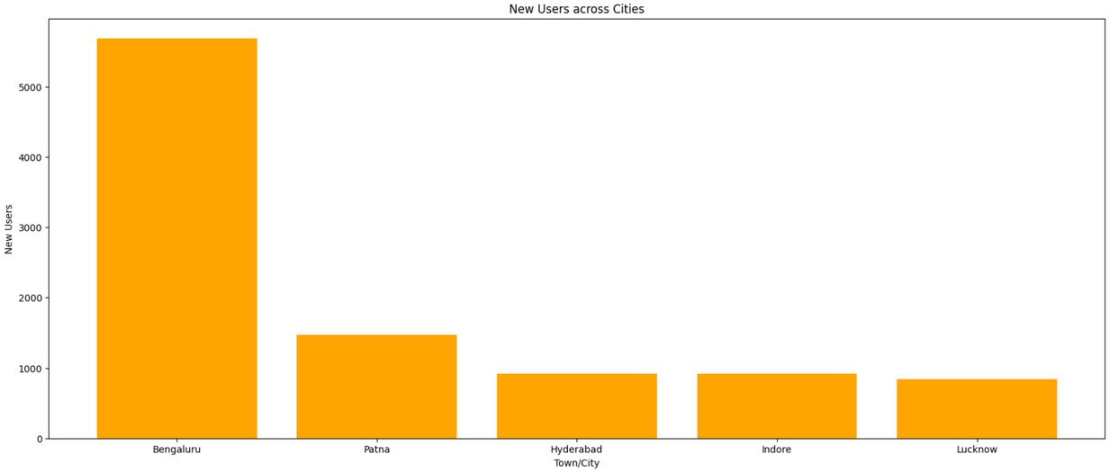
NEW USERS ACROSS CITIES
New users across cities highlight the geographic distribution of individuals who have recently joined our website
THE FINDINGS:
Bengaluru generated the most amount of new users.
Patna generated the second-most amount of new Users.
Hyderabad stood third in terms of generating New Users.
Indore generated the fourth-most amount of New Users.
Lucknow stood fifth in terms of generating New Users.

Slide 35
GENDER REPORT

Slide 36
GENDER REPORT
A gender report is a detailed analysis that sheds light on the demographic distribution of users based on gender within a website.
This insightful report breaks down user engagement, conversions, and other relevant metrics, providing businesses with a comprehensive understanding of their audience composition.
By exploring user behavior through the lens of gender, organizations can tailor their content, marketing strategies, and user experiences to better resonate with diverse demographic groups.
The gender report becomes a valuable tool for making data-driven decisions, optimizing marketing campaigns, and ensuring that products or services are effectively meeting the needs and preferences of both male and female users. Ultimately, it plays a pivotal role in fostering inclusivity and enhancing overall user satisfaction.

Slide 37
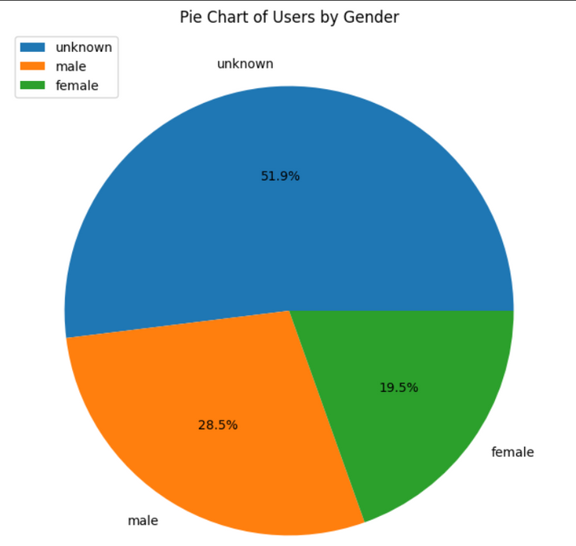
DISTRIBUTION OF USERS BY GENDER
THE FINDINGS:
The Distribution in the Pie-Chart gives us an insight that the Gender with the Unknown Category has the highest count.
Male Users contributed to be 28.5%.
Female Users contributed to be the least among the other genders

Slide 38
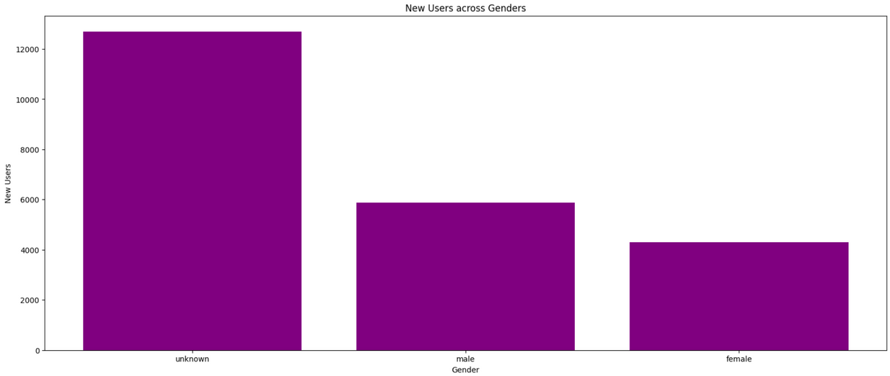
NEW USERS ACROSS GENDER
THE FINDINGS:
The Unknown category of gender contributed to be the most in terms of New Users.
The Male gender stood second in terms of New Users.
The Female gender contributed the least in terms of generating New Users.

Slide 39
USER INTERESTS

Slide 40
USER INTERESTS
User interests form a crucial aspect of understanding and catering to the diverse needs of an online audience.
Through detailed analysis and tracking of user behavior, websites and digital platforms can discern specific areas of interest among their users. These insights provide a roadmap for tailoring content, products, and services to align with the preferences and inclinations of the audience.
By delving into user interests, businesses can create a more personalized and engaging experience, enhancing user satisfaction and loyalty.
This information also serves as a foundation for targeted marketing strategies, ensuring that promotional efforts resonate with the unique interests of the audience, thereby fostering a stronger connection between the platform and its users.

Slide 41
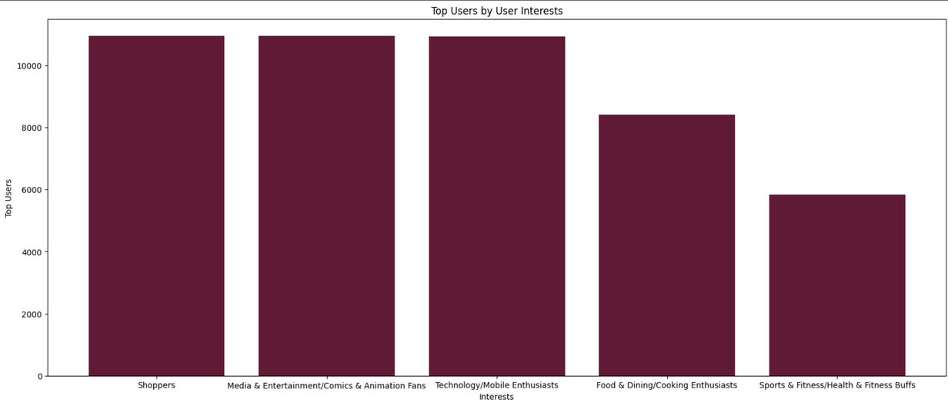
TOP USERS BY INTEREST
THE FINDINGS:
Most of our User are Interesting into Shopping.
Media and Entertainment is the second most Interested factor for our user.
Third most amount of Users are Technological Enthusiasts.
Fourth most interested factor is Food and Dining.
Sports and Fitness stood fifth in terms of an interested factors for our Users

Slide 42
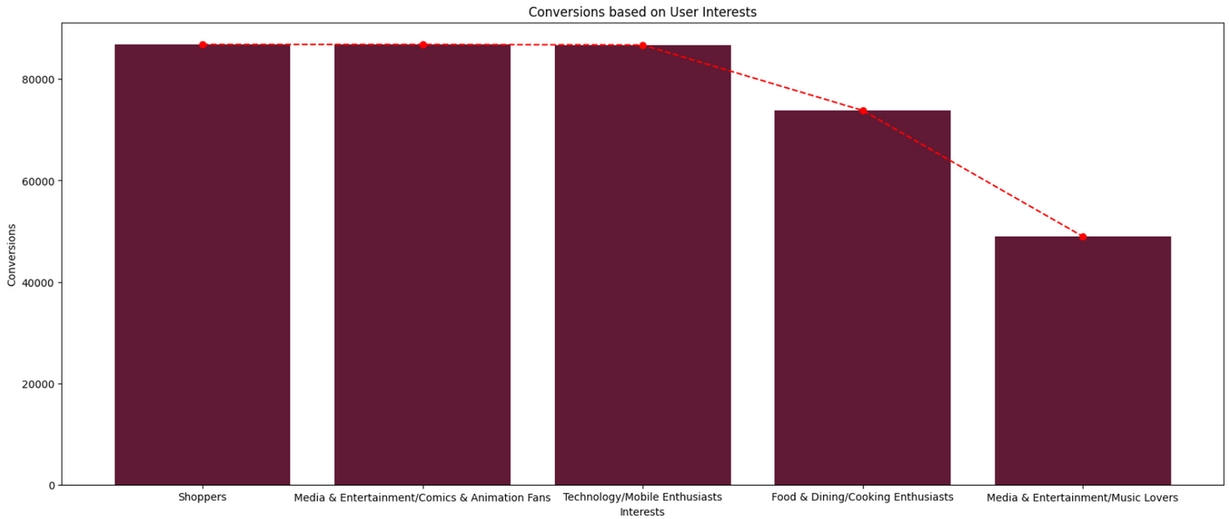
CONVERSION BASED ON INTEREST
THE FINDINGS:
Most of the conversions were carried out by Users Interested into Shopping.
Media and Entertainment is the second most Interested factor for Conversion.
Third most amount of Conversions were generated by Technological Enthusiasts.
Fourth most interested factor is Food and Dining in terms of generating conversions.
Sports and Fitness stood fifth in terms of an interested factors for our Conversion.

Slide 43
USER BY LANGUAGE

Slide 44
USER BY LANGUAGE
Analyzing users by language is a pivotal aspect of understanding the diverse linguistic preferences within a user base on websites or digital platforms.
This report provides valuable insights into the primary languages spoken by the audience, enabling businesses to tailor content and communication to resonate more effectively with users in different linguistic groups.
By acknowledging and accommodating varied language preferences, organizations can enhance user experiences, improve engagement, and foster inclusivity.
The users-by-language metric becomes especially crucial for global or multilingual platforms, guiding strategic decisions on localization, content translation, and overall optimization to ensure that the digital environment caters to the linguistic diversity of its users.

Slide 45
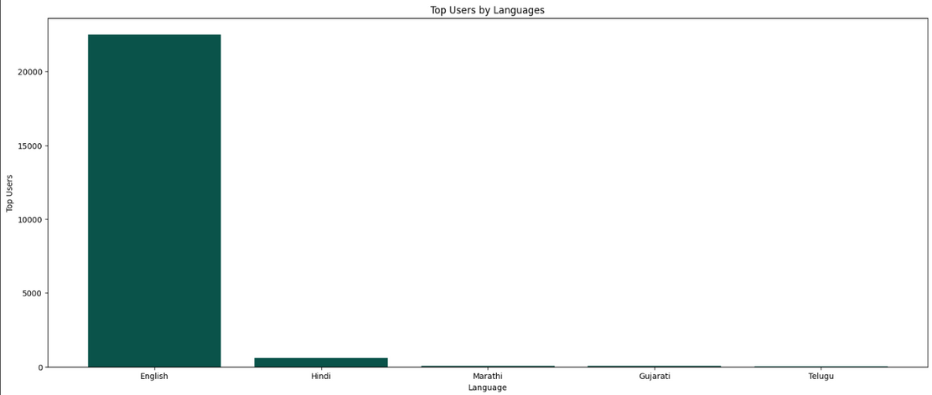
TOP USERS BY LANGUAGES
THE FINDINGS:
English has been the most understood language for the users on our website.
Hindi stood second in terms of User Language
Marathi stood third in terms of User Language.
Gujarati is the fourth-most understood language by our user.
Telugu is the fifth-most language for the User preference on our website.

Slide 46
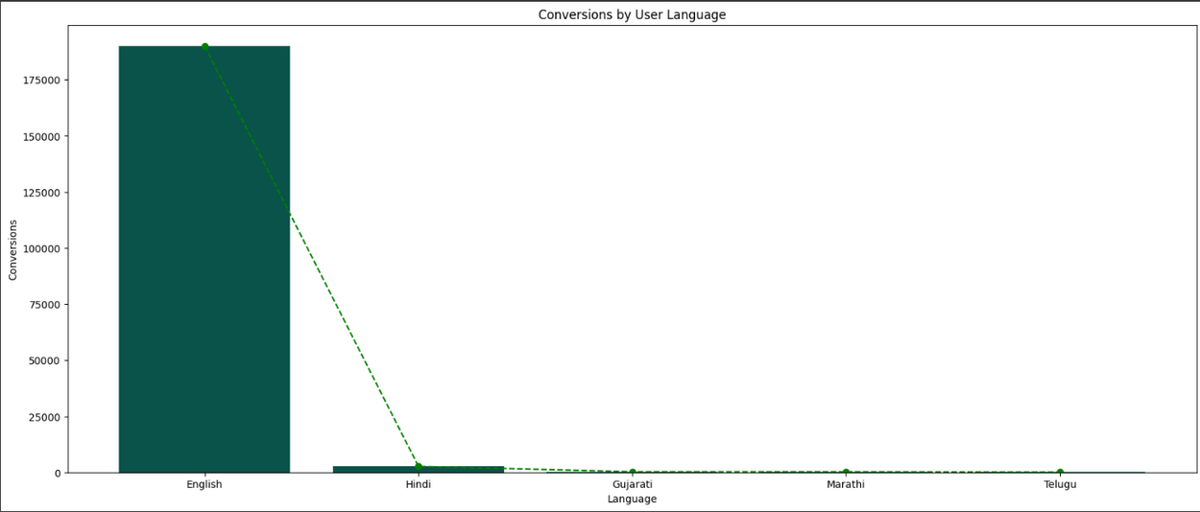
CONVERSION BY USER LANGUAGE
THE FINDINGS:
English Users generated the most amount of Conversions.
Hindi Users generated the second-most amount of Conversions.
Gujarati stood third in terms of generating conversions.
Marathi stood fourth in terms of generating conversions.
Telugu generated the fifth-most conversions

Slide 47
USER BY AGE

Slide 48
USER BY AGE
User age demographics play a pivotal role in shaping the dynamics of a digital audience, offering valuable insights into the composition and preferences of website or platform users.
By categorizing users based on age groups, businesses can gain a nuanced understanding of their audience's generational characteristics and tailor content, features, and marketing strategies accordingly.
This information is instrumental in creating a more personalized and engaging user experience, ensuring that products and services resonate with the unique preferences of different age segments.
Analyzing user age also aids in developing targeted marketing campaigns, allowing businesses to reach specific generations with messages that align with their interests and lifestyles.
Ultimately, user age data serves as a powerful tool for optimizing digital strategies, enhancing user satisfaction, and fostering long-term connections with a diverse user base.

Slide 49
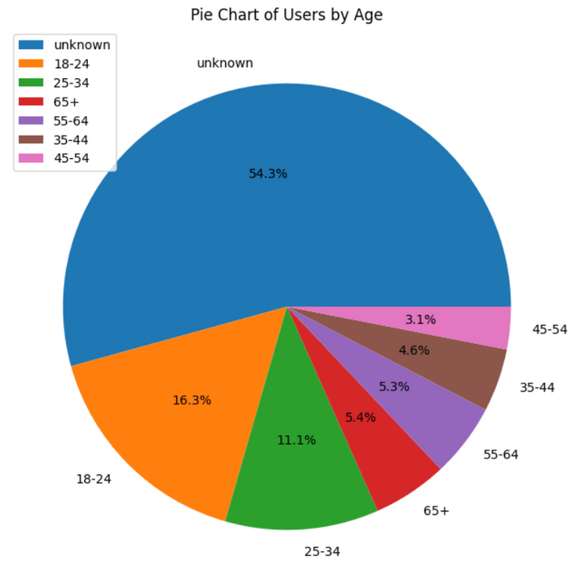
DISTRIBUTION OF USER AGE
THE FINDINGS:
The most amount of distribution was observed for the Unknown age category
The second most distribution was observed by Ages 18-24.
The third most distribution was observed by Ages 25-34.
The fourth most distribution was observed by Ages 65+
The fifth most distribution was observed by Ages 55-64
The second least amount of distribution was observed by Ages 35-44
The least amount of distribution was observed by Ages 45-54.

Slide 50
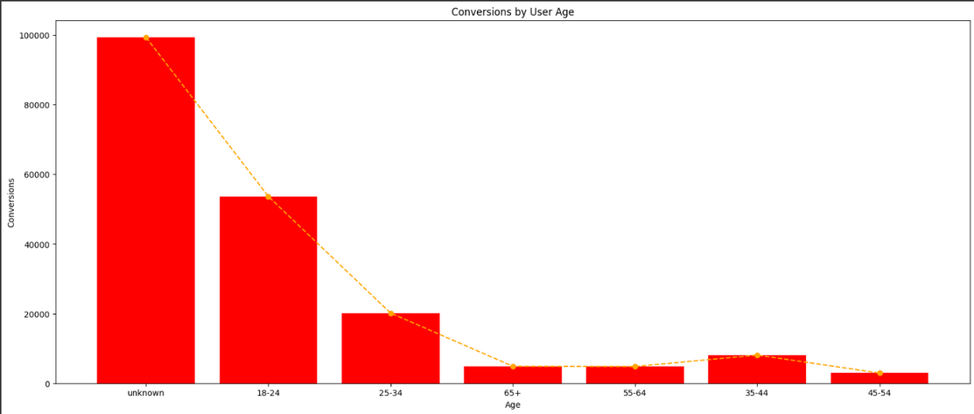
CONVERSION BY USER AGE
THE FINDINGS:
The Unknown category had the most amount of Conversions.
Ages 18-24 had the second most amount of Conversions.
Ages 25-34 had the third most amount of Conversions.
Ages 35-44 had the fourth most amount of Conversions.
Ages 55-64 had the fifth most amount of Conversions.
Ages 65+ had the second least amount of Conversions.
Ages 45-54 had the least amount of Conversions.

Slide 51
RECOMMENDATIONS

Slide 52
RECOMMENDATION
Target specific customer segments
Strategizing to target specific customer segments involves a systematic and customer-centric approach. The process commences with thorough market research and segmentation, identifying distinct groups with shared characteristics, needs, and behaviors.
Creating detailed customer personas helps in understanding the unique preferences and challenges of each segment.
Tailoring the value proposition to address the specific pain points of these segments is crucial, ensuring that marketing messages resonate authentically.
Employing targeted marketing campaigns, personalized communication, and industry-specific content contributes to a more effective strategy.
Utilizing analytics tools for continuous monitoring, gathering customer feedback, and staying abreast of market trends allows for ongoing optimization.
This dynamic and iterative approach enables businesses to align their products, services, and marketing efforts with the nuanced requirements of specific customer segments, fostering stronger connections and long-term relationships.

Slide 53
RECOMMENDATION
Improve product offering
Strategizing the improvisation of product offerings is a dynamic process that involves a keen understanding of market demands and customer preferences.
Businesses must first conduct a comprehensive analysis of their current product portfolio, considering factors like customer feedback, market trends, and competitor offerings.
Identifying areas for enhancement or new features becomes crucial in aligning products with evolving consumer needs.
Engaging with customer feedback, conducting surveys, and leveraging market research are integral steps in gaining insights into user expectations. The strategy may involve refining existing products, introducing new variants, or even exploring partnerships to complement the product range.
Continuous monitoring of industry trends and competitor innovations helps ensure that the product improvisation strategy remains agile and responsive. Ultimately, a successful approach to improvising product offerings centers on adaptability, customer-centricity, and a commitment to delivering value in an ever-changing market landscape.

Slide 54
RECOMMENDATION
Modifying market strategy
Strategizing the modification of a market strategy requires a comprehensive and flexible approach.
It begins with a thorough evaluation of current market conditions, competitor landscapes, and customer feedback. Identifying areas for improvement or shifts in customer preferences becomes pivotal in the modification process. Utilizing data analytics and market research, businesses can gain valuable insights into emerging trends and evolving consumer behaviors.
The strategy modification should align with the overarching business goals, and adjustments may involve refining target demographics, optimizing product positioning, or enhancing marketing channels.
Regularly monitoring key performance indicators (KPIs) allows for real-time assessment of the modified strategy's impact, facilitating further adjustments for optimal outcomes.
A successful modification strategy embraces adaptability, responsiveness to market dynamics, and a commitment to meeting the changing needs of the target audience.

Slide 55
THANK YOU

