Slide 1
BUSINESS ANALYST ASSIGNMENT
DATA ANALYSIS AND INSIGHTS FOR DIFFERENT PAGE OPTIMIZATION
How to get more user install and Engagement from the App and Website;
Shanmugavel S

Slide 2
CONTENTS
01
08
INTRODUCTION & OBJECTIVE
GENDER REPORT
02
09
USER ACQUISITION
USER BY INTEREST
03
TRAFFIC ACQUISITION
10
USER BY LANGUAGE
04
EVENT REPORT
11
USER BY AGE
05
CONVERSION REPORT
12
RECOMMENDATIONS
06
PAGES AND SCREEN REPORT
07
CITIWISE REPORT

Slide 3
INTRODUCTION AND OBJECTIVE

Slide 4
INTRODUCTION AND OBJECTIVE
ASSIGNMENT DESCRIPTION
As an intern in the Business Analytics team, the task of a Business Analyst is to analyze the dataset and generate actionable insights to optimize page performance for a fictional company called “XYZ”.
The dataset contains user data from various regions, customer demographics, product information, and marketing campaign details
ASSIGNMENT OBJECTIVE
The objective of the assignment is to identify critical factors influencing Data Analysis and Insights for different Page Optimization and how to get more user installation and engagement from the App and Website User and propose recommendations for improving performance.

Slide 5
USER ACQUISITION

Slide 6
USER ACQUISITION
User acquisition is a fundamental aspect of business growth, emphasizing the strategic methods employed to increase the user base.
Successful user acquisition involves understanding the target audience, creating compelling value propositions, and utilizing various marketing channels such as content marketing, social media, paid advertising, and email campaigns.
The goal is not only to acquire users but also to convert them into active and engaged customers. Analytics and tracking play a crucial role in measuring the effectiveness of different acquisition channels, enabling businesses to make data-driven decisions over time.

Slide 7
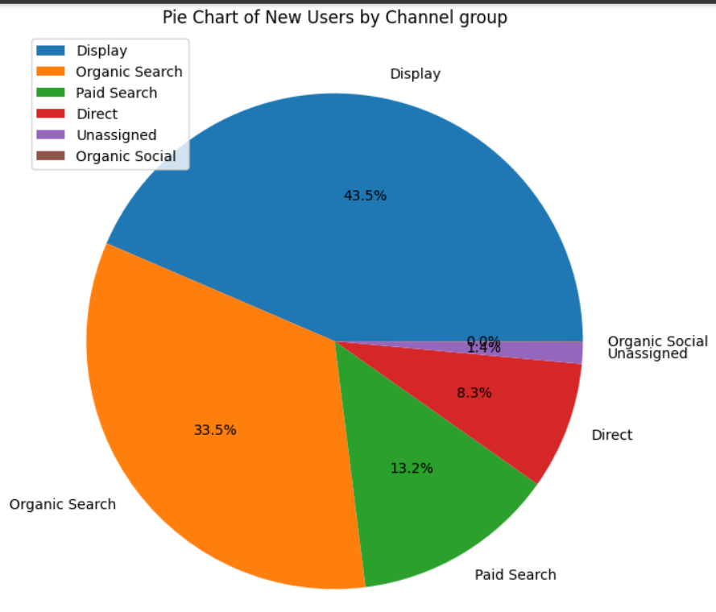
NEW USER BY CHANNEL GROUP
Channels are predefined categories that help you track and analyze where your website's traffic comes from. -
They provide a clear way to monitor the performance of different sources sending visitors to your site, such as search engines, social media, or referral links.
THE FINDINGS:
Most amount of Users reached our website by the Display Channel Mode.
Organic Search Mode generated 33.5% of User Acquisition.
Paid Search stood third in terms of most contributions towards user acquistion with 13.2% of Acquisition.
Only 8.3% of the Users reached our website in the Direct Channel Mode.
The Unassigned channel mode contributed the second least with just 1.4% of Users.
Organic Social contributed the least amount of Users to the website.

Slide 8
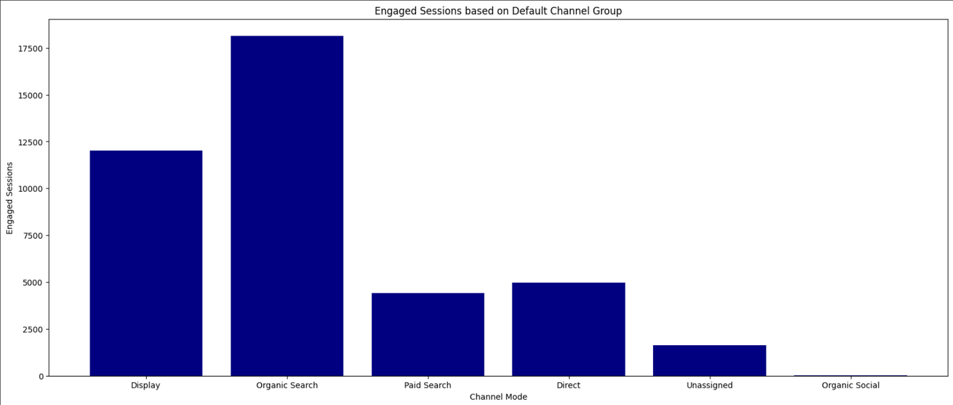
ENGAGED SESSIONS BASED ON CHANNEL GROUP
Engagement session is a metrics that enables you to measure and analyze user engagement with your website or app.
THE FINDINGS:
The users that found us using Organic Search had the most amount of Engaged Session.
The Display Channel generated the second most Engaged Session for the User.
The users who Directly searched for our website stood third in terms of Engaged Session.
The Paid Search mode accounted to be the fourth most Session Engagement to the Users.
The Unassigned and Organic Social generated the least amount of User Engagement

Slide 9
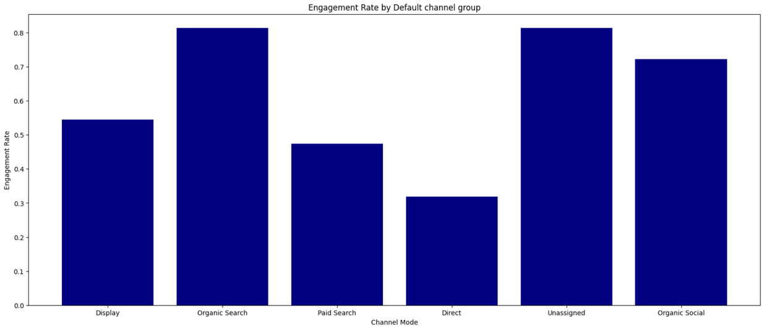
ENGAGEMENT RATE BASED ON CHANNEL GROUP
The engagement rate is the percentage of engaged sessions on your website or mobile app
THE FINDINGS:
The Organic Search Users accounted the most amount of Engagement Rate.
The Unassigned Channel stood second.
Users with Organic Social accounted to be the third most Engagement rate for the Users.
The Display mode generated the fourth most amount of Engagement Rate.
The Paid Search and Direct channel mode generated the least engagement rate compared to the other channels

Slide 10
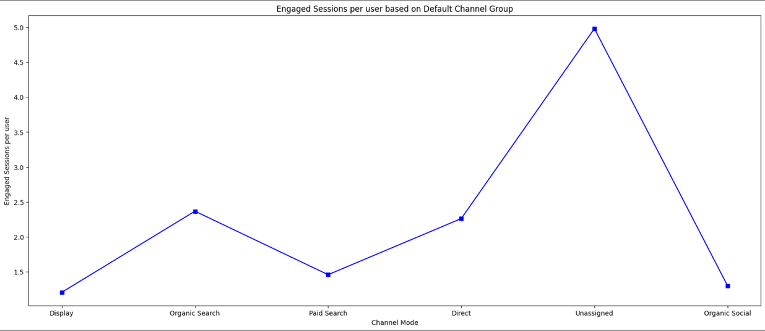
ENGAGED SESSIONS PER USER BASED ON CHANNEL GROUP
An engaged session is a period during which a user is engaged with your website or app.
An engaged session is a session that lasts longer than 10 seconds, has a conversion event, or has at least 2 pageviews
THE FINDINGS:
The Unassigned Search mode accounted the most amount of Engagement per User amount.
Users finding us through Organic Search stood second.
The Direct Search mode generated the third most amount of engagement per user.
Paid Search and Display channel mode generated the least amount of Engagement per user.

Slide 11
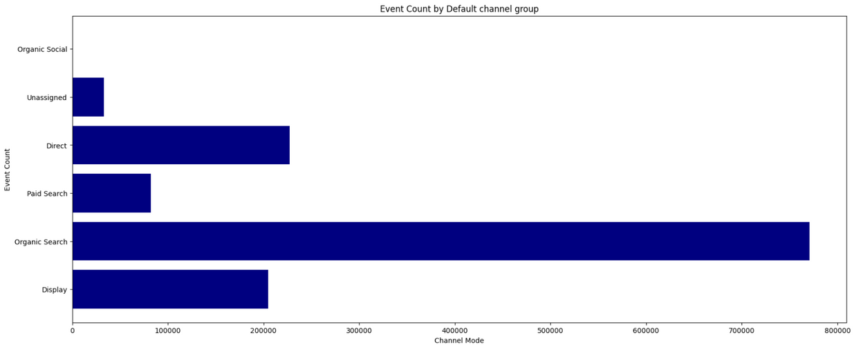
EVENT COUNT BY CHANNEL MODE
Event count measures how often users interact with specific elements on a website within a given time span. The higher the number, the more likely users are to find something worth clicking, watching, or purchasing on the site.
THE FINDINGS:
Users that found the website using Organic Search accounted to generate the most Event Counts.
The Display mode generated the second most Event Counts.
The Direct mode generated the third most Event Counts.
Users that found using the Paid Search mode generated the fourth most Event Counts.
Unassigned and Organic Social generated the least amount of Event Counts

Slide 12
CONVERSION BASED ON BY CHANNEL GROUP
A conversion is any user action that's valuable to your business; for example, a user purchasing from your store or subscribing to your newsletter are examples of common conversions.
THE FINDINGS:
The Organic search mode generated the most amount of Conversions.
The Display search mode generated the second most amount of Conversions.
Users with Direct Channel mode generated the third most Conversions.
Paid Search accounted to generate the Fourth most amount of conversions.
Unassigned and Organic Social generated the least amount of conversions

Slide 13
TRAFFIC ACQUISITION

Slide 14
TRAFFIC ACQUISITION
Traffic acquisition is the strategic process of attracting and directing visitors to a website or online platform.
The ultimate goal of traffic acquisition is not just to bring in any visitors but to target and engage the right audience—those who are likely to convert into customers, subscribers, or active users.
Analyzing the effectiveness of different acquisition channels, optimizing strategies, and adapting to changing trends are essential aspects of a successful traffic acquisition strategy, contributing significantly to the overall growth and success of an online presence

Slide 15
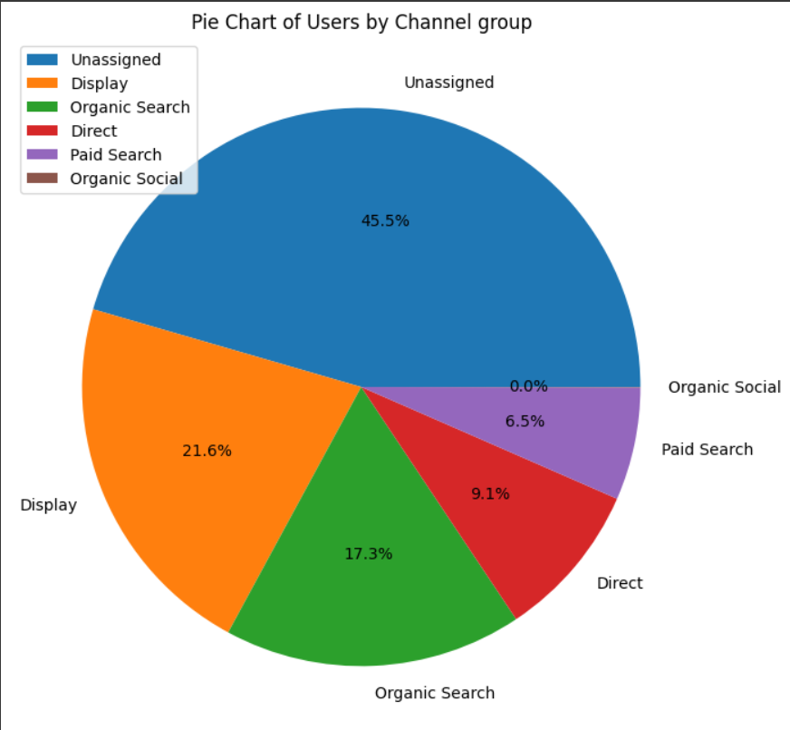
USER BY CHANNEL GROUP
Users by Channel Group refers to a metric that provides insights into the number of users visiting a website based on different predefined channel groupings. Channels represent the various sources through which users find and access a website.
THE FINDINGS:
The Unassigned Channel Group attracted the most amount of Users.
The Display Channel group stood second in terms of Traffic Acquisition.
The Organic Search Channel generated the third most amount of Users.
Users through Direct Search generated the fourth most amount of Users.
The least amount of Traffic was generated by the Paid Search and Organic Social Channel mode.

Slide 16
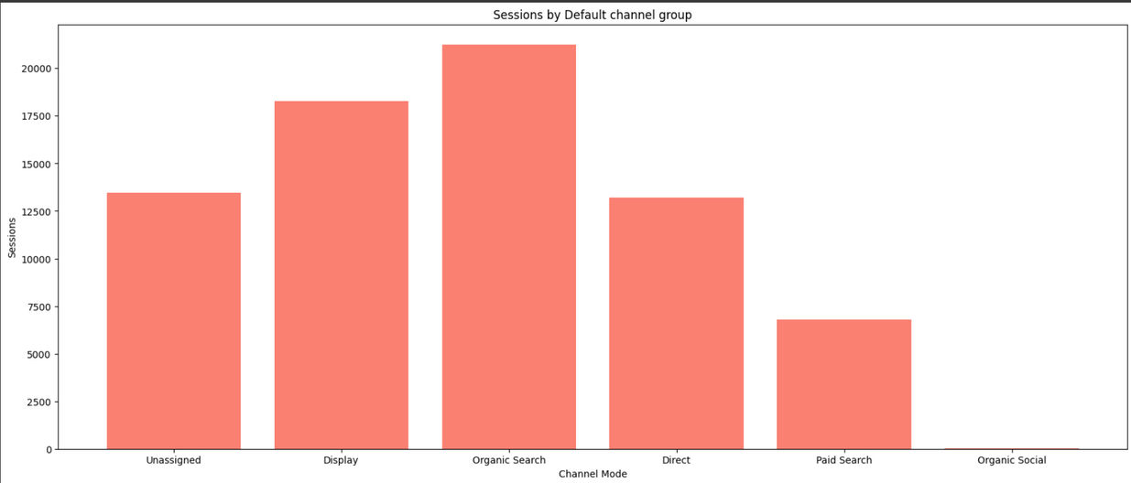
SESSION BY CHANNEL MODE
Engagement session is a metrics that enables you to measure and analyze user engagement with your website or app.
THE FINDINGS:
The Organic Search Channel Group generated the most amount of Sessions.
The Display Channel group stood second in terms of Sessions.
The Unassigned Channel generated the third most amount of Sessions.
Users through Direct Search generated the fourth most amount of Users.
The least amount of Session was generated by the Paid Search and Organic Social Channel mode.

Slide 17
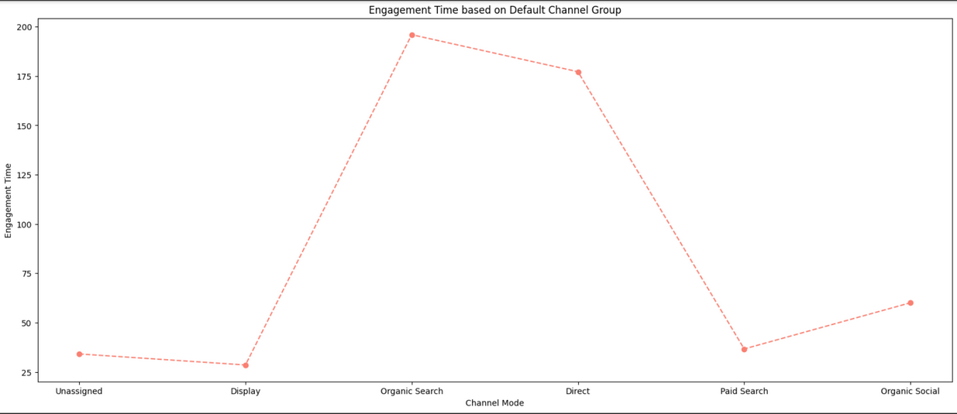
ENGAGEMENT TIME BASED ON GROUP CHANNEL
Engagement time refers to the amount of time users spend actively interacting with or consuming content on a website, application, or digital platform.
It is a metric used to gauge the level of user involvement and interest in the provided content.
THE FINDINGS:
The Organic Search Channel observed the most amount of Time Engagement.
The Direct Search Channel observed the second most amount of Time Engagement.
The Organic Social stood third.
Users through Paid Search Channel observed the fourth most amount of Time Engagement.
The Display and Unassigned Channel observed the least amount of Time Engagement

Slide 18
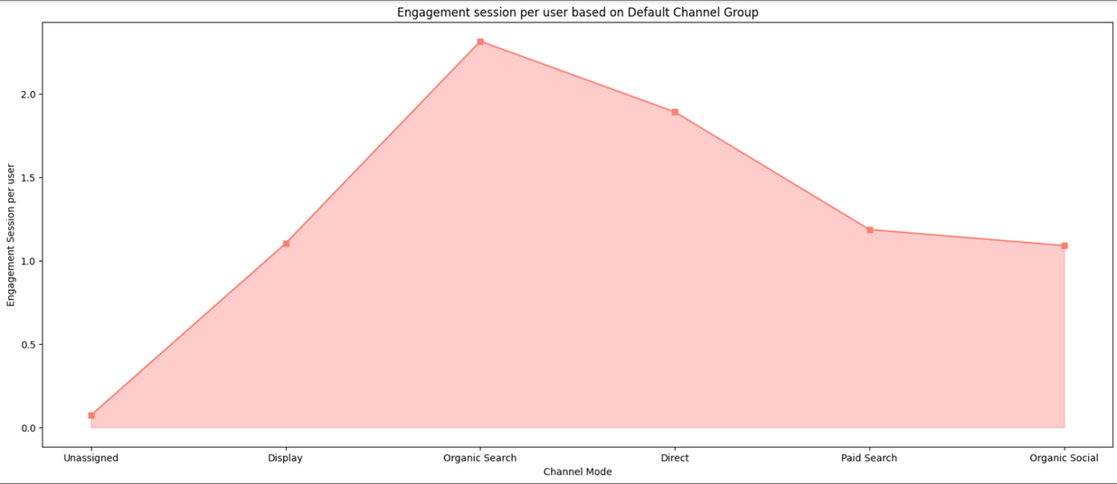
ENGAGEMENT SESSION PER USER
Engagement session per user is a crucial metric that provides insights into the level of interaction and interest a user has with a website or application during a single visit.
This metric measures the average time a user spends actively engaging with content or features, indicating the depth of their involvement
THE FINDINGS:
The Organic Search Channel observed the most amount of Engagement Session per user.
The Direct Search Channel observed the second most amount of Engagement session per user.
Users through Paid Search Channel observed the third most amount of Engagement Session per user.
The Organic Social stood fourth in terms of most amount of Engagement session per user.
The Display and Unassigned Channel observed the least amount of Engagement

Slide 19
CONVERSION REPORT

Slide 20
CONVERSION REPORT
A conversion report is a comprehensive analysis that provides valuable insights into the success of a website, campaign, or marketing strategy in terms of achieving predefined goals.
The conversion report typically outlines the number of conversions, conversion rates, and the effectiveness of different channels in driving successful outcomes.
This report is a critical tool for businesses to evaluate the performance of their digital initiatives, helping them identify high-performing channels and areas that may require improvement.
A well-analyzed conversion report not only provides a snapshot of past performance but also serves as a valuable guide for making data-driven decisions to improve future campaigns and achieve business objectives.

Slide 21
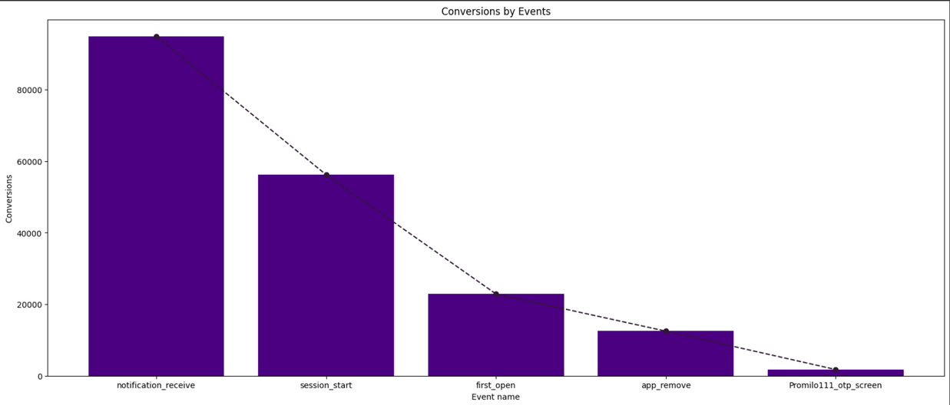
CONVERSION BASED ON TOP 5 EVENTS
Conversions, or successful outcomes on a website, become clearer when we focus on the top five events that matter most, shedding light on the key actions users take to achieve specific goals.
THE FINDINGS:
The top-most Event was named notification_receive, which gives us an insight that the specific event generated the most amount of Conversions.
session_start event generated the second-most amount of Conversions.
The third most Conversion was generated by first_open event.
app_remove event Converted to be the fourth-most Event.
Promilo_111_otp_screen stood fifth in terms of most Conversions

Slide 22
TOTAL USERS BY EVENT NAME
The total number of users categorized by event name gives a detailed breakdown of user interactions, providing a comprehensive view of specific actions and their respective impacts on a website or application
THE FINDINGS:
first_open events generated the most amount of Users.
session_start event generated the second most amount of Users in terms of Conversions.
app_remove event generated the third most amount of Users.
notification_receive generated the fourth most amount of Users.
Promilo11_Event_Enter_Feed_Page generated the fifth mostamount of Users based on Conversion.

Slide 23
EVENT REPORT

Slide 24
EVENT REPORT
An event report is a detailed analysis that offers insights into the occurrences and impact of specific events tracked on a website or digital platform.
Events can range from user interactions, such as clicks, downloads, or form submissions, to more complex activities like product views or purchases.
The event report typically provides a comprehensive overview of the frequency and distribution of these events, allowing businesses to gauge user engagement, identify patterns, and assess the effectiveness of various features or campaigns.
By delving into the event report, organizations can make informed decisions, optimize their strategies, and enhance the overall user experience based on a thorough understanding of user behavior and interaction with key events.

Slide 25
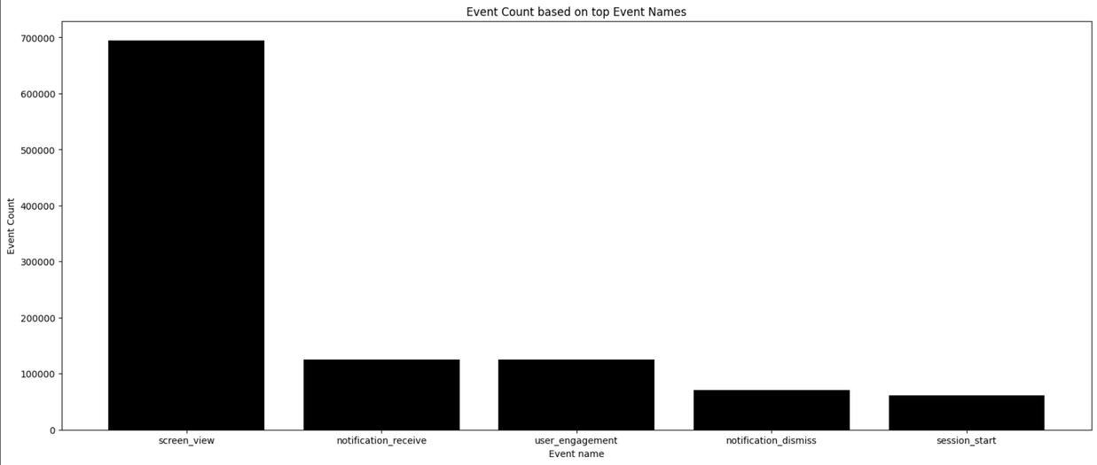
EVENT COUNT BASED ON EVENT NAME
Event counts based on specific event names provide a numerical breakdown, offering a precise overview of user interactions and engagement with distinct activities on a website or digital platform.
THE FINDINGS:
The most amount of Event Count was observed by the screen_view event.
notification_receive and user_engagement event shared the second spot in terms of Event Counts.
notification_dismiss event stood third in terms of most event counts.
session_start stood fourth in terms of most event counts.

Slide 26
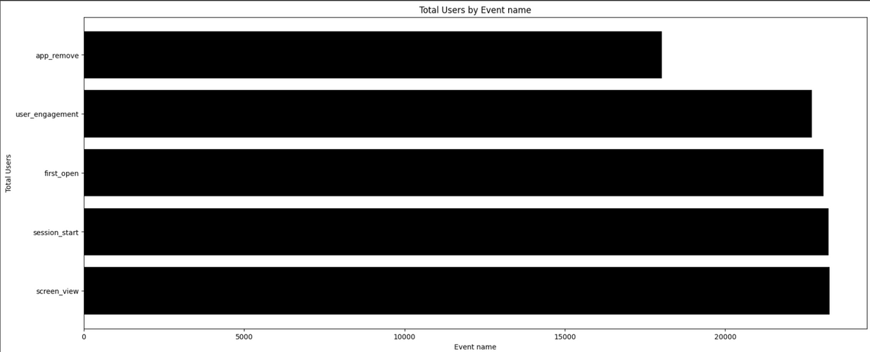
TOTAL USERS BY EVENT COUNT
The total user count by event provides a consolidated measure of user engagement, offering a clear snapshot of how many individuals have participated in specific activities or interactions on our website.
THE FINDINGS:
The screen_view event generated the most amount of Users.
The session_start event generated the second most amount of Users.
Third most Users were generated by the first_open event.
user_engagement generated the fourth most amount of Users.
The fifth-most amount of Users were generated by the app_remove event.

Slide 27
PAGES AND SCREEN REPORT

Slide 28
PAGES AND SCREEN REPORT
A pages and screen report is a valuable analytical tool that provides insights into user navigation and content consumption on a website or digital application.
This report typically outlines the number of pages viewed or screens accessed by users during their sessions. By examining this data, businesses can identify popular content, track user journeys.
Understanding the pages and screen report helps organizations optimize user experiences, enhance site navigation, and tailor content to better meet user expectations.
Additionally, this report can uncover potential areas for improvement, guiding strategic decisions to boost engagement and overall user satisfaction.
In essence, the pages and screen report serves as a key resource for businesses aiming to refine their online presence and deliver a more seamless and engaging digital experience.

Slide 29
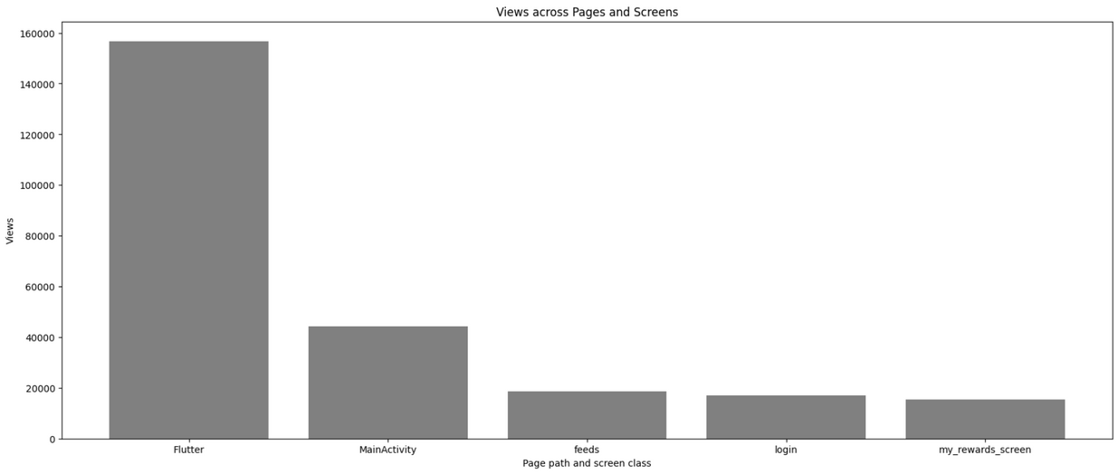
VIEWS ACROSS PAGES AND SCREENS
Views across pages provide a measure of how users engage with different sections of a website or digital platform.
THE FINDINGS:
The Flutter Page and Screen accounted with the most amount of views.
The Main Activity Page and Screen accounted with the second-most amount of views.
The third most amount of page views was observed by the feeds Page.
The login page stood fourth in terms of views.
The my_rewards_screen stood fifth in terms of most viewed page.

Slide 30
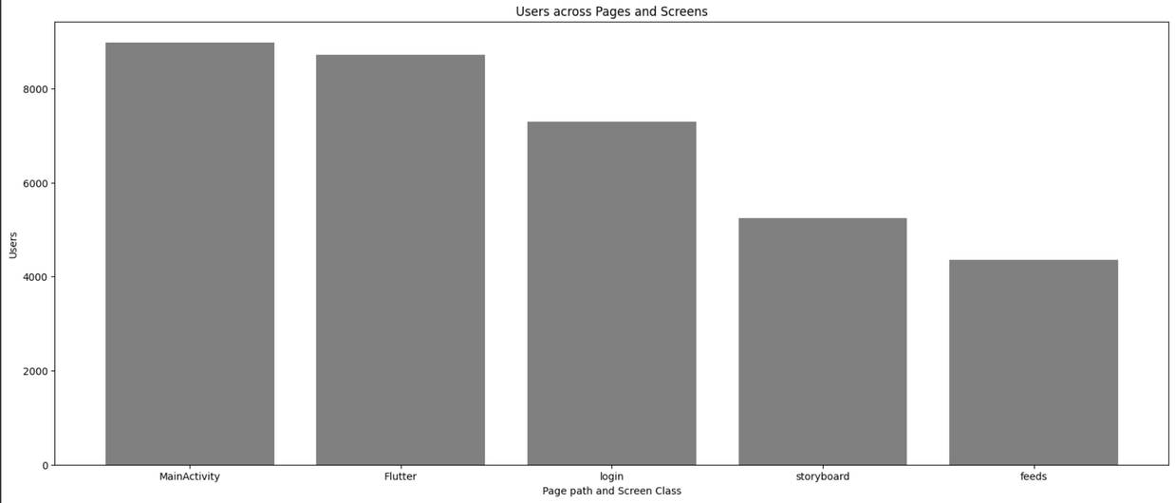
USERS ACROSS PAGES AND SCREENS
Users across pages indicate the breadth of engagement, revealing how individuals navigate and interact with diverse sections on a website.
THE FINDINGS:
The Main Activity page accounted to be gather more users.
The Flutter page gather the second-most amount of users.
The third most Users were generated by the login page.
The storyboard generated the fourth-most amount of Users.
The feeds page generated the fifth-most amount of Users.

