Slide 1


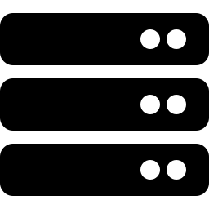


A CLASSROOM PRIMER ON WEB TECHNOLOGY
Internet & the World Wide Web
Browsers, Servers, HTTP/HTTPS, Client–Server Architecture,
HTML Basics & Web Page Structure
Internet
Browser
Server
HTTPS
HTML
Prepared for Lecture & Seminar Use

Slide 2
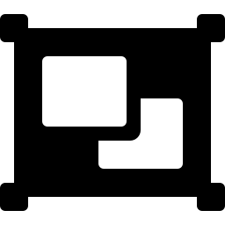

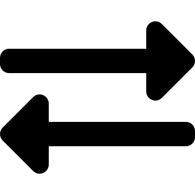
AGENDA
What We'll Cover
1. The Internet
2. Internet vs. WWW
A global network of interconnected networks
Why they are not the same thing
3. Client–Server Architecture
4. Web Browsers & Servers
The request/response model behind every website
The two ends of every web transaction
5. HTTP & HTTPS
02
6. HTML Basics & Page Structure
The protocol that moves the Web, and how it's secured
The building blocks of every web page

Slide 3

FOUNDATIONS
What Is the Internet?
A global network of networks that connects billions of computers and devices worldwide, allowing them to communicate and exchange data using a common set of rules called protocols.
A SIMPLE PICTURE
Interconnected Networks
Network of Networks
Homes, universities, businesses and governments run their own networks — the Internet links them together.
Common Protocols
Devices agree on rules like TCP/IP so data from any device can reach any other device.
Carries Many Services
Email, file transfer, video calls and the Web all travel over the same underlying Internet.
03
Each dot is a device or network; lines are the physical and wireless links that carry data between them.

Slide 4
FOUNDATIONS
Internet vs. World Wide Web
They're used interchangeably, but they are not the same layer of technology.
The Internet
The World Wide Web
The Infrastructure
A Service on the Internet
A physical and logical network of interconnected computers and cables, satellites, and wireless links
A system of interlinked documents (web pages) accessed via the Internet using HTTP/HTTPS
Exists at the hardware / transport level (routers, cables, IP addresses)
Exists at the application / content level (HTML pages, hyperlinks, browsers)
Carries many services: email, file transfer (FTP), video calls, gaming — not just web pages
One of many services that run over the Internet
04
Has existed since the late 1960s (ARPANET)
Invented by Tim Berners-Lee in 1989 at CERN

Slide 5




ARCHITECTURE
Client–Server Architecture
The Web works on a request–response model: clients ask, servers answer.
1. HTTP Request (GET /index.html)
CLIENT
SERVER
Web browser on a user's
device (PC, phone, tablet)
Powerful computer that
stores & serves web content
2. HTTP Response (HTML, CSS, images)
05
Many Clients, One Server
Stateless Requests
Servers Can Be Distributed
A single server can respond to thousands of clients making requests at once.
By default, each HTTP request is independent — the server treats every request fresh.
Large sites use many servers, load balancers, and content delivery networks (CDNs).

Slide 6



THE CLIENT SIDE
Web Browsers
Software that requests, interprets, and displays web content to the user.
Sends Requests
Takes a URL you type or click and turns it into an HTTP request to a server.
COMMON BROWSERS & ENGINES
Google Chrome
Parses HTML/CSS/JS
Blink rendering engine
Reads the returned code and figures out how the page should look and behave.
Mozilla Firefox
Gecko rendering engine
Renders the Page
Paints text, images, layout and interactive elements onto the screen.
Apple Safari
WebKit rendering engine
Manages Security
06
Microsoft Edge
Verifies certificates, enforces HTTPS, and sandboxes untrusted content.
Blink (Chromium-based)
The rendering engine is the part of the browser that converts HTML/CSS into pixels on screen.

Slide 7
THE SERVER SIDE
Web Servers
Hardware and software that store, process, and deliver web content on request.
WHAT A WEB SERVER DOES
POPULAR WEB SERVER SOFTWARE
1
Listens for incoming HTTP/HTTPS requests on a network port (commonly 80 / 443)
Apache HTTP Server
Open-source, highly configurable, oldest major server
2
Locates the requested resource — a static file (HTML, image) or triggers a program to generate one dynamically
Nginx
High-performance, popular for load balancing & static content
3
Packages the resource into an HTTP response with status code and headers
Microsoft IIS
4
Sends the response back to the requesting client
Integrated with the Windows Server platform
07
Node.js (Express)
5
Handles many simultaneous connections, logging, and security checks
Lets JavaScript run server-side to build dynamic apps

Slide 8


ARCHITECTURE
The Request–Response Cycle
What actually happens between typing a URL and seeing a page.
1
2
3
You Enter a URL
›
DNS Lookup
›
Request Sent
Type www.example.com or click a link in your browser.
The domain name is translated into a numeric IP address.
Browser sends an HTTP request to the server at that IP address.
4
5
6
Server Processes It
›
Response Returned
›
Page Rendered
08
Server locates/generates the requested resource.
Server sends back HTML, CSS, JS, images, and a status code.
Browser parses the response and displays the finished page.

Slide 9
PROTOCOLS
HTTP — HyperText Transfer Protocol
HTTP is the set of rules browsers and servers follow to request and deliver web resources such as pages, images, and data.
COMMON HTTP METHODS
ANATOMY OF A REQUEST/RESPONSE
GET
Retrieve data from the server (e.g., load a page)
Request
POST
Send new data to the server (e.g., submit a form)
GET /index.html HTTP/1.1
Host: www.example.com
User-Agent: Mozilla/5.0
Accept: text/html
PUT
Update an existing resource on the server
DELETE
Remove a resource from the server
Response
HTTP/1.1 200 OK
Content-Type: text/html
Content-Length: 1256
<html>...page content...</html>
COMMON STATUS CODES
09
200
OK — success
301
Moved Permanently — redirect
404
Not Found — resource missing
500
Internal Server Error
HTTP is a stateless, text-based protocol — each request/response pair stands alone.

Slide 10



PROTOCOLS
HTTPS — Securing the Web
HTTPS is HTTP wrapped in an encryption layer (TLS/SSL) that protects data in transit.
HTTP
HTTPS
Port 80 · Unencrypted · Data readable by anyone intercepting it
Port 443 · Encrypted with TLS/SSL · Data unreadable to eavesdroppers
WHY HTTPS MATTERS
Confidentiality
Integrity
Authentication
Encrypts data (passwords, card numbers) so third parties can't read it
Ensures data isn't altered or corrupted while traveling
10
Certificates confirm you're really talking to the intended website
Look for the padlock icon in the address bar — it indicates a valid HTTPS connection.

Slide 11

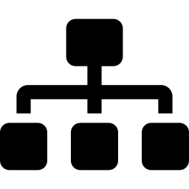

BUILDING BLOCKS
HTML Basics
HyperText Markup Language — the standard language used to structure content on the Web.
Elements & Tags
A MINIMAL HTML DOCUMENT
Content is wrapped in tags like <p> and </p>; most tags come in opening/closing pairs.
<!DOCTYPE html>
<html>
<head>
<title>My Page</title>
</head>
<body>
<h1>Hello, World!</h1>
<p>This is a paragraph.</p>
<a href="page2.html">Next page</a>
</body>
</html>
Attributes
Extra information inside a tag, e.g. href in <a href="...">, giving elements properties.
Nesting
Elements sit inside other elements, forming a hierarchical tree of content.
Hyperlinks
11
The <a> tag connects pages together — the 'links' that make the Web a web.

Slide 12
BUILDING BLOCKS
Web Page Structure
Every HTML document forms a tree of nested elements — the Document Object Model (DOM).
<html>
<head>
<body>
<title>
<h1>
<p>
<a>
<img>
"My Page"
"Hello, World!"
12

Slide 13
WRAP-UP
Key Takeaways
The Internet is the physical/logical network; the Web is a service that runs on top of it.
Every web interaction follows a client–server, request–response pattern.
Browsers request and render content; servers store, process, and deliver it.
HTTP defines the rules of exchange; HTTPS adds encryption via TLS/SSL for safety.
13
HTML structures content into nested elements, forming the DOM tree of a page.
Thank You

