Slide 1
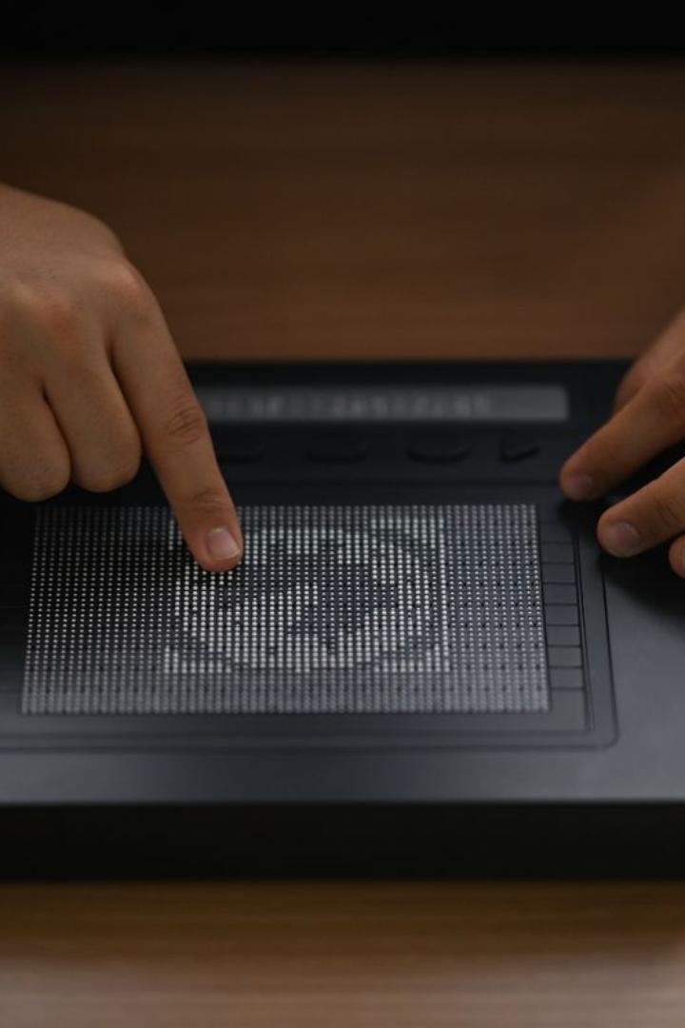
Innovative Tactile Display for the Visually Impaired
Discover how the Innovative Tactile Display revolutionizes the way visually impaired individuals interact with the world through tactile feedback.

Slide 2

Overcoming Challenges in Cost, Complexity, and Scalability
In the pursuit of enhancing accessibility for the visually impaired, our project focuses on developing a revolutionary tactile display capable of conveying diagrams and text. As the lead mechanical engineer, my objective is to address several challenges, including high cost, complexity per dot, poor resolution, and scalability issues.
Project Overview
The project, led by [Vikasita and Nehasri], aims to create a tactile display that serves as a valuable tool for the blind, enabling them to interpret complex information through touch. The challenges faced include the high cost of development, intricate design complexities, insufficient tactile dot resolution, and the scalability hurdles associated with implementing hundreds or thousands of raisable dots.

Slide 3
Key Challenges
1.Cost and Complexit
Tackling the high cost and complexity per dot by emphasizing the importance of cost-effective and streamlined solutions.
2.Resolution and Scalability
Addressing poor tactile dot resolution and scalability challenges related to power consumption and screen refresh rate for a large array of raisable dots.

Slide 4
Design Criteria
To ensure the effectiveness of our tactile display, we've established specific design criteria:
Dot spacing: Limited to a maximum of 2.5mm between dots.
Dot height: Each dot should raise by around 0.7mm.
Strength: The tactile dots must resist up to 300 grams without being pushed down.

Slide 5
Actuation System Ideation
In the pursuit of meeting the defined design criteria, our focus is on developing an innovative actuation system that seamlessly integrates mechanical motion and electrical input. Consideration of real-world parameters is paramount in this ideation process. We aim to achieve precise control through simulation modeling and the integration of tactile feedback algorithms.
Actuation System Simulation
For a comprehensive understanding of our actuation system, we conduct simulations for a single tactile dot. This involves modeling the electrical input required for controlled motion and analyzing the resulting mechanical motion against the specified criteria. This step ensures that our tactile display meets the defined standards.

Slide 6
Fabrication Plan
To bring our tactile display to life, we meticulously plan the fabrication process. Material selection is critical, and we prioritize materials that offer a balance of durability, flexibility, and cost-effectiveness. The manufacturing process is detailed step by step, with an emphasis on precision to achieve uniform dot characteristics across the entire display.

Slide 7
Innovation in Scalability:
Addressing scalability challenges is pivotal for the success of our project. We explore strategies for optimizing power consumption and overcoming screen refresh rate limitations, ensuring a seamless implementation of a large array of tactile dots.

Slide 8
Understanding the Needs of the Visually Impaired
Challenges Faced
Importance of Tactile Feedback
Limitations of Existing Solutions
Explore the daily obstacles faced by visually impaired individuals and the limitations of conventional solutions.
Understand why tactile feedback is crucial for enhancing sensory perception and facilitating a more inclusive experience.
Highlight the shortcomings of current systems and the opportunities for improvement offered by the Innovative Tactile Display.

Slide 9

The Concept of the Innovative Tactile Display
Design and Functionality
Immersive Tactile Experience
Get an overview of the Innovative Tactile Display's sleek design and its versatile functionality.
Learn how the display utilizes cutting-edge technology to provide a rich and immersive tactile experience.
Benefits and Potential Applications
Discover the wide array of benefits and potential applications of the Innovative Tactile Display beyond assisting the visually impaired.

Slide 10

Technologies Behind the Innovative Tactile Display
1
Exploration of Tactile Feedback Technologies
2
Incorporation of Haptic Sensors and Actuators
Delve into the various tactile feedback technologies employed by the Innovative Tactile Display.
Learn how haptic sensors and actuators are seamlessly integrated into the display to enhance the user experience.
3
Integration with Other Assistive Technologies
Explore the seamless integration of the Innovative Tactile Display with other assistive technologies for enhanced accessibility.

Slide 11

User Experience and Feedback
1
Perspectives of Visually Impaired Users
Gain insights into the firsthand experiences and testimonials of visually impaired individuals using the Innovative Tactile Display.
Testing and Refinement Process
2
Explore the rigorous testing and refinement process that ensures the display's usability and effectiveness meet the highest standards.
3
Real-Life Impact and Testimonials
Uncover the tangible impact of the Innovative Tactile Display on the lives of visually impaired individuals through inspiring success stories.

Slide 12
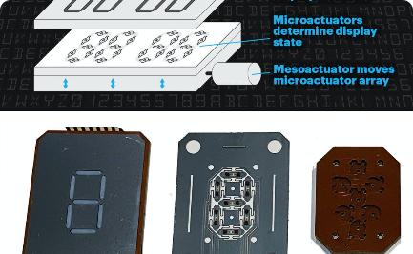


Advancements and Future Possibilities
Upcoming Developments in Tactile Displays
Potential Collaborations and Research Areas
Vision for a More Inclusive Future
Discover the latest advancements in tactile displays and how they will further enhance accessibility for the visually impaired.
Explore the potential collaborations and exciting research areas that hold the key to continued innovation in tactile display technology.
Envision a future where the Innovative Tactile Display and similar advancements redefine accessibility and inclusivity for all.

Slide 13
Conclusion
Recap of Key Points
Call to Action for Further Exploration and Adoption
Summarize the key features and benefits that set the Innovative Tactile Display apart, emphasizing the transformative impact it can have.
Encourage further exploration and adoption of the Innovative Tactile Display to create a more inclusive and accessible world.

