Slide 1
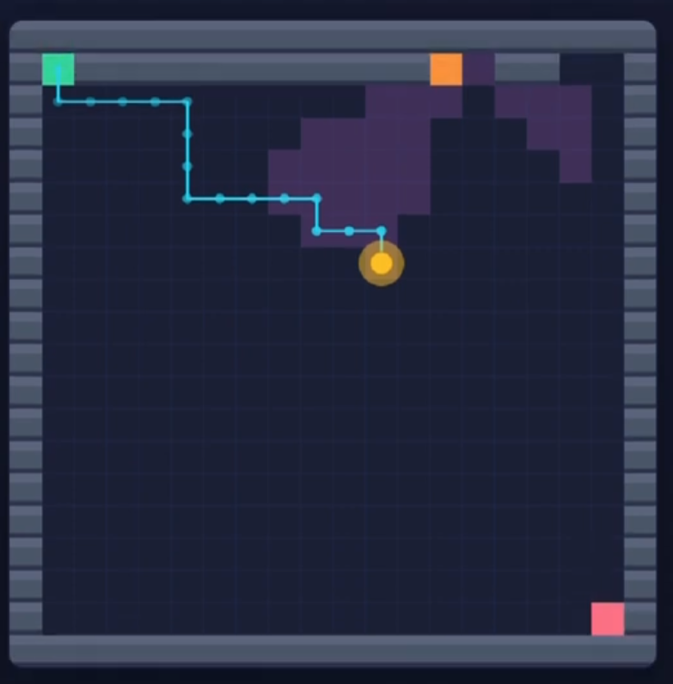
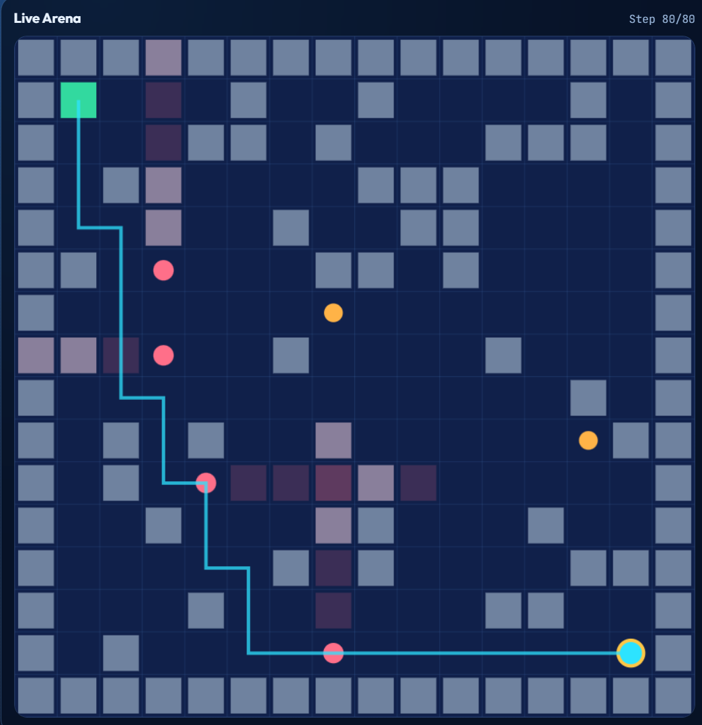
HEIST ARCHITECT
Adversarial Reinforcement Learning Framework
Two AI agents play an infinite game of cops-and-robbers. One designs the security system. The other breaks in.
PHASE I
PHASE II
Local Training → Kaggle Cloud Scale-Up → 17,000 Episodes
CSE4019 – Reinforcement Learning Project | 2025–2026
Built with PyTorch · Flask · CUDA · Kaggle T4 GPUs | Hugging Face: Shanmuk4622/heist-architect-v2

Slide 2
Presentation Outline
A two-phase journey from local prototype to cloud-scale AI
PHASE I — Local Framework
PHASE II — Cloud Scale-Up
01. Problem Statement & Motivation
01. Phase II — Kaggle Cloud Scale-Up
02. Adversarial RL Concept
02. 17,000 Episode Training on Dual T4 GPUs
03. Dual-Agent Architecture (Architect vs Solver)
03. Collapse & Recovery Cycles (Adversarial Dynamics)
04. Environment Design — 20×20 Grid World
04. ELO Arms Race — Strategic Equilibrium
05. Security Components (Walls, Cameras, Guards)
05. Web Dashboard — Real-Time Monitoring
06. Curriculum Learning Pipeline
06. Key Quantitative Results
07. Neural Networks (CNN + LSTM / Encoder-Decoder)
07. Emergent Strategies & Nash Equilibrium
08. Phase I Results — 500 Episode Local Run
08. References

Slide 3



Problem Statement
What are we solving, and why does it matter?
"Standard RL trains a single agent on a fixed environment. Real-world security is a dynamic, adaptive adversarial game."
Static Environments
Single-Agent Limitation
No Adversarial Co-Learning
Traditional RL agents memorize solutions. Security threats evolve — a defender must adapt to an ever-improving attacker.
Training on a fixed maze produces brittle policies. An intelligent adversary (Architect) forces the agent to generalize, not memorize.
Existing benchmarks (e.g., MiniGrid) lack an intelligent, learning opponent. This project fills that gap with simultaneous dual-agent training.

Slide 4
Adversarial Reinforcement Learning
Self-play that drives emergent intelligence
🔹 Standard MDP
⚔️ Markov Game (This Project)
• One agent, one fixed environment • Converges to a stable optimal policy • Learns to memorize patterns • Fails when environment shifts
• Two agents, adversarially generated environment • Strategically non-stationary — task changes as opponent evolves • Forces generalisation over memorisation • Converges toward Nash Equilibrium
VS
Non-Stationarity
Nash Equilibrium
Task distribution changes as the opponent learns new strategies
Stable endpoint where neither agent can improve by changing strategy alone
Co-Adaptation
ELO Rating
Both policies evolve in response to each other — arms race dynamics
Relative skill score that tracks which agent is currently dominating

Slide 5
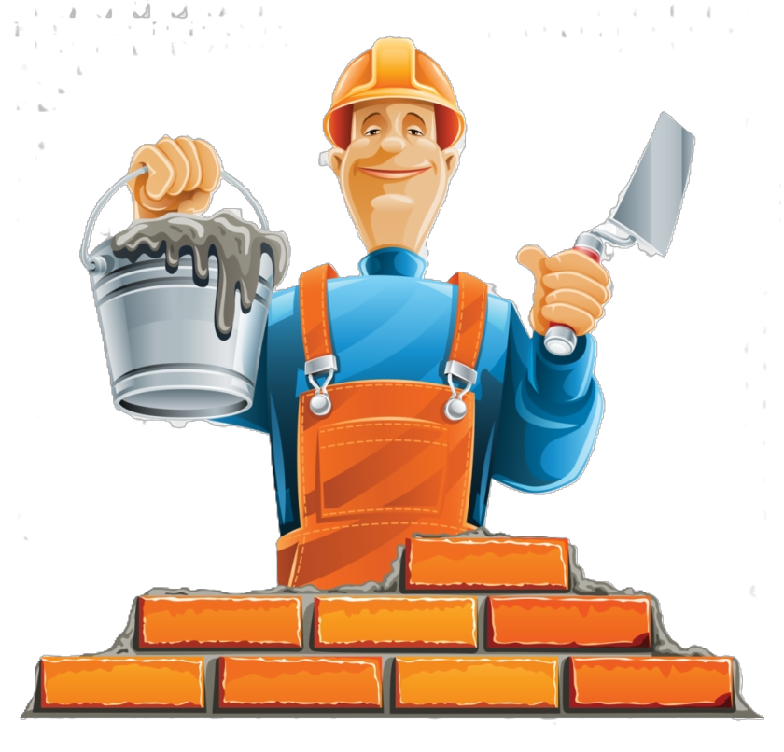

The Two Agents
Architect vs Solver — an infinite adversarial game
🔒 THE ARCHITECT
🕵️ THE SOLVER (ROBBER)
Security Designer — The Adversary
Infiltrator — The Navigator
▸ Places Walls, Cameras & Guards on a 20×20 grid
▸ Must stay within a budget (Wall=1 pt, Cam=3 pt, Guard=5 pt)
▸ Budget grows with curriculum: 5 → 8 → 15 → 22 pts
▸ Penalised if no valid path exists to the Vault
▸ Penalised if the Solver finds it too easy (>80% solve rate)
▸ Rewarded proportionally to Detection Rate achieved
▸ Network: ResNet + Group Norm Backbone — 8.5M parameters
▸ Uses 512-dim LSTM hidden state to map a dense 400-cell grid
▸ Navigates from Start (1,1) to Vault (18,18) undetected
▸ Actions: UP, DOWN, LEFT, RIGHT, WAIT
▸ Sees 12-channel spatial tensors (geodesic dists, danger zones)
▸ WAIT action is critical — times camera rotations precisely
▸ Uses massive 512-param LSTM memory to track temporal guard sequences
▸ Penalised -1.0 for detection; rewarded +10.0 for vault reach
▸ Network: CNN + 512-dim LSTM — 7M parameters
▸ Distance-based shaping guides learning from episode one

Slide 6
The Grid World Environment
A 20×20 dynamic adversarial arena
#################### #S. . . . . . . . . . . . . . . . . # # . . . .# # # # . . . .. . . . .# # . . . . . . . . . . .. . . . . .. # #. . . . .. C . . . . . . . . . .# # . . . . .. . . . . G. . .. . . . # #. . X X X. . . . . . .. . . . . # # . . . . X X X X X. . .. . . . # #. . . . .. . . X XX X X X .. # # . . . . . . . . . . . . . . .. # #. . . . . . . . . . . . . . . . . V# ####################
MAP LEGEND
S =
Start — Solver spawns here
V =
Vault — Solver's objective
C =
Camera — rotating vision cone
G =
Guard — mobile patrol unit
# =
Wall — blocks movement & sight
X =
Danger Zone — currently surveilled
. =
Empty — walkable safe tile
Key Rules
• Border tiles are always walls • BFS validates path existence • Visibility map is recomputed every tick via raycasting • Camera FOV, rotation speed & guard patrol paths are Architect-defined

Slide 7
Security Components
Budget-constrained adversarial assets
🧱 WALL
📷 CAMERA
💂 GUARD
Cost: 1 pt
Cost: 3 pts
Cost: 5 pts
▸ Static obstacle — no movement
▸ Fixed position, rotating heading over time
▸ Mobile patrol along Architect-defined waypoint routes
▸ Blocks Solver's path AND line-of-sight
▸ Triangular vision cone — raycasted, wall-occluded
▸ Vision cone follows direction of movement
▸ Architect uses walls to create chokepoints and corridors
▸ Solver must time movements to exploit rotation gaps
▸ Most expensive — hardest for Solver to predict
▸ Funnels Solver into surveilled kill-zones
▸ Architect places at intersections for maximum sweep area
▸ Architect learns to sync guard patrols with camera blind spots

Slide 8
Reward System — Zero-Sum Design
Precisely engineered incentives that drive adversarial learning
🕵️ Solver Rewards
🔒 Architect Rewards
+0.1
Move closer to Vault (distance shaping)
+1.0
Detection rate × 1.0 (more detections = better security)
-0.1
Move further from Vault
-0.5
Solver succeeds >80% of attempts (too easy)
-0.01
Per time-step penalty (efficiency)
+0.2
Solver succeeds 20–60% (challenging but fair zone)
+0.05
Proximity bonus within 3 tiles of Vault
-1.0
Invalid layout — no valid path to Vault
+10.0
REACH THE VAULT ✅
-1.0
DETECTED by camera or guard 🚨
🎯 Architect's Sweet Spot: ~30% Solve Rate Security challenging enough to catch most attempts, but not impossibly hard.
+2.0
Partial credit at timeout (distance-based)

Slide 9
Curriculum Learning Pipeline
Gradual difficulty ramp — stability before adversarial competition
WARMUP
PHASE I
PHASE II
PHASE III
PHASE IV
Pre-Training Ep 1–30
Walls Only Ep 31–80
+ Cameras Ep 81–200
Full Security Ep 201–400
Expert Mode Ep 401–500
Budget: 0
Budget: 5
Budget: 8
Budget: 15
Budget: 22
Empty grid; Solver learns basic navigation toward the Vault
Walls introduced; Solver learns path-finding around obstacles
Rotating cameras added; LSTM memory exploits rotation timing windows
Guards introduced; true adversarial competition begins — collapse then recovery
Maximum budget; Architect fortifies vault rooms; Solver adapts dynamically
Solve Rate
Solve Rate
Solve Rate
Solve Rate
Solve Rate
100% solve
~100%
45–100%
0→50%
~60%
Detection
Detection
Detection
Detection
Detection
—
0%
20–40%
50–80%
~40%

Slide 10
Neural Network Architecture
Solver: CNN + LSTM | Architect: Encoder-Decoder CNN
🕵️ Solver Network — 550K Parameters
🔒 Architect Network — 407K Parameters
INPUT
3-Channel Grid (20×20)
INPUT
1-Channel grid (start/vault/border)
↓
↓
CONV ×3
3→32→64→64 kernels, ReLU activation
ENCODER ×3
1→32→64→128, ReLU — spatial compression
↓
↓
LSTM
256 units, 128 hidden — temporal memory
DECODER ×3
128→64→32→3, ConvTranspose, Sigmoid
↓
↓
POLICY HEAD
5-action probability distribution (U/D/L/R/WAIT)
PLACEMENT MAP
Per-tile probabilities: [wall, camera, guard]
↓
↓
VALUE HEAD
State value estimate for PPO critic
PARAM HEADS
Camera FOV, rotation speed, guard patrol paths
Why LSTM? Cameras rotate — the Solver needs memory to predict when a camera will rotate away, creating a safe movement window.
Samples from probability distributions with temperature — higher temperature creates chaotic, unpredictable layouts; lower temperature maximises confidence.

Slide 11
PHASE I — Results: Local Training Run
500 Episodes · 20×20 Grid · 126.5 min runtime · ResNet-Enhanced Architecture
59.5%
40.5%
0.335
7.813
Final Solve Rate
Final Detection Rate
Avg Architect Reward
Avg Solver Reward
Phase I: Warmup & Walls (Ep 1–80)
Solver mastered open grid navigation by Episode 30 — reaching vault in 42 steps. With static walls, solve rate stayed at 100% (walls only deflect, not detect).
Phase II: Cameras Added (Ep 81–200)
Solve rate instantly plummeted to 45% at Ep 80. Within 10 episodes (Ep 90), LSTM memory learned to wait for camera rotation windows — solve rate restored to 100%.
Phase III: Guards Introduced (Ep 200–400)
Catastrophic collapse: Solve Rate dropped to 0.00, Detection to 1.00. Chokepoints + guards = lethal traps. After 100 episodes of adaptation, Solver clawed back to 50/50 — Nash balance.
Phase IV: Expert Mode (Ep 400–500)
Architect given maximum budget (22 pts). Win rate fluctuated wildly (5% at Ep 470, 100% at Ep 490). Final ~60% average against expert security — proves neural architecture is fully operational.

Slide 12
PHASE II — Kaggle Cloud Scale-Up
Dual NVIDIA Tesla T4 · 17,000 Episodes · Hugging Face Integration
Phase I proved the framework works — agents learn, compete, and reach equilibrium in 500 episodes.
Phase II answers: what happens when we train 34× longer with cloud GPU acceleration?
The answer revealed deep adversarial cycling — collapse, recovery, and strategic arms race dynamics impossible to observe in short local runs.
Scale
Curriculum
Cloud Storage
17,000 episodes vs 500 (34× more training)
4-stage:
→ Rookie → Intermediate → Expert → Master
Checkpoints auto-synced to Hugging Face every 500 ep
Hardware
ELO System
Dual NVIDIA Tesla T4 GPUs vs local CPU/single GPU
Real-time relative skill tracking per episode
⚡ Key Insight from Phase II
The training history is not a smooth curve — it is evidence of adversarial cycling. The Solver dominated early, collapsed twice under Architect pressure, and recovered twice. This collapse-recovery pattern is the theoretical signature of adversarial co-adaptation, not a training failure. Final best checkpoint (ep17000): Robber win-rate 1.00, ELO +1093.

Slide 13
Phase II — Advanced Methodologies
Architectural Anatomy and PPO Engine Mechanics
🔒 The Architect's Anatomy
• Explicitly engineered with an 8.5M parameter ResNet + Group Normalization backbone. • Leverages a 512-dimensional LSTM hidden state to map decision branching over a dense 400-cell grid matrix. • Avoids standard DataParallel computations via True Split Asynchronous Deployment on dedicated cuda:0.
🕵️ The Robber's Anatomy
• Processes 12-channel spatial tensor inputs (tracking normalized geodesic distances and danger zones). • Replaces simple CNNs passing with a 512-parameter LSTM (7M parameters total) to track temporal guard sequences. • Detaches hidden states across continuous timesteps to construct a reliable memory of rotating camera phases.
⚙️ Core Engine Mechanics (PPO)
• Utilizes Proximal Policy Optimization (PPO) with Generalized Advantage Estimation (λ = 0.95, γ = 0.99). • Enforces a clipped surrogate objective (ϵ = 0.2) to prevent catastrophic network self-destruction during updates. • Applies entropy regularization (coef = 0.02) to actively circumvent Strategy Collapse and avoid boring Nash Equilibria.

Slide 14
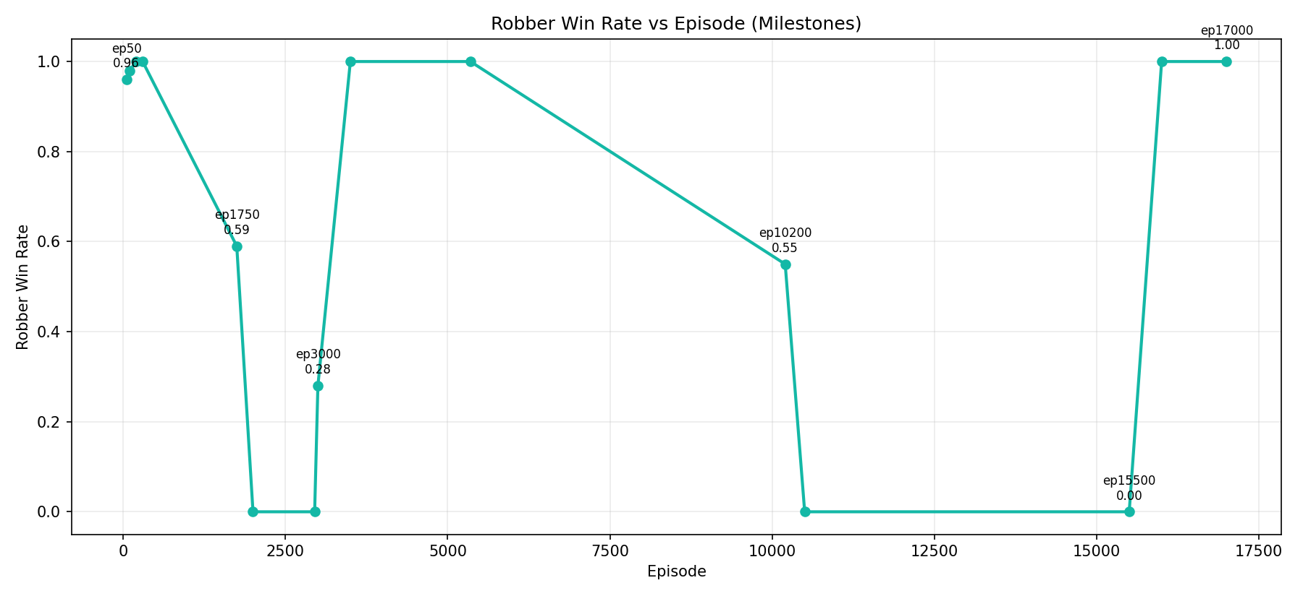
Training Dynamics — Collapse & Recovery Cycles
17,000 episodes of adversarial co-adaptation across 5 distinct phases
Episode
Stage
Win Rate
ELO Diff
Interpretation
Ep 50
Rookie
0.96
+477
Solver starts strong
Ep 200
Expert
1.00
+737
Solver generalises quickly
Ep 300
Master
1.00
+810
Peaks at hardest curriculum
Ep 1750
Master
0.59
-381
First collapse begins
Ep 2950
Master
0.00
-1060
First collapse low point
Ep 3000
Master
0.28
+206
Recovery begins
Ep 5350
Master
1.00
+994
High-performance peak
Ep 10200
Master
0.55
-382
Second collapse begins
Ep 15500
Master
0.00
-1317
Deepest valley observed
Ep 16000
Master
1.00
+895
Recovery after restart
Ep 17000
Master
1.00
+1093
Best visible checkpoint ⭐

Slide 15
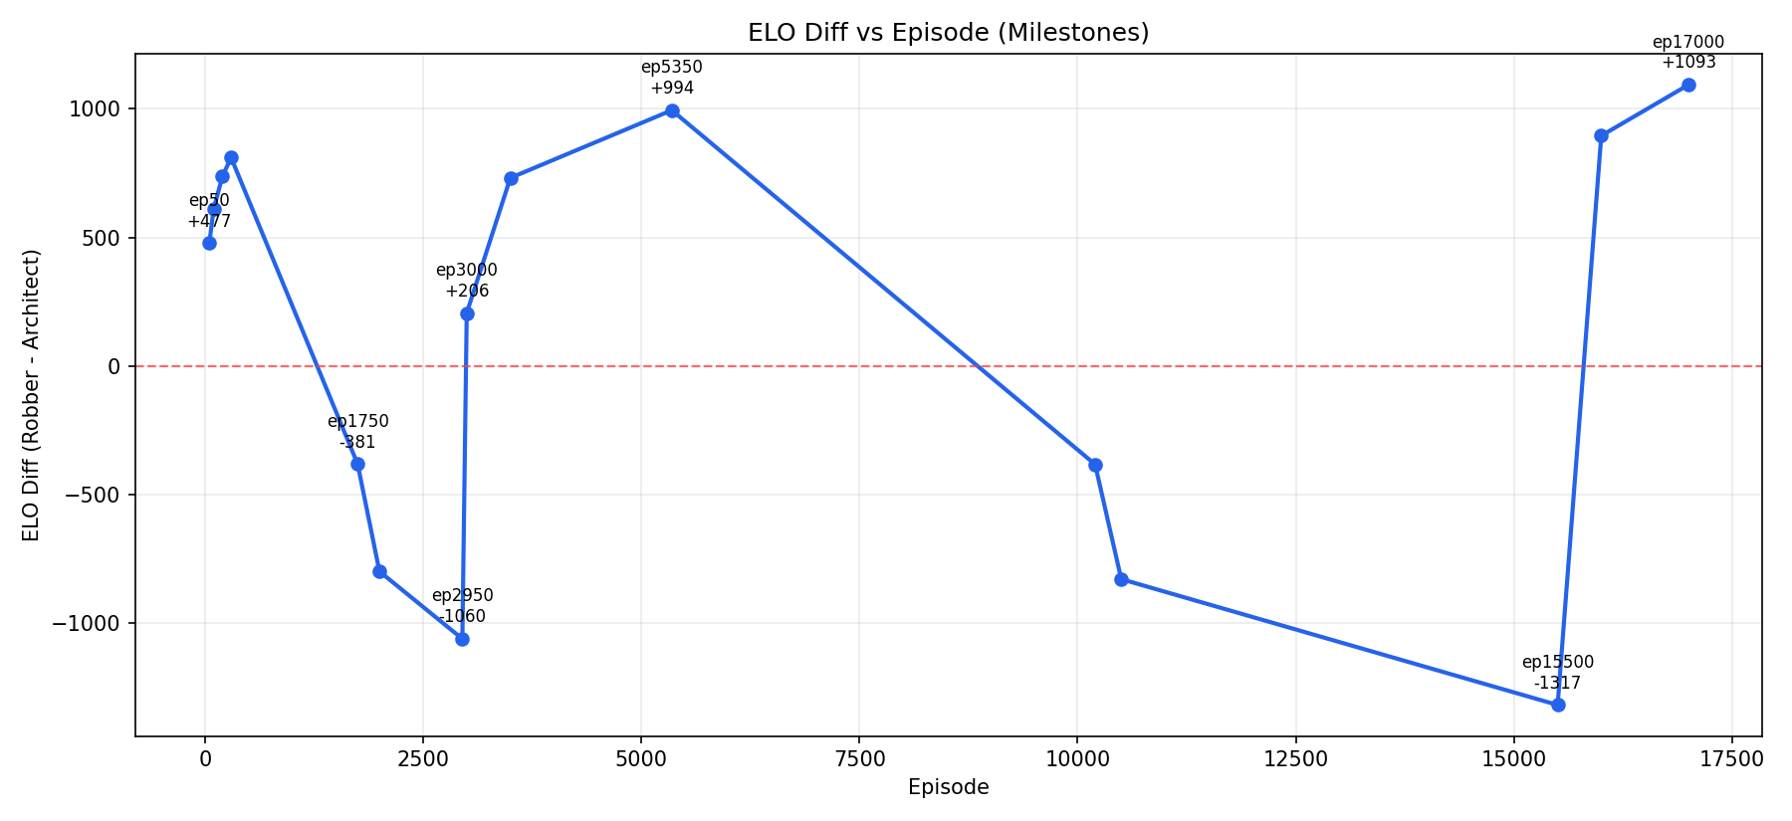
Training Dynamics — ELO Diff vs Episode (Milestones)
17,000 episodes of adversarial co-adaptation across 5 distinct phases
Episode
Stage
Win Rate
ELO Diff
Interpretation
Ep 50
Rookie
0.96
+477
Solver starts strong
Ep 200
Expert
1.00
+737
Solver generalises quickly
Ep 300
Master
1.00
+810
Peaks at hardest curriculum
Ep 1750
Master
0.59
-381
First collapse begins
Ep 2950
Master
0.00
-1060
First collapse low point
Ep 3000
Master
0.28
+206
Recovery begins
Ep 5350
Master
1.00
+994
High-performance peak
Ep 10200
Master
0.55
-382
Second collapse begins
Ep 15500
Master
0.00
-1317
Deepest valley observed
Ep 16000
Master
1.00
+895
Recovery after restart
Ep 17000
Master
1.00
+1093
Best visible checkpoint ⭐

Slide 16
ELO Arms Race — Strategic Equilibrium
Relative skill tracking reveals adversarial co-adaptation cycles
ELO is a relative skill metric borrowed from chess and competitive gaming. Here it tracks which agent is currently dominating. A positive ELO diff means the Solver is winning; negative means Architect dominates. Under PPO constraints, neither side easily exploits the other — LSTM hidden states push both agents into high-level spatial deduction rather than memorised routes.
The Rookie Stage (Ep 50–300)
Robber ELO spikes to +810 because randomly-walking guards provide minimal map coverage. Single-agent navigation dominates early — layout complexity is insufficient to challenge a learning Solver.
The Overfit Rebound (Ep 1750–2950)
Architect learns to cluster cameras near the Vault. Solver ELO collapses to -1060 — the Architect has found an effective chokepoint strategy that the Solver hasn't seen before.
The Recovery Window (Ep 3000–10000)
Solver discovers new blind-spot exploitation strategies. ELO recovers to +994 — a long positive regime where the Solver consistently outperforms the Architect.
The Final Arms Race (Ep 10200–17000)
Second deep collapse to -1317, then full recovery to +1093 at ep17000. Classic adversarial cycling — each side forces the other to find superior strategies.
⭐ ep17000 — Best Checkpoint: Win-Rate 1.00 · ELO +1093 · Stage: Master → Default evaluation target for all dashboard demos.

Slide 17
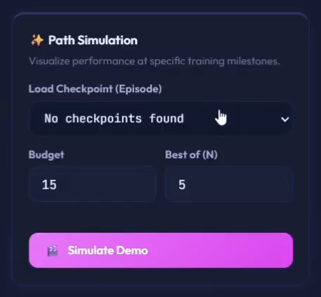
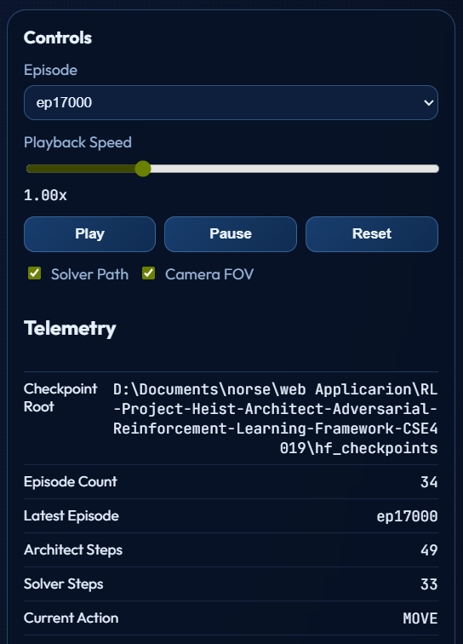
Real-Time Web Dashboard
Flask + WebSocket live monitoring and control interface
🗺️ Grid Visualization (Left Panel)
🔄 Path Simulation & Checkpoints
📊 Live Metrics & Charts
▸ 👁 Eye icon toggles sweeping purple vision cones
▸ Two spline charts: Rewards & Rates over time

Slide 18
PHASE II — Key Results: Cloud Training
17,000 episodes · Dual T4 · Checkpoint ep17000 as best model
1.00
+1093
+2.3
17,000
Robber Win-Rate at ep17000
ELO Differential
Robber Reward (ep17000)
Total Episodes Trained
Training Timeline Summary
Phase A — Curriculum Climb (Ep 50–1700)
Rookie → Master in ~300 episodes. Win-rate 0.90–1.00 consistently. ELO grew to +810. Solver generalised to all 4 curriculum stages faster than expected.
Phase B — First Collapse (Ep 1750–2950)
Win-rate collapsed to 0.00. ELO dropped to -1060. Architect discovered vault-room fortification strategy — combining chokepoints, cameras, and guards with high density.
Phase C — First Recovery (Ep 3000–10000)
Solver rediscovered wall-hugging + blind-spot timing strategy. ELO returned to +994. 7000-episode positive regime demonstrated long-term stability after adversarial rebound.
Phase D — Second Collapse (Ep 10200–15500)
Deepest valley: ELO -1317. Architect evolved patrol synchronisation — guards timed so no safe window existed. Solver spent 5300 episodes at 0% win-rate.
Phase E — Final Recovery (Ep 15501–17000)
Full recovery: Win-rate 1.00, ELO +1093. Post-restart, Solver learned fundamentally superior strategies. ep17000 selected as best checkpoint for all evaluations.

Slide 19
Emergent Strategies & Nash Equilibrium
Nobody programmed these tactics — they arose from competition
🔒 Architect Discovered
🕵️ Solver Discovered
▸ Chokepoints — Narrow corridors covered by rotating cameras
▸ Dead Ends — Walls that look like paths but lead into kill-zones
▸ Patrol Synchronisation — Guards timed so no safe window exists
▸ Camera Crossfire — Multiple cameras covering each other's blind spots
▸ Vault Fortification — Dense security rings around the objective
▸ Budget Efficiency — Cameras > Guards for cost-per-coverage
▸ Wall Hugging — Using walls as cover from camera vision cones
▸ Timing Windows — Waiting for cameras to rotate away before sprinting
▸ Indirect Paths — Longer routes that avoid high-density detection zones
▸ Patience (WAIT) — Staying still at critical moments for guard cycles
▸ Blind Spot Exploitation — Navigating through camera angle gaps
▸ Temporal Mapping — LSTM remembers guard positions from 5 steps ago
🎯 Nash Equilibrium — The Natural Balance Point
Phase I converged at ~30% Solve Rate | 40% Detection Rate — the mathematical sweet spot. Phase II showed deeper cycling but returned to competitive balance. At equilibrium: the Architect cannot catch the Solver more reliably without making invalid levels; the Solver cannot reach the Vault more often without exposing itself to detection. This is the same framework used in poker AI, military strategy models, and economic game theory.

Slide 20
References
Key literature supporting this adversarial RL framework (2021–2025)
[1]
Schulman et al., 2017
[7]
Gleave et al., 2022
"Proximal Policy Optimization Algorithms," arXiv:1707.06347. [PPO — core RL algorithm for both agents]
"Adversarial Policies: Attacking Deep Reinforcement Learning," ICLR 2022. [Adversarial policy dynamics]
[2]
Baker et al., 2020
[8]
Hausknecht & Stone, 2015
"Emergent Tool Use From Multi-Agent Autocurricula," ICLR 2020. [Foundation for emergent multi-agent strategies]
"Deep Recurrent Q-Networks for Partially Observable MDPs," AAAI. [LSTM in RL for temporal memory]
[3]
Vinyals et al., 2019
[9]
Littman, 1994
"Grandmaster level in StarCraft II using multi-agent RL," Nature, 575. [Adversarial curriculum for complex games]
"Markov games as a framework for multi-agent RL," ICML 1994. [Markov Game theoretical backbone]
[4]
Bengio et al., 2021
[10]
Lanctot et al., 2023
"Curriculum Learning," ICML 2021. [Theoretical basis for difficulty scheduling and curriculum design]
"OpenSpiel: A Framework for Reinforcement Learning in Games," JMLR. [Multi-agent game benchmarks]
[5]
Mnih et al., 2022
[11]
Elo, 1978 / Silver et al., 2021
"Playing Atari with Deep Reinforcement Learning," NeurIPS. [CNN feature extraction for RL observations]
"The Rating of Chessplayers" / "A general RL algorithm AlphaZero," Science. [ELO rating adaptation]
[6]
OpenAI, 2021
[12]
Chevalier-Boisvert et al., 2023
"Asymmetric self-play for automatic goal discovery," arXiv:2101.04882. [Architect-Solver game formulation]
"MiniGrid & MiniWorld: Modular & Customisable RL Grid Environments," NeurIPS. [Related grid-world baselines]

Slide 21
CONCLUSIONS
Heist Architect — CSE4019 Adversarial RL Framework
✓ Phase I proved the concept:
Local 500-episode run achieved Nash Equilibrium at ~60% Solve / 40% Detect.
✓ Phase II deepened the science:
17,000 episodes on Kaggle T4 GPUs revealed adversarial cycling — collapse, recovery, arms race.
✓ Emergent complexity works:
Chokepoints, patrol sync, wall-hugging, timing — none programmed; all emerged from competition.
✓ The architecture scales:
CNN+LSTM Solver (550K params) and Encoder-Decoder Architect (407K) remain competitive at Master level.
✓ Game theory is validated:
Nash Equilibrium, Markov Games, and ELO dynamics are empirically reproducible in our custom environment.
Shanmuk4622/heist-architect-v2 | CSE4019 — 2025-2026 | Built with PyTorch · Flask · CUDA · Kaggle

