Slide 1
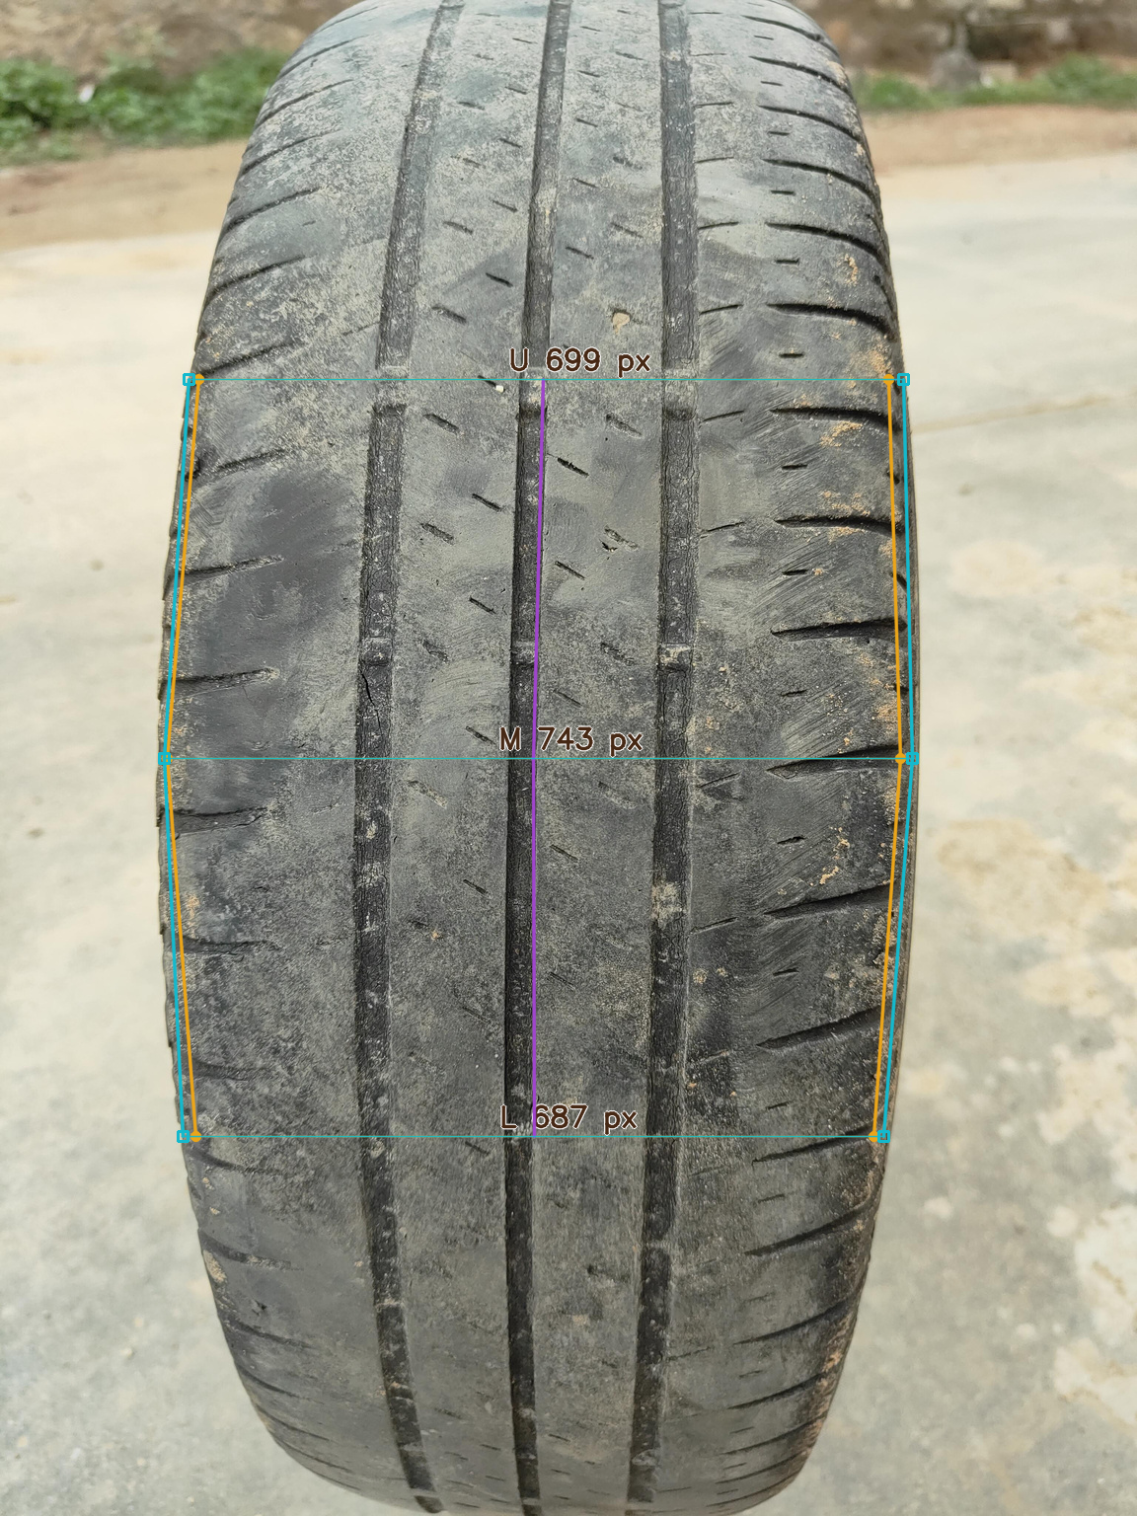
Vision-based
tyre inspection
Experiments, learned geometry
and Tread Station
Shanmukesh Bonala
VIT-AP University
01
Notes:
Introduce the project as a research study and working inspection prototype. Mileage labels are proxies. The image shows original matched learned geometry, not a physical tread-depth measurement.
Sources: ACCESS_latex_template_20260513/sections/results.tex
Evidence reflects repository records through 24 September 2026. Presentation prepared 27 October 2026.

Slide 2
What the project delivers
A reproducible study of mileage-proxy recognition, tyre/tread localisation and boundary learning.
A second training release using annotated workshop video frames.
A desktop workstation that compares models and saves inspection evidence.
02
Notes:
The original work evaluates components and their interactions. Phase 2 adds video-derived training data and deploys a separate model set. Neither study establishes physical wear or safety accuracy.
Sources: ACCESS_latex_template_20260513/sections/results.tex; phase2/workstation/README.md
Evidence reflects repository records through 24 September 2026. Presentation prepared 27 October 2026.

Slide 3
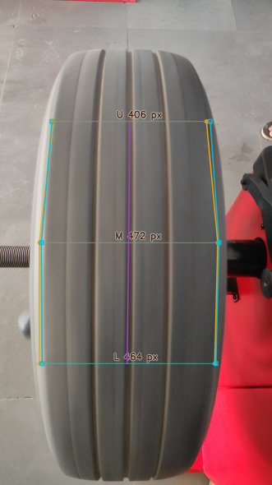
Three outputs on the same tyre
Recognition
Low / mid / high proxy
Localisation
Tyre and tread regions
Geometry
Six boundary positions
03
Notes:
Recognition predicts low/mid/high mileage proxy. Segmentation predicts overlapping tyre and tread regions. Six boundary positions support image-relative widths and tilt. These outputs answer different questions.
Sources: phase2/workstation/README.md
Evidence reflects repository records through 24 September 2026. Presentation prepared 27 October 2026.
Image crop retains the complete tyre photograph and removes the surrounding diagnostic UI.

Slide 4
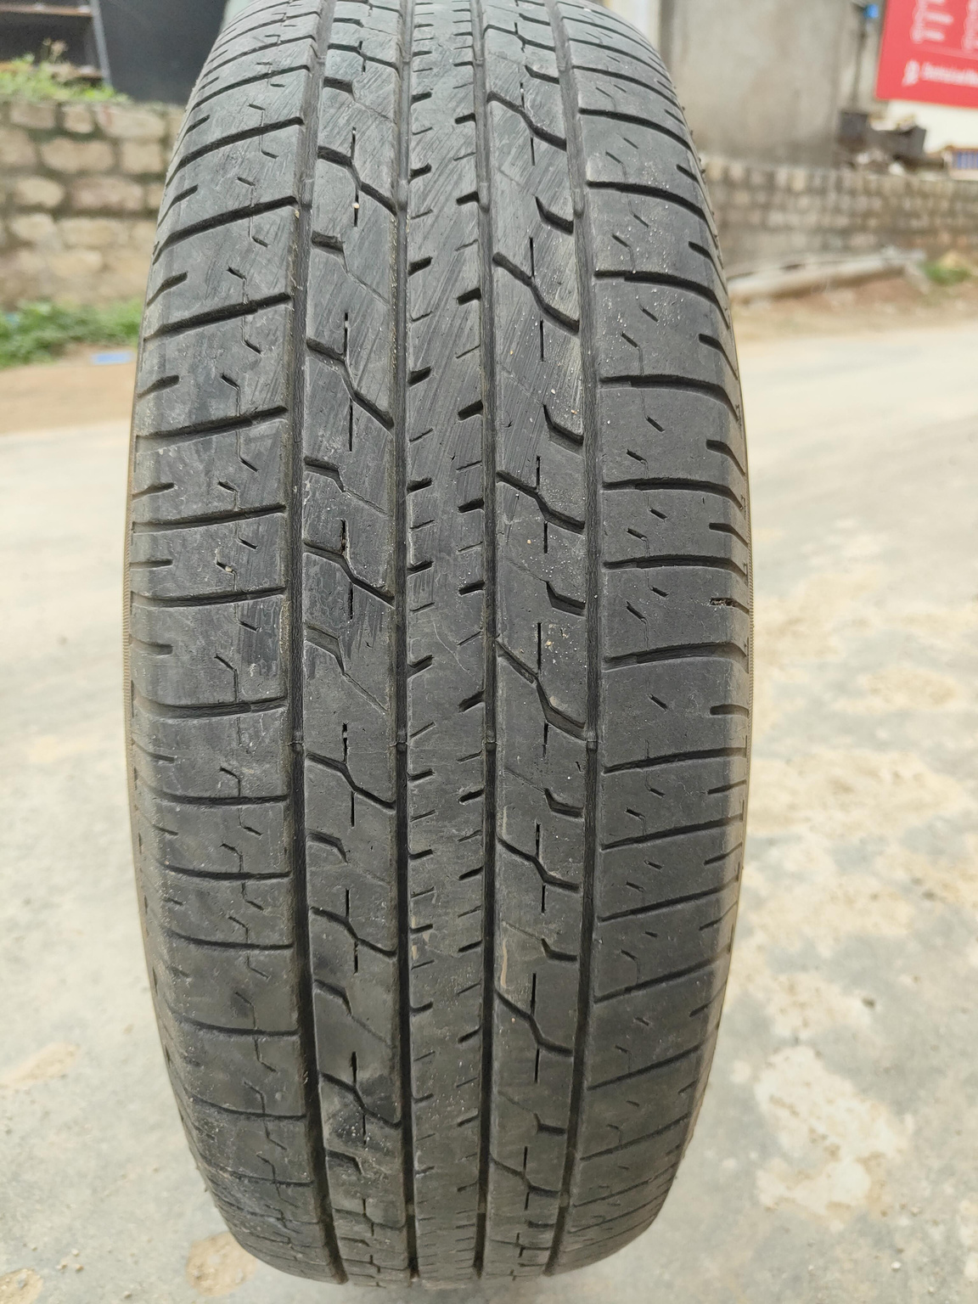
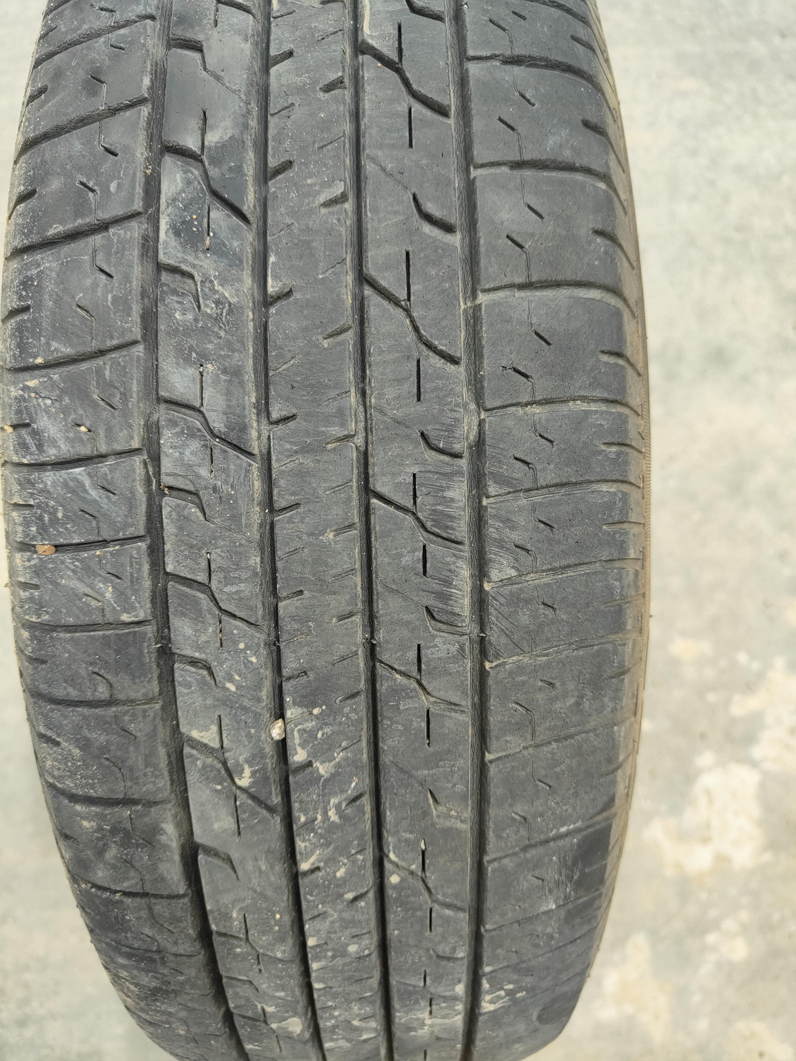
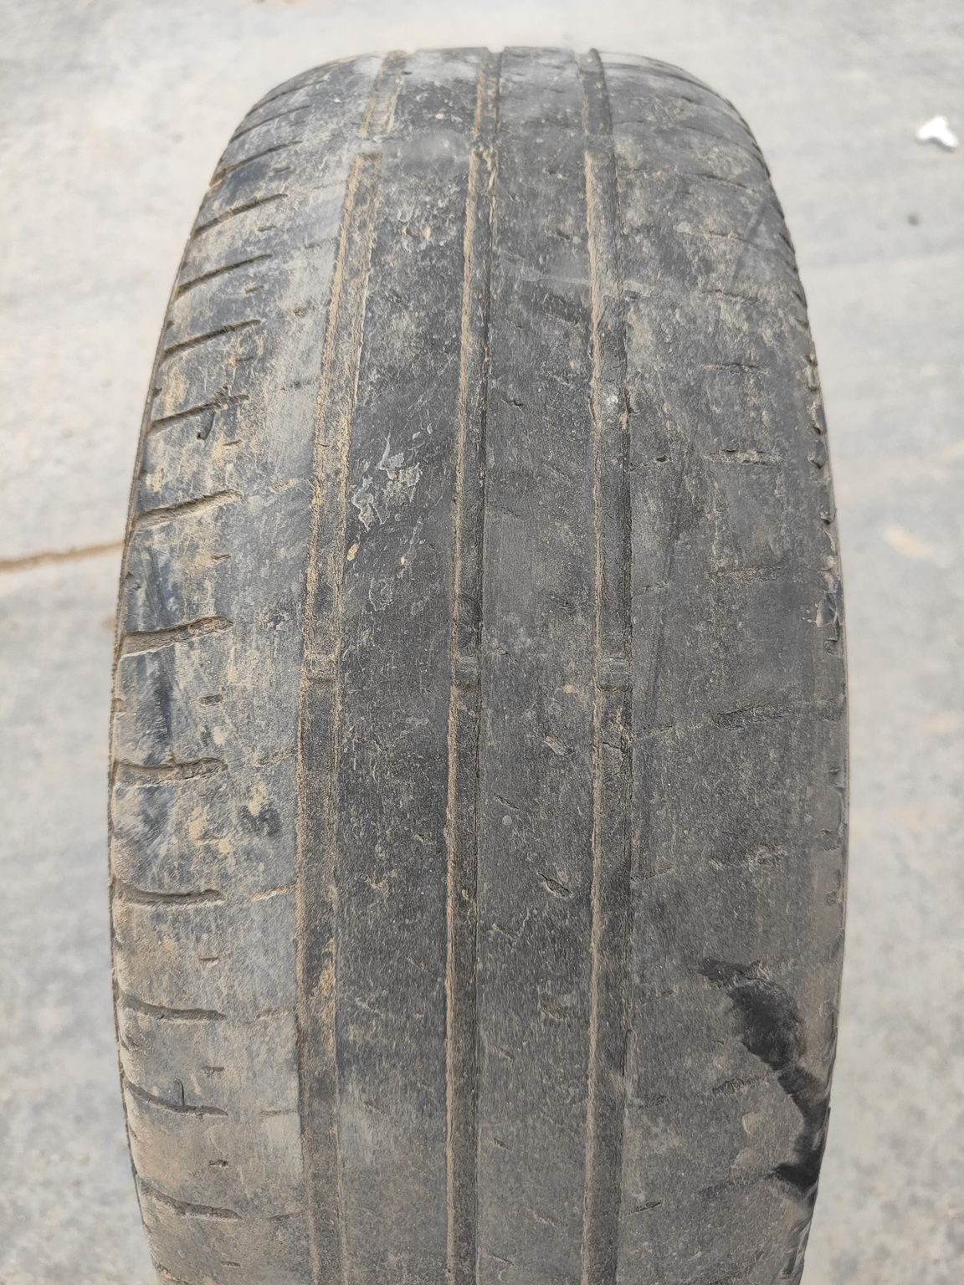
The original dataset
Low mileage proxy
Mid mileage proxy
High mileage proxy
418 original photographs / 12 tyres / 4,180 derived augmentations
04
Notes:
418 original photographs across 12 recorded sessions. User confirmed distinct physical tyres. Derived augmentations are not independent samples. The latest membership audit reports disjoint session groups in each original fold, but that is not an independent identity audit.
Sources: undertand3.md; ACCESS_latex_template_20260513/sections/methods.tex
Evidence reflects repository records through 24 September 2026. Presentation prepared 27 October 2026.

Slide 5
Experiment coverage
Experiment | Completed evidence
Architecture screening | 153 usable runs across 17 architectures
OFAT and confirmation | 108 Stage B runs + 18 confirmation runs
Detection and segmentation | 81 runs, each reaching 60 epochs
Matched boundary comparison | HRNet + SegFormer, 3 seeds each
Phase 2 deployment training | 5 families × 3 seeds = 15 runs
05
Notes:
These are different experiment families, not one combined benchmark. Counts exclude the nine quarantined architecture runs from usable evidence. Training counts are not independent tyres. Original NB11 reliability/SAM2 comparison remains deferred.
Sources: PROGRESS.md; docs/21_RECOVERY_COMPLETION_AUDIT.md; docs/24_S5_MANUAL_DENSE_TASKS.md; docs/36_MATCHED_GEOMETRY_RESULTS_AND_INTEGRATION.md
Evidence reflects repository records through 24 September 2026. Presentation prepared 27 October 2026.

Slide 6
Baselines exposed strong fold dependence
Simple visual cues
can look strong on
one allocation and
fail on another.
Macro-F1. Internal grouped folds, not an external benchmark.
06
Notes:
Values are macro-F1 per fold. A simple colour probe and HOG+SVM perform very differently across folds. This motivates scrutiny of capture cues but does not identify a unique shortcut or establish leakage.
Sources: ACCESS_latex_template_20260513/sections/results.tex
Evidence reflects repository records through 24 September 2026. Presentation prepared 27 October 2026.

Slide 7
Architecture identity mattered
153
9
usable architecture runs
quarantined runs
Model names, parameter counts and checkpoint tensors must agree.
All 27 foundation-model executions remain valid.
07
Notes:
All 162 execution records exist. Nine convnextv2_s-labelled runs reported 11,177,538 parameters and a sampled checkpoint had a ResNet-18 tensor signature. We quarantined these instead of relabelling them as successful ConvNeXtV2-S evidence.
Sources: docs/18_STAGE_A_RESULTS.md; docs/21_RECOVERY_COMPLETION_AUDIT.md
Evidence reflects repository records through 24 September 2026. Presentation prepared 27 October 2026.

Slide 8
Checkpoint selection changes the conclusion
Fold 1
A high selected score
can hide deterioration
by the final epoch.
Macro-F1 on the same internal fold. The checkpoint policy must accompany the score.
08
Notes:
The selected checkpoint is the earliest maximum validation-QWK checkpoint. The displayed metric is macro-F1. These selected scores reuse the validation fold and are not a separate unbiased test estimate. Fixed-final results preserve a common 60-epoch endpoint.
Sources: ACCESS_latex_template_20260513/sections/results.tex
Evidence reflects repository records through 24 September 2026. Presentation prepared 27 October 2026.

Slide 9
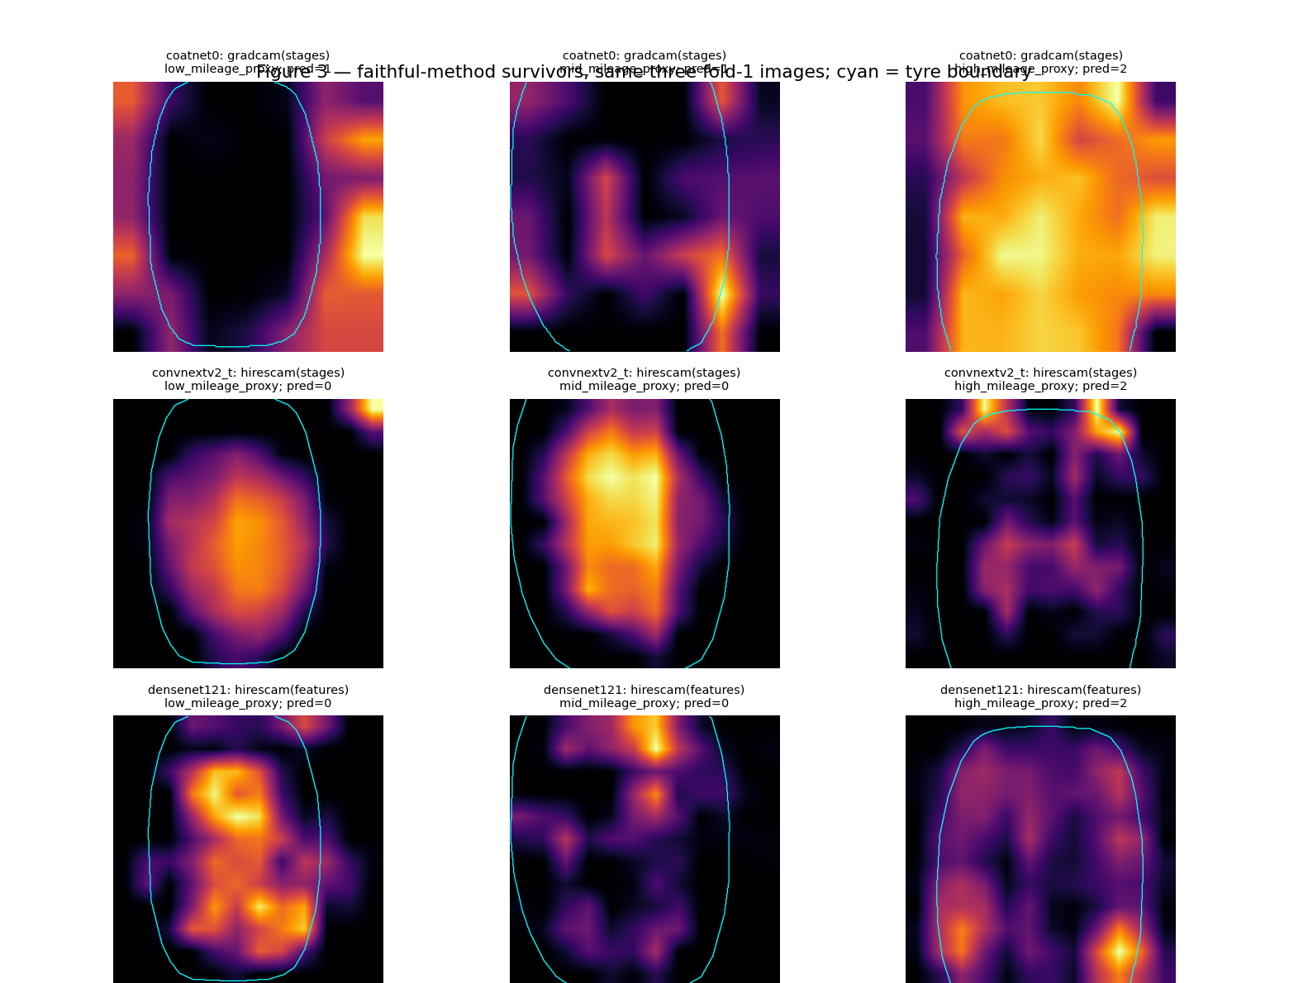
XAI checked where the classifier looked
Randomisation sanity check
Insertion and deletion tests
Tread evidence analysis
The original tread-evidence versus stability hypothesis was not supported.
09
Notes:
Grad-CAM and HiResCAM were evaluated with randomisation and insertion/deletion diagnostics. The shortlist comprised RegNetY016, DenseNet121 and ResNet50. The historical saliency panels illustrate explanations, not causal proof of the correct feature.
Sources: docs/report/evidence/figures/legacy_fig03_saliency_panels.png; ACCESS_latex_template_20260513/sections/results.tex
Evidence reflects repository records through 24 September 2026. Presentation prepared 27 October 2026.
The displayed crop shows the first three rows of the archived saliency panel, enlarged for readability.

Slide 10
OFAT, confirmation and robustness checks
Question | Experiment | Finding
Training choices | 108 OFAT + 18 confirmation | Sampling effects vary by model
Image perturbations | Stress-test evaluation | Sensitivity needs explicit reporting
Confidence quality | Temperature scaling | Fold-1 ECE: 0.1896 to 0.0738
Prediction sets | Nominal 90% coverage | Observed coverage differs by fold
Calibration and robustness results remain internal to the acquisition cohort.
10
Notes:
Stage B varied one factor at a time for three XAI-selected architectures. S4b added two architectures with 18 runs on fold 1. NB08 performed stress tests, NB09 ensembles, calibration and prediction sets. Effects vary by architecture and endpoint. These experiments do not isolate factor interactions.
Sources: docs/23_S4B_CONFIRMATION.md; ACCESS_latex_template_20260513/sections/results.tex
Evidence reflects repository records through 24 September 2026. Presentation prepared 27 October 2026.

Slide 11
S5 trained nine localisation pipelines
81
Semantic: U-Net, DeepLabV3+, SegFormer B0/B2
completed training runs
YOLO: Nano/Small detection and segmentation
RT-DETRv2: box detection
3 folds × 3 seeds × 9 pipelines. Existing manual tyre/tread masks.
11
Notes:
Four semantic models, four YOLO detection/segmentation configurations and one RT-DETRv2 configuration. Each ran three folds and three seeds for 60 epochs. Manual masks provide the reference. There is no completed independent annotator reliability or full SAM2 comparison.
Sources: docs/24_S5_MANUAL_DENSE_TASKS.md; ACCESS_latex_template_20260513/sections/results.tex
Evidence reflects repository records through 24 September 2026. Presentation prepared 27 October 2026.

Slide 12
Region overlap and boundary quality differ
Good coverage of a large region can coexist with displaced contour pixels.
12
Notes:
Fold-1 means across three seeds. IoU and boundary F1 are different metrics, even though both range from zero to one. Boundary F1 uses a strict two-native-pixel tolerance. The chart compares representative models rather than all nine.
Sources: ACCESS_latex_template_20260513/generated/localisation.tex
Evidence reflects repository records through 24 September 2026. Presentation prepared 27 October 2026.

Slide 13
Crops and fixed fusion did not improve the mean
Change from full-image classification, in macro-F1 percentage points.
13
Notes:
Paired frozen-classifier interventions across 81 localisation source runs. Tyre-only and tread-only crops change inputs without crop-specific retraining. Reported differences are macro-F1 percentage points, not relative percentages. Full/tyre/tread fusion has fold-specific changes of 0, -4.107 and +0.136 points.
Sources: ACCESS_latex_template_20260513/sections/results.tex
Evidence reflects repository records through 24 September 2026. Presentation prepared 27 October 2026.

Slide 14
The geometry study used 120 annotated images
Partition | Images | Tyres
Training | 72 | 8
Validation | 24 | 2
Test | 24 | 2
Six points per image: left and right at upper, middle and lower guide rows.
14
Notes:
The pilot first tested whether mask-derived points could already match manual points. The later cohort contains 120 newly annotated images and six horizontal boundary targets per image. User-confirmed 12 distinct tyres enabled a frozen 8/2/2 tyre allocation.
Sources: docs/30_S9_HRNET_AND_COMPLETION_PLAN.md; docs/36_MATCHED_GEOMETRY_RESULTS_AND_INTEGRATION.md
Evidence reflects repository records through 24 September 2026. Presentation prepared 27 October 2026.

Slide 15
HRNet reduced matched boundary error
23.75%
lower mean error
22 of 24 image averages
favour HRNet
Mean horizontal error (% image width). 24 images / 2 tyres. SegFormer coverage: 100%.
15
Notes:
Both methods used the same tyre allocation and test annotations, three seeds and 60 epochs. HRNet point supervision and SegFormer mask supervision differ, so this is a pipeline comparison, not an architecture-only ablation. Means derive from 432 paired point records.
Sources: docs/36_MATCHED_GEOMETRY_RESULTS_AND_INTEGRATION.md; ACCESS_latex_template_20260513/sections/results.tex
Evidence reflects repository records through 24 September 2026. Presentation prepared 27 October 2026.

Slide 16
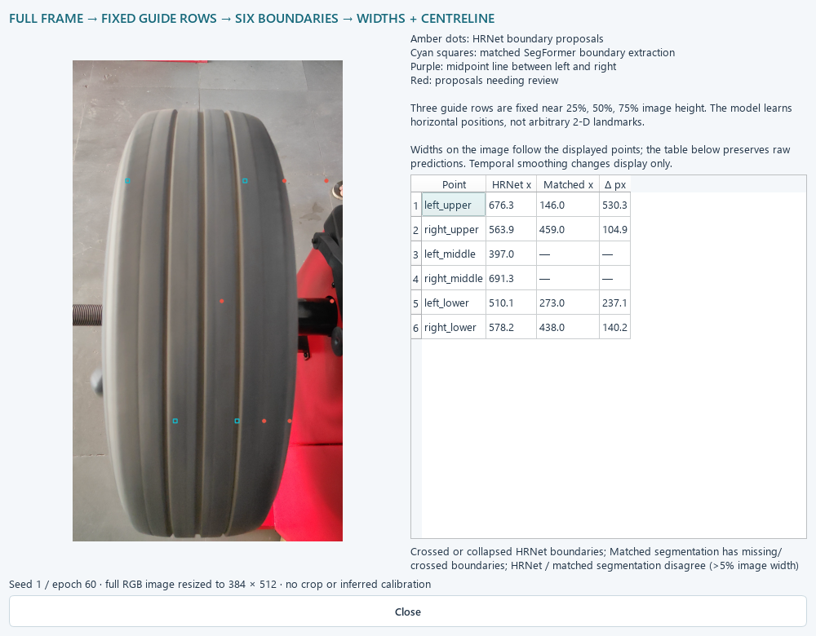
Video frames exposed geometry failures
Crossed point proposals
Missing mask boundaries
Invalid widths withheld
A good still-image result does not establish reliable video transfer.
16
Notes:
This is the original matched-model integration example, retained before the Phase 2 replacement. Crossed left/right proposals and missing mask boundaries can occur. The app withholds invalid measurements and preserves raw proposals. No quantitative video point-label benchmark exists.
Sources: ACCESS_latex_template_20260513/figures/video1-learned-diagram.png; ACCESS_latex_template_20260513/sections/results.tex
Evidence reflects repository records through 24 September 2026. Presentation prepared 27 October 2026.

Slide 17
Phase 2 added 152 labelled video frames
570
combined images
The 4,180 augmentations
are excluded from this count.
Phase 2 is a new experiment with its own data release and protocol.
17
Notes:
Three videos sampled at two frames per second produced 27, 93 and 32 frames. There are 152 LabelMe records and 304 tyre/tread polygons. They show three existing mid-mileage tyres, not new independent tyres. Original raw images and annotations are preserved.
Sources: phase2/phase2DatasetAudit.md; phase2/phase2RunNotebooks.md
Evidence reflects repository records through 24 September 2026. Presentation prepared 27 October 2026.

Slide 18
The Phase 2 split protects held-out tyres
8 / 2 / 2 tyres
All videos stay in training.
Held-out labels cover
low and high only.
234 old training photos + 152 new video frames = 386 training images.
18
Notes:
Exact video-to-original mid-tyre mapping is unresolved. All three original mid-mileage tyres and all video frames stay in training, so any possible mapping remains inside that partition. The test set has low/high tyres only. No unseen-mid or unseen-video claim is supported.
Sources: phase2/phase2RunNotebooks.md
Evidence reflects repository records through 24 September 2026. Presentation prepared 27 October 2026.

Slide 19
Labels and supervision remain traceable
Model | Treatment of labels
SegFormer | Ignore contradiction pixels in loss and metrics
YOLO26 Medium | Training-only tyre/tread union
HRNet W18 | 70 human + 152 weakly labelled training images
Weak geometry targets | Weight 0.25, separate from human ground truth
Raw annotations remain unchanged. Evaluation uses the declared reference policy.
19
Notes:
45 containment conflicts affect 172,439 pixels. SegFormer ignores conflicts. YOLO uses a training-only union of tyre and tread and disables its incompatible exclusive-class auxiliary semantic branch. HRNet uses 70 human training images plus 152 weak polygon-derived targets. Validation/test each have 25 human-labelled images.
Sources: phase2/phase2RunNotebooks.md; phase2/phase2DatasetAudit.md
Evidence reflects repository records through 24 September 2026. Presentation prepared 27 October 2026.

Slide 20
Kaggle training resumes and publishes evidence
Dual T4 workers run independent jobs with ownership checks.
Durable checkpoints preserve update position and random state.
Hugging Face stores versioned results, hashes and resume snapshots.
An 18 GiB managed-output budget leaves storage headroom.
20
Notes:
Phase 2 saves optimizer-update state including model, optimizer, scheduler, scaler, RNG and sample position. One parent uploader batches publication approximately every 30 minutes, at model completion and on catchable Stop/error. A hard kernel kill or lost network cannot guarantee a last upload. Earlier notebooks have their own resume granularity.
Sources: phase2/phase2TrainingContract.md; phase2/phase2RunNotebooks.md
Evidence reflects repository records through 24 September 2026. Presentation prepared 27 October 2026.

Slide 21
All 15 Phase 2 runs completed
Family | Completed runs | Installed seed / epoch
MobileNetV4 Medium | 3 of 3 | 1 / 4
ResNet50 | 3 of 3 | 2 / 1
YOLO26 Medium seg | 3 of 3 | 1 / 10
SegFormer B0 | 3 of 3 | 2 / 29
HRNet W18 | 3 of 3 | 3 / 2
21
Notes:
Five families, three seeds and 60 epochs each. Final completion and export audit at HF revision 714a8daa65305f450e4e72ca82dd36b2922e7151. Selected checkpoints use validation only. The optional old-only comparison condition has not run, so we cannot isolate the benefit of adding video data.
Sources: phase2/phase2Seed3Completion.md
Evidence reflects repository records through 24 September 2026. Presentation prepared 27 October 2026.

Slide 22
Phase 2 results are mixed
Component | Held-out result | Interpretation
MobileNetV4 / ResNet50 | 50% balanced accuracy each | Recognition remains weak
SegFormer B0 | 98.957% Dice | Strong internal region overlap
YOLO26 Medium seg | 98.790% Dice | Strong internal region overlap
HRNet W18 | 0.859% image-width error | 25 human-labelled test images
Different cohorts prevent a direct improvement claim over the original geometry study.
22
Notes:
Selected models only. Classifier balanced accuracy covers held-out low/high tyres, not a full three-class test. Segmentation Dice uses the declared conflict handling. HRNet test labels cover 25 human-annotated images. These metrics use different units and must not share an accuracy ranking. MobileNet seed3 had a better test score but was not substituted after observing it.
Sources: phase2/workstation/README.md
Evidence reflects repository records through 24 September 2026. Presentation prepared 27 October 2026.

Slide 23
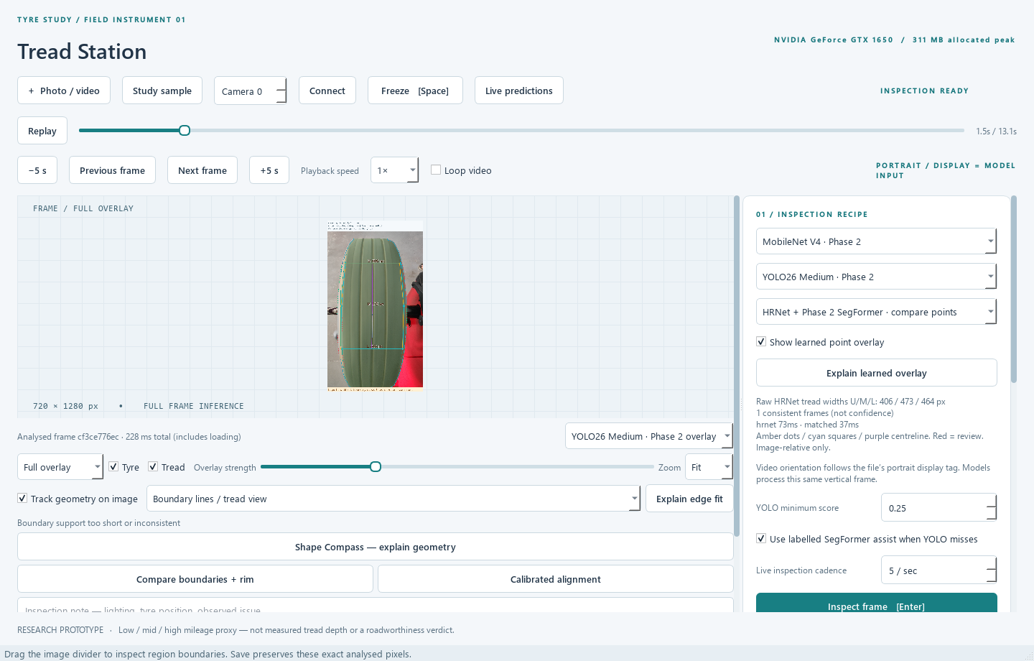
Tread Station integrates the five exports
Photo, video and camera input with recognition, regions and learned geometry.
23
Notes:
Current Phase 2 workstation. Native PySide6 interface, local offline inference after model preparation, strict model identity and hash checks. The workstation preserves original model files for rollback. Screenshot shows an actual supplied video frame, which belongs to the training cohort.
Sources: phase2/workstation/README.md
Evidence reflects repository records through 24 September 2026. Presentation prepared 27 October 2026.

Slide 24
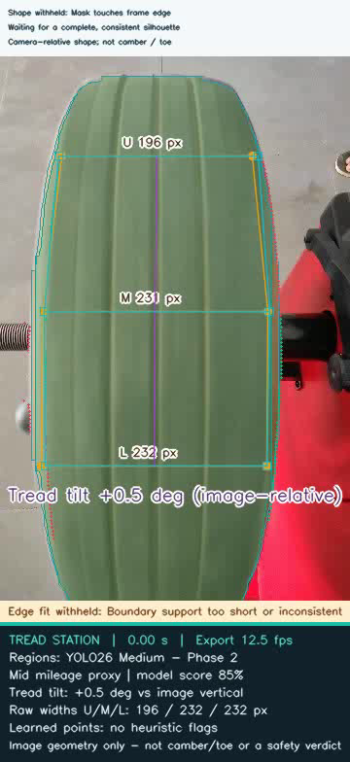
The operator can preserve the exact evidence
Save the shown frame
Export annotated video
Restore an inspection record
Records include image/masks, model provenance, timings and operator notes.
24
Notes:
Frame exports preserve the analysed pixels. Video export supports 1–60 FPS including fractional rates, uses a separate CPU process and preserves duration within one output frame. Selected output FPS is not model throughput. Exports can contain labels, image-relative widths and tilt, and review state.
Sources: phase2/phase2VideoControls.md; prototype/README.md
Evidence reflects repository records through 24 September 2026. Presentation prepared 27 October 2026.

Slide 25
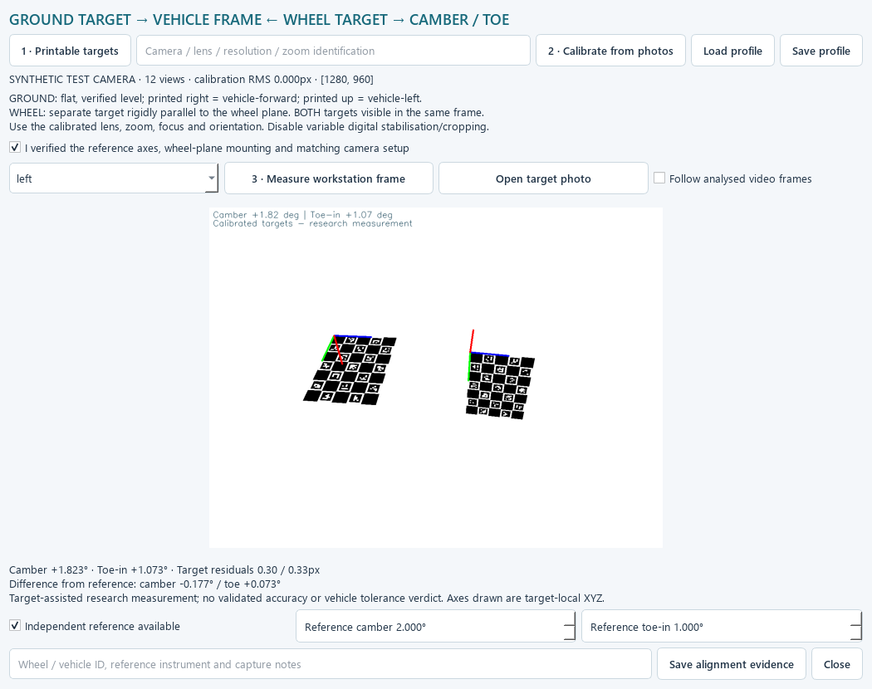
Alignment software still needs physical validation
Calibration and target workflow exists.
Physical reference validation remains open.
Image tilt cannot establish roadworthiness.
25
Notes:
The target-assisted bench includes camera calibration, printable ChArUco targets and measurement/evidence paths. Existing synthetic/software checks do not establish real-world camber/toe accuracy. Learned centreline tilt remains relative to the image. Physical reference measurements and target capture tests remain needed.
Sources: prototype/CALIBRATED_ALIGNMENT.md; prototype/README.md
Evidence reflects repository records through 24 September 2026. Presentation prepared 27 October 2026.

Slide 26
The project now has a complete research manuscript
16 pages
8 figures 13 tables
34 references
Verified source package and illustrated results
Final author review and submission declarations remain.
26
Notes:
Current IEEE Access manuscript: Evaluating Vision-Based Tyre Inspection: Checkpoint Sensitivity, Region Interventions, and Boundary Localisation. It reports the original experiments and limitations. Phase 2 is a distinct deployment experiment, not silently mixed into original benchmark tables. Source and PDF match their saved audit. Submission needs author approval and declarations.
Sources: ACCESS_latex_template_20260513/README.md; ACCESS_latex_template_20260513/VERIFICATION.json
Evidence reflects repository records through 24 September 2026. Presentation prepared 27 October 2026.

Slide 27
What the evidence supports
Checkpoint policy substantially changes reported recognition results.
High region overlap does not guarantee better recognition.
Point learning reduced error in the matched geometry study.
The workstation makes predictions and failures inspectable.
27
Notes:
Summarise supported conclusions rather than claiming overall success or completed original scope. The experimental contribution includes negative fusion results, checkpoint sensitivity, matched geometry and observable deployment failures.
Sources: ACCESS_latex_template_20260513/sections/results.tex; phase2/workstation/README.md
Evidence reflects repository records through 24 September 2026. Presentation prepared 27 October 2026.

Slide 28
Remaining work has a clear scope
Open question | Required next evidence
Generalisation | New independently labelled tyres and videos
Physical wear / alignment | Measured tread depth and calibrated angle references
PatchCore anomaly detection | Verified healthy-reference data
Annotation reliability | Independent repeat labels / declared SAM2 comparison
Effect of video training data | Matched old-only Phase 2 controls
28
Notes:
PatchCore requires verified healthy reference data. Independent blind reannotation/SAM2 comparison remains unmeasured. Physical tread depth and alignment require reference measurements. Optional old-only Phase2 controls were not run. Current software and training are completed within their declared scope.
Sources: docs/CURRENT_STATUS.md; phase2/phase2RunNotebooks.md; ACCESS_latex_template_20260513/SUBMISSION_CHECKLIST.md
Evidence reflects repository records through 24 September 2026. Presentation prepared 27 October 2026.

Slide 29
Discussion
A reproducible experiment archive
and a working inspection workstation
The next scientific milestone is independent validation
of recognition and physical measurements.
29
Notes:
The presentation distinguishes completed component experiments, completed Phase2 model installation and validation that remains outside the evidence. No further routine rerun is required simply to give this presentation.
Sources: ACCESS_latex_template_20260513/sections/results.tex; phase2/phase2Seed3Completion.md
Evidence reflects repository records through 24 September 2026. Presentation prepared 27 October 2026.

Slide 30
Appendix: notebook and evidence map
Notebook group | Purpose
NB00–NB10 + recovery notebooks | Original screening, XAI, OFAT, stress and analysis
NB11–NB20 | Mask protocol, confirmation, S5, fusion and reports
NB21–NB32 | Pilot, 120 annotated images, HRNet/SegFormer
Original NB33 | 28 pipelines × 9 qualitative examples
Phase 2 NB00–NB07 | New data, resume checks, training, export and gallery
30
Notes:
Use this slide during technical questions. The original notebook sequence deliberately runs XAI NB07 before StageB NB06. NB33 original replay is distinct from Phase2 NB07. The exact original replay HF revision is 3e0906adfe78e8b1437ea9a4dc76e6ca5f3723d3. Current local NB33 has no executed outputs but the manuscript includes a verified upstream replay.
Sources: notebooks/README.md; phase2/phase2RunNotebooks.md; ACCESS_latex_template_20260513/revision_evidence/visual/AUDIT.json
Evidence reflects repository records through 24 September 2026. Presentation prepared 27 October 2026.

Slide 31
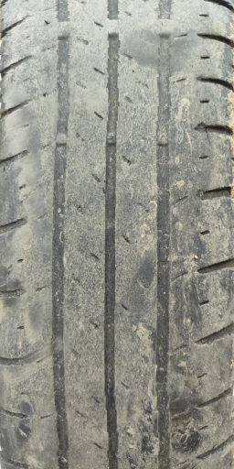
Phase 3
Custom tyre models
and local texture evidence
TREAD-ONE, TREAD-TWO and the unified inspection workstation
31
Notes:
Phase 2 established a five-model workstation. Phase 3 asked whether one custom network could preserve dense geometry and support reliable recognition, then investigated which texture information survives compression.
Sources
phase3/phase3ProjectRetrospective.md
phase3/workstation/README.md

Slide 32
Phase 3 reuses the existing tyre dataset
570 images
418 photographs + 152 video frames from 12 recorded tyres
Allocation | Train | Validation | Historical test
Images | 386 | 81 | 103
Recorded tyres | 8 | 2 | 2
Low / mid / high | 67 / 249 / 70 | 40 / 0 / 41 | 62 / 0 / 41
Human point labels | 70 | 25 | 25
Both held-out roles contain two tyres and cover low and high mileage proxies.
32
Notes:
The 152 derived video frames were added in Phase 2 and remain in training. Uncertain mid-parent links are conservatively grouped, leaving six train components and two per held-out role. Historic test images had already informed development. There are no held-out mid-proxy labels.
Sources
phase3/ACCESS_latex_template_20260513/sections/data_protocol.tex

Slide 33
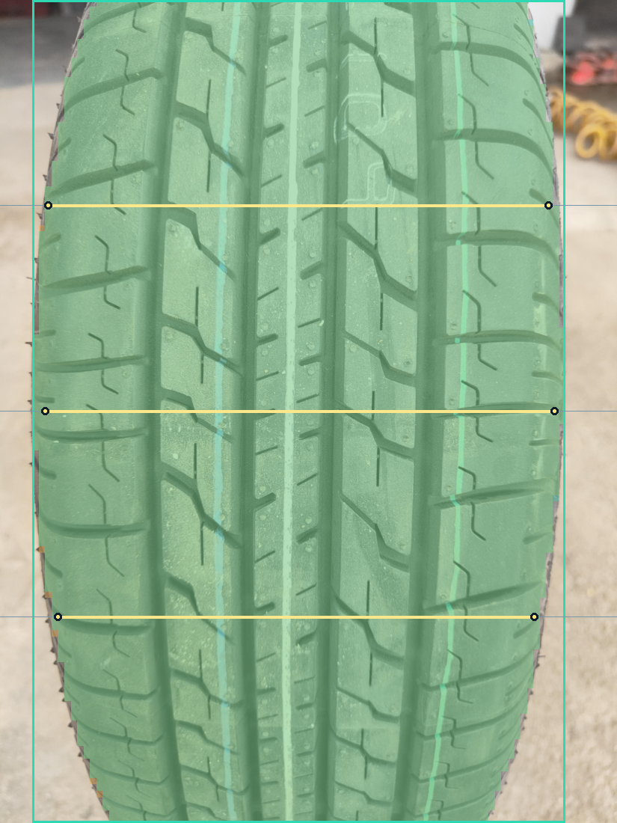
TREAD-ONE shares one model across four outputs
Mileage proxy
Low, mid and high scores
Region masks
Overlapping tyre and tread masks with derived boxes
Boundary proposals
Six image-space points on three guide rows
Signed logit evidence
Spatial contributions plus a separate global bias
1.37 million parameters in the validation-selected seed 3, epoch 20 export.
33
Notes:
The selected deployment export is seed 3, epoch 20. The custom model has 1,372,159 parameters. Boxes are derived from thresholded masks. Signed evidence and bias reconstruct each logit, which is an accounting check rather than a demonstration of causal input pixels.
Sources
phase3/phase3ProjectRetrospective.md
phase3/workstation/README.md
phase3/workstation_validation/unified_7df1e725/captures/20261106_214748_658724_39f2343f/overlay.png

Slide 34
TREAD-ONE held-out recognition remained weak
0 of 62 low images
Every selected seed missed every low-proxy test image. Seed 3 still reached 98.419% Dice for the two region masks.
Observed-class balanced accuracy on low and high. Each seed uses its own validation-selected checkpoint.
34
Notes:
Validation and historical-test observed-class balanced accuracy are shown for the checkpoint selected within each seed. The historical test has 62 low and 41 high images from two tyres. All three selected seeds miss every low image. The deployed seed 3 export records 98.419% mean Dice and 1.196% of width mean absolute point error on the historical test. The point measure applies to images with eligible human reference labels.
Sources
phase3/ACCESS_latex_template_20260513/sections/results.tex
phase3/phase3CompletionAudit.md

Slide 35
Shared gradients and the ATLAS revisions
Experiment | What changed | Observed result
Paired TREAD-ONE | Project conflicting task gradients | Historical BA fell from 50.00% to 17.07%
ATLAS | Align tread texture in a canonical atlas | All 62 low images were predicted as mid
ATLAS-LC | Use local contrast and paired views | Selected NLL fell from 1.178 to 0.961
ATLAS-CONTEXT | Add position-aware patch context | Selected NLL rose to 2.175
All three ATLAS variants reached 50% historical balanced accuracy with zero low recall. NLL is negative log-likelihood.
35
Notes:
The paired comparison used one matched seed. Shared projection acted on 91.84% of updates and reduced the selected historical balanced accuracy by 32.93 points. ATLAS, LC and CONTEXT are successive one-seed designs. Their NLL changes did not fix low-proxy recall. See the appendix for full training notebook mapping.
Sources
phase3/phase3ProjectRetrospective.md
phase3/ACCESS_latex_template_20260513/sections/results.tex
phase3/phase3NB05Completion.md

Slide 36
GEO separated geometry from texture learning
60 of 60
0 of 60
epochs passed the geometry floor
epochs passed the representation gate
Validation point MAE | Frozen G0 baseline | GEO epoch 60
% of image width | 0.8085% | 0.7662%
GEO completed its run without an eligible checkpoint under the joint rule.
36
Notes:
GEO passed its geometry floor at all 60 validation epochs, but failed representation eligibility at every epoch. Final validation point error was 0.7662% image width, versus 0.8085% for frozen G0. The drop is 5.23% relative. The final masked improvement of 4.03% fell below the 5% gate. Learned error heads also lost to constant controls. These are validation-only results for GEO.
Sources
phase3/ACCESS_latex_template_20260513/sections/results.tex
phase3/phase3NB17Completion.md
phase3/phase3NB20Completion.md

Slide 37
TRACE learns texture on frozen geometry
Image + frozen GEO → canonical atlas
32 × 48 token grid
The encoder produces 48 values per tile. Both paths share encoder and decoder weights.
512 × 256 atlas → 32 tread tiles
Auxiliary global projection
Local contrast → tile encoder
Mask → contrast → encode
Five weighted moments summarize the full-context tokens.
Decode each tile directly
Mix axial context → decode
71,022 trainable parameters
Geometry stays frozen while the texture model learns.
Local fields
Hidden-tile fields
Reconstruction targets include image contrast and orientation derived from the input.
37
Notes:
TRACE freezes the final research geometry from GEO. The atlas is 512 × 256, tiled into 32 positions. The local decoder reads tile encodings directly. The masked branch hides raw RGB and observation support before contrast extraction and uses a shared two-block axial stack. Both branches share the encoder and decoder weights. The auxiliary global head takes five weighted moments of full-context tokens. See the complete paper architecture for metadata, support replacement and the axial block.
Sources
phase3/ACCESS_latex_template_20260513/sections/models.tex
phase3/ACCESS_latex_template_20260513/audit/TRACE_ARCHITECTURE.json
phase3/ACCESS_latex_template_20260513/figures/architecture.png

Slide 38
TRACE improved local and masked reconstruction
0 of 60 eligible
Local and masked utility passed at all 60 epochs. The global diversity requirement passed at none.
Final loss reduction. Local and masked branches use their own fixed controls.
38
Notes:
The final epoch uses clean view 0 and a recorded hidden-tile plan. The local gain compares against a train-position target mean. The masked gain compares against the strongest original control, the visible-band mean. Every eligible validation image and historical-test image beat the three masked controls for this particular plan. The original diversity gate rejected all 60 epochs, so TRACE remained an unselected research result.
Sources
phase3/phase3NB24Completion.md
phase3/ACCESS_latex_template_20260513/sections/results.tex

Slide 39
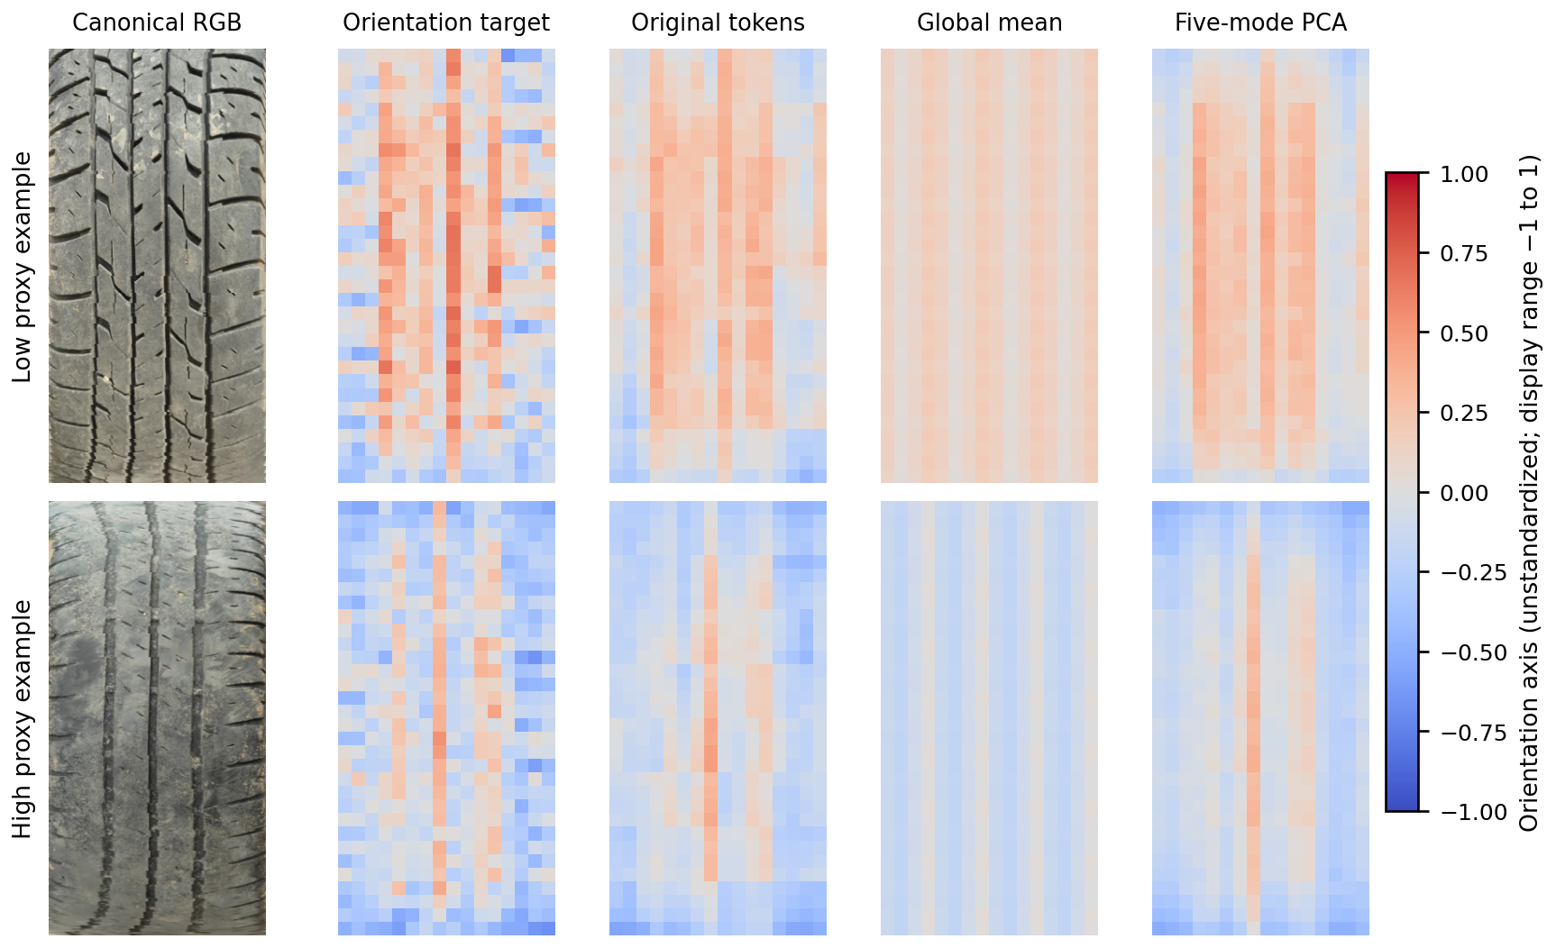
Global averaging smoothed local orientation detail
Two validation examples. Colour encodes image orientation on a common scale.
39
Notes:
These are the lexicographically first validation examples in the observed low and high proxy groups. The orientation-axis target is derived from image gradients. Colours show descriptor values on the displayed unstandardized scale. Five-mode PCA keeps more of the band-to-band pattern than a single mean in these examples.
Sources
phase3/ACCESS_latex_template_20260513/figures/qualitative.png
phase3/ACCESS_latex_template_20260513/sections/results.tex

Slide 40
Five fitted modes preserved about 89% of local utility
240 / 1,536
coefficients per image
Each basis uses the same five-mode budget and the same decoder.
Local reconstruction advantage retained relative to the train-position control.
40
Notes:
The primary matched-budget comparison uses a common position template, fixed training mass and identical scoring support. At five modes the budget is 240 image-dependent coefficients instead of 1,536 tokens entries. PCA gains 7.76 and 6.85 percentage points over fixed moments before rounding. Decoder-aware alternatives show small, inconsistent improvements at five modes. These are reconstructions from frozen tokens rather than newly trained architectures.
Sources
phase3/ACCESS_latex_template_20260513/evidence/spatial_budget_summary.csv
phase3/ACCESS_latex_template_20260513/sections/spatial_results.tex

Slide 41
Masked retention depended on the decoder
Local retention held
With an affine readout, the masked path kept 18.07% on validation and 10.62% on the historical test.
Five-mode token PCA. Retention is relative to each readout’s own uncompressed margin.
41
Notes:
The alternate affine decoder fits uncompressed clean-view training tokens using ridge regression. Each decoder’s retention uses its own uncompressed reference. Local five-mode token PCA stays near 90% for both readouts. The affine masked results fall sharply, even though the uncompressed affine masked loss is close to that of the original decoder. Residual-subspace overlaps between the fitted PCA variants are 0.9773–0.9896 at this checkpoint.
Sources
phase3/ACCESS_latex_template_20260513/evidence/review_affine_readout.csv
phase3/ACCESS_latex_template_20260513/evidence/review_subspace_angles.csv
phase3/ACCESS_latex_template_20260513/sections/reviewer_results.tex

Slide 42
Training and evidence can be resumed and audited
10 fits
Kaggle recovery
Saved model, optimizer and random state support continuation.
600 epochs across seven fit families
Hugging Face publication
Pinned revisions retain direct CSVs and native artifacts.
3,553
Independent replay
TRACE’s 2,940 objectives and 60 selection decisions reconciled.
direct TRACE fit CSVs
The CSV rows record repeatable observations from the existing study images.
42
Notes:
Ten measured fits across seven families comprise 600 epochs and 29,400 updates through NB24. This excludes engineering fixtures and counts NB13A as continuation. TRACE fit publication contains 3,553 direct CSVs and 47,263,346 rows, including inherited cache rows. Native arrays and PyTorch state are kept for replay and recovery. Ordinary publications are batched, with boundary and catchable-stop flushes when possible. A hard stop cannot guarantee an upload.
Sources
phase3/phase3ProjectRetrospective.md
phase3/phase3NB24Completion.md
phase3/phase3DataRetentionPolicy.md

Slide 43
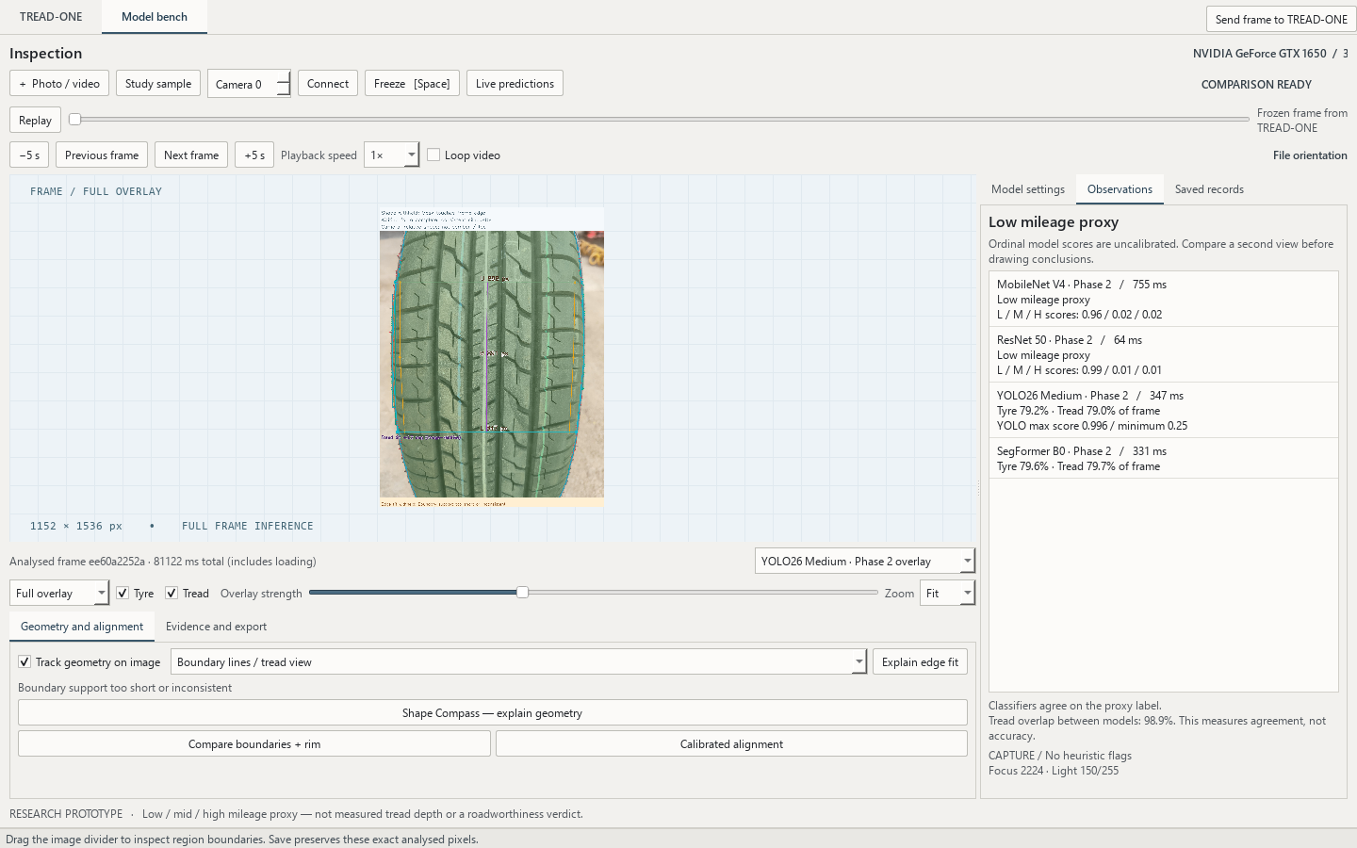

One workstation now hosts both inspection workflows
TREAD-ONE
Masks, points, signed evidence and CSV captures
Model bench
Four-model comparison, playback and exports
Send frame
Compare the same pixels across tabs
TREAD-ONE geometry controls
Actual desktop capture using an existing study photo.
43
Notes:
The current Phase 3 desktop app combines TREAD-ONE and the original Model bench in one window. A transfer carries the exact displayed RGB snapshot and the available source timestamp. Each tab applies its own model preprocessing and keeps its own evidence formats. The four-model comparison, video stepping and full MP4 export passed integration checks.
Sources
phase3/workstation/README.md
phase3/workstation_validation/unified_7df1e725/VALIDATION.json
phase3/workstation_validation/unified_7df1e725/model_bench.png

Slide 44
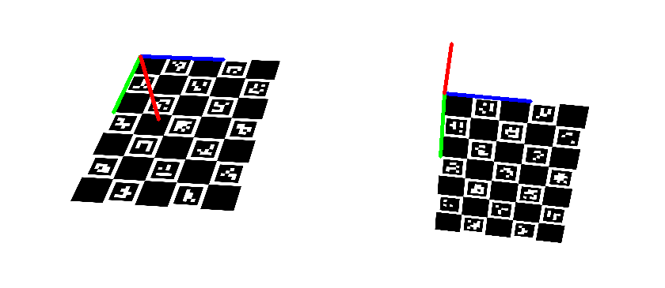
Calibrated wheel alignment in TREAD-ONE
Camera and targets
Load the matching camera profile. Both reference boards must be visible.
Camber and toe-in
The tool estimates angles from the calibrated targets.
Boundary and rim
The TREAD-ONE mask supports a separate image-space comparison.
+1.82° camber
+1.07° toe-in
Synthetic target fixture. Physical reference measurements remain open.
44
Notes:
The TREAD-ONE tab opens the shared calibrated wheel tool on its native RGB frame. The camera profile and both verified ChArUco targets are required for calibrated camber and toe-in. Image-space boundary and rim fits use the tyre mask in a separate tool. The saved screenshot and readouts are from a synthetic software-validation scene, with no workshop accuracy claim.
Sources
phase3/workstation/README.md
prototype/CALIBRATED_ALIGNMENT.md
phase3/workstation_validation/unified_7df1e725/VALIDATION.json
phase3/workstation_validation/unified_7df1e725/model_bench/results/alignment/20261106-214752-7c7ad2/alignment.json

Slide 45
Phase 3 findings and research manuscript
Vision
Dense masks and image-space points were useful on the existing cohort.
IEEE Access draft
Texture
18 pages
A small spatial basis retained useful local structure in TRACE.
Recognition
Decoder-aware spatial budget audit for local tyre texture
Low-proxy recall stayed weak across the tested designs.
Physical validation
Groove depth and field alignment need calibrated reference measurements.
45
Notes:
The updated IEEE Access draft reports the single-checkpoint matched-budget audit, separate decoder-order effects and affine readout comparison. It has 18 pages, nine figures and eight tables. The study supports local texture reconstruction, preserves the unselected GEO and TRACE status, and documents the poor held-out recognition. TREAD-ONE and the original Model bench are available in the unified desktop app. Independent tyre cohorts and calibrated groove-depth or wheel-angle references are still needed for physical claims.
Sources
phase3/ACCESS_latex_template_20260513/README.md
phase3/ACCESS_latex_template_20260513/audit/VALIDATION.json
phase3/workstation/README.md

Slide 46
Phase 3 notebook and evidence map
Notebook group | What it covers
NB01–NB07 | TREAD-ONE fit, diagnostic gates, paired projection and review
NB08–NB15 | ATLAS, appearance/reference checks, LC, CONTEXT and recovery
NB16–NB20 | GEO engineering, resumable pilot and consolidated postrun
NB21–NB24 | TRACE preparation, fit, review and all-in-one batch
Saved evidence replay | Aggregation, spatial budget, affine readout and paper figures
Reviews and recovery steps preserve the original training and selection records.
46
Notes:
The slide groups training, engineering and review notebooks by purpose. NB13A is the recovery of the same CONTEXT fit. NB20 wraps the GEO postrun work. NB24 is the TRACE all-in-one batch and executes the NB22 fit once. The spatial-budget and affine analyses replay saved evidence and do not count as new network training.
Sources
phase3/phase3ProjectRetrospective.md
phase3/notebooks
phase3/phase3EvidenceRegister.md
phase3/phase3NB24Completion.md

