Slide 1
WhatsUrSay?
Team Name:
DSEs (D Software Engineers)
Team Members:
Abhinav Bhandaram
Rajashekhar Korakoppula
Nikhitha Kaza
Shanmukh Madhavarapu
Sreedevi Koppula

Slide 2
Agenda
Project Description
Team Members & Responsibilities
Core Requirements
Development Environment
Testing
Feedback from peer reviews
Code inspection results
Limitations

Slide 3
Project Description
An online polling and survey system
Enables authorized users to perform the below actions:
Create polls/surveys
Create and maintain User Groups
Publish the results of polls/surveys
View the results of polls/surveys

Slide 4
Team Members & Responsibilities
Abhinav Bhandaram (Team Lead):
Login
Register
User Dashboard
Session Management
Shanmukh Madhavarapu:
Poll Creation
Participate in Poll
View Poll results
Create User Groups

Slide 5
Team Members & Responsibilities (cont.)
Rajashekhar Korakoppula:
Survey Creation
Participate in Survey
View Survey results
Edit User Groups
Nikhitha Kaza:
Database creation
Database maintenance
Unit Testing

Slide 6
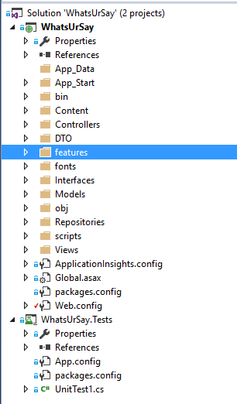
Project Structure

Slide 7
Core Requirements
User Registration
Provides a new user to register in the system
User Login
Grants access for an authorized user to login to the system
Groups Creation
Permits an authorized user to create a user group
Polls Creation
Permits an authorized user to create a poll (public/private)
Participate in Polls
Allows an authorized user to participate in a poll
Surveys Creation
Permits an authorized user to create a survey(public/private)

Slide 8
Core Requirements (cont.)
Participate in Surveys
Allows an authorized user to participate in a survey
View Poll Results
Users can view the results of polls that they participated in
View Survey Results
Users can view the results of survey that they participated in
Edit Groups Details
Permits an authorized user to add/remove users to/from a user group
Request for Group Leadership
A normal user can request for the Group Leader role
Logout
Facilitates the user to safely exit from the system

Slide 9
Development Environment
OS: Windows
Browser: Chrome
Programming Languages: C#
Database: SQL Server
UI and JavaScript Frameworks: Bootstrap, Foundation, Angular JS, HTML, CSS
Server side Technologies: ASP.NET MVC Web API, ASP.NET Core
Other Frameworks: Entity Framework

Slide 10
Feedback from peer reviews
Feedback on write up of the requirements in deliverable 2 document
No comments regarding the components or features of the system
Code inspection results
No comments received in the code inspection

Slide 11
Limitations
Time Constraint:
Root Admin is not introduced in the application due to time constraint
We have limited our application to permit only ‘Admin’
Publishing results of polls/surveys through email is not supported
We are publishing the results on user dashboard
Platform Dependent Constraint:
Session Management
Server side session management using Session is not supported by ASP.NET Web API. Therefore we had to come up with an approach on client side to implement session using Angular Session Storage

Slide 12
Testing
Unit Testing:
Manual:
Each individual unit tested the methods implemented by him/her
Web API controller methods are tested using the tool ‘Fiddler’
Angular JS controller methods are tested by enabling the developer tools on the browser
Automated
Microsoft Unit Testing
TestMethods written for each Web API controller
Functional Testing:
Manual
Each individual manually reviewed the functionalities developed by other developers

Slide 13
Testing Experiences
Not enough time to write unit test cases for all implemented methods
Faced challenges while writing the Microsoft Unit Testing TestMethods for the controller methods that interact with application’s database.
Challenges:
New to the test framework
Identifying the test scenarios
Debugging the root cause in case of a test failure that is supposed to pass

Slide 14


