Slide 1
PROJECT DETAILS
Project Name: SportyShoes.com
Details: Background of the problem statement:
Sporty Shoes is a company that manufactures and sells sports shoes. They have a walk-in store, and now, they wish to launch their e-commerce portal sportyshoes.com.
Developer Details
Name: Shanmukh Talawar
Email: shtalawa@cisco.com

Slide 2
REQUIRED TOOLS
Spring Tool Suite v.4
Tomcat Server v.10
Java
JPA, JDBC
MySql
Spring Boot
Spring MVC
Rest API
PostMan

Slide 3
WHAT IS CLIENT LOOKING FOR
The admin should be able to change his password if he wants, he should be able to:
Manage the products in the store including categorizing them
Browse the list of users who have signed up and be able to search
See purchase reports filtered by date and category

Slide 4
WHAT I DEVELOPED
Customer can explore by browsing given link “http:8080/SportyShoes.com”
He can buy shoes what customer wants.
He need an account to login, else he can create account
After login he need to make transactions
Admin login available
Admin can check Customer list
Admin can change password
Admin can check orders by filtering Date and Category wise.

Slide 5
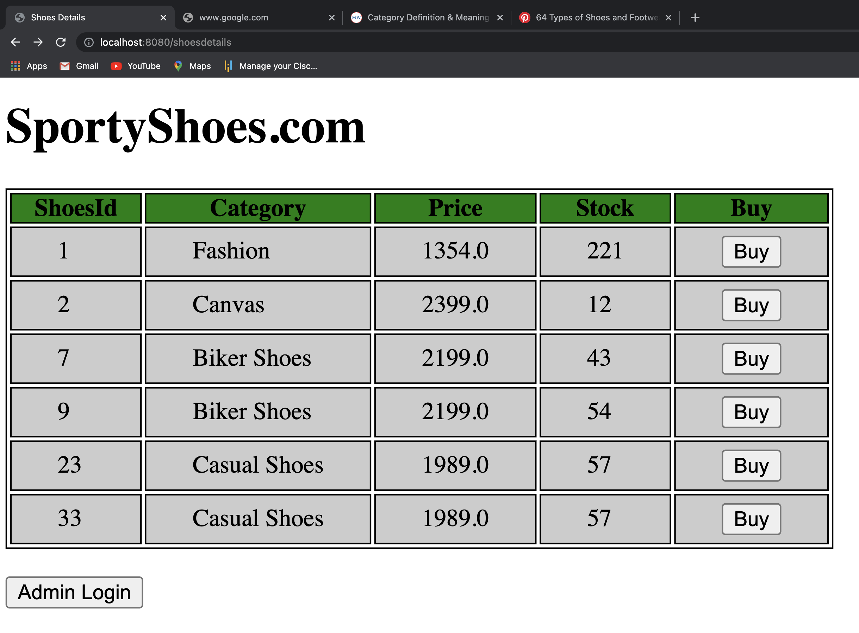
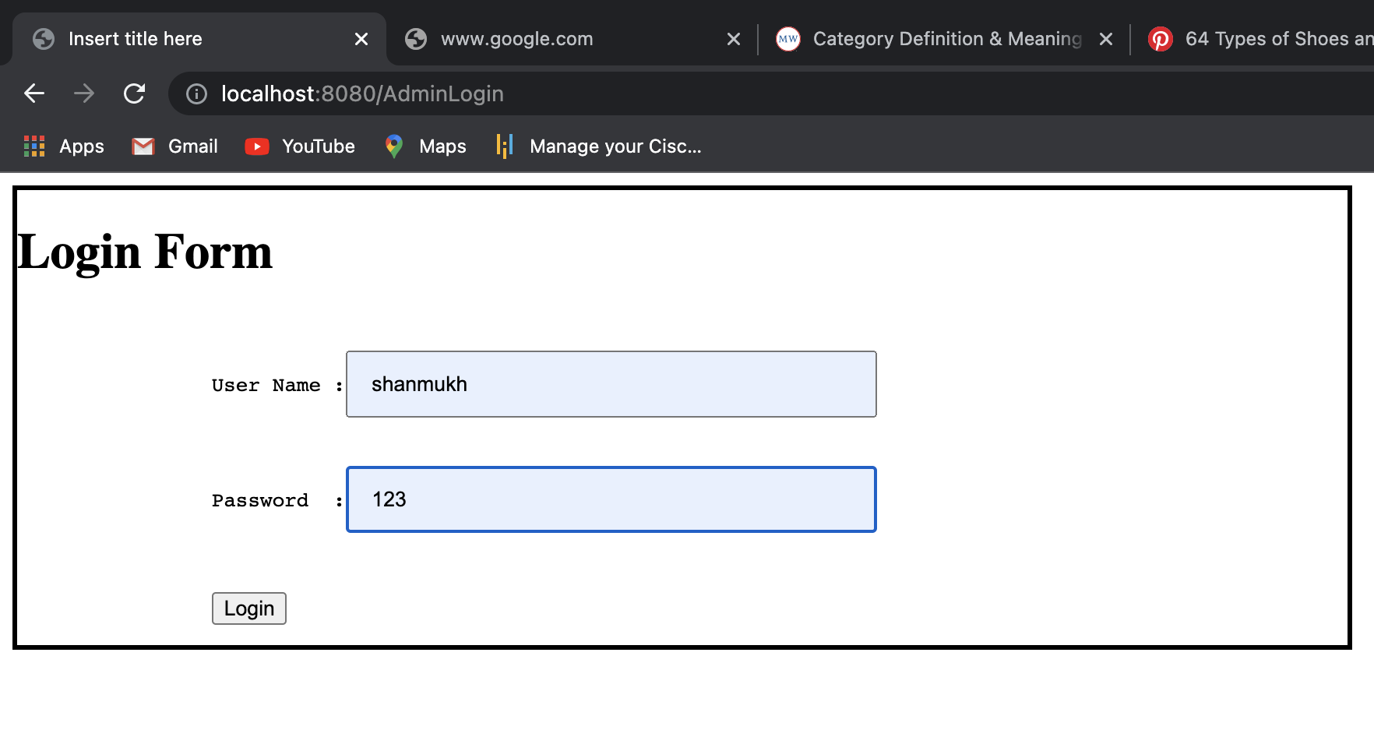
Welcome Page
Admin Login Page
Buyer Can explore shoes details price, Stock
Admin has to enter username and password

Slide 6
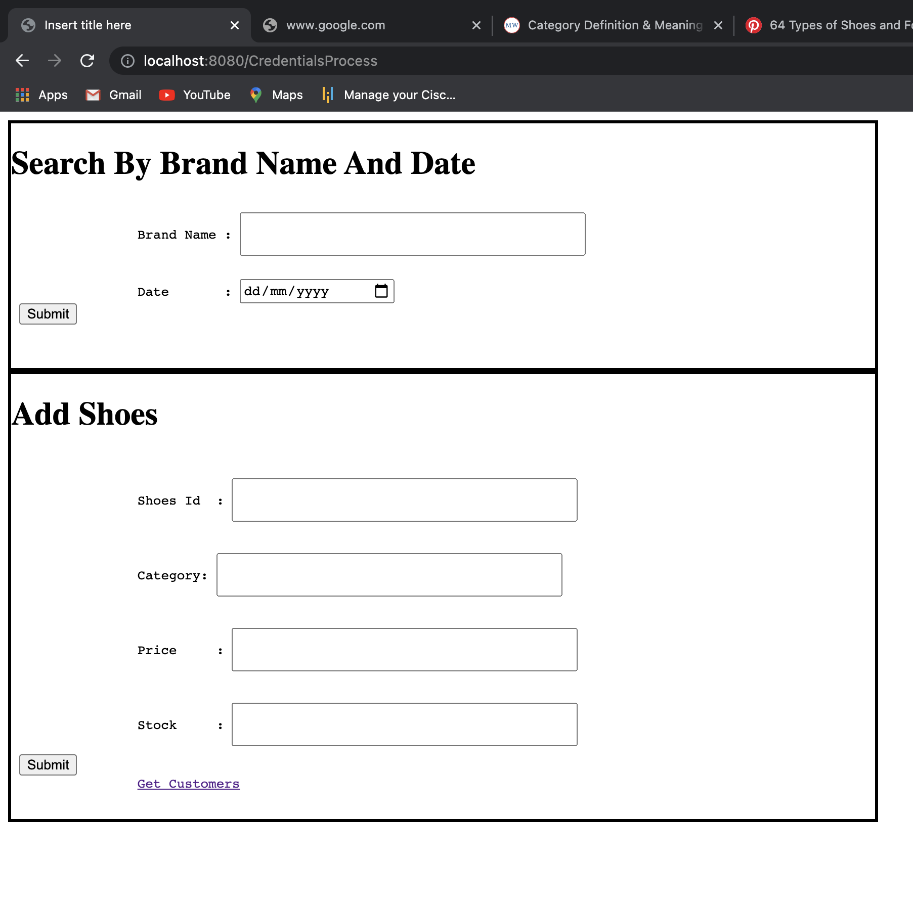
Ordered Details And Adding New Shoes
Admin can search by Brand name and ordered date
He can add new shoes
He can get Customer details by clicking ”Get Customers” button

Slide 7
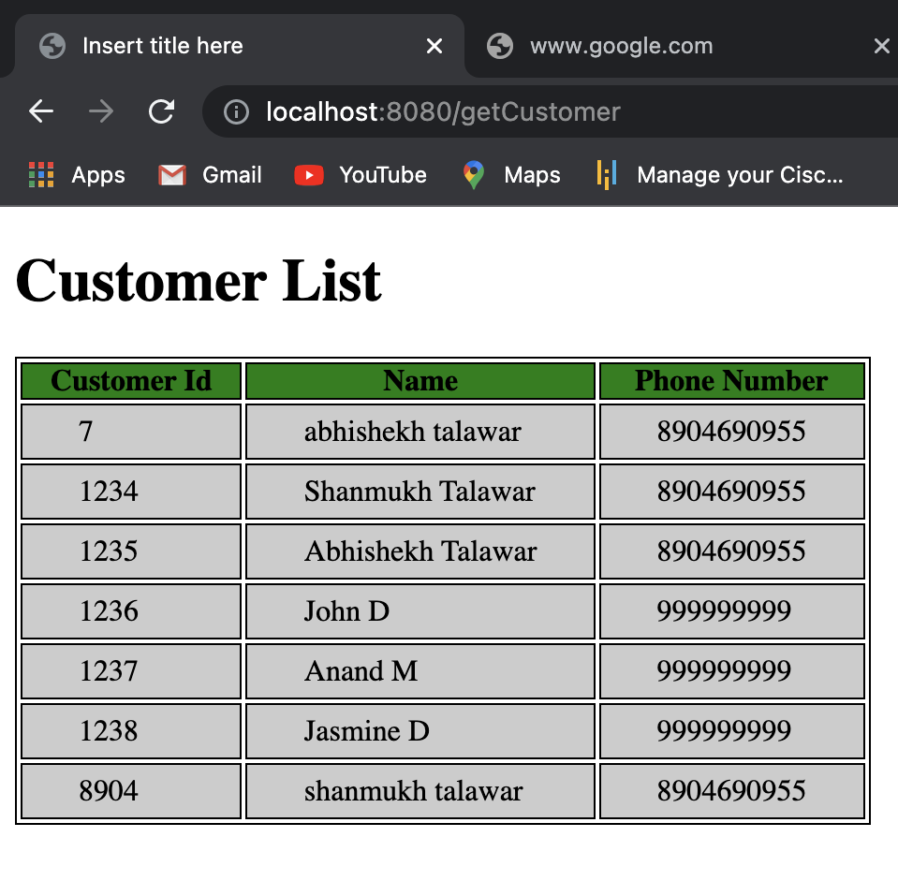
All Customer Details
The list gives details of all customers who have done sugnUp

Slide 8
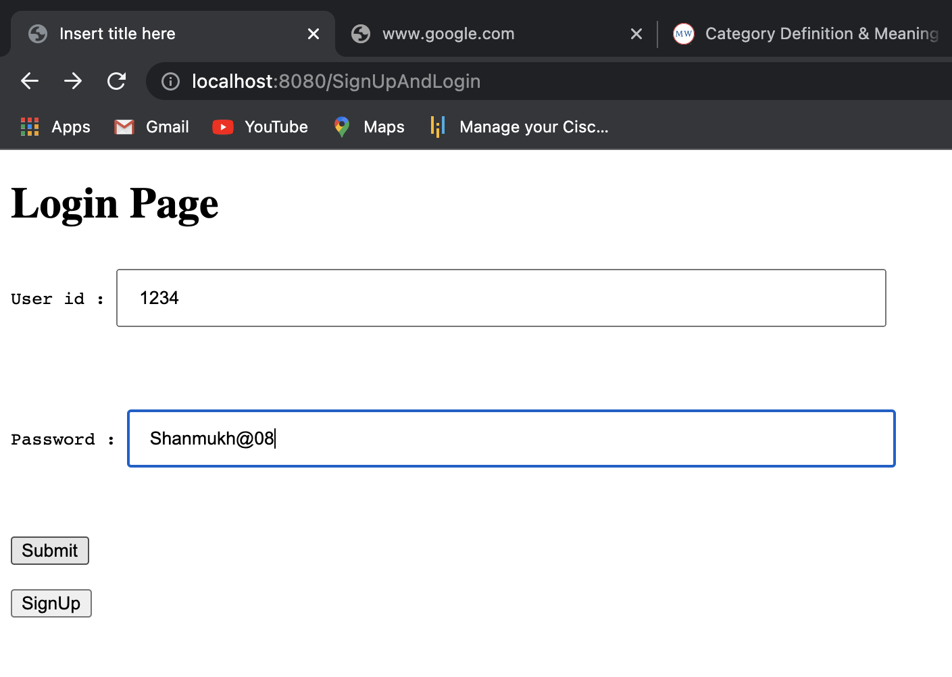
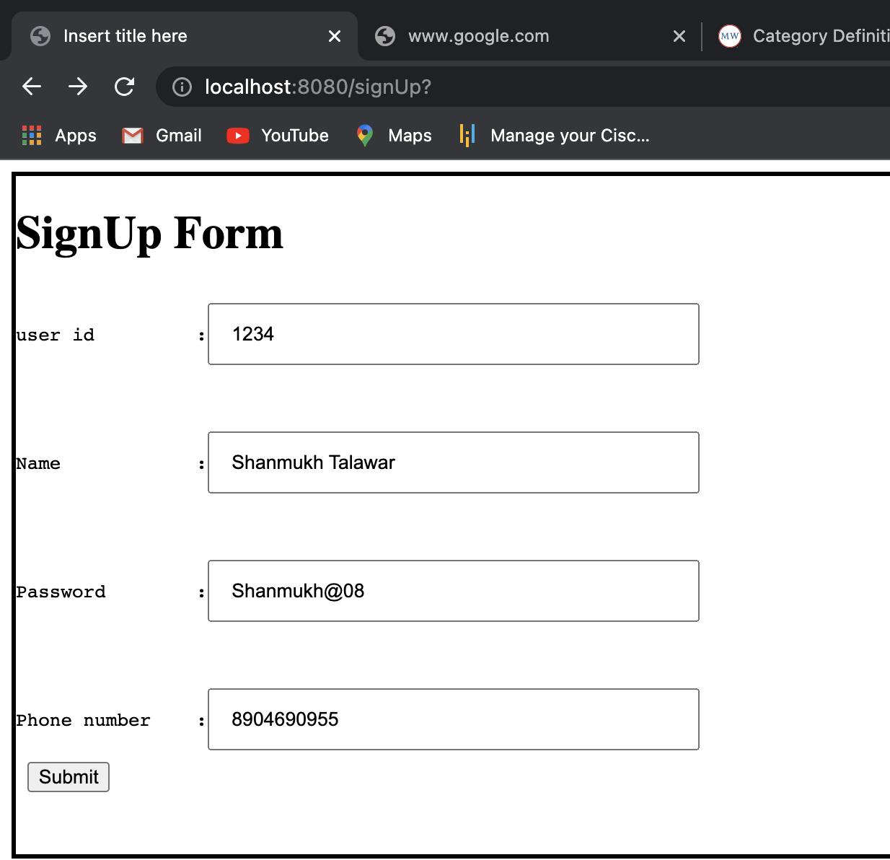
Customer Login
CUSTOMER SIGNUP

Slide 9
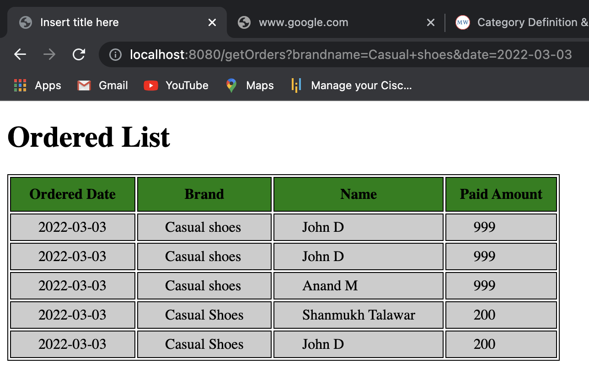
Ordered Details By Ordered Date Wise

Slide 10
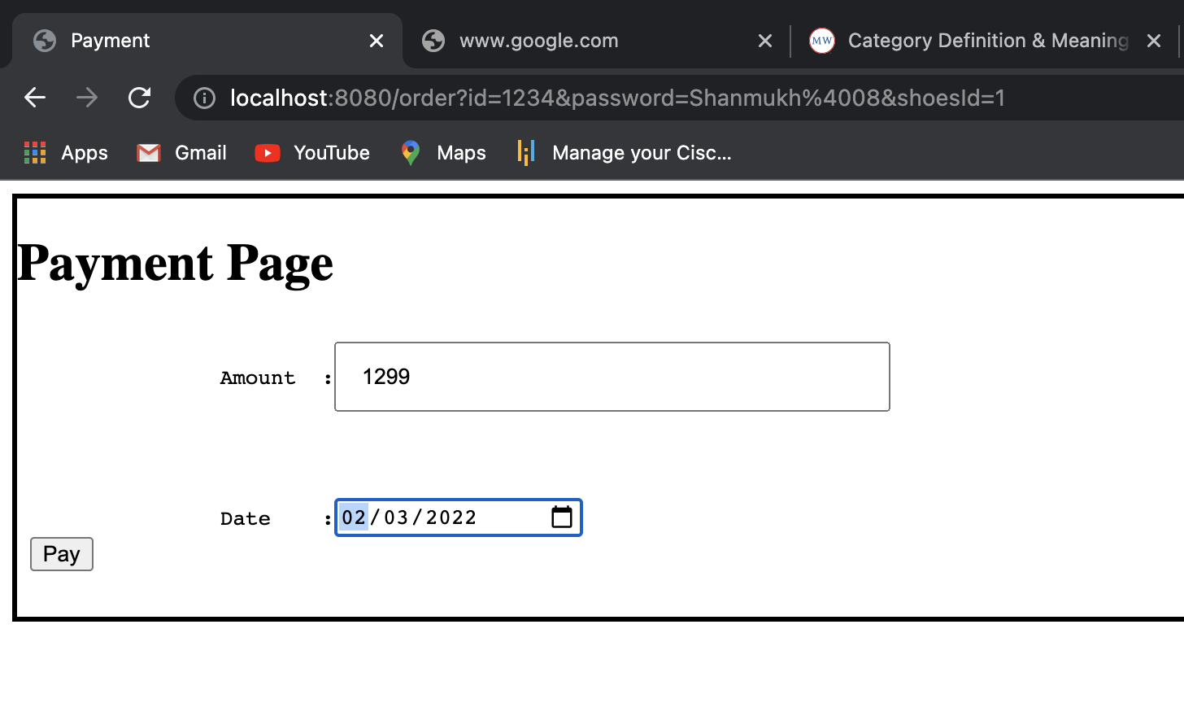
PAYMENT PAGE

Slide 11
THANK YOU

