Slide 1
6th Semester CSE Mini Project
Smart Healthcare
Analytics Platform
A cloud system that reads patient documents and gives
doctors AI-powered insights to make better decisions.
AWS • React • Terraform • Amazon Bedrock Nova Lite

Slide 2
The Problem
📄
Medical records are locked inside PDFs and images — impossible to search or analyze at scale.
⏱
Doctors spend hours manually reading documents instead of focusing on patient care.
🔗
Patient data is scattered across departments — no single unified view exists.
⚠
Drug interactions and dangerous lab trends stay hidden in text, leading to preventable errors.

Slide 3
How It Works
1
2
3
4
5
Upload
Read
Understand
Analyze
Act
Doctor uploads a patient document
(PDF, image or text file)
AWS Textract scans and extracts
all text from the document
Comprehend Medical identifies
medicines, diagnoses, lab values
Amazon Bedrock AI generates
a clinical summary and risk flags
Doctor views insights and
recommendations on the dashboard

Slide 4
AWS Services Used
📝 Textract
🧠 Comprehend Med
⚡ Bedrock AI
Reads text from PDFs and images
Finds medicines, diagnoses & lab values
Generates summaries and risk flags
🗄 DynamoDB
☁ S3 + CloudFront
🔐 Cognito
Stores patients, documents, insights
File storage and website hosting
Secure login for doctors only

Slide 5
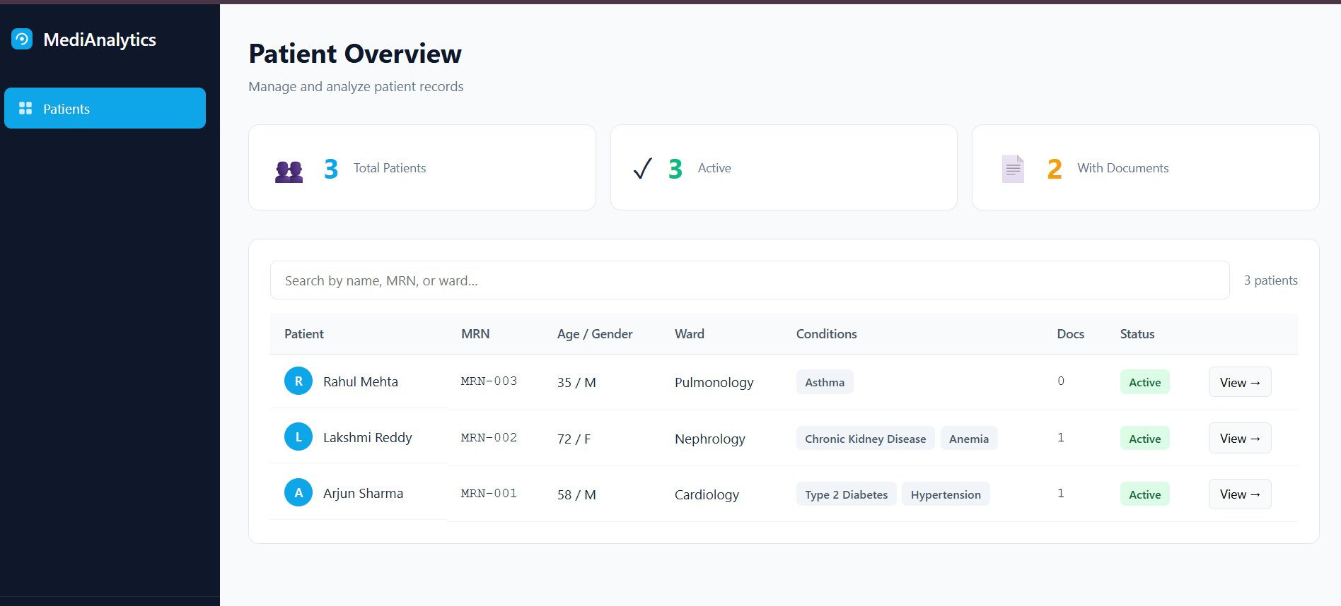
Live Platform — Patient Dashboard
3 patients • search & filter • document count • active status

Slide 6
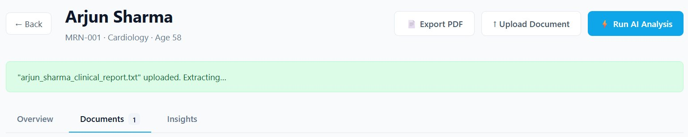
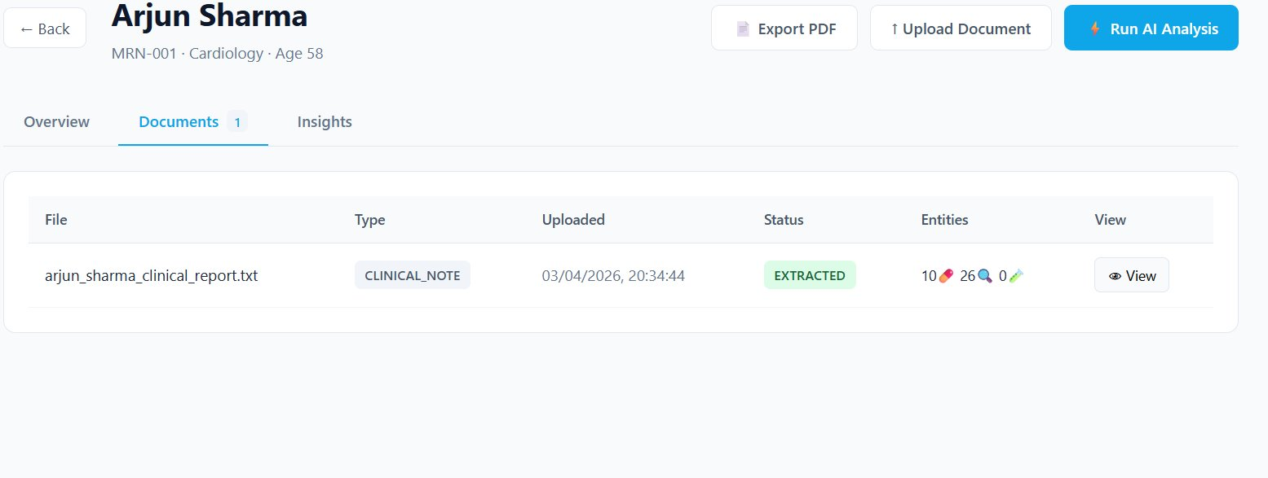
Upload → Extraction in Action
Uploading — extraction running
Done — 10 medicines • 26 diagnoses found

Slide 7
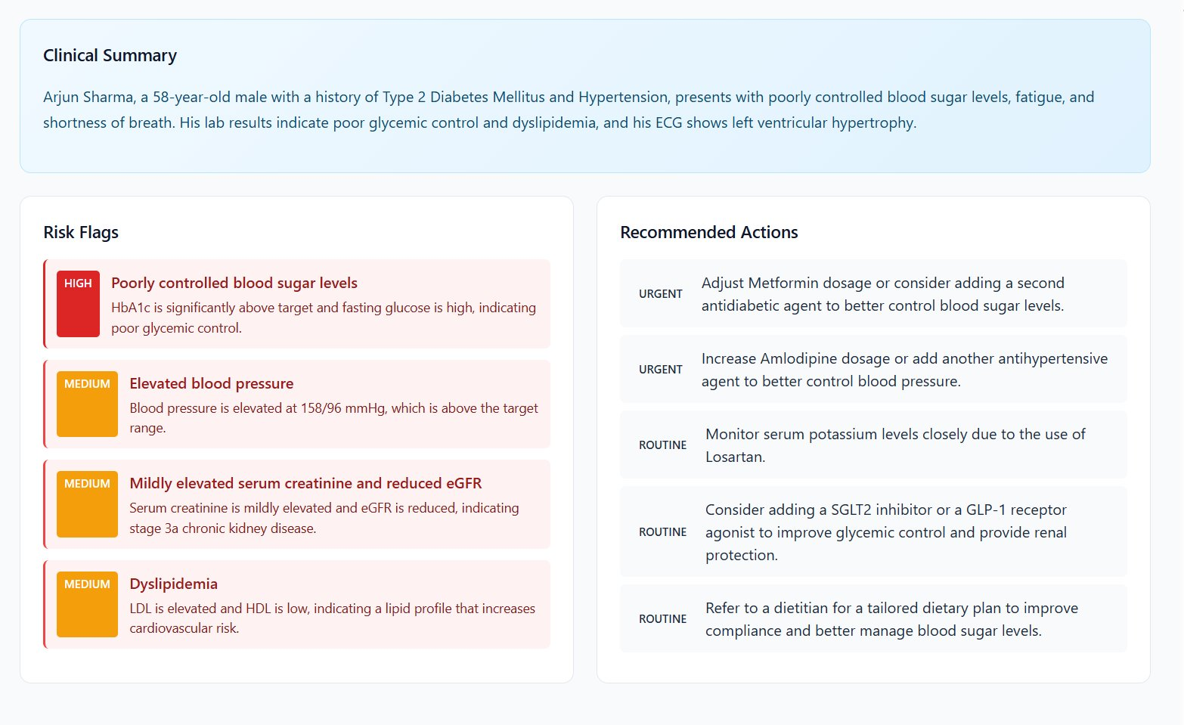
AI Insights — Arjun Sharma, 58M · Cardiology

Slide 8
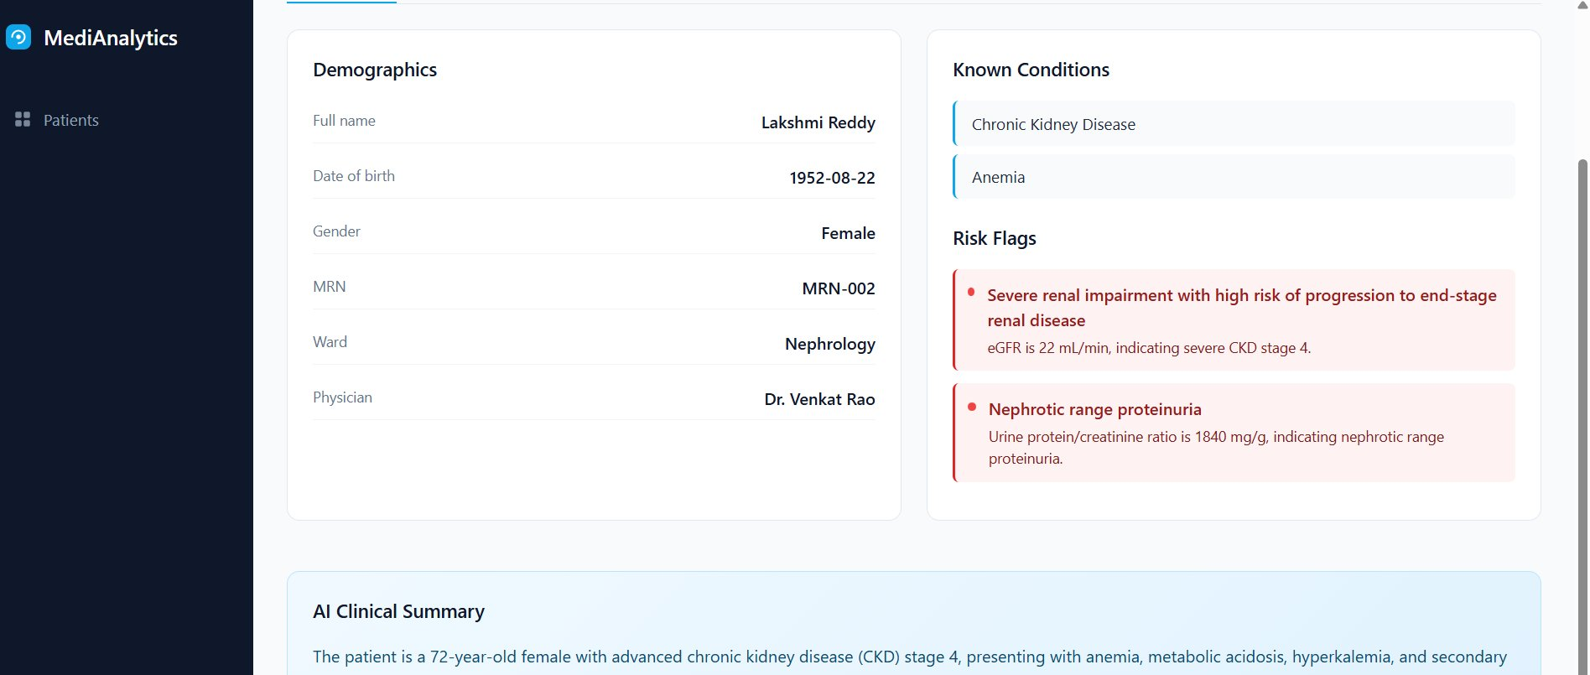
AI Insights — Lakshmi Reddy, 72F · Nephrology
Key Findings
HIGH
Severe kidney disease
eGFR 22 — CKD Stage 4
HIGH
Dangerous protein in urine
1840 mg/g — very high
MED
High potassium levels
5.6 mEq/L — review meds
MED
Blood too acidic
Bicarbonate 18 — therapy needed

Slide 9
Security
🔐
Secure Login
Only authorised doctors can access the system using AWS Cognito.
🔒
Data Encrypted
All files and records are encrypted — unreadable without a key.
🛡
No Public Access
Documents are never exposed directly — only served through the app.
👤
Role Permissions
Each part of the system only accesses exactly what it needs.

Slide 10
Summary
✅ What We Built
💡 What We Learned
Secure doctor login with AWS Cognito
Cloud & AWS
Build and deploy serverless systems
Upload & auto-extract any medical document
AI & NLP
Make machines read medical text
AI reads it and generates risk flags + summary
LLMs
Use Bedrock to generate human summaries
Export PDF report — live at cloudfront URL
Full Stack
React + Python + REST API + Terraform
🌐 https://d2ynvzjzxw6inc.cloudfront.net | 6th Semester CSE Project

