Slide 1

COMPLIER DESGIN
BATCH-17
T.S SUDHA KIRAN- 211FA04003; RAVIKIRAN.K-211FA04043; DEEPTHI.U-211FA04046; SAHILRAJ-211FA04677

Slide 2
Problem Statement
Generate the TAC for
a. Expression a < b or c < d and e > notf.
b. The following C Code
While(A<C[i] and B>D[i])
{
If A=1 then C[i]++;
Else while A<=D[i] do
D[i]=D[i]+C[i]
I++ }
c. If[(a<b) and ((c>d) or (a>d) ] then
z = x + y * z
Else
z = z+1
d. C Code for basic calculator by switch statement
e. C code for scientific calculator by using functions.

Slide 3

ABSTRACT
In this paper, we initiate our exploration by introducing the concept of Intermediate Code as a pivotal metric for deriving Three Address Code. The focus lies on generating intermediate code for looping and conditional statements, as well as switchcase structures. To exemplify the application of these concepts, we delve into the intermediate code generation for a switch-case scenario, using a simple calculator as an illustrative example. Through this exercise, our objective is to elucidate the intricate process of determining Three Address Code within the context of practical problem-solving.

Slide 4
INTRODUCTION
.INTERMEDIATE CODE: Intermediate code is a machineindependent representation used during compilation. It acts as a bridge between high-level source code and target machine code. This abstract representation simplifies program analysis and optimization. Examples include threeaddress code or abstract syntax trees. Intermediate code can be represented in three ways : 1) Linear Representation 2) Hierarchical Representation 3) Three address code(TAC).
.THREE ADDRESS CODE: Three Address Code is a low-level intermediate code representation used in compilers to express instructions with at most three operands. Each instruction in this format typically contains an operation, along with two source operands and one destination operand. It simplifies the translation from high-level programming languages to machine code by providing a more manageable and uniform structure for compiler optimizations and code generation. Three address code can be represented using: 1.triples 2.quadtriples 3.indirect triples

Slide 5
ALGORITHM
1.start
2.Read two values a,b.
3.Read the operator ,which is used to perform operation.
4. Initialize a variable result to store the calculation result.
5.Maintain the function to calculate Intermediate code.
6.With in function apply basic calculation using operator.
7.For addition (operation == '+’):
• Call the add function with num1 and num2 as arguments.
• Store the returned value in result.
8.For subtraction (operation == '-’):
• Call the subtract function with num1 and num2 as arguments.
• Store the returned value in result.

Slide 6
ALGORITHM
9.For multiplication (operation == '*’):
• Call the multiply function with num1 and num2 as arguments.
• Store the returned value in result
10. For addition (operation == '/’):
• Call the division function with num1 and num2 as arguments.
• Store the returned value in result.
11.Convert each statement into Intermediate code.
12.Display the resulting code.
13.Stop

Slide 7
SOURCE CODE
def generate_intermediate(cleaned_code):
final_code = []
current_temp = 1
for codeline in cleaned_code:
if '=' in codeline: # Assignment statement
variable, expression = map(str.strip, codeline.split("="))
temp_var = f"temp{current_temp}"
final_code.append(f"{temp_var} = {expression}")
final_code.append(f"{variable} = {temp_var}")
current_temp += 1
elif 'if' in codeline:
# If statement condition = codeline.split('if')[1].split('goto')[0].strip() goto_line = codeline.split('goto')[1].strip('()')

Slide 8
final_code.append(f"{variable} = input({prompt})")
elif 'return' in codeline: # Return statement
value = codeline.split('return')[1].strip() final_code.append(f"return {value}")
elif 'END' in codeline: # End statement final_code.append("END")
return final_code
final_code.append(f"if {condition} goto {goto_line}")
elif 'goto' in codeline: # Goto statement
goto_line = codeline.split('goto')[1].strip('()') final_code.append(f"goto {goto_line}")
elif 'print' in codeline: # Print statement
value = codeline.split('print')[1].strip('()') final_code.append(f"print({value})")
elif 'input' in codeline: # Input statement
variable, prompt = map(str.strip, codeline.split('='))

Slide 9
code = [
"def add(x, y):",
" return x + y",
"",
"def subtract(x, y):",
" return x - y",
"",
"def multiply(x, y):",
" return x * y",
"",
"def divide(x, y):",
" if y != 0:",
" return x / y",
" else:",
" return 'Error: Division by zero’”,
"",
"# Input reading and function invocation",
"operation = input('Enter operation (+, -, *, /): ')",
"num1 = float(input('Enter first number: '))",
"num2 = float(input('Enter second number: '))",
"",
"result = 0",
"",
"if operation == '+':",
" result = add(num1, num2)",
"elif operation == '-':",
" result = subtract(num1, num2)",
"elif operation == '*’:”,
" result = multiply(num1, num2)",
"elif operation == '/’:”,
" result = divide(num1, num2)",

Slide 10
"else:",
" print('Invalid operation’)”,
"",
"# Output the result",
"print(f'Result: {result}’)”,
]
cleaned_code = [line.strip() for line in code] final_code = generate_intermediate(cleaned_code) print('\nIntermediate code is:’)
for i, line in enumerate(final_code, 1):
print(f'{i}: {line}')

Slide 11
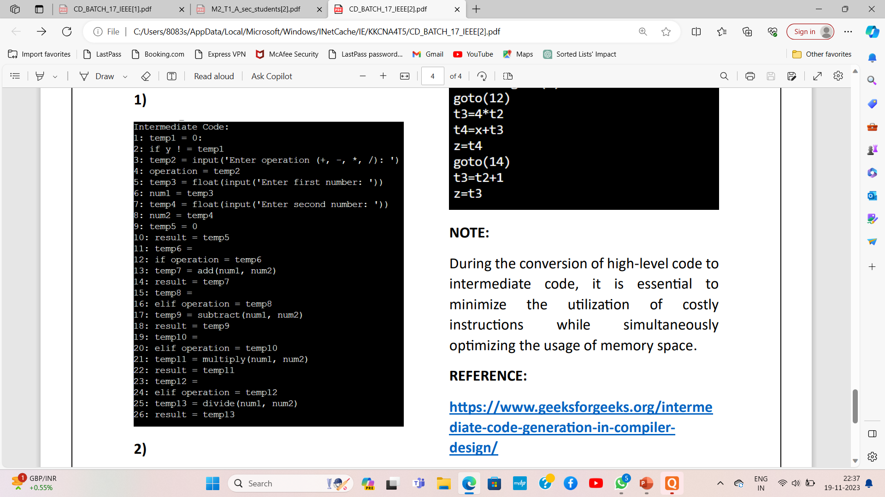
OUTPUT
Test Case-1:
.

Slide 12
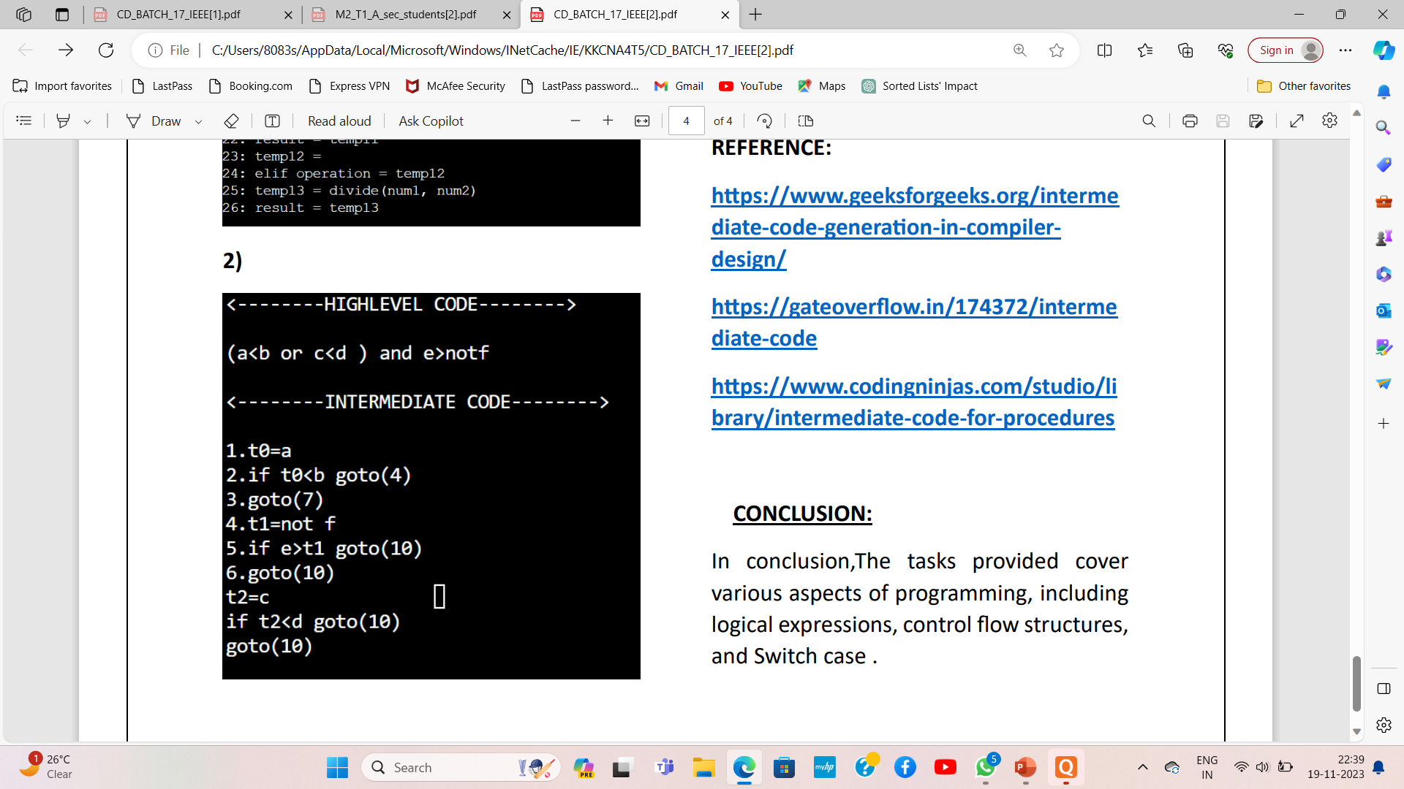

Slide 13
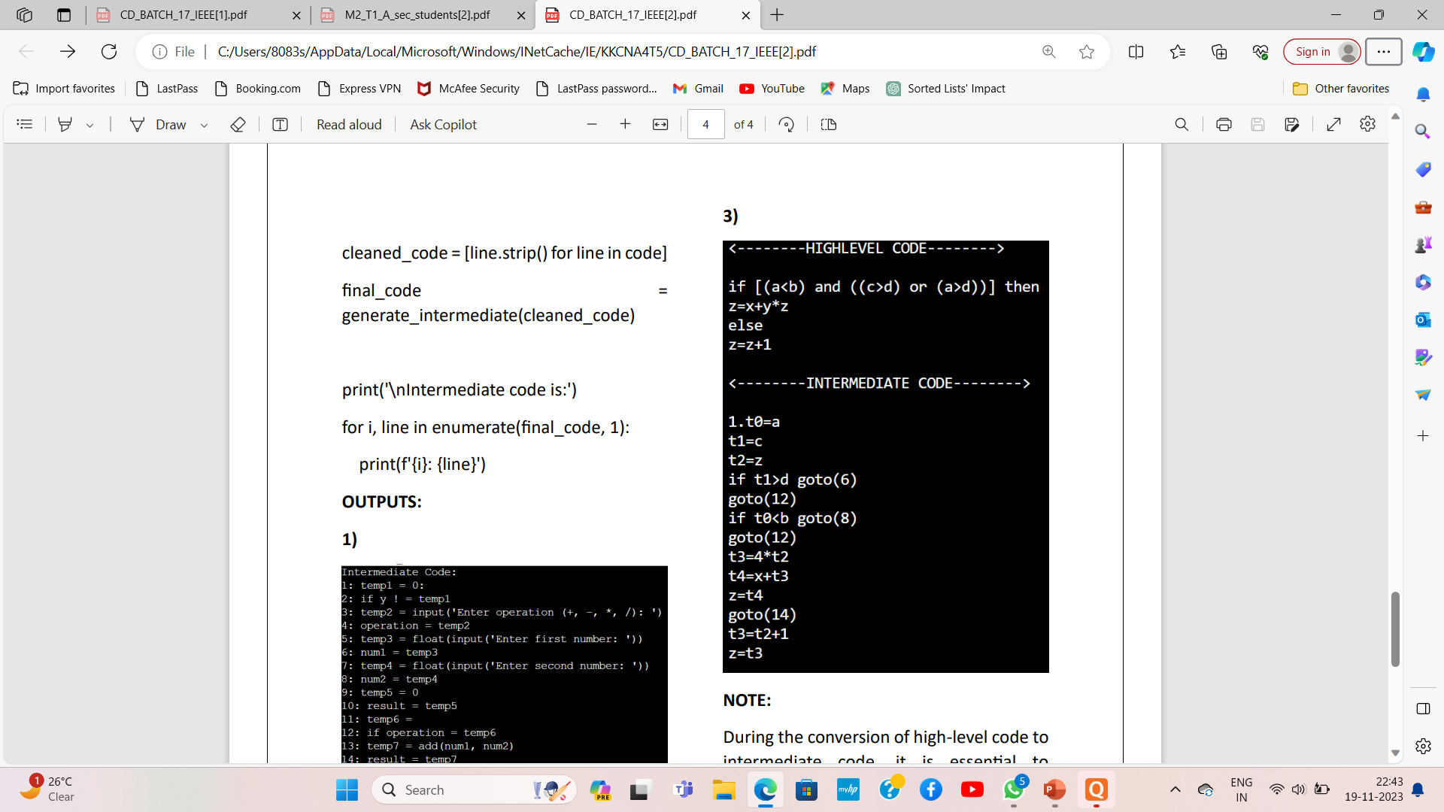

Slide 14
REFRENCE
https://gateoverflow.in/174372/interme
https://www.codingninjas.com/studio/li
https://www.geeksforgeeks.org/interme

Slide 15
CONCLUSION
In conclusion,The tasks provided cover various aspects of programming, including logical expressions, control flow structures, and Switch case

Slide 16

Thank you
FROM :
Group-17

