Slide 1
SOLID WASTE MANAGEMENT

Slide 2
BATCH-5
T.Shanmukha Sudha Kiran
211FA04003
K.Sruthi Chowdary
211FA04005
P.Vamsi
211FA04018
P.Amrutha
211FA04126

Slide 3
ABSTRACT
As urbanization accelerates, municipal solid waste (MSW) management emerges as a critical challenge, demanding innovative and sustainable solutions. This paper explores the complex nexus of MSW management and environmental consequences, with a specific focus on the case study of Guntur Municipal Corporation and Vijayawada Municipal Corporation. The study addresses the growing concerns surrounding landfill leachate, emphasizing the need for integrated leachate management strategies to foster sustainable municipal solid waste practices.

Slide 4
INTRODUCTION
Rapid urbanization in society has led to an unexpected surge in municipal solid waste (MSW) generation, demanding innovative and sustainable solutions for effective waste management. As urban centres like Guntur and Vijayawada
experience vast populations and increased industrial activities, the challenges associated with MSW management become particularly pronounced. Among the concerns, the management of landfill leachate stands out as a critical issue, posing environmental threats that necessitate urgent attention and strategic intervention

Slide 5
Guntur Municipal Corporation (GMC) and Vijayawada Municipal Corporation (VMC) are two of the largest cities in Andhra Pradesh, India. These cities are facing challenges in managing their MSW, including inadequate infrastructure, a lack of public awareness and participation, and financial constraints. In recent years, GMC and VMC have taken steps to improve their MSW management practices, including implementing integrated leachate management strategies.
In this report, we will discuss the integrated leachate management strategies implemented by GMC and VMC, and assess their effectiveness in reducing the environmental impact of MSW disposal. We will also provide recommendations for future improvements.

Slide 6
BACKGROUND
Leachate is a liquid that percolates through landfills, carrying with it dissolved pollutants from the MSW. These pollutants can contaminate groundwater and surface water, and release harmful gases into the atmosphere. The composition of leachate depends on the type of MSW, the landfill design, and the age of the landfill. Fresh leachate is typically high in organic matter and ammonia, while older leachate is more concentrated in metals and inorganic salts.

Slide 7
In addition to its impact on water quality, leachate can also release harmful gases into the atmosphere. These gases can contribute to climate change and air pollution.

Slide 8
METHODOLOGY
Integrated leachate management strategies employ a combination of methodologies to minimize the environmental impact of municipal solid waste (MSW) disposal. These methodologies can be broadly categorized into
1)Prevention
2) Collection
3)Treatment and
4)Disposal strategies.

Slide 9
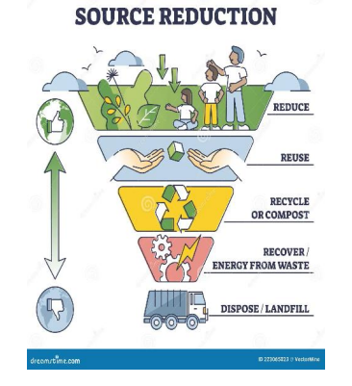
PREVENTION
Source Reduction: By encouraging the use of reusable products, minimizing packaging materials, and reducing the consumption of disposable items, the overall volume and toxicity of MSW can be significantly decreased, thereby reducing leachate production.

Slide 10
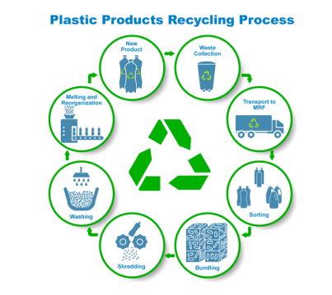
Material Recycling: Recycling materials such as paper, plastic, metal, and glass not only reduces the amount of MSW entering landfills but also conserves natural resources and reduces energy consumption associated with waste disposal.

Slide 11
COLLECTION
Leachate Collection Systems: Efficient leachate collection systems are essential to prevent leachate from infiltrating groundwater or surface water. These systems typically involve a network of pipes and pumps that collect leachate from within the landfill and transport it to treatment facilities.
Leachate Storage Tanks: Leachate storage tanks provide temporary storage for collected leachate before it is transported for treatment.
These tanks ensure that leachate is properly managed and does not overflow or leak into the environment.

Slide 12
TREATMENT
Biological Treatment: Biological treatment methods utilize microorganisms to break down and remove organic pollutants from leachate. These methods can include activated sludge processes, trickling filters, and bioreactors.
Advanced Oxidation Processes (AOPs): AOPs employ powerful chemical reactions to break down complex organic pollutants and inorganic contaminants in leachate. These methods can include ozonation, Fenton processes, and photocatalytic oxidation.

Slide 13
DISPOSAL
Municipal Wastewater Treatment Plants: Treated leachate can be discharged to municipal wastewater treatment plants for further purification before being released into the environment. This approach ensures that leachate meets stringent discharge standards.
Deep Well Injection: In areas with deep, impermeable geological formations, treated leachate may be injected deep underground for permanent disposal. This method ensures that leachate does not contaminate shallow groundwater or surface water.

Slide 14
CHALLENGES
Leachate Composition Variability: The composition of leachate can vary significantly depending on the type of MSW, landfill design, and age of the landfill, making it challenging to design and implement a treatment system that effectively removes all pollutants.
Long-Term Monitoring and Maintenance: Continuous monitoring of leachate quality and treatment system performance is crucial to ensure ongoing effectiveness and prevent environmental damage.

Slide 15
High Initial Investment Costs: The initial investment in leachate collection, treatment, and disposal infrastructure can be substantial, requiring municipalities to secure adequate funding.

Slide 16
BENEFITS
Reduced Groundwater Contamination: By preventing leachate from escaping landfills, integrated leachate management strategies safeguard groundwater resources from contamination with harmful pollutants
Revenue Generation from Waste-to-Energy: Integrated leachate management strategies may incorporate waste-to-energy technologies, generating revenue from the production of electricity or other energy sources.
Reduced Greenhouse Gas Emissions: By diverting MSW from landfills and implementing recycling programs, integrated leachate management strategies minimize methane emissions, a potent greenhouse gas.

Slide 17
CONCLUSION
Integrated leachate management strategies offer economic advantages by reducing remediation costs, extending landfill life, generating revenue from wasteto-energy technologies, and enhancing property values. These economic benefits can contribute to the overall financial sustainability of municipalities. In conclusion, integrated leachate management strategies provide a holistic approach to addressing the environmental and public health concerns associated with MSW disposal. By embracing these strategies, municipalities can embark on a path towards sustainable development, ensuring a healthier and more environmentally responsible future for generations to come.

Slide 18
REFERENCES
https://niua.in/resources-and-waste/sites/default/files/2022-04/TANA_Report_for_Guntur.pdf
https://www.ijrte.org/wp-content/uploads/papers/v7i6c2/F11490476C219.pdf

