Slide 1
Modules: A set of functions you want to include in your application.
USERDEFINED MODULES
HTTPS MODULE
FILE SYSTEM MODULE
URL MODULE

Slide 2
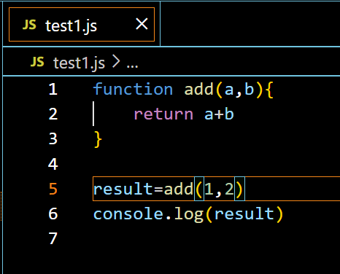
Basic Code:

Slide 3
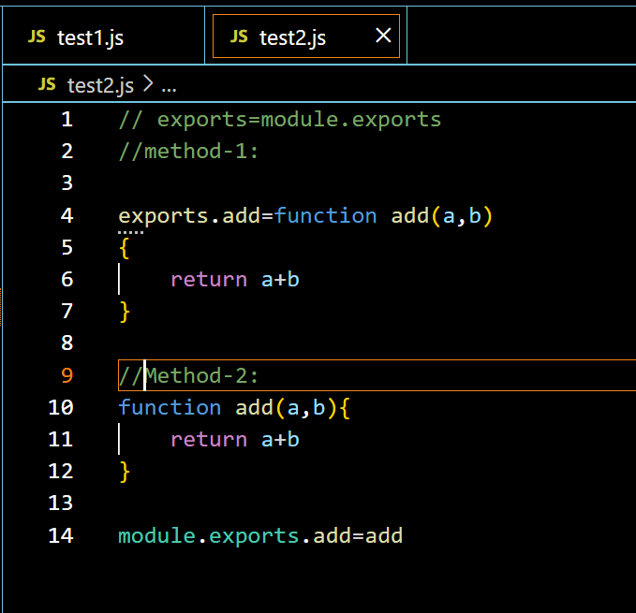
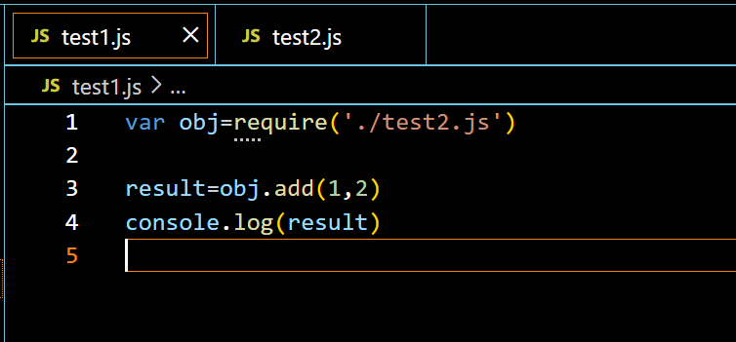
User Defined modules:
1)To include a module, use the require() function with the name of the module:
2)Notice that we use ./ to locate the module, that means that the module is located in the
same folder as the Node.js file.

Slide 4
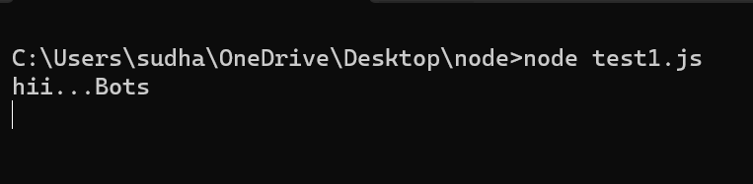
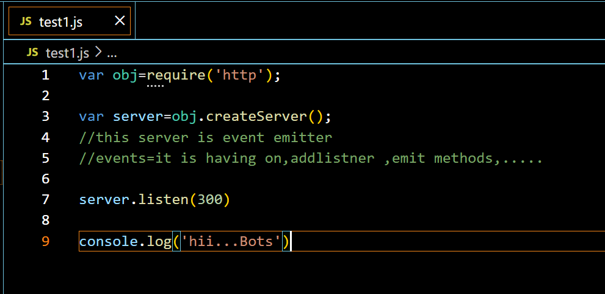
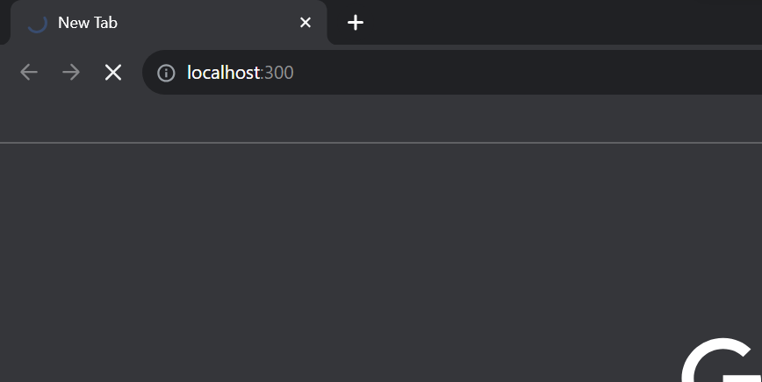
HTTP Module:
1) Node.js has a built-in module called HTTP, which allows Node.js to transfer data over the Hyper Text Transfer Protocol (HTTP).
2)The HTTP module can create an HTTP server that listens to server ports and gives a response back to the client.
3)Use the createServer() method to create an HTTP server:

Slide 5
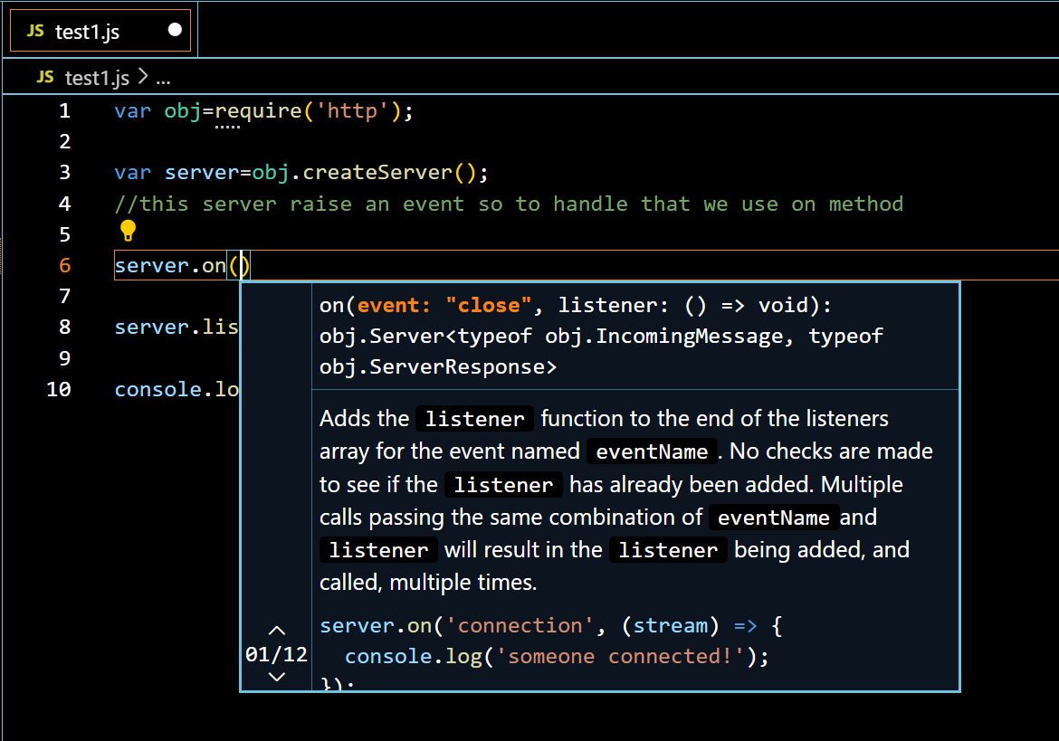
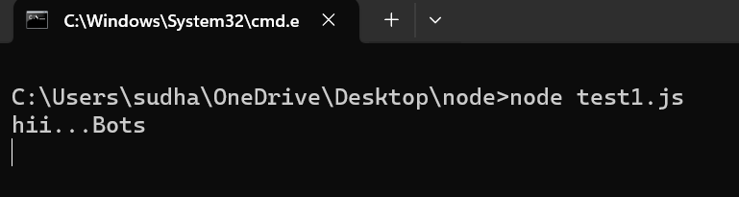
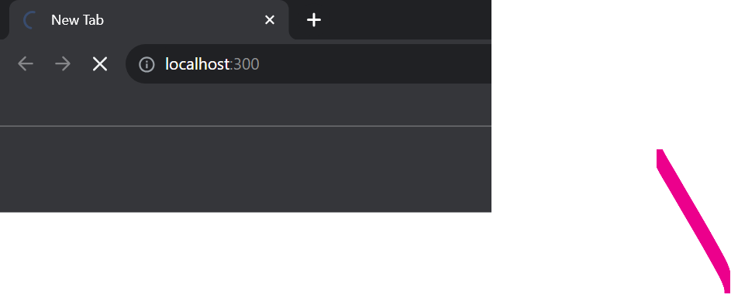
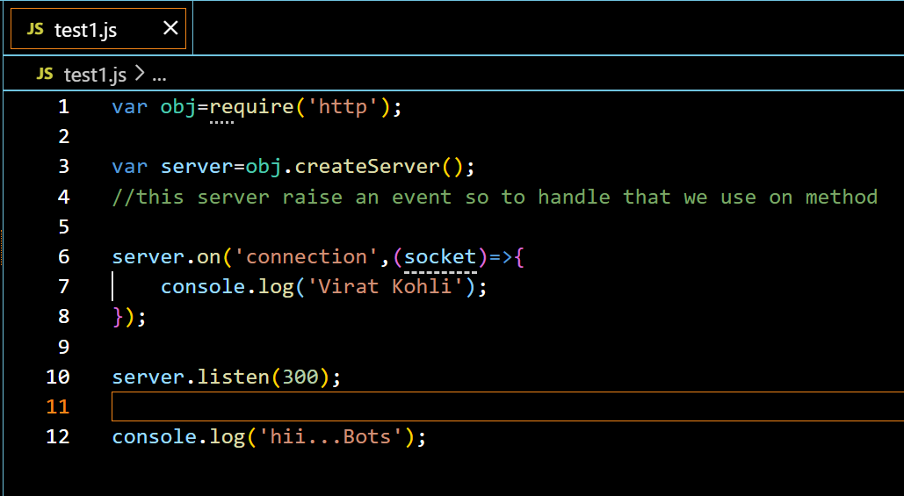
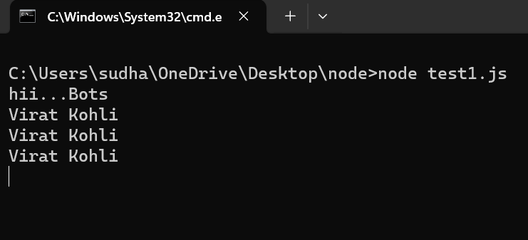

Slide 6
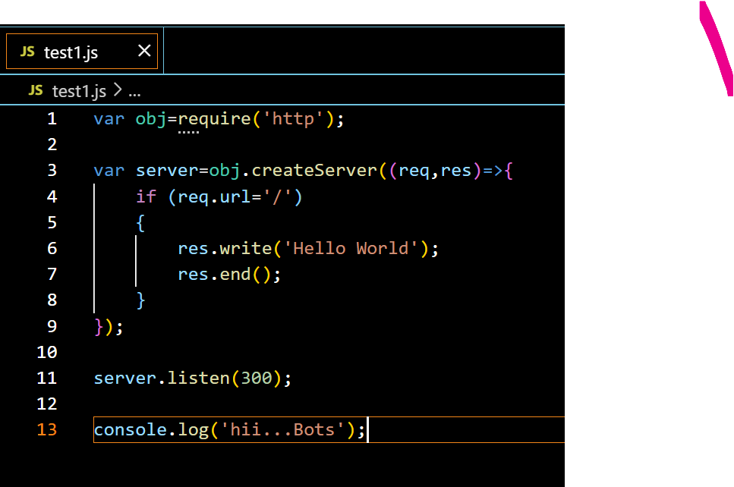
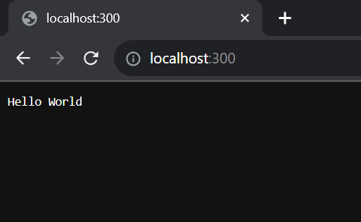

Slide 7
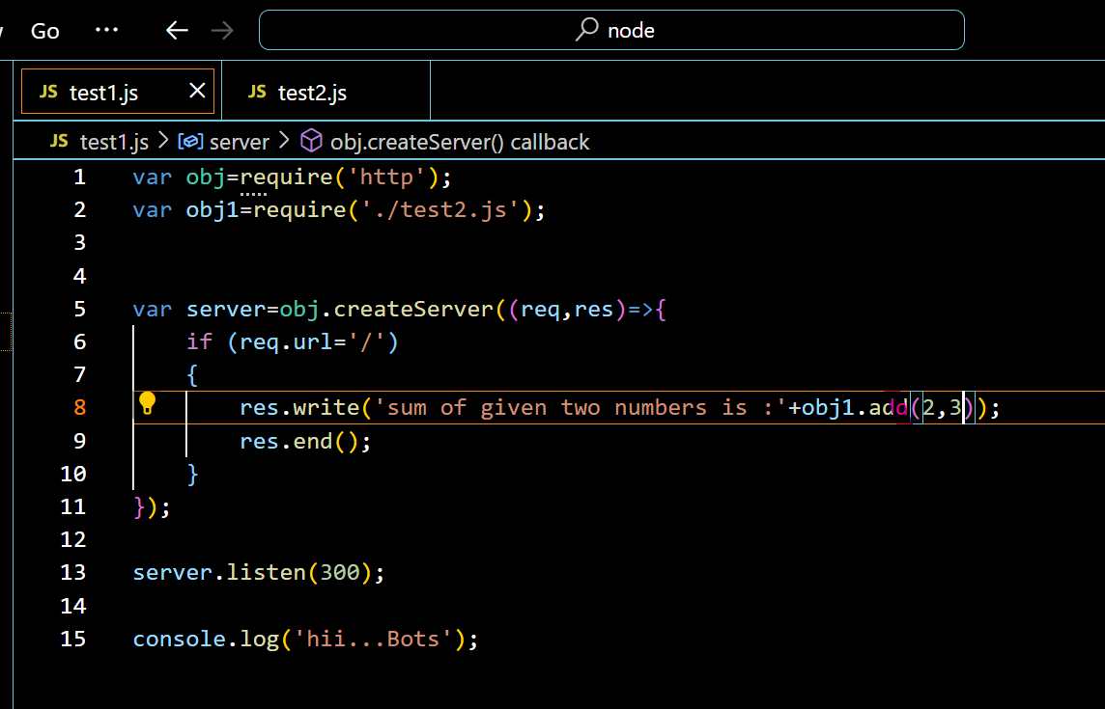
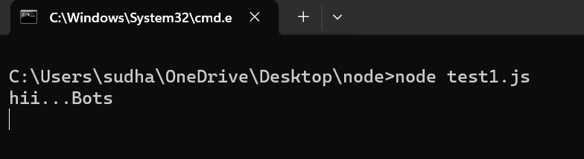
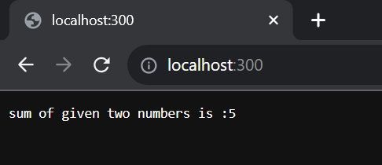
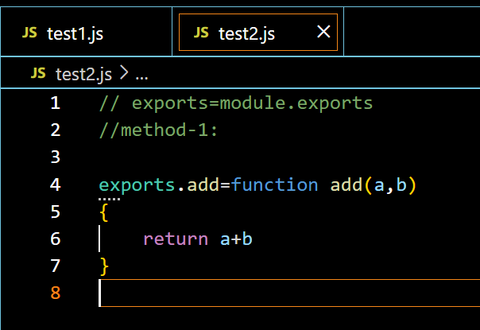

Slide 8
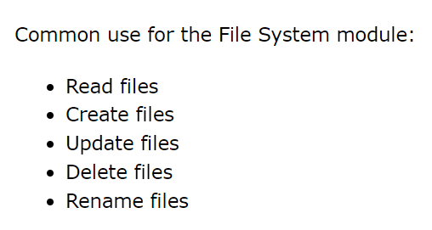
File module:

Slide 9
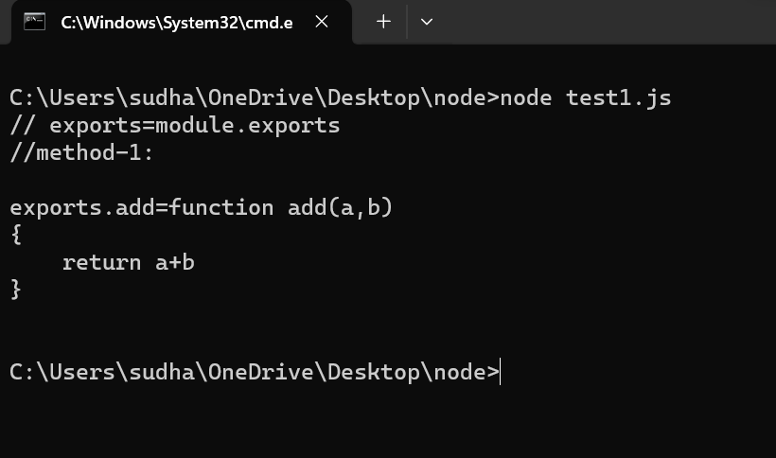
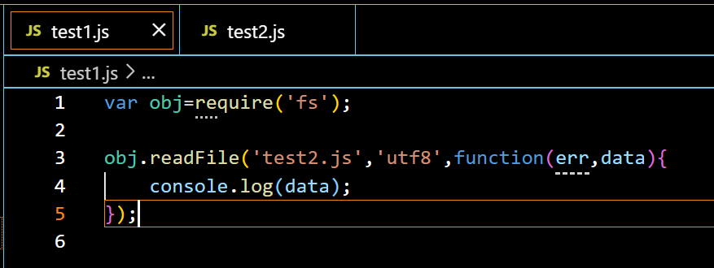
Read files:

Slide 10
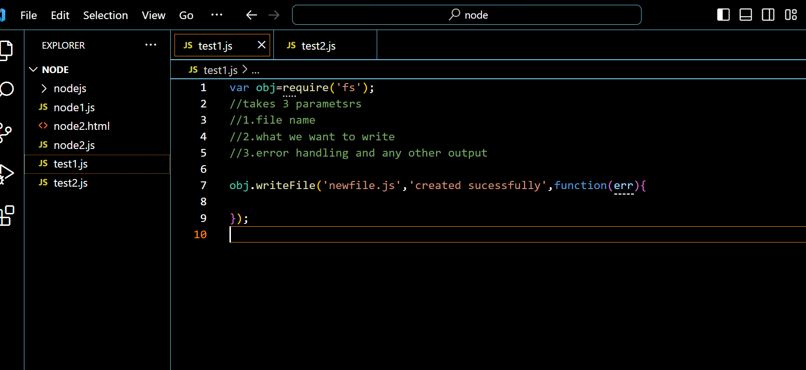
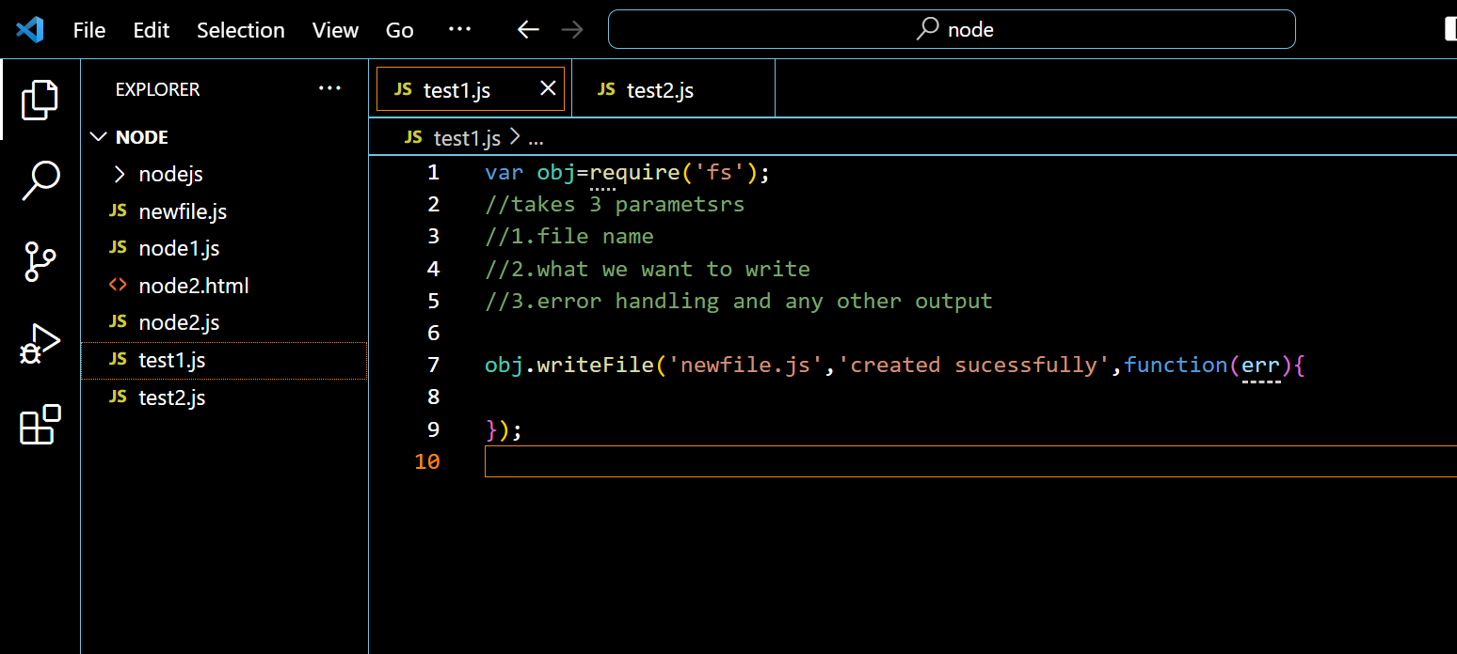
Creating file(write and Append):
1)The fs.readFile() method is used to read files on your computer.
2)The File System module has methods for creating new files:
fs.appendFile()
fs.open()
fs.writeFile()
The fs.appendFile() method appends specified content to a file. If the file does not exist,

Slide 11
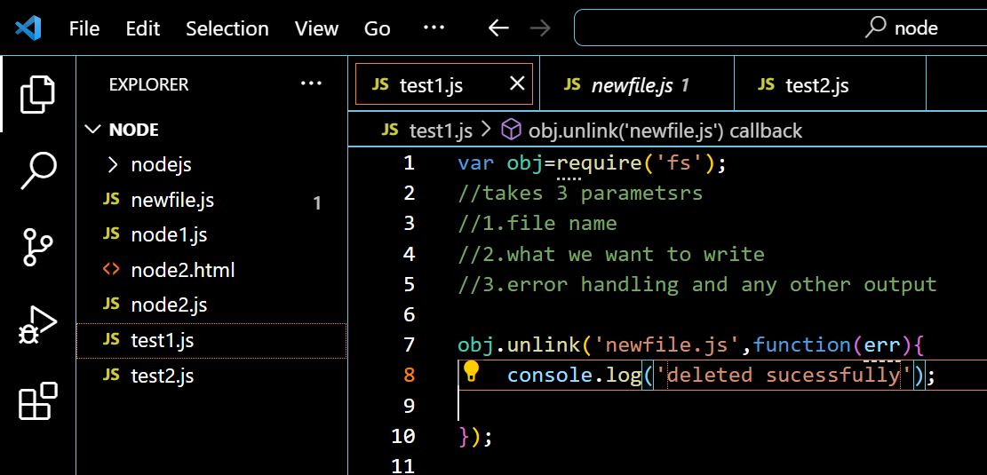
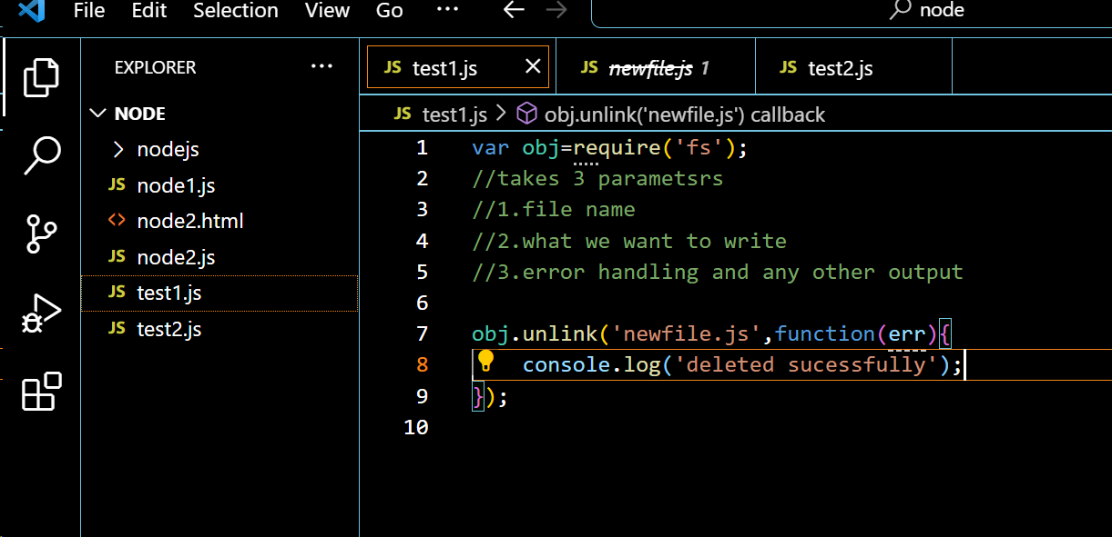
Delete:
1)To delete a file with the File System module, use the fs.unlink() method.
2)The fs.unlink() method deletes the specified file:

Slide 12
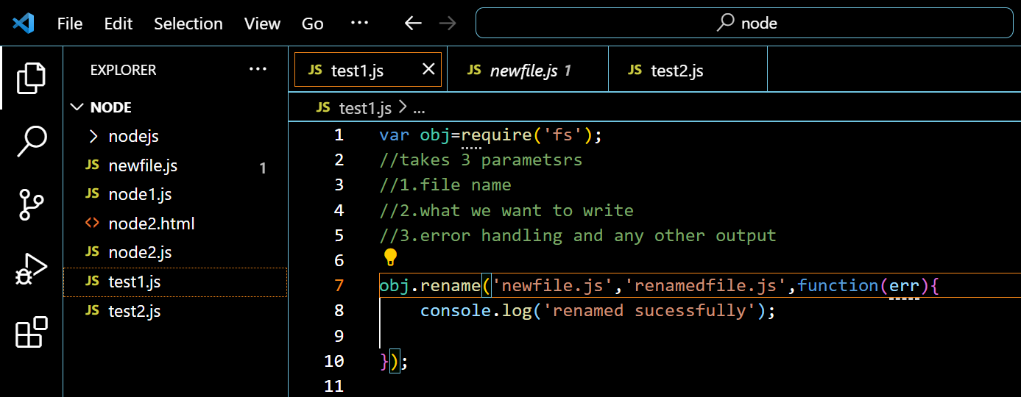
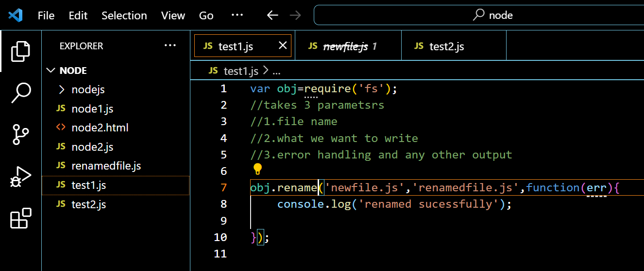
Rename:
1)To rename a file with the File System module, use the fs.rename() method.
2)The fs.rename() method renames the specified file:

Slide 13
URL MODULE

Slide 14
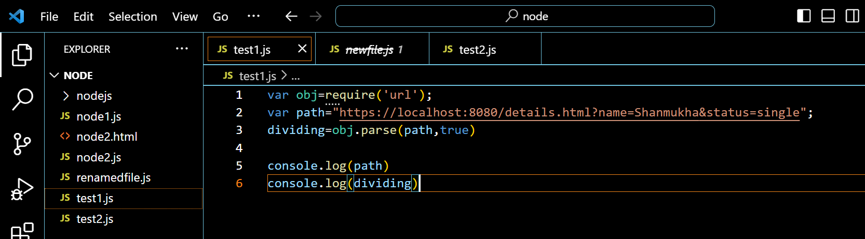
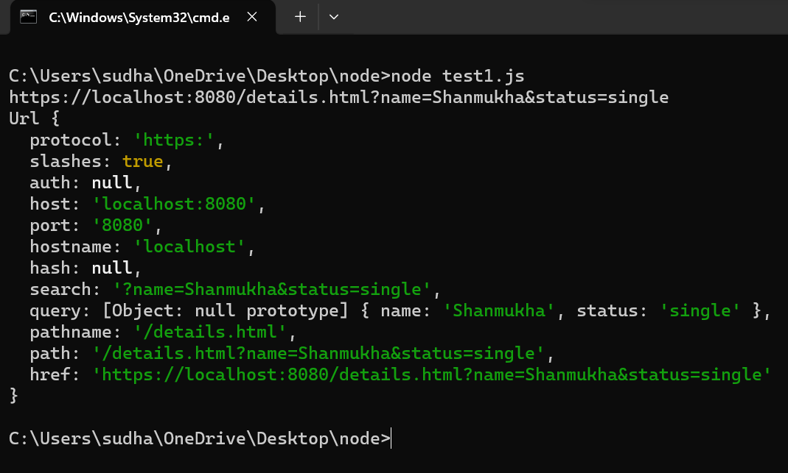
1)The URL module splits up a web address into readable parts.
2)To include the URL module, use the require() method:
var url = require('url');
3)Parse an address with the url.parse() method, and it will return a URL object with each part of the address as properties:

Slide 15
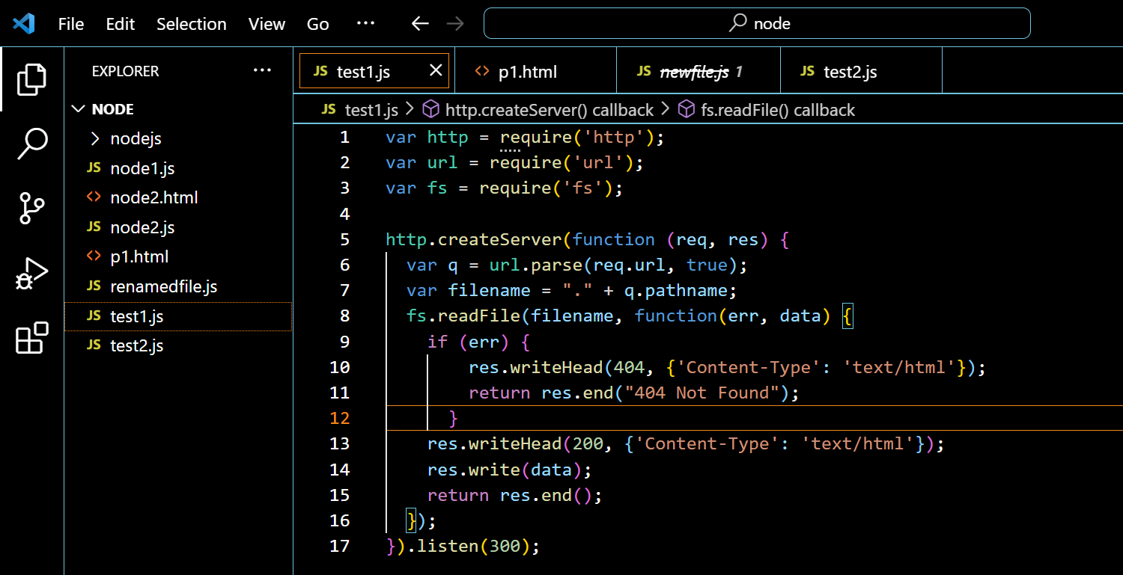
Example:

Slide 16
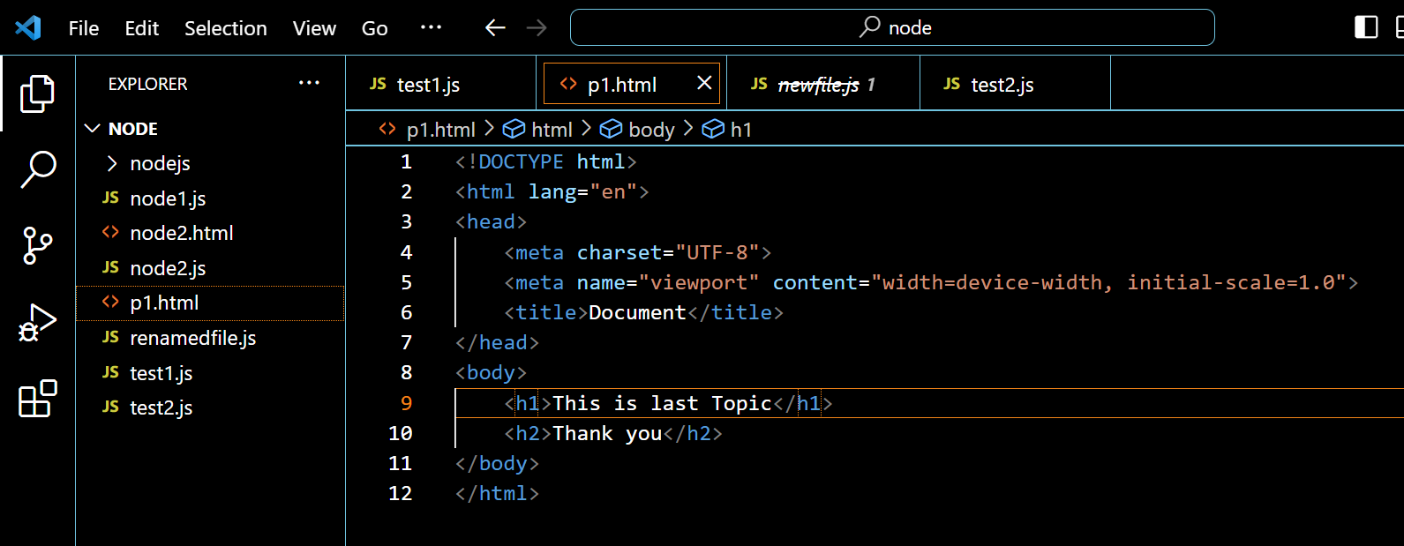
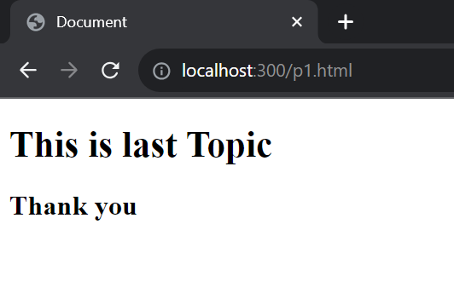

Slide 17


