Slide 1
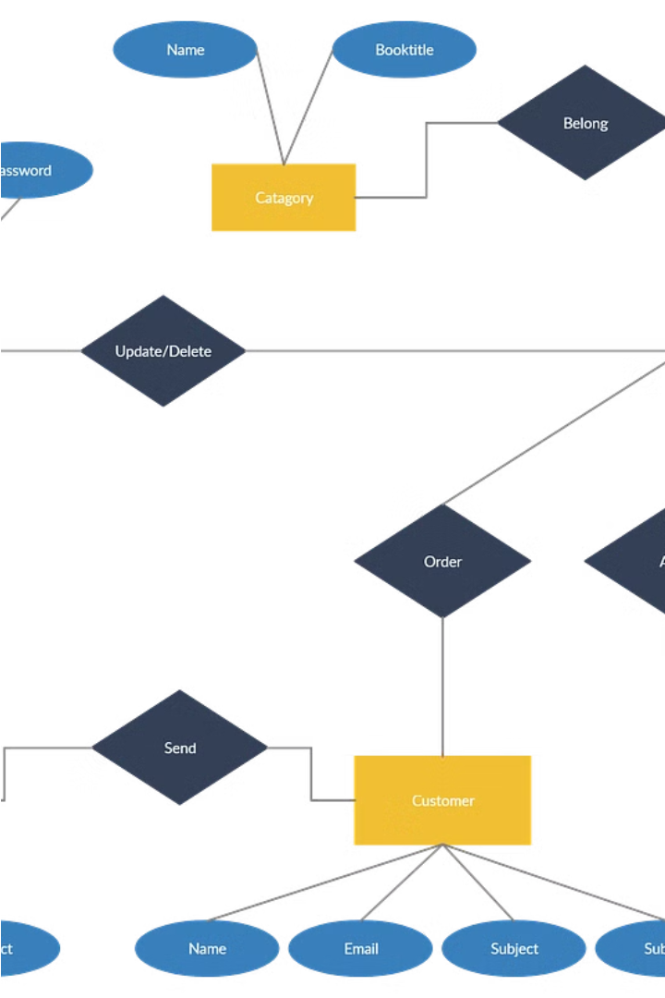
Online Bookstore Management System
Done by,
Dandamudi Gowreesh Raja – AP22110010081
B Hemanth – AP22110010074
Munagala Shanmukha Krishna Chaitanya – AP22110010089
Jetti Kundan Kumar – AP22110010116

Slide 2
Project Background
The online bookstore management system is a comprehensive solution designed to revolutionize the way books are sold and distributed in the digital age. This project aims to create a user-friendly and efficient platform that caters to the needs of both book enthusiasts and publishing houses. With the rapid growth of e-commerce and the increasing demand for accessible and diverse book selections, the development of this system is a timely and crucial endeavor.
The project is rooted in the recognition that traditional brick-and-mortar bookstores are facing significant challenges in the face of emerging online marketplaces. By leveraging the power of the internet and modern technology, the online bookstore management system will provide a centralized hub where customers can easily browse, purchase, and access a wide range of literary works, from bestsellers to niche titles. This comprehensive approach will not only benefit the end-users but also empower publishers and authors to reach a broader audience and streamline their distribution channels.
At the heart of this project lies the goal of creating a seamless and enjoyable user experience. Through intuitive design, personalized recommendations, and robust customer support, the system will strive to foster a sense of community and excitement around the world of books. By embracing the advantages of e-commerce, the project aims to revolutionize the way people discover, acquire, and engage with literature, ultimately transforming the landscape of the publishing industry.

Slide 3

Description of the Project
The Online Bookstore Management System is a comprehensive software solution designed to streamline the operations of an online bookstore. The project aims to create a user-friendly platform that allows customers to browse, search, and purchase books from the comfort of their own homes. The system will feature a robust catalog with a wide range of book titles, genres, and authors. Customers will be able to easily navigate the catalog, read book descriptions, and view customer reviews to help them make informed purchasing decisions. The platform will also offer personalized recommendations based on customer browsing and purchase history, enhancing the shopping experience. In addition to the customer-facing features, the system will provide a powerful administrative interface for bookstore managers. This will allow them to efficiently manage inventory, process orders, handle customer inquiries, and generate comprehensive sales reports. The system will also include secure payment processing capabilities, ensuring a smooth and trusted transaction experience for both customers and the bookstore. The project will leverage the latest web technologies and industry best practices to deliver a modern, responsive, and scalable online bookstore solution. The goal is to create a platform that not only meets the needs of the bookstore but also provides a delightful and user-friendly experience for customers, ultimately driving increased sales and customer loyalty.

Slide 4
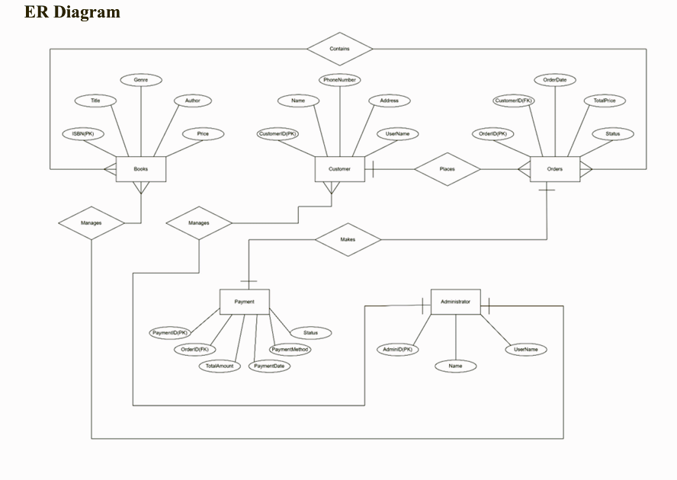
ER Diagram
The entity-relationship (ER) diagram is a crucial component of the Online Bookstore Management System project. This visual representation illustrates the relationships between the various entities, or key components, that make up the system. The ER diagram provides a clear and concise way to understand the structure and interconnections of the bookstore's data model, which is essential for the development and implementation of the system.
The ER diagram for the Online Bookstore Management System will likely include entities such as "Books," "Authors," "Publishers," "Customers," "Orders," and "Payments." These entities will be connected through various relationships, such as "a book is written by an author," "a customer places an order," and "an order includes multiple books." By clearly defining these relationships, the ER diagram will help the development team ensure that the system's data is organized in a logical and efficient manner, making it easier to manage and maintain the bookstore's operations.

Slide 5
Description of ER Diagram
The Entity-Relationship (ER) diagram for the Online Bookstore Management System depicts the entities, attributes, and relationships involved in the system's database design. The ER diagram provides a visual representation of the conceptual model, illustrating how different entities are related to each other and how they store and interact with data.
Entities:
The above ER Diagram includes the following entities:
Books: Represents individual books available in the bookstore, with attributes such as ISBN, Title, Genre, Author, and Price.
Customer: Represents customers who interact with the bookstore, with attributes including CustomerID, Name, PhoneNumber, Address, and UserName.
Orders: Represents individual orders placed by customers, with attributes such as OrderID, Order Date, Total Price, and Status.
Payment: Represents payments made for orders, with attributes including PaymentID, TotalAmount, PaymentDate, PaymentMethod and Status.
Administrator: Represents administrators who manage the bookstore's operations, with attributes such as AdminID, Name, and UserName.
Relationships:
The ER diagram illustrates the following relationships between entities:
Customer-Order Relationship: Represents the fact that each customer can place multiple orders, and each order is placed by one customer (one-to-many relationship).
Order-Book Relationship: Represents the fact that each order can contain multiple books, and each book can be included in multiple orders (many-to-many relationship).
Payment-Order Relationship: Represents the fact that each payment is associated with one order, and each order can have one payment (one-to-one relationship).
Administrator-Book Relationship: Represents the fact that each administrator can manage multiple books, and each book is managed by one administrator (one-to-many relationship).
Administrator-Customer Relationship: Represents the fact that each administrator can manage multiple customers, and each customer is managed by one administrator (one-to many relationship).
Attributes and Keys: Each entity in the ER diagram includes attributes that describe the properties of the entity. Primary keys are indicated for each entity, denoting the unique identifier for each record in the table.

Slide 6
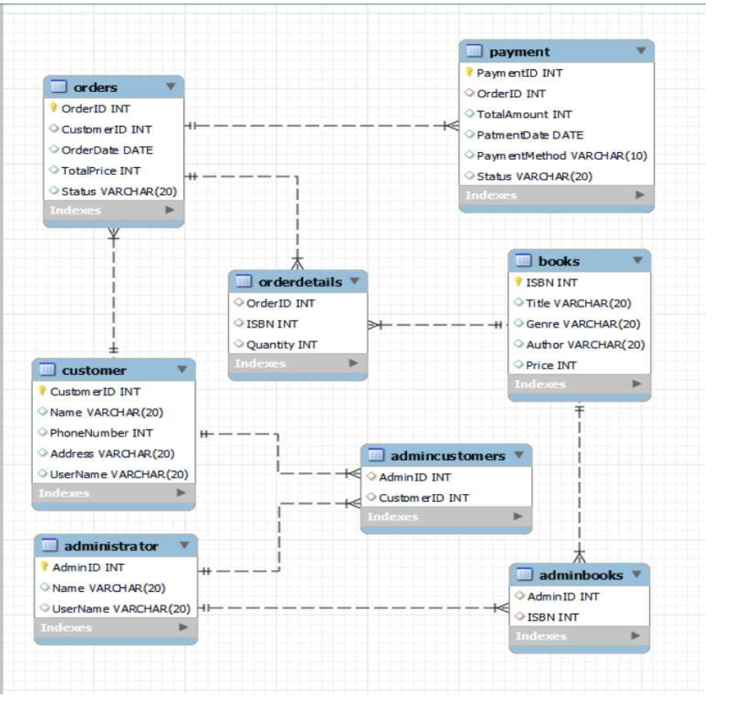
ER Diagram in the form of Tables

Slide 7
Description of Tables
Books: The Books table stores information about individual books available in the bookstore. It includes attributes such as ISBN, Title, Genre, Author, and Price. Each record in the Books table represents a unique book entry in the bookstore's inventory.
Customer: The Customers table stores information about customers who interact with the bookstore. It includes attributes such as CustomerID, Name, PhoneNumber, Address, and UserName. Each record in the Customers table represents a unique customer registered with the bookstore.
Orders: The Orders table stores information about individual orders placed by customers. It includes attributes such as OrderID, Order Date, Total Price, Status and CustomerID (Foreign Key referencing Customer table). Each record in the Orders table represents a unique order placed by a customer.
Payment: The Payment table stores information about payments made for orders. It includes attributes such as PaymentID, TotalAmount, PaymentDate, PaymentMethod, Status and OrderID (Foreign Key referencing Orders table). Each record in the Payment table represents a unique payment transaction associated with an order.
Administrator: The Administrator table stores information about administrators who manage the bookstore's operations. It includes attributes such as AdminID, Name, and UserName. Each record in the Administrator table represents a unique administrator responsible for overseeing bookstore activities.
OrderDetails: The OrderDetails table serves as an intermediate table to represent the many-to-many relationship between orders and books. It stores information about the books included in each order, along with the quantity of each book. It includes attributes such as OrderID (Foreign Key referencing Orders table), ISBN (Foreign Key referencing Books table), and Quantity.
AdminBooks: The AdminBooks table serves as an intermediate table to represent the one-to-many relationship between administrators and books. It stores information about the books managed by each administrator. It includes attributes such as AdminID (Foreign Key referencing Administrator table) and ISBN (Foreign Key referencing Books table).
AdminCustomers: The AdminCustomers table serves as an intermediate table to represent the one-to-many relationship between administrators and customers. It stores information about the customers managed by each administrator. It includes attributes such as AdminID (Foreign Key referencing Administrator table) and CustomerID (Foreign Key referencing Customers table).

Slide 8
Normalization
In database management systems (DBMS), normal forms are a series of guidelines that help to ensure that the design of a database is efficient, organized, and free from data anomalies. There are several levels of normalization, each with its own set of guidelines, known as normal forms they are 1NF, 2NF, 3NF, BCNF, 4NF, and 5NF.
First Normal Form (1NF): This is the most basic level of normalization. In 1NF, each table cell should contain only a single value, and each column should have a unique name. The first normal form helps to eliminate duplicate data and simplify queries.
Second Normal Form (2NF): 2NF eliminates redundant data by requiring that each non key attribute be dependent on the primary key. This means that each column should be directly related to the primary key, and not to other columns.
Third Normal Form (3NF): 3NF builds on 2NF by requiring that all non-key attributes are independent of each other. This means that each column should be directly related to the primary key, and not to any other columns in the same table.
Boyce-Codd Normal Form (BCNF): BCNF is a stricter form of 3NF that ensures that each determinant in a table is a candidate key. In other words, BCNF ensures that each non-key attribute is dependent only on the candidate key.
Fourth Normal Form (4NF): 4NF is a further refinement of BCNF that ensures that a table does not contain any multi-valued dependencies.
Fifth Normal Form (5NF): 5NF is the highest level of normalization and involves decomposing a table into smaller tables to remove data redundancy and improve data integrity.
Normal forms help to reduce data redundancy, increase data consistency, and improve database performance. However, higher levels of normalization can lead to more complex database designs and queries. It is important to strike a balance between normalization and practicality when designing a database.
Normalization of tables up to 3NF
In our Online Bookstore Management System, the database schema has been structured in such a way that it inherently satisfies the requirements of the Third Normal Form (3NF) without the need for explicit normalization efforts. The initial design of the schema ensures that each table is organized to avoid data redundancy and dependency, thereby preserving data integrity and minimizing anomalies. By acknowledging the principles of 3NF from the outset, our database schema supports efficient data storage, manipulation, and retrieval, contributing to the overall robustness and reliability of the system.
.

Slide 9
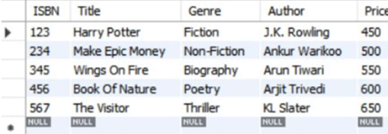
Creation of Data in Tables
Books:
create table Books(
ISBN int primary key,
Title varchar(20),
Genre varchar(20),
Author varchar(20),
Price int
);
insert into Books values(123,"Harry Potter","Fiction","J.K. Rowling",450);
insert into Books values(234,"Make Epic Money","Non-Fiction","Ankur Warikoo",500);
insert into Books values(345,"Wings On Fire","Biography","Arun Tiwari",550);
insert into Books values(456,"Book Of Nature","Poetry","Arjit Trivedi",600);
insert into Books values(567,"The Visitor","Thriller","KL Slater",650);
select * from Books;
Output:

Slide 10
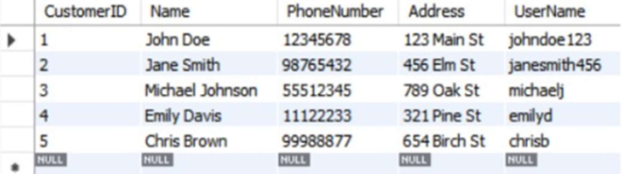
Customers:
create table Customer(
CustomerID int primary key,
Name varchar(20),
PhoneNumber int,
Address varchar(20),
UserName varchar(20)
);
INSERT INTO Customer VALUES(1, 'John Doe', 12345678, '123 Main St', 'johndoe123’);
INSERT INTO Customer VALUES(2, 'Jane Smith', 98765432, '456 Elm St', 'janesmith456’);
INSERT INTO Customer VALUES(3, 'Michael Johnson', 55512345, '789 Oak St', 'michaelj’);
INSERT INTO Customer VALUES(4, 'Emily Davis', 11122233, '321 Pine St', 'emilyd’);
INSERT INTO Customer VALUES(5, 'Chris Brown', 99988877, '654 Birch St', 'chrisb’);
select * from Customer;
Output:

Slide 11
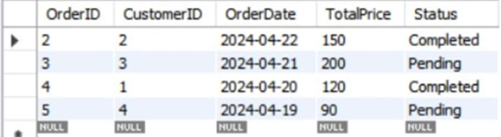
Orders:
create table Orders(
OrderID int primary key,
CustomerID int,
OrderDate date,
TotalPrice int,
Status varchar(20),
foreign key(CustomerID) references Customer(CustomerID)
);
INSERT INTO Orders VALUES(1, 1, '2024-04-23', 100, 'Pending’);
INSERT INTO Orders VALUES(2, 2, '2024-04-22', 150, 'Completed’);
INSERT INTO Orders VALUES(3, 3, '2024-04-21', 200, 'Pending’);
INSERT INTO Orders VALUES(4, 1, '2024-04-20', 120, 'Completed’);
select * from Orders;
Output:

Slide 12
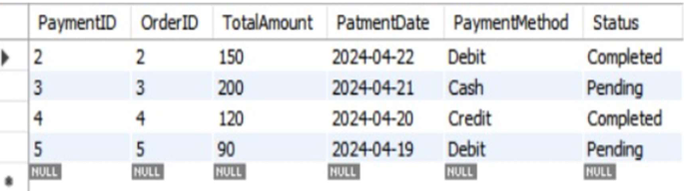
Payment:
create table Payment(
PaymentID int primary key,
OrderID int,
TotalAmount int,
PatmentDate date,
PaymentMethod varchar(10),
Status varchar(20),
foreign key(OrderID) references Orders(OrderID)
);
INSERT INTO Payment VALUES(1, 1, 100, '2024-04-23', 'Credit', 'Completed'); INSERT INTO Payment VALUES(2, 2, 150, '2024-04-22', 'Debit', 'Completed'); INSERT INTO Payment VALUES(3, 3, 200, '2024-04-21', 'Cash', 'Pending’);
INSERT INTO Payment VALUES(4, 4, 120, '2024-04-20', 'Credit', 'Completed’);
INSERT INTO Payment VALUES(5, 5, 90, '2024-04-19', 'Debit', 'Pending’);
select * from Payment;
Output:

Slide 13
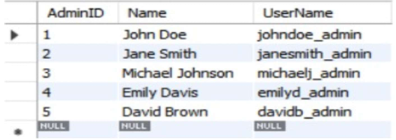
Administrator:
create table Administrator(
AdminID int primary key,
Name varchar(20),
UserName varchar(20)
);
INSERT INTO Administrator VALUES(1, 'John Doe', 'johndoe_admin’);
INSERT INTO Administrator VALUES(2, 'Jane Smith', 'janesmith_admin’);
INSERT INTO Administrator VALUES(3, 'Michael Johnson', 'michaelj_admin’);
INSERT INTO Administrator VALUES(4, 'Emily Davis', 'emilyd_admin’);
INSERT INTO Administrator VALUES(5, 'David Brown', 'davidb_admin’);
select * from Administrator;
Output:

Slide 14
OrderDetails:
create table OrderDetails(
OrderID int,
ISBN int,
Quantity int,
foreign key(OrderID) references Orders(OrderID),
foreign key(ISBN) references Books(ISBN)
);
AdminBooks:
create table AdminBooks(
AdminID int,
ISBN int,
foreign key(AdminID) references Administrator(AdminID),
foreign key(ISBN) references Books(ISBN)
);
AdminCustomers:
create table AdminCustomers(
AdminID int,
CustomerID int,
foreign key(AdminID) references Administrator(AdminID),
foreign key(CustomerID) references Customer(CustomerID)
);

Slide 15
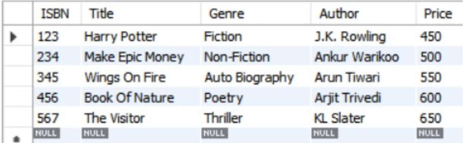
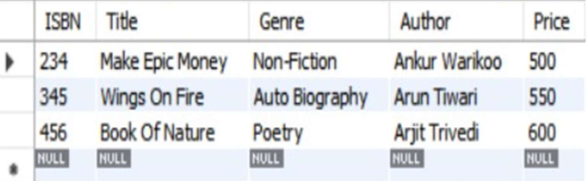
SQL Queries on the created tables
Problem Statement:
Write a Query to Update the Genre as “Auto Biography” where ISBN is 345.
Query:
update Book set Genre=”Auto Biography” where ISBN=345;
Output:
Problem Statement:
Write a query to delete data from the table where ISBN is 123 or Genre is “Thriller”
Query:
delete from Book where ISBN=123 or Genre = “Thriller”;
Output:

Slide 16
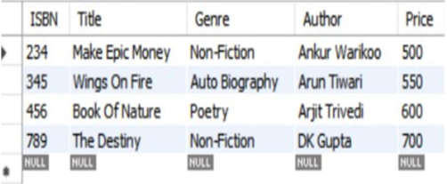
Problem Statement:
Write a query to insert a new data row in the table
Where ISBN is 789,
Title is “The Destiny”,
Genre is “Non-Fiction”,
Author is “DK Gupta”,
and Price is 700.
Query:
insert into Book values(789,”The Destiny”,”Non-Fiction”,”DK Gupta”,700);
Output:
Problem Statement:
Write a query to add a new column as “Year” of int datatype to the table.
Query:
alter table Book add Year int;
Output:

Slide 17
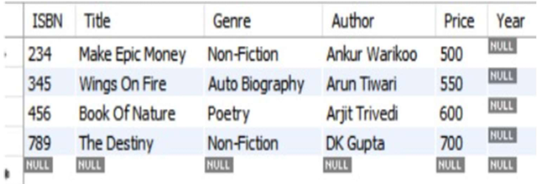

Problem Statement:
Write a query to Display the sum of prices in the table as “TotalCost”.
Query:
select sum(Price) as TotalCost from Books;
Output:

Slide 18
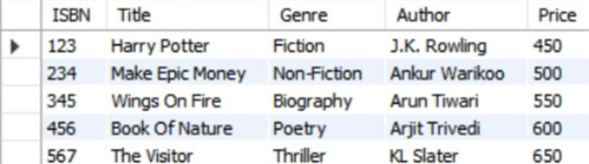
Creation of Views using Tables
Problem Statement:
Write a Query to create a View named as BooksView.
Query:
CREATE VIEW Books View AS SELECT ISBN, Title, Genre, Author, Price
FROM Books;
SELECT * FROM BooksView;
Output:
Problem Statement:
Write a Query to create a View named as CustomersOrdersView.
Query:
CREATE VIEW CustomerOrdersView AS
SELECT o.OrderID, o.CustomerID, c.Name AS CustomerName, o.OrderDate, o.TotalPrice, o.Status
FROM Orders o
JOIN Customer c ON o.CustomerID = c.CustomerID;
SELECT * FROM CustomerOrdersView;
Output:

Slide 19
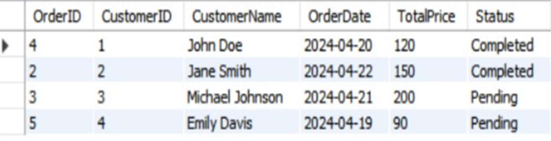
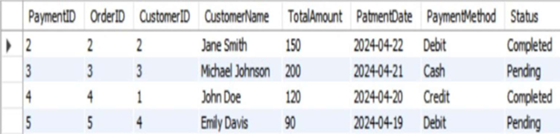
Problem Statement:
Write a Query to create a View named as PaymentDetailsView.
Query:
CREATE VIEW PaymentDetailsView AS
SELECT p.PaymentID, p.OrderID, o.CustomerID, c.Name AS CustomerName,
p.TotalAmount, p.PatmentDate, p.PaymentMethod, p.Status
FROM Payment p
JOIN Orders o ON p.OrderID = o.OrderID
JOIN Customer c ON o.CustomerID = c.CustomerID;
select * from PaymentDetailsView;
Output:

Slide 20
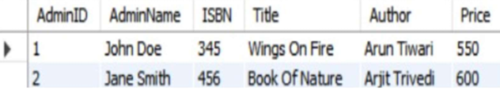
Problem Statement:
Write a Query to create a View named as AdministratorBooksView.
Query:
CREATE VIEW AdministratorBooksView AS
SELECT ab.AdminID, a.Name AS AdminName, ab.ISBN, b.Title, b.Author, b.Price
FROM AdminBooks ab
JOIN Administrator a ON ab.AdminID = a.AdminID
LEFT JOIN Books b ON ab.ISBN = b.ISBN;
select * from AdministratorBooksView;
Output:
Problem Statement:
Write a Query to create a View named as AdminCustomersView.
Query:
CREATE VIEW AdminCustomersView AS
SELECT ac.AdminID, a.Name AS AdminName, c.CustomerID, c.Name AS CustomerName, c.PhoneNumber, c.Address, c.UserName
FROM AdminCustomers ac
JOIN Administrator a ON ac.AdminID = a.AdminID JOIN Customer c ON ac.CustomerID = c.CustomerID;
Output:

Slide 21
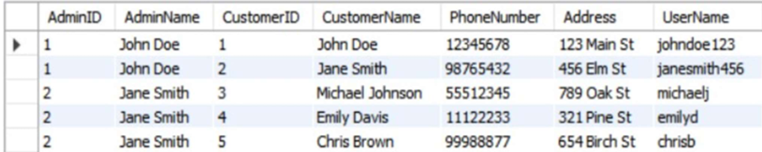
----- Thank You -----

