Slide 1

BINF5312 • NATURAL LANGUAGE PROCESSING
Using NLP to Extract
Cardiovascular Risk Factors,
Treatments & Outcomes
from Research Abstracts
Shanmukha Sai Prakash Jeelakarra
Rutgers University • Healthcare Informatics • April 2025

Slide 2
Presentation Outline
Problem & Motivation
Dataset & Preprocessing
01
02
CVD burden, data challenges
Cardio_v1, text cleaning
Biomedical NER Pipeline
Clustering & Embeddings
03
04
d4data model, entity extraction
MiniLM, KMeans, PCA viz
Relation Extraction & Knowledge Graph
Evaluation & Results
05
06
Zero-shot, NetworkX
Precision, Recall, F1

Slide 3
Problem & Motivation
~20M
5,000+
Manual?
CVD Deaths
Annually (WHO, 2021)
PubMed Abstracts
Analyzed
Impossible to
Review at Scale
❌ The Challenge
✅ The NLP Solution
Most biomedical knowledge lives in unstructured text
Manual extraction is impractical at scale
Key clinical relationships often go unmined
Limits clinical decision-support systems
Automated NLP pipeline to extract:
Risk factors (e.g. hypertension, obesity)
Treatments (e.g. amiodarone, ablation)
Outcomes (e.g. mortality, survival)

Slide 4

Dataset & Preprocessing
Preprocessing Pipeline
1
Combine Fields
Cardio_v1 Dataset
title + abst → single text
Hugging Face (InMedData, 2025)
2
Lowercase
Source
PubMed Cardiology Abstracts
Normalize capitalization
Rows Loaded
5,000 (nrows=5000)
3
Remove Punctuation
Regex: keep [a-z\s] only
Fields Used
title + abst → text
4
Tokenize & Filter
NER Applied
First 1,000 rows
Remove stopwords, len > 2
Relation Ext.
First 50 rows
5
Store clean Column
df['clean'] ready for NLP

Slide 5

Biomedical Named Entity Recognition (NER)
Model: d4data/biomedical-ner-all (HuggingFace Transformers)
1
Chunk Input:
Text truncated to 1,024 characters for BERT context window
2
Run NER Pipeline:
aggregation_strategy='simple' — merges subword tokens
3
Merge ##fragments:
Subword pieces starting with ## stitched back to full words
4
Filter Noise:
Remove: len ≤ 4, non-alpha, bad_words set, broken fragments
5
Return Entity List:
Unique lowercase medical terms per abstract
Entities Classified Into:
Disease / Condition
Treatment / Drug
Outcome / Risk
fibrillation, tachycardia, infarction
amiodarone, ablation, bypass
mortality, survival, hypertension
📌 Placeholder for your NER output screenshot here

Slide 6
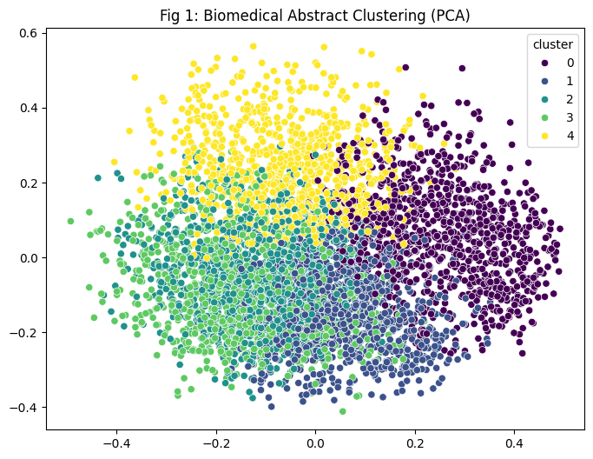
Semantic Clustering with Embeddings
Sentence Embeddings
Fig 1: Biomedical Abstract Clustering (PCA)
SentenceTransformer
all-MiniLM-L6-v2
384-dim dense vectors
KMeans Clustering
📊 Paste your PCA scatter plot
(Fig 1) here
5 clusters • random_state=42
n_init=10 • 5,000 abstracts
PCA Visualization
Reduce to 2D for plotting
seaborn scatterplot
Color-coded by cluster

Slide 7
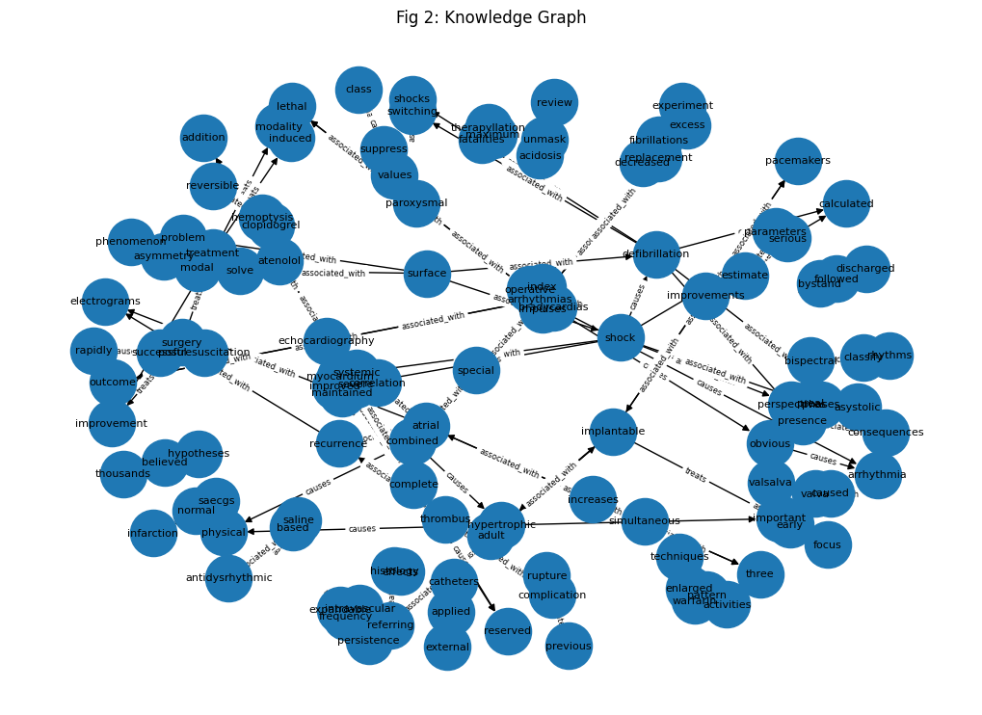
Relation Extraction & Knowledge Graph
How It Works
Fig 2: Knowledge Graph
Model:
valhalla/distilbart-mnli-12-3
Task:
Zero-shot text classification
Relation Labels:
treats
🕸️ Paste your Knowledge Graph
(Fig 2) here
causes
increases_risk
reduces_risk
associated_with
Threshold: score > 0.30 | Scope: first 50 abstracts, top 3 entities each

Slide 8
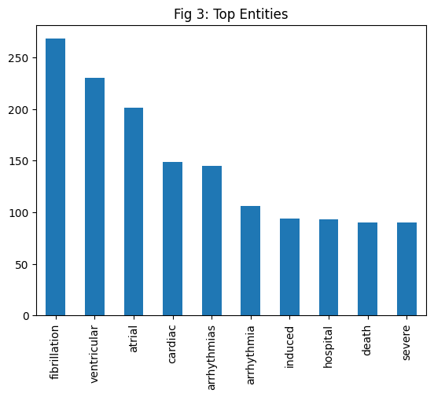
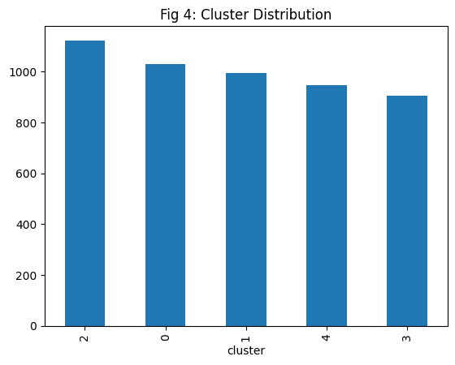
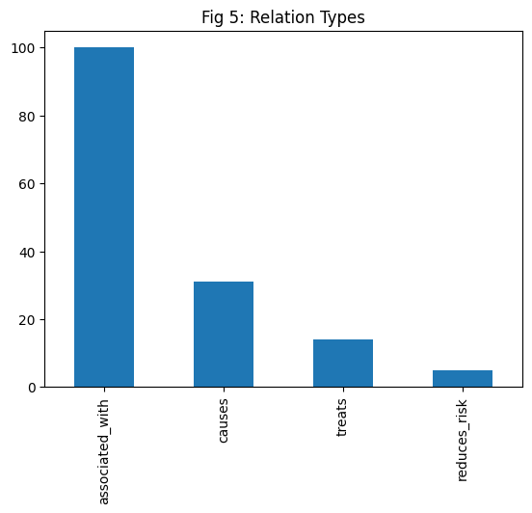
Analysis Visualizations
Fig 3: Top Entities
Fig 4: Cluster Distribution
Fig 5: Relation Types
📊 Paste Fig 3
here
📊 Paste Fig 4
here
📊 Paste Fig 5
here
Most frequent biomedical terms extracted across corpus
How abstracts spread across 5 semantic clusters
Distribution of extracted relation labels

Slide 9
Evaluation Results
🎯
🔍
⚖️
0.0657
0.4333
0.1119
Precision
Recall
F1 Score
TP / (TP + FP)
TP / (TP + FN)
Harmonic mean
Evaluation Methodology
Gold Standard: Manually defined entity lists for 10 abstracts (e.g., amiodarone, fibrillation, tachycardia)
Matching: Fuzzy substring matching — if 'ventricular' ∈ 'ventricular tachycardia', counted as TP
Semantic Similarity: cosine_similarity > 0.70 via all-MiniLM-L6-v2 for soft matching
TABLE I: Structured Knowledge Extraction Results (paste below during presentation)

Slide 10
Discussion & Limitations
✅ Strengths
⚠️ Limitations
Domain-specific NER model (biomedical-ner-all) trained on clinical corpora
Co-occurrence ≠ true semantic relation (e.g., negation not handled)
Zero-shot relation extraction — no labeled training data needed
Only top-3 entities used per abstract for relation extraction
Caching prevents redundant API calls, improving speed
NER limited to 1,000 rows — may not generalize to full corpus
End-to-end: raw CSV → structured knowledge graph
Hard-coded gold standard (10 rows) limits evaluation robustness
Scalable: batch processing supports large abstract sets
Broken subword fragments still possible despite manual filtering

Slide 11
Future Work & Conclusion
Future Improvements
Key Takeaways
BioBERT / PubMedBERT
NLP can automate structured extraction from cardiology literature
Deeper contextual NER beyond simple token labels
Negation Handling
Biomedical NER + zero-shot RE form a powerful, label-free pipeline
Detect 'does NOT cause' vs 'causes' relations
Knowledge graphs surface hidden clinical relationships at scale
Expand Entity Types
Add symptoms, procedures, patient demographics
Foundation for clinical decision support & evidence-based care
Clinical QA System
Answer 'what treats X?' from knowledge graph
Thank You! Questions Welcome.

