Slide 1

Title:
ENHANCING RELIABILITY PREDICTION
IN AMAZON REVIEWS
Team Alpha:
23WH1A6606 – D. Akshaya
23WH1A6627 – G. Hema Ashrita
23WH1A6630 – M. Shanmukhi
24WH5A6603 – K. Thripada

Slide 2
INTRODUCTION
This project is designed to assess the reliability of customer reviews on Amazon by leveraging automated web scraping and advanced sentiment analysis techniques. Using Selenium for data extraction and a large language model (LLM) to evaluate sentiment scores, the system filters out unreliable reviews based on specific thresholds and patterns. A machine learning model is then trained to classify reviews as either reliable or unreliable, enabling businesses to better understand genuine customer feedback and minimize the impact of misleading or fake reviews.

Slide 3
OBJECTIVES
Automate Review Extraction
Perform Cleaning and Sentiment Analysis
Classify the Reliable and Unreliable Reviews
Train a Classifier Model

Slide 4
LITERATURE SURVEY
The increasing influence of customer reviews on e-commerce platforms has led to a surge in research focused on detecting fake or unreliable reviews through sentiment analysis and machine learning techniques. Studies also emphasize the importance of pre-processing techniques—such as removing short and neutral reviews—to enhance model accuracy. This project draws upon these foundations to build an integrated system that scrapes Amazon reviews, analyses sentiment using an LLM API, and classifies review reliability using machine learning models, providing a comprehensive solution for review authenticity assessment.

Slide 5
SYSTEM ARCHITECTURE
AND DATASETS
System Architecture :
Datasets:
Web Scraping Layer
Data Pre-processing Layer
Sentiment Analysis Layer
Machine Learning Classification Layer
Model Evaluation & Deployment Layer
Scraped Amazon Reviews Dataset
Processed Dataset for Model

Slide 6
TESTING
Unit Testing
Integration Testing
Accuracy Testing
Performance Testing
User Testing

Slide 7
LIBRARIES USED
selenium
pandas
scikit-learn
xgboost
joblib
spacy
requests
matplotlib / seaborn (for visualization)
en_core_web_sm (for spaCy)

Slide 8
IMPLEMENTATION
Collect the dataset through scraping and store it in a csv file.
Classify the sentiment using an LLM API,
clean the data and store it in csv.
Perform the exploratory data analysis(EDA) on the cleaned sentiment inclusive dataset.
Check the confusion matrix to find out the best supported model among
all the classifier models.
Predict the reliability of the sentences given as input.

Slide 9
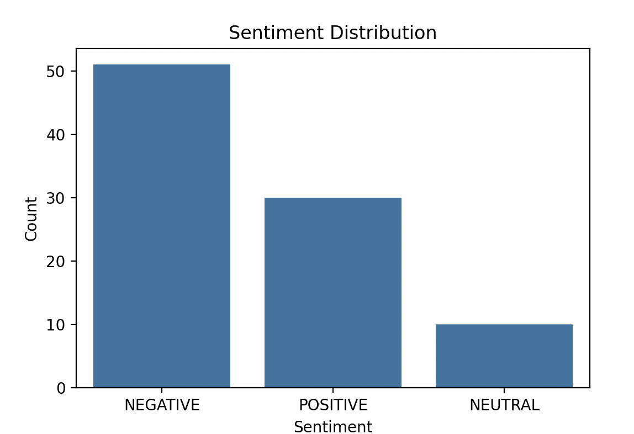
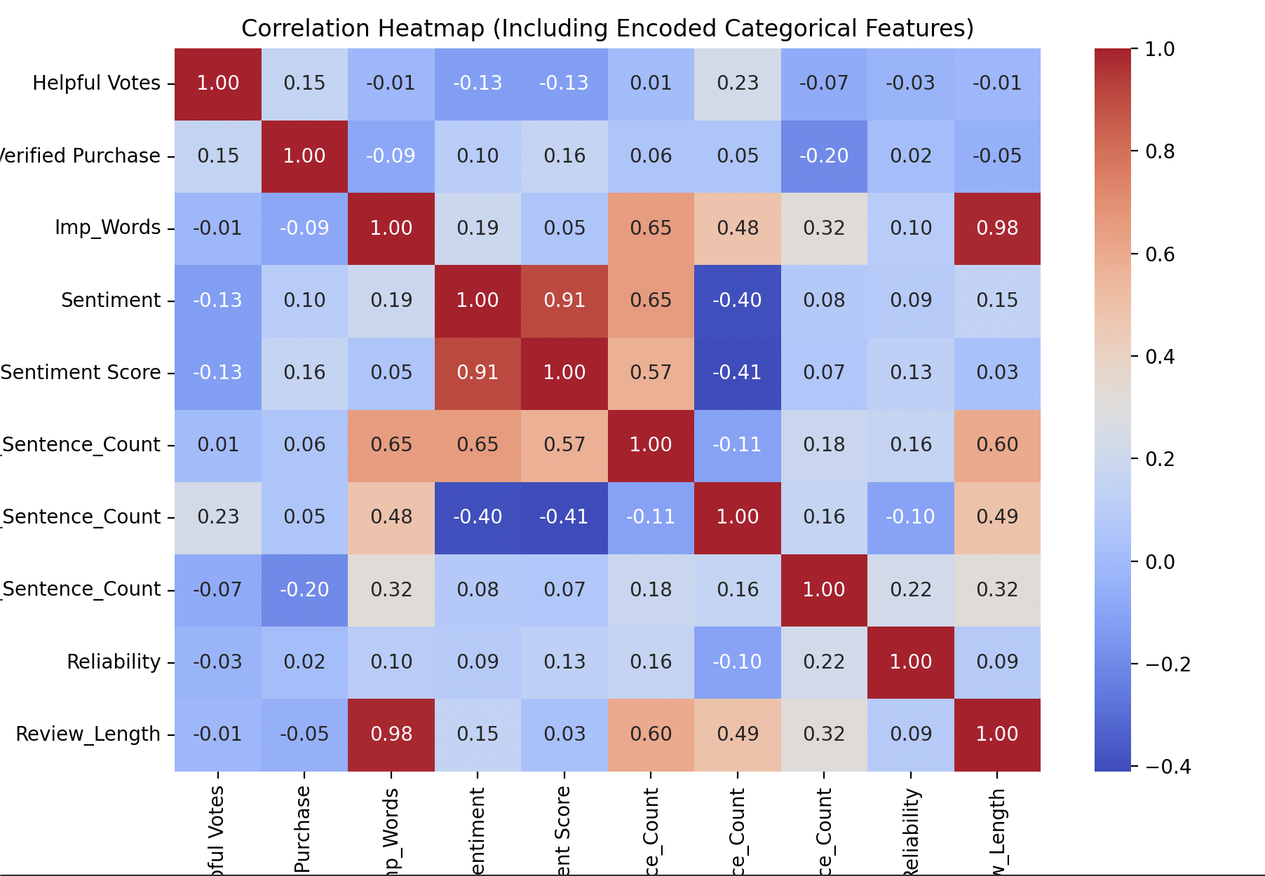
DATA VISUALIZATION

Slide 10
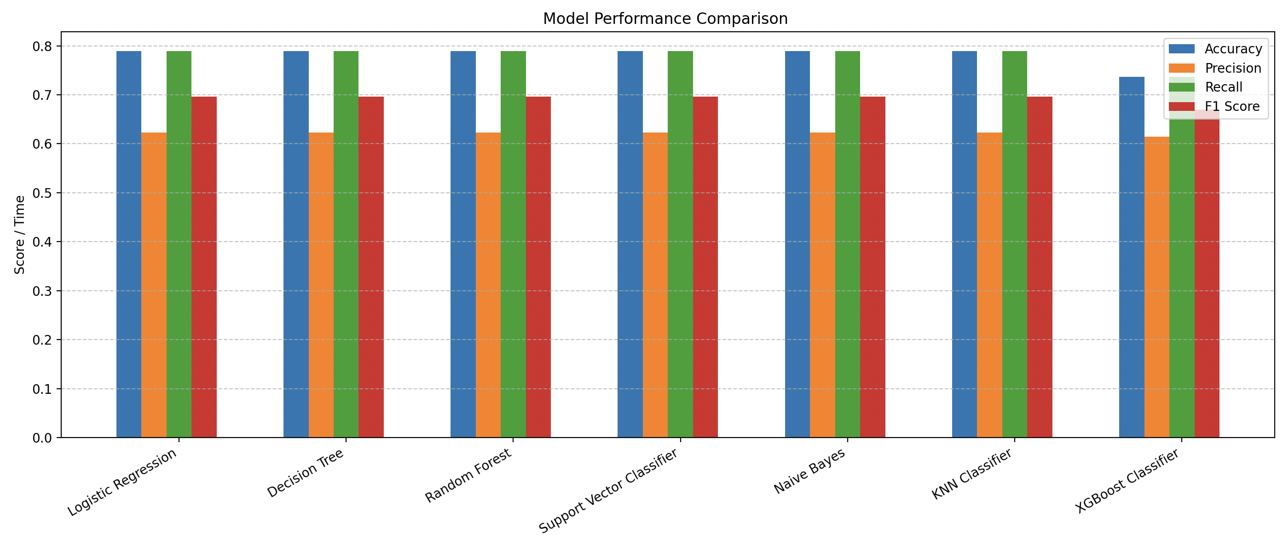
MODEL COMPARISION

Slide 11
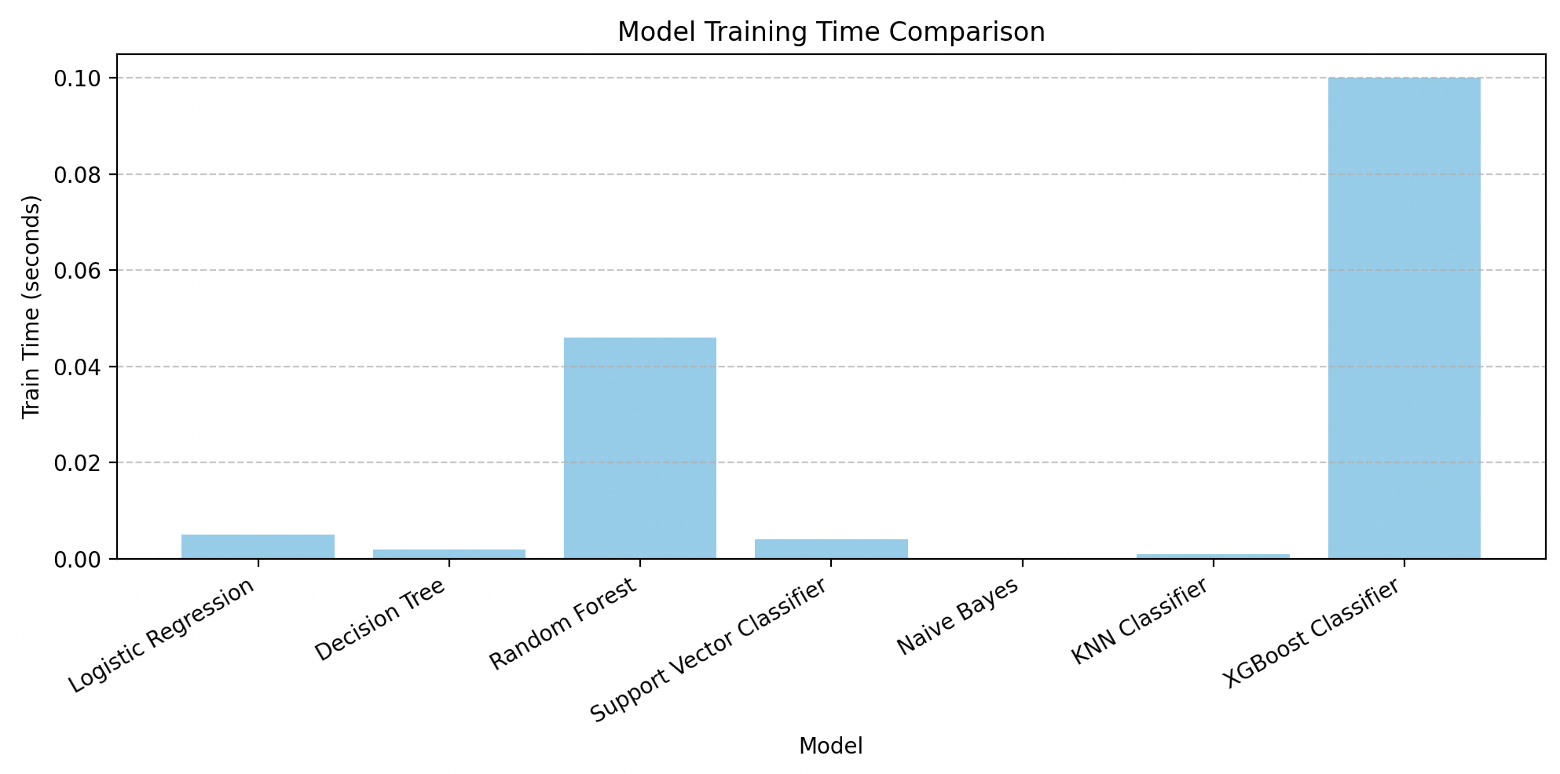
MODEL COMPARISION

Slide 12
FUTURE SCOPE
Aspect-Based Sentiment Analysis
ii. Fake Review Detection Enhancement
Dashboard & Visualization Integration
iv. Voice/Image Review Analysis

Slide 13
THANK YOU

