Slide 1
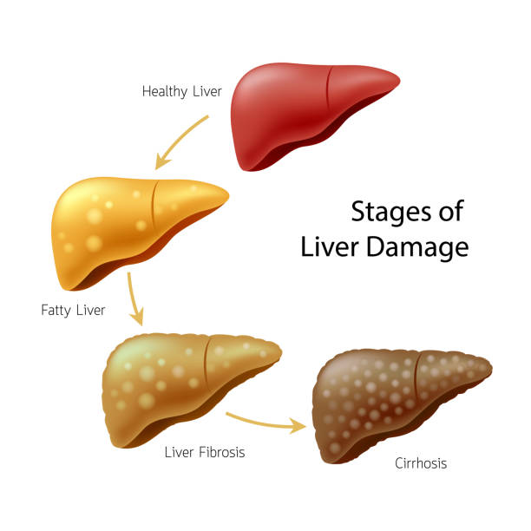
Liver Cirrhosis Prediction
Shanna Badhesha
TRGN 515- Spring 2023

Slide 2
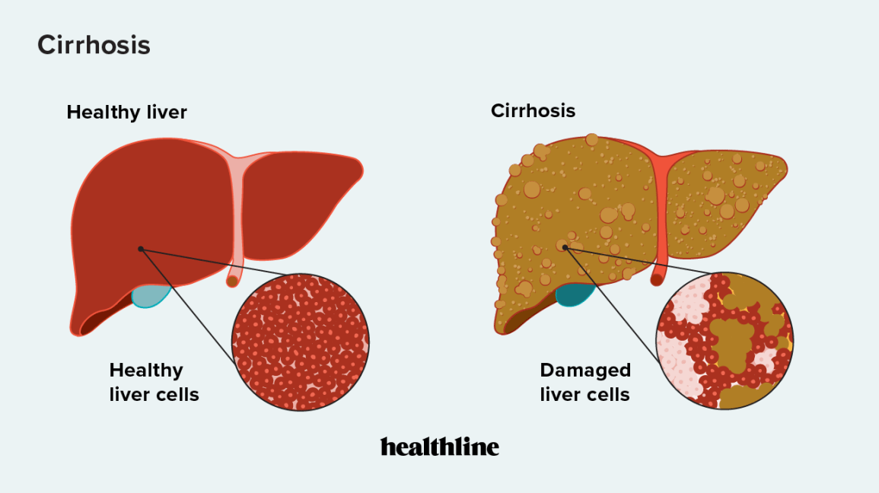
Liver Cirrhosis
Liver cirrhosis is severe scarring of the liver.
Caused by conditions such as:
Hepatitis B and C
Excessive alcohol consumption
Non-alcoholic fatty liver disease
Not reversible.
Early disease detection can prevent liver cirrhosis.
4.5 million adults diagnosed in the U.S.
80-100 million adults are undiagnosed with some form of liver disease that can cause cirrhosis.

Slide 3
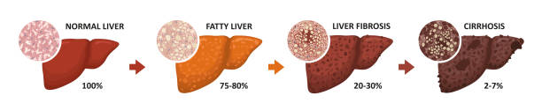
Stages of Disease
STAGE 1: Beginning of liver disease. Inflammation. Reversible.
STAGE 2: Moderate liver damage with some scar tissue forming. Reversible.
STAGE 3: Significant liver damage with significant amount of scar tissue. May still be reversible.
STAGE 4: Severe liver damage (cirrhosis). Not reversible.

Slide 4
DataseT
Found in the book “Counting Processes and Survival Analysis” by Thomas R. Fleming and David Harrington and on Kaggle
Study conducted between 1974 and 1984
GOAL:
Create a machine learning model that can predict liver cirrhosis using clinical data, laboratory results and drug treatment.
Address issues from using a small dataset to train the machine learning model.
Number of Observations: | 418
Number of Features: | 20
Missing Values: | 12 out of 20 features with missing data
Data Type: | Numerical and Categorical

Slide 5
Attributes | Description
ID | Study ID
N_Days | Number of days between registration and the earlier of death, transportation, or study analysis
Status | Patient status (censored or death)
Drug | D-penicillamine, placebo, or N/A
Age | Patient age (days)
Sex | Patient sex (0= Female, 1= Male)
Ascites | Presence (0= No, 1= Yes)
Hepatomegaly | Presence (0= No, 1= Yes)
Spiders | Presence (0= No, 1= Yes)
Edema | Presence (0= yes without diuretics, 1= No, 2= Yes with diuretic therapy)
Bilirubin | Measured in mg/dL
Cholesterol | Measured in mg/dL
Albumin | Measured in mg/dL
Copper | Measured in ug/dL
Alk_phos | Measured in U/Liter
SGOT | Measured in U/mL
Triglycerides | Measured in mg/dL
Platelets | Platelets per cubic (ml/1000)
Prothrombin | Prothrombin time in seconds (s)
Stage (Target) | Histologic stage of disease. Stage 1-3 will represent no cirrhosis. Stage 4 will represent cirrhosis

Slide 6
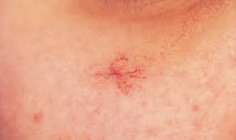
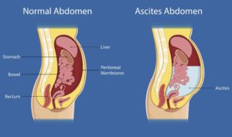
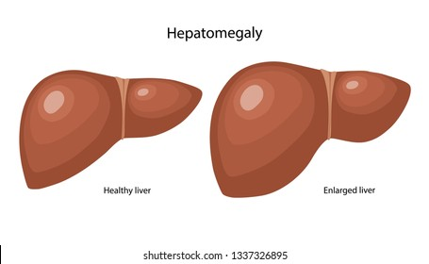
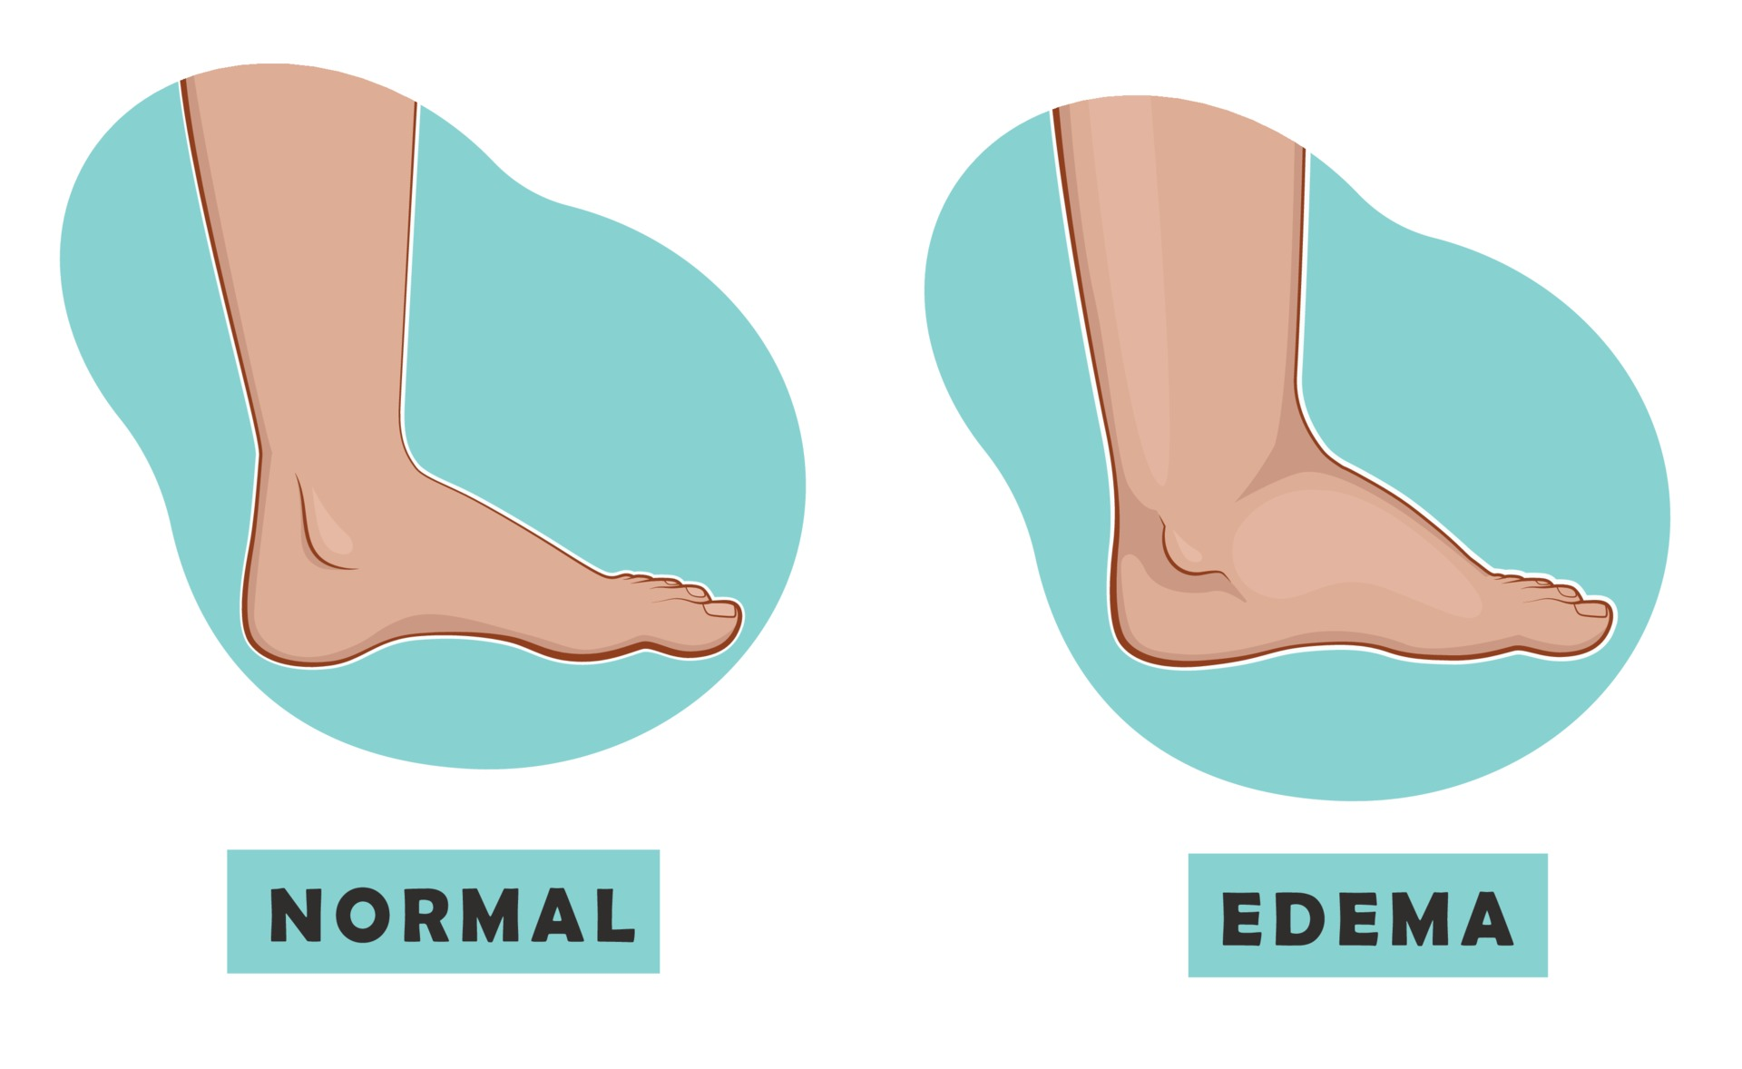
Features
ASCITES
Fluid accumulation in the peritoneal cavity.
Takes 10 years to develop after diagnosis of liver cirrhosis.
80% cases are caused by liver cirrhosis.
HEPATOMEGALY
Enlarged liver.
SPIDERS
Refer to spider angiomas or spider nevi.
Small, reddish, spider-like blood vessels on the skin’s surface.
33% of those with liver cirrhosis have spiders.
EDEMA
Liver cirrhosis can slow the flow of blood in the liver which can lead to swelling in the legs and abdomen.
Occurs in about 50% of people within 10 years of being diagnosed with liver cirrhosis.

Slide 7
PREPROCESSING
Missing Values
Correlated Data
Label Encoding
Class Imbalance
ISSUES
Small dataset
Strong imbalance
A lot of missing values

Slide 8
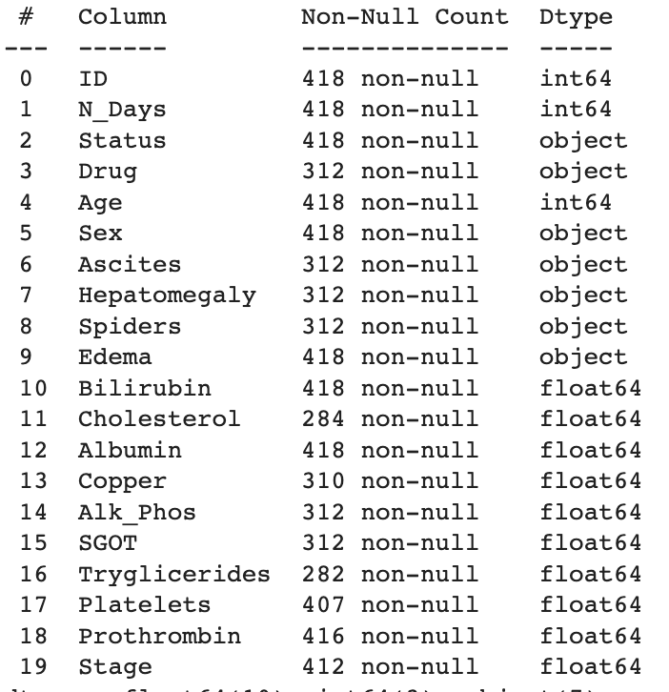
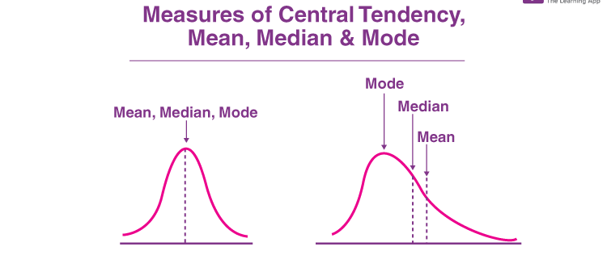
Handling missing values
25% of the data is missing from over half of the columns
Since the dataset is already small, the best approach would be to replace the missing values instead of removing them.
Steps:
Evaluate each feature
If numerical, observe distribution
If skewed, use median since it is not as sensitive to outliers
If normal distribution, use mean since it will be an accurate representation of the dataset as a whole
If categorical, use mode to replace the missing data

Slide 9
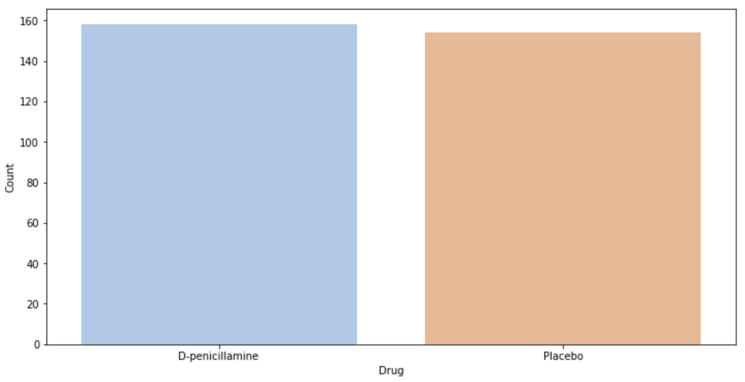
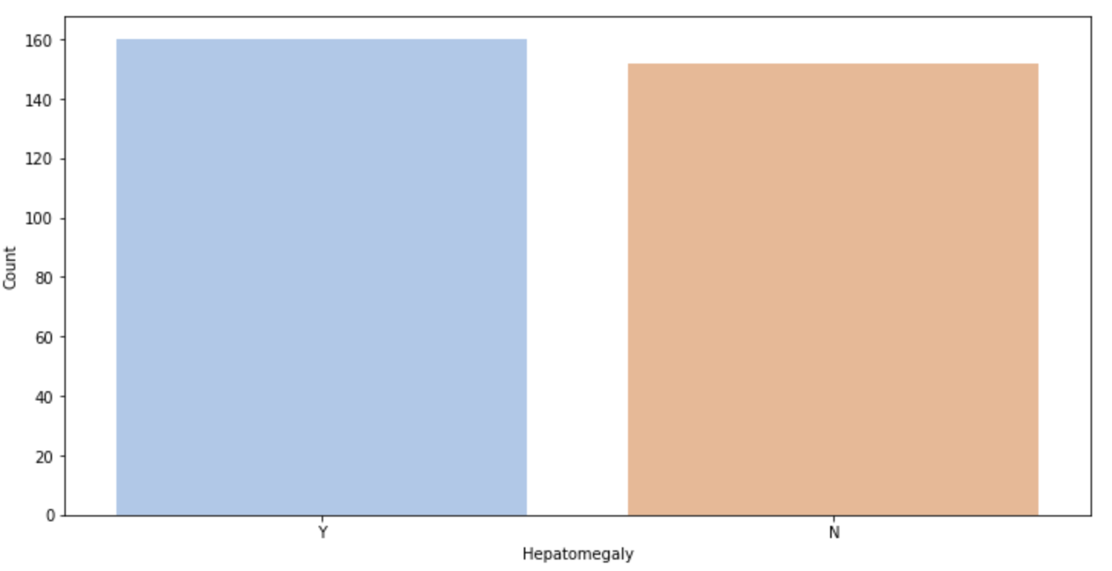
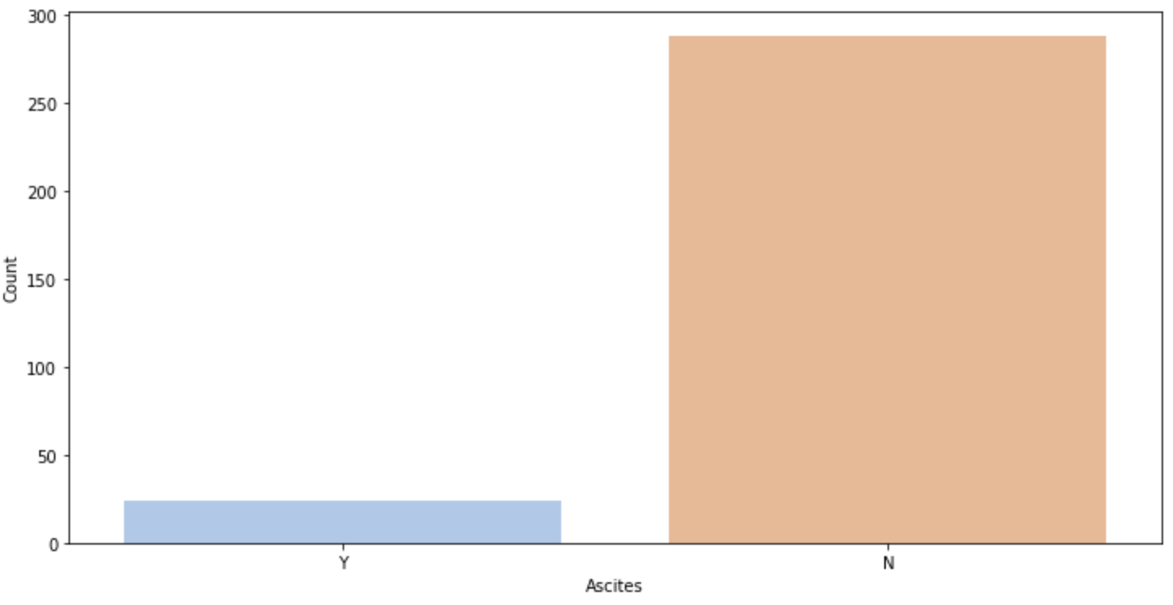
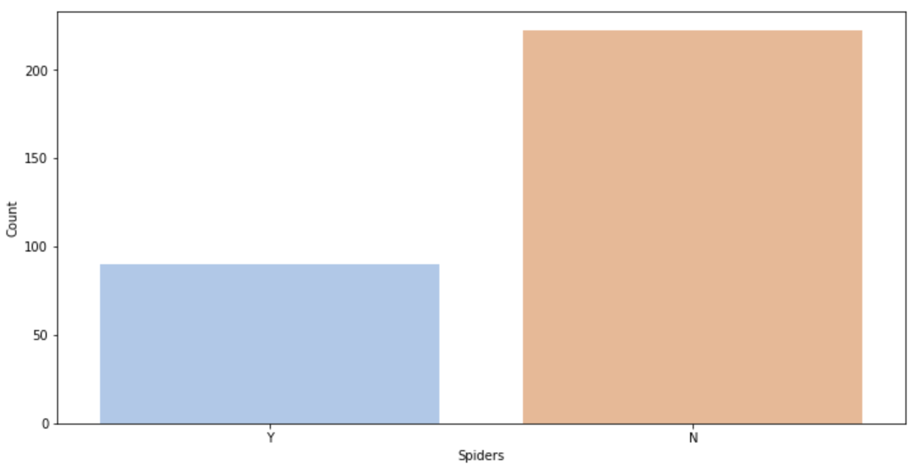
Dealing with missing values: Categorical

Slide 10
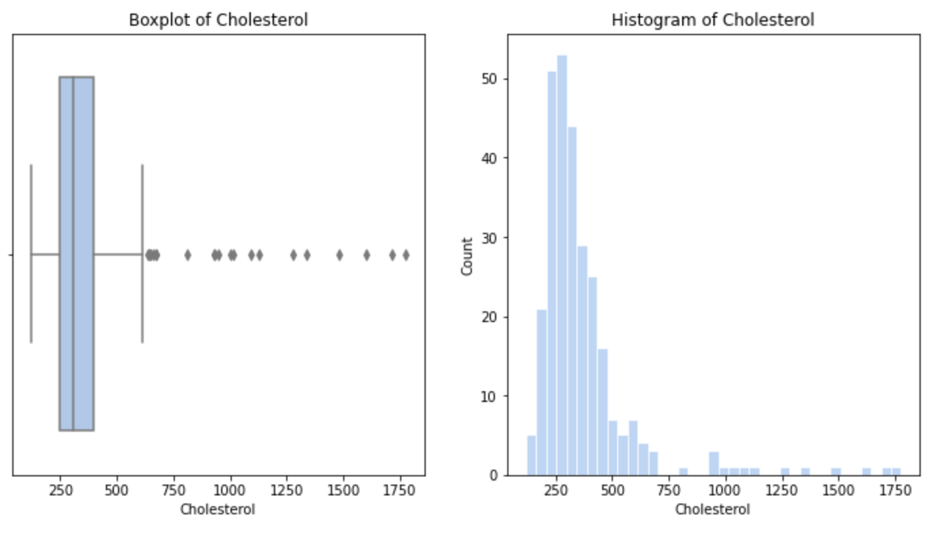
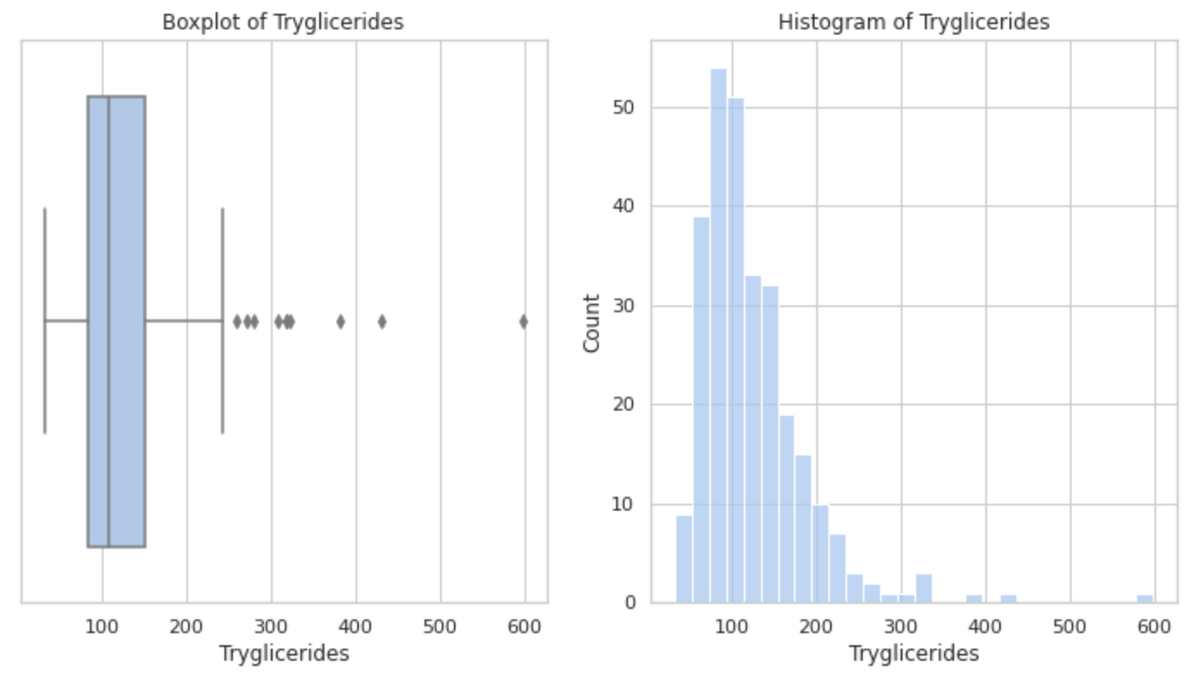
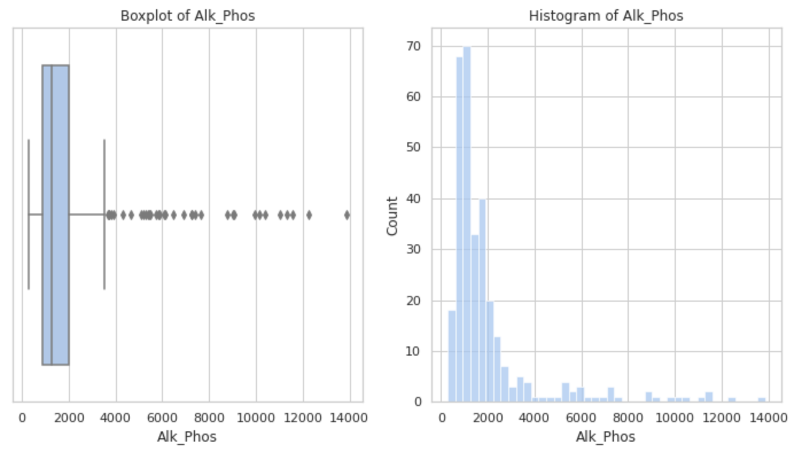
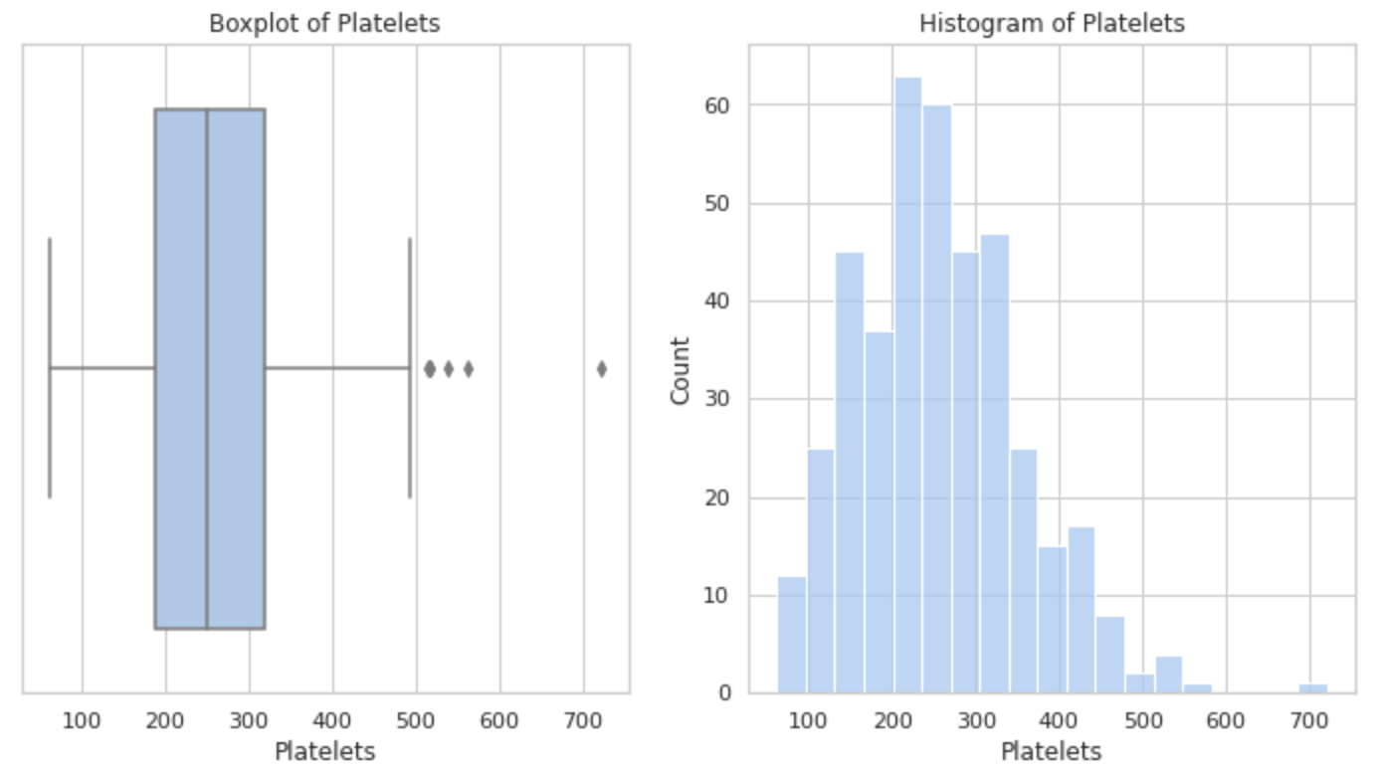

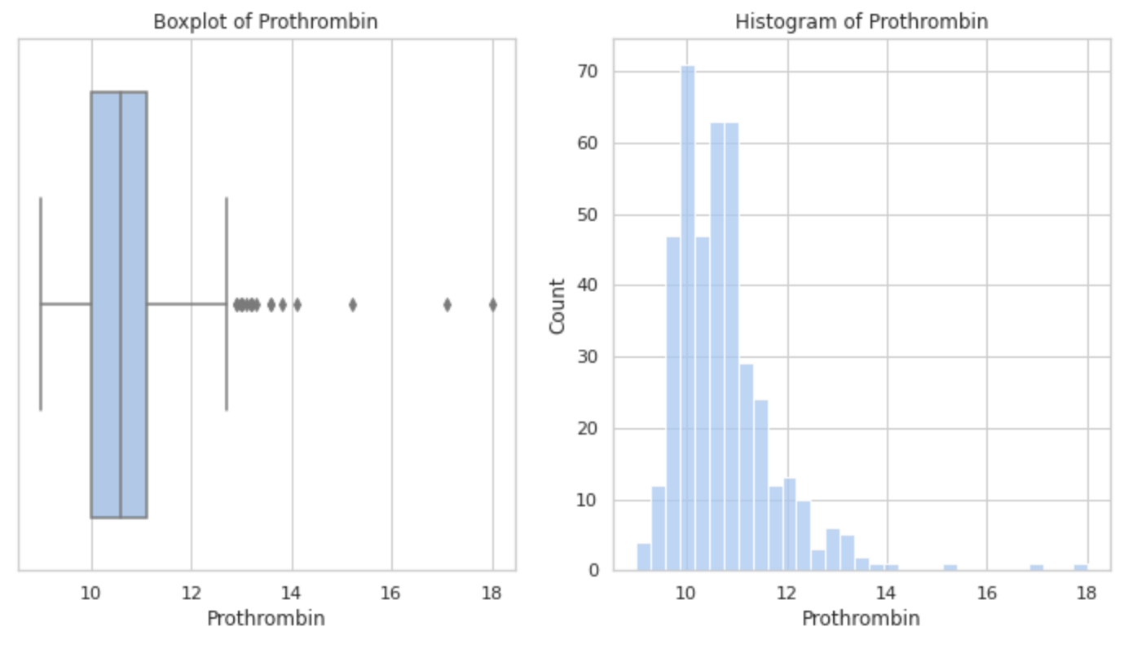
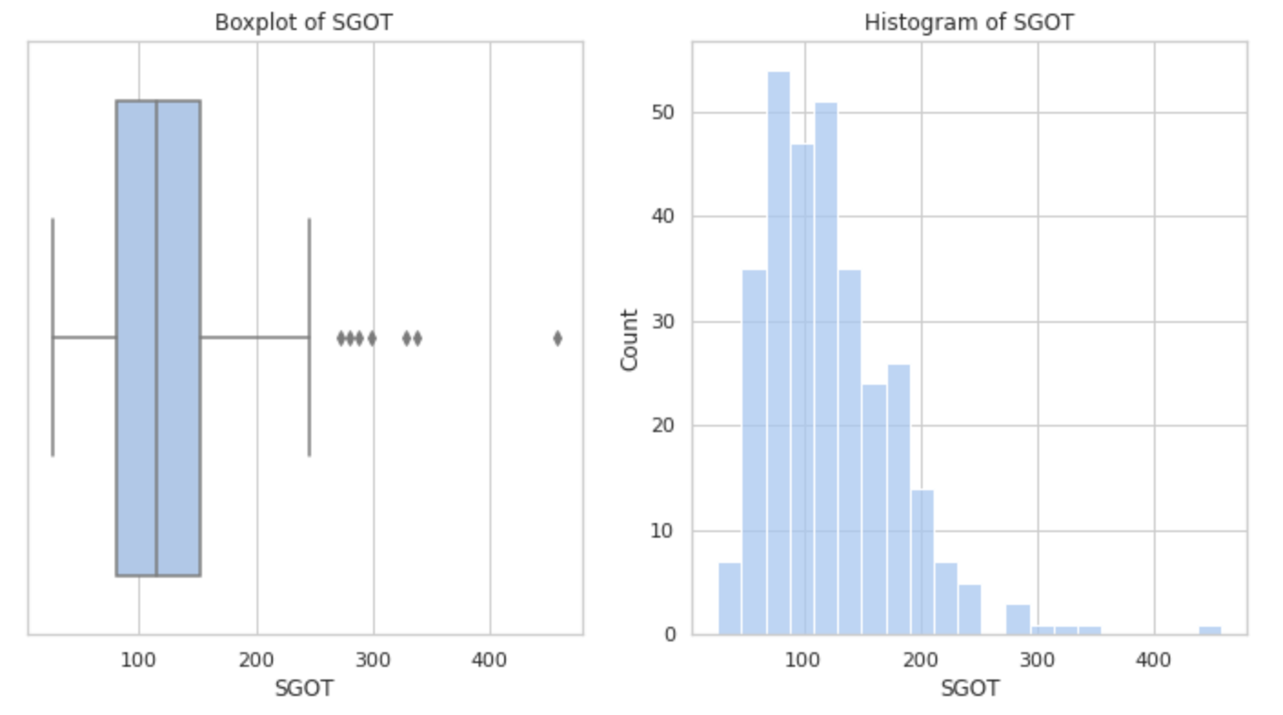
Dealing with missing values: Numerical

Slide 11
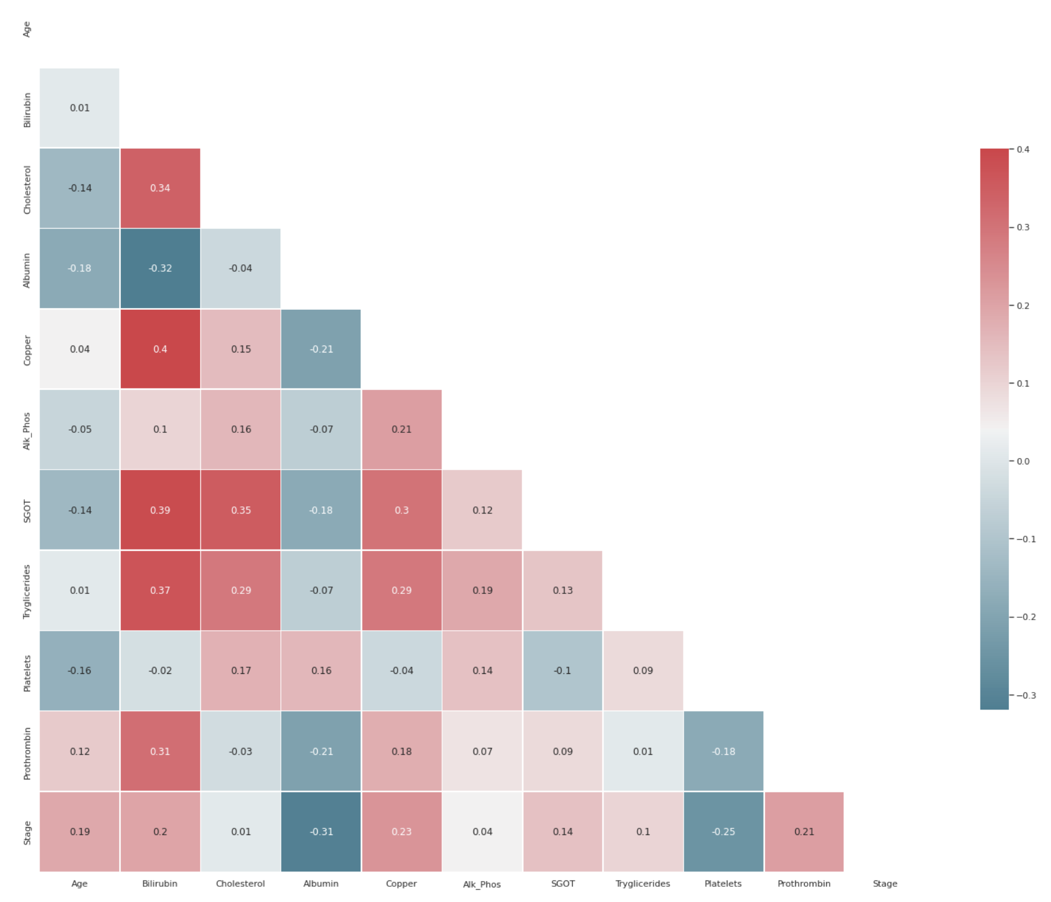
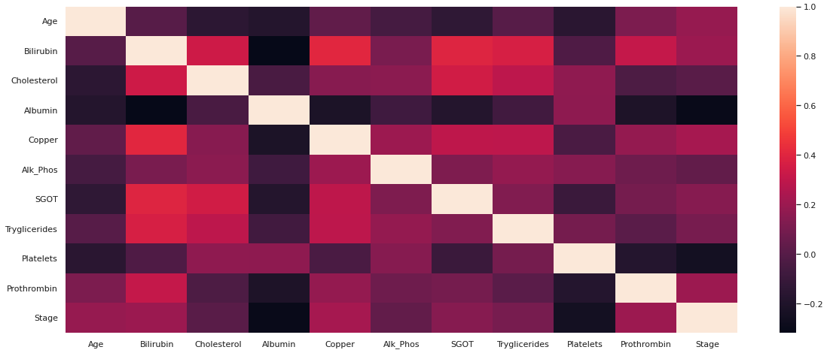
Correlated data
Correlation matrix that uses the Pearson correlation coefficient to measure the linear relationship between two variables.
Heatmap based off the correlation matrix.
Highly correlated features can cause overfitting if not removed.

Slide 12
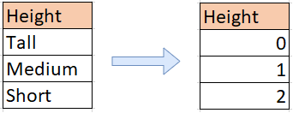
LABEL ENCODING
To use categorical data for machine learning algorithms, the categorical data needs to be transformed to numerical data.
Label encoding allows algorithms to process categorical data as numerical data, which can sometimes improve the accuracy of the model.
Unique numerical values are assigned to each category in a categorical features.

Slide 13
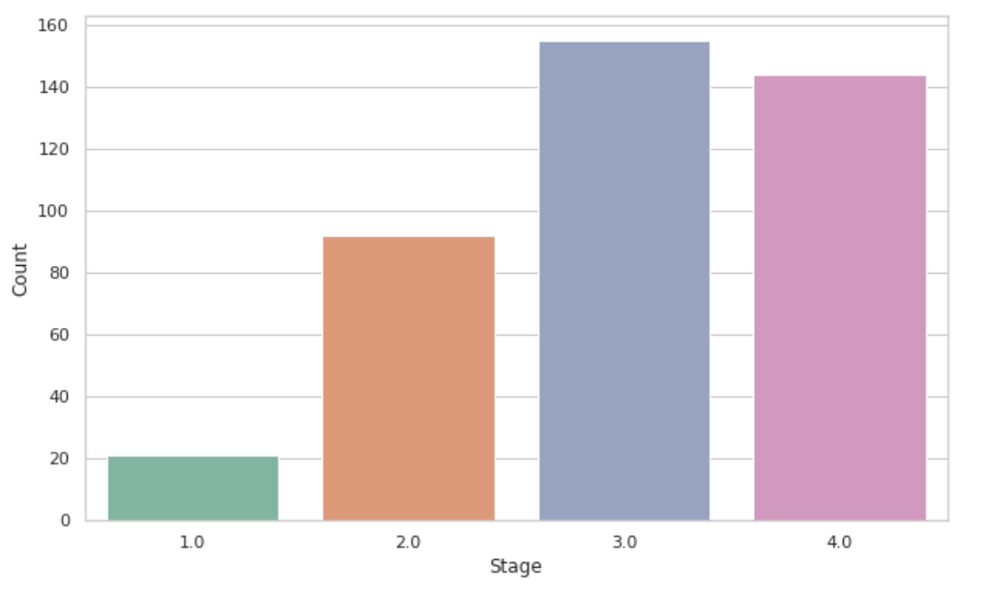
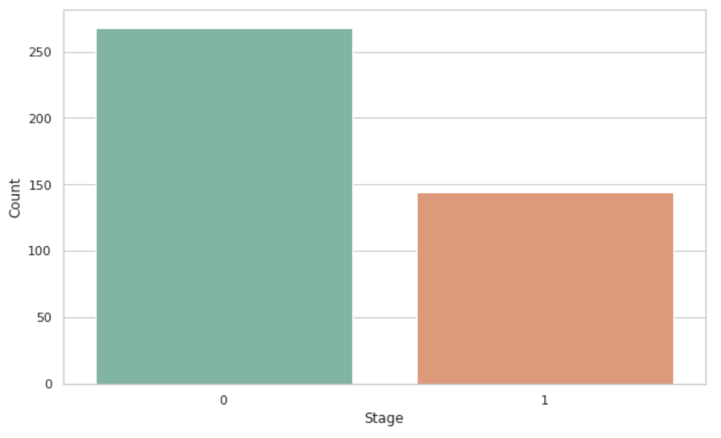
Class imbalance
Occurs when the distribution of classes in a dataset is uneven.
If left unresolved, the model will have a bias towards the majority class.
Random undersampling
Choosing random samples from the majority class to match the minority class.
Random oversampling
Randomly duplicating samples from the minority class to increase its representation.
Best Approach: random oversampling

Slide 14
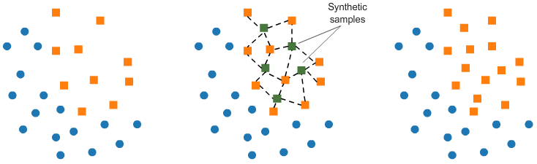
Class imbalance: SMOTE
SMOTE: Synthetic Minority Oversampling Technique
Creates synthetic samples that are similar to the existing minority class but not identical.
Choosing sample randomly from minority class and then finding the k nearest neighbors to interpolate synthetic samples.
K nearest neighbor finds samples that are similar to randomly chosen sample from the minority class.

Slide 15
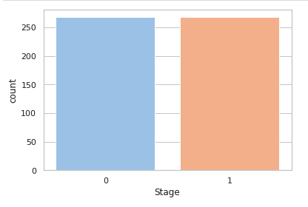
Class imbalance
Classes with separated stages
Stage 0: Absence of liver cirrhosis
Stage 1: Presence of liver cirrhosis
Balanced after using SMOTE

Slide 16
MODEL BUILDING
Splitting the Dataset
Model Selection
Best Model
Hyper-parameter Tuning

Slide 17
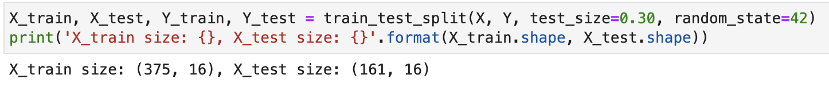
Splitting the dataset
Split the dataset into training and testing datasets
Training dataset: used to teach the model how to make predictions by showing examples
Testing dataset: used to evaluate the performance of the model by feeding it new data
Helps show how the model will generalize to new, unseen data

Slide 18
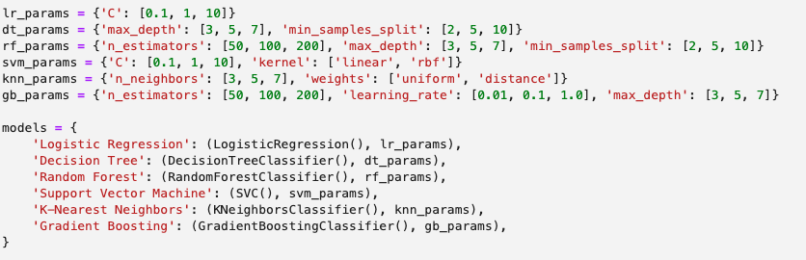
Model Selection
Use GridSearchCV
Uses a dictionary of hyperparameters that the user sets. Selects the best possible combination of hyperparameters that gives you the best model performance.
Hyperparameters: values that are set before training the model that impact how the model learns and behaves during training.
Models:
Logistic regression: uses linear regression
Decision tree: hierarchical tree structure
Random forest: ensemble of decision trees
Support vector machine: best hyperplane to separate data
K-nearest neighbor: predict classes based on neighbors
Gradient boosting: ensemble of decision trees

Slide 19
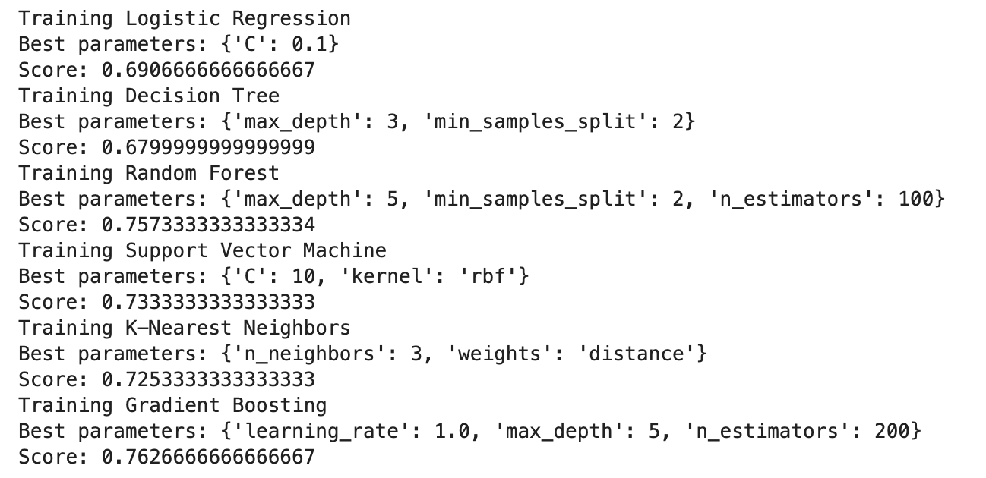
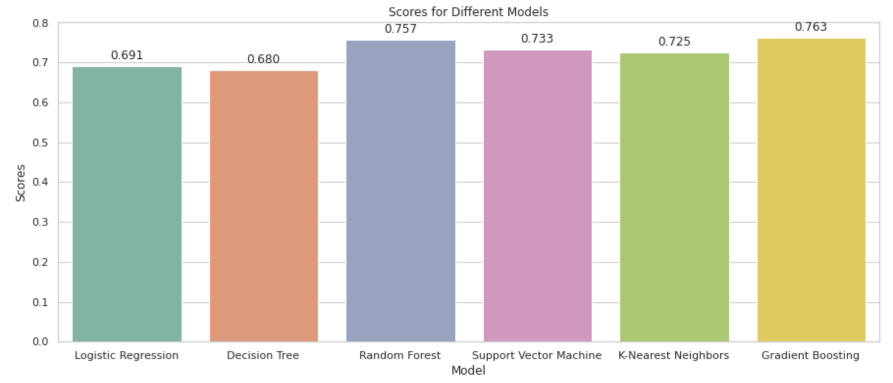
Model selection
Output received from GridSearchCV listing the best hyperparameters and their training scores.
Score closer to 1 is desired.

Slide 20
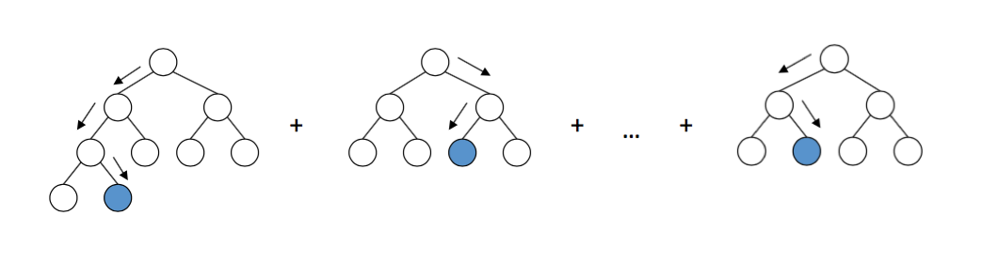
Best Model: Gradient Boosting Classifier
Used for classification.
Classes: absence of liver cirrhosis and presence of liver cirrhosis.
What is gradient boosting?
Gradient boosting classifier uses supervised learning.
Learning from labeled examples to predict the output from new input data.
Works by iteratively adding decision trees to the ensemble, where each new tree is trained to correct the errors of the previous trees.

Slide 21
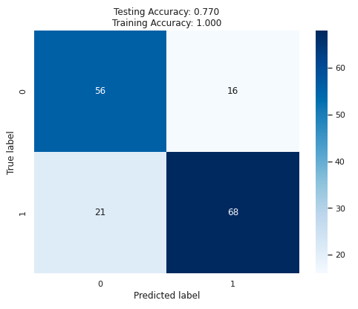
GRADIENT BOOSTING PERFORMANCE
True Negative | False Positive
False Negative | True Positive
Template of what each box in a confusion matrix represents.
Training accuracy indicates that there is overfitting.

Slide 22
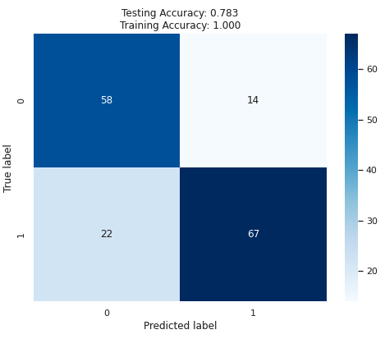
Hyperparameter tuning
To address overfitting, adjust a subset of hyperparameters to better train the model.
Hyperparameters: values that are set before training that impact how the model learns and how it behaves during training.
Hyperparameters:
N_estimators: number of decision trees used.
Learning_rate: controls how much each tree contributes to the final prediction.
Max_depth: max depth of each decision tree.
Max_features: number of features used.
Min_samples_leaf: minimum number of samples per leaf.
Min_samples_split: minimum number of samples to split.
Testing accuracy is 78.3%
Training accuracy is 100% which indicates that there is still overfitting.

Slide 23
TROUBLESHOOTING & CONCLUSION
There were clear signs of overfitting that hyperparameter tuning did not fix.
Two experiments: one with missing values but balanced data & one with class imbalance and no missing values
Could remove the missing values, but this would decrease our sample size to ~300.
Issues:
Small dataset leading to overfitting because there isn’t enough data to capture underlying patterns.
Class imbalance can cause bias.
25% missing data in 9 out of 16 of our final features leading to bias.
For better results, increase the sample size.
Allows for model to detect patterns.
Potentially reduces the impact of missing data on the overall model.
Datasets in real-world projects aren’t perfect. This provided a good learning opportunity to dealing with those issues.

Slide 24
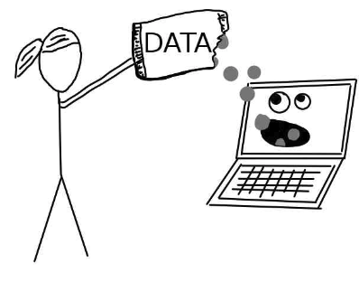
References, presentation, code and dataset: Https://github.com/shannabadhesha/liver_cirrhosis_prediction
Thank you! Questions?

