Slide 1
Candidate Topics for Final Project

Slide 2
Goal: Conduct Research and Write Papers
Choose some topics aligned with your own research
Candidate topic examples from teachers
KDD Cup
Kaggle Competitions
DCASE

Slide 3
Candidate 1: CPDC Challenge
Common-sense Persona-Grounded Dialogue
https://www.aicrowd.com/challenges/commonsense-persona-grounded-dialogue-challenge-2025
Goal:
Make NPCs have natural small talk that aligns with the game’s worldview and the NPCs’ personas.
Support task-oriented dialogues that reflect in-game actions.
Tracks:
Task 1: Task-Oriented Dialogue Agents
Task 2: Context-Aware Dialogue Agents
Task 3: Integrating Contextual Dialogue and Task Execution
Starter-Kit:
https://gitlab.aicrowd.com/aicrowd/challenges/sony-commonsense-persona-grounded-dialogue-challenge-2025/sony-cpdc-2025-starter-kit

Slide 4
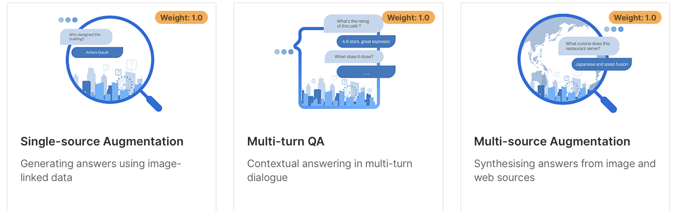
Candidate 2: CRAG-MM Challenge
Improve RAG with Real-World Benchmarks
https://www.aicrowd.com/challenges/meta-crag-mm-challenge-2025
Goal:
an MM-RAG system constructs a search query by synthesizing information from the image and the question, searches external sources to retrieve relevant information, and then provides grounded answers to address the question.
Tracks:

Slide 5
Candidate 3: Stanford RNA 3D Folding
Background: The 3D structure of RNA is crucial for understanding its functions (such as catalytic reactions and gene regulation), but experimental methods (e.g., X-ray crystallography) for determining the structure are costly and time-consuming. AI can reduce costs and accelerate the process.
Input: The nucleotide sequence of RNA (e.g., AUCG) and its potential base-pairing information (secondary structure).
Output: Predicted 3D coordinates (x, y, z) of each atom in the RNA strand, forming a plausible spatial conformation.
https://www.kaggle.com/competitions/stanford-rna-3d-folding

Slide 6
Candidate 4: LLM - Detect AI Generated Text
Background: we hope to foster open research and transparency on AI detection techniques applicable in the real world. This competition challenges participants to develop a machine learning model that can accurately detect whether an essay was written by a student or an LLM. The competition dataset comprises a mix of student-written essays and essays generated by a variety of LLMs.
The competition gives a good chance to systematically use and analyze LLMs. You can access different LLM models or APIs by yourself.
The competition has been closed, but a late submission is valid. And you can try to learn from the top solutions.
https://www.kaggle.com/competitions/llm-detect-ai-generated-text

Slide 7
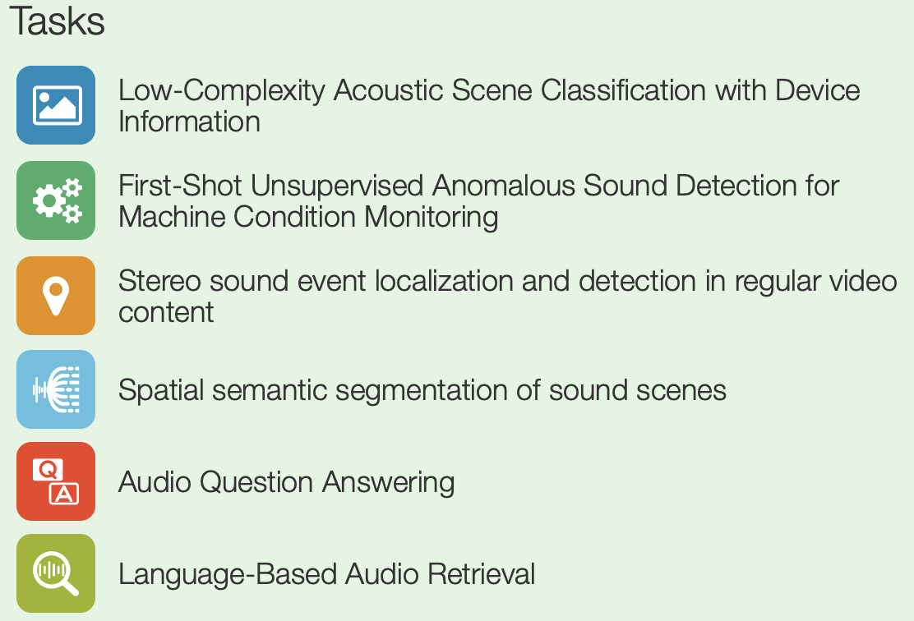
Candidate 5: DCASE
Task: participate one of DCASE 2025 challenges and write report
6 tasks
Most of which are audio tasks
April 1st - June 15th
https://dcase.community/challenge2025/

Slide 8
Candidate 6: 3D Computer Vision
Essential properties for a good 3D point cloud feature
Permutation invariance
Local structure exploitation
Discriminative
Robust to rotation, sampling…
Existing point cloud networks
PointNet, PointNet++, PointMLP, PointNeXT, Vector Neurons (MLP-based)
DGCNN, KPConv, PointConv, RSCNN, PAConv (CNN-based)
Point Cloud Transformer, Point Transformer, Point Transformer v2 (Transformer-based)

Slide 9
Candidate 6: 3D Computer Vision
Datasets
ModelNet40, ScanObjectNN (Object-level)
ScanNet, S3DIS (Scene-level)
…
Task
Study the performance of latest methods (such as PointMLP, PointNeXT, Point Transformer v2) on the widely-used datasets
Find the potential issue and try to improve
Design competitive point cloud networks，
Competition: SemanticKITTI Moving Object Segmentation https://semantic-kitti.org/tasks.html#mos

